Slide 1
Lecture 8: Stoichiometry
California State University, Fullerton
2023 Fall Semester – Chem 123

Slide 2

QUESTIONS, COMMENTS, AND CONCERNS?

Slide 3
Outline
Announcements
Exam 1 scores
Ch. 5: Stoichiometry
Moles Concept – Molecules, Moles/Mass Conversion, Chemical Equation
Mole/Mass Calculations for Chemical reactions
Limiting Reagent Problems
Theoretical and Percent Yields

Slide 4
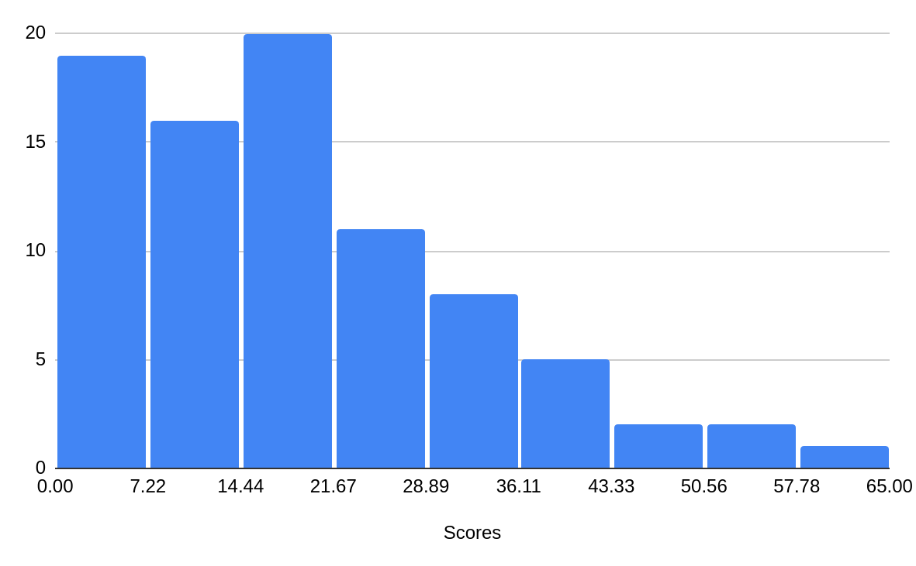
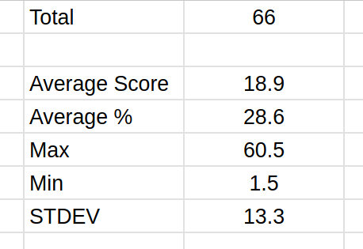
Announcements
Exam 1 scores

Slide 5
announcement
Q: What can we do better? What are your thoughts?
Exam redo for half the points – 33 points out of 66 total points
On a separate document/paper, redo all problems with the correct answers for half the points
Submit the corrections online as well as your exam
Due Mon, Oct 2nd at 11:59pm

Slide 6
Outline
Announcements
Exam 1 scores
Ch. 5: Stoichiometry
Moles Concept – Molecules, Moles/Mass Conversion, Chemical Equation
Mole/Mass Calculations for Chemical reactions
Limiting Reagent Problems
Theoretical and Percent Yields

Slide 7
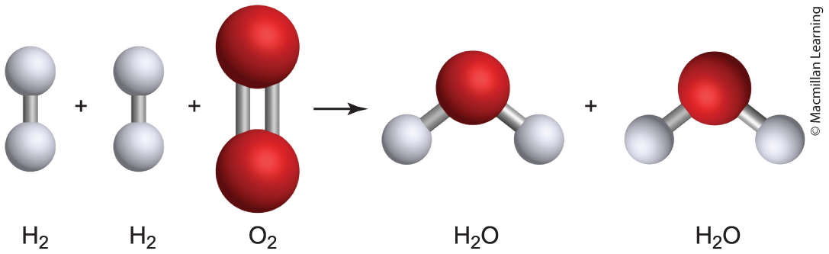
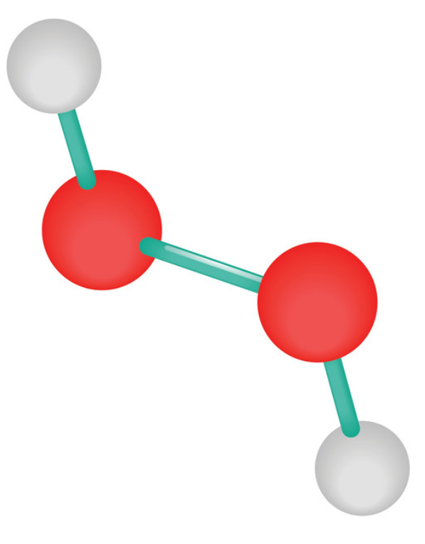
Concept of the mole
Recall Dalton's Atomic Theory - Atoms of different elements combine in fixed whole-number ratios when forming compounds.
Examples:
H₂O
Dihydrogen monoxide
H₂O₂
Dihydrogen dioxide

Slide 8
Concept of the mole
Examples:
H₂O
1 molecule H₂O -> 2 H atoms and 1 O atom
1 mol H₂O -> 2 mol H and 1 mol O
H₂O₂
1 molecule H₂O₂ -> 2 H atoms and 2 O atom
1 mol H₂O₂ -> 2 mol H and 2 mol O

Slide 9
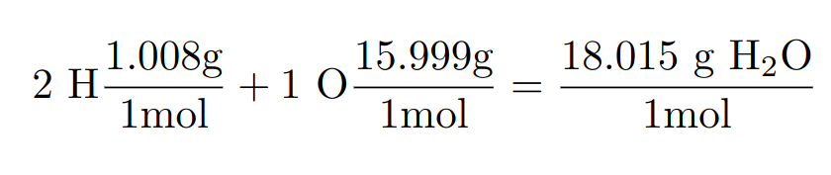
Molar mass calculation
Molar mass calculations: Add the molar masses of all elements obtained from the periodic table
H₂O:
Q: What can the molar mass quantity be used for? Hint: Ratio of mass and moles

Slide 10
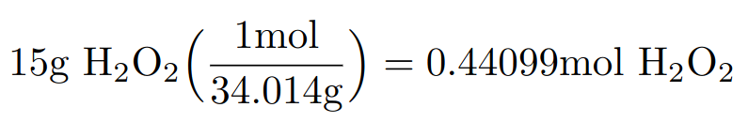
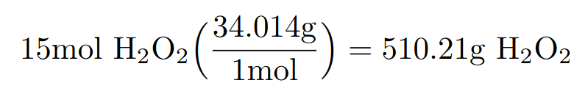
Mole to mass conversion and vice versa
Q: What can the molar mass quantity be used for? Hint: Ratio of mass and moles
Conversion ratio between mole to mass and vice versa
Example: Convert 15 g H₂O₂ to moles
Example: Convert 15 moles H₂O₂ to mass in g

Slide 11
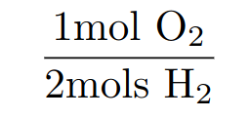
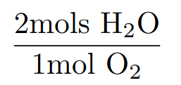
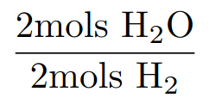
Chemical equation: Analogy to cookbook
Example: 2 H₂(g) + O₂(g) ---> 2 H₂O(g)
Every 2 moles H₂(g) and 1 mole O₂(g), there are 2 moles H₂O(g) produced
Conversion Ratios:

Slide 12
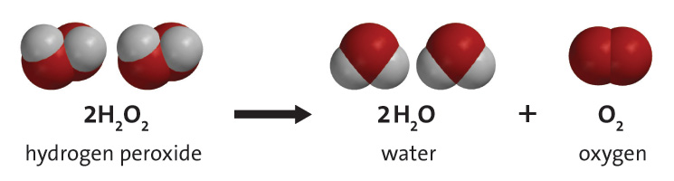
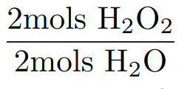
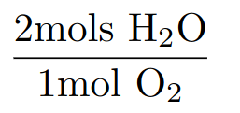
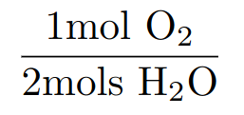
Chemical equation: Analogy to cookbook
Example: 2 H₂O₂(l) ---> O₂(g) + 2 H₂O(l)
Every 2 moles H₂O₂(l), it decomposes into 1 mole O₂(g) and 2 moles H₂O(l)
Conversion ratios

Slide 13
Your turn: generating conversion ratios
For the chemical reaction:
2 P(s) + 3 Cl₂(g) ---> 2 PCl₃(l)
Show all possible conversion ratios.

Slide 14
Outline
Announcements
Exam 1 scores
Ch. 5: Stoichiometry
Moles Concept – Molecules, Moles/Mass Conversion, Chemical Equation
Mole/Mass Calculations for Chemical reactions
Limiting Reagent Problems
Theoretical and Percent Yields

Slide 15
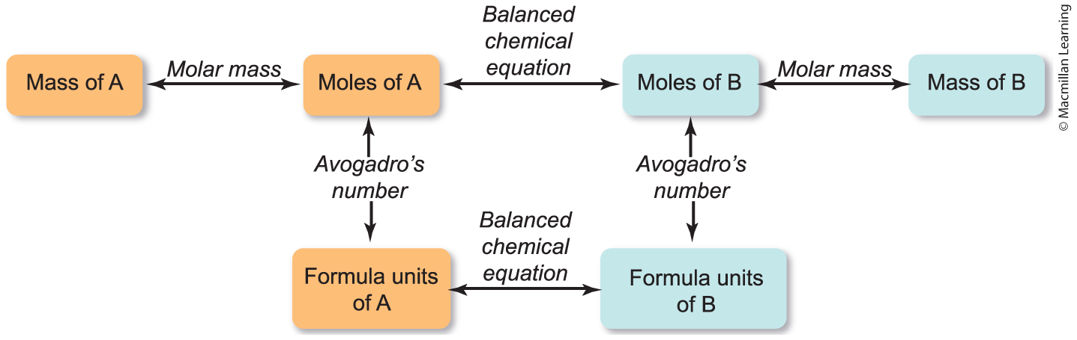
Stoichiometry: Flowchart mass-mole conversions
Generic Chemical Reaction: 2 A ---> 3 B

Slide 16
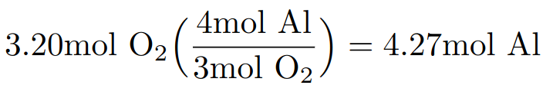
Mole-mole problems
Example: Calculate the amount of moles of Al(s) that will react with 3.20 mol O₂(g) to form Al₂O₃(s)
4 Al(s) + 3 O₂(g) ---> 2 Al₂O₃(s)

Slide 17
Mole-mole problems
Example: Calculate the amount of moles of Al₂O₃(s) produced when you react 3.20 mol O₂(g) with excess Al(s)
4 Al(s) + 3 O₂(g) ---> 2 Al₂O₃(s)

Slide 18
Mole-mass problems
Example: Calculate the amount of mass in g of Al₂O₃(s) produced when you react 3.20 mol O₂(g) with excess Al(s)
4 Al(s) + 3 O₂(g) ---> 2 Al₂O₃(s)

Slide 19
Mass-mass problems
Example: Electrolysis of NaCl(aq) yields NaOH(aq), H₂(g), and Cl₂(g) which are all important industrial chemicals. Calculate the mass of Cl₂(g) in g that can be produced by electrolysis of 50.0kg NaCl(aq).
2 NaCl(aq) + 2 H₂O(l) ---> 2 NaOH(aq) + Cl₂(g) + H₂(g)
Q: What units do we need to be in to use the chemical equation?

Slide 20
Mass-mass problems
Example: Electrolysis of NaCl(aq) yields NaOH(aq), H₂(g), and Cl₂(g) which are all important industrial chemicals. Calculate the mass of Cl₂(g) in g that can be produced by electrolysis of 50.0kg NaCl(aq).
2 NaCl(aq) + 2 H₂O(l) ---> 2 NaOH(aq) + Cl₂(g) + H₂(g)

Slide 21
your turn: stoichiometry problems
H₂SO₄(aq) is produced by a series of reactions. The overall reaction is:
2 SO₂(g) + O₂(g) + 2 H₂O(l) ---> 2 H₂SO₄(aq)
Calculate the number of moles of SO₂(g) required to prepare 50.0 kg of H₂SO₄(aq). (Molar mass SO₂ = 64.066 g/mol; H₂SO₄ = 98.079 g/mol)

Slide 22
Outline
Announcements
Exam 1 scores
Ch. 5: Stoichiometry
Moles Concept – Molecules, Moles/Mass Conversion, Chemical Equation
Mole/Mass Calculations for Chemical reactions
Limiting Reagent Problems
Theoretical and Percent Yields

Slide 23
Limiting and excess reagent
Limiting Reagent – The reagent that is completely used up when the chemical reaction goes to completion; determines the maximum amount of product produced
Excess Reagent – Leftover reagent after the chemical reaction goes to completion
Example: 2 H₂(g) + O₂(g) ---> 2 H₂O(g); Suppose you have 4 mols H₂(g) and 8 mols O₂(g), what is the limiting and excess reagents? How much H₂O(g) is produced?

Slide 24
approach for limiting reagent problems
aA + bB ---> cC + dD
Given amount of reagents A and B, choose one reagent and ask how much of the other reagent is needed to completely react.
Compare the amount of the other reagent needed with what you have.
If the amount of the other reagent needed is more than what you have, then the other reagent is limiting reagent.
If the amount of the other reagent needed is less than what you have, then the other reagent is excess reagent.
Q: What determines the maximum amount of product produced?

Slide 25
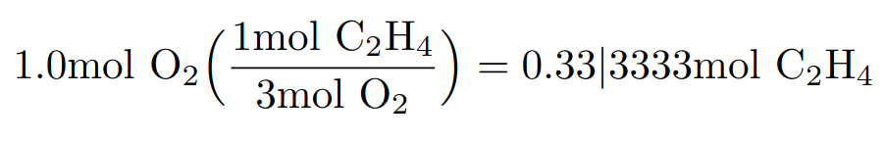
Example: limiting reagent problem
Ethylene, C₂H₄(g), is highly flammable and burns in the presence of O₂(g). Suppose a mixture of 0.25 mol C₂H₄(g) and 1.0 mol O₂(g) leads to a combustion. Determine the limiting reactant, excess reactant and amount of CO₂(g) formed in mols.
C₂H₄(g) + 3 O₂(g) ---> 2 CO₂(g) + 2 H₂O(g)
Q: What is the limiting and excess reagents? What determines the maximum amount of CO₂(g) formed?

Slide 26
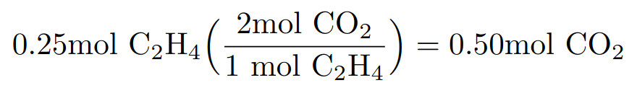
Example: limiting reagent problem
Ethylene, C₂H₄(g), is highly flammable and burns in the presence of O₂(g). Suppose a mixture of 0.25 mol C₂H₄(g) and 1.0 mol O₂(g) leads to a combustion. Determine the limiting reactant, excess reactant and amount of CO₂(g) formed in mols.
C₂H₄(g) + 3 O₂(g) ---> 2 CO₂(g) + 2 H₂O(g)

Slide 27
Your turn: limiting reagent problem
What mass of Na₂SO₄(aq) will be formed by mixing 14.2g NaHCO₃(aq) with 4.90g H₂SO₄? (Molar Mass Na₂SO₄ = 142.04 g/mol; NaHCO₃ = 84.01 g/mol; H₂SO₄ = 98.07 g/mol)

Slide 28
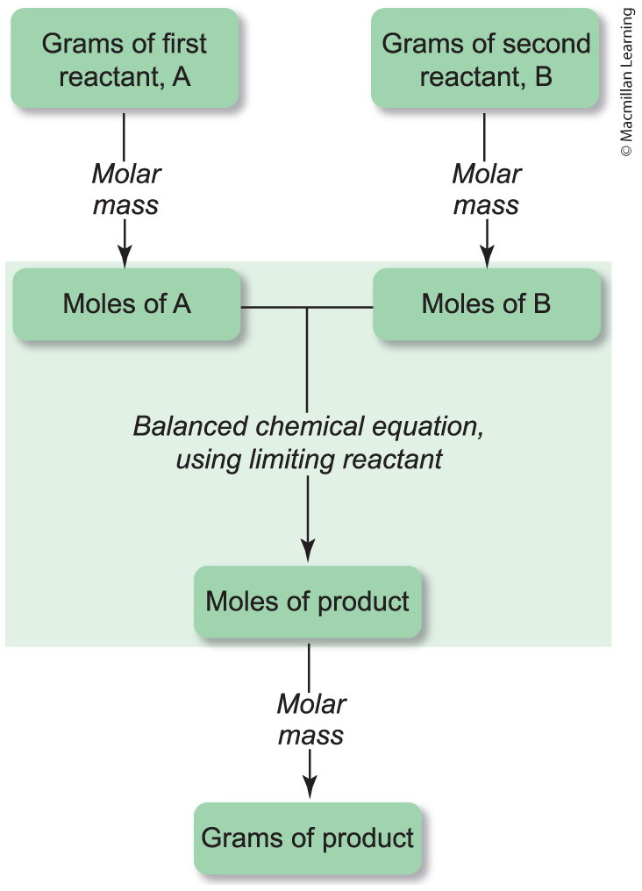
Alternative method: limiting reagent

Slide 29
Outline
Announcements
Exam 1 scores
Ch. 5: Stoichiometry
Moles Concept – Molecules, Moles/Mass Conversion, Chemical Equation
Mole/Mass Calculations for Chemical reactions
Limiting Reagent Problems
Theoretical and Percent Yields

Slide 30
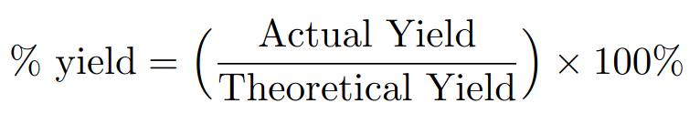
Theoretical, actual and percent yields
Theoretical yield – maximum amount of product that can be formed from a reaction based on the amount of reagents
Actual yield – the amount of product obtained in an experiment
Percent yield – percentage ratio of the actual to theoretical yields
Note: Percent yield can be combined with limiting reagent problems

