Slide 1
Lecture 9: Theoretical/Actual Yields, Molarity
California State University, Fullerton
2023 Fall Semester – Chem 123

Slide 2

QUESTIONS, COMMENTS, AND CONCERNS?

Slide 3
Outline
Announcements
  Exam 1 Redo
  In-class worksheet on Monday, Oct 2nd
Ch. 5: Stoichiometry
  Limiting Reagent Problems
  Theoretical and Percent Yields
  Quantifying concentrations of solutions – Molarity
  Electrolytes revisited – Molarity of Ions

Slide 4
announcement
Exam redo for half the points – 33 points out of 66 total points
  On a separate document/paper, redo all problems with the correct answers for half the points
  Submit the corrections online as well as your exam
  Due Mon, Oct 2nd at 11:59pm
Attend Monday, Oct 2nd – in-class worksheets
  Majority of the time spent on the worksheets along with potential EC opportunity
  Submit in-class worksheets onto canvas graded base on completion and effort

Slide 5
Outline
Announcements
  Exam 1 Redo
  In-class worksheet on Monday, Oct 2nd
Ch. 5: Stoichiometry
  Limiting Reagent Problems
  Theoretical and Percent Yields
  Quantifying concentrations of solutions – Molarity
  Electrolytes revisited – Molarity of Ions

Slide 6
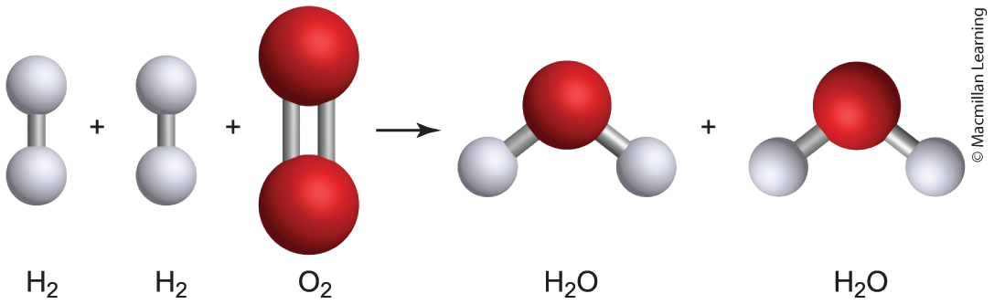
Limiting and excess reagent
Limiting Reagent – The reagent that is completely used up when the chemical reaction goes to completion; determines the maximum amount of product produced
Excess Reagent – Leftover reagent after the chemical reaction goes to completion
Example: 2 H₂(g) + O₂(g) ---> 2 H₂O(g); Suppose you have 4 mols H₂(g) and 8 mols O₂(g), what is the limiting and excess reagents? How much H₂O(g) is produced?

Slide 7
approach for limiting reagent problems
aA + bB ---> cC + dD
Given amount of reagents A and B, choose one reagent and ask how much of the other reagent is needed to completely react.
Compare the amount of the other reagent needed with what you have.
If the amount of the other reagent needed is more than what you have, then the other reagent is limiting reagent.
If the amount of the other reagent needed is less than what you have, then the other reagent is excess reagent.
Q: What determines the maximum amount of product produced?

Slide 8
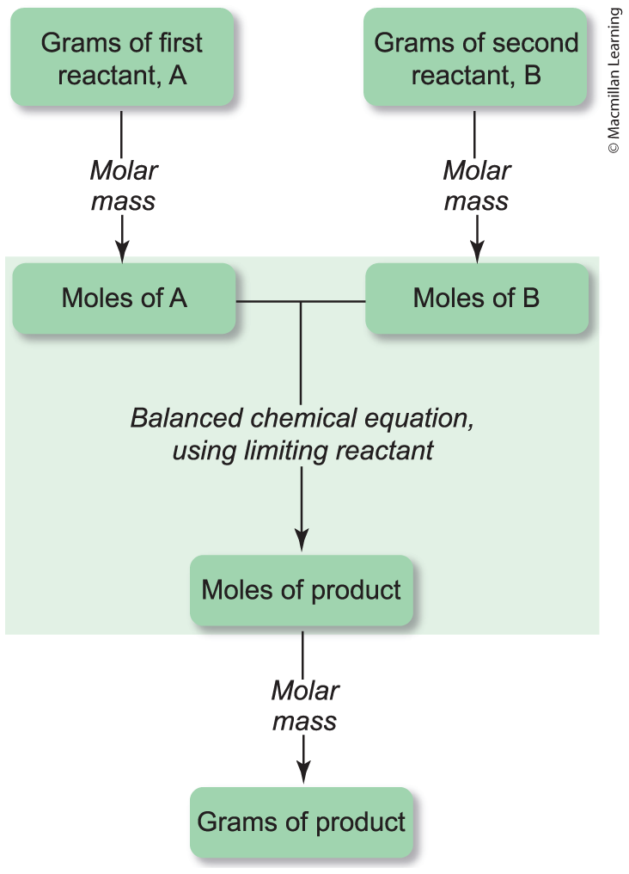
Alternative method: limiting reagent

Slide 9
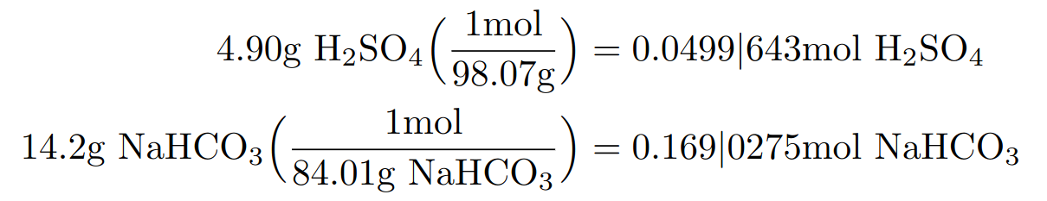
Example BOth ways: limiting reagent problem
What mass of Na₂SO₄(aq) will be formed by mixing 14.2g NaHCO₃(aq) with 4.90g H₂SO₄? (Molar Mass Na₂SO₄ = 142.04 g/mol; NaHCO₃ = 84.01 g/mol; H₂SO₄ = 98.07 g/mol)
H₂SO₄(aq) + 2 NaHCO₃(aq) ---> Na₂SO₄(aq) + 2 H₂O(l) + 2 CO₂(g)
Prof. Brian's way: 1) Convert all to mols

Slide 10
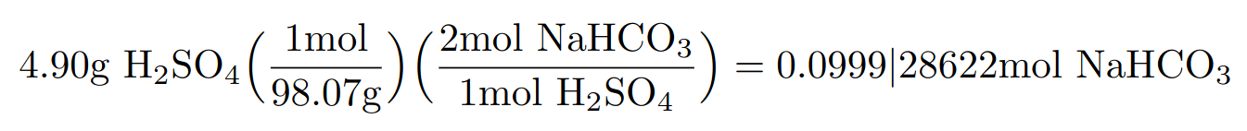
Example BOth ways: limiting reagent problem
What mass of Na₂SO₄(aq) will be formed by mixing 14.2g NaHCO₃(aq) with 4.90g H₂SO₄? (Molar Mass Na₂SO₄ = 142.04 g/mol; NaHCO₃ = 84.01 g/mol; H₂SO₄ = 98.07 g/mol)
H₂SO₄(aq) + 2 NaHCO₃(aq) ---> Na₂SO₄(aq) + 2 H₂O(l) + 2 CO₂(g)
Prof. Brian's way: 2) Choose a reagent and ask how much of the other needed

Slide 11
Example BOth ways: limiting reagent problem
What mass of Na₂SO₄(aq) will be formed by mixing 14.2g NaHCO₃(aq) with 4.90g H₂SO₄? (Molar Mass Na₂SO₄ = 142.04 g/mol; NaHCO₃ = 84.01 g/mol; H₂SO₄ = 98.07 g/mol)
H₂SO₄(aq) + 2 NaHCO₃(aq) ---> Na₂SO₄(aq) + 2 H₂O(l) + 2 CO₂(g)
Prof. Brian's way: 3) Compare to what is needed vs have. Conclusions?
Need --->
Have --->

Slide 12
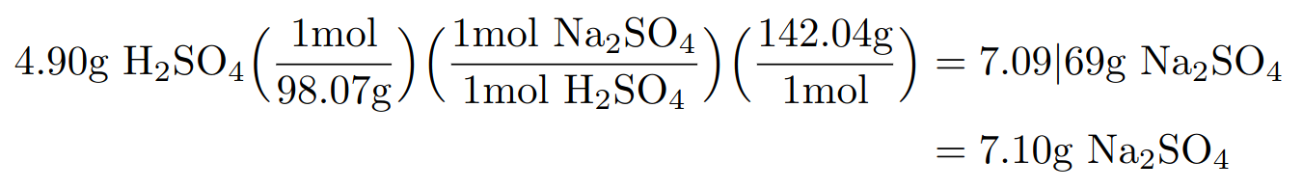
Example BOth ways: limiting reagent problem
What mass of Na₂SO₄(aq) will be formed by mixing 14.2g NaHCO₃(aq) with 4.90g H₂SO₄? (Molar Mass Na₂SO₄ = 142.04 g/mol; NaHCO₃ = 84.01 g/mol; H₂SO₄ = 98.07 g/mol)
H₂SO₄(aq) + 2 NaHCO₃(aq) ---> Na₂SO₄(aq) + 2 H₂O(l) + 2 CO₂(g)
Prof. Brian's way: 4) Take limiting reagent and determine mass of Na₂SO₄

Slide 13
Example BOth ways: limiting reagent problem
What mass of Na₂SO₄(aq) will be formed by mixing 14.2g NaHCO₃(aq) with 4.90g H₂SO₄? (Molar Mass Na₂SO₄ = 142.04 g/mol; NaHCO₃ = 84.01 g/mol; H₂SO₄ = 98.07 g/mol)
H₂SO₄(aq) + 2 NaHCO₃(aq) ---> Na₂SO₄(aq) + 2 H₂O(l) + 2 CO₂(g)
Textbook's way: 1) Convert all to mols

Slide 14
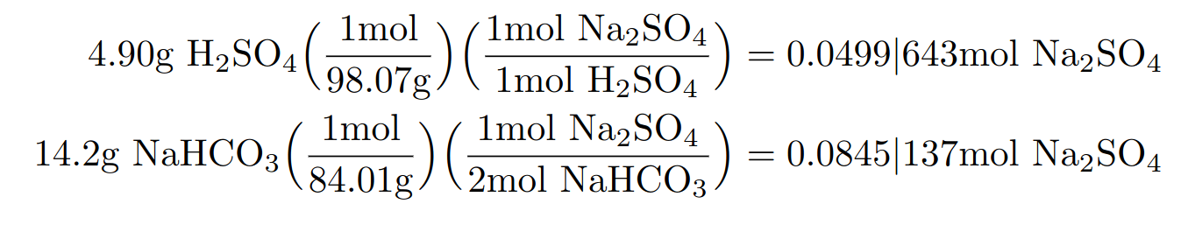
Example BOth ways: limiting reagent problem
What mass of Na₂SO₄(aq) will be formed by mixing 14.2g NaHCO₃(aq) with 4.90g H₂SO₄? (Molar Mass Na₂SO₄ = 142.04 g/mol; NaHCO₃ = 84.01 g/mol; H₂SO₄ = 98.07 g/mol)
H₂SO₄(aq) + 2 NaHCO₃(aq) ---> Na₂SO₄(aq) + 2 H₂O(l) + 2 CO₂(g)
Textbook's way: 2) Determine amount of product produced each reagent
Q: What are the limiting and excess reagents?

Slide 15
Example BOth ways: limiting reagent problem
What mass of Na₂SO₄(aq) will be formed by mixing 14.2g NaHCO₃(aq) with 4.90g H₂SO₄? (Molar Mass Na₂SO₄ = 142.04 g/mol; NaHCO₃ = 84.01 g/mol; H₂SO₄ = 98.07 g/mol)
H₂SO₄(aq) + 2 NaHCO₃(aq) ---> Na₂SO₄(aq) + 2 H₂O(l) + 2 CO₂(g)
Textbook's way: 3) Take limiting reagent and determine mass of Na₂SO₄

Slide 16
Your turn: Limiting reagent problem
Determine the mass of CO₂(g) produced when 25.0g HBr(aq) completely reacts with 12.3g NaHCO₃(aq).
HBr(aq) + NaHCO₃(aq) ---> NaBr(aq) + CO₂(g) + H₂O(l)
Molar Mass: HBr = 80.91 g/mol;
NaHCO₃ = 84.01 g/mol;
CO₂ = 44.01 g/mol;
H₂O = 18.02 g/mol;
NaBr = 102.89 g/mol

Slide 17
Outline
Announcements
  Exam 1 Redo
  In-class worksheet on Monday, Oct 2nd
Ch. 5: Stoichiometry
  Limiting Reagent Problems
  Theoretical and Percent Yields
  Quantifying concentrations of solutions – Molarity
  Electrolytes revisited – Molarity of Ions

Slide 18
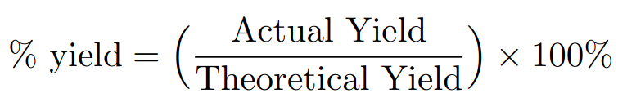
Theoretical, actual and percent yields
Theoretical yield – maximum amount of product that can be formed from a reaction based on the amount of reagents
Actual yield – the amount of product obtained in an experiment
Percent yield – percentage ratio of the actual to theoretical yields
Note: Percent yield can be combined with limiting reagent problems

Slide 19
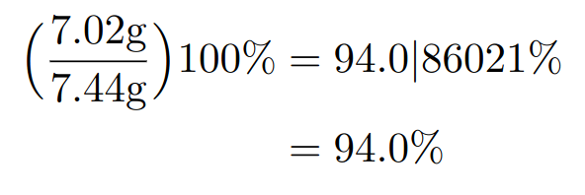
Example: Theoretical, actual and percent yields
Calculate the percent yield of a reaction if the theoretical yield is 7.44g and the actual yield is 7.02g.
Note: Use masses to compute % yields

Slide 20
Outline
Announcements
  Exam 1 Redo
  In-class worksheet on Monday, Oct 2nd
Ch. 5: Stoichiometry
  Limiting Reagent Problems
  Theoretical and Percent Yields
  Quantifying concentrations of solutions – Molarity
  Electrolytes revisited – Molarity of Ions

Slide 21
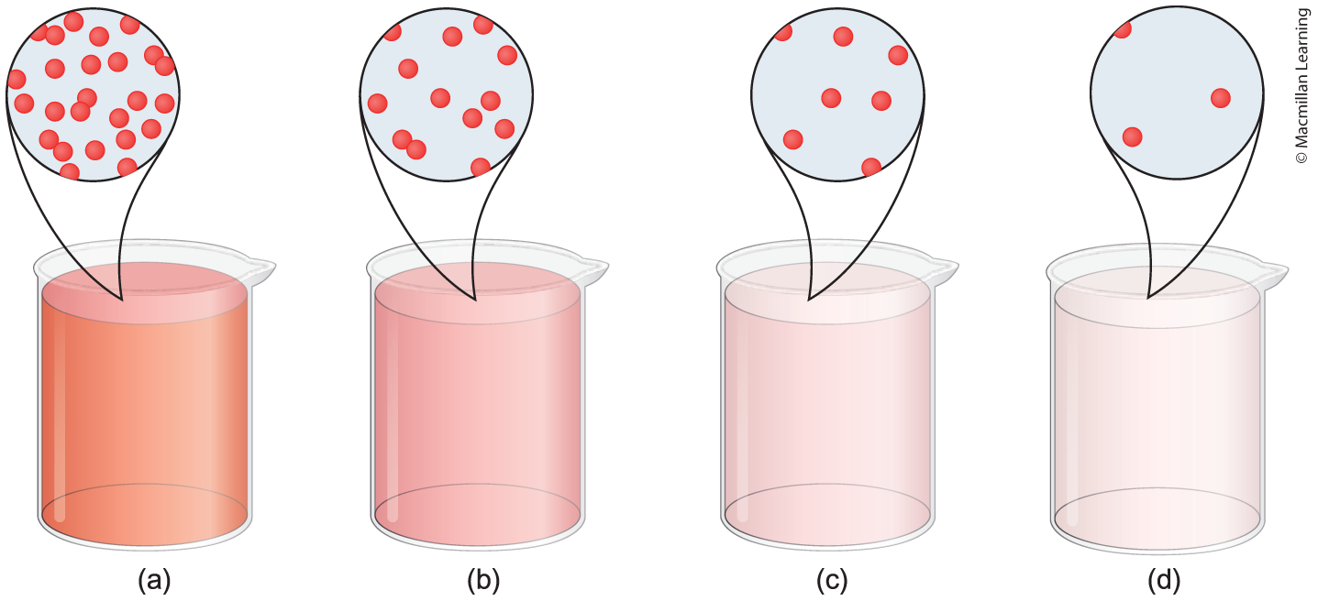
What are solutions?
Solute: generally, a solid and the smallest amount
Solvent: makes up most of the solution's mass typically a liquid

Slide 22
Concentrated and diluted solutions
(a) - supersaturated solution: dissolves more solute than the solution has the capacity to at a given temperature
(b) - saturated solution: at full capacity to dissolve solute
(c)+(d) - unsaturated solution: solvent can dissolve more solute

Slide 23
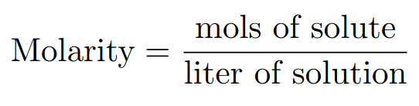
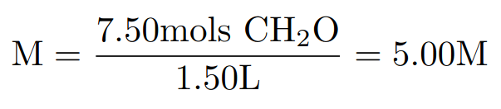
quantifying concentration of solutions
Molarity (M): The ratio of moles solute and liter solution
Example: Calculate the molarity of a solution containing 7.50 mol formaldehyde (CH₂O) in water to form 1.50 L of solution.

Slide 24
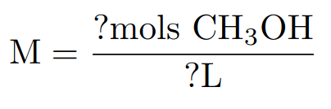
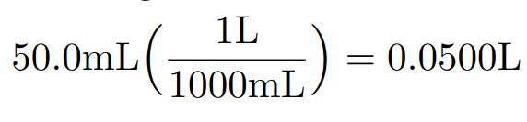
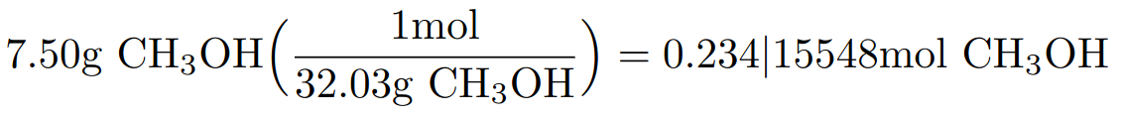
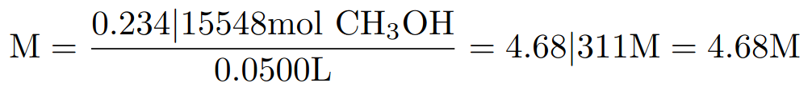
Example making methanol solution from mass
Calculate the molarity of 50.0 mL of solution containing 7.50 g of CH₃OH. Molar mass of CH₃OH = 32.03 g/mol

Slide 25
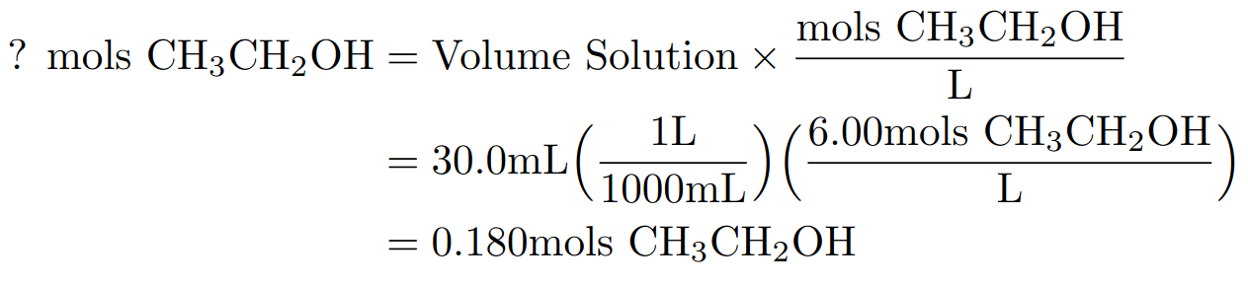
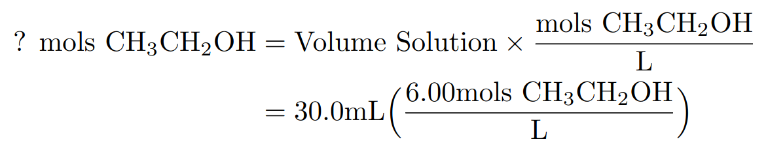
Revisiting the molarity (mols/L)
Q: What information does molarity (mols/L) give you? Hint: Conversion ratio
Example: Calculate the amount of moles of ethanol (CH₃CH₂OH) is in 30.0 mL of 6.00 M ethanol solution.

Slide 26
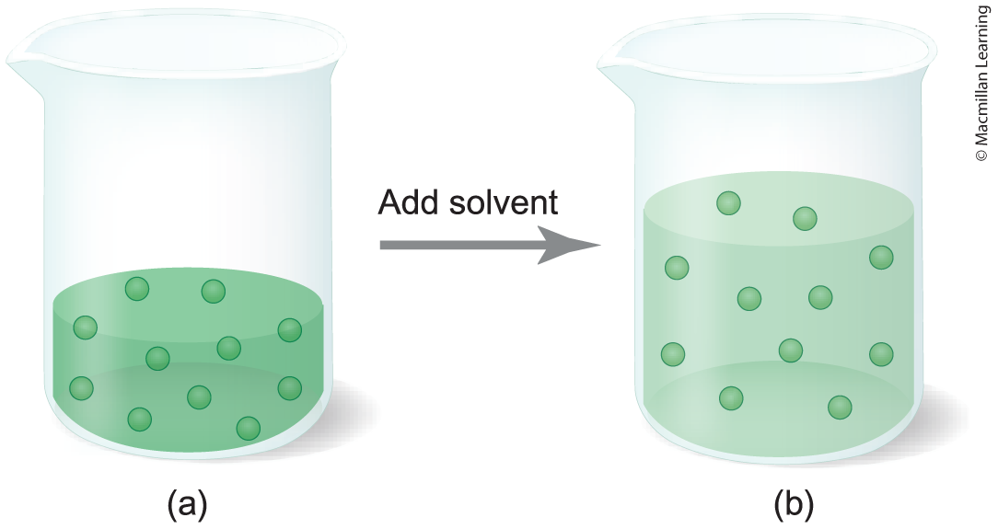
What is dilution?
Making solutions less concentrated by adding more solvent
Q: What happens to the mols of solute? Increase? Decrease? Or remains the same?

Slide 27


What is dilution?
M₁ is the initial molarity
M₂ is the final molarity
V₁ is the initial volume
V₂ is the final volume
n₁ is the initial mols of solute
n₂ is the final mols of solute

Slide 28
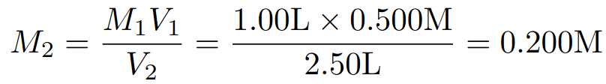
Example dilution problem
Calculate the final concentration of NaCl(aq) after 1.00 L of 0.500 M NaCl(aq) is diluted to 2.50 L with water.
Q: What quantity is the question asking to find?

Slide 29
Outline
Announcements
  Exam 1 Redo
  In-class worksheet on Monday, Oct 2nd
Ch. 5: Stoichiometry
  Limiting Reagent Problems
  Theoretical and Percent Yields
  Quantifying concentrations of solutions – Molarity
  Electrolytes revisited – Molarity of Ions

Slide 30
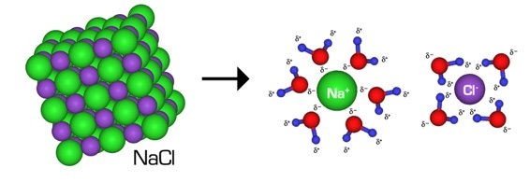
electrolyte revisited
Electrolyte: substance that conducts electric current because of a dissociation into positively and negatively ions

Slide 31
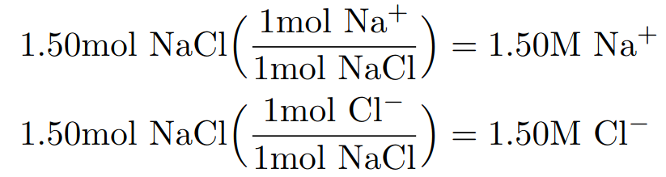
Molarity of ions
Example: What are the concentrations of Na+(aq) and Cl-(aq) in 1.50M NaCl(aq)?

