Slide 1
Capabilities
00.00.00

Slide 2
Capabilities

Slide 3
Capabilities
00.00.00

Slide 4
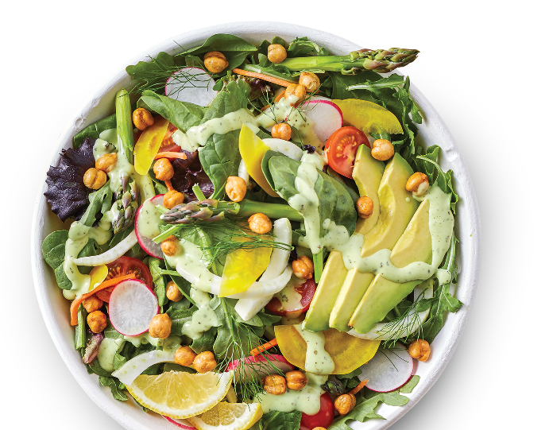
Agenda subhead goes here

Slide 5
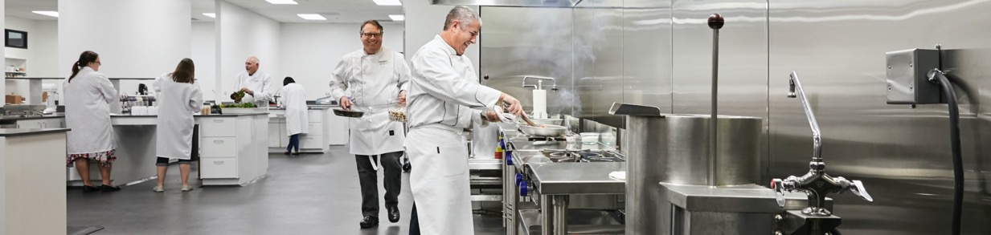
Company Overview
Company Vision:
ESG, Philanthropy
Our past & present:
The Better Way
Striving to serve you better

Slide 6

Company Vision
Our ambition is to become The Better Food Company. That means bringing together better people who make better products in a better corporate culture, and who work in unison to make the world a little bit better every day.
We stand ready to collaborate, shoulder-to-shoulder, with your culinary, supply chain
and marketing teams to help you grow
your business and delight your customers.
– Dave Ciesinski
President & CEO
T. Marzetti parent company is Lancaster Colony Company, a public company (Symbol: LANC).
Fiscal year 2022 sales for retail and foodservice of $1.7 billion.

Slide 7
ESG Commitments
We are dedicated to creating a better world. Part of that is better understanding
and mitigating our impacts on the environment. Beyond the environment, our commitment to a better world extends directly into the hearts of the people
who live in the communities where we operate.
We believe that the world is better only when
we do the things for others that make it so.
Corporate
Economic
Environmental
Social
Our team is what makes us better. We invest in people by making conscious efforts to promote safety, accountability and employee advancements at every level.
People are at the center
of our corporate efforts for betterment. we've set standards to ensure maximum transparency and ethical partnership that build communities around the world.
Better business comes from doing everything we can to meet the needs of our customers
and yours. That means solving problems of today and anticipating future challenges.
Better future is only possible
if we take batter care of the planet. It's why we have set measurable goals around water, energy, emissions and waste.

Slide 8

Philanthropy
Lancaster Colony contributes funds and volunteer time to many community organizations and foundations, such as the Children's Hunger Alliance,
Susan G. Komen Race for the Cure, YMCA, Pelotonia and Cornerstones of Hope.
Our giving is aligned with the United Nations Sustainable Development Goals.
In FY20, we donated more than $428,000 in support of community causes. Because of growing pandemic-related community needs, we also donated
more than $342,000 to local food banks and other organizations in FY20.

Slide 9
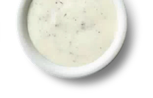
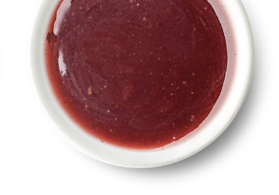
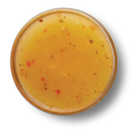
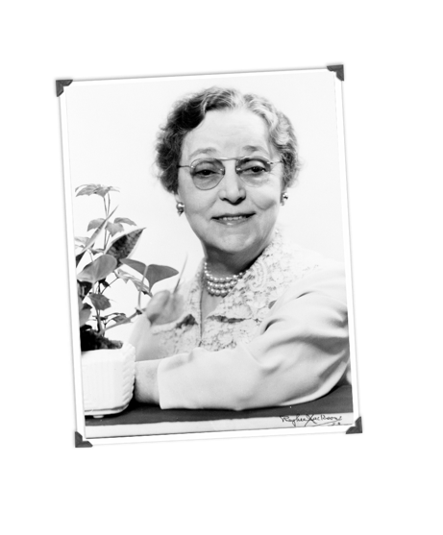
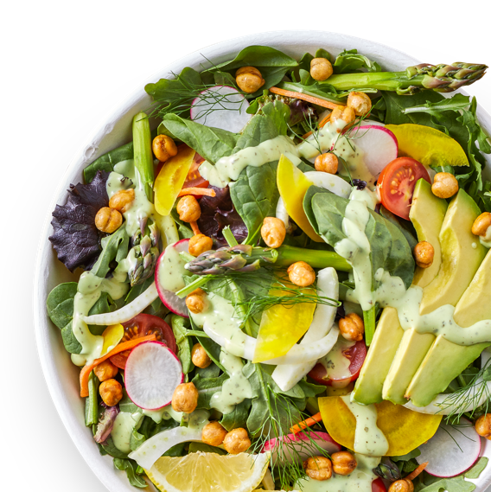
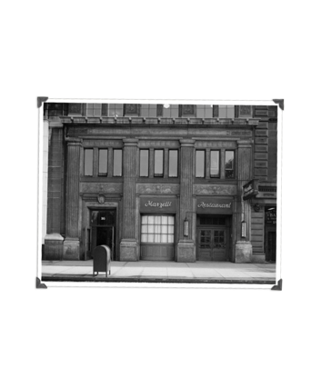

Our Past
Where we started
Teresa Marzetti opened a restaurant in Columbus, Ohio with a focus on making better food. In 1940 the iconic Marzetti Restaurant opened across from the Ohio State capital building and soon became
a four-star restaurant and legend in Midwest dining. The restaurant's salad dressings became
so popular they started bottling them for sale.

Slide 10
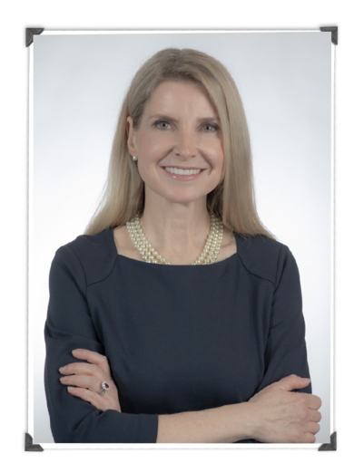

Our Present
At T. Marzetti, we believe that it's not about being the best, it's about being better than you were yesterday.
We don't rest on the laurels of yesterday's achievements. When we develop a good product, we're always thinking about the little tweaks that could make it cleaner, easier, tastier, better. When we help solve a customer's problem, we think ahead to prevent the next one.
Striving for better is the T. Marzetti way.
What you will love about the T. Marzetti foodservice team is that we continuously strive to serve you better. As individuals, and as a team, we are committed
to pursuing better for you.
– Kristin Bird
President Foodservice
12

Slide 11
Our Present
T. Marzetti is a $1.7 billion* food company, focused on developing
premium quality food products for both the foodservice and retail markets.
Today we remain focused on enabling restaurants to serve better food. We innovate and collaborate with leading national restaurant chains in decades-long partnerships. we also have an extensive branded portfolio of sauces, dressing, rolls and frozen pasta available from foodservice distributors.
17 of the top
25 national chain restaurants trust
T. Marzetti
Retail Sales
55%
45%
Did you
know?
Foodservice Sales

Slide 12
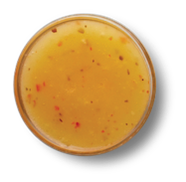





is no Accident
The products in our family of brands are prepared with the same attention you put into every line on the menu. They're packaged to make the consumer experience better, and back-of-house prep easier.

Slide 13
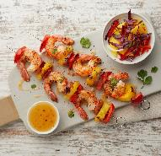
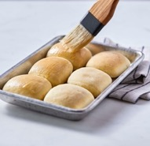
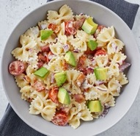
Our Portfolio
Our culinary, food science and R&D teams diligently
develop, test and perfect every product recipe.
This process ensures we always deliver quality that keeps guest
coming back with the convenience that fast-paced operations demand.
DRESSINGS
& SAUCES
+ World-famous
+ Trend-savvy
+ Flavor-forward
FROZEN BREADS
& ROLLS
+ Simple prep
+ Ready-to-serve
+ Heat and Serve
FROZEN
PASTA
+ Fast, easy prep
+ Impressive quality

Slide 14
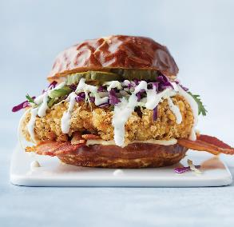
Our Products
Our products are prepared with the same attention you put into every line on the menu.
CONSUMER FACING
CUSTOM PRODUCTS
We have the dressings, sauces and dips guests love all wrapped up and ready to go.
CUPS / PACKETS / BOTTLES
We partner with restaurant concepts, convenience stores and commissaries to create solutions.
From innovation ideation to culinary concept development and full-scale production, we’re ready to help turn unique needs into unique products.
BACK-OF-HOUSE
SPECIALTY BULK PASTA
We have practical packaging perfect for stocking shelves
and prep lines.
GALLONS / POUCHES
In addition to Branded and National Account
sales, Marzetti Frozen Pasta® products are sold
in specialty bulk quantities to manufacturers.

Slide 15
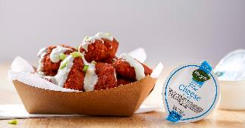
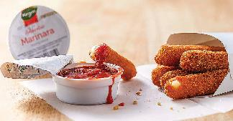
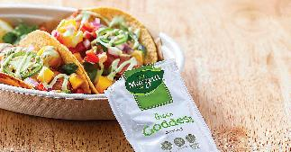
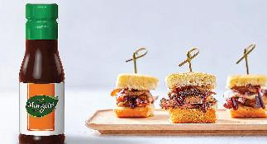
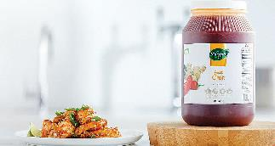
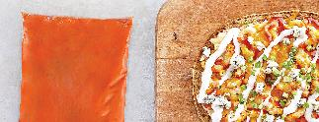
Our Portfolio
Our products are packaged to make the consumer experience better.

Slide 16
Our Expertise
T. Marzetti’s dynamic team is like none other in the business.
Composed of experienced food scientists, chefs and nutritionists, we cohesively translate a deep understanding of food science and culinary arts into consumer-loved proprietary and branded products—all at the speed of trends.
IDEATION
INNOVATION
DEVELOPMENT
TESTING
PRODUCTION

Slide 17
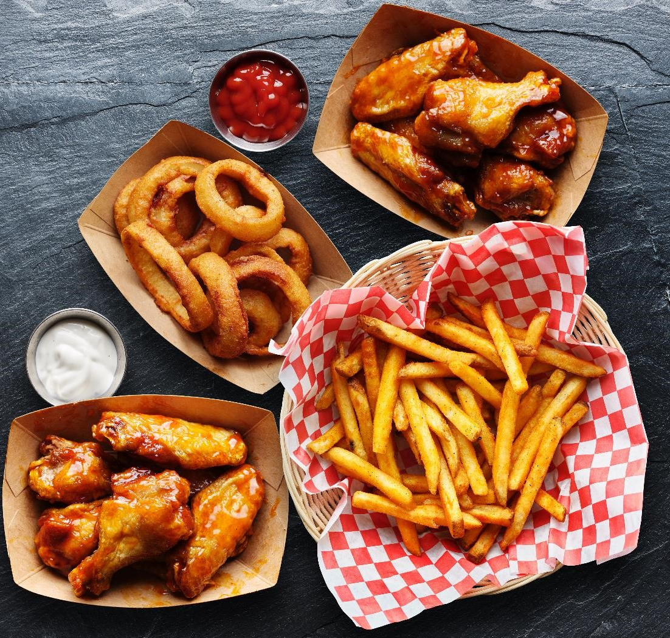
Ideation
& Insights
We use trend data, insights, sensory research and your vision to guide our ideation journey.
Knowing where food is going is half the battle.
That's why each of our cross-functional teams embrace the trends & insights that matter to
your business.

Slide 18
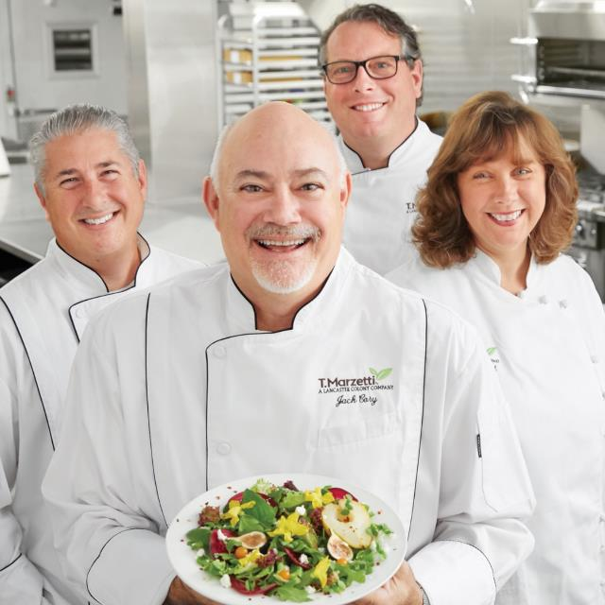
Innovation
Better Culinary
Our culinary teams take emerging concepts and holistic industry knowledge and translate both into inspired new products and menu concepts.
Our dedicated teams of food scientists and chefs are passionate about working with you
to understand your needs in order to develop an innovative customized sauce or dressing solution that your consumers will crave.”
– Sandra Bichsel
Director of Foodservice R&D

Slide 19
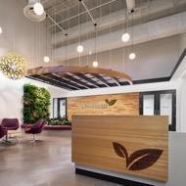
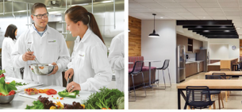
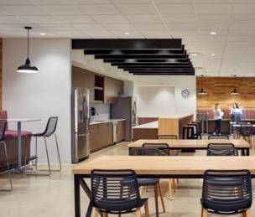
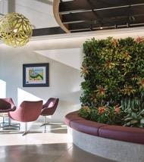

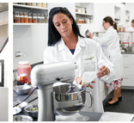
Innovation Center
Our Innovation Center opened in 2019 in Columbus, OH.
With 45,000 square feet dedicated to culinary innovation
and research & development with food safety, quality, regulatory and engineering all under one roof, we are poised to help you deliver innovation from concept to launch!
21

Slide 20
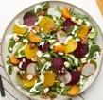
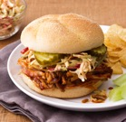
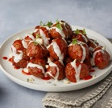
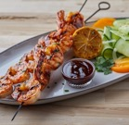
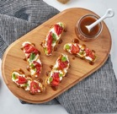
R&D Development
Research & Development at Marzetti includes Food Science and Culinary Arts in collaboration with world class Food Safety, Quality & Regulatory to bring award-winning results to the table for our customers.
Our State-of-the-art R&D lab is designed to aid in rapid prototyping to develop unique, bold
and on-trend flavors in commercial formulations that meet consumer and operational demand.
Our dressings and sauces expertise include:
SALAD DRESSINGS
& MARINADES
SANDWICH
SAUCES
WING SAUCES
& GLAZES
DIPPING
SAUCES
SWEET SAUCES & PREMIUM BEVERAGE SAUCES
Creamy & Vinaigrette
Spreads & Aioli’s
Buffalo, Sweet & Spicy, Asian, Buttery
BBQ, Marinara, Salsa
Chocolate, Caramel, Icing, Fruit-based

Slide 21

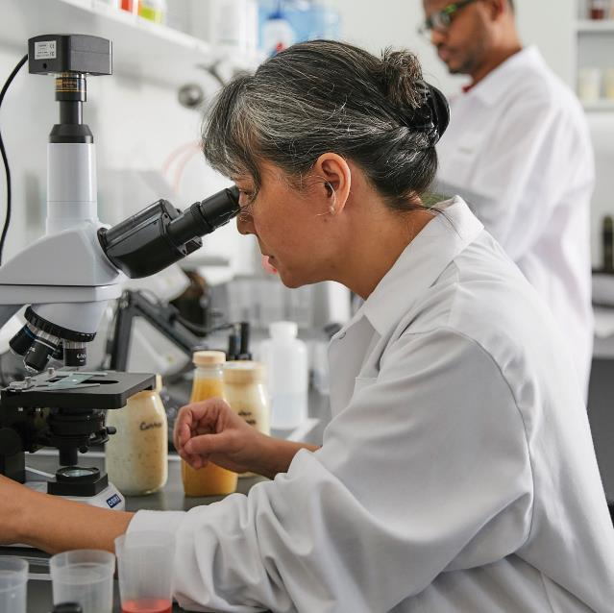
Technical Services
Our food scientists ensure that approved samples translate into successful manufactured products.
All this is done with careful consideration of
food safety and high standards of quality assurance.
Thousands of retail, foodservice and industrial
products at 16 Marzetti facilities plus co-packers
1,700 + ingredients & specifications focusing on
procuring ingredients from top quality suppliers
and the prevention of food fraud
950+ approved supplier facilities
On-going compliance with nutritional
and ingredient statement labeling requirements

Slide 22
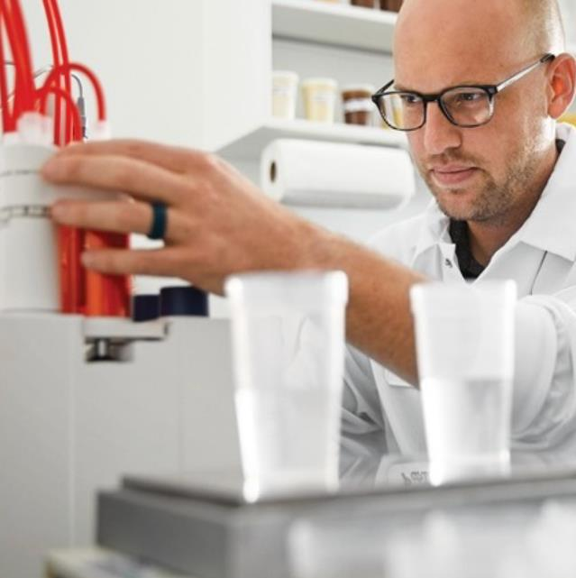
Quality Assurance
The Food Safety, Quality & Regulatory team ensures that our products, processes and facilities not only
meet all specifications but exceed customer and consumer expectations.
We have professionals dedicated along every step of the process from development through launch and after launch, our Quality and Food Safety processes, procedures and standards focus on delivering great tasting products without food safety or regulatory risk.
We have strong internal auditing capabilities but add the additional layer of verification by a globally recognized
GFSI certification scheme (BRC).

Slide 23

Sensory Testing
Sensory attributes play a significant
role in your guest's experience.
Our science-backed sensory testing and consumer
study services can help you gain consumer acceptance
and ensure success of every menu item.
We will partner with you to conduct discriminating/
difference test, Triangle test, Tetrad test, Descriptive
profiling, and a variety of acceptance test including
paired and Hedonic ratings.

Slide 24
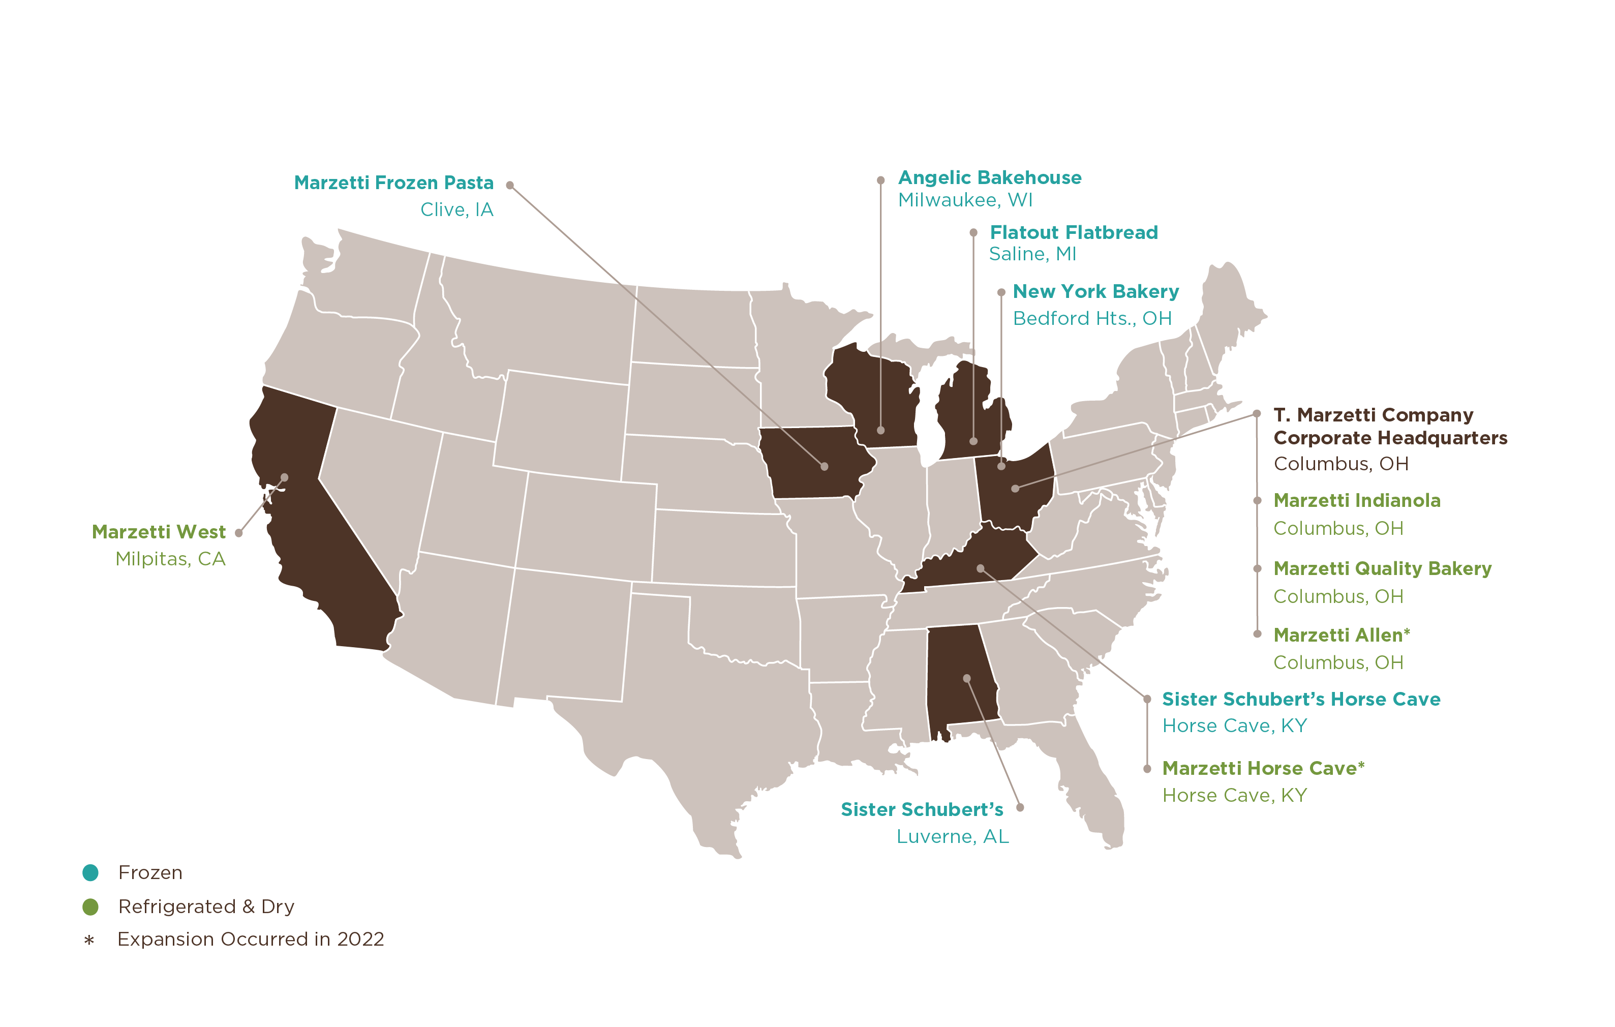
Foodservice Manufacturing Facilities
Investing for growth and anticipating
your needs, we have devoted over
$300 million in the last three years
in expanding and equipping our manufacturing network.

Slide 25
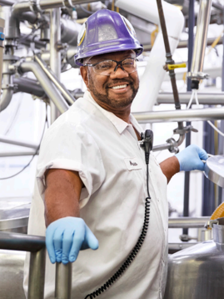
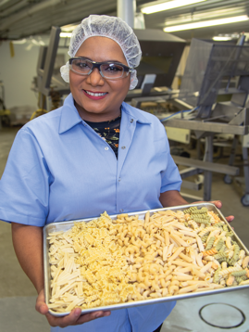
Facility Updates
Indianola Facility Columbus, Ohio
Allen Facility Columbus, Ohio
$25 million in improvements
Recent investments, expansions and upgrades
  New employee facility renovation
  Soybean oil tanks
  Production line upgrades
  Portion pouch lines
Now equipped
to better deliver
  Portion control cups
  Portion control packets
  Retail bottles
  Gallons
$32 million in improvements 165+ employees
Recent investments, expansions and upgrades
  17,000 square foot additional production & warehousing
  New portion cup lines
  Kitchen expansion
  Fire Protection for entire facility
Now equipped
to better deliver
  Portion control cups
  Retail dip cups
  Cryovac pouches
T. Marzetti Invest $22.8M in
Expansion of Facility
in Columbus, Ohio
“Marzetti to Expand Its West Side Facility… Expansion will add 20 more jobs to the 116 jobs now at the facility.”
- The Columbus Dispatch

Slide 26
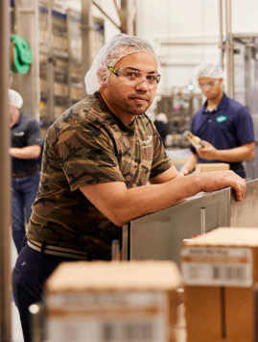
Facility Updates
Horse Cave Dressings Facility
Horse Cave, Kentucky
Horse Cave Sister Schubert’s Facility Horse Cave, Kentucky
Opened 2007 and expanded in 2020
$60 million in improvements
200+ employees
Recent investments, expansions and upgrades
  Frozen yeast rolls
  Proof & bake
  RTE, fully baked rolls
  Retail packaged rolls
  Foodservice bulk packed rolls
  Foodservice foil tray pack rolls
Opened 2006 and expanded in 2021
$148 million in improvements | 500+ employees
  Recent investments, expansions and upgrades
  New retail bottle lines
  New portion cup lines
  Cook kitchen
  Processing area
  Cryovac pouch capacity
Now equipped to better deliver
  Cryovac pouch
  Portion control cups
  Portion control packets
  Gallons
  Retail bottles
  Drums
T. Marzetti Co. Breaks Ground on
220-Job Expansion in Hart County

Slide 27
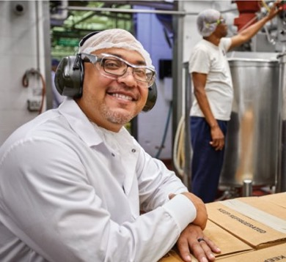
Facility Updates
ALTOONA FACILITY
Altoona, Iowa
$30 million in improvements
200+ employees
Recent investments, expansions and upgrades
  Frozen warehouse converted to cold pillow packaging room freezing capacity expansion
  Tunnel freezer
  New ammonia building
Now equipped to better deliver
  Short Goods
  Lasagna
  Spaetzle
T. Marzetti Co. Breaks Ground on
220-Job Expansion in Hart County

Slide 28
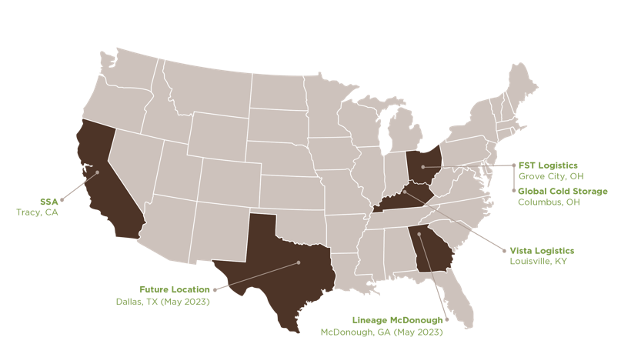
Dry and Refrigerated Distribution

Slide 29
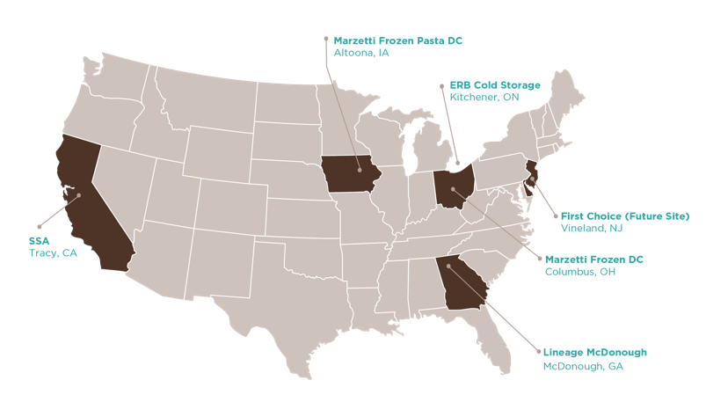
Frozen Distribution

Slide 31
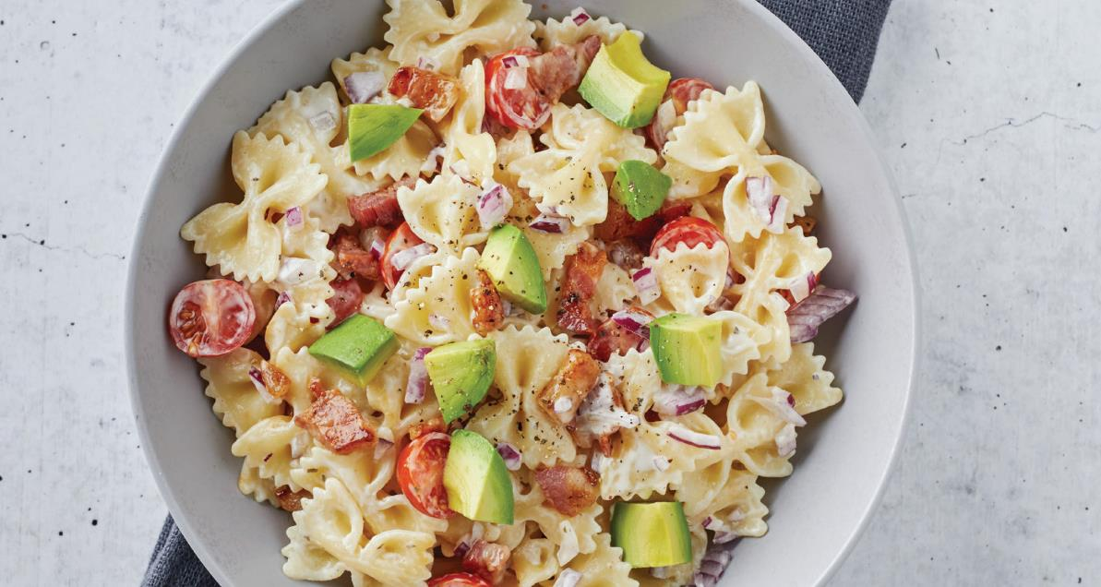
Appendix
33

