Slide 1
Ben-MS-Thesis Progress

Slide 2
Summer 2020

Slide 3
Meeting 11
Tblade3
Geomturbo
Fine/Turbo

Slide 4
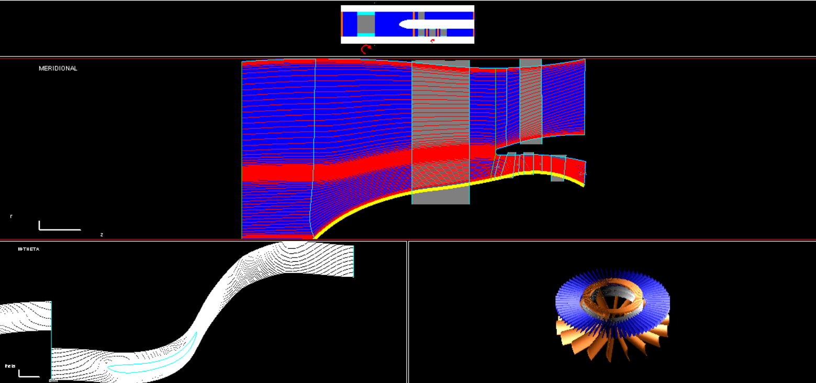
Autogrid Geomturbo Adv_tutorial4

Slide 5
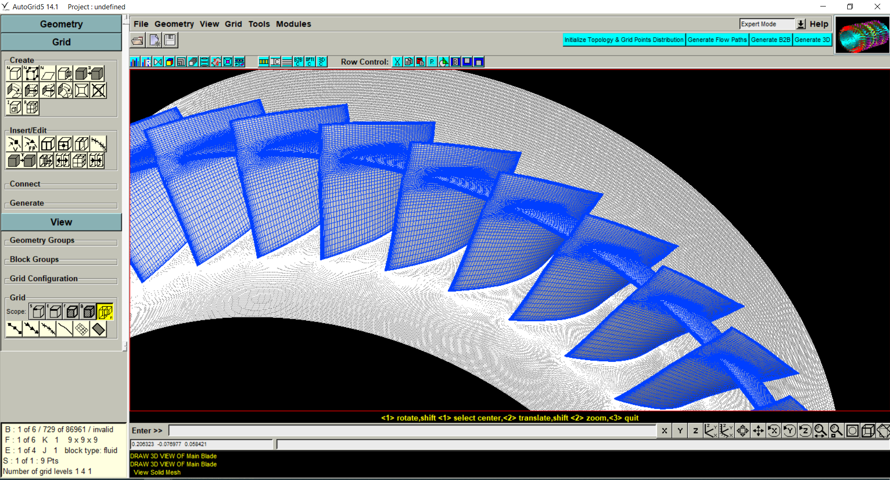
Autogrid Geomturbo Adv_tutorial 7

Slide 6
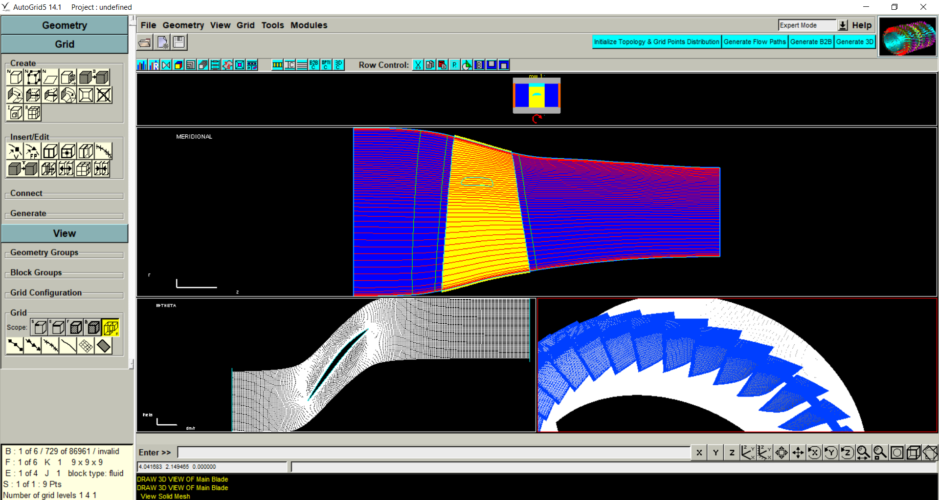
Part 3: 3D Snubber without Fillet

Slide 7
After Spring Break 2020
Converted the curve coordinates of the fan into individual files using IGG.
Shared the modified curve format with Chris and saw how his python code works.

Slide 8
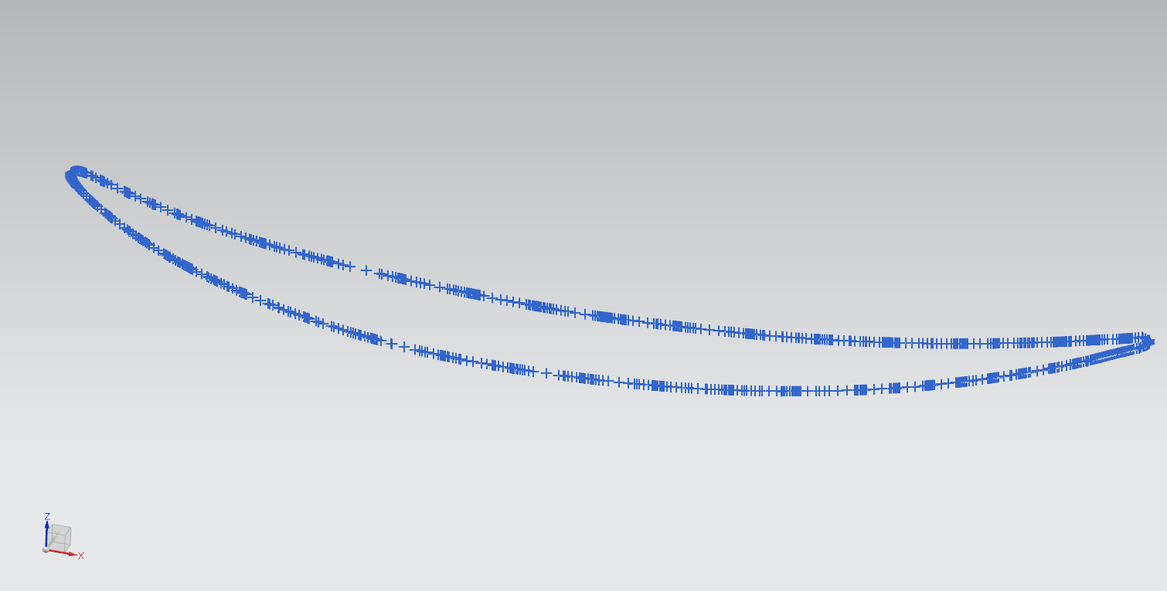
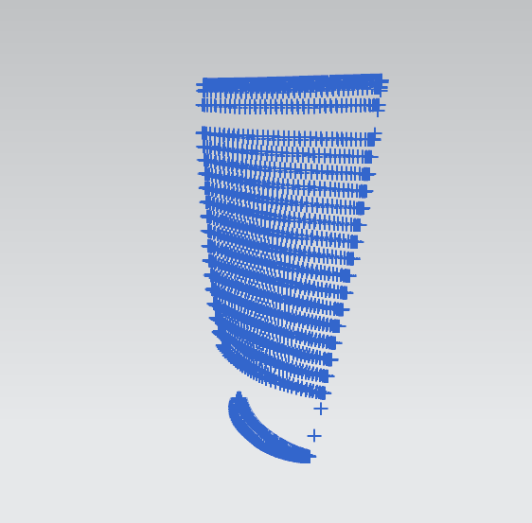
Progress in Spring Break 2020

Slide 9
Was able to isolate the coordinates using IGG. Still struggling on how to include the coordinates of the stubber into these files.

Slide 10
Before Spring Break 2020

Slide 11
Other files
There are two more types of folders that I have not include in this presentation. One with all a set of files that contain all the constituent files of the components and another that contains the flow simulations of HPT, LPT and HPC. All these files need to be processed in FINE/Turbo before interpreting. I will need some more time to do that.

Slide 12
NPSS Model Folder
\20150003286\NPSS Model\eee-cruise\Final Report.docx
contains a report of the compressor and turbine maps and compares the Justin Grey and Philips Owen model.
\20150003286\NPSS Model\eee-cruise\Map Comparisons.docx
contains a comparison of the results obtained by Justin Gray and Phil Owens. This report gives no conclusions and simply shows the enlarged maps of LPC, HPC, HPT and LPT.

Slide 13
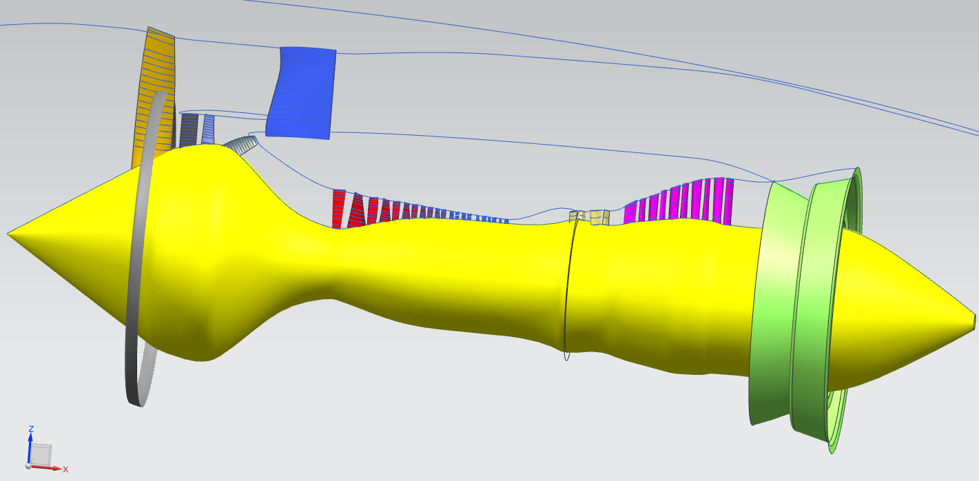
EEE_engine_all.igs without the shrouds.
Not sure how this differs form the previous one.

Slide 14
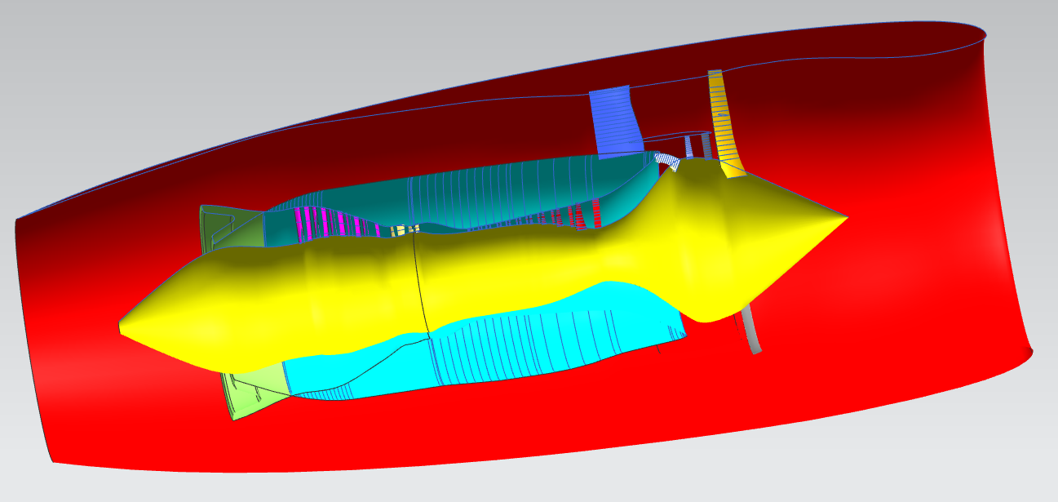
Full Engine geometry inside the EEE_3d_uns.igs file

Slide 15
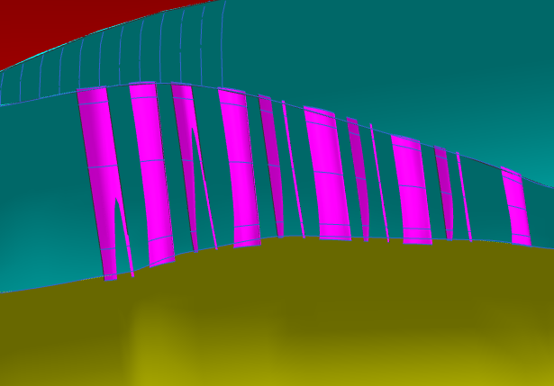
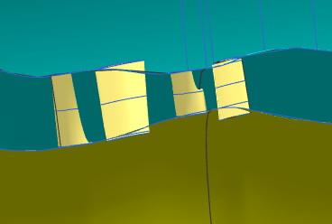
LPT and HPT

Slide 16
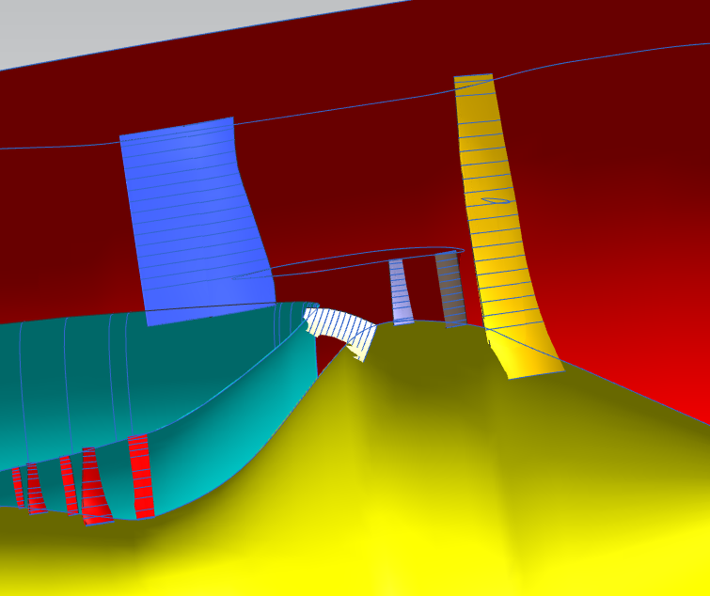
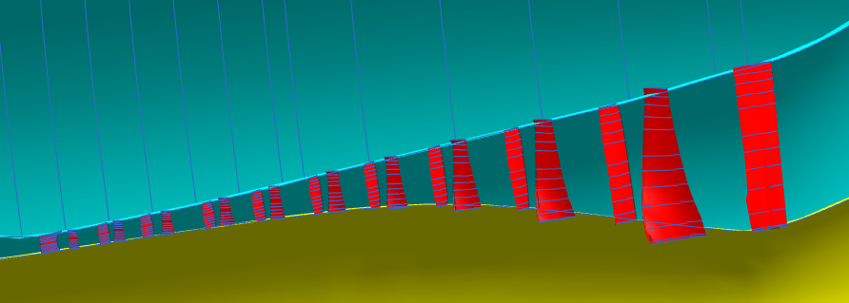
EEE_3d_uns.igs had the following geometry.
Fan+Booster and HPC

Slide 17
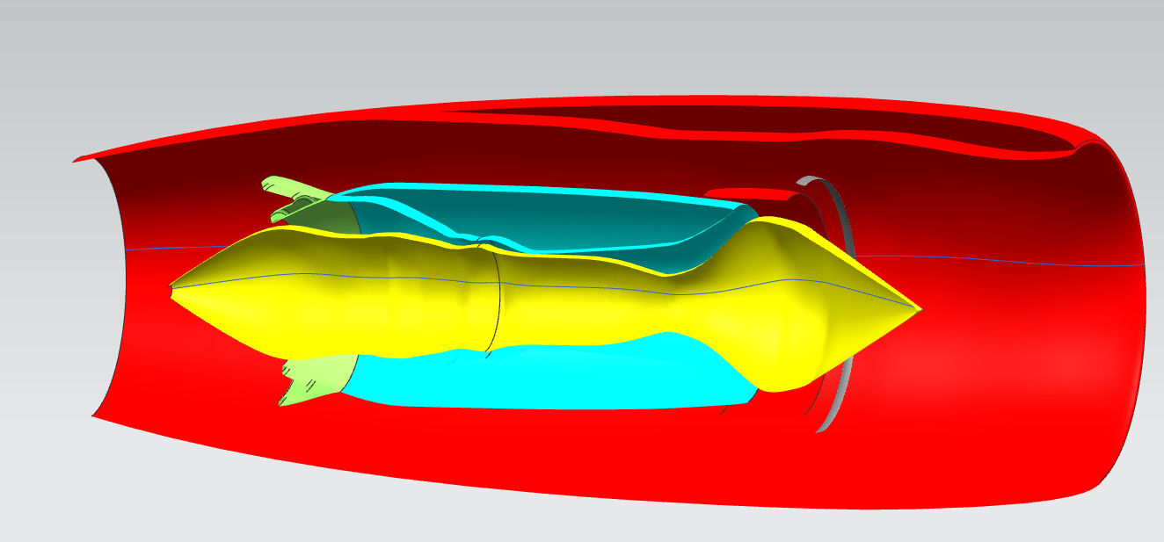
EEE_3d_sym.igs file has the following geometry.

