Slide 1
Security Risk Management (SRM)
Oct. 2019

Slide 2
Agenda
SRM overview..
Improvements
Plus: Fun & Games!
Notes:
TIMELINE
…

Slide 3
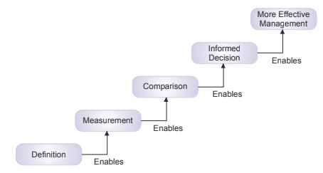
Security Risk Management
Effective Risk Management
The objective of a risk management program is to position the organization to experience an acceptable frequency and magnitude of loss events, in a cost-effective manner.
Spoiler: Definition comes first!
Notes:
Later, we’ll get into some of the connections between these program components (and other Security team programs)
SRM: differentiated from financial, operational, regulatory, etc.
Effective Risk Mgmt (diagram *explain from the top*):
Without a logical, tightly-defined taxonomy, risk assessment approaches will be significantly impaired by an inability to measure and/or estimate risk factor variables. This, in turn, means that management will not have the necessary information for making well-informed comparisons and choices, which will lead to inconsistent and often cost-ineffective risk management decisions.
… it becomes immediately apparent that failures at lower levels of the stack cripple the ability to achieve effectiveness at higher levels

Slide 4
Security Risk Management: Use Cases & Examples
Methodical risk management should support business decision making. Examples:
Benchmarking risk levels, to inform budgeting needs
Prioritizing efforts & resources
Measuring progress & ROI
Additional opportunities:
What decisions do we lack confidence in the decision-making process?
Or feel the need for less subjectivity?
Notes:
More specific examples:
How much engineering time to dedicate to remediating a vulnerability
(or selecting among vulnerabilities to remediate)
Whether to engage in a vendor partnership
Which of several alternative controls to implement
Whether to accept a risk
ROI of a control (to decide whether to extend contract)
Other examples / use cases?
Possible additional (specific) use cases:
Whether to disable Bonjour / Airdrop;
Whether to purge all recordings from sales recording platform due to risk of PII exposure;
Whether to validate / reject customers’ X509 certs if expired/revoked, for mutual TLS-based auth;
Whether to require a code for zoom meetings;
Adoption Continuum: “At the <lightweight> end of the adoption continuum are organizations that don’t try to quantify risk and just leverage FAIR as a framework for understanding risk better, and as a way to normalize internal conversations about risk. At the other end of the continuum are organizations that quantify risk for all major strategic, and many tactical, decisions.”

Slide 5
Fun and Games

Slide 6
Risk Scoping Exercise
Below is a representative list of “top cyber risks” maintained by a large HCO:
Mobile / BYOD
Cloud computing
DDoS
Third party risk
Social engineering
Unintentional errors
Ransomware
Nation-state hacking groups
Web application vulnerabilities
User awareness
Data leakage
Insider threats
Your challenge: determine which are likely to be the top 5 risks for a large HCO
Notes:
https://www.fairinstitute.org/blog/best-approach-to-prioritize-risks-part-1
Discuss / Debate
At first glance most people would look at this list and nod in agreement that those seem like significant cyber risks. Maybe, but now answer the question, “Which are the top three risks in this list?”
A first principle of prioritization is that comparisons can only be made between things that are fundamentally similar to one another and/or can be evaluated using a common unit of measure. Unfortunately, the list above is a grab-bag of different risk landscape elements. For example, mobile technologies are just that — a technology, while cyber criminals are a specific community within the overall threat population, social engineering is a method used by various threat communities, and web application vulnerabilities are an example of weaknesses within a specific part of the technology landscape.
If you and I are just having a conversation on the street about everyday things, there’s rarely a problem with using words in an inconsistent way because the context of the conversation usually makes the intent clear. However, when we’re in a professional setting discussing things like risk measurement, prioritization and clear communication, the rules change — or at least they should change.
In the 1930’s, a philosopher by the name of W. V. Quine said, “The less a science is advanced, the more its terminology rests on an uncritical assumption of mutual understanding.” At the time he was speaking about mathematics, but if you look at the history of any discipline we think of today as being “mature”, they all went through an early stage where nobody could agree on basic principles and nomenclature. It’s an unavoidable part of the maturation process.
Will cyber risk management ever become a “true science?” That depends on how you define science, but there’s little question that it needs to become much better at measurement and communication, and you can’t reliably measure or discuss what you haven’t clearly defined. That's an important part of what it means to be a mature discipline, and nobody should feel good about the fact that our profession doesn’t consistently use what is perhaps the most fundamental term in our professional nomenclature (after all, everything we do is intended to help manage risk).

Slide 7
SRM Improvements

Slide 8
Security Risk Management Improvements
Over time, improve connections between SRM and other security programs
Eventually, make SRM more data-driven, scalable, and “full circle”
  More widely-solicited estimates and data
  Frequently revisit / near-continuously update forecasts
  Broaden applicability / adoption of risk assessment process
  Move towards “self-service”
  Better incorporate and analyze remediation / control options (incl. ROI)
Notes:
While security risk management provides important capabilities in and of itself (such as communicating risk to executive leadership), it should not exist in a silo. Close connections should exist with the vulnerability management and third party security risk management programs, at a minimum. Similarly, incident detection and response efforts should be informed, at least in part, by risk management - ensuring that attacks aligned with high risk areas are detected and responded to quickly, in the event that preventative controls fail.
Meaningful, objective metrics from each security program will also contribute to effective security risk management, by providing data points that can be used to improve our ability to forecast risk scenarios, and measure our progress in reducing risk.
VM, 3P, etc. as “inputs” (meaningful, objective metrics)
Prioritized assessments / audits, detection, alerting informed by “outputs”
Similarly, scalable risk analysis processes should benefit other programs, by enabling more disciplined and informed, yet efficient decision making - for example, cost/benefit analyses of alternative mitigation options, risk acceptance decisions, and allocation of security budget.
Frequent updates: in some / most (?) cases, Bayesian
Self-service: enable other teams / programs to do risk assessments to fit their purposes, without needing to engage Risk program

Slide 9
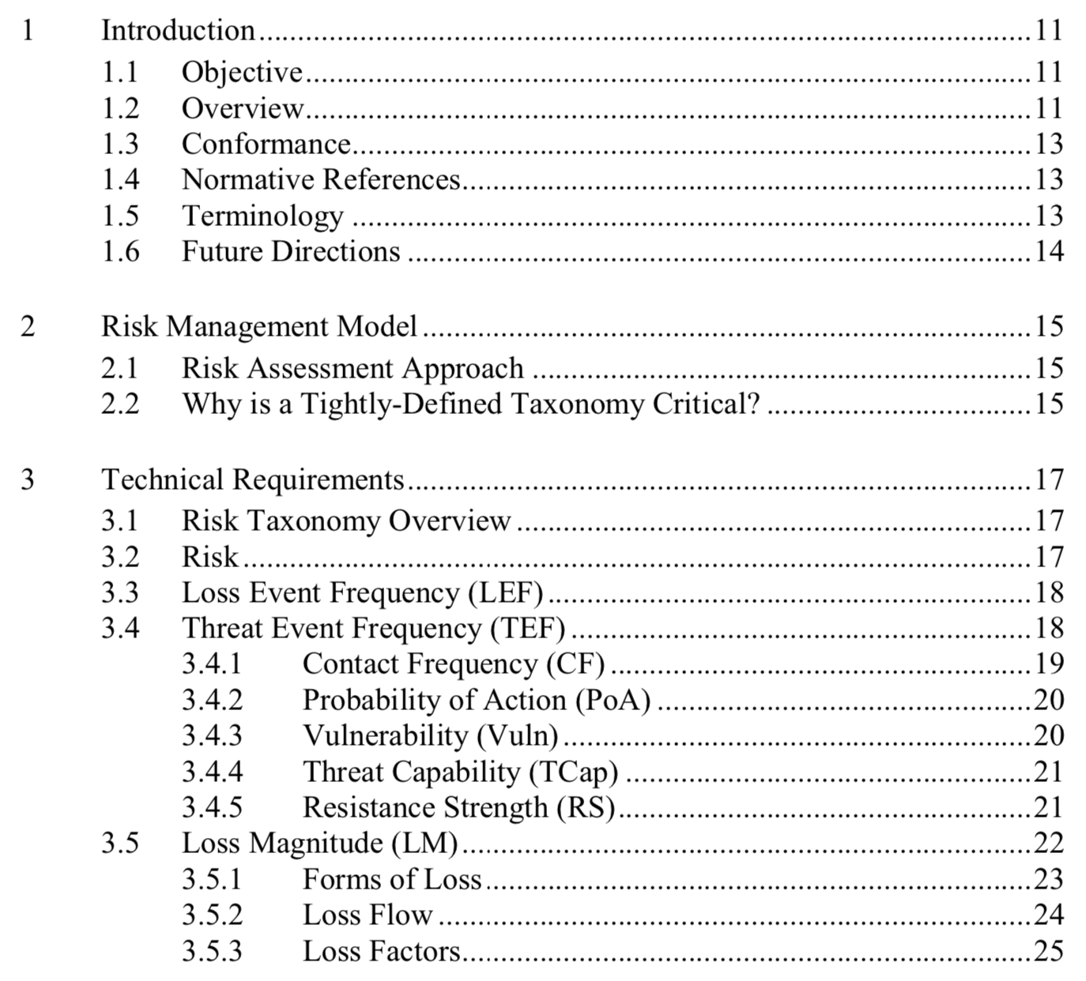
Improvement #1: Terminology and Methodology
FAIR ('Factor Analysis of Information Risk') is an open standard that provides a model for measuring, analyzing, and understanding information risk; an analytic model of the factors that drive frequency and magnitude of loss.
  Defines the factors as well as the relationship between those factors
  FAIR is not a compliance or risk management framework, nor is it a list of controls or best practices
“Everyday terms induce an illusion of communication - people assume that everyone interprets the terms consistently and similarly, and fail to appreciate the variance in the interpretations of these words.”
“How much credibility would the physics profession have if practitioners could not agree on foundational terms like mass, weight, and velocity? As silly as that may seem, the security / risk professions struggles with foundational terminology on this profound a scale.”
"Risk Taxonomy" publication / FAIR Risk Ontology chapter
Or, One-Pager
Notes:
Shortcoming #1: Inconsistently-used and overlapping terminology
Proposal: adopt FAIR (* Plus, some definitions / content from HTMA.. )
->
FAIR = taxonomy / ontology (<-- the irony of using two distinct terms to describe it…)
“the FAIR framework is more accurately described as an ontology. The difference is that taxonomies are used to classify things (e.g., mammals versus amphibians versus reptiles), whereas ontologies describe relationships between elements (e.g., the molecular and biological processes surrounding genes). The term “taxonomy” was inaccurately applied early in FAIR’s existence
and gained common use and recognition. Live and learn.”
“Simply stated, the ontology represents a model of how risk works by describing the factors that make up risk and their relationships to one another. These relationships can then be described mathematically, which allows us to calculate risk from measurements and estimates of those risk factors.”
“Keeping in mind that no models are perfect, FAIR’s ontology has evolved over the years to reflect growth in our understanding of risk, risk analysis and, in some cases, analyst behaviors. It’s reasonable to expect the ontology to continue to evolve”
A key component of FAIR is the taxonomy that defines these factors, and how they affect each other. The definitions and relationships provided by the standard are clear and comprehensive. Wider adoption of such a taxonomy is sorely needed to improve the inconsistent and often contradictory use of terminology in our field. (for example: https://lnkd.in/eBXEFZJ)
In short, FAIR can help align security decisions and efforts with business priorities & tolerances, to achieve the shared goal of cost-effective risk reduction.
FAIR is not intended to replace existing, widely-accepted risk assessment frameworks (NIST RMF, ISO 2700X, etc.), but instead complements them by objectively evaluating the likelihood and impact of factors that contribute to risk.
A closing quote from the Risk Taxonomy Technical Standard (https://www.opengroup.org/certifications/openfair):
"Security organizations sometimes find that management rejects their risk conclusions and recommendations, in part because it’s difficult to articulate the intuition and experience that led to those conclusions. The ability to explain how conclusions were arrived at using a logical and rigorous method can have a very significant impact on credibility in the eyes of management."

Slide 10
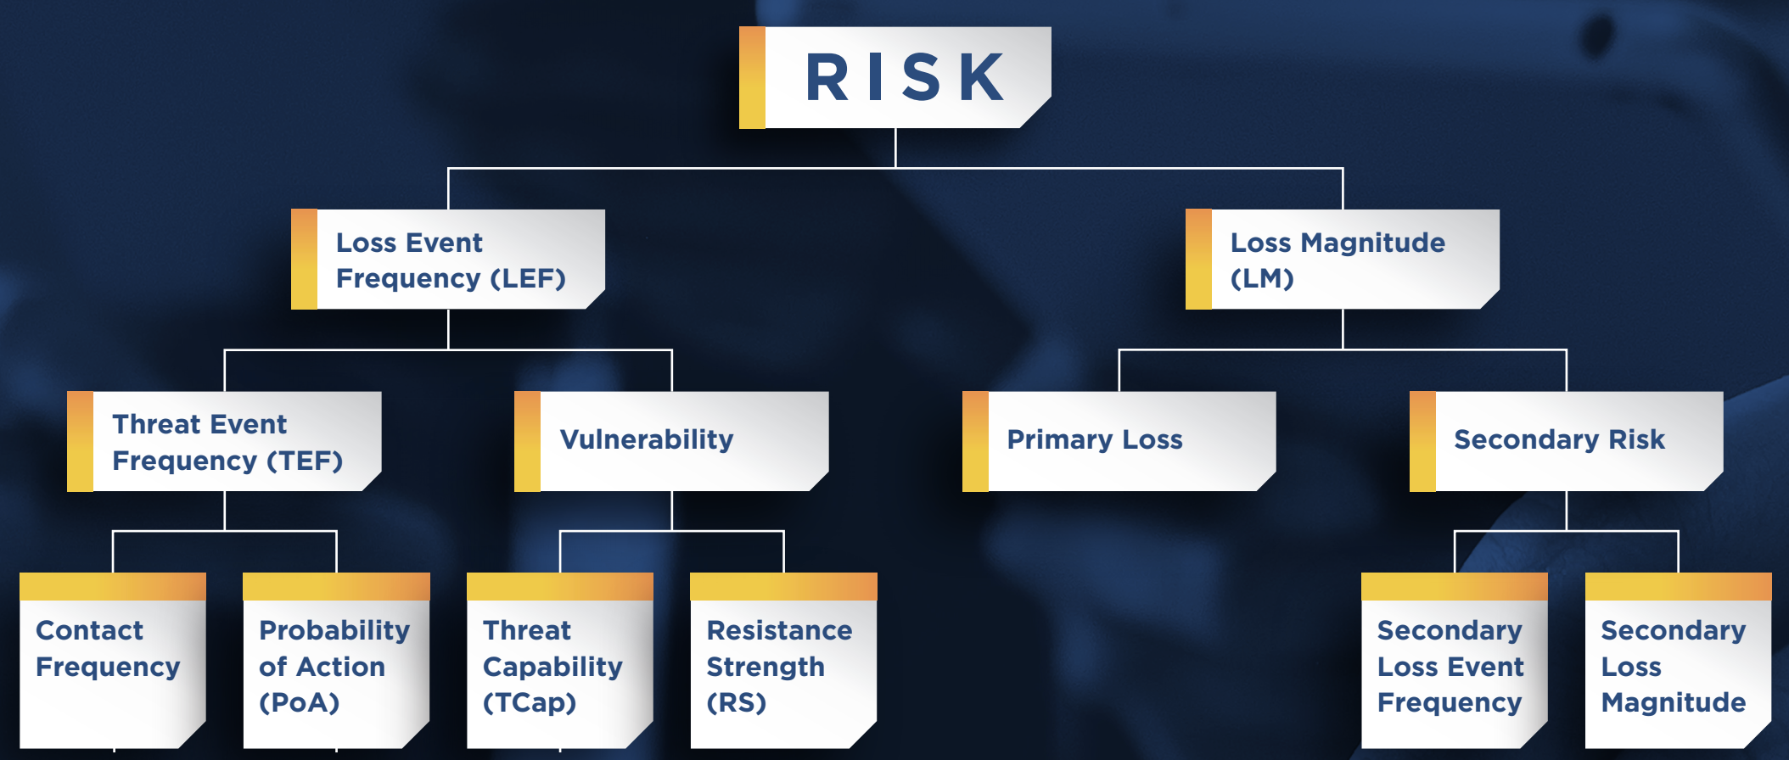
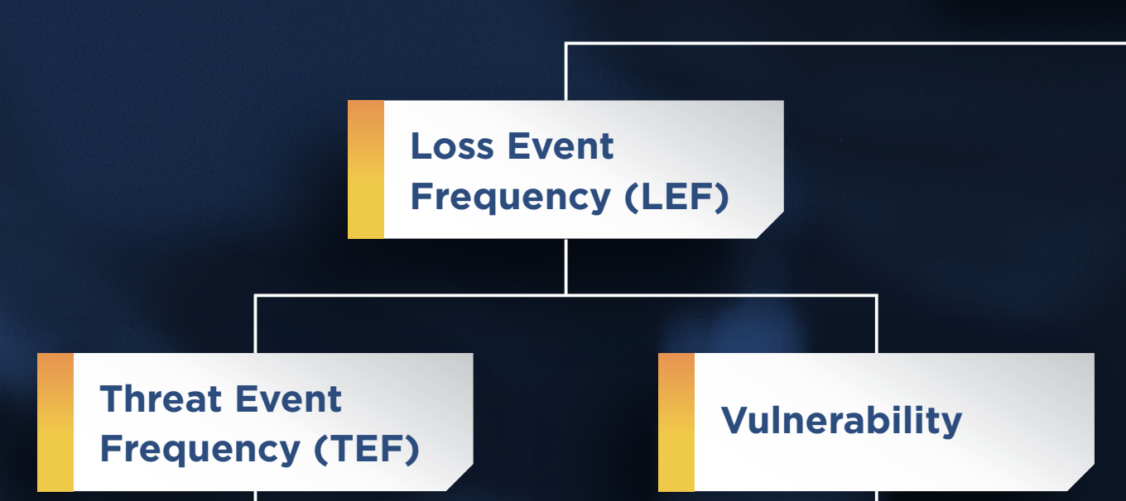
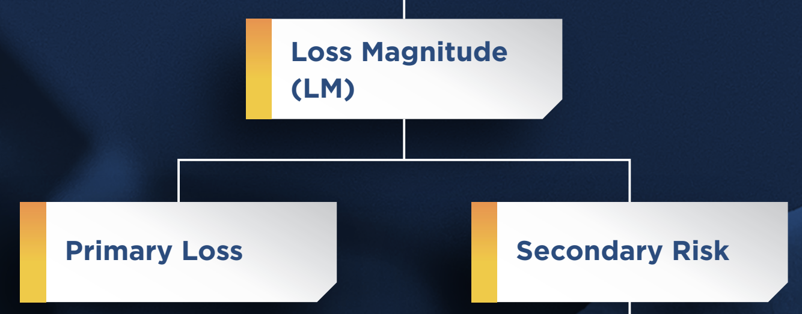
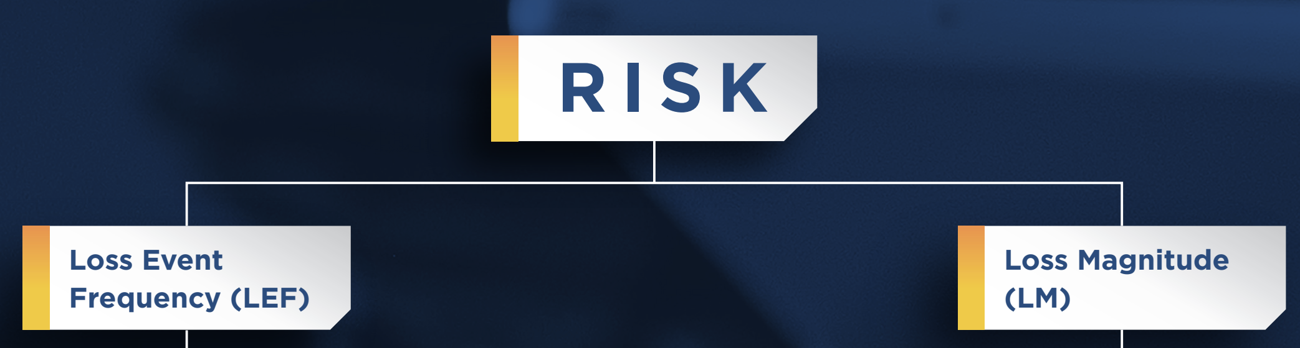
FAIR Ontology
Begins with the concept that Risk equates to “Loss Exposure.”
Loss Exposure is derived from the probable frequency and probable magnitude of loss.
Then, "decompose" these two sides of the risk equation...
TEF: Frequency that threat agents are expected to act against an asset
Vuln: The probability that a threat agent’s actions will result in loss
PLM: Primary stakeholder loss directly as a result of the event
2LM: Primary stakeholder loss-exposure due to the potential for secondary stakeholder reactions to the primary event
Notes:
“With this as a starting point, the first two factors become obvious: Loss event frequency (LEF) and Loss Magnitude (LM)”
The FAIR definition for Vuln (shorthand for Vulnerability) is probably the single greatest point of variance from common usage out of all of the FAIR terms.
In common usage, things like a weak password or an unlocked window would be called vulnerabilities. The notion being that these conditions represent weaknesses that can be exploited (--> ~”NOUN”).
This perspective though, can be misleading. Too often, people infer that a locked window or a strong password are not vulnerable, which is clearly not the case. The truth is, the only difference between the locked window and the unlocked window is the level of effort required by the threat agent. It’s a matter of degree rather than a difference of whether a loss event can happen or not.
From a FAIR perspective, Vuln is a percentage representing the probability (--> ~adjective / STATE) that a threat agent’s actions will result in loss
2LM: Think of this as fallout from the primary event.
In many scenarios, the potential LM from things like reputation damage, fines and judgments, and other forms of fallout can be much different and often times greater than primary losses from an event
Concepts of “Decomposition” / Abstraction
Differentiate:
Risk: an item to be tracked & measured over time (not binary (exists | not exists))
vs. a shortcoming / deficiency / “vulnerability” to be remediated, verified as fixed, and closed out

Slide 11
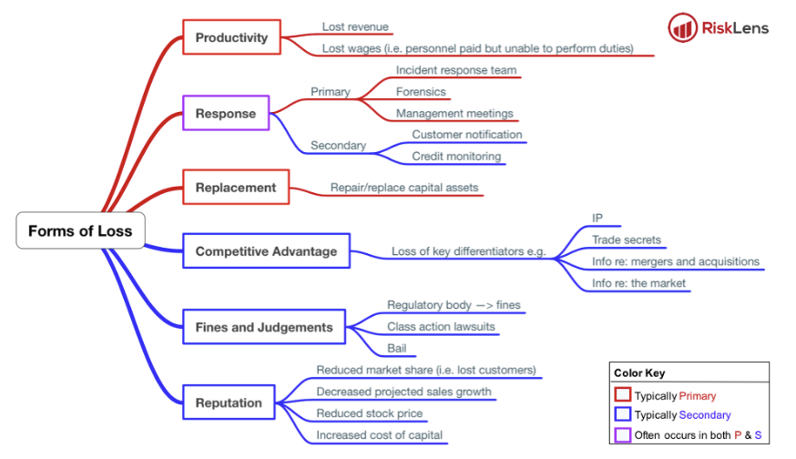

Forms of Loss
(contributing to Loss Magnitude)
https://www.risklens.com/blog/the-six-types-of-loss-in-cyber-incidents/
Notes:
Categories that have been defined to help analysts think through and account for the different ways in which loss materializes
Help make our estimates of financial loss both more granular / discrete, and structured
* Productivity – generally represents the reduction in an organization’s ability to generate its primary value proposition (e.g., income, goods, services, etc.). Note that this is the category where loss of revenue due to operational outages and discontinuation would be accounted for (e.g., revenue lost when a retail web site is unavailable due to a system outage). Productivity loss may also include sunk costs associated with personnel who are unable to perform their duties but who continue to collect their paycheck (e.g., a call center’s phone lines are down, but personnel continue to be paid). Note that it can be important to distinguish lost revenue from delayed revenue. For example, when a retail web site goes down some proportion of its customers may wait to perform their transactions rather than use a different retailer. This, of course, is highly dependent on the nature of the market and competition. The sales and marketing departments in most organizations will have reliable data to inform these estimates.
* Response – expenses associated with managing a loss event (e.g., internal or external person-hours, logistical expenses, legal defense, public relations expenses, etc.).
* Replacement – the intrinsic value of an asset. Typically represented as the capital expense associated with replacing lost or damaged assets (e.g., rebuilding a facility, purchasing a replacement laptop, replacing a terminated employee, covering the losses experienced by fraud, etc.).
* Fines and Judgments – legal or regulatory actions levied against an organization. Note that this includes bail for any organization members who are arrested. Note that the costs associated with legal defense are captured in Response costs.
* Competitive Advantage – losses associated with diminished competitive position. Within this framework, competitive advantage loss is specifically associated with assets that provide competitive differentiation between the organization and its competition. Within the commercial world, examples would include trade secrets, merger and acquisition plans, etc. Outside the commercial world, examples would include military secrets, secret alliances, etc.
* Reputation – losses associated with an external stakeholder’s perception that an organization’s value proposition is diminished and/or that the organization represents

Slide 12
Fun and Games, Part 2

Slide 13
Calibration Exercise
Ten 90% CI questions
Provide (useful) upper and lower bounds
  Such that you believe there is a 90% chance the answer will fall between the bounds
Ten binary questions
Select ‘true’ or ‘false’
  Then, indicate how confident you are in the answer (50 - 100%)
Notes:
Most people are bad at estimating probabilities (i.e. very few people are naturally calibrated estimators) - either overconfident (mostly) or underconfident
Most people can be trained to be much better at it (i.e. assessing uncertainty is a general skill that can be taught with a measurable improvement)
https://hubbardresearch.com/wp-content/uploads/2018/12/calibration-questions.png
Blank Sheet (participant)
Sheet with Answers
Even if you can’t quantify something exactly, you can come up with an estimate based on what you do know.
But how confident are you in your estimate? 90%? 80%? 70%? Obviously if it is an estimate your confidence level is going to be something less than 100%, but being able to state your level of confidence helps you know whether your estimate is good enough, or whether you need to do more research to further reduce your uncertainty.
To express our uncertainty about a (continuous) number is to think of it as a range of probable values. A range that has a particular chance of containing the correct answer is called a confidence interval (CI)
Measurement is “a quantitatively expressed reduction of uncertainty based on one or more observations.”
Note that probabilities must always include a period of time
Refer to https://docs.google.com/document/d/1i1YOxk--kRWxmySCiUemZ1m4Gg5D4zrnxopzvmn8_5I/edit#bookmark=id.l2a2xdaipp53 (personal) for answers

Slide 14
Ways to Improve Forecasts
Calibration
Repetition and feedback
Identify arguments against your estimates
Think in terms of two separate questions
Reverse the anchoring effect
‘Equivalent Bet Test’
Group-based forecasting
(Refer also to to the Calibration section of One-Pager)
Notes:
Two separate questions: 95% certainty for each bound
You can also force your natural anchoring tendency to work the other way. Instead of starting with a point estimate and then making it into a range, start with an absurdly wide range and then start eliminating the values you know to be extremely unlikely.... sometimes call this the “absurdity test.”
Group-based forecasts should be: independent; averaged
Strike appropriate balance between accuracy and precision. Accuracy is king; arrive at a useful degree of precision.
People who are very good at assessing their uncertainty (i.e., they are right 80% of the time they say they are 80% confident, etc.) are called “calibrated.”

Slide 15

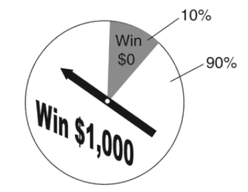
‘Equivalent Bet Test’
For a given question, you are asked to provide a range with 90% CI.
Example: Estimate the frequency of malware infections across Redox in 2020
Suppose I offer you a chance to win $1000, in one of two ways:
If your estimation turns out to be correct; or
Spin a dial divided into two unequal “pie slices,” one comprising 90% of the dial and the other 10%.
Notes:
Research indicates that even just pretending to bet money significantly improves a person’s ability to assess odds.
If the dial lands on the large slice, you win $1,000. If it lands on the small slice, you win nothing (i.e., there is a 90% chance you win $1,000).
Would you prefer to take a spin? If so, your range is too small (i.e. you have less than 90% confidence), and you need to increase the range.
If you decide to answer the question your range is too large (i.e. you are more than 90% confident), and you should narrow it.
If you don’t mind whether you answer the question or take a spin then it really is your 90% CI.

Slide 16
Improvements, Part 2

Slide 17
Improve Risk Scoping
What are the worst outcomes we can realistically foresee?
Brainstorm the ways that ^these could likely materialize
  Across environments, areas of responsibility, etc.
Formulate risk scenarios accordingly
  Ensure each has a clearly defined asset at risk, threat actor(s), effect, loss event
  Identify any that should be combined (highly similar likelihood & impact), or conversely split
“Useful degree of granularity”
‘Most Likely’ values
Non-overlapping
Minimize “unknown unknowns” *
Notes:
Probably the single most important step for us, setting a foundation for everything else..
Risk scenarios have to be granular enough to allow making reasonably well-informed estimates, but not so granular as to be overwhelming in their number...
In order for the math used to aggregate / sum up our risks to “work”, scenarios must be independent & non-overlapping
* similar (but not identical to) “Black Swans”; also relatedly, power law distributions
3: “loss event”: ~how the loss will actually manifest

Slide 18
Improve Forecasting
Improve data collection (metrics)
Improve the expert (calibration)
What makes a good forecast?
Correctness
“Honesty”
Economic Value
Notes:
Two (non-mutually-exclusive) approaches to improving quantification / forecasting: “Improve the expert as an approximation tool; improve the collection of data as a statistical one”
The key to making a good forecast… is not in limiting yourself to quantitative information. Rather, it’s having a good process for weighing the information appropriately. This is the essence of Beane’s philosophy: collect as much information as possible, but then be as rigorous and disciplined as possible when analyzing it.
Correctness: aka “quality” / “accuracy”
Honesty: aka “consistency” - the best possible forecast that could’ve been made, at the time? Reflecting best judgement, and free of agenda / influence?
Economic value: does it help others make better decisions?

