Slide 1
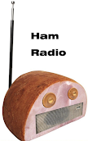
Amateur Radio (aka )
Notes:
*Clarify that not the entire presentation is about ham per se, but radio more generally

Slide 2
Agenda & Timeline
Props / Labs / Demos:
...
Overview: 10 min
  * Highlights / Takeaways:
Electricity: 15 min + 5 min quiz
  * Highlights / Takeaways:
    electricity is super interesting - and not rocket science
RF: 40 min
  (incl. 2 quiz, and antenna slideshow)
  * Highlights / Takeaways:
Ham Rules / Standards / Safety: 10 min
  * Highlights / Takeaways:
Equipment: 15 min.
  (incl. show & tell of HT, fixed station, and SDR antenna)
  * Highlights / Takeaways:
Ham Communicating: 5 min
  * Highlights / Takeaways:
Scenarios: 15 min + 10 min demo
  (SDR demo)
  * Highlights / Takeaways:

Slide 3
Ham Radio: What Is It; Common Uses
Amateur radio operators can build / modify / repair their own radios, and operate across a wide variety of radio frequencies, methods, etc. For example:
Multi-party, PTT-style communication
  event coordination; between security personnel, etc.
Communications in rural areas
  camping / hiking / exploring
Navigation
  GPS; air traffic control, marine navigation
Passive listening / observation*
  weather reports, public safety (police, fire), TV (legacy); broadcast radio; air & marine navigation / control
Regional (1:1, or group) communications
  Interest groups; emergency prep; etc.
Long distance (1:1) communications
Space-based
  Communicate with astronauts; telecommands & telemetry w/ satellites; relay via satellites; moon-bounce; meteor scatter
Emergency communications
  SOS; Morse code
Secret communications
  Morse code; other… *
Emergency coordination
  Power/internet outages; natural disasters
Notes:
*anyone can passively listen to radio communications (with the right equipment) - does not require licensing
B/c of the flexibility and variability of ham radio, the FCC sets strict technical standards for the equipment, and how they can be used (as contrasted with most typical radio users)
Contrast with:
FRS (Family Radio Service) / GMRS (General Mobile Radio Service) handhelds (“Unlicensed Personal Radios”)
22 channels in a narrow frequency band
Short-range, line-of-sight comms
Max 0.5 watt transmitter output power
Or, for that matter: WiFi, cell phone, Bluetooth thermometer, car lock remote, etc….

Slide 4
Ham Benefits
Functional in areas without other communications coverage
Learning opportunities
  + Technological advancement
Simplicity / tinkerability
  Intimate understanding of the equipment
  Enables building, testing, improving / improvising, diagnosing, fixing
Lack of typical dependencies
  Power grid
  Internet service provider
  Mobile phone providers
  Apps / platforms / websites / forums

Slide 5
Ham Skills / Knowledge Required
Electricity
  Electrical components
Electromagnetic radiation (EMR)
  aka radio waves
Hardware components
  Radio, peripherals, connecting cables, antennas, etc.
Software components
  For programming radios, “digital modes”, and software-defined radio (*all optional)
Rules
  Safety, etiquette, standards

Slide 6
Layers of Learning
Electricity
  Electrical components
  Schematics
  Implementations
Radio Fundamentals
  EMR / Radio Waves
  Frequency & Wavelength
  Modulation
  Radiation / Antennas
  Propagation
  Receiving
Equipment (Hardware)
Communicating
Rules, Standards, and Safety
Scenarios

Slide 7
Electricity

Slide 8
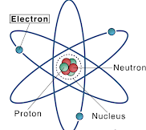
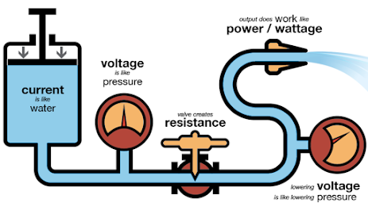
Electricity
Electrons: negatively charged atomic particles
Voltage (E): force that causes electrons to move
  Measured in volts (V)
Current (I): flow of electrons
  Measured in amps (A)
  1A = flow of 6.25 x 10^18 electrons per sec (light a 100 watt bulb)
Resistance (R): impeding the flow of electrons
  Measured in Ohms
Notes:
Electrical voltage, which measures the force of electricity, is like the water pressure.
Electrical current is like the water flow rate, and electrical resistance is like the friction loss that occurs at the nozzle or at a valve that limits the water flow.

Slide 9
Ohm’s Law & Power
Ohm’s Law: Voltage, current, and resistance are proportional
  Current is directly proportional to Voltage; inversely proportional to Resistance
  Current = Voltage % Resistance
    (I = E / R)
Power (P): rate at which electrical energy is used
  Measured in Watts (W)
  Watt’s Law: P = E * I

Slide 10
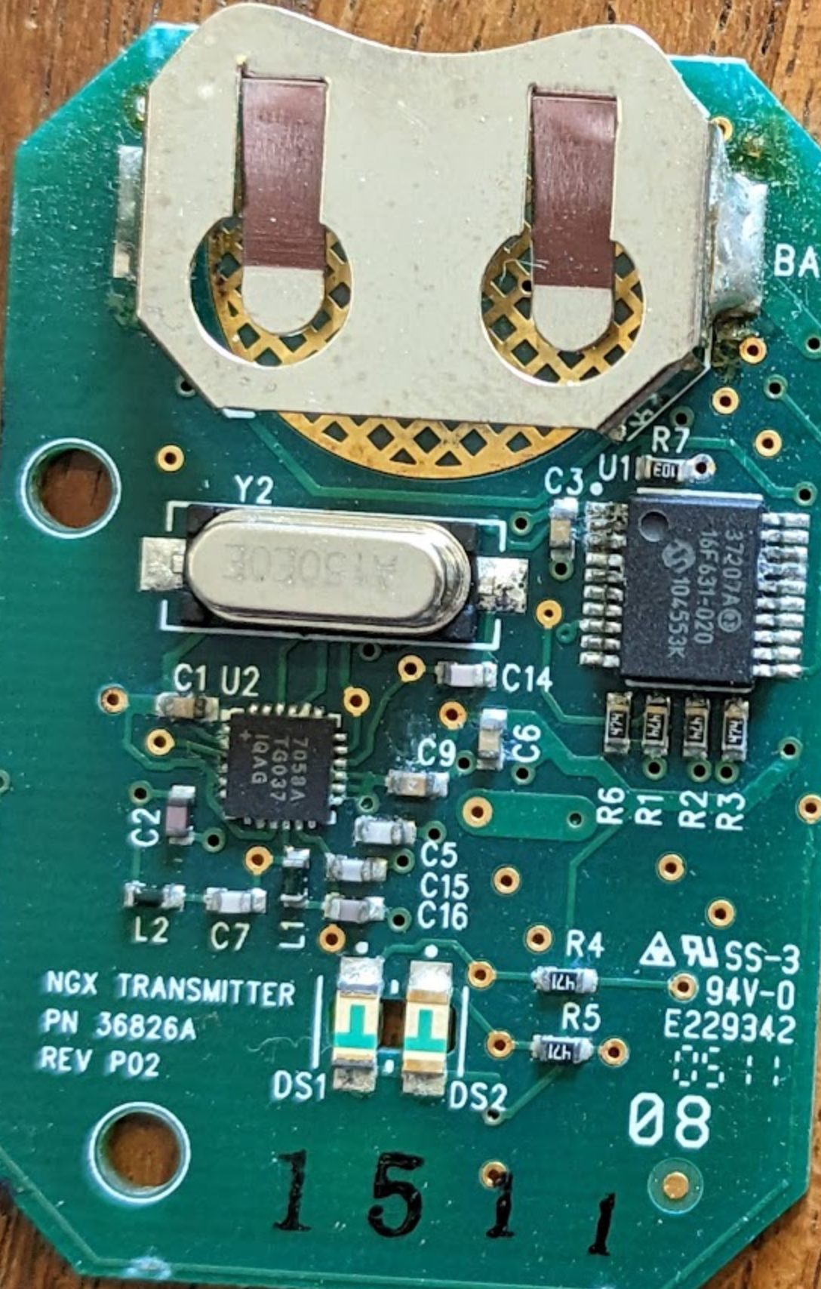
Electrical Components
Circuit: a path through which current can flow
Conductor: material that electrons flow easily thru
  (in response to applied voltage)
Insulator: material that resists/prevents electron flow
Capacitor: stores electrical energy
  smooths out voltage changes
Inductors: stores magnetic energy
  smooths out current changes
Notes:
Each component of an electronic circuit performs a discrete function: storing or dissipating energy, routing current, or amplifying a signal

Slide 11
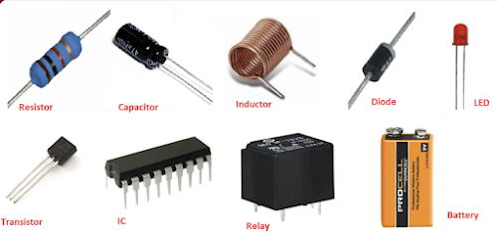
Electrical Components, cont’d
Semiconductor: doesn’t conduct as well as a conductor; nor insulate as insulator
  response depends on the polarity and value of voltage & current
Diode: semiconductor that only allows current flow in one direction
Transistors: structures made from patterns that enable voltages & currents to control larger ones
Integrated Circuit: Components connected together and packaged as a useful circuit

Slide 12
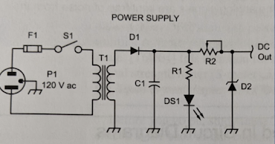
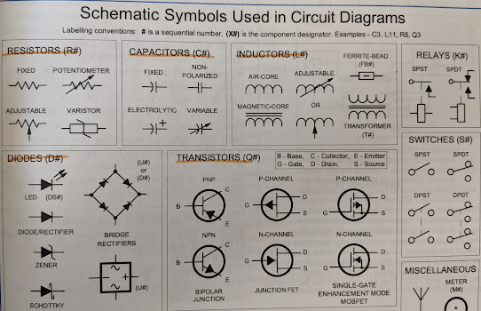
Schematics

Slide 13
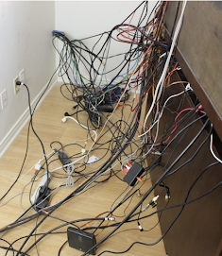
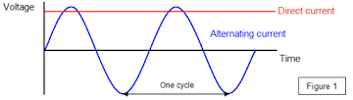
Implementations
Leads: wires that make connections to components
DC: current that flows in one direction all of the time
  Batteries, solar cells, etc.
AC: current that regularly reverses direction
  Household power
Notes:
AC frequency:
In Britain the a.c mains varies with a frequency of 50 Hz. This means that there are 50 cycles per second and so one cycle takes 1/50 s.
The most common frequency of alternating current is 60 cycles per second (usually termed 60 cycles) or more commonly, 60 Hertz (Hz).

Slide 14
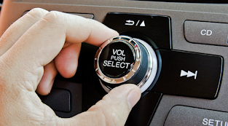
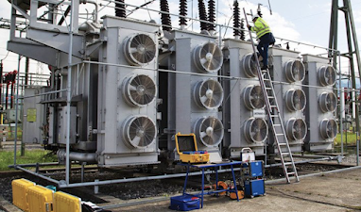
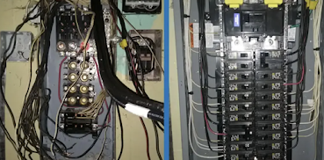
Implementations, cont’d
Each basic component type is also available in adjustable / variable models
  e.g. to adjust voltage or potential (such as for a volume control), or dim a light
Transformers: two or more inductors that share their stored energy
  Energy can be transferred from one to another, while changing the combination of voltage and current
Protective components: prevent equipment damage or safety hazards
  Fuse
  Circuit breaker
  GFCI
  Surge protector

Slide 15
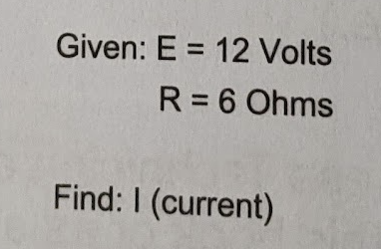
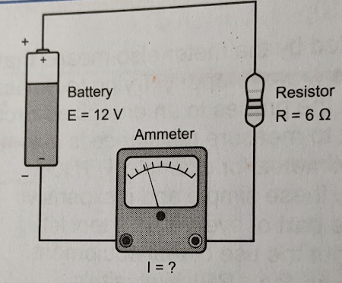
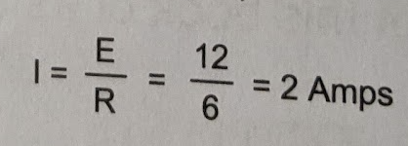
*** Pop Quiz! (Ohm’s Law)

Slide 16
*** Pop Quiz! (Power / Watt’s Law)
Our laminator connects via 120 volt power cord, and uses 0.8 amps. What “load” does it draw (i.e. how much power (watts))?
P = E * I

Slide 17
Radio Fundamentals

Slide 18
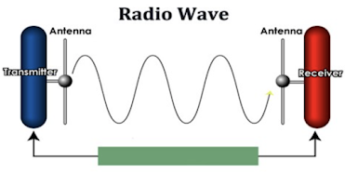
Signals - aka Radio Waves
Radio waves are composed of both electrical & magnetic energy
electrons moving back & forth in antenna - creating ‘electromagnetic’ waves
A transmitters’ output is “radiated” as radio waves, leaving an antenna
Radio waves travel at the speed of light (c)
  3 x 10^8 meters per second, in space & air (300M m/s; >600M mph)
  (lower in water, glass, or along wires / cables)
Frequency: the rate at which a signal changes direction (cycles per second)
Cycle: each complete back-and-forth sequence of a signal
  Phase: position within a cycle
Amplitude: strength of a radio signal (height of the sine wave)
Wavelength (ƛ): distance that a radio wave travels during one complete cycle
ƛ is related to frequency and speed of light: ƛ=c/f
  (as frequency increases, wavelength decreases; vv)
ƛ in meters = 300 / f in MHz
Notes:
Ref. https://www.flight-mechanic.com/radio-communication-radio-waves/ (??)
Speed of light: “circumnavigate the globe approximately seven and a half times in one second”
(It is common for amateur bands to be referred to by wavelength)
Relationship between wavelength & frequency: handhelds often operate on the following wavelengths:
2m = 300 / f MHz -> 150MHz
70cm = 300 / f MHz -> 429 MHz

Slide 19
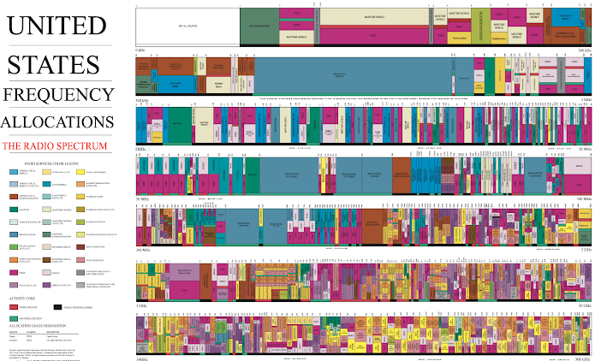
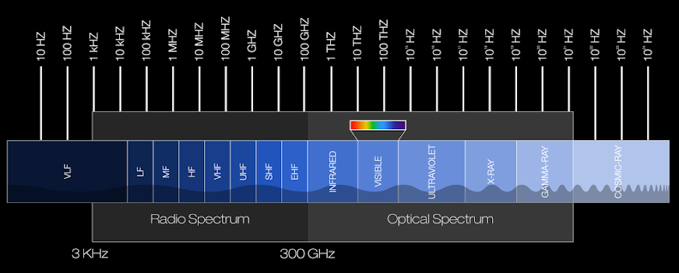
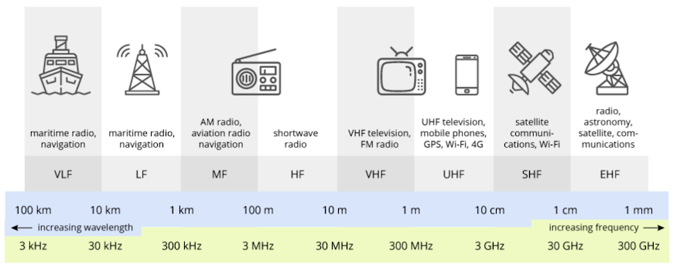
Frequencies & Wavelengths
Radio spectrum link (zoomable)
Notes:
Emphasize HF, VHF, UHF
(and relationship between wavelength and frequency, obviously)
Highlight a few areas of interest within the spectrum, and encircle them - e.g., wifi, GPS, air traffic, etc.
* End by showing https://upload.wikimedia.org/wikipedia/commons/thumb/c/c7/United_States_Frequency_Allocations_Chart_2016_-_The_Radio_Spectrum.pdf/page1-6300px-United_States_Frequency_Allocations_Chart_2016_-_The_Radio_Spectrum.pdf.jpg, zoomed in
Audio Frequency (AF): signals below 20 kHz that produce sound waves humans can hear
Radio Frequency (RF): signals greater than 20 kHz
Range is the radio spectrum (20 kHz to several hundred GHz)
Highlight what portion of the allocation chart wifi takes up..
“Band”: specific range of frequencies in which signals are use for a common purpose or have similar characteristics

Slide 20
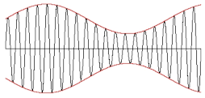
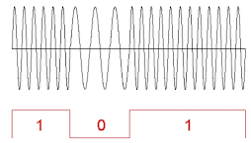
Modulation
To communicate information, it must be embedded in the signal
Modulation: modifying a signal to add information to it
  Modulator: a circuit that combines data or voice signal with an RF signal or carrier
Demodulation: retrieving information from a modulated signal
  Ring a bell, anyone over 40?
Analog mode: carry information to be understood directly by a human
  AM, FM
Data / digital mode: requires computer processing
Notes:
Images: AM; FSK
Difference between frequency of lowest & highest component signals is the ‘bandwidth’

Slide 21
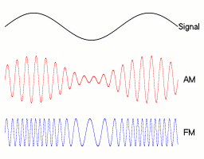
Common Types of (Analog) Modulation
Amplitude modulation (AM): vary the power/amplitude of a signal
Frequency modulation (FM): vary the frequency of a signal
FM is generally preferred, for short-range / regional communications
Higher fidelity / less susceptible to noise
- Consumes more bandwidth
Notes:
Cool visualization of where FM lies among the radio spectrum: https://en.wikipedia.org/wiki/FM_broadcasting#/media/File:ElectromagneticSpectrum-Radio-VHF-FM.png
Phase modulation (PM): vary the phase of a signal

Slide 22
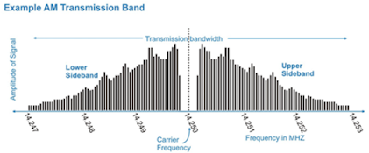
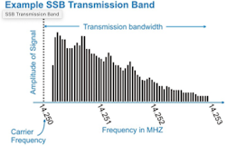
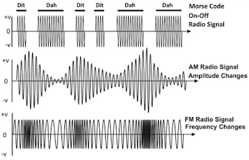
Variations
Single Sideband (SSB): AM signal, with carrier wave and one sideband removed
Much more efficient, from power & bandwidth standpoint
Useful where signals are weaker, and/or spectrum space is limited
Morse / CW: signal turned on & off, in a pattern
Best for long-range, and noisy conditions; effective at low signal strength
Notes:
(for comparison, CW requires 100-150 Hz bandwidth)
Composite: groups of individual signals that combine to a single signal

Slide 23
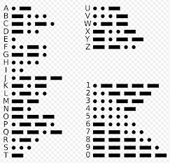
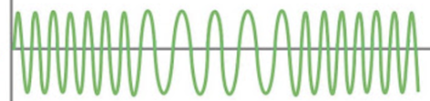

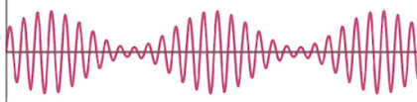
*** Pop Quiz! (modulation types)
Notes:
Clockwise, from upper left:
FM
Morse / CW
AM
FSK (Digital / data)

Slide 24
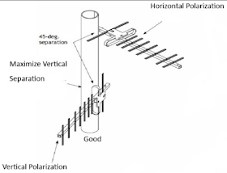
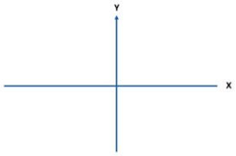
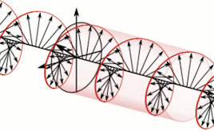
Radiation & Antennas
Radiate: turning a transmitter’s output into radio waves that leave an antenna
(Not the same as ionizing radiation, from radioactivity)
Any electrical conductor can act as an antenna for radio signals
To work efficiently, must be an “appreciable fraction” of the wavelength
Elements: conducting portions, by which signals are transmitted/received
  Driven: connected to the feed line
  Parasitic: not directly connected to feed line, but influence antenna performance
“Gain” of antennas is specified in dB
  e.g., dBd - with respect to a dipole
Polarization: direction in which electric field of radio wave is oriented
  Linear: Horizontal, or Vertical
  Circular: right hand circular (RHC)clockwise), left hand circular (LHC) (counter)
  Important to align receiving communicating antennas!

Slide 25
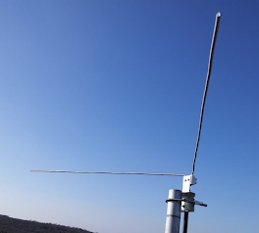
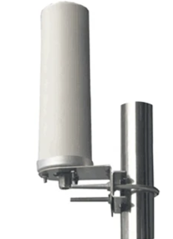
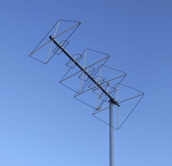
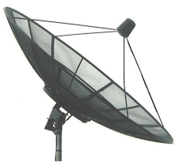
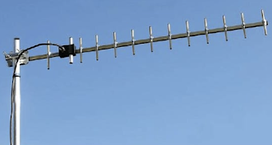
Antenna Types
Dipole: Simplest type of antenna: “two electrical poles”
Omnidirectional: for communicating over a wide region
Beam / directional: gain in a single direction
  Yagis
  Quads
  Dishes
Notes:
Yagis / Quads: Only the driven element is connected to a feed line - but it’s the parasitic elements that determine the radiation pattern. (Parasitic elements parallel to boom in the direction of max gain are slightly smaller than driven element)

Slide 26
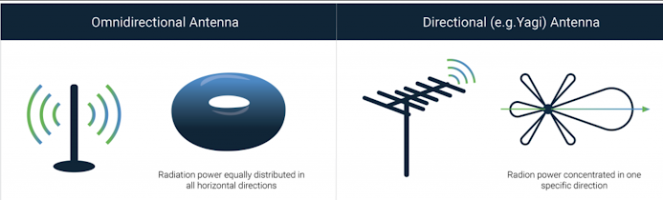
Antenna Types, cont’d
Notes:
Yagis / Quads: Only the driven element is connected to a feed line - but it’s the parasitic elements that determine the radiation pattern. (Parasitic elements parallel to boom in the direction of max gain are slightly smaller than driven element)

Slide 27
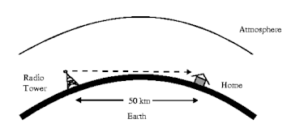
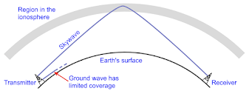
Propagation
How radio waves get from one place to another
Spread in a straight line, unless reflected or diffracted (just like light)
  Eventually, becomes too weak to be received because it has spread out too much, or something along its path absorbed or scattered it
  “Range”
VHF+: Line-of-sight propagation
  Within direct sight, only
  Radio horizon (curvature of the earth)
  Increasing antenna height or transmitter power can increase range
  Tropospheric propagation (“tropo”): assisted by (lower) atmospheric phenomena
    Enables VHF & UHF contacts over longer distances (300+ mi)
    Reflected by conductive contents in atmosphere
HF-: Ground wave propagation
  signals follow the contour of the Earth, bending so that signals extend beyond the horizon
  Skywave propagation: bent back towards earth by refraction in (upper) atmosphere

Slide 28
Obstacles & Penetration
Materials in nature and in the built environment have effects on radio waves: some signals get through, some are filtered, some are blocked. The effect is dependent on the material's properties and the wavelength of the signal.
General rules:
EM radiation is affected by features that have sizes larger than their wavelength
RF can penetrate openings in solid objects if the opening is longer than ~½ wavelength
HF gets through most things because they are mostly transparent (??)
VHF gets through fewer things, and starts to get attenuated indoors
UHF gets through even less and has more attenuation
...if you're indoors and must use handheld radios, UHF is narrow enough to have at least one full wavelength fit through windows, doors, hallways, etc.

Slide 29
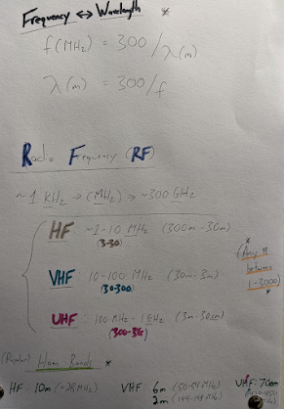
Frequencies, Wavelengths, and Propagation
Lower frequencies - Pros:
better penetration of obstacles
  the longer the wavelength, the further a signal can penetrate through solid objects or liquids
propagate farther in the environment, naturally
Cons:
transmitting antennas must be very large
amount of information that can be sent is limited
  (proportional to frequency)*
Frequencies must be changed, for communications reliant on skywave transmission
  (frequency used within the HF band for skywaves depends on the properties of the ionosphere, which are highly variable)
-> Best to use for direct, low bandwidth, long distance communications
Notes:
*sometimes referred to as “bandwidth” - probably better thought of as “throughput”

Slide 30
Interlude: Identify that Antenna!
Photo slideshow: Radio Antennas all around us
Where is it?
How easy or difficult was it to assemble?
Is it more likely used for:
  Long range, short range, or medium range communications?
  High / medium / low throughput
What other examples of antennas can you think of (or observe)?
Notes:
Bonus questions:
When / why is higher frequency better (e.g. higher data rates)? When / why is lower frequency better?

Slide 31
Receiving
Detector: one type of demodulator, which converts a modulated RF signal direct to a data or voice signal
Receivers are compared on the basis of two primary characteristics:
Sensitivity: ability to detect weak signals
Selectivity: ability to retrieve information from the desired signal, in the presence of unwanted signals
Filter: circuit that rejects unwanted signals
Passive: made from resistors, inductors, and capacitors
Active: made from electronic circuits containing amplifiers

Slide 32
Pop Quiz!
Frequency / Wavelength calculations:
  What is the wavelength of your favorite radio station?
  What is the wavelength of 2.4 and 5 gigahertz Wi-Fi?
AM versus FM: differences in range and signal quality? why?
Notes:
Bonus questions:
When / why is higher frequency better (e.g. higher data rates)? When / why is lower frequency better?

Slide 33
Equipment / Hardware

Slide 34
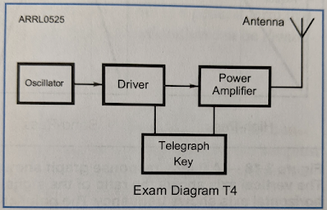
Radio Circuits
Block diagrams are used to describe simple radios - showing how successive circuits (‘stages’) are arranged - e.g. Simple CW transmitter:
Oscillator: produces a steady signal at one frequency

Slide 35
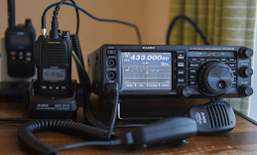
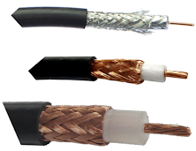
Radio Equipment
Transmitter (XMTR): generates a signal
Receiver (RCVR): recovers the information from a signal
Transceiver (XCVR): combines transmitter and receiver
  Using a Transmit-Receive switch
Feed line: connect a radio to an antenna - and to conduct an RF signal from one piece of equipment to another
  Made from two conductors, separated by an insulating material

Slide 36
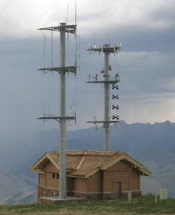
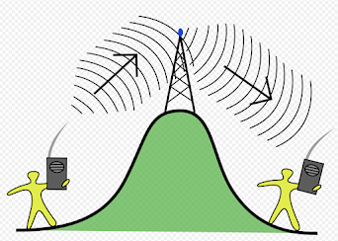
Radio Equipment, cont’d
Antenna: turns signals from transmitter into energy that travels as radio waves
  Also captures radio waves and turns them into radio signals
  Feed line (aka transmission lines): connect antenna to XMTR / RCVR
Repeater: transmits a received signal simultaneously on another frequency / channel
  Receiver and transmitter connected together
  Uses a duplexer, rather than transmit-receive switch - since it does both simultaneously

Slide 37
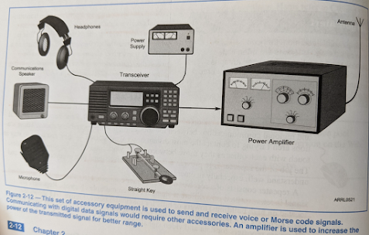
Equipment, cont’d
Power supply: converts household electrical power to the form needed by radio / accessories
Microphone: turns an operator’s voice into electrical audio signal
Morse key: switch used by operator to turn transmitter’s output signal on and off in a pattern
Speaker: turns electrical audio signal back into audible sound
Amplifier: equipment that increase the strength of a signal
Notes:
Quiz: which form of power is used in a typical household, and which is needed by radio / accessories?

Slide 38
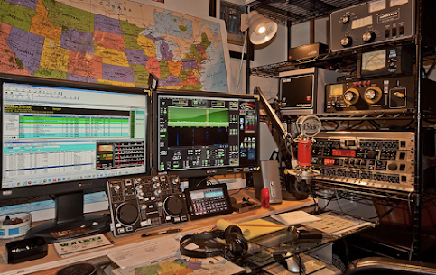
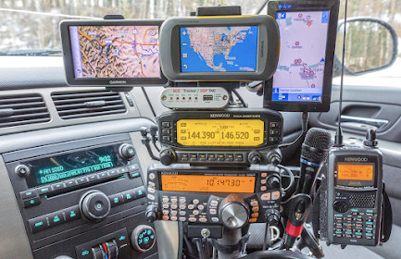
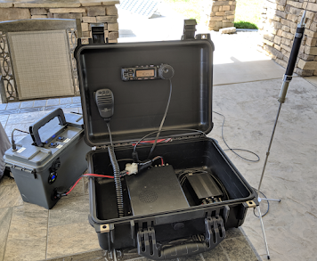
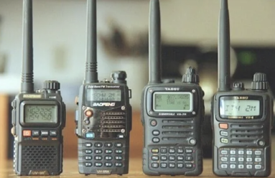
Equipment types
Base / Fixed
Mobile
Portable
Handheld
SDR*
Notes:
Portable
Handheld
* = not so much “hardware”..

Slide 39


Software-Defined Radio (SDR)
Components that have been typically implemented in hardware (e.g. mixers, filters, amplifiers, modulators/demodulators, detectors, etc.) are instead implemented in software on a computer
Wide-spectrum identification
Signal analysis, decoding, charting, plotting
Notes:
“Modulating / demodulating signals done in code (software), rather than hardware / wired electronics / etc.”

Slide 40
Ham Radio: Licensing, Rules, Standards, Communications, and Safety

Slide 41
FCC / Licensing
FCC: administers all radio signals transmitted by US radio stations (Also coordinates with the International Telecommunication Union (ITU))
Licensing: different set of rules for each type of radio use (‘services’)
Land Mobile, Aviation, Broadcasting, ‘Amateur Service’, etc.
Most services do not require an exam to be licensed, b/c FCC sets strict technical standards for the radio equipment, and restricts how they can be used. Contrastingly, amateurs can build / repair / modify their own - so therefore must be more knowledge - and must pass a licensing exam
Notes:
Ham licensing only really required for transmitting (on a small subset of frequencies, all told..)

Slide 42


Privileges & Allocations
Privileges: frequencies and modes and methods hams are allowed to use
Allocations: frequency privileges granted to various services
Amateur allocations are sprinkled throughout the radio spectrum
Additional restrictions based on mode or ‘emission type’
  Mode-restricted: parts of ham bands permitting only certain modes

Slide 43




Communication etiquette / standards
‘Signing’: Identifying yourself by call sign
(required regularly during every ‘contact’)
Q codes - e.g., ‘CQ’: open call to anyone to respond
‘Signal report’: quality of reception from other station
Phonetic alphabet

Slide 44

Safety: Electrical, Lightning
Never work on live equipment unless necessary
Remove, insulate, or otherwise secure loose wires & cables
Never assume equipment is off or de-energized
  check with a meter / tester, first
Lightning protection is critical
  All antennas & masts should be grounded, at the base
  When lightning is anticipated, disconnect all cables outside, and unplug equipment inside
    interrupts lightning’s path to get to ground
    (don’t just turn off equipment - lightning jumps across switches easily)

Slide 45

Safety: RF energy
Health / safety hazards from exposure to electromagnetic radiation (EMR):
No health issues known, from low-level exposure to RF
FCC sets limits on Maximum Permissible Exposure (MPE) from radio transmitters
The only demonstrated hazard from exposure to RF energy is thermal effects (heating)
Injury only if the combination of frequency and power causes excessive energy absorption
  Bodily absorption of RF energy varies with frequency
Specific Absorption Rate (SAR): total amount of heating
  Dependent on RF field intensity & frequency
In short: Prevent access to locations where strong fields are present

Slide 46
Uses & Scenarios of Interest

Slide 47
Scenarios - TEMPLATE
Starting from lowest level - e.g. EMR, then power supplies, emanation, propagation, modulation, etc...

Slide 48
Scenarios - Ideas
Urban environment
Camping / hiking
‘Round-the-world
Satellite-based
Regional comms
Passive listening
Emergency
Event coordination
...

Slide 49


Emergency Communications
Part 97.1 lists emergency comms as the first reason for the Amateur Service
“Go kit”
Test regularly
Equipment that operates without need for commercial power
  include alternate power sources

Slide 50

DXing
Notes:
“The name of the hobby comes from DX, telegraphic shorthand for "distance" or "distant"”
“DXing is the hobby of receiving and identifying distant radio or television signals, or making two-way radio contact with distant stations in amateur radio”

Slide 51



Satellites
Communications Through
Telemetry From

Slide 52


Space Communications
Monitor Spacex Rocket Launches With Software-defined Radio
Amateur Radio on the ISS
Mission Control: after Launch Control
once beyond initial communications reach / visibility
(as progressed from early launches - which were just up to space & back)
doesn't need to be in the same place launched from (as Launch Control does)
Multiple, for ISS: Houston, Moscow (area), Tokyo (area), Montreal, Munich
CAPCOM ("Capsule Communicator")
The Space Network
NASA stays in contact with astronauts orbiting more than 250 miles above Earth with a network of communications satellites and ground-based antennas.
A constellation of satellites (TDRS) form the space-based portion of the network. They work like cell phone towers in space. TDRS are located in geosynchronous orbit more than 22,000 miles above Earth, which lets the space station contact one of the satellites from anywhere in its orbit. All of this happens in milliseconds so that there is no noticeable delay

Slide 53



Navigation systems
Highways
Traffic lights
Boats
Airplanes...

Slide 54
Demo! (SDR)
Notes:
wide-spectrum listening (?)
dump1090
FM radio

