Slide 1
Network Monitoring & Incident Response

Slide 2
Use Cases
Attack detection:
Targeted attack attempts
Ongoing intrusion attempts
Origin of malware infection
Compromise detection:
Specific host(s)
Specific user(s)
Specific protocols / applications
Comprehensive monitoring for indicators
    internal
    outbound
Notes:
Post-compromise activities - e.g., lateral movement, C2, exfil

Slide 3
Rationale
“Cannot trust the host”
Network monitoring can be done surreptitiously
  (and (hopefully) without being tampered with)

Slide 4
Incident Handling Steps
Notes:
Exact wording and order and overlap of phases varies by source, but the general idea remains:
- Prepare, Detect, Formulate Response, Investigate, Remediate, Report

Slide 5
Pre-Incident Preparation
Basics: install & configure firewalls, proxy, flow collection, and network intrusion systems
Ensure network topology is conducive to monitoring
Configure supplementary sources
Acquire monitoring capability (technology); train staff; implement policies & procedures
Notes:
Much of this applies to cloud hosting environments equally as traditional infrastructure - just different terminology, different UIs / APIs, architectures and ability to interact with network stack, etc.
Supplementary sources: web proxy, DHCP, DNS servers, internal & border switches / routers
Network topology design considerations:
VLANs (can acquire data from multiple logical segments via trunk)
VPN connections (inbound & outbound)
NAT (may need supplementary sources to correlate)
Encryption (post-inbound termination?; outbound inspection?)
Egress filtering (restrict ports / protocols allowed to allow better anomaly detection; force thru defined chokepoints (e.g., proxy, FW))
Wireless
BYOD mobile devices?
Cloud??

Slide 6
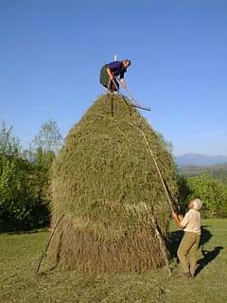
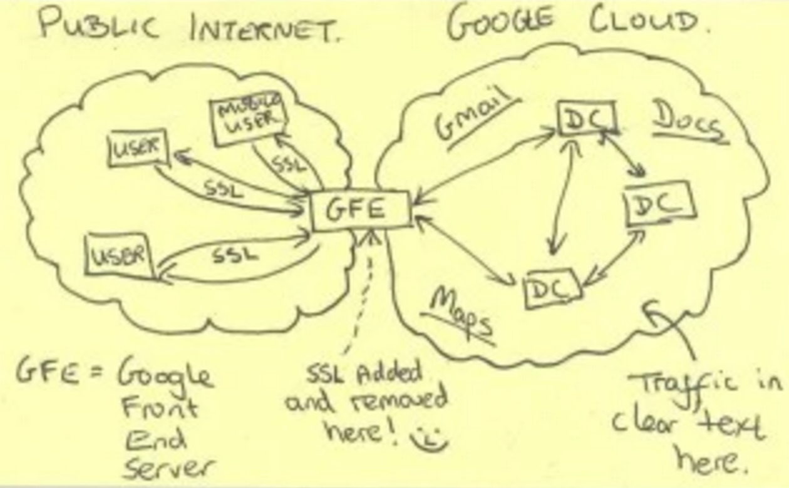
Challenges
(Very) Low signal to noise ratio
Increasing use of encryption
Notes:
"The director of national intelligence on Monday blamed NSA whistleblower Edward Snowden for advancing the development of user-friendly, widely available strong encryption. "As a result of the Snowden revelations, the onset of commercial encryption has accelerated by seven years," James Clapper said. The shortened timeline has had "a profound effect on our ability to collect, particularly against terrorists,”
- https://theintercept.com/2016/04/25/spy-chief-complains-that-edward-snowden-sped-up-spread-of-encryption-by-7-years/
* Encryption: including organizations shooting themselves in the foot by implementing HTTPS for all inbound web traffic, but failing to account / plan for visibility / insight.

Slide 7
Approaches
Full packet capture
  for targeted, in-depth analysis
Signature-based detection
Statistical anomaly detection
  e.g., metadata analysis
  “data is content; metadata is context"
… supplemented with log analysis, host-based analysis, malware reversing, etc.
Notes:
Signature based: Snort, etc.
Statistical / Metadata: BRO; NetFlow / IPFIX

Slide 8

Full packet capture:
tcpdump: simplest, lowest-level; best suited for large-scale capture
BPF filter primitives: highly efficient
  $ tcpdump -n -r bigfile.pcap -w smallerfile.pcap ‘not (udp and port 53) and not ‘tcp and (port 80 or port 443 or port 139 or port 445))’
Notes:
BPF can be used to filter capture in real-time, or reduce size of an existing pcap file

Slide 9
BPF Filters
man ‘pcap-filter’
# tips for large-scale capture:
-C: rotate pcap after filesize reached
-G: rotate pcap after # of seconds
-W: limit number of rotated pcap files
-F: load BPFs from file
$ tcpdump -nn -i eth0 -w dns.pcap -G 86400 -W 14 ‘(tcp or udp) and port 53’

Slide 10

Full packet capture: Wireshark
full packet capture capability
  relatively inefficient due to GUI, decoders
  disable DNS name resolution
post-capture: search packets and perform extended analysis of protocols & sessions
  traffic flow reassembly and data extraction capabilities
  Display Filters: https://wiki.wireshark.org/DisplayFilters
tshark: provides all Wireshark functions, via CLI
  preferable for scaling and scripting
  great for data reduction using robust display filters
Notes:
disable DNS resolution for two reasons: OPSEC and performance
Note display filters link as important reference for labs (also: analogous to BPFs, but different syntax)

Slide 11
Mini-Lab #1: Cleartext PCAP Traffic Analysis
Windows Server 2000/2003/2008/2012 with Domain Services enabled
Authenticates and authorizes all the users and computers in a Windows domain
Assigns and enforces policies through Group Policy Objects (GPOs
CHECK OUT 1.PCAPNG
As an Security Analyst, what activity of interest can you identify?
  What commands were run?
  What information was retrieved?
  What changes were made?
Where did the attack originate from? (source IP)
Hint: 76k total packets - includes a significant amount of legitimate web traffic.
Find it & filter it.
Notes:
filtering
concept of stream reassembly, and possibility to evade
Hint: 76k packets. This includes significant amount of legitimate web traffic w/ MS web server. Filter it.
Then 'Limit to display filter' in Conversations view to see ‘top talkers’ (and keep in mind this lab is focused on *cleartext traffic* analysis (Telnet)):
->
!(ip.addr == 191.234.4.50) # this is a MS host (likely provide a software update download), as determined by hostname resolution
->
Conversations - Telnet - Follow Stream
!(ip.addr == 191.234.4.50) && (tcp.port == 23)
10.0.2.5 = server
10.0.2.4 = attacker

Slide 12
Mini-Lab
tshark Traffic Filtering
Windows Server 2000/2003/2008/2012 with Domain Services enabled
Authenticates and authorizes all the users and computers in a Windows domain
Assigns and enforces policies through Group Policy Objects (GPOs

Slide 13
Mini-Lab
Wireshark Statistical Analysis
Windows Server 2000/2003/2008/2012 with Domain Services enabled
Authenticates and authorizes all the users and computers in a Windows domain
Assigns and enforces policies through Group Policy Objects (GPOs

Slide 14
Traffic Capture and Analysis
Capture sources:
switches (port mirroring / SPAN port)
hardware taps
NGFW
wireless
MITM
network packet analytics system (Packetbeat)

Slide 15
Full packet capture:
tcpdump: simplest, lowest-level; best suited for large-scale capture
BPF filter primitives: highly efficient
  $ tcpdump -n -r bigfile.pcap -w smallerfile.pcap ‘not (udp and port 53) and not ‘tcp and (port 80 or port 443 or port 139 or port 445))’
Notes:
BPF can be used to filter capture in real-time, or reduce size of an existing pcap file

Slide 16
BPF Filters
man ‘pcap-filter’
# tips for large-scale capture:
-C: rotate pcap after filesize reached
-G: rotate pcap after # of seconds
-W: limit number of rotated pcap files
-F: load BPFs from file
$ tcpdump -nn -i eth0 -w dns.pcap -G 86400 -W 14 ‘(tcp or udp) and port 53’

Slide 17
Full packet capture: Wireshark
full packet capture capability
  relatively inefficient due to GUI, decoders
  disable DNS name resolution
post-capture: search packets and perform extended analysis of protocols & sessions
  traffic flow reassembly and data extraction capabilities
  Display Filters: https://wiki.wireshark.org/DisplayFilters
tshark: provides all Wireshark functions, via CLI
  preferable for scaling and scripting
  great for data reduction using robust display filters
Notes:
disable DNS resolution for two reasons: OPSEC and performance
Note display filters link as important reference for labs (also: analogous to BPFs, but different syntax)

Slide 18
Mini-Lab #1: Cleartext PCAP Traffic Analysis
Windows Server 2000/2003/2008/2012 with Domain Services enabled
Authenticates and authorizes all the users and computers in a Windows domain
Assigns and enforces policies through Group Policy Objects (GPOs
CHECK OUT 1.PCAPNG
As an Security Analyst, what activity of interest can you identify?
  What commands were run?
  What information was retrieved?
  What changes were made?
Where did the attack originate from? (source IP)
Hint: 76k total packets - includes a significant amount of legitimate web traffic.
Find it & filter it.
Notes:
filtering
concept of stream reassembly, and possibility to evade
Hint: 76k packets. This includes significant amount of legitimate web traffic w/ MS web server. Filter it.
Then 'Limit to display filter' in Conversations view to see ‘top talkers’ (and keep in mind this lab is focused on *cleartext traffic* analysis (Telnet)):
->
!(ip.addr == 191.234.4.50) # this is a MS host (likely provide a software update download), as determined by hostname resolution
->
Conversations - Telnet - Follow Stream
!(ip.addr == 191.234.4.50) && (tcp.port == 23)
10.0.2.5 = server
10.0.2.4 = attacker

Slide 19
Mini-Lab
tshark Traffic Filtering
Windows Server 2000/2003/2008/2012 with Domain Services enabled
Authenticates and authorizes all the users and computers in a Windows domain
Assigns and enforces policies through Group Policy Objects (GPOs

Slide 20
Mini-Lab
Wireshark Statistical Analysis
Windows Server 2000/2003/2008/2012 with Domain Services enabled
Authenticates and authorizes all the users and computers in a Windows domain
Assigns and enforces policies through Group Policy Objects (GPOs

Slide 21

Signature-based detection: Snort
Open source intrusion detection and prevention
Uses signatures to trigger alerts on packets
Primarily useful for known malware, attacks, or malicious hosts
  Highly-customizable, however

Slide 22
Snort Rules
Need: Trigger on access attempts to /etc/passwd via HTTP
$ cat ./community.rules | grep “/etc/passwd”
# alert tcp $EXTERNAL_NET any -> $HTTP_SERVERS $HTTP_PORTS (msg:"SERVER-WEBAPP /etc/passwd file access attempt"; flow:to_server,established; content:"/etc/passwd"; fast_pattern:only; http_uri; metadata:ruleset community, service http; classtype:attempted-recon; sid:1122; rev:14;)
Keep in mind evasion tactics.
How might an attacker attempt to bypass this rule?
How might the IDS handle these attempts?
Notes:
The fast pattern matcher is used to select only those rules that have a chance of matching by using a content in the rule for selection and only evaluating that rule if the content is found in the payload. Though this may seem to be overhead, it can significantly reduce the number of rules that need to be evaluated and thus increases performance.
The fast_pattern keyword is a content modifier that sets the content within a rule to be used with the fast pattern matcher. Since the default behavior of fast pattern determination is to use the longest content in the rule.
The optional argument only can be used to specify that the content should only be used for the fast pattern matcher and should not be evaluated as a rule option.
The http_uri keyword is a content modifier that restricts the search to the NORMALIZED request URI field.
For example, the URI:
/scripts/..%c0%af../winnt/system32/cmd.exe?/c+ver
will get normalized into:
/winnt/system32/cmd.exe?/c+ver
Another example, the URI:
/cgi-bin/aaaaaaaaaaaaaaaaaaaaaaaaaa/..%252fp%68f?
will get normalized into:
/cgi-bin/phf?
Note: classtype: ‘attempted-recon’? (FOSS buyer beware)

Slide 23
Signature Based Detection Challenges
  Easy detection
    Cleartext shell connection over port 6666
      keywords such as whoami, root, passwd, shadow, etc.
  Moderate difficulty
    TLS (encrypted) reverse callback connection over non-standard port
      Invalid SSL certificate
      Noticeably anomalous volume of traffic
      Regular, heartbeat-style intervals
Notes:
Paradox: the easy-to-catch attackers are the ones you don’t need to be very concerned with…

Slide 24
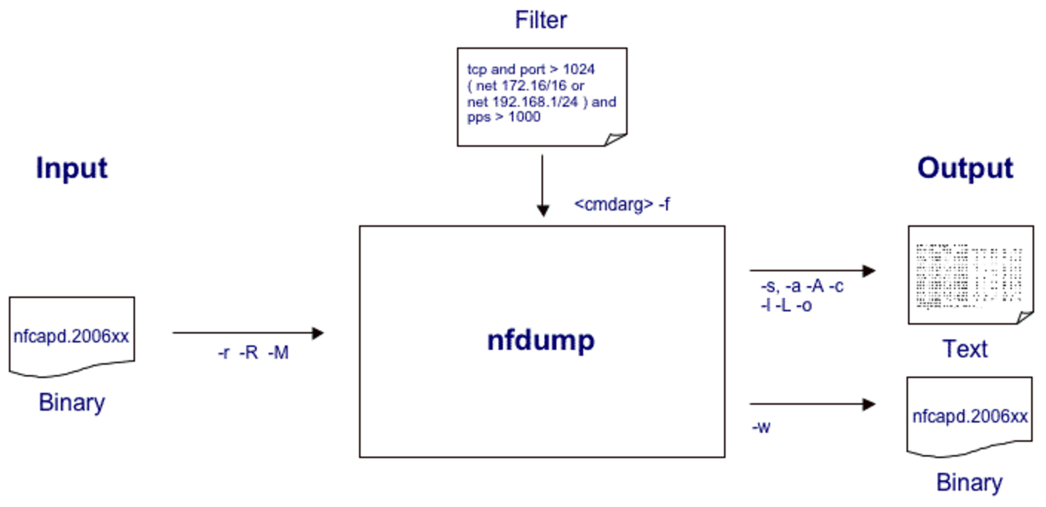
Statistical / Metadata analysis:
NetFlow data excels for identifying lateral movement, data exfiltration
records volume, timing, and packet counts sharing common characteristics: hosts, ports, protocol
nfcapd: ‘collector’ daemon that receives NetFlow / IPFIX data from ‘exporters’
    ~ 1MB of NetFlow storage per 2GB of network traffic
nfdump: applies filters to data from nfcapd:
protocol; source / destination address; s/d network; s/d port; etc.
$ nfdump -R /var/local/flows -t ‘2013/07/12.18:00:00-2013/07/13.09:00:00’ -O tstart -c 50 ‘proto udp and dst port 8765 and host 1.2.3.4’
NFSen: web front-end
Notes:
One way to think about it is that data is content, and metadata is context. Metadata can be much more revealing than data, especially when collected in the aggregate.
When you have one person under surveillance, the contents of conversations, text messages, and emails can be more important than the metadata. But when you have an entire population under surveillance, the metadata is far more meaningful, important, and useful. As former NSA General Counsel Stewart Baker said: “Metadata absolutely tells you everything about somebody’s life. If you have enough metadata you don’t really need content.”
In 2014, former NSA and CIA director Michael Hayden remarked: “We kill people based on metadata.”
1MB of NetFlow storage per 2GB of network traffic - i.e., 1/2000 (.05%) storage req. of FPC
suddenly, 20TB of data = relatively manageable 10GB of metadata

Slide 25
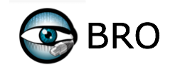
Statistical / Metadata analysis:
Assembles metadata and other layer 4+ data from observed traffic
    HTTP packet: capture GET / POST request content
    DNS: capture request & response
Feed data into ELSA for easy searching
Can manually define rules for extended / ongoing collection

Slide 26
Mini-Lab #2: Traffic Graph Analysis
Windows Server 2000/2003/2008/2012 with Domain Services enabled
Authenticates and authorizes all the users and computers in a Windows domain
Assigns and enforces policies through Group Policy Objects (GPOs
2.PCAPNG
(Same network environment)
What type of recon / attack activity was captured?
What type of tool might have been used?
Hint: We know from the previous exercise that a system in the 10.0.2.x network subnet acted maliciously. Consider this “threat intell” in reviewing this PCAP.
Notes:
~Statistics - Endpoints - IPv4
Statistics - IO Graphs (apply display filter for ‘known malicious actor’ .4 first)
- click around packet 7527 @ 207s (or anytime just before)
-> port scan begun from .4 to .5

Slide 27
Mini-Lab #3: Stream Assembly & File Extraction
Windows Server 2000/2003/2008/2012 with Domain Services enabled
Authenticates and authorizes all the users and computers in a Windows domain
Assigns and enforces policies through Group Policy Objects (GPOs
3.PCAP
A compromised client retrieved a malicious file from the server on TCP port 4444.
Use Wireshark ‘Follow TCP Stream’ and Raw export to determine:
  What type of file was it?
  What was the md5sum of the file?
  What does VirusTotal / malwr suggest about this file?
CREDIT: SANS
Notes:
Display filter for tcp.srcport==4444
Export only packets from server to client (although Wireshark may reverse this)
Or, Foremost, xplico / tcpxtract / etc.
MD5(testfile)= 3b7f836dd107cf58c8aa94ff8b5720f6
Note ‘MZ’ magic byte contents in wireshark traffic from server to client (ref. http://www.fileformat.info/format/exe/corion-mz.htm)
https://www.virustotal.com/en/file/033275a669b1c28b16969253b2cf10ea2ac28bda39dccca6cc33a2e393668177/analysis/

Slide 28
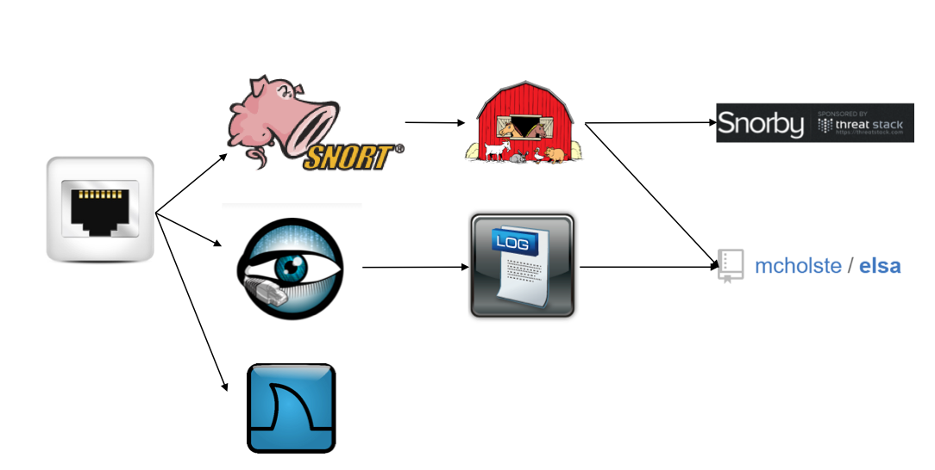
SecurityOnion - Data Flow

Slide 29
Barnyard and Syslog
Read in data from Snort and BRO; push it to other interfaces so Snorby & ELSA can read it
Can define custom triggers and rules at this layer

Slide 30
Snorby and ELSA
Snorby
Provides web interface for Snort alerts
Team-based detection & response / investigation
ELSA
'Enterprise Log Search and Archive'
Provides log receiver, archive, and indexer
Easy to search logs. e.g.:
class: BRO_CONN dstip: 8.8.8.8 groupby: srcip

Slide 31
Mini-Lab
SecurityOnion (?)
Windows Server 2000/2003/2008/2012 with Domain Services enabled
Authenticates and authorizes all the users and computers in a Windows domain
Assigns and enforces policies through Group Policy Objects (GPOs

Slide 32

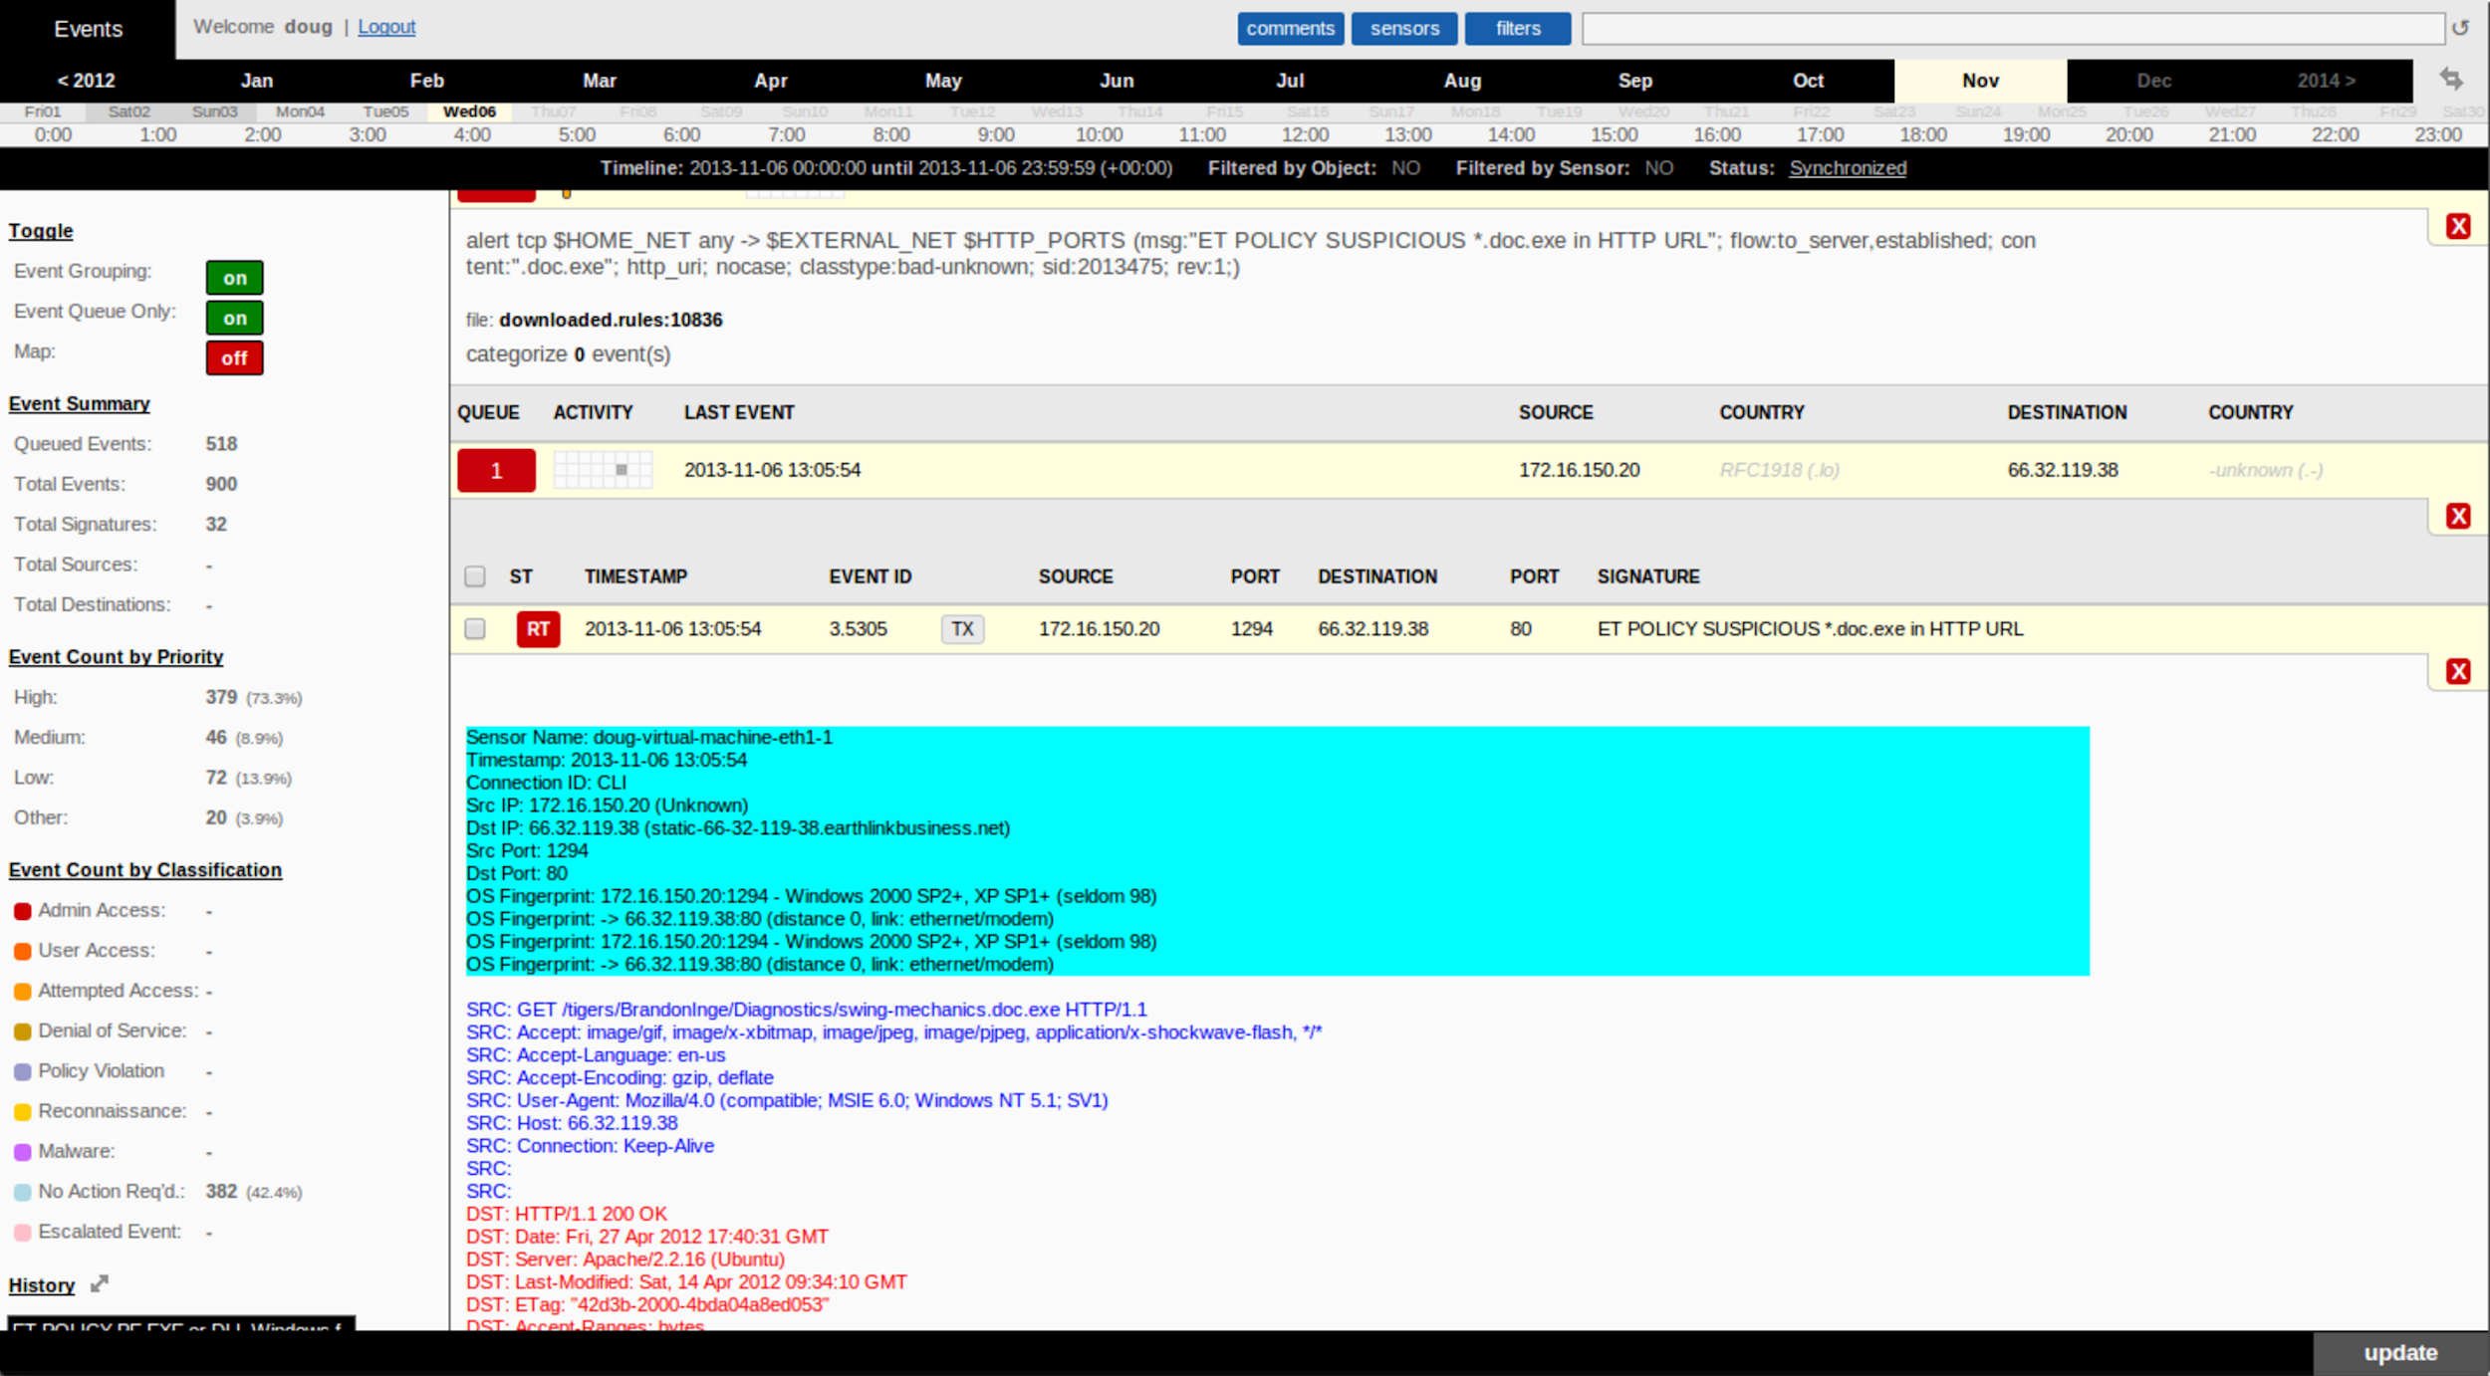
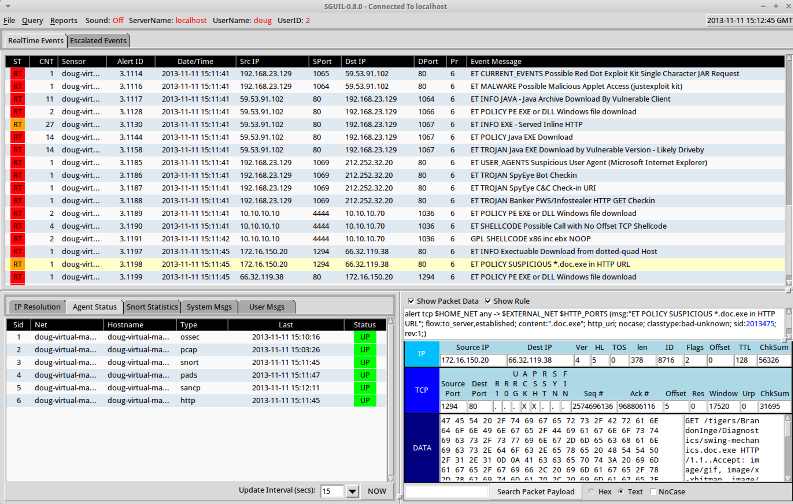
Network Monitoring Toolset:
Linux distro including Snort, BRO, Snorby, ELSA, etc.

Slide 33
SecurityOnion - Data Flow

Slide 34
Barnyard and Syslog
Read in data from Snort and BRO; push it to other interfaces so Snorby & ELSA can read it
Can define custom triggers and rules at this layer

Slide 35
Snorby and ELSA
Snorby
Provides web interface for Snort alerts
Team-based detection & response / investigation
ELSA
'Enterprise Log Search and Archive'
Provides log receiver, archive, and indexer
Easy to search logs. e.g.:
class: BRO_CONN dstip: 8.8.8.8 groupby: srcip

Slide 36
Mini-Lab
SecurityOnion (?)
Windows Server 2000/2003/2008/2012 with Domain Services enabled
Authenticates and authorizes all the users and computers in a Windows domain
Assigns and enforces policies through Group Policy Objects (GPOs

Slide 37
Moving Beyond Basic Detection
Lack of readily-detected C2 and/or obvious exfil activity does not necessarily equate to lack of compromise
  (Especially when rapidly increasing % of all network traffic is encrypted (inbound and outbound))
  We need to do more than monitor ingress and egress chokepoints for suspicious / malicious traffic in cleartext, communications with "known bad" systems, etc.
Supplement analysis with additional data sources (server logs, DNS transactions, NetFlow data)
Supplement with host-based visibility / checks
Analysis of encrypted traffic
Notes:
logs from (or RO access to) web servers, proxy, FW, VPN, DHCP & DNS, Windows, etc.
sampled host-based IR tool checks (Redline et al); authenticated vuln scans (Nessus); baselining / file integrity checks
Possible reasons for lack of detected C2 / exfil activity: dormant malware; infrequent C2 w/ jitter; communications w/ unknown / new malicious domains / IPs; insider abuse; use of legitimate services (twitter); remote VPN connections*; etc.
("In 2014, this trend hit a new watermark: we saw more cases in which attackers gained access to victims’ VPNs than ever before... In all of these cases, VPN logs were a telltale source of evidence: the source IP addresses of authenticated user sessions targeted by the attack would change quickly" - Mandiant 2015 Threat Report)
Outbound SSL interception: as long as certificates aren’t pinned, and ignoring potential drawbacks / weaknesses introduced as a result..
Retroactive decryption - as long as not implementing Perfect Forward Secrecy (PFS) (generate (with a non-deterministic algorithm) a random public key per session)

Slide 38
Encrypted Traffic Analysis
Statistical / volume analysis
  direction ratios (anomalies per protocol)
  frequency / periodicity of transmissions
Client/server characterization
  fingerprinting cipher suite preferences
  certificate analysis (CN, protocols / uses, validity dates, etc.)
Cleartext protocol correlation
  primarily DNS
SSL interception (outbound) / termination (inbound)
“Threat intelligence” / “threat data”
Notes:
“Lack of readily-detected C2 and/or obvious exfil activity does not necessarily equate to lack of compromise. In order to more thoroughly investigate the environment for potential compromise, we need to do more than monitor the egress chokepoint for:”
logs from (or RO access to) web servers, proxy, FW, VPN, DHCP & DNS, Windows, etc.
sampled host-based IR tool checks (Redline et al); authenticated vuln scans (Nessus); baselining / file integrity checks
Possible reasons for lack of detected C2 / exfil activity: dormant malware; infrequent C2 w/ jitter; communications w/ unknown / new malicious domains / IPs; insider abuse; use of legitimate services (twitter); remote VPN connections*; etc.
("In 2014, this trend hit a new watermark: we saw more cases in which attackers gained access to victims’ VPNs than ever before... In all of these cases, VPN logs were a telltale source of evidence: the source IP addresses of authenticated user sessions targeted by the attack would change quickly" - Mandiant 2015 Threat Report)
Outbound SSL interception / retroactive decryption - as long as not implementing Perfect Forward Secrecy (PFS) (generate (with a non-deterministic algorithm) a random public key per session)

Slide 39
Advanced Detection Challenges
  Challenging
    Encrypted reverse callback connections over HTTPS / DNS
      Infrequent, inconsistently-timed connections
      Traffic blends reasonably well with normal protocol traffic
          e.g., ViewState parameters
      Multiple domains, multiple C2 servers, and use of “redirectors”
    “Domain Fronting” via Google and CDNs
        Utilizing known, innocuous, high reputation domains and services
          (exempt from SSL interception?)
          e.g., gmail, wikipedia images, etc.
  “Good Luck”
    Out-of-band (unmonitored) egress connection
      neighboring company's guest wifi, cell network, bluetooth, etc.
Notes:
Paradox: the easy-to-catch attackers are the ones you don’t need to be very concerned with…

Slide 40
Mini-Lab
Wireshark Decryption & Analysis
Windows Server 2000/2003/2008/2012 with Domain Services enabled
Authenticates and authorizes all the users and computers in a Windows domain
Assigns and enforces policies through Group Policy Objects (GPOs
RSASNAKEOIL2.CAP
View the capture contents normally. What can be deduced about the traffic?
Load the SSL private key file into Wireshark (via preferences). What HTTP requests can be observed now?
Notes:
SSL private key
WiFi PSK

Slide 41
Mini-Lab
SSL Cert Analysis
Windows Server 2000/2003/2008/2012 with Domain Services enabled
Authenticates and authorizes all the users and computers in a Windows domain
Assigns and enforces policies through Group Policy Objects (GPOs
# COMBINATION OF TSHARK & SSLDUMP COMMANDS TO PARSE & PRINT OUT ALL SSL CERT DETAILS; USEFUL TO GET AN IDEA OF WHERE ENCRYPTED TRAFFIC IS HEADING:
$ TSHARK -R CAPTURE.PCAP -Y 'SSL.HANDSHAKE.CERTIFICATE' -W CERTS.PCAP && SSLDUMP -N -E -N -R CERTS.PCAP

Slide 42
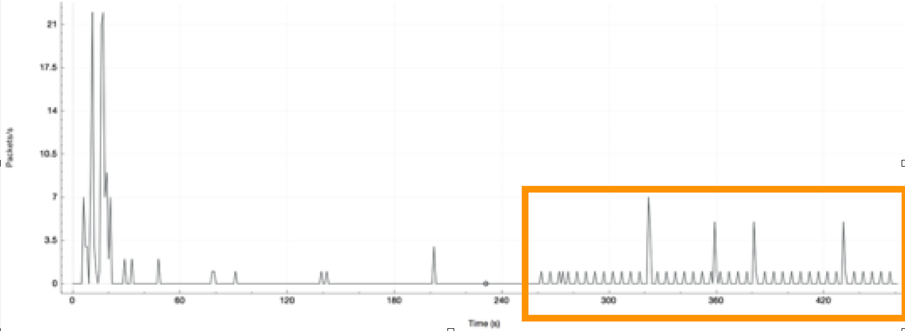
Mini-Lab
Medium/Hard PCAP Analysis
Windows Server 2000/2003/2008/2012 with Domain Services enabled
Authenticates and authorizes all the users and computers in a Windows domain
Assigns and enforces policies through Group Policy Objects (GPOs
3.PCAP
What happened?
  What time was the system compromised?
  What is the primary form of callback communications?
  What is unusual about this communication channel?
  Hint:
Notes:
http.request and ! (ip.dst == 204.79.197.200 || ip.dst == 128.83.40.146 || ip.dst == 23.235.44.193)
Statistics - IO Graph - incl. Display filter to identify pattern
packet #6839 @ 78.33s = requesting beacon payload

Slide 43
Additional Resources
SANS Digital Forensics and Incident Response Blog: Category - Network Forensics: https://digital-forensics.sans.org/blog/category/network-forensics-computer-forensics
Sample PCAP files: https://wiki.wireshark.org/SampleCaptures, http://www.netresec.com/?page=PcapFiles
The Practice of Network Security Monitoring (book): https://www.nostarch.com/nsm
Practical Packet Analysis, 3rd Edition: https://www.nostarch.com/packetanalysis3
SecurityOnion site: https://security-onion-solutions.github.io/security-onion/
Mandiant "M-Trends 2016" annual threat report provides trends, statistics and case studies to illustrate how advanced threat actors have evolved over the past year: https://www2.fireeye.com/M-Trends-2016.html
Verizon 2015 Data Breach Investigations Report: http://www.verizonenterprise.com/DBIR/2015/

