Slide 1
Overview
Learning, Astronaut Training, and Pre-Launch
Launching
Rockets (In Depth)
Orbits
Steering & Navigation
Landing
Spaceship Design
Space Stations
Living In Space
Traveling to Mars
Returning Home

Slide 2
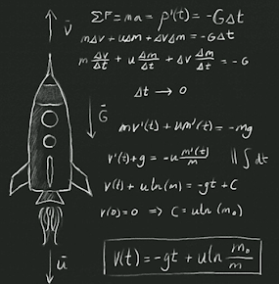
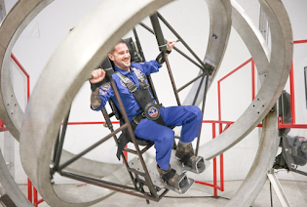
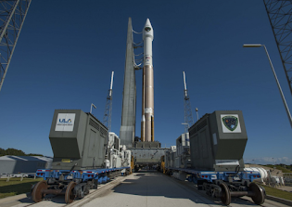
Learning, Astronaut Training, and Pre-Launch
Notes:
“Student” at Space Camp (I think)
ULA rocket on stand

Slide 3
Skills Needed for Space Exploration
Rocket scientists, pilots, astronomy
Medical doctors, geologists, chemists, meteorologists
Construction / building skills
  Even moreso in the future..
All need to be generalists (moderate knowledge of a lot of different things)
  There are ~200 (!) experiments active onboard the ISS right now
Psychological fit
  Kind, mature, responsible
Able to plan for / survive emergency landing on earth
  Whether in the Arctic, desert, tundra, jungle, water

Slide 4
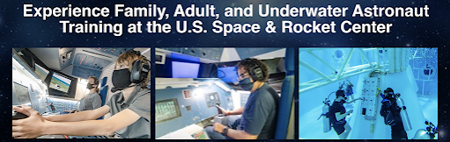
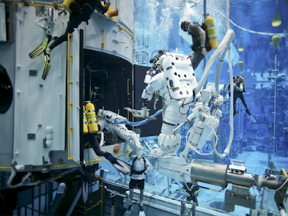
Astronaut Training
Space Camp
NASA Astronaut Training
Johnson Space Center - Houston
“ASCAN”s

Slide 5
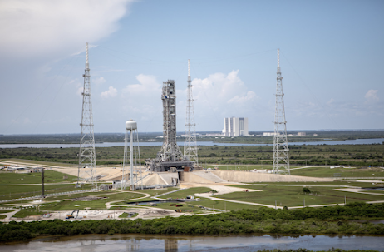
Launch Site Logistics / Locations
Launch sites tend to be close to equator
  In order to take advantage of the physics of earth's rotation
  Peopled launches in U.S. generally from Kennedy Space Center in Fla
At the equator, the earth is ~24-25 km wide - rotates in 24 hrs
  ~= 1000mph rotation
  (vs. at the north pole, basically no rotation)
Taking advantage of this rotational speed means less fuel req'd
  (Only applies for eastbound orbiting)
Notes:
KSC

Slide 6
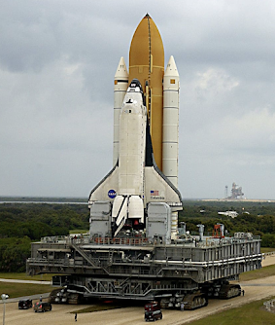
Pre-Launch
NASA astronauts quarantine for 1 week prior
  (always - including pre-COVID)
Mobile Launch Platform (MLP) rolls out of the Vehicle Assembly Building at KSC, on NASA's “crawler”
  380-foot-tall platform
  4 mile journey to the launch pad - takes approximately 10 hours
  Approximately two weeks in advance
Prefer early morning launch (stormy afternoon weather)
3 mile “exclusion radius”
  (bleachers for spectating are positioned 5 miles away)
Astronauts ride ~20 stories high in elevator to enter...
Notes:
VID: https://www.masterclass.com/classes/chris-hadfield-teaches-space-exploration/chapters/rockets-what-it-feels-like-to-launch 0:00 -> ~1:02

Slide 7
Launching

Slide 8
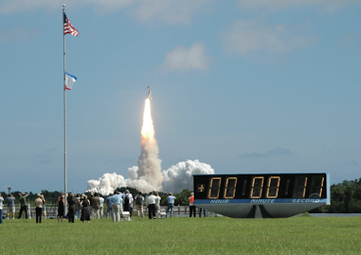
Rocket Launches
Countdown:
T-5min (5 minutes prior to launch): activate systems that consume fuel
T-30sec: -> automated systems; basically autonomous from earth at this point
T-6: light 3 of the 5 rocket engines
  for final check; not quite enough power to launch, though..
T-0: final 2 rockets (solid rockets on sides) light…
T+<time>: post-launch...
Notes:
VID: ~7:50 -> of https://www.masterclass.com/classes/chris-hadfield-teaches-space-exploration/chapters/rockets-what-it-feels-like-to-launch

Slide 9
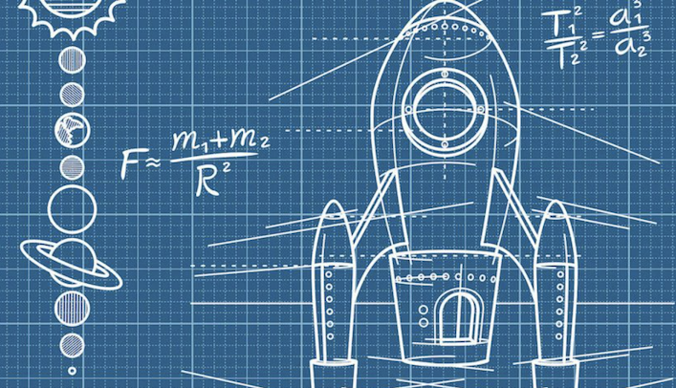
Rockets (In Depth)

Slide 10
Rockets
At its most basic, rockets are composed of / carry four main things:
“Payload” (crew, supplies, etc.) *
Fuel *
  Liquid: Hydrogen (+ O2)
    (need to bring O2 with - as contrasted w/ airplane, which utilizes O2 within atmosphere)
  Solid fuel
    These burn above the atmosphere - where can no longer intake O2 from outside
Steering apparatus
“Where hot stuff comes out” (exhaust)
* Every pound of payload we take to Mars requires about 200 lbs of rocket to take it there (mostly fuel)

Slide 11
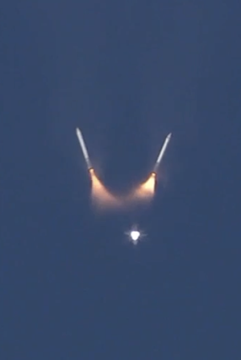
Rocket stages
Stage 1: “get above the air”
  Up to ~150 km (100mi)
Stage 2: speed up, to stay in orbit (“orbital velocity”)
  Minimal air; almost no drag - easier to speed up
  Easier to get to orbital speed without carrying the weight of empty propellant tanks and early-stage rockets - so, jettison
  ~8:40 min: Engines shut off @ orbital velocity; Weightlessness..
  Velocity of 5mps; 17,500mph) req'd to orbit earth
    (“orbital speed”: 25x speed of sound)
(Possible) Stage 3: landing on another celestial body
  Smaller, concealed motor for this - to travel to destination
  Must be able to stop & start
Notes:
VID: https://www.masterclass.com/classes/chris-hadfield-teaches-space-exploration/chapters/rockets-how-rockets-work 0:00 -> 3:40; ~6 (launch); ~6:30 - 12 (Space Shuttle)
re: atmosphere / beginning of space: https://www.businessinsider.com/where-does-space-begin-2016-7; https://www.nesdis.noaa.gov/content/where-space#:~:text=Although%20most%20people%20are%20generally,depends%20on%20who%20you%20ask.&text=According%20to%20them%2C%20space%20starts,50%20miles%20above%20Earth's%20surface.
Stage 2: We need a certain amount of thrust to get above the atmosphere, and then further thrust to accelerate to a speed fast enough to stay in orbit around Earth
- Jettisoning empty propellant tanks

Slide 12
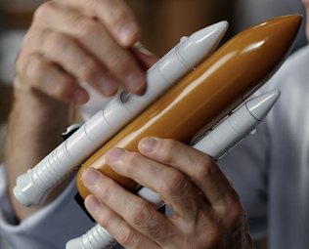
Rockets: Fuels and Propulsion
Space shuttle rocket assembly had:
Two solid fuel rockets (long side tubes)
  tough; simple; reliable
  cannot throttle or stop/start
  generally for the simplest part of a flight (first stage)
    (don't need to throttle up or down; shut off & on)
Liquid hydrogen & oxygen (middle tank)
  controllable (via valve shutoffs)
Possible Future Ion Rockets:
Tiny amount of gas with an electric charge ('ionized' - with a magnetic charge (positive or negative))
Then, use a magnetic accelerator to increase the speed the gas exits
  Need a large power source to provide this ionization
  Generally, solar power at this point - but this only provides a relatively small amount of thrust
Purpose is to carry / use less mass of fuel - but push it out the back correspondingly faster - providing a resulting equivalent amount of thrust
  (e.g. 1/4 of the mass of fuel, but exiting at 4x velocity)
Notes:
Most powerful rocket ever - Saturn V: https://www.youtube.com/watch?v=Iwn4LVVvAUQ (4 min vid)

Slide 13
Atmospheric Drag
Flying a rocket thru the atmosphere is the hardest & most dangerous part
A math equation was created to calculate how fast a spaceship should go, to make it through:
Drag equation: D = 1/2*p * (v^2) * S
p = density (thickness of air) # higher = thinner ("rho")
v = velocity (drag goes up as the square of the speed)
S = (cross-sectional) surface area (moving thru air) # "That's why rockets are pointy"

Slide 14
Rocket Re-use
“When the fuel/oxygen for each stage of a rocket is used up, we jettison that stage, and it falls back to Earth…”
Until recently, very few components could be re-used, economically
SpaceX Falcon rocket turns around once complete (with just enough fuel), then uses some engines to slow itself down & steer - to land on barge in ocean - or, back to original launch point (adjacent landing pad)
Notes:
Falcon Heavy first landing
Watch SpaceX Make History With Rocket Landing on Drone Ship
See SpaceX's Falcon Heavy rocket land all 3 boosters for the first time

Slide 15
Orbits

Slide 16
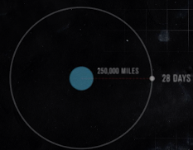
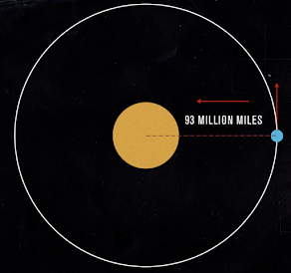
Earth & Lunar Orbits
Balance between the gravitational pull of sun, and inertia of earth in orbit (outward pull) results in orbit @ distance of 93,000,000 miles over 365.25 days
(analogous to ball on end of a string being whipped around)
vs. 28 days for moon @ only 250,000 miles distance from earth

Slide 17
Orbital Mechanics
“Mechanism by which you change your orbit"
Orbit is only ~250 miles above the earth's surface (still well above the atmosphere)
To change orbit, need to change speed - but, counter-intuitively:
The higher / further the orbit, the slower
So, if speed up / accelerate in a low earth orbit - will get to a higher orbit (pulling away from earth's gravity) - but, end up going slower as a result
So: to catch up to something / go more quickly, may have to decelerate, to fall into a lower orbit, in order to then go a faster speed, in order to catch up

Slide 18
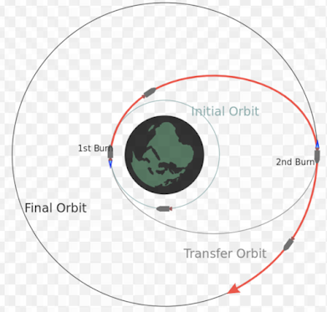
Changing Orbits with Hohmann Transfer
(Discovered by a German mathematician, inspired by sci-fi in 1920s) The most efficient way to go from a lower orbit to a higher orbit:
Fire engines, resulting in a deformed (to oval-shaped) orbit - then, fire again once reach the edge (@ new, desired orbit), in order to "circularize" the new orbit (instead of stay in an oval)

Slide 19
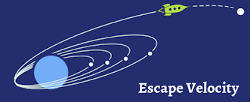
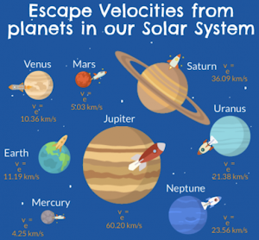
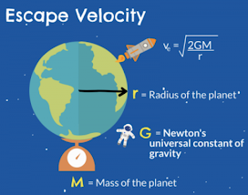
Escape Velocity
Orbital speed: @ 250 miles above earth (ISS): 17,500 mph (5mps)
Speed required to escape earth's gravity (exiting orbit): ~1.4x orbital speed
(1.4 = sq. root of 2) (~41% faster)

Slide 20
Effects of Gravity on Orbital Mechanics
“Newton’s Law of Universal Gravitation”:
The force (F) of gravity pulling between two objects is the mass of A * the mass of B, divided by the radius between them squared; multiplied by a constant (G) ->
The further away from the earth, the less magnified the effect of the earth's gravity - and so its effects on orbital mechanics is reduced
Eventually, in 'deep space' - whichever way you fire your engines, the space ship would travel "as expected" in that direction (free of gravitational influence of nearby bodies)

Slide 21
Steering & Navigation

Slide 22
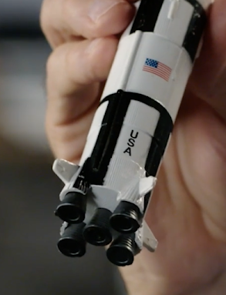
Steering
Fins help steer within the atmosphere
  (with air to push against)
Beyond that, need to be able to control which way the exhaust is coming out
  Engines (at bottom) on rotating hinges ('gimbals')
  + Big, aerodynamic surfaces
Further into the solar system - use the gravity of other planetary bodies to help turn / slingshot
  (turning is otherwise extremely difficult / energy-intensive, at such high speeds)
Notes:
“Within the atmosphere, aerodynamic fins can help steer the rocket, like an airplane. Beyond the atmosphere, though, there’s nothing for those fins to push against in the vacuum of space. So rockets also use gimbaling engines—engines that can swing on robotic pivots—to steer. Another name for this is vectored thrust.”
VID: ~5:10 -> 6:00 https://www.masterclass.com/classes/chris-hadfield-teaches-space-exploration/chapters/rockets-how-rockets-work?action=preview&controller=chapters&course_id=chris-hadfield-teaches-space-exploration&id=rockets-how-rockets-work&logged_in=true

Slide 23
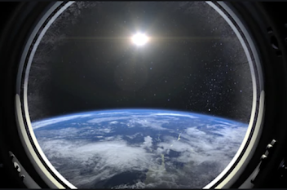
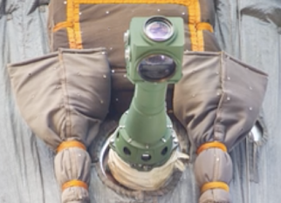
Navigation - Visual
Star tracking - via windows
line up with a pair of stars; then rotate ship to point at another pair of stars - by calculating what angle the ship rotated between the two, can calculate location
Or, periscope (a la Soyuz)
turn the ship until horizon is reflected through all mirrors on periscope - then, get a visual bearing based on which way earth is moving below

Slide 24
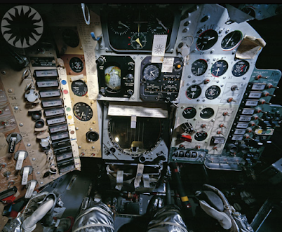
Instrumented Navigation
Based on:
earth's magnetic fields
atmospheric drag
  determine altitude, based on change in speed
sun / moon / stars
Using:
accelerometers
gyroscopes
radar
"predictor programs" (~simulators, on-board)
GPS
Important: b/c of high speed, tiny initial errors will result in HUGE distance errors
"State vector": where are you, and where are you going ("vector")
Extrapolate out constantly - 1 second out, 10 seconds out, etc...

Slide 25
Landing

Slide 26
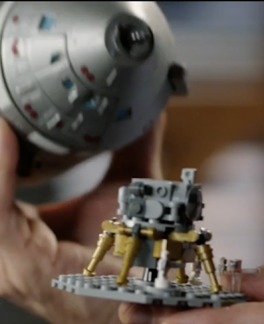
Landers
Detach from within larger spaceship structure - never have to fly thru air / atmosphere
so, can be ungainly / non-aerodynamic
skin could be extremely thin / light
  (just tough enough to keep pressure inside)
Lunar lander:
Upon departure from moon, just the top portion (gray part) left the moon’s surface, to bring the astronauts (and their gathered rocks) back to the command module
Remainder was then jettisoned - to intentionally crash back into moon
  To observe quakes on moon (from deployed sensors) - to help determine inner composition of moon

Slide 27
Pop Quiz!
Name three skills needed in space exploration
What are astronaut training candidates called at NASA?
When do the first rockets ignite, during a launch?
  T-0, T-60, T-6, T-1
List two of the three ways rockets can steer

Slide 28
Spaceship Design

Slide 29
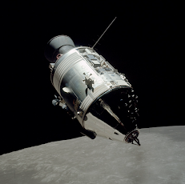
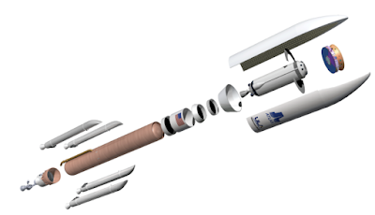
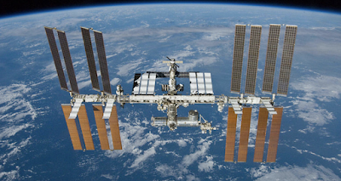
Spaceship Design
All spaceships are a series of compromises
  power source; meteorite protections; cost; etc.
Design is driven by what the spaceship is for
  e.g. 3 day trip to moon vs. permanent earth orbit vs. long trip to Mars
  Manned vs. unmanned
  If manned, need to bring along things to keep us alive
    Air, water, food, climate control, waste processing
Try to prepare for all contingencies
Notes:
Upper right: Apollo command module (Lander inside)
Lower left: ISS
Lower right: ULA (prospective ?) Mars-bound rocket

Slide 30
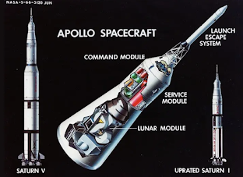
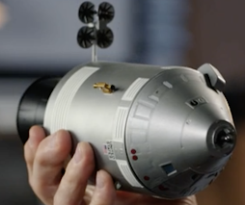
Early Spaceships - Apollo
re-entry capsule on the top
command module in the middle
engines on the bottom
thrusters on the side (to turn in space)
radiators on the side
can't have one side of the spaceship always facing the sun
  Instead, slowly spin (rotisserie-like)
  as long as antennas always pointing towards earth
  angle between spaceship & sun = "beta angle"
    (major factor in controlling thermal level of ship)
Notes:
Lower right: Service & Command module portions of Apollo

Slide 31
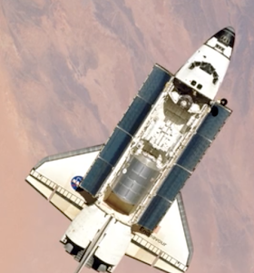
Space Shuttles
Early attempt to make rockets more re-usable (more like airplanes)
~2/3 of all people who have flown to space did so on a Space Shuttle
Official program name was Space Transportation System (STS)
Five complete Space Shuttle vehicles were built and flown
  total of 135 missions from 1981 to 2011
Winged design:
  once back into atmosphere is the only time wings serve a purpose
  allowed bringing back large payloads from space (space labs, space stations, etc.)
  makes the ship much more complicated
Ships are likely evolving back to capsule design, at this point

Slide 32
Space Stations
Notes:
Salyut space station

Slide 33
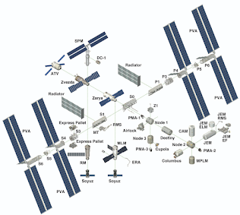
Space Stations
After initial rocket launches, orbits, and moon travel, desire for a semi-permanent space station
  To be able to conduct scientific experiments in (effectively) no gravity
Not a rocket ship - don’t need to be streamlined - can be “purpose-built”
Initial space stations:
  Salyut (Russian), SkyLab (NASA), Mir (Russian)
  ISS - first piece in 1998; cooperation btwn 15 countries
    first crew in 2000
    companies can now “buy time" to conduct experiments
Modular Design:
  Over 100 yards long
  Must launch pieces individually from earth
  Bolted together over ~20 years
Notes:
VID: https://www.masterclass.com/classes/chris-hadfield-teaches-space-exploration/chapters/the-iss-conception-design-and-construction 9:35 -> 10:55

Slide 34
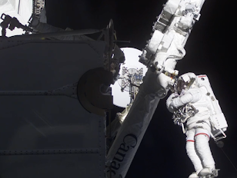
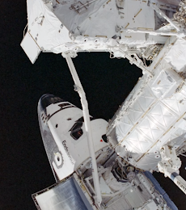
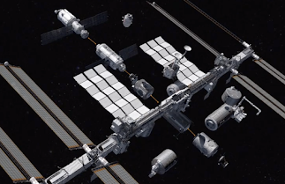
ISS - Building It
Fly up individual pieces, and connect - power, data, environmental ctrl systems, etc.
Simple pieces relatively simple to manage/assemble remotely, from earth
More complex pieces require more dexterity so
  Either spacewalks - or, large robotic arm:
    Canadarm - attached to space shuttle, retrieves a large piece from the cargo bay to attach:

Slide 35
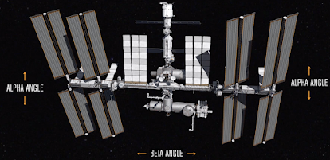
ISS, Cont’d
Power, Heating, & Cooling:
  Solar power is the obvious choice
  8 solar arrays - twist & spin, in order to track the sun (following 'alpha' and 'beta' angles), while keeping the center stable:
Orientation:
  If always point solar arrays towards the sun, then in orbiting earth, angle relative to the earth will constantly change - complicating communications, and stability (due to gravitational pull of side oriented towards earth)
  So, instead - always flat / parallel with the horizon of earth (LVLH (local vertical, local horizontal)) - and rotate solar arrays to follow sun
Notes:
? VID: https://www.masterclass.com/classes/chris-hadfield-teaches-space-exploration/chapters/the-iss-conception-design-and-construction 11:00 - 14:25 (Power, heating, & cooling)

Slide 36

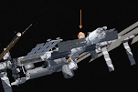
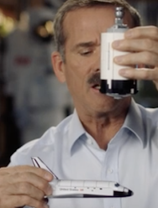
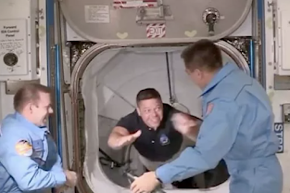
ISS, Cont’d - Docking
Several docking options on the US / EU, and Russian sides:
Approaching:
Aim to get within easy sighting, within the same orbit ("co-altitude")
"navigate by committee": carefully controlled burns to approach closer
aim to be a few hundred feet directly below the space station
switch from "rendezvous mode" to "proximity operations"
Docking:
space shuttle primarily docks visually & manually
docking mechanism latches loosely to begin
stop firing thrusters
ISS re-enables “attitude control”
equalize pressure between two vessels
  in order to be able to open hatch
~50 hours from launch to space shuttle opening hatch to ISS
Notes:
? VID: https://www.masterclass.com/classes/chris-hadfield-teaches-space-exploration/chapters/the-iss-conception-design-and-construction 16:12 -> 17:23 (Docking)
Navigate by committee: need to be highly fuel-efficient, and avoid risking a collision
Proximity operations: less concerned w/ orbital mechanics; moreso w/ fine control
Space shuttle + ISS docking: "elephant ballet"
After stop firing thrusters:
begin spinning / rotating slightly (due to inertia)
wait until this damps down (via dampening springs)
then docking mechanism latching tightens
ISS attitude control: to point panels at sun; comms to earth

Slide 37
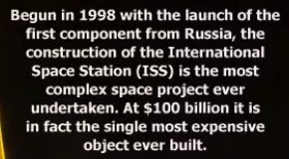
ISS Facts
The ISS is the third brightest object in the sky, after the Sun and Moon.
Every 3 days, the ISS passes over the same place on Earth.
It takes about 90 minutes for the ISS to circle Earth one time. The ISS orbits Earth 16 times per day, so astronauts can see 16 sunrises and 16 sunsets each day!
During the daylight periods, temperatures reach 200 ºC, while temperatures during the night periods drop to -200 ºC.
Notes:
VID: https://www.masterclass.com/classes/chris-hadfield-teaches-space-exploration/chapters/spacewalking-spacewalks 9:00 - 13:00 re: northern lights spacewalk from ISS experience (12:25 - 13:00 shows the lights)

Slide 38
Living In Space

Slide 39
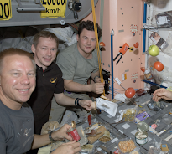
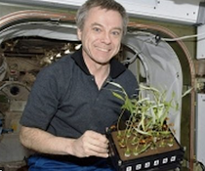
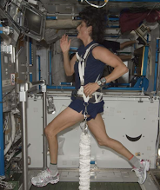
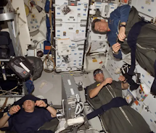
Living in Space
Water: Recycle breath, urine, experiments' waste liquid -> purification system (spinning & chemical filters) -> potable water
Eating: Dehydrated food, brought from earth
no use of fridges / freezers / stoves / ovens
just food in cans that can be heated
Growing Food
Growing crops on the space station would provide food, and allow converting CO2 back into Oxygen
In limited gravity (and more radiation) - which way is “up”? How well will plants grow?
  Hydroponics
  Botanists / horticulturists will be required to advance this
Toilet: includes foot restraints and handholds
Waste is disposed of in water-tight bags
Most are loaded into a cargo ship that burns up on re-entry
Protections from the Elements
Moon & Mars lack the magnetic field that the earth has, which helps protect from radiation of the universe
So, lander / habitat & suit need to additionally protect against this

Slide 40
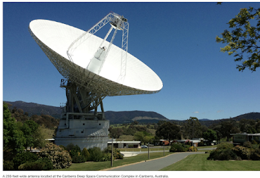
Communications
Mission Control: after Launch Control
once beyond initial communications reach / visibility
(as progressed from early launches - which were just up to space & back)
doesn't need to be in the same place launched from (as Launch Control does)
Multiple, for ISS: Houston, Moscow (area), Tokyo (area), Montreal, Munich
CAPCOM ("Capsule Communicator")
The Space Network
NASA stays in contact with astronauts orbiting more than 250 miles above Earth with a network of communications satellites and ground-based antennas.
A constellation of satellites (TDRS) form the space-based portion of the network. They work like cell phone towers in space. TDRS are located in geosynchronous orbit more than 22,000 miles above Earth, which lets the space station contact one of the satellites from anywhere in its orbit. All of this happens in milliseconds so that there is no noticeable delay
Notes:
CAPCOM: - holdover title, from when spaceships were mere capsules): astronaut speaking to astronauts. Listen to what the flight director wants the crew to know, and translate / communicate to astronauts in their language
Before the Space Network, NASA astronauts and spacecraft could only communicate with the support team on Earth when they were in view of an antenna on the ground. That allowed only for communications less than 15 minutes every hour and a half.
However, farther from Earth, latency can become a challenge. At Mars’ closest approach — about 35 million miles away — the delay is about four minutes. When the planets are at their greatest distance — about 250 million miles away — the delay is around 24 minutes. This means that astronauts would need to wait between four and 24 minutes for their messages to reach mission control, and another four to 24 minutes to receive a response.

Slide 41
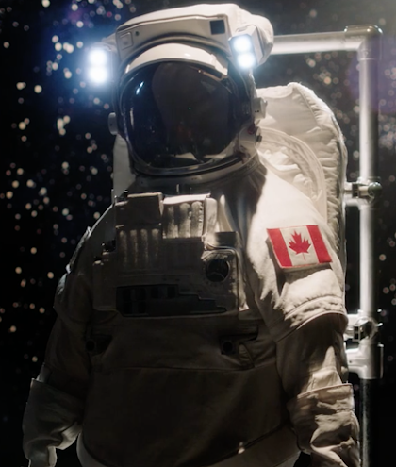
Spacesuits
Dexterity, sensitivity, judgment, tactile interactions require humans to interact / go outside of spaceship
Spacewalking suit: EMU
(Extravehicular Mobility Unit) aka Spacesuit
Pressurized
  (only to ~1/3 of earth atmosphere for more flexibility)
insulated (~120F in sun; -100F in shade)
  14 layers (inner = rubber bladder)
  exterior is white (mostly to reflect sunlight)
meteorite protection - akin to a 1-person spaceship
Personal Life Support System (PLSS):
  Oxygen purification
  battery power
  Radio
  Cooling
Cameras at the top (multiple lenses)
  allows Mission Control etc. to see
Gold-plate sunshade for in the sunlight
Thermostat - can be viewed in mirror on wrist
Tool clip-ins
Notes:
VID: https://www.masterclass.com/classes/chris-hadfield-teaches-space-exploration/chapters/spacewalking-spacesuits 0:00 -> 2:05

Slide 42
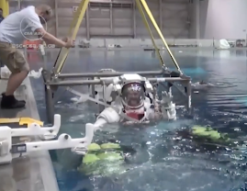
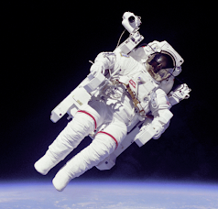
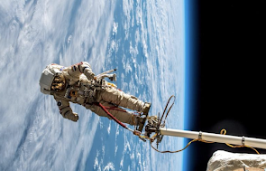
Spacewalks
Training @ JSC:
Underwater training facility
Replica section of ISS in a pool
'Neutral Buoyancy laboratory' (45' deep)
During - stay constantly aware:
how space suit is doing
what is my next task
how does this tool / operation work
is everything safe
interactions with crew & CapCom
Of two spacewalking astronauts, the one with red stripe is the lead space walker
Safety: Only connection to ship is a single tether / safety line - ~60' reel, attached to hip
If this fails - 'SAFER' jetpack, with joystick that pops out from side (Nitrogen tank, with multiple thrusters to allow steering)
Notes:
X (pretty repetitive with spacesuit vid content) VID: https://www.masterclass.com/classes/chris-hadfield-teaches-space-exploration/chapters/spacewalking-spacewalks 0:00 -> 1:51

Slide 43
Traveling to Mars
Notes:
(CGI)

Slide 44
Mars: Getting There
Currently, chemical engines propelling a habitat & cargo area:
Mars & Earth: 35M miles apart when closest in orbits; ~250M miles apart when on opposite sides of sun..
  Minimum trip length (at closest distance): ~6 mos
Fire rockets a few times to get away from earth, then out of orbit - then, spend most of the time coasting to e.g. Mars, before turning and slowing / decelerating
  Hohmann transfer: most energy efficient (takes advantage of coasting), but - may take too long (in terms of impact on human crew)
  Not very time-efficient - would be more ideal to be able to fire engines the entire first half of the trip (to continually accelerate) - then, decelerate the entire second half of the trip..
If not just coasting, though - how to slow down when arriving at destination?
  Historically & currently: Turn spaceship around, and fire the engines in opposite direction to slow down
  Requires bringing the additional fuel to do so
  Alternative: use the drag of the atmosphere - by just brushing into the upper reaches of the atmosphere repeatedly on recurring elliptical orbits (?) - just use a bit of friction each time..
One of the best solutions would be to not have to bring everything (see ISRU...)

Slide 45
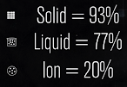
From Earth Orbit to Mars
From 8km/sec (earth orbit speed) -> need to increase velocity by ~6.6km/s
Newton's law: F = M*A
  The force provided will be proportionate to the mass of the rocket * acceleration provided
  (Since we need to solve for acceleration: A = F / M)
"Equal and opposite reaction" propels ship forward
  (Newton's third law of motion: Every action produces an equal and opposite reaction)
  Exhaust is exiting the back of the ship at 'VE' ('exhaust velocity')
  The greater the force of exhaust exiting the ship, the greater the acceleration
  'Specific impulse' (ISP):
    Solid fuel: exits at ~2km/s (VE)
    Liquid: ~4km/s
    Ion: ~30km/s
To get change in velocity of 6.6km/s, we would need to carry:
  fuel as a % of the total spaceship mass

Slide 46
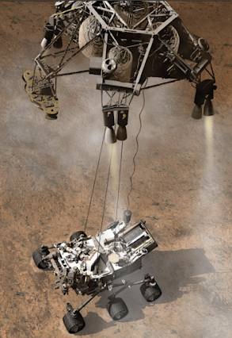
Mars: Landing There
Martian atmosphere is poor for landing - too thin for parachute or wings (wouldn’t be supported by the thin atmosphere)
The atmosphere is not negligible enough to ignore - would generate way too much heat in landing (as compared to e.g. Moon)
Recent innovation: a small capsule, with rockets to slow, surrounded by air bags - to land/bounce on surface, then deflate
Only works for a capsule / payload up to a certain size
Any larger than that - use atmosphere to slow down, then use rockets to slow
  then (to avoid payload getting burnt up by rockets) lower the payload down via cable/”skycrane”, cut the cables
  e.g., Curiosity rover @ ~1 ton (heaviest thing put on Mars)
Notes:
VID: https://www.youtube.com/watch?v=gwinFP8_qIM Curiosity Rover landing @ 0:55 -> 3:30

Slide 47
Mars: Living There
What humans need to stay alive:
Something to breathe: Oxygen
Heat: Hydrogen
Water: H2O
  Mars (and Moon) have water (frozen in ice - in craters, and polar ice caps - at least)
  Electric current run through water (‘electrolysis’) separates water into its constituent elements:
    Something to breathe, and H2, O2 -> fuel (for heat, and rocket fuel)
    We can use solar energy as a source of electricity...
Communications / Guidance
  Martian Communication Protocol: <= 22 min delay for communications - even traveling at light speed
  Therefore, need to rethink communication standards / habits.
In-Situ Resource Utilization (‘ISRU’)
Don’t necessarily need to bring all the required equipment in the same ship that travelers will travel in
Perhaps send an automated cargo ship, in advance
  To start building a small robotic base - which could generate oxygen, hydrogen, power, etc.
Every resource we can generate in-place (on Mars) is one less thing we have to “pay” to bring from earth
  Mars has an atmosphere, and “oceans” of ice
So, a big part of preparing for Mars travel is not just rocket science - also, building a habitable environment

Slide 48
Returning Home

Slide 49
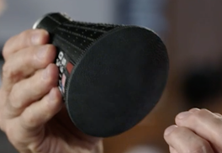
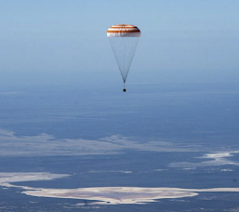
Re-Entering Earth’s Atmosphere & Splashdown
Just a capsule is designed to survive re-entry to earth's atmosphere
  slow down enough to fall out of orbit
  experience tremendous air drag, and slow down further
    early capsules experienced ~8x gravity
  can control / steer somewhat via small thrusters towards landing spot
Sacrificial heat shield to absorb heat + friction to slow down
  rather than being streamlined / pointy - wide / blunt / flat
  to spread out the heat/energy
  (b/c can't make a material strong enough to absorb all the heat)
    thousands of degrees of heat on exterior of capsule
Parachute to slow enough to land (typically in the ocean)
  deploy a drag chute, then one or more main chutes
Inflatable ring(s) to float, upright
Notes:
Model version of Apollo return capsule (heat shield side)
“The Soyuz MS-15 space capsule carrying International Space Station crew members descends for a landing Friday in a remote area near Dzhezkazgan, Kazakhstan”
VID: https://www.youtube.com/watch?v=A83anvGUrCs Apollo 13 re-entry (~6 min)
“Apollo 13 was the seventh crewed mission in the Apollo space program and the third meant to land on the Moon. The craft was launched from Kennedy Space Center on April 11, 1970, but the lunar landing was aborted after an oxygen tank in the service module (SM) failed two days into the mission. The crew instead looped around the Moon, and returned safely to Earth on April 17.”

Slide 50



Notes:
90sec VID - Apollo 15 (1971): https://www.youtube.com/watch?v=E-Vd75Ptg9I “Splashdown of Apollo 15 command module "Endeavour" in the Pacific Ocean on August 7, 1971. During Earth re-entry and descent, one of the 3 parachutes failed to open fully. As a result, descent velocity was 4.5km/hr (2.8mph) faster than planned. The crew was unharmed.”
“Gemini 8 capsule following splashdown in the western Pacific ocean, approximately 800km east of Okinawa, the result of an emergency landing. Aboard the capsule are United States astronauts David Scott (left) and Neil Armstrong (right).”
“Aboard the USS Iwo Jima: The Apollo 13 command module is lifted aboard the recovery carrier Iwo Jima following splashdown here.”
“Astronauts Thomas Stafford (right) and Eugene Cernan wave to the crowd aboard the aircraft carrier USS Wasp as they emerge from their Gemini-9 capsule”

Slide 51
Pop Quiz!
How long have people been living on the ISS?
What is the least amount of time it would take to get to Mars, currently?
Which of the following do space suits *not* have:
  radio, cameras, smart phone, sunshade, thermostat
What happens if a spacewalking astronaut’s tether breaks?

Slide 52
Risks and Failures in Space Exploration
Exploration and doing new things always carries more risk
Disasters:
  Challenger (space shuttle): 1986
    individual, sealed segments of side rocket allowed small leak thru side (related to launch on very cold day), which cut the strut to the main external tank, which broke apart the whole shuttle vehicle
  Columbia (space shuttle): 2003
    piece of insulating foam on external tank popped off, came down, and hit the wing of shuttle itself
      (liquid oxygen and hydrogen within external tank needs to be insulated b/c it is so cold)
    bits of foam always flake off, but - hitting the wing made a hole, so upon re-entry - the heat melted the internal structure of the wing, and the vehicle came apart
We have learned and improved as a result of failures
"What is worth doing in life?" Then, accept the risks
"The best antidote to fear is competence"
  If competent, you can not only do a thing - but relax / enjoy it, while doing so..

