Slide 1

If it Ain’t Broke, Fix It?
Link to github
Link to LinkedIn

Slide 2
Goal
Predict Compressor Failure Rates
Compressors are critical, and diverse in use and size.
Geographically separated production regions
  Struggles are different
    Weather
    Geography
    Types of wells
  Separation of regions
    Data is not shared
    Methods are not shared
  BP is pushing centralized Data Driven Decisions

Slide 3
What Makes a Compressor Fail?
Cold!
Age / lack of maintenance
Power
Other changes in the well
Manufacturing Defects
Human interference

Slide 4
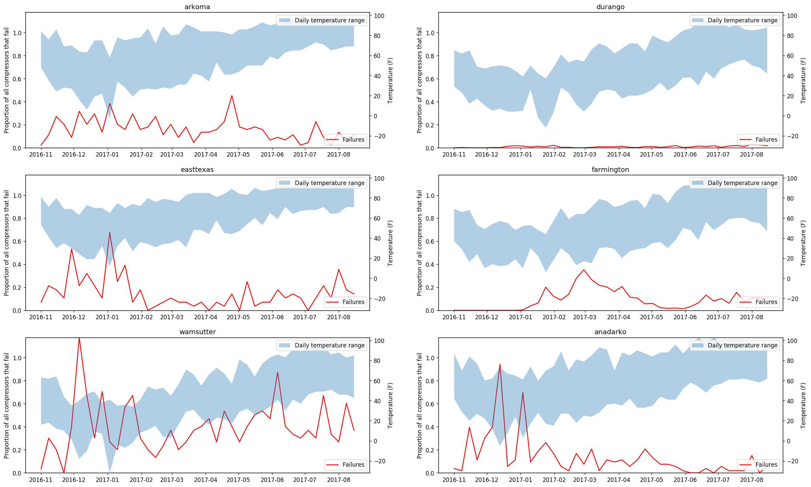
Weekly Failures per Business Unit
Add a dotted line for avg temperature

Slide 5
Weekly Failures per Business Unit
Add a dotted line for avg temperature

Slide 6
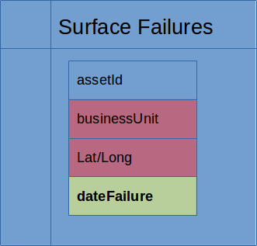
Data

Slide 7
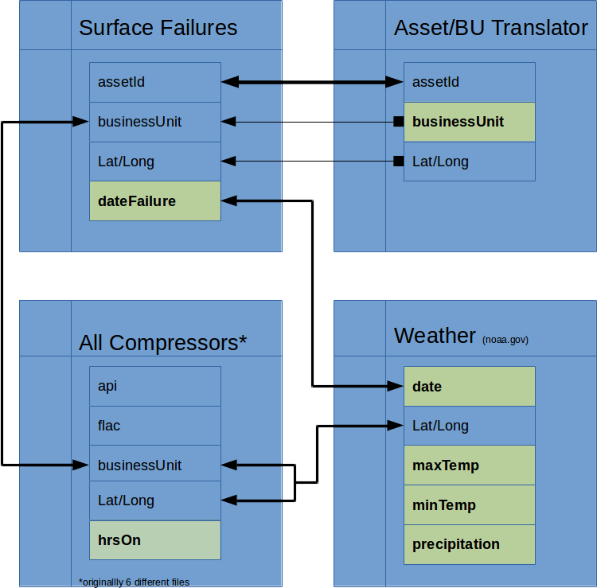
Data

Slide 8
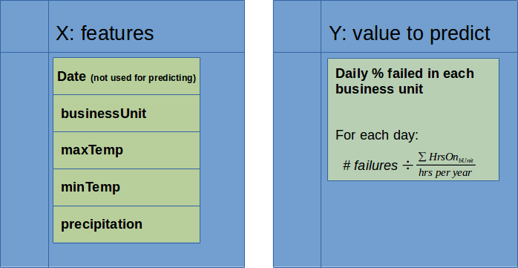
Data

Slide 9
Models
Limitations
Very little data
Extremely few features
Results will drive changes to the features, so interpretability is important
Choices
n^2 Linear Regression
  Allows temperatures to affect different regions independently
  Increases number of features
Gaussian Process
  Works well with Periodic Time Series data
  Bayesian technique, provides confidence intervals
  Potentially interpretable results based on kernels used

Slide 10
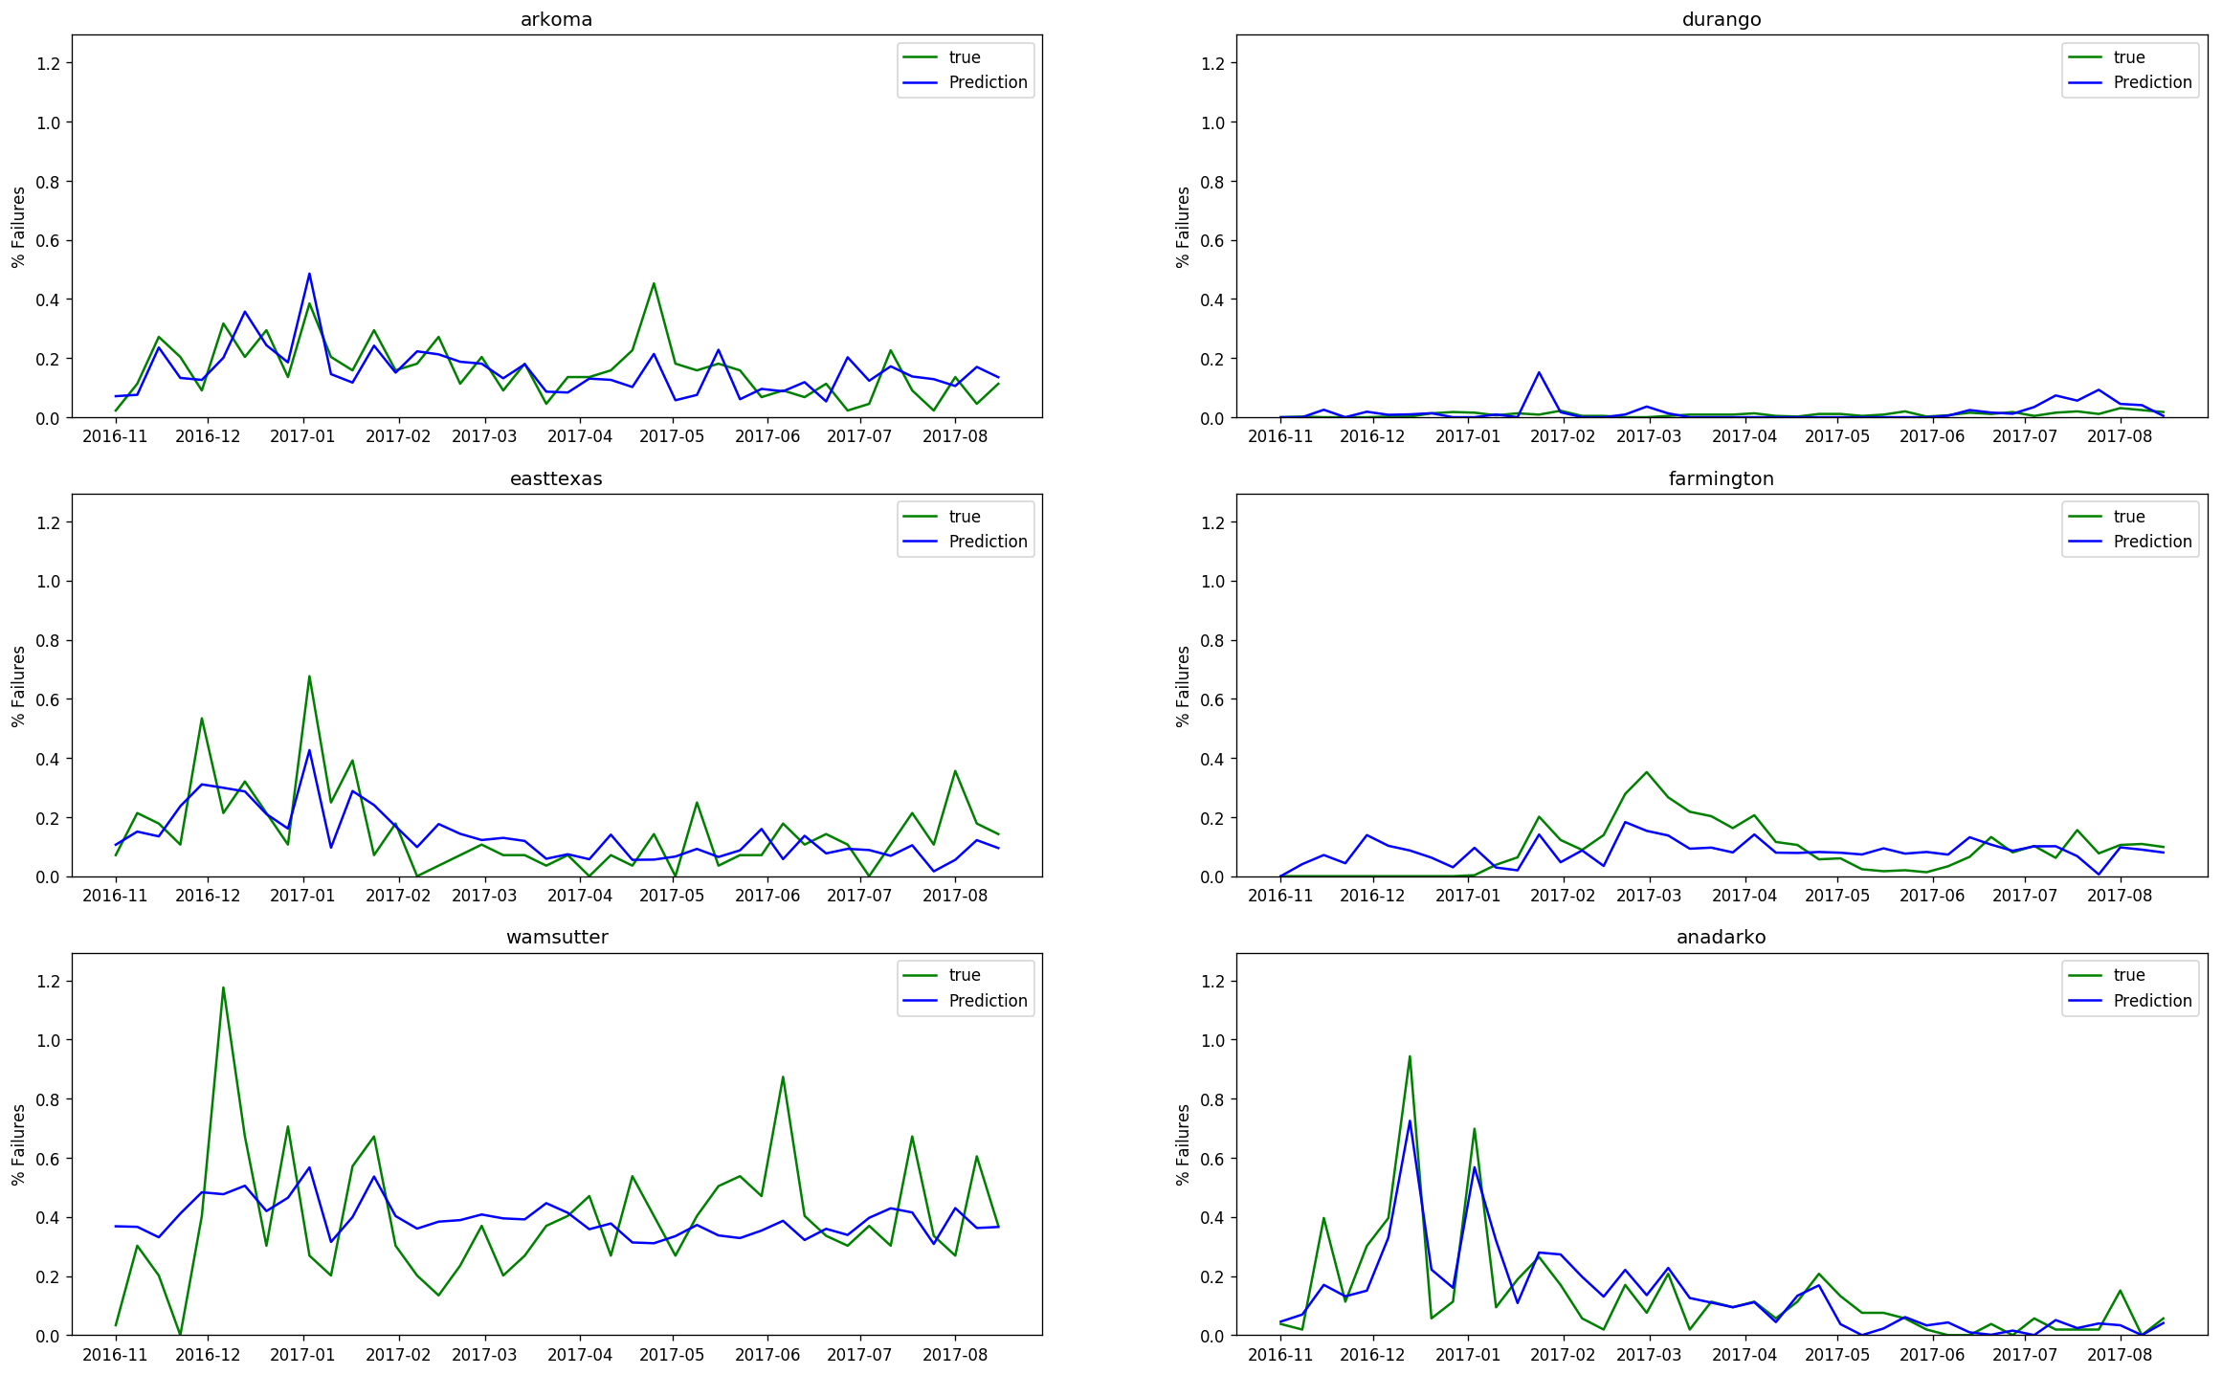
n² Linear Regression

Slide 11
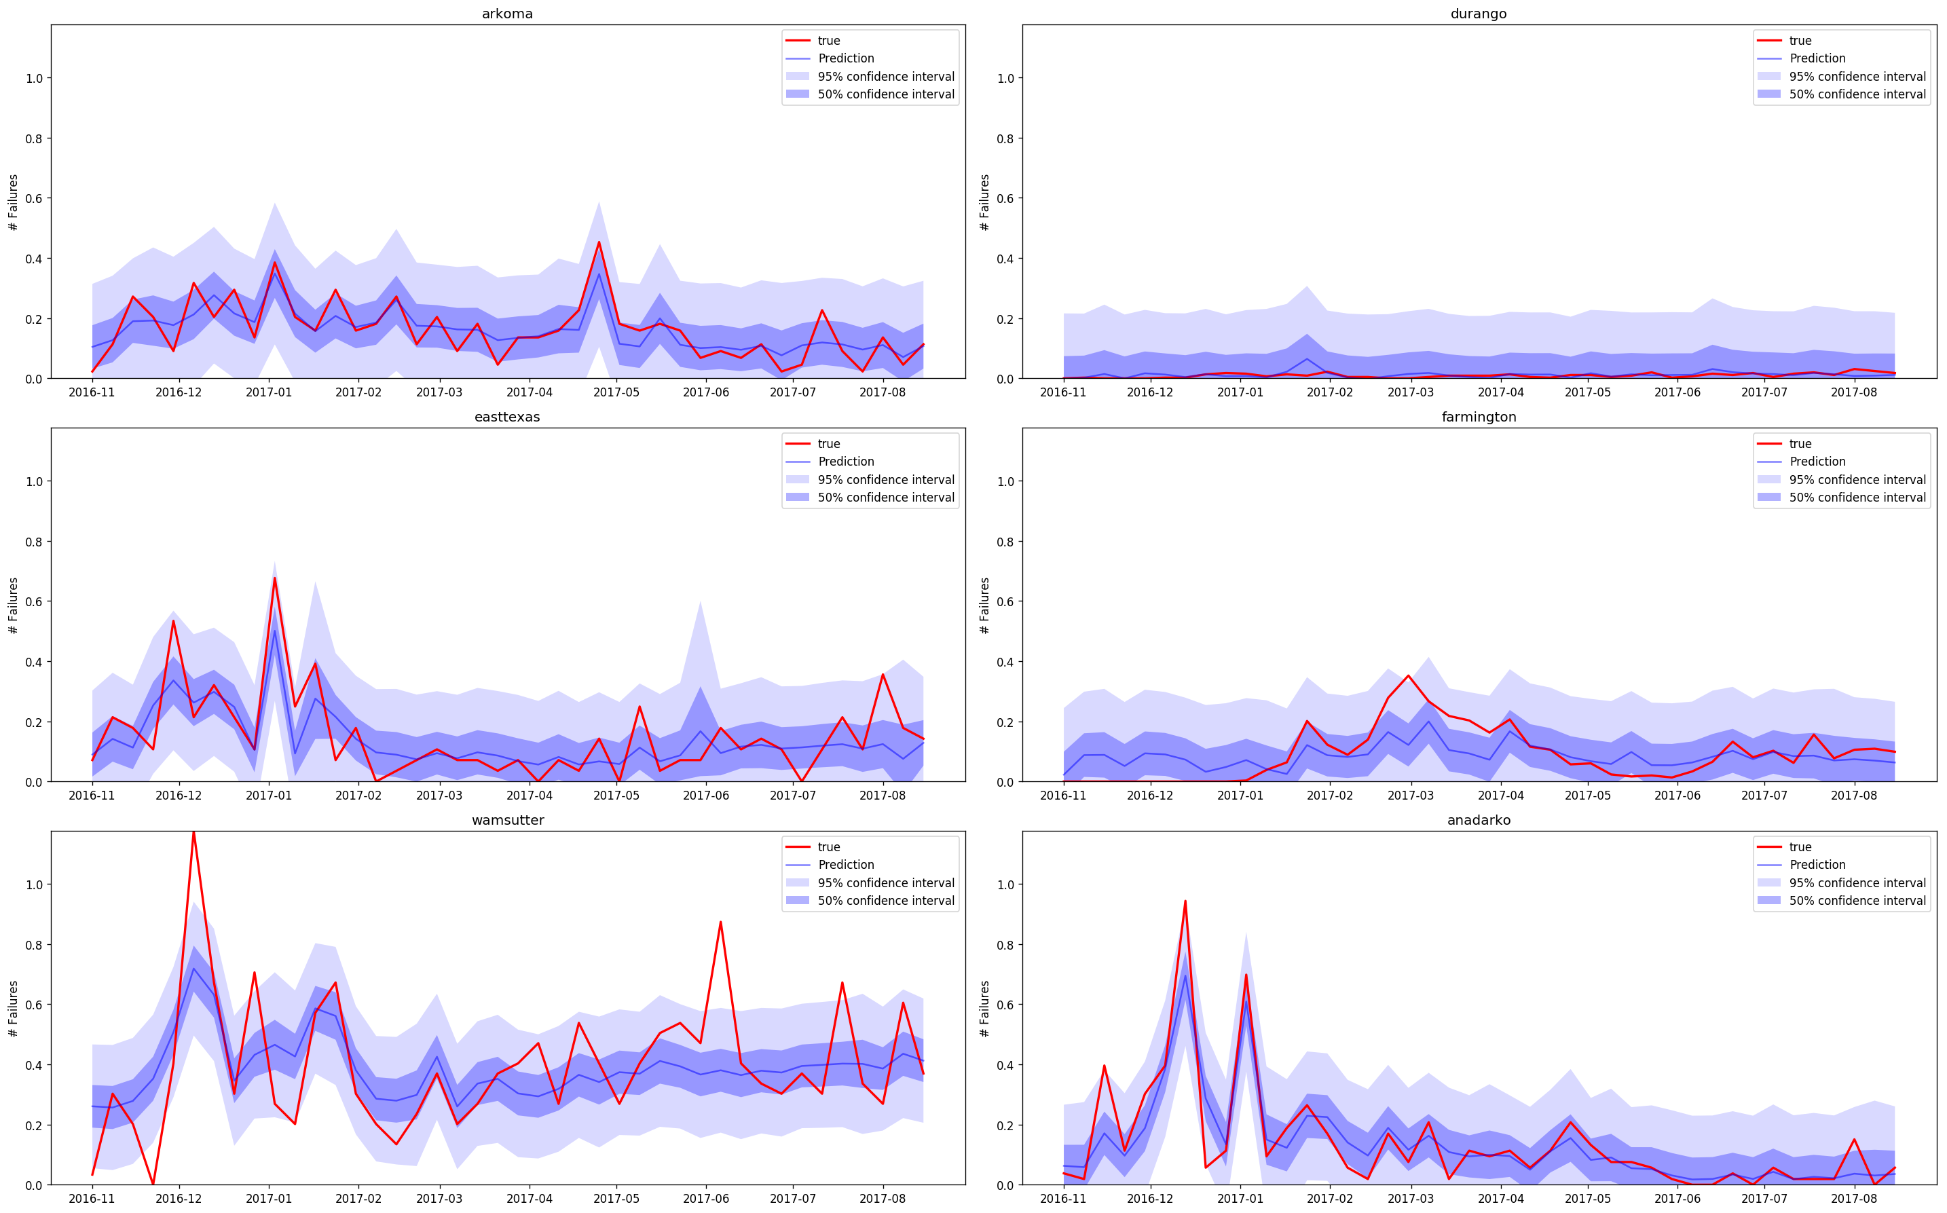
Gaussian Process
(Rational Quadratic & White Kernels)

Slide 12
Interesting Conclusions
AvgTemp is the most predictive weather feature
  Severely low temps don’t matter as much as prolonged cold does.
  Precipitation doesn’t matter
Weather is obviously not the only factor
Farmington seems unaffected by weather. What can we learn from them?

Slide 13
What Next
Modeling Techniques
Gaussian Process in PyMC3
  Enables more interpretability of feature importance
Recurrent Neural Net
Data
Multiple years/cycles
Predict individual compressor failures

Slide 14
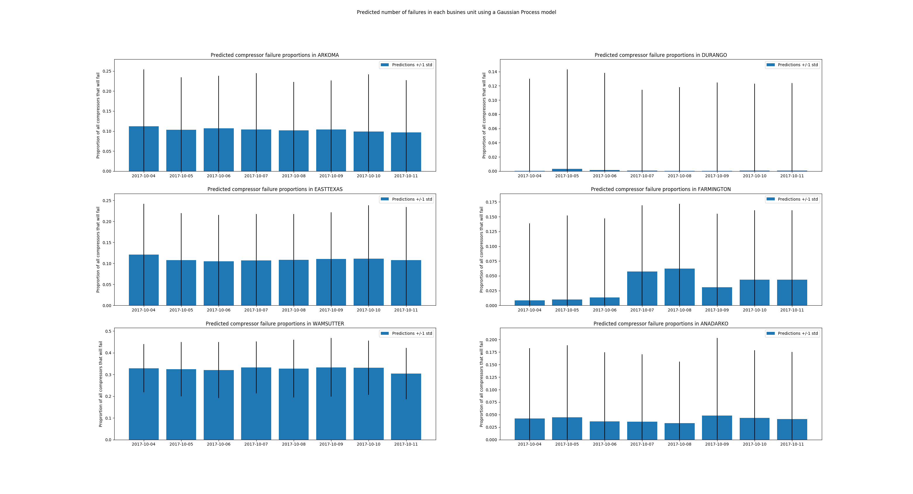
Using the Weather Forecast
Link to Github
Link to LinkedIn

Slide 15
Really Bad Assumptions
About the Data
The date that the failure was recorded was the same as the date of the failure
The weather at the general business unit station is indicative of the weather for all compressors in the business unit
The number of compressors in each business unit is constant throughout the year
Different compressor makes/models are similarly affected by weather
About the Model
Weather is the only factor affecting compressor failures
Less than one year of data is an accurate sample of all conditions
About the Approach
Summarizing the data by Business Unit is the best way to predict and view results

