Slide 1

LSMS Research Impact
Tracking Pipeline
Automated identification and validation of published research using LSMS survey data
Notes:
Welcome the audience and introduce the project in one sentence: this is an automated pipeline that finds every research paper that actually uses LSMS survey data, replacing a manual, spreadsheet based process that used to take significant staff time.

Slide 2
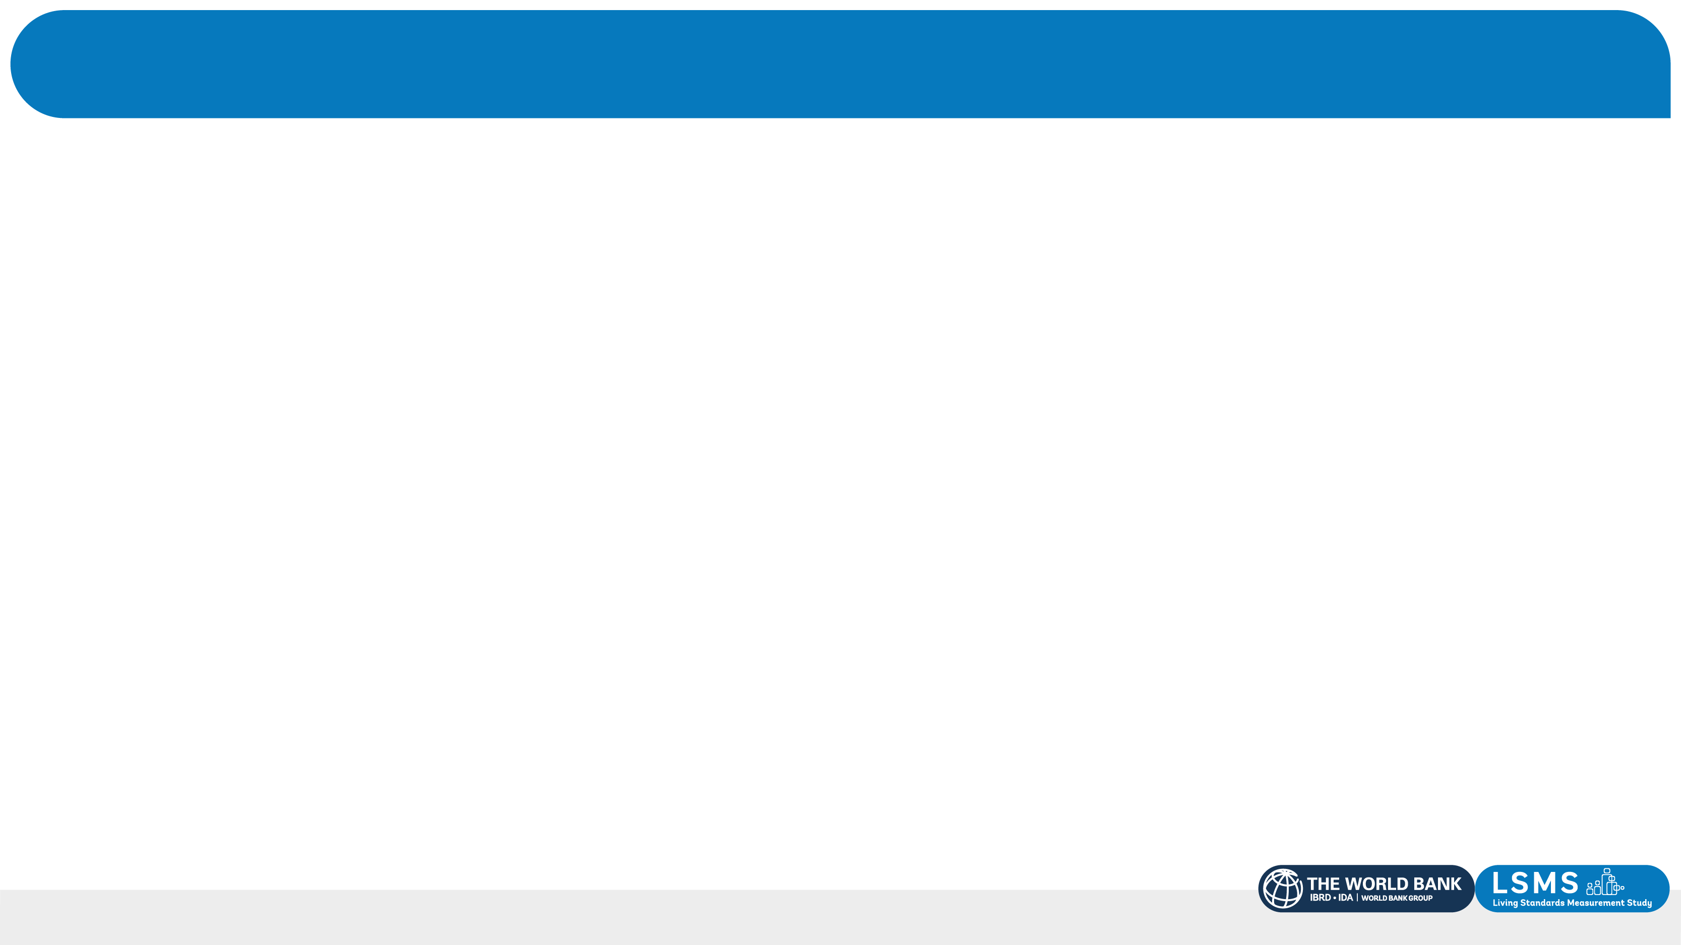

“Who is this?”
From Budapest, Hungary.
Yale M.P.P., and M.S. in Computer Science at Georgia Tech.
Dual Yale B.A., with a term at Cambridge along the way.
Previously UNICEF, the UN, and a few startups.
Race Canoeing, Travel, Live Music, Low-budget Shows
Bendegúz (“Ben”) Dörnyei
LSMS Survey Innovation Fellow
World Bank Group, Washington, DC
Notes:
Briefly introduce your background. From Budapest, Hungary. Currently pursuing an M.P.P. in Global Affairs at Yale and about to start an M.S. in Computer Science at Georgia Tech. Completed a dual B.A. in Global Affairs and Statistics and Data Science at Yale, including a study abroad term at Cambridge. Before joining the World Bank, worked at UNICEF's Global Shared Services Centre and at UN Headquarters, plus time at a few startups. Now serving as an LSMS Survey Innovation Fellow, building the pipeline covered in this presentation.

Slide 3
Incentive
Objectively measure the impact of LSMS data.
Goal: Find the TOTAL, FLOW and SHARE of papers using our surveys.
Notes:
The LSMS team needed an objective measure of how much published research actually uses LSMS survey data, and no single metric existed for this. The three headline metrics the branch needs are TOTAL (the full count of papers using an LSMS dataset across all years), FLOW (new papers per World Bank fiscal year), and SHARE (the percentage of papers with an African affiliated author). Citation counts do not reliably capture data use: a paper can cite the survey without ever touching the microdata, and a paper that does use the data does not always cite it in a way standard citation tracking can find. A previous, manual version of this tracking existed, but it depended on reviewing papers by hand and building results into a spreadsheet, which made it slow to repeat and hard to keep consistent across reviewers. On the technical choice: Google Scholar was considered first, but its programmatic access runs through a costly third party API. OpenAlex was selected instead: an open source, comprehensive index of scholarly literature, recommended by a Yale research librarian for peer reviewed coverage. Being open source keeps the API substantially cheaper, approximately $1.60 per full run, and the free tier allows about two runs per day. The project's core contribution goes beyond keyword search: rather than counting every paper that mentions LSMS, it tries to identify the papers that actually used the data.

Slide 4
Overview
Metrics
TOTAL, FLOW, and SHARE: papers using LSMS data, new papers per World Bank Group fiscal year, and the share with African affiliated authors.
Source
OpenAlex, covering journal articles, working papers, preprints, and grey literature, searched against title, abstract, and full text.
Matching
109 keywords in 10 survey families. Each keyword is assigned one of three tiers according to how ambiguous the term is in isolation.
Decision rule
Two independent axes, identity and use, each scored on a 2 point threshold. A paper is retained only if both axes clear the threshold.
Output
One Excel workbook: discovered papers, analysis with charts, keyword register, search audit trail, and every excluded paper with the reason.
Cost
Approximately $1.60 per full run. The free OpenAlex tier allows approximately two runs per day.
Notes:
Walk through the figure left to right. INPUT: The user supplies a free OpenAlex API key. The search runs against 109 keywords across the ten LSMS survey families. GATE 1, KEYWORD SEARCH: Recall is prioritized over precision at this stage, since missing a paper here is permanent while a false match just gets filtered later. Each keyword is assigned to one of three tiers based on how ambiguous the term is in isolation. Tier A (38 terms) covers unambiguous names like "Uganda National Panel Survey", accepted on a full text match alone. Tier B (28 terms) covers generic real names like "National Panel Survey", which require an LSMS country term and an allowed subject field. Tier C (43 terms) covers short acronyms like "IHPS" or "LSMS", which need the same gating as Tier B plus a case sensitivity check for acronym collisions. A key precision fix belongs here: OpenAlex applies stemming by default, which treats LSMS as equivalent to LSM, the standard abbreviation for land surface model. For a single fiscal year, the stemmed query returned 13,506 results; the correct, exact match count was 698. The acronym LSMS also collides with a neurological condition and other unrelated multi word phrases, which is why every query runs in exact match mode and Tier C keywords require country and subject field context rather than a bare acronym match. GATE 2, RELEVANCE SCORING: Every candidate paper is scored on two independent axes, Identity and Use, each on a 2 point threshold, and a paper is retained only if both axes clear the threshold. This design exists because a single combined score let a literature review that merely named the survey three times, written by a World Bank affiliated author, outscore a real empirical study that used the microdata. Identity signals: survey name in the title or abstract (strong, 2 points); terms matched from two or more survey families (strong, 2 points); admission on an unambiguous Tier A name (strong, 2 points); World Bank affiliated author (weak, 1 point, supporting only). Use signals: first person data use language within 40 words of the survey name (strong, 2 points); data use language in the abstract alongside the survey name (1 to 2 points depending on specificity); general empirical language with no survey named (capped at 1 point total, cannot carry a finding alone). EXCLUSION FILTER: Even after both gates, a handful of predictable false positive patterns get filtered out. Transitive citation: the paper cites another paper that uses LSMS data without touching the microdata itself. Survey or meta-analysis inclusion: a broader literature review lists an LSMS using paper among many others without analyzing the microdata directly. Negative or contrastive mention: the survey is named only to argue against it, for example "despite LSMS efforts". Unsupported data citation: the paper lists the dataset as a source but shows no evidence of engaging with it, sometimes a sign the citation was generated without ever using the data. OUTPUT: One Excel workbook, covered on a later slide.

Slide 5
How the Pipeline Works
Five stages, from a free API key to a validated Excel workbook.
→
→
→
→
Input
Gate 1
Gate 2
Exclusion Filter
Output
OpenAlex API key,
109 keywords
Keyword
search
Relevance
scoring
Remove false
positives
Excel
workbook
Notes:
Walk through the figure left to right. INPUT: The user supplies a free OpenAlex API key. The search runs against 109 keywords across the ten LSMS survey families. GATE 1, KEYWORD SEARCH: Recall is prioritized over precision at this stage, since missing a paper here is permanent while a false match just gets filtered later. Each keyword is assigned to one of three tiers based on how ambiguous the term is in isolation. Tier A (38 terms) covers unambiguous names like "Uganda National Panel Survey", accepted on a full text match alone. Tier B (28 terms) covers generic real names like "National Panel Survey", which require an LSMS country term and an allowed subject field. Tier C (43 terms) covers short acronyms like "IHPS" or "LSMS", which need the same gating as Tier B plus a case sensitivity check for acronym collisions. A key precision fix belongs here: OpenAlex applies stemming by default, which treats LSMS as equivalent to LSM, the standard abbreviation for land surface model. For a single fiscal year, the stemmed query returned 13,506 results; the correct, exact match count was 698. The acronym LSMS also collides with a neurological condition and other unrelated multi word phrases, which is why every query runs in exact match mode and Tier C keywords require country and subject field context rather than a bare acronym match. GATE 2, RELEVANCE SCORING: Every candidate paper is scored on two independent axes, Identity and Use, each on a 2 point threshold, and a paper is retained only if both axes clear the threshold. This design exists because a single combined score let a literature review that merely named the survey three times, written by a World Bank affiliated author, outscore a real empirical study that used the microdata. Identity signals: survey name in the title or abstract (strong, 2 points); terms matched from two or more survey families (strong, 2 points); admission on an unambiguous Tier A name (strong, 2 points); World Bank affiliated author (weak, 1 point, supporting only). Use signals: first person data use language within 40 words of the survey name (strong, 2 points); data use language in the abstract alongside the survey name (1 to 2 points depending on specificity); general empirical language with no survey named (capped at 1 point total, cannot carry a finding alone). EXCLUSION FILTER: Even after both gates, a handful of predictable false positive patterns get filtered out. Transitive citation: the paper cites another paper that uses LSMS data without touching the microdata itself. Survey or meta-analysis inclusion: a broader literature review lists an LSMS using paper among many others without analyzing the microdata directly. Negative or contrastive mention: the survey is named only to argue against it, for example "despite LSMS efforts". Unsupported data citation: the paper lists the dataset as a source but shows no evidence of engaging with it, sometimes a sign the citation was generated without ever using the data. OUTPUT: One Excel workbook, covered on a later slide.

Slide 6
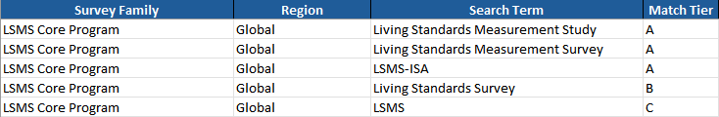
Discovery: Keyword Search (Gate 1)
APPROACH
109 keywords across the ten survey families, derived from the team’s existing keyword list.
Recall is prioritized over precision at this stage. Missing a paper here is permanent; an irrelevant match is filtered in Gate 2.
Each keyword is assigned to one of three tiers by how ambiguous the term is in isolation.
Tier
Terms
Example
Matching rule
A
38
"Uganda National Panel Survey", "LSMS-ISA"
Full-text match accepted without additional context.
B
28
"National Panel Survey", "Living Standards Survey"
Requires an LSMS country term and an allowed subject field.
C
43
"IHPS", "LSMS", "UNPS", "ESS4"
Same gating as Tier B, plus a case-sensitivity check for acronym collisions.
Notes:
Walk through the figure left to right. INPUT: The user supplies a free OpenAlex API key. The search runs against 109 keywords across the ten LSMS survey families. GATE 1, KEYWORD SEARCH: Recall is prioritized over precision at this stage, since missing a paper here is permanent while a false match just gets filtered later. Each keyword is assigned to one of three tiers based on how ambiguous the term is in isolation. Tier A (38 terms) covers unambiguous names like "Uganda National Panel Survey", accepted on a full text match alone. Tier B (28 terms) covers generic real names like "National Panel Survey", which require an LSMS country term and an allowed subject field. Tier C (43 terms) covers short acronyms like "IHPS" or "LSMS", which need the same gating as Tier B plus a case sensitivity check for acronym collisions. A key precision fix belongs here: OpenAlex applies stemming by default, which treats LSMS as equivalent to LSM, the standard abbreviation for land surface model. For a single fiscal year, the stemmed query returned 13,506 results; the correct, exact match count was 698. The acronym LSMS also collides with a neurological condition and other unrelated multi word phrases, which is why every query runs in exact match mode and Tier C keywords require country and subject field context rather than a bare acronym match. GATE 2, RELEVANCE SCORING: Every candidate paper is scored on two independent axes, Identity and Use, each on a 2 point threshold, and a paper is retained only if both axes clear the threshold. This design exists because a single combined score let a literature review that merely named the survey three times, written by a World Bank affiliated author, outscore a real empirical study that used the microdata. Identity signals: survey name in the title or abstract (strong, 2 points); terms matched from two or more survey families (strong, 2 points); admission on an unambiguous Tier A name (strong, 2 points); World Bank affiliated author (weak, 1 point, supporting only). Use signals: first person data use language within 40 words of the survey name (strong, 2 points); data use language in the abstract alongside the survey name (1 to 2 points depending on specificity); general empirical language with no survey named (capped at 1 point total, cannot carry a finding alone). EXCLUSION FILTER: Even after both gates, a handful of predictable false positive patterns get filtered out. Transitive citation: the paper cites another paper that uses LSMS data without touching the microdata itself. Survey or meta-analysis inclusion: a broader literature review lists an LSMS using paper among many others without analyzing the microdata directly. Negative or contrastive mention: the survey is named only to argue against it, for example "despite LSMS efforts". Unsupported data citation: the paper lists the dataset as a source but shows no evidence of engaging with it, sometimes a sign the citation was generated without ever using the data. OUTPUT: One Excel workbook, covered on a later slide.

Slide 7
Relevance Scoring: Identity and Use Signals (Gate 2)
IDENTITY SCORE
USE SCORE
Is this really one of our surveys, or still a name collision?
Strong (2pts) examples:
Matched terms from multiple survey families
Matched two or more survey variants of one survey family
World Bank affiliated author
Weak (1 pt) examples:
An LSMS country is named in the title or abstract
An LSMS country is named around the keyword (full-text)
Did the authors actually work with the microdata, or do they only mention it?
Strong (2 pt) examples:
First-person data use language within 40 words of keyword (“we use”, “using data from”, “microdata”)
Uses microdata URL
Weak (1 p) examples:
Abstract names the survey AND uses weaker or broader data-source language (“World Bank”)
A paper is retained only if identity and use both reach a threshold of 2 points.
Notes:
Walk through the figure left to right. INPUT: The user supplies a free OpenAlex API key. The search runs against 109 keywords across the ten LSMS survey families. GATE 1, KEYWORD SEARCH: Recall is prioritized over precision at this stage, since missing a paper here is permanent while a false match just gets filtered later. Each keyword is assigned to one of three tiers based on how ambiguous the term is in isolation. Tier A (38 terms) covers unambiguous names like "Uganda National Panel Survey", accepted on a full text match alone. Tier B (28 terms) covers generic real names like "National Panel Survey", which require an LSMS country term and an allowed subject field. Tier C (43 terms) covers short acronyms like "IHPS" or "LSMS", which need the same gating as Tier B plus a case sensitivity check for acronym collisions. A key precision fix belongs here: OpenAlex applies stemming by default, which treats LSMS as equivalent to LSM, the standard abbreviation for land surface model. For a single fiscal year, the stemmed query returned 13,506 results; the correct, exact match count was 698. The acronym LSMS also collides with a neurological condition and other unrelated multi word phrases, which is why every query runs in exact match mode and Tier C keywords require country and subject field context rather than a bare acronym match. GATE 2, RELEVANCE SCORING: Every candidate paper is scored on two independent axes, Identity and Use, each on a 2 point threshold, and a paper is retained only if both axes clear the threshold. This design exists because a single combined score let a literature review that merely named the survey three times, written by a World Bank affiliated author, outscore a real empirical study that used the microdata. Identity signals: survey name in the title or abstract (strong, 2 points); terms matched from two or more survey families (strong, 2 points); admission on an unambiguous Tier A name (strong, 2 points); World Bank affiliated author (weak, 1 point, supporting only). Use signals: first person data use language within 40 words of the survey name (strong, 2 points); data use language in the abstract alongside the survey name (1 to 2 points depending on specificity); general empirical language with no survey named (capped at 1 point total, cannot carry a finding alone). EXCLUSION FILTER: Even after both gates, a handful of predictable false positive patterns get filtered out. Transitive citation: the paper cites another paper that uses LSMS data without touching the microdata itself. Survey or meta-analysis inclusion: a broader literature review lists an LSMS using paper among many others without analyzing the microdata directly. Negative or contrastive mention: the survey is named only to argue against it, for example "despite LSMS efforts". Unsupported data citation: the paper lists the dataset as a source but shows no evidence of engaging with it, sometimes a sign the citation was generated without ever using the data. OUTPUT: One Excel workbook, covered on a later slide.

Slide 8
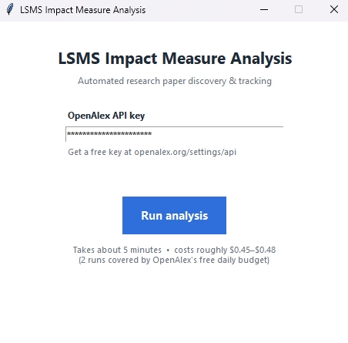
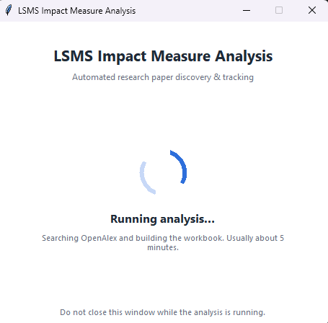
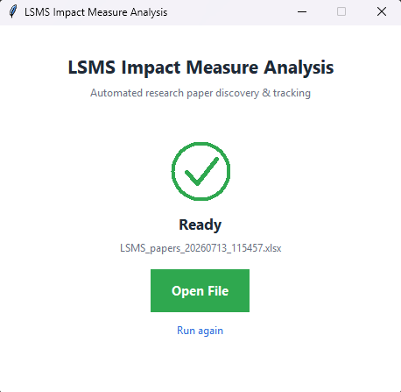
The Product
1. Start
2. Run (~5 min)
3. Complete
Output: one Excel workbook with six sheets, Papers, Analysis, FY Trend, Keywords, Search Log, and Not Relevant (Backup).
Notes:
Walk through the three screenshots: the user pastes a free API key and clicks Run; the pipeline searches OpenAlex and builds the workbook, which takes about five minutes; when it finishes, the workbook opens directly from the interface. The output is one Excel workbook with six sheets. Papers: one row per discovered paper, including title, DOI, authors, institutional affiliations, publication year and fiscal year, dataset country, research topic, peer review status, journal tier, identity and use scores, and the individual signals that fired. Analysis: headline FLOW and Africa SHARE figures, a breakdown by match tier and by the identity and use axes, and the summary charts. FY Trend: papers per World Bank fiscal year, with the current, still open fiscal year excluded so the trend is not distorted by a partial year. Keywords: all 109 keywords, each with its tier, matching rule, required country context, and the exact OpenAlex query sent. Search Log: an audit trail of every query run, when it ran, and how many raw results it returned before filtering. Not Relevant (Backup): papers that matched a keyword but scored below threshold, excluded from all headline counts and charts but kept for future review.

Slide 9
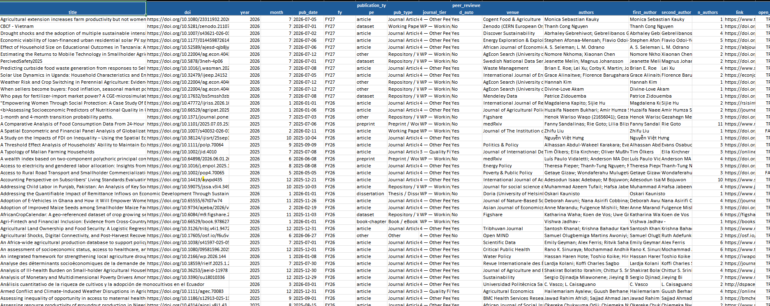
Output: Papers Sheet
Data available for each paper:
title,
DOI, and OpenAlex URL,
authors,
institutional affiliations,
publication year/ WBG FY,
dataset country, WBG global region
research affiliate countries,
research topic,
full abstract,
peer-reviewed / working-paper,
journal tier,
survey family,
keywords that matched,
match tier (A/B/C) and reason (in abstract, etc.),
the identity and use scores and the added relevance score
Notes:
Walk through the three screenshots: the user pastes a free API key and clicks Run; the pipeline searches OpenAlex and builds the workbook, which takes about five minutes; when it finishes, the workbook opens directly from the interface. The output is one Excel workbook with six sheets. Papers: one row per discovered paper, including title, DOI, authors, institutional affiliations, publication year and fiscal year, dataset country, research topic, peer review status, journal tier, identity and use scores, and the individual signals that fired. Analysis: headline FLOW and Africa SHARE figures, a breakdown by match tier and by the identity and use axes, and the summary charts. FY Trend: papers per World Bank fiscal year, with the current, still open fiscal year excluded so the trend is not distorted by a partial year. Keywords: all 109 keywords, each with its tier, matching rule, required country context, and the exact OpenAlex query sent. Search Log: an audit trail of every query run, when it ran, and how many raw results it returned before filtering. Not Relevant (Backup): papers that matched a keyword but scored below threshold, excluded from all headline counts and charts but kept for future review.

Slide 10
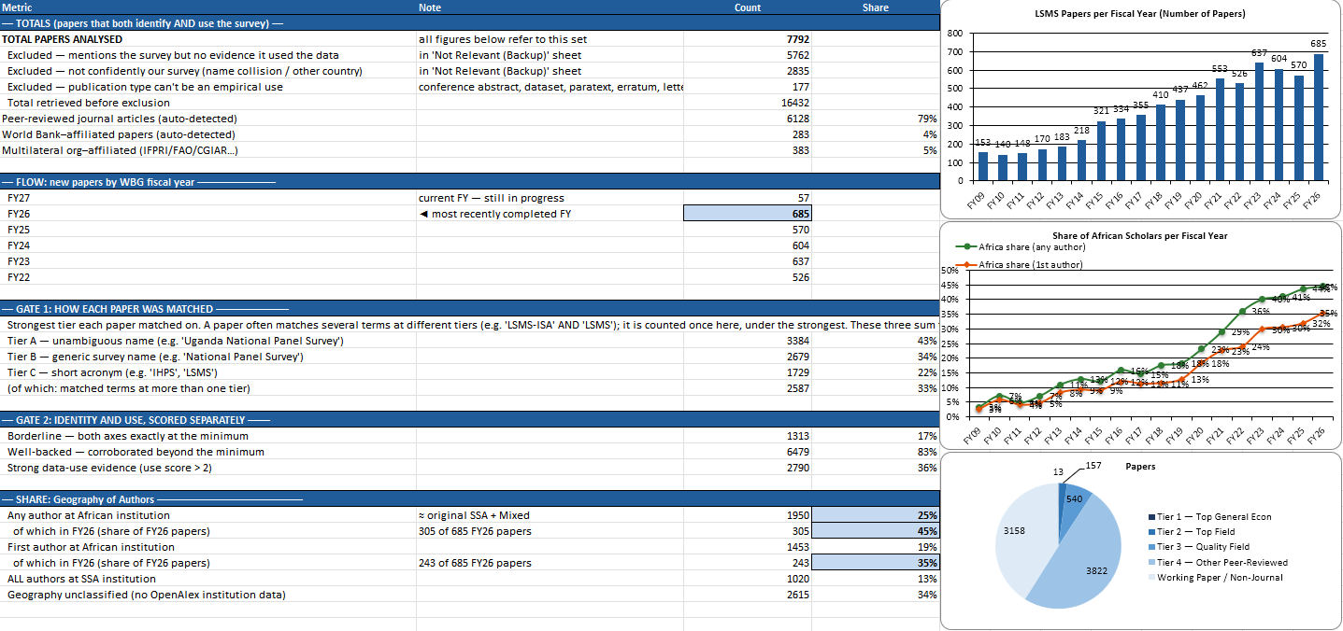
Output: Automatic Analysis Sheet
Includes key metrics, such as the TOTAL, FLOW, and SHARE
Notes:
Walk through the three screenshots: the user pastes a free API key and clicks Run; the pipeline searches OpenAlex and builds the workbook, which takes about five minutes; when it finishes, the workbook opens directly from the interface. The output is one Excel workbook with six sheets. Papers: one row per discovered paper, including title, DOI, authors, institutional affiliations, publication year and fiscal year, dataset country, research topic, peer review status, journal tier, identity and use scores, and the individual signals that fired. Analysis: headline FLOW and Africa SHARE figures, a breakdown by match tier and by the identity and use axes, and the summary charts. FY Trend: papers per World Bank fiscal year, with the current, still open fiscal year excluded so the trend is not distorted by a partial year. Keywords: all 109 keywords, each with its tier, matching rule, required country context, and the exact OpenAlex query sent. Search Log: an audit trail of every query run, when it ran, and how many raw results it returned before filtering. Not Relevant (Backup): papers that matched a keyword but scored below threshold, excluded from all headline counts and charts but kept for future review.

Slide 11
Product Strengths
MANUAL VALIDATION
SOURCE
RICH DATA
52 / 55
OpenAlex
45
papers agree with decision based on manual, paper-by-paper review
distinct, useful indicators displayed for each paper
free, non-profit, open-source, and open-data
Notes:
These numbers come from testing the pipeline against papers that had already been assessed by hand. Candidate data use phrases were tested against a 36 paper set already assessed by hand, to decide which phrases actually signal use. Agreement with manual, paper by paper assessment was then measured on a separate 28 paper review set: 22 of the 28 agree. Two candidate phrases, "this paper uses" and "based on the", were removed after testing showed they were more common in citations than in genuine use. On the exact match fix: switching from OpenAlex's default stemmed search to exact match search cut a single fiscal year's raw result count from 13,506 to 698, a reduction of about 95 percent, by eliminating the land surface model collision. Approximate cost is $1.60 per full run, and the free OpenAlex tier covers about two runs a day.

Slide 12


Status and Next Steps
DELIVERED
KNOWN LIMITATIONS
FUTURE POTENTIAL
TOTAL, FLOW, and SHARE, automated in place of manual tracking
Easy-to-use interface
Free tor run daily
Fast (5-10 minutes to run)
Clear trail of inclusion criteria
45 distinct, useful indicators displayed for each paper
Automatic analysis
Reference-only matches, difficult to exclude precisely
Full-text source coverage is limited to Open-Source papers (90.2% Open Access 7029/7792, in Non-Relevant it’s even higher, 94%)
Automatic weekly updating website with dashboard
Further data analysis and graphs based on the 45 indicators
Increased precision of inclusion-exclusion criteria using LLMs to help decide the corner cases
Notes:
Delivered: TOTAL, FLOW, and SHARE are now produced automatically in place of manual tracking, using the two axis identity and use scoring, with a full audit trail (keyword register, search log, and excluded paper backup). Known gaps: two patterns still slip through occasionally. Reference-only matches: a citation carries the survey's name without indicating use; four papers in the review set are counted this way in error. Unindexed data statements: some papers declare data use in a table or section OpenAlex has not indexed; in one verified case, the full survey name is entirely absent from the index while the acronym alone is present. Europe PMC was tested as an alternative full text source; it separates use from mention correctly where covered, but only covers 4 of the 10 sample papers in this corpus, so closing both gaps needs a full text source with broader coverage of development and agricultural economics, not further tuning of the current signals. Next steps: move country and context requirements into the OpenAlex query itself, using boolean and proximity search against full text; update the README and user documentation to reflect the current tier system; continue regression testing against flagged papers to improve recall.

Slide 13
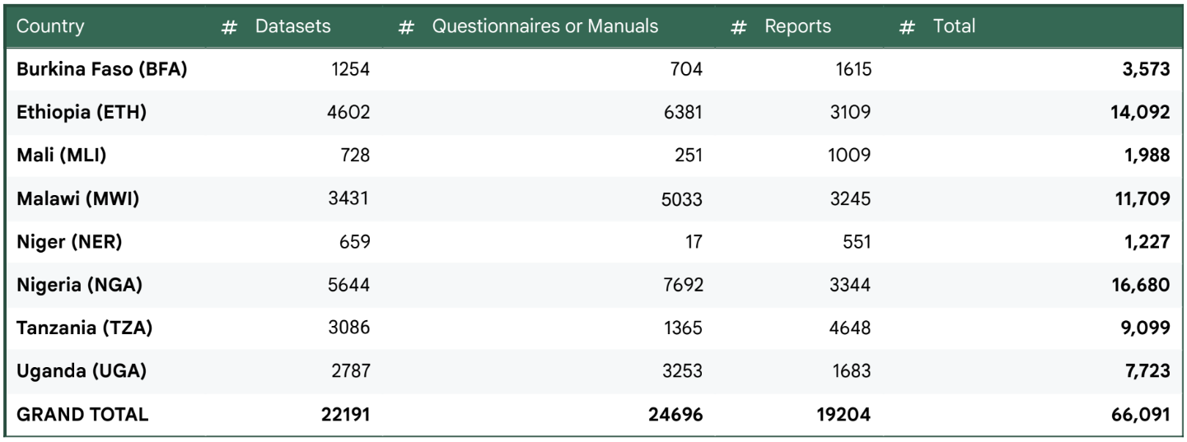
Other projects (1): LSMS Microdata Library Analysis
(Data Download Aggregates by Survey Country and Type of Product)
Notes:
Delivered: TOTAL, FLOW, and SHARE are now produced automatically in place of manual tracking, using the two axis identity and use scoring, with a full audit trail (keyword register, search log, and excluded paper backup). Known gaps: two patterns still slip through occasionally. Reference-only matches: a citation carries the survey's name without indicating use; four papers in the review set are counted this way in error. Unindexed data statements: some papers declare data use in a table or section OpenAlex has not indexed; in one verified case, the full survey name is entirely absent from the index while the acronym alone is present. Europe PMC was tested as an alternative full text source; it separates use from mention correctly where covered, but only covers 4 of the 10 sample papers in this corpus, so closing both gaps needs a full text source with broader coverage of development and agricultural economics, not further tuning of the current signals. Next steps: move country and context requirements into the OpenAlex query itself, using boolean and proximity search against full text; update the README and user documentation to reflect the current tier system; continue regression testing against flagged papers to improve recall.

Slide 14
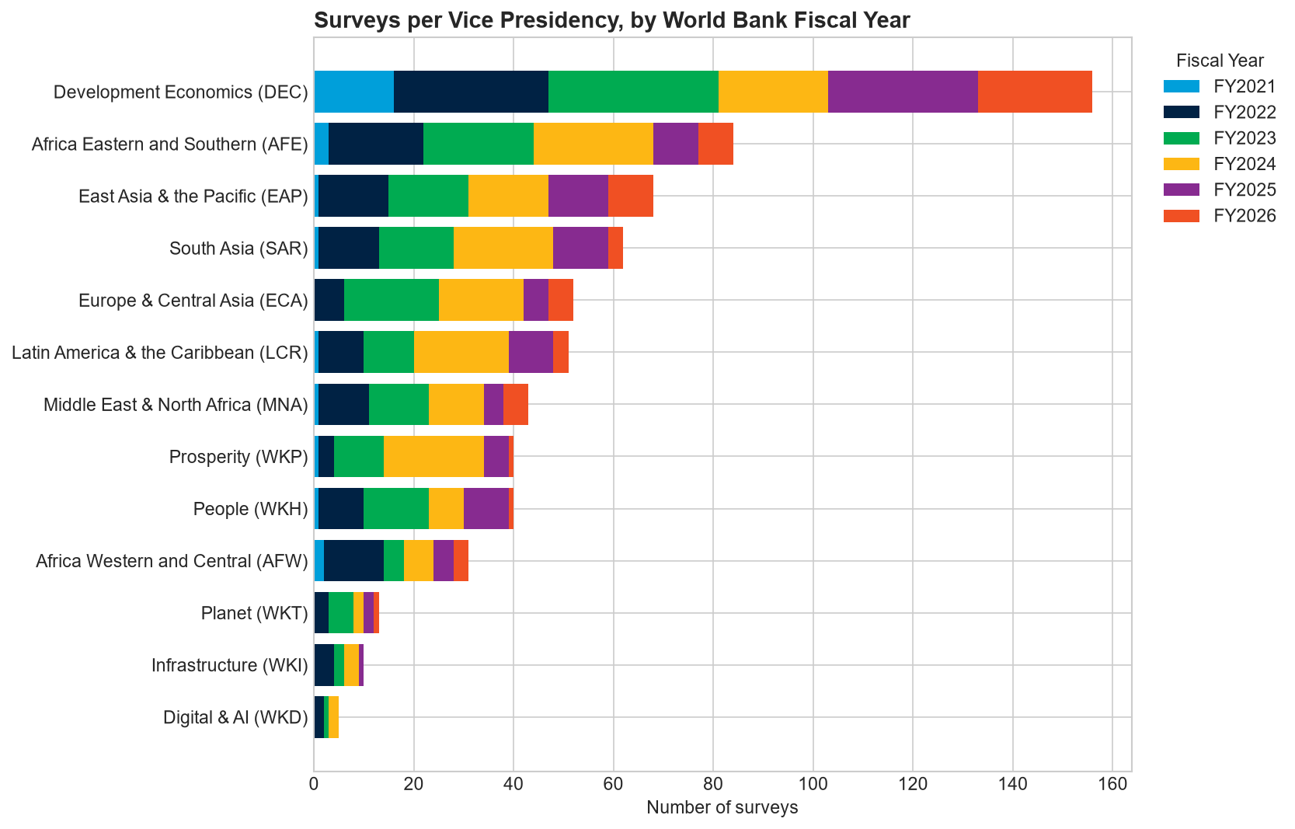
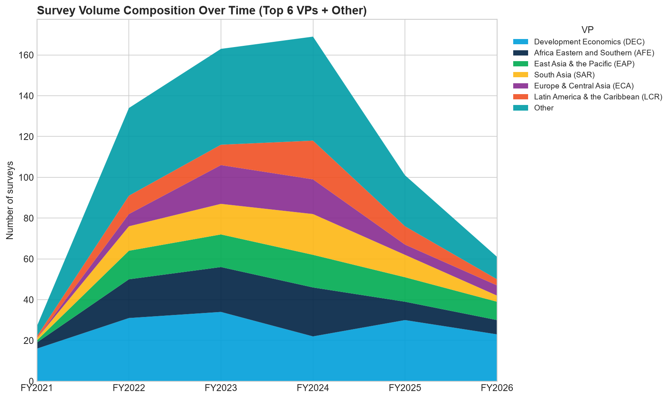
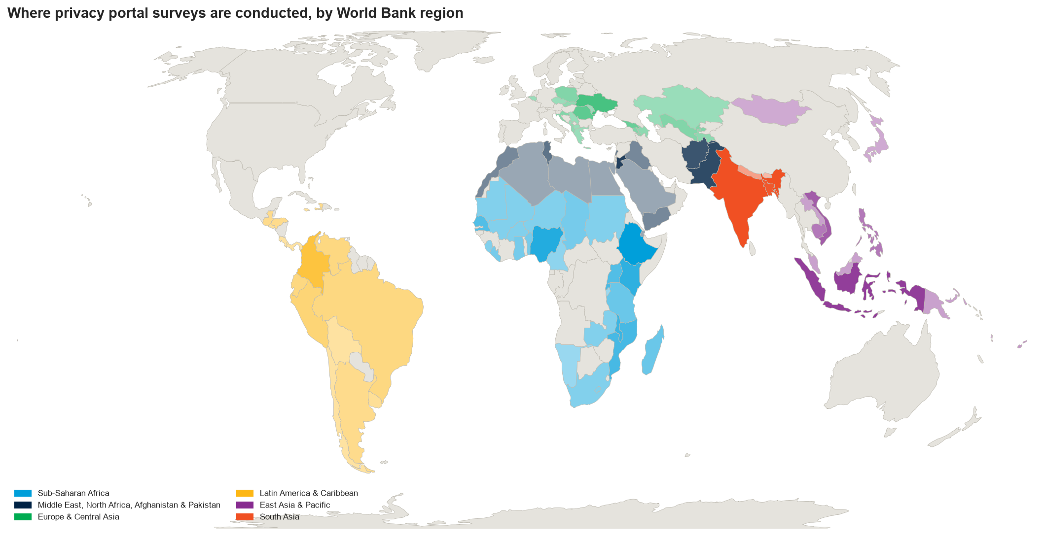
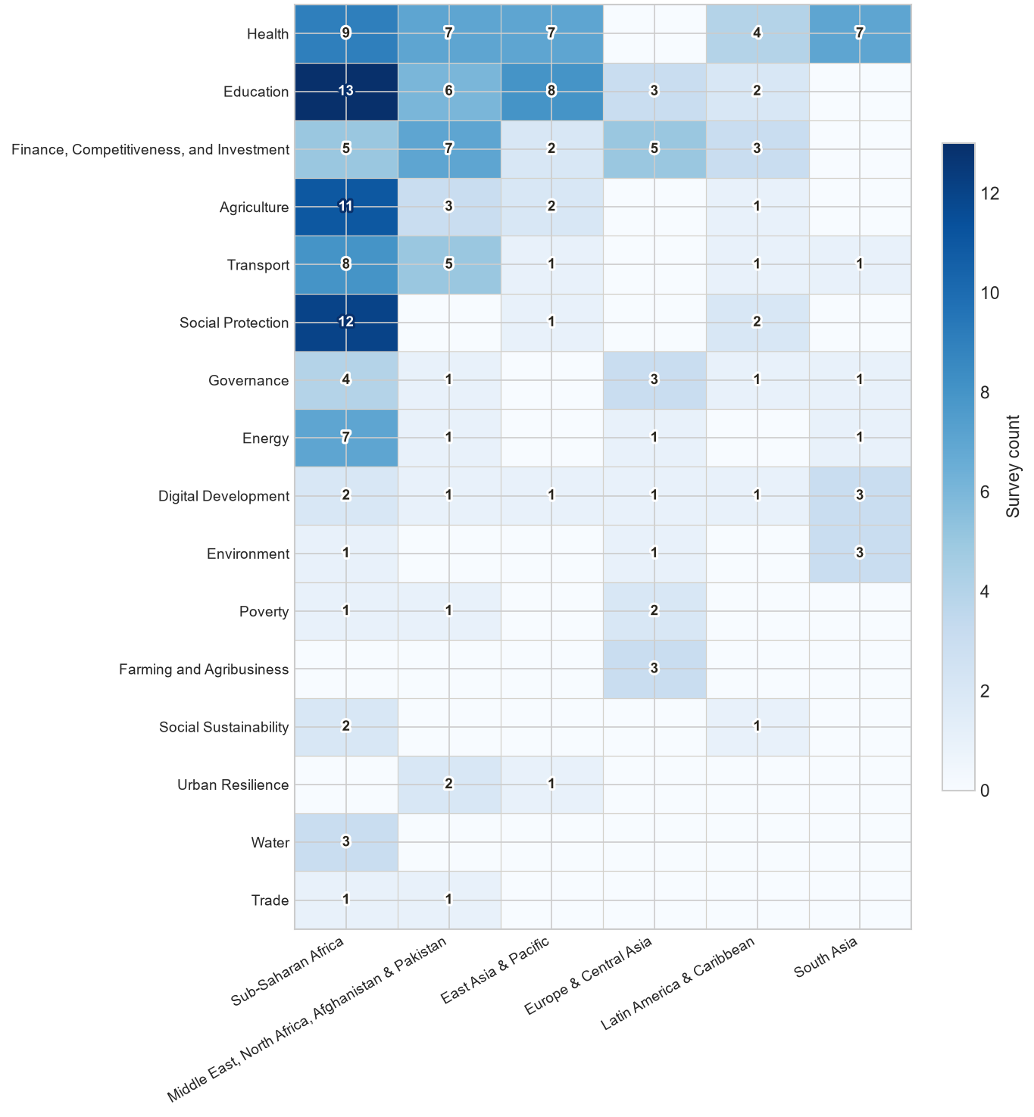
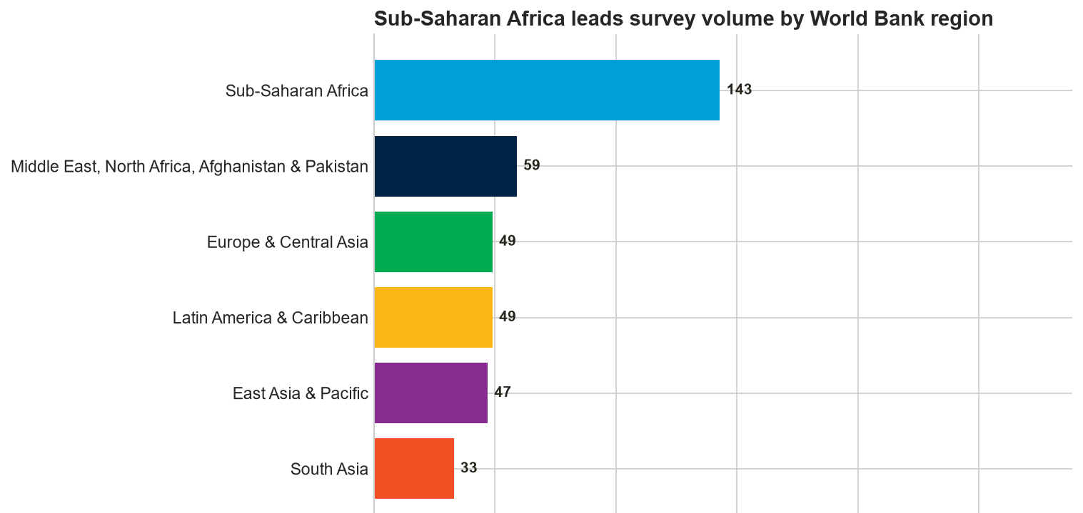
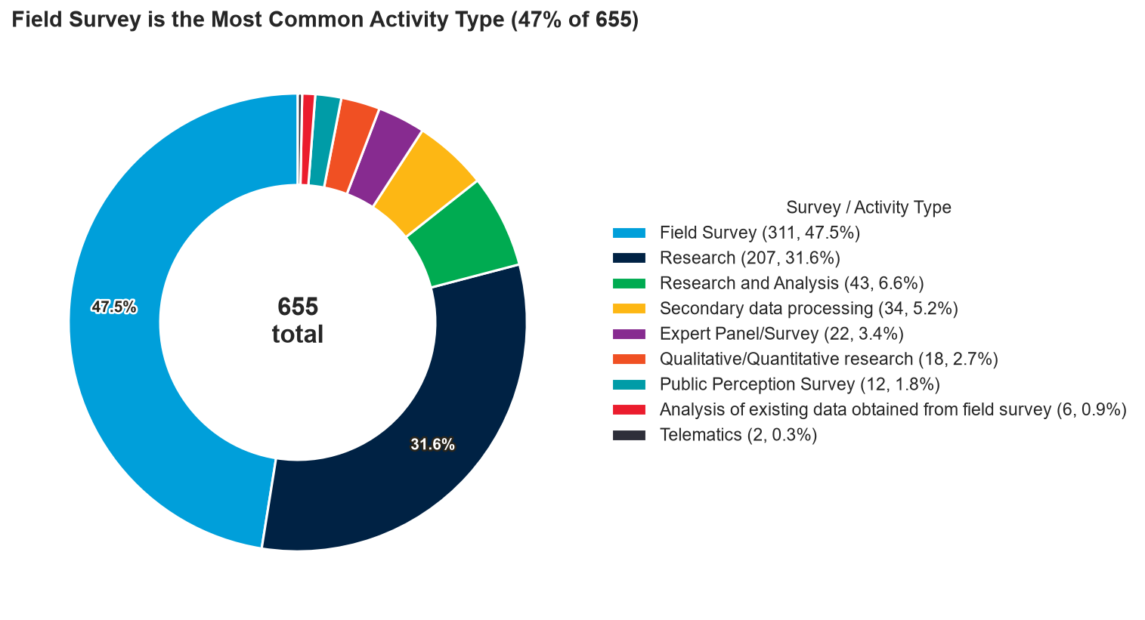
Other projects (2): Privacy Portal Data
Notes:
Delivered: TOTAL, FLOW, and SHARE are now produced automatically in place of manual tracking, using the two axis identity and use scoring, with a full audit trail (keyword register, search log, and excluded paper backup). Known gaps: two patterns still slip through occasionally. Reference-only matches: a citation carries the survey's name without indicating use; four papers in the review set are counted this way in error. Unindexed data statements: some papers declare data use in a table or section OpenAlex has not indexed; in one verified case, the full survey name is entirely absent from the index while the acronym alone is present. Europe PMC was tested as an alternative full text source; it separates use from mention correctly where covered, but only covers 4 of the 10 sample papers in this corpus, so closing both gaps needs a full text source with broader coverage of development and agricultural economics, not further tuning of the current signals. Next steps: move country and context requirements into the OpenAlex query itself, using boolean and proximity search against full text; update the README and user documentation to reflect the current tier system; continue regression testing against flagged papers to improve recall.

Slide 15
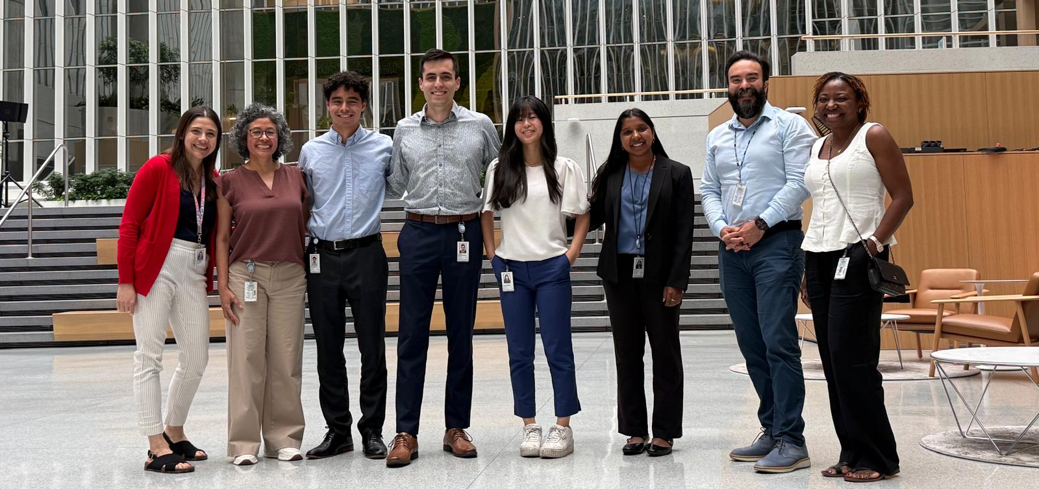
Thank you!
Notes:
Delivered: TOTAL, FLOW, and SHARE are now produced automatically in place of manual tracking, using the two axis identity and use scoring, with a full audit trail (keyword register, search log, and excluded paper backup). Known gaps: two patterns still slip through occasionally. Reference-only matches: a citation carries the survey's name without indicating use; four papers in the review set are counted this way in error. Unindexed data statements: some papers declare data use in a table or section OpenAlex has not indexed; in one verified case, the full survey name is entirely absent from the index while the acronym alone is present. Europe PMC was tested as an alternative full text source; it separates use from mention correctly where covered, but only covers 4 of the 10 sample papers in this corpus, so closing both gaps needs a full text source with broader coverage of development and agricultural economics, not further tuning of the current signals. Next steps: move country and context requirements into the OpenAlex query itself, using boolean and proximity search against full text; update the README and user documentation to reflect the current tier system; continue regression testing against flagged papers to improve recall.

Slide 16
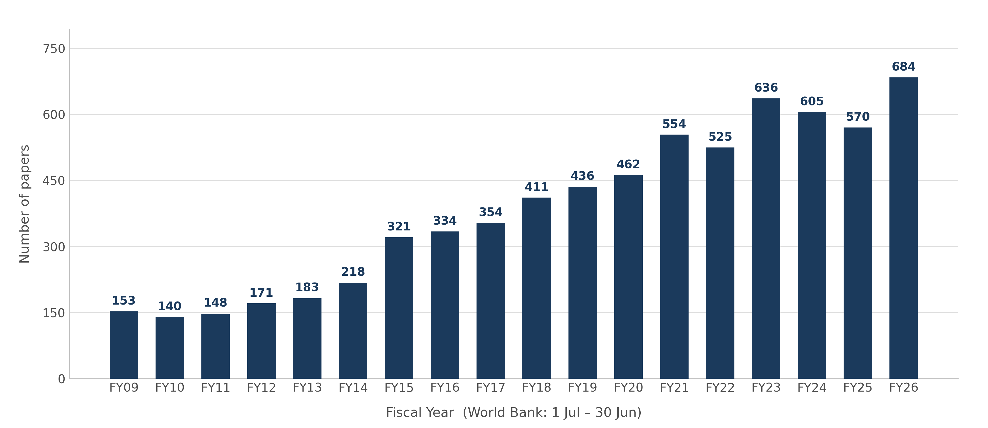
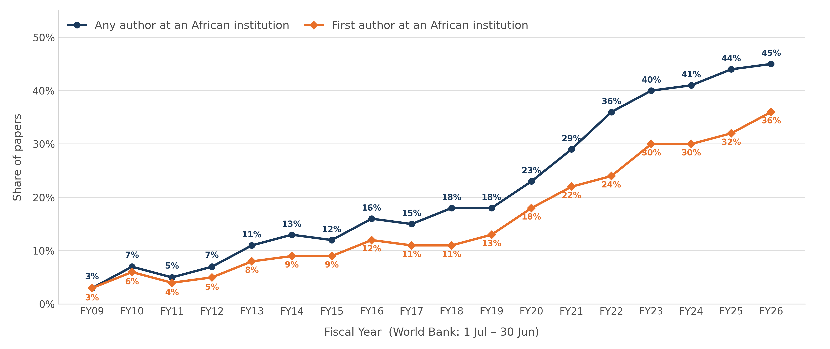
Output: Key Metrics
“TOTAL” – Total # of publications using LSMS data (FY80-FY26): 7792
“FLOW” – New papers per FY using LSMS data FY09-FY26
“SHARE” – Share of African research affiliations FY09-FY26
Notes:
Walk through the three screenshots: the user pastes a free API key and clicks Run; the pipeline searches OpenAlex and builds the workbook, which takes about five minutes; when it finishes, the workbook opens directly from the interface. The output is one Excel workbook with six sheets. Papers: one row per discovered paper, including title, DOI, authors, institutional affiliations, publication year and fiscal year, dataset country, research topic, peer review status, journal tier, identity and use scores, and the individual signals that fired. Analysis: headline FLOW and Africa SHARE figures, a breakdown by match tier and by the identity and use axes, and the summary charts. FY Trend: papers per World Bank fiscal year, with the current, still open fiscal year excluded so the trend is not distorted by a partial year. Keywords: all 109 keywords, each with its tier, matching rule, required country context, and the exact OpenAlex query sent. Search Log: an audit trail of every query run, when it ran, and how many raw results it returned before filtering. Not Relevant (Backup): papers that matched a keyword but scored below threshold, excluded from all headline counts and charts but kept for future review.

Slide 17
Exclusion Filter (Gate “2+”)
COMMON FALSE POSITIVES
Transitive citation
The paper cites another paper that uses LSMS data, without touching the microdata itself. The survey name enters only through a second order reference.
Survey or meta-analysis inclusion
A broader literature review lists an LSMS-using paper among many others, without analyzing the microdata directly. The review itself is not a data user.
Negative or contrastive mention
The survey is named only to argue against it or contrast with it, for example "despite LSMS efforts." The mention signals awareness, not use.
Unsupported data citation
The paper lists the dataset as a source but shows no evidence of engaging with it, sometimes a sign the citation was generated without ever using the data.
Notes:
Walk through the figure left to right. INPUT: The user supplies a free OpenAlex API key. The search runs against 109 keywords across the ten LSMS survey families. GATE 1, KEYWORD SEARCH: Recall is prioritized over precision at this stage, since missing a paper here is permanent while a false match just gets filtered later. Each keyword is assigned to one of three tiers based on how ambiguous the term is in isolation. Tier A (38 terms) covers unambiguous names like "Uganda National Panel Survey", accepted on a full text match alone. Tier B (28 terms) covers generic real names like "National Panel Survey", which require an LSMS country term and an allowed subject field. Tier C (43 terms) covers short acronyms like "IHPS" or "LSMS", which need the same gating as Tier B plus a case sensitivity check for acronym collisions. A key precision fix belongs here: OpenAlex applies stemming by default, which treats LSMS as equivalent to LSM, the standard abbreviation for land surface model. For a single fiscal year, the stemmed query returned 13,506 results; the correct, exact match count was 698. The acronym LSMS also collides with a neurological condition and other unrelated multi word phrases, which is why every query runs in exact match mode and Tier C keywords require country and subject field context rather than a bare acronym match. GATE 2, RELEVANCE SCORING: Every candidate paper is scored on two independent axes, Identity and Use, each on a 2 point threshold, and a paper is retained only if both axes clear the threshold. This design exists because a single combined score let a literature review that merely named the survey three times, written by a World Bank affiliated author, outscore a real empirical study that used the microdata. Identity signals: survey name in the title or abstract (strong, 2 points); terms matched from two or more survey families (strong, 2 points); admission on an unambiguous Tier A name (strong, 2 points); World Bank affiliated author (weak, 1 point, supporting only). Use signals: first person data use language within 40 words of the survey name (strong, 2 points); data use language in the abstract alongside the survey name (1 to 2 points depending on specificity); general empirical language with no survey named (capped at 1 point total, cannot carry a finding alone). EXCLUSION FILTER: Even after both gates, a handful of predictable false positive patterns get filtered out. Transitive citation: the paper cites another paper that uses LSMS data without touching the microdata itself. Survey or meta-analysis inclusion: a broader literature review lists an LSMS using paper among many others without analyzing the microdata directly. Negative or contrastive mention: the survey is named only to argue against it, for example "despite LSMS efforts". Unsupported data citation: the paper lists the dataset as a source but shows no evidence of engaging with it, sometimes a sign the citation was generated without ever using the data. OUTPUT: One Excel workbook, covered on a later slide.

