Slide 1
An LLM-enhanced Topic Modelling Pipeline
Brandon Loh, A-STAR

Slide 2
A Typical Topic Modelling Pipeline
SOCIAL MEDIA POSTS ON SICSS
Insightful talk by Prof X at SICSS
what is Brandon talking about?
…
Looking forward to meeting new people at SICSS
SUMMARY OF POSTS
Feedback on talk
networking
…
“Embed” each message
Cluster message embeddings
Interpret clusters
Notes:
Noisy Text embedding :
People describe similar phenomena in vastly different ways.
People use similar words to describe different things (nouns, conjunctions)
Statistical regularities in text embeddings to not reflect the statistical regularity that the researcher cares about
Since clustering / dimension reduction algorithms

Slide 3
A Typical Topic Modelling Pipeline
SOCIAL MEDIA POSTS ON SICSS
Insightful talk by Prof X at SICSS
what is Brandon talking about?
…
Looking forward to meeting new people at SICSS
SUMMARY OF POSTS
Feedback on talk
networking
…
“Embed” each message
Cluster message embeddings
Interpret clusters
1
insightful | SICSS | … | talk*
1 | 1 | … | 1
0 | 0 | … | 1
…
0 | 1 | … | 0
Notes:
Noisy Text embedding :
People describe similar phenomena in vastly different ways.
People use similar words to describe different things (nouns, conjunctions)
Statistical regularities in text embeddings to not reflect the statistical regularity that the researcher cares about
Since clustering / dimension reduction algorithms

Slide 4
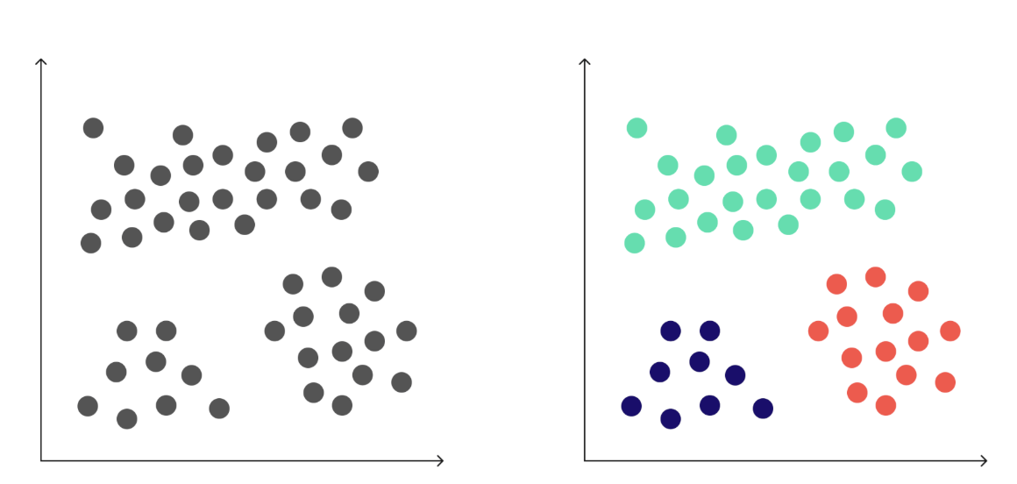
A Typical Topic Modelling Pipeline
SOCIAL MEDIA POSTS ON SICSS
Insightful talk by Prof X at SICSS
what is Brandon talking about?
…
Looking forward to meeting new people at SICSS
SUMMARY OF POSTS
Feedback on talk
networking
…
“Embed” each message
Cluster message embeddings
Interpret clusters
1
2
Notes:
Noisy Text embedding :
People describe similar phenomena in vastly different ways.
People use similar words to describe different things (nouns, conjunctions)
Statistical regularities in text embeddings to not reflect the statistical regularity that the researcher cares about
Since clustering / dimension reduction algorithms

Slide 5

A Typical Topic Modelling Pipeline
SOCIAL MEDIA POSTS ON SICSS
Insightful talk by Prof X at SICSS
what is Brandon talking about?
…
Looking forward to meeting new people at SICSS
SUMMARY OF POSTS
Feedback on talk
networking
…
“Embed” each message
Cluster message embeddings
Interpret clusters
1
2
3
Notes:
Noisy Text embedding :
People describe similar phenomena in vastly different ways.
People use similar words to describe different things (nouns, conjunctions)
Statistical regularities in text embeddings to not reflect the statistical regularity that the researcher cares about
Since clustering / dimension reduction algorithms

Slide 6
Topic modelling is challenging due to the differences in language processing between humans and machines.
Love is the quiet understanding and mature acceptance of imperfection.
Two souls connect, drawn by an unseen force that defies logic and time.
Success is the calm recognition and thoughtful acceptance of personal limitation.
a
b
c

Slide 7
Topic modelling is challenging due to the differences in language processing between humans and machines.
Love is the quiet understanding and mature acceptance of imperfection.
Two souls connect, drawn by an unseen force that defies logic and time.
Success is the calm recognition and thoughtful acceptance of personal limitation.
a
b
c
Cosine Similarity Between Sentences
 | Tfidf | S-bert
a vs b | 0.036 | 0.209
a vs c | 0.327 | 0.447

Slide 8
Topic modelling is challenging due to the differences in language processing between humans and machines.
Messages are similar if they share similar words
Messages are similar if they share meaning

Slide 9



An LLM-enhanced Topic Modelling Pipeline
SOCIAL MEDIA POSTS ON SICSS
Insightful talk by Prof X at SICSS
what is Brandon talking about?
…
Looking forward to meeting new people at SICSS
SUMMARY OF POSTS
“Embed” each message
Cluster message embeddings
Interpret clusters
Summarise each message
Feedback on talk
networking
…
0
1
2
3
Notes:
Noisy Text embedding :
People describe similar phenomena in vastly different ways.
People use similar words to describe different things (nouns, conjunctions)
Statistical regularities in text embeddings to not reflect the statistical regularity that the researcher cares about
Since clustering / dimension reduction algorithms

Slide 10
a
b
c
Love is the quiet understanding and mature acceptance of imperfection.
Two souls connect, drawn by an unseen force that defies logic and time.
Success is the calm recognition and thoughtful acceptance of personal limitation.
Cosine Similarity Between Sentences
 | Tfidf | S-bert
a vs b | 0.036 | 0.209
a vs c | 0.327 | 0.447
Notes:
Make the label bigger

Slide 11
a
b
c
Love is the quiet understanding and mature acceptance of imperfection.
Two souls connect, drawn by an unseen force that defies logic and time.
Success is the calm recognition and thoughtful acceptance of personal limitation.
Cosine Similarity Between Sentences
 | Tfidf | S-bert
a vs b | 0.036 | 0.209
a vs c | 0.327 | 0.447
“summarise”
a’
b’
c’
Cosine Similarity Between Summaries
love
love and connection
success
 | Tfidf | S-bert
a' vs b’ | 0.473 | 0.631
a’ vs c’ | 0.0 | 0.393
Notes:
Make the label bigger

Slide 12
Model management
frameworks
Individual LLMs

Slide 13
Model management
frameworks
Individual LLMs

Slide 14
OR

Slide 15
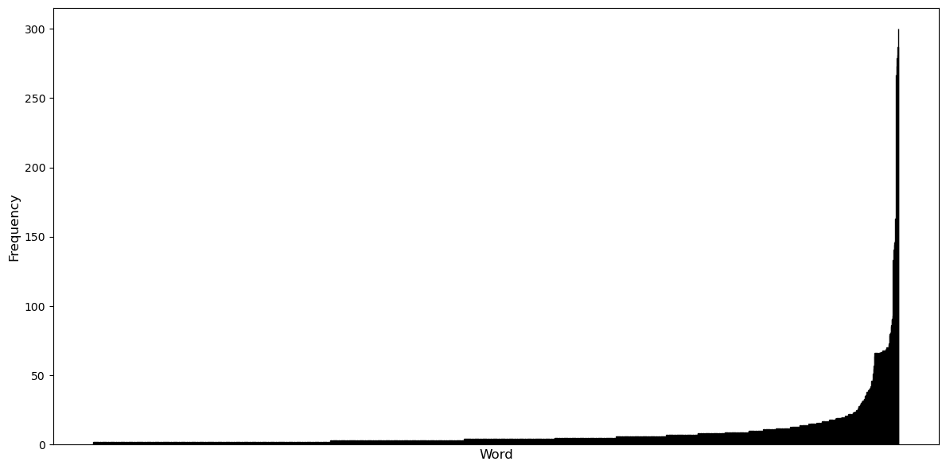
Word frequency of 100 posts sampled from r/cmv (number of words = 2207)
People, like, feel, think, …
Islam, religion, Nazi, Palestine, lgbt,
heterosexual, feminist,…
Notes:
Sell problem
High noise is common problem

