Slide 1
HTTP/2 – the future of web
Rohith Rajan & Mohammed Fasiulla

Slide 2
Agenda
Web (HTTP 1.1) and it’s current state
What is (HTTP/2) – and How fast is it?
Goals of HTTP/2
HTTP/2 Concepts
How to troubleshoot ?

Slide 3
Web – current state
HTTP 1.1 is huge
HTTP 1.0 RFC 1945 – released 1996 -60 pages
HTTP 1.1 RFC 2626-released 1999-176 pages
Now split into 6 documents-RFC 7230 and family
Incomplete implementations of RFC
Eg. http pipelining
Inadequate use of TCP

Slide 4
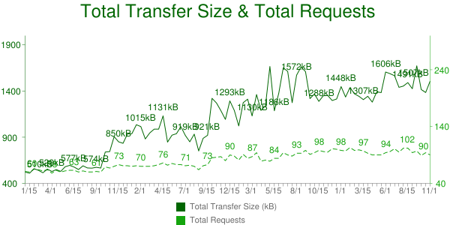
The average web page has grown 150% in just three years
Jan 2012- Nov 2015 (httparchive.org) top 1000 sites

Slide 5
Shortcomings –current web
Concurrent connection limit
Latency –Page Load Time
Head of line blocking
TCP slowstart
Inadequate use of TCP

Slide 6
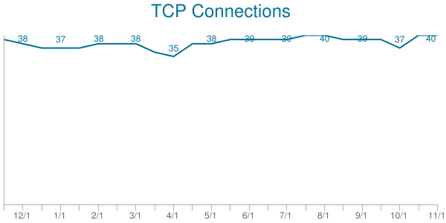
Max Persistent Connections
Firefox 2: 2
Firefox 3+: 6
Opera 9.26: 4
Opera 12: 6
Safari 3: 4
Safari 5: 6
IE 7: 2
IE 8: 6
IE 10: 8
Chrome: 6
Top 300K URLS –avg. TCP connections
http://httparchive.org/trends.php
The HTTP 1.1 specification (RFC2616) mandates the two-connection limit. Most browsers does not conform anymore

Slide 7
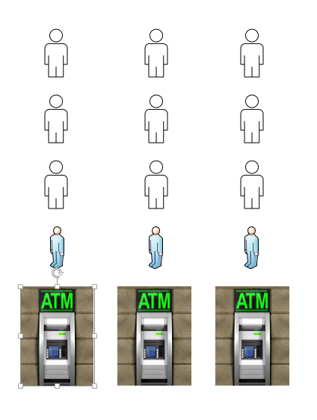
Head of Line Blocking
HTTP 1.1 MaxConnections PerSever
Img Src: atmbusinessblueprint.com

Slide 8
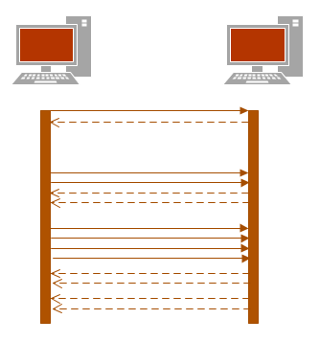
TCP Slow Start
TCP does not use full bandwidth capacity from start
TCP probes network to find available capacity

Slide 9
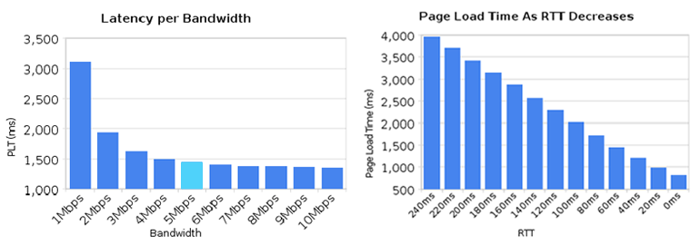
Latency
The average web page has over 50 objects that will need to be downloaded to complete page rendering of a single page
(reference: http://www.websiteoptimization.com/speed/tweak/average-web-page/)
Graphic credit: Ilya Grigorik (Google)
round-trip time (RTT) is the length of time it takes for a packet to be sent plus
the length of time it takes for an acknowledgment of that signal to be received

Slide 10
What have we done to improvise?
Spriting
Reduces number of requests and latency overhead
Inlining
Eliminates the request for small resources
Concatenation (javascript,css)
Reduces number of requests and latency overhead
Sharding
overcome max connections ,cookie free requests

Slide 11
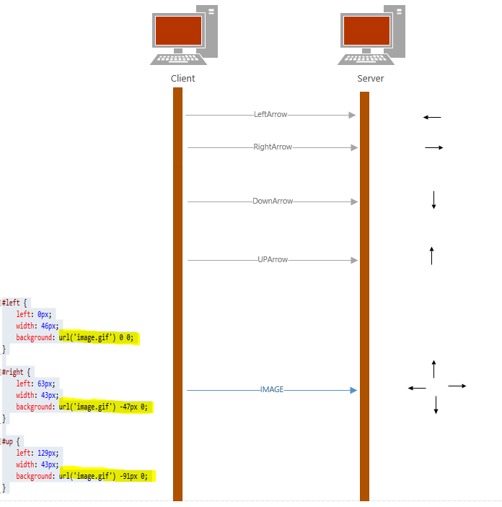
Spriting

Slide 12
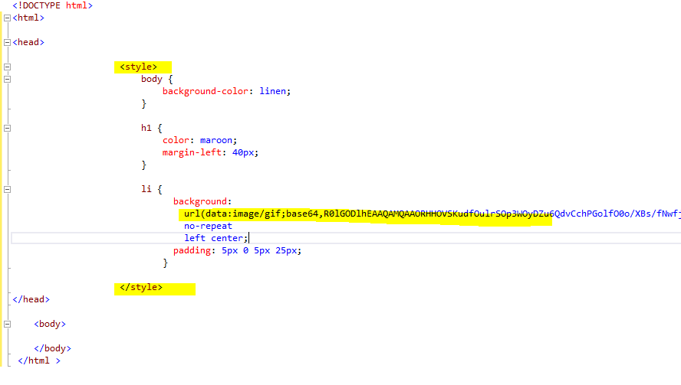
Inlining

Slide 13
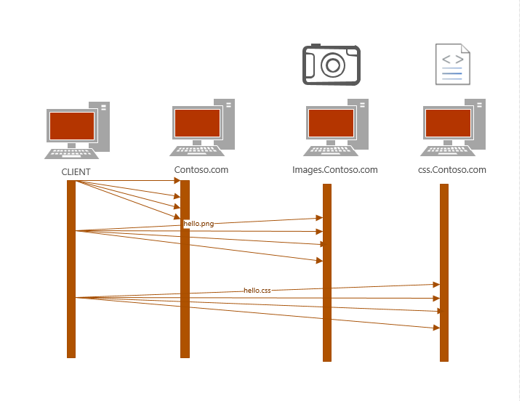
Sharding

Slide 14
Problems with “optimizations”
Spriting
Painful and annoying preprocessing, cache invalidations, slower executions etc
Inlining
Resource can’t be cached,inflates parent document,30% overhead of base64
Concatenation (javascript,css)
Less modular code, expensive cache invalidations, slower execution
Sharding
TCP slowstart ?Cause congestion, latency etc

Slide 15
HTTP/2 to the rescue
Improve latency and less RTT sensitive
Fix pipelining and Remove “head of line blocking”
Not require multiple connections
Achieved all this by retaining semantics of HTTP 1.1

Slide 16
What is HTTP /2
HTTP/2 uses a single, multiplexed connection, replacing the multiple connections per domain that browsers opened up in HTTP/1.x.
HTTP/2 compresses header data and sends it in a concise, binary format, rather than the plain text format used previously.
By using a single connection, HTTP/2 reduces the need for several popular HTTP/1.x optimizations, making your web applications simpler.

Slide 17
HTTP/2 Demo https://http2demo.cloudapp.net
How fast it can be ?

Slide 18
HTTP/2 support
Servers
Browsers
Edge
IE11 (windows 10)
Firefox 40+
Chrome 43+
Safari 9+
Opera 32+
IOS Safari 9.1+
Chrome for Android 46+
CURL
Microsoft IIS – windows 10 and windows server 2016(beta)
Apache 2.4.12
Nginx 1.9.5
Jetty 9.3
And many more
Google ,facebook, twitter ,yahoo,youtube and many more are using http/2 already
HTTP/2 is used by 2.1% of all the websites reference: http://w3techs.com/

Slide 19
With HTTP/2 – you can
Unshard your assets
Undo http 1.x hacks
Faster delivery
Better caching

Slide 20
http2 for https:// - h2
http2 shipped with TLS as optional
But Firefox and Chrome devs have stated clearly that they will only implement http2 over TLS
The spec specifies that TLS should be at least version 1.2 and there are cipher suite restrictions.
Application Layer Protocol Negotiation –protocol used to negotiate HTTP/2 with TLS servers

Slide 21
http2 for http:// -h2c
Uses Upgrade header
Internet Explorer team expressed plans to support
curl and libcurl already supports this.
GET / HTTP/1.1
Host: server.example.com
Connection: Upgrade, HTTP2-Settings
Upgrade: h2c
HTTP2-Settings: <base64url encoding of HTTP/2 SETTINGS payload>
HTTP/1.1 101 Switching Protocols
Connection: Upgrade
Upgrade: h2c
[ HTTP/2 connection ...

Slide 22
HTTP/2 is comprised of two specifications:
Started with SPDY-draft 3
Hypertext Transfer Protocol version 2 - RFC7540
HPACK - Header Compression for HTTP/2 - RFC7541
h2 – http/2 over TLS
h2c- http/2 over http://

Slide 23
HTTP/2 CONCEPTS
.MultiPlexing
.Binary Frames
.Header Compression
.Server Push

Slide 24


HTTP 1.1
HTTP/2
Vs

Slide 25
Multiplexing
Streams look like TCP connections to IIS/ASP.NET apps
HTTP/1.1 – Request = Connection
HTTP/2 – Request = Stream
Hello.aspx
Image1.png
Style.css
File.pdf
…
Each request required dedicated TCP connection | TCP connection can have multiple streams (requests)
Responses come in order per connection | Responses can come out of order, server can optimize
Each connection requires setup + slow start | No connection setup for new streams, no slow start
Application sees “connections” | Streams are represented as “connections” to apps

Slide 26
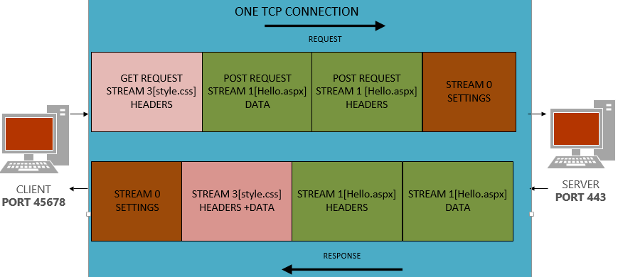
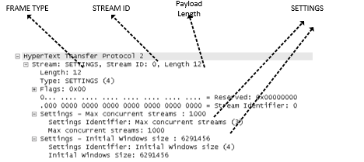
HTTP/2 Connection and Frames

Slide 27
HTTP/2 is Binary
.Binary protocols are more efficient to parse
.More Compact on Wire
.Less Error-prone

Slide 28
HOW TO TROUBLESHOOT?
.View http/2 Traffic- Dev Tool Bar
.SSLKEYLOGFILE
.WireShark Developer version

Slide 29
DEMO-HTTP2 Traffic
.http/2 Handshake- overhttp v/s TLS
.Frames and Settings.

Slide 30
Server Push/Demo
.Server may know what client will request before client does
If you request index.htm, you’ll probably be back for style.css, script.js, logo.png, etc…
Push allows server to anticipate these requests and pre-respond
Several possible uses:
Dependent resources
Future navigations
Cache revalidation/invalidation
.A client can request that server push be disabled. The SETTINGS_ENABLE_PUSH setting can be set to 0 to indicate that server push is disabled
.ASP.NET Support through HttpResponse.PushPromise Method
https://msdn.microsoft.com/en-us/library/dn823340(v=vs.110).aspx

Slide 31
Summary-HTTP/2 – the future
Multiplexing
.Multiple Request and Response
.Fix Head of Line Blocking Problem
.Avoid the http1.1 hacks like spriting, inlining, sharding
Mechanism for Request Prioritization
Fewer TCP connections
.Reduce the TCP Slow Start
Better header compression using HPACK
Server Push

Slide 32
Credits/References
References:
http://daniel.haxx.se/http2/
http://http2-explained.haxx.se/
https://http2.github.io/
RFC7540
RFC7541
Demos inspired from:
https://http2.akamai.com/demo
http://http2.golang.org/gophertiles
Source Code :
https://github.com/rohithkrajan/http2demo
https://github.com/rohithkrajan/pushpromisedemo

Slide 33
Thank You.

Slide 34
Questions?

