Slide 1



Valuation of Bermudan options and electricity storage contracts
on the electricity market by means of the COS method
by
$${Boris Boonstra}^{1}$$
1

Slide 2
Contents presentation
Relevance of electricity storage
Electricity market
Bermudan option and the electricity storage contract
The COS method
Numerical results

Slide 3
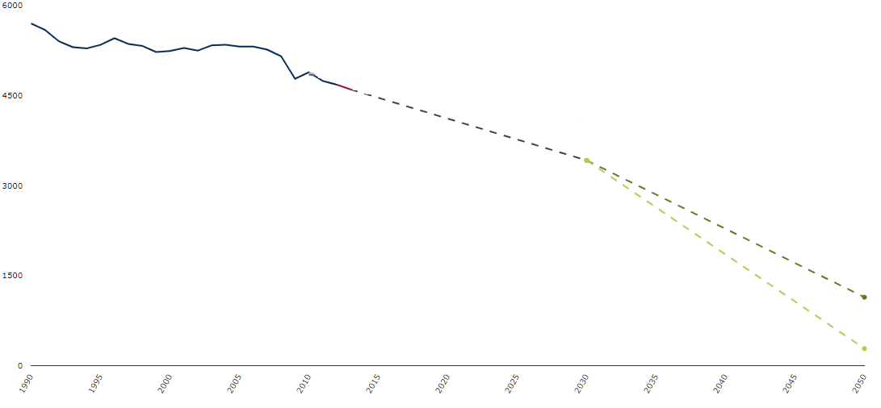
Relevance of electricity storage
EU has agreed to reduce the greenhouse gas emission:
1990 level
2017
-21%
Target 2030
-40%
Target 2050
-80% -95%

Slide 4
Relevance of electricity storage
EU has agreed to reduce the greenhouse gas emission.
To meet the targets we see a growth of renewable energy sources, i.e. wind and solar energy.
Renewable energy sources cause an increase in uncertainty and variability in the supply of energy.
One of the main solutions for these uncertainties is electricity storage:
Store electricity if there is too much supply
Return electricity to the grid when there is too much demand.
Technologies for electricity storage improve rapidly and expected to be used a lot in the future.
Increasingly interesting from a financial point of view.

Slide 5
Electricity market
Last few decades countries have liberalized their electricity market.
Now electricity is considered a commodity
Exchanges to trade electricity options (e.g. APX)
However, behaves differently than other commodities:
Not stored in big amounts
Prices respond more extreme to supply and demand and external events, i.e. shortage of coal or weather conditions.
Impact of external events increase with the transition to renewable energy.

Slide 6
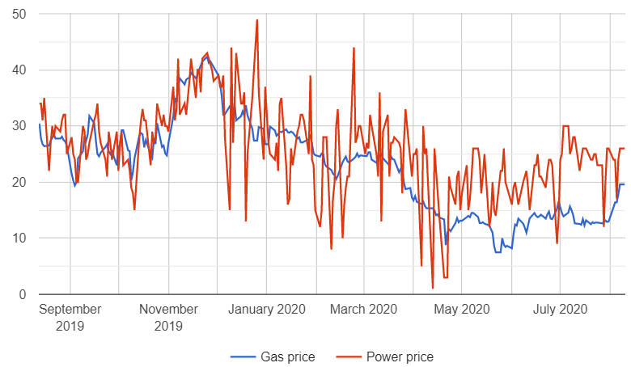
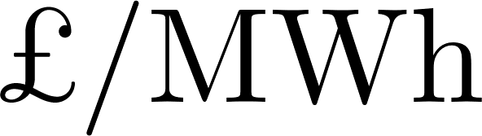
Electricity market
These features make the electricity price exhibit unique characteristics:
High volatility
Extreme price spikes
Mean reversion
Average daily market spot prices

Slide 7

Options and contracts
Option
Financial contract that gives the option holder the right, but not the obligation, to trade an underlying asset for a predetermined strike price at a fixed time in the future.
General distinction between Put and Call option:
Call: right to buy the asset for strike price K
Put: right to sell the asset for strike price K
Discuss the following financial derivatives:
Bermudan
The electricity storage contract

Slide 8

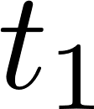
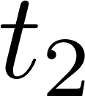
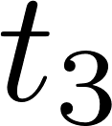
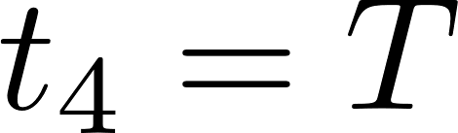
Options: Bermudan option
Bermudan option gives the holder the right to exercise the option once at a predetermined finite set of exercise moments before maturity:
Start of contract
Maturity time
At every exercise moment the holder must make the decision to exercise or continue, respectively denoted by
The holder of the option will make the decision which results in the highest value:

Slide 9
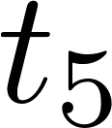
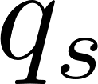
Electricity storage contracts
The holder has the right to change the electricity level in the storage by buying or selling electricity at a predetermined finite set of exercise moments before expiry:
Start of contract
Maturity time
Settlement date
For an electricity storage contract additional features need to be taken into account:
Physical characteristics of an electricity storage (e.g. capacity, efficiency and endurance).
Operational constraints (e.g. maximum charge/discharge rates).
The possibility to have negative payoff by withdrawing electricity.
A settlement date where the holder receives a penalty if he/she does not comply with the contract conditions, denoted by .

Slide 10
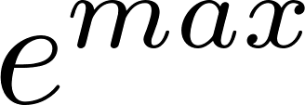


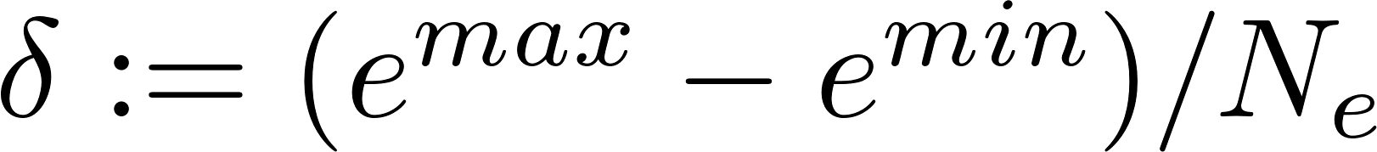

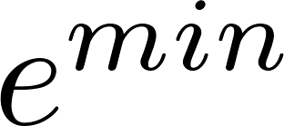
Electricity storage contracts
How to formalize the contract?
We discretize the electricity storage capacity into energy levels:

Slide 11
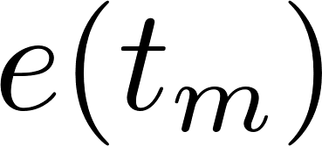
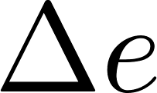
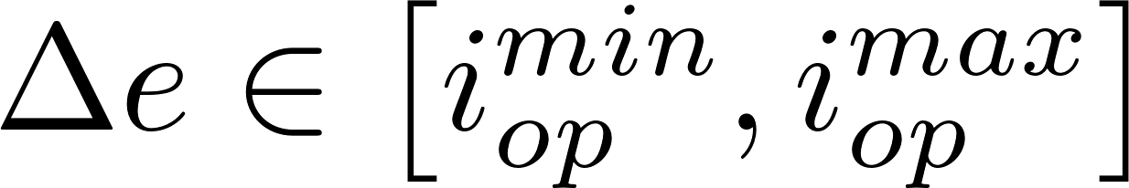
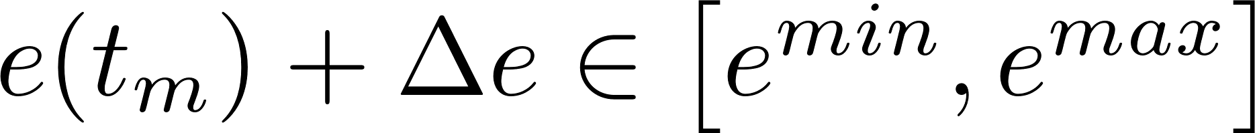
Electricity storage contracts
How to formalize the contract?
We discretize the electricity storage capacity into energy levels:
At any exercise moment with electricity in storage, the holder of the contract can choose an action , taking into account the operational constraints and physical limitations:
and

Slide 12
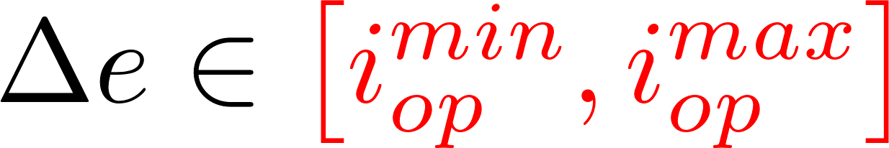
Electricity storage contracts
How to formalize the contract?
We discretize the electricity storage capacity into energy levels:
At any exercise moment with electricity in storage, the holder of the contract can choose an action , taking into account the operational constraints and physical limitations:
and

Slide 13
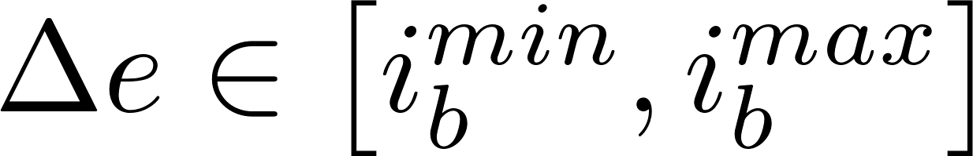
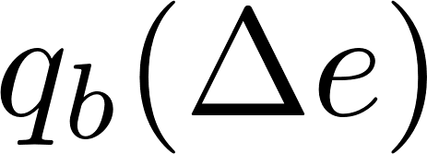
Electricity storage contracts
How to formalize the contract?
We discretize the electricity storage capacity into energy levels:
At any exercise moment with electricity in storage, the holder of the contract can choose an action , taking into account the operational constraints and physical limitations:
and
Charging/discharging an electricity storage too quickly reduces the lifetime of the storage, therefore we set actions on which the storage can last as long as possible:
,otherwise a penalty is issued.

Slide 14
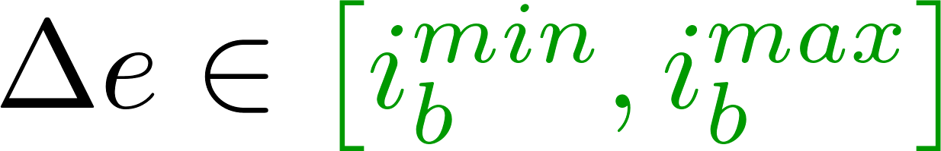
Electricity storage contracts
How to formalize the contract?
We discretize the electricity storage capacity into energy levels:
At any exercise moment with electricity in storage, the holder of the contract can choose an action , taking into account the operational constraints and physical limitations:
and
Charging/discharging an electricity storage too quickly reduces the lifetime of the storage, therefore we set actions on which the storage can last as long as possible:
,otherwise a penalty is issued.

Slide 15

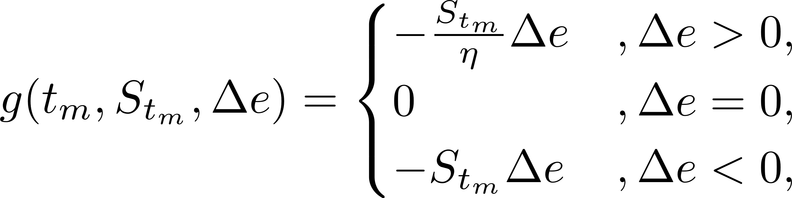
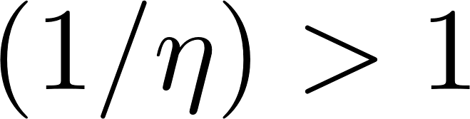

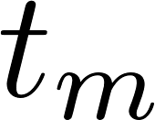

Electricity storage contracts
The current electricity storages have an efficiency between 60%-95%, therefore the payoff function for an action is defined by:
which implies that units of energy need to be bought in order to sell unit of energy.
At every exercise moment with energy in storage, the holder of the contract has to make a decision which allowed action to take.
The holder will choose the action which results in the highest value:
where

Slide 16

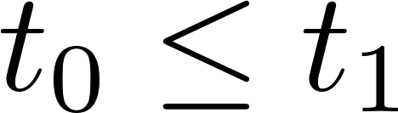
Option and contract pricing
Option and contract pricing usually comes down to computing the conditional expectation of the discounted value of an option under the risk-neutral measure , for :
called the risk-neutral valuation formula.
There are several computational methods to solve this, e.g.:
Analytical methods
Numerical integration (e.g. the COS method )
Monte Carlo simulation (e.g. the LSMC method)

Slide 17



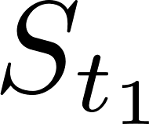
The COS method
The COS method is a numerical integration pricing method, introduced by Fang and Oosterlee, which approximates the risk-neutral valuation formula.
The risk-neutral valuation formula:
where the state variables and can be any function of respectively the asset prices and .
Main idea COS method: approximate the probability density function by a Fourier cosine series expansion.

Slide 18
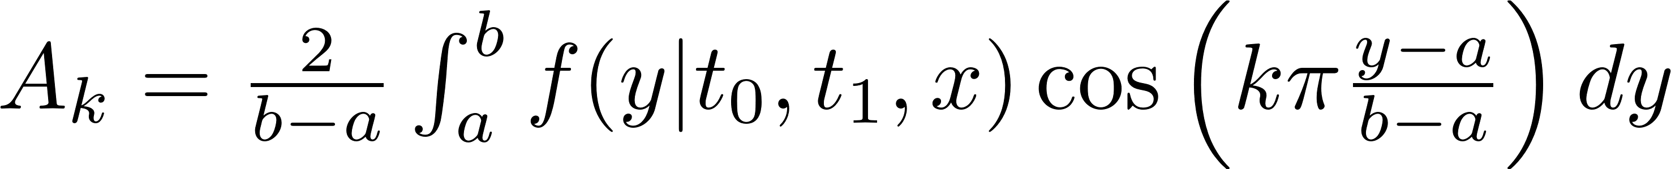


The COS method
How does it work?
Starting from the risk-neutral valuation formula:
Step 1: Truncate the infinite integral range:
Step 2: Replace the probability density function by its Fourier cosine series expansion and truncate the series summation:
where
and implies that the first term of the summation is multiplied by .
,
,
,

Slide 19
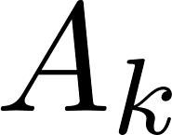
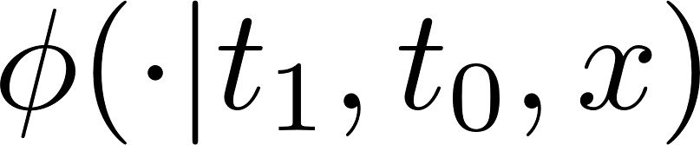
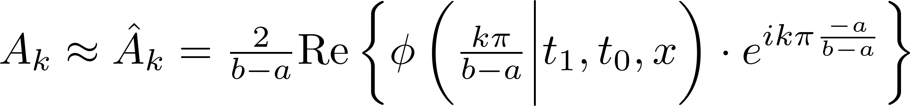
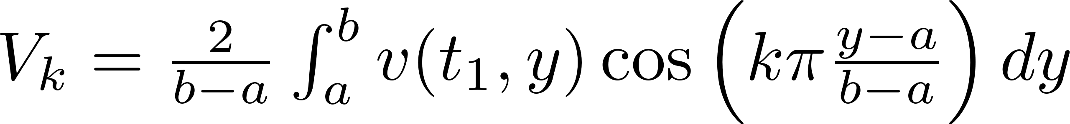
The COS method
Step 3: Approximate the coefficients such that the characteristic function is used instead of density:
and substitute in the Fourier cosine expansion:
,
Final step 4: Substitution of this approximated density function in the truncated risk-neutral valuation formula:
where
,

Slide 20
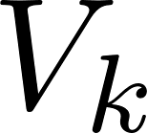
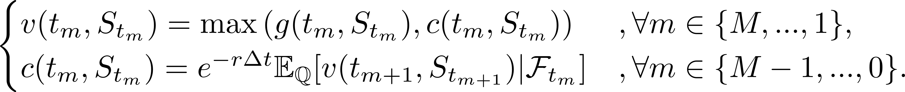
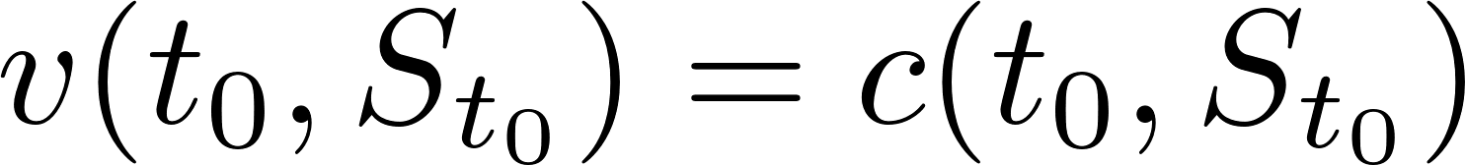
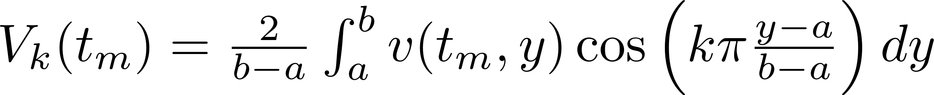
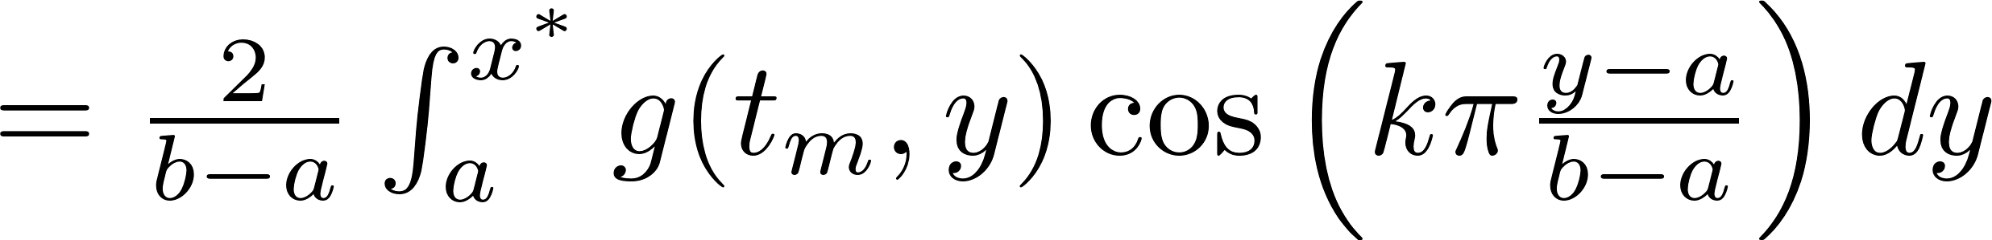
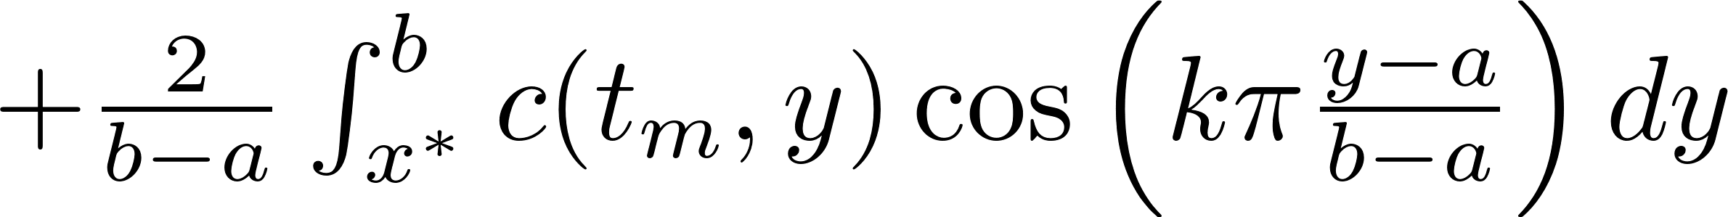
The COS method
Recovery of the coefficients for Bermudan options
Bermudan:
followed by .
COS formula:
,

Slide 21
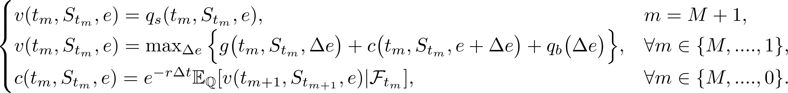
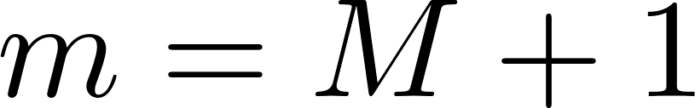
The COS method
Recovery of the coefficients for the electricity storage contract
Electricity storage contract:
followed by .
COS formula:
,
for

Slide 22
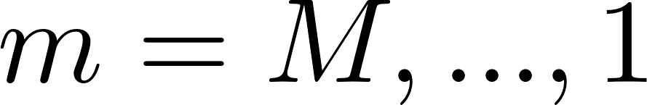
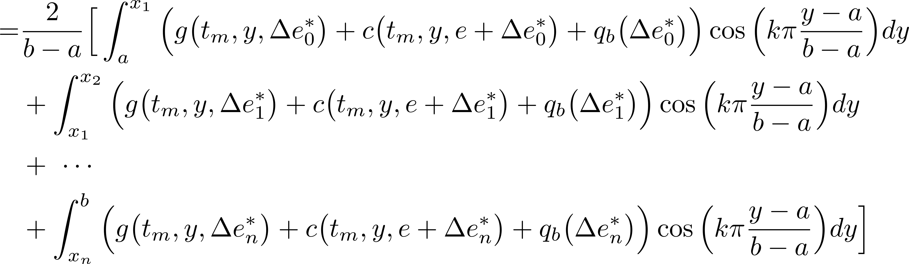
The COS method
Recovery of the coefficients for the electricity storage contract
for

Slide 23

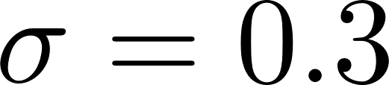
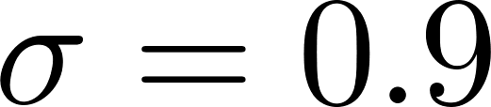
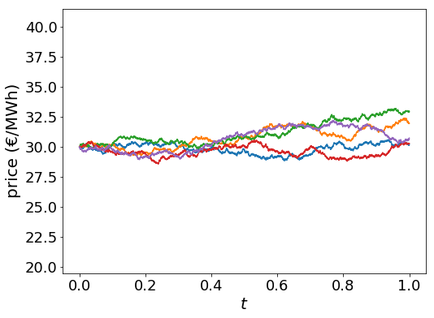
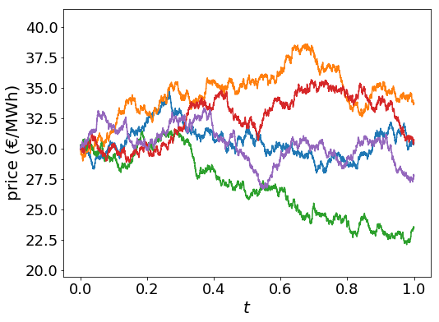
Numerical results: Electricity storage contracts
Electricity storage contract:
One electricity storage system and the concept Car-Park as Power Plant will be discussed.
We look at two different volatility parameters for the electricity price process.
Analyse two different volatility parameters for the price process.

Slide 24
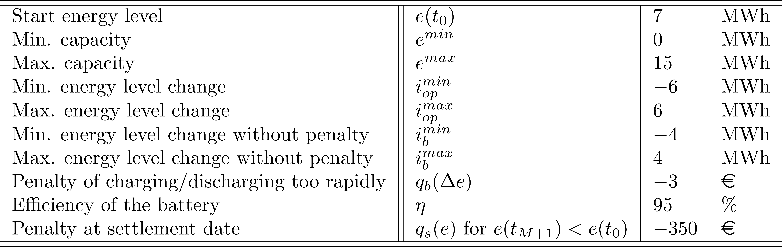
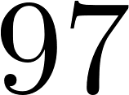
Numerical results: Electricity storage contracts
Contract characteristics:

Slide 25
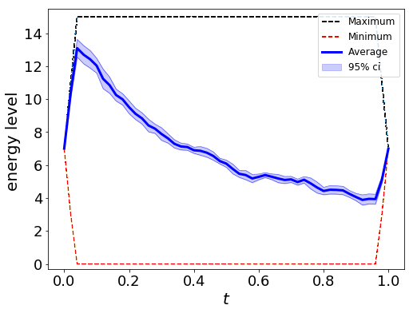
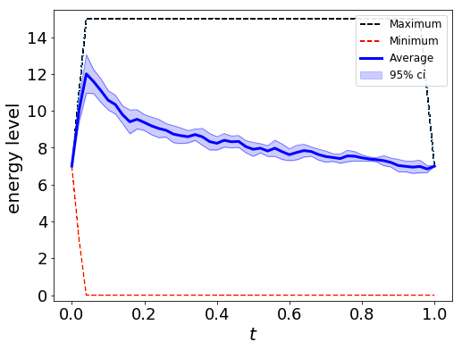
Numerical results: Electricity storage contracts
Contract 1:
Contract values:
Pricing method: | LSMC 95% c.i. | The COS method
 | [1.2804 , 1.3286] | 1.3026
 | [5.2309 , 5.2836] | 5.2621
Strategy:

Slide 26

Numerical results: Electricity storage contracts
Car Park as Power Plant:

Slide 27
Conclusions
We can solve non-linear Bermudan-style and contract problems by writing it in a dynamic pricing algorithm, with the use of conditional expectations.
The COS method is a Fourier-based method to approximate these conditional expectations in a numerical way.
Formalized a contract for storing electricity by trading on the electricity market, allowing the contract to be valued efficiently.
Various electricity storage systems and new concepts for storing electricity by trading on the electricity market can be valued by means of the COS method.

Slide 28

Questions?

