Slide 1
In Situ Calibration Process
for seismic/infrasonic sensors
Theoretical asymptotic results
Test on the MSC
Weighted estimation of the SUT response
Codes for FB analysis
Wind coherence model (explaining the curve shape)
Evaluation on a very large campaign of measurement
Here we focus on the last item
ED section meeting
July 8th, 2015
1

Slide 2
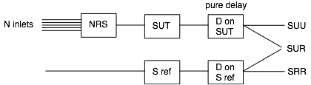
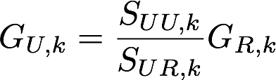
In Situ Calibration Process
for seismic/infrasonic sensors
ED section meeting
July 8th, 2015
2

Slide 3
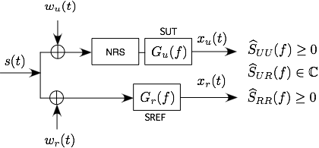
In Situ Calibration Process
for seismic/infrasonic sensors
ED section meeting
July 8th, 2015
2

