Slide 1
Movie Recommender
Adam, Brendan, Curt, Philip, Thien

Slide 2
Adam
Layout took inspiration from other machine learning applications
Keep visual layout simple
Minimize guidance needed to interact with application

Slide 3
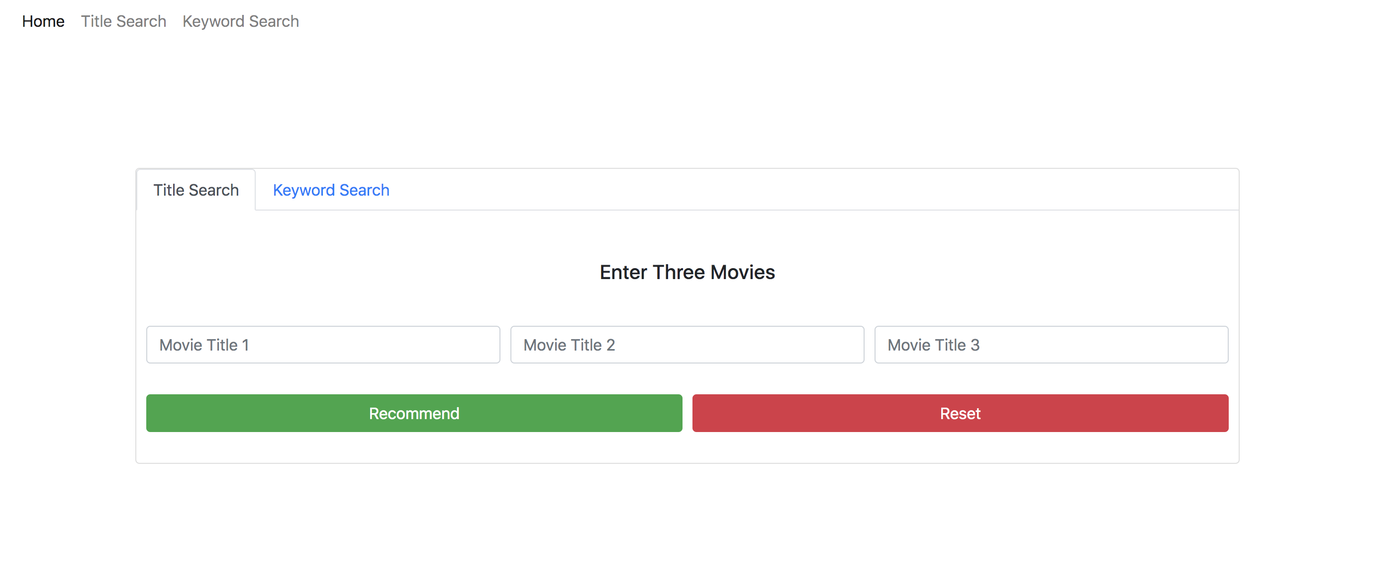
Movie Title Search

Slide 4
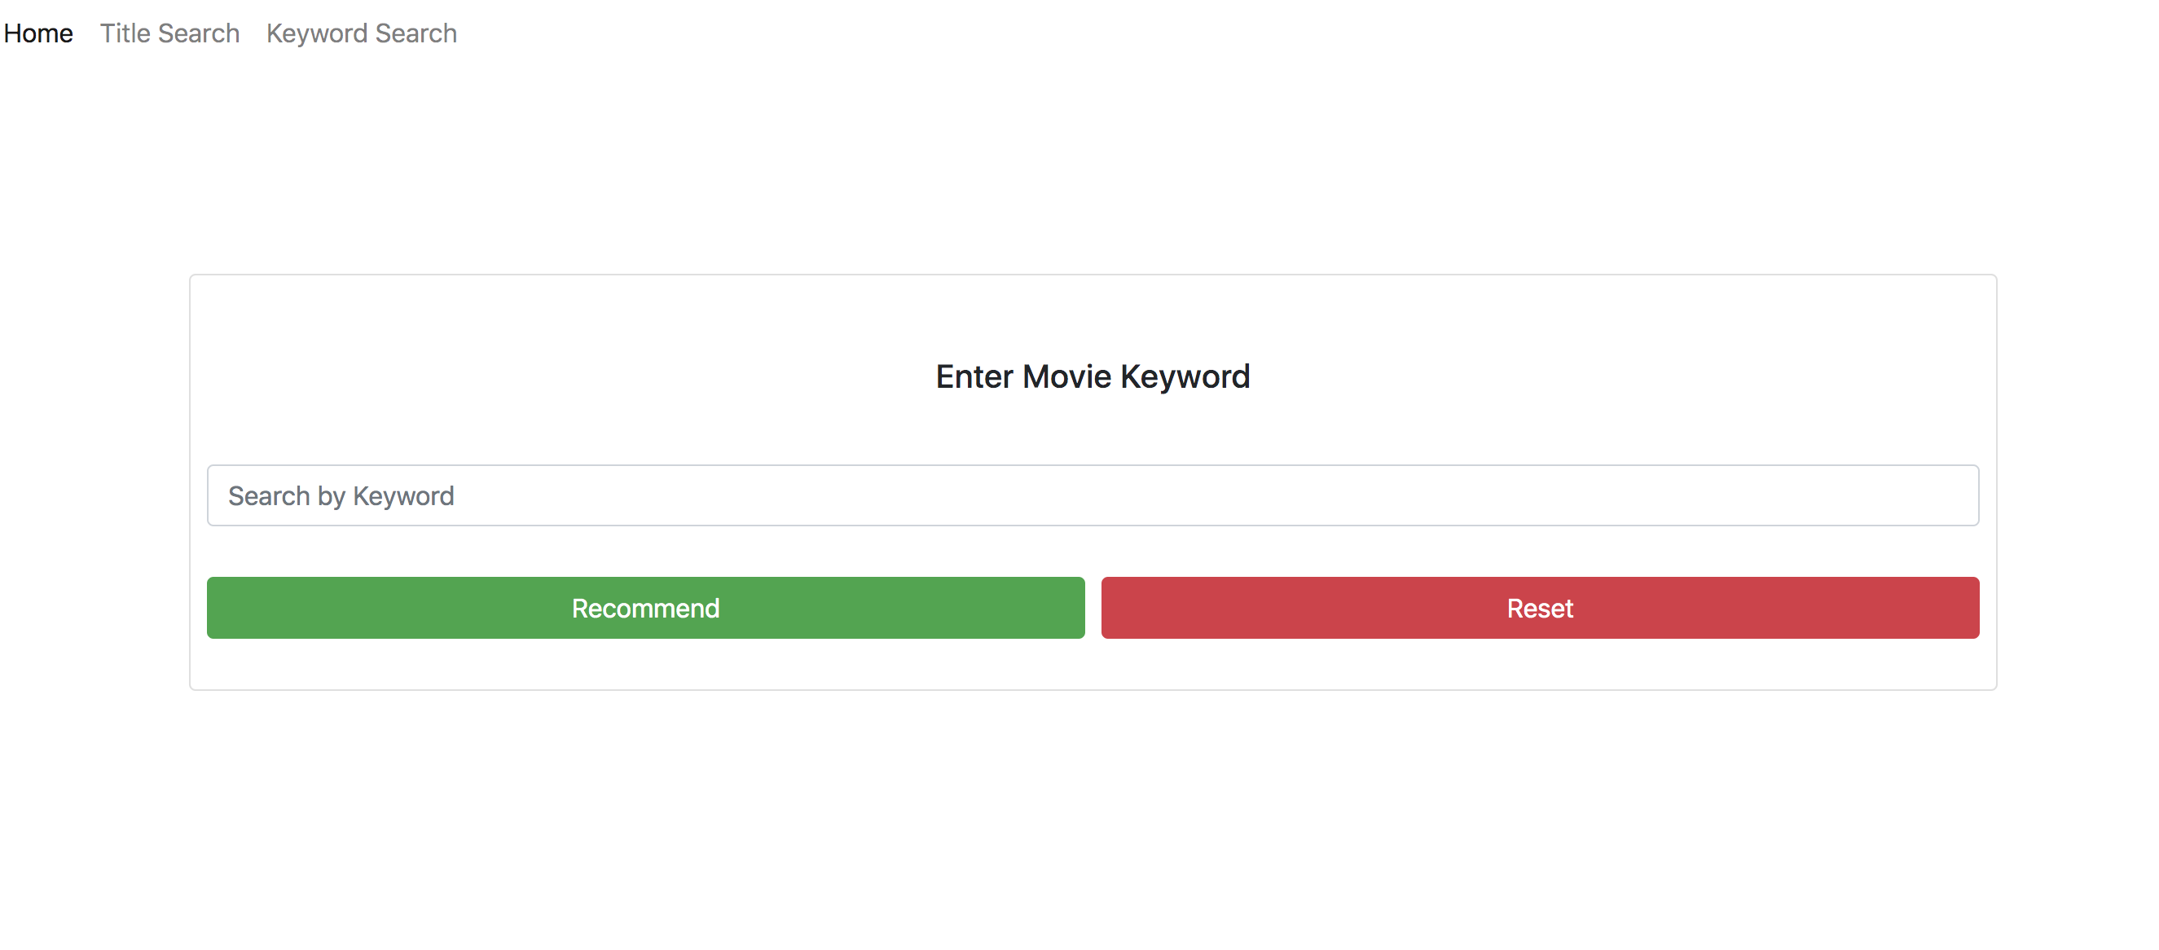
Keyword Search

Slide 5
Takeaways
Multiple different interfaces provide flexibility
Balancing providing too many or too few options
How does the interface design influence user interactions with application

Slide 6
Brendan
Stuff to talk about for 2 minutes & 30 seconds

Slide 7
Philip
Stuff to talk about for 2 minutes & 30 seconds

Slide 8
Curt
Stuff to talk about for 2 minutes & 30 seconds

