Slide 1
College Football Recruiting and Team Statistics and their impact on overall Team Success
Nathan Kosiba
Spencer Harrison
Brendan Dowd

Slide 2
Project Overview
Objective
The purpose of our project is to uncover trends in college football data. Our group examined relationships between indicators such as recruiting class, ratings, and team statistics. We compared these relationships to the success of a football team over the last 15 years.
Research Questions
How much does recruiting rank effect the performance of a team?
How long does it take for recruiting to impact the performance of a team?
How much does the success of a team effect the quality of recruiting classes?
Does the distribution of play type (run/pass) affect the success of a team?

Slide 3
Data Overview
Identification and Sourcing
Main Source: https://api.collegefootballdata.com
Data Exploration and Cleaning
Review of API output for data points that would contribute to the research.
Data points confirmed, data broken into chunks for targeted API calls and ease of reconstructing unique data sets relevant to our analysis.
Issues with win percentage and other key data points
Source issues with API call for certain seasons (missing 2011 stats)
Good API definitions but complex response objects (duplicates, etc.)
Due to the sheer size of the dataset we limited the teams to the Power 5 conferences

Slide 4
Analysis Summary
Predictive indicators
Recruiting points
Pass/Run Ratio
Success Outcomes
Win percentage
S&P+ ranking
Methods
Linear regression
Binning
Plots
Histogram
Scatter Plot
Line Plot

Slide 5
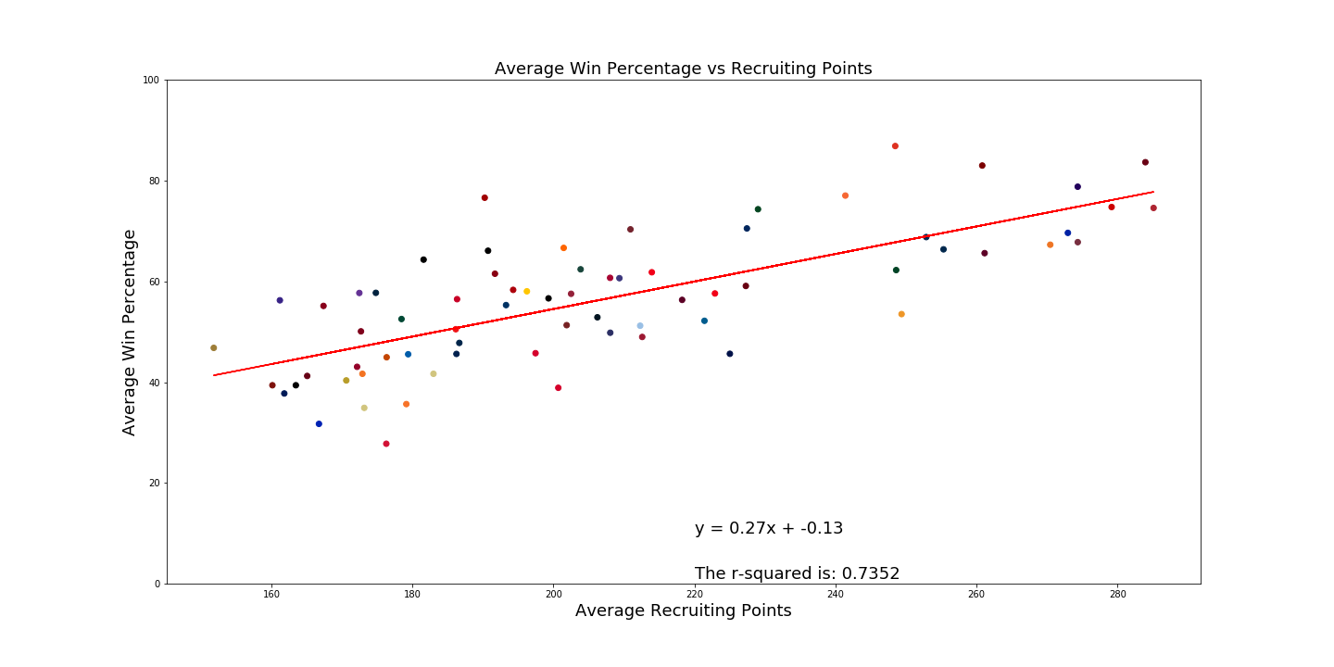

Slide 6
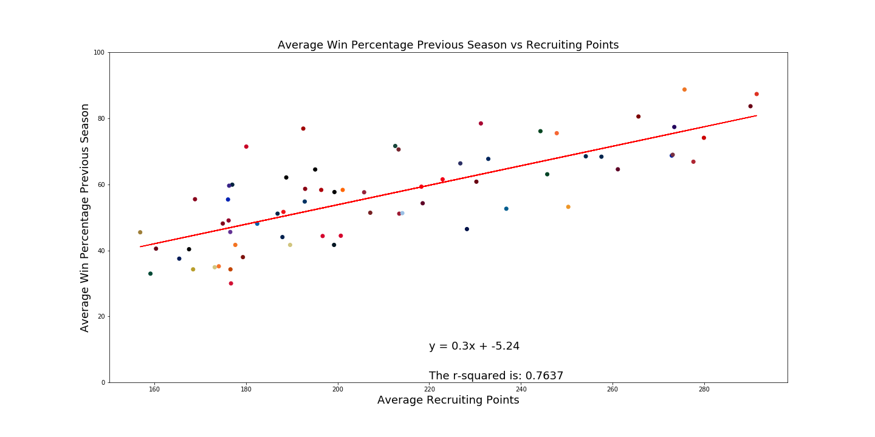

Slide 7
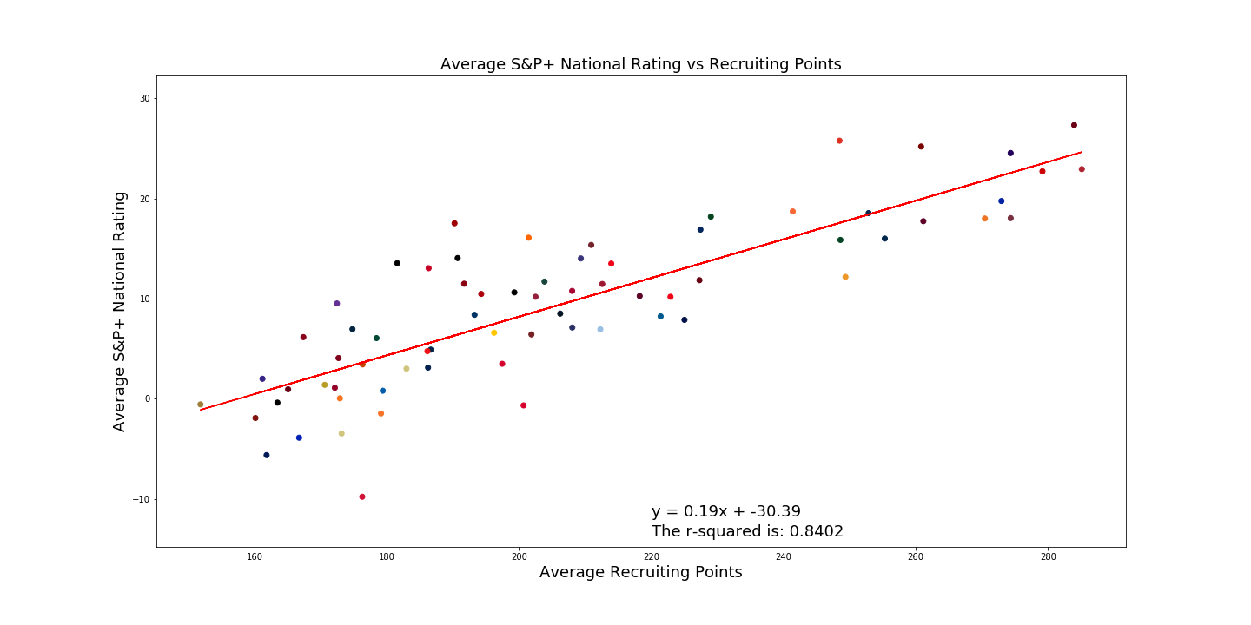

Slide 8
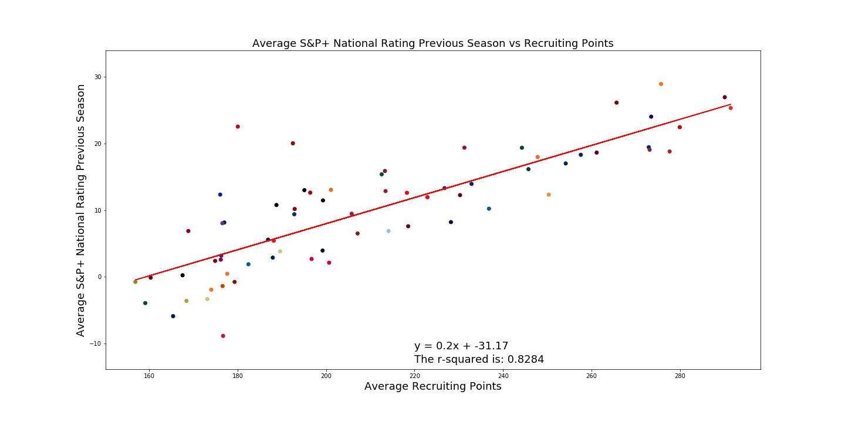

Slide 9
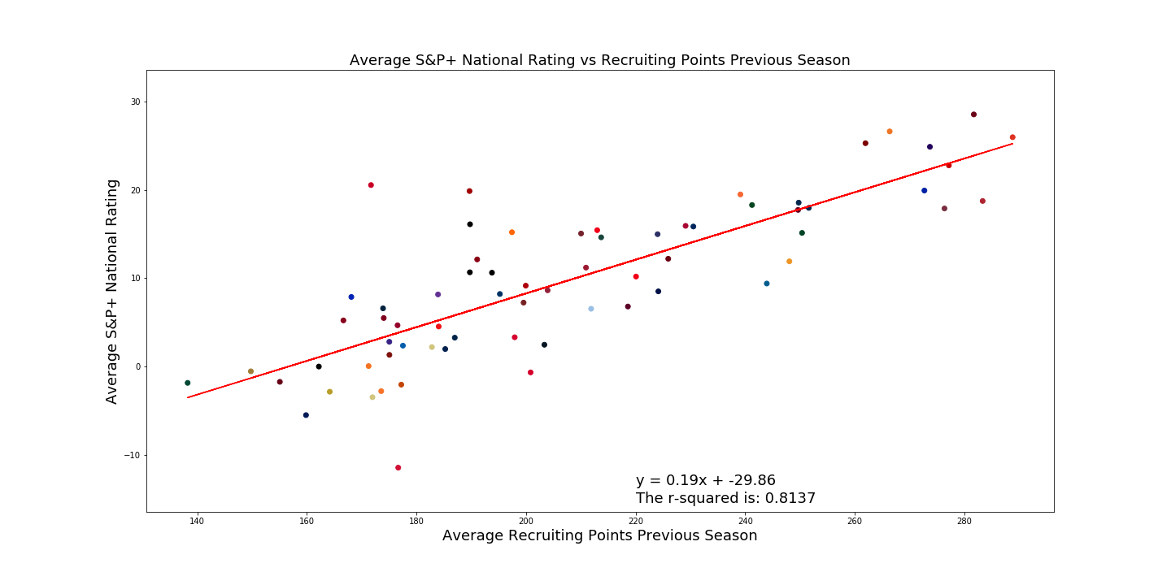

Slide 10
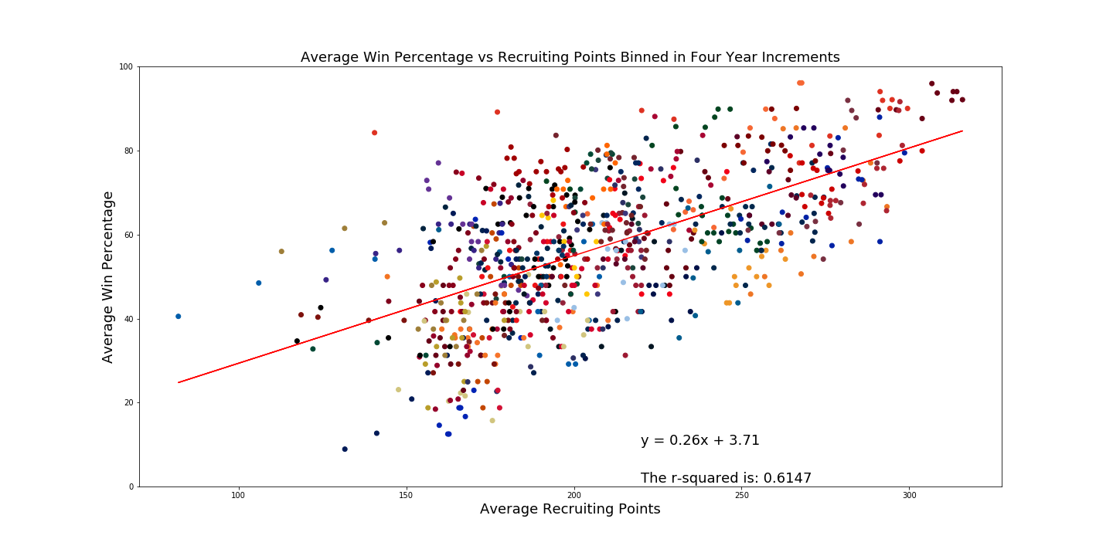

Slide 11
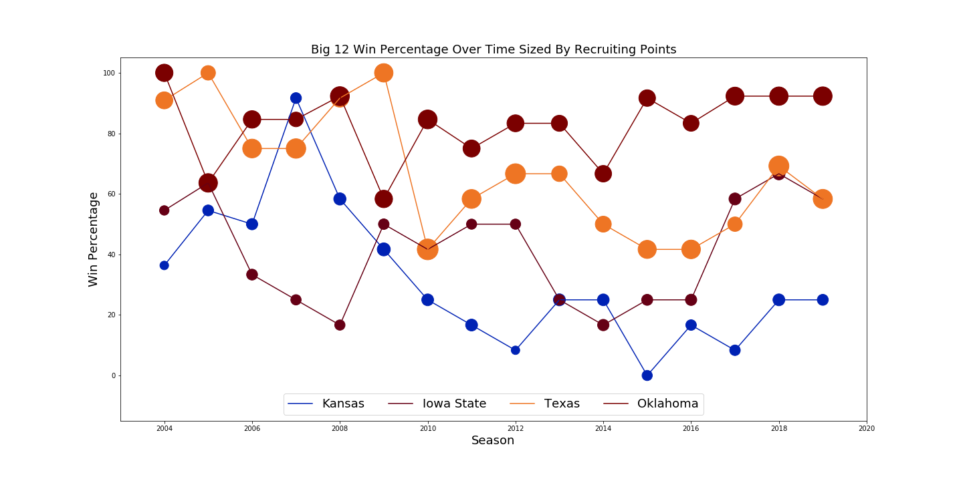

Slide 12
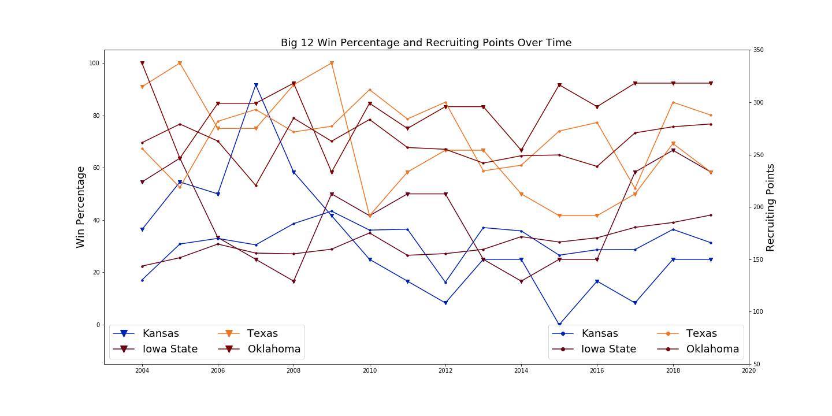

Slide 13
Recruiting Analysis Findings
The current and previous season’s recruiting points have a positive effect on the current season success of a team by both success outcomes
R squared values in the .7 and .8 range
The previous season’s success outcomes of a team have a positive effect on the recruiting of the current season
R squared in the .7 and .8 range
The previous season’s success outcomes have a higher correlation to the predictive measures of the current season
When binned by four-year periods to create more data points, the correlation was less.
R squared of .61
You can create some cool looking figures that give you no real conclusion or that take forever to decipher

Slide 14
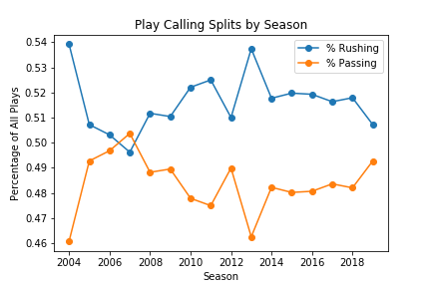
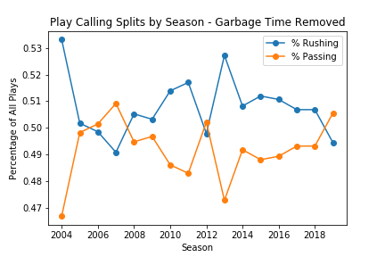
Play Call Analysis – Pass/Run Splits

Slide 15
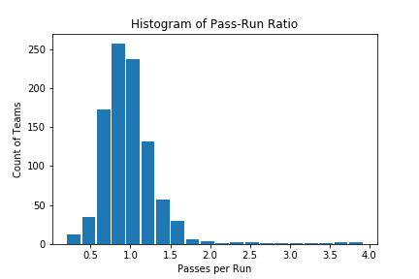

Play Call Analysis – Pass/Run Ratios

Slide 16
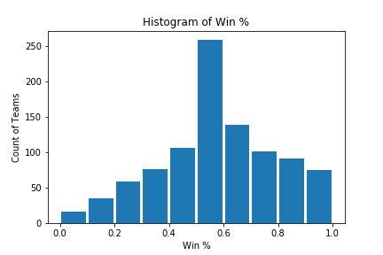
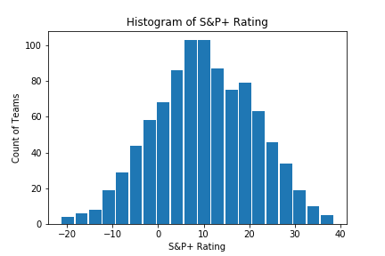
Play Call Analysis – Win % vs S&P+

Slide 17
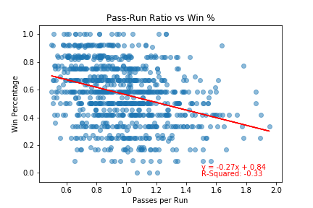
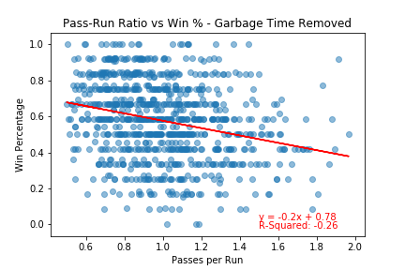
Play Call Analysis – Garbage Time Comp

Slide 18
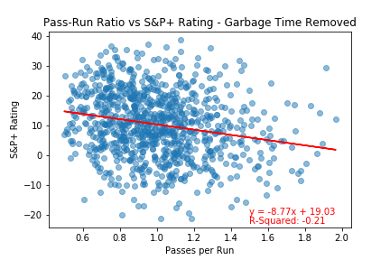
Play Call Analysis – S&P Rating Comp

Slide 19
Play Call Analysis Findings
First Pass: Pass-Run Ratio vs Win %
No correlation between passes per run and win rate
R-Squared Values: -0.24
Second Pass: Removing garbage time data
No correlation between passes per run (in competitive situations) and win rate
R-Squared Value: -0.18
Third Pass: Comparison to S&P+ Rating
No correlation between passes per run (in competitive situations) and win rate
R-Squared Value: -0.13

Slide 20
Further Questions
Could this data be better explored by doing a series of case studies on schools that might show variances in these data in the same team?
For example: Clemson or Alabama
Are there other predictive measures that have a better correlation to our success outcomes?
Turnovers
Time of possession
Red zone success
3rd down conversion rate
Would a grouping by coach be a better way to look at the data?

