Slide 1
Introduction to CSS3 and GitHub
Week 6 – Grids – Part III

Slide 2
Re-Introduction
From Part II, we will looked at three different auto-flow techniques:
Grid auto-placement
Grid auto-flow column
Combination Grid auto-placement and placed items
In Part III, we will take a brief look at nested grids

Slide 3
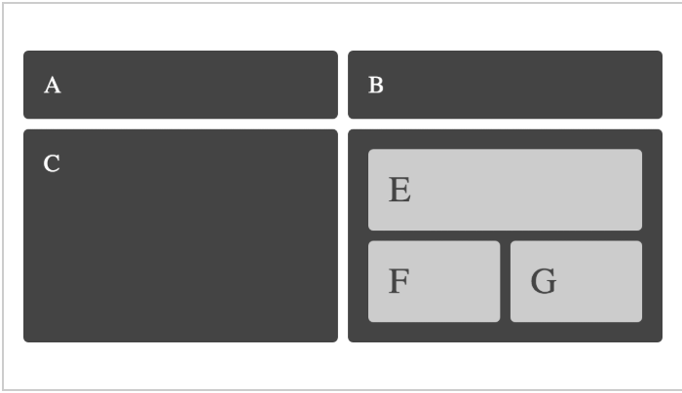
Nested Grids
This will provide us with a simple example of nesting one grid inside another.
Any Grid Area can become a grid itself, by setting display:grid and then defining the rows and columns.

Slide 4
Nested Grid - CSS
.c {
grid-column: col / span 2;
grid-row: row 2;}
.d{
grid-column: col 3 / span 2;
grid-row: row 2;
display: grid;
grid-gap: 10px;
grid-template-columns: 1fr 1fr; }
.e {
grid-column: 1 / 3;
grid-row: 1;}
.f {
grid-column: 1;
grid-row: 2;}
.g {
grid-column: 2;
grid-row: 2;}
<div class="wrapper">
<div class="box a">A</div>
<div class="box b">B</div>
<div class="box c">C</div>
<div class="box d">
<div class="box e">E</div>
<div class="box f">F</div>
<div class="box g">G</div>
</div>
</div>
body {
margin: 40px;
}
.wrapper {
display: grid;
grid-gap: 10px;
grid-template-columns: repeat(4, [col] 150px ) ;
grid-template-rows: repeat(2, [row] auto );
background-color: #fff;
color: #444;
}
.box {
background-color: #444;
color: #fff;
border-radius: 5px;
padding: 20px;
font-size: 150%;
}
box .box {
background-color: #ccc;
color: #444;}
.a {
grid-column: col / span 2;
grid-row: row;}
.b {
grid-column: col 3 / span 2;
grid-row: row;}

