Slide 1

CS 2123: Data Structures
L3 - Algorithm Analysis
09/05/19
Bernard Ku
Fall 2019

Slide 2
Acknowledgements
The slides in this lecture are derived from slides originally prepared by
  Professor Eric Roberts (Stanford University)
They were modiﬁed with permission and reformatted for use in our class. You should consider them as copyright material; do not repost them anywhere.

Slide 3
iClicker Question #1
What is a ADT?
Simple Dara Structure such as array and string
Complex Data Structure with well defined interfaces
Medium Data Structure which can be called by driver progran

Slide 4
iClicker Question #2
What kind of machine is our UTSA hen server?
64 bit Linux Server
48 bit Linux Server
32 bit Linux Server

Slide 5
Due Reminder
Q&A on Lab/HW/Project
HW2 due on 06/10 (Mon) @ 11:59 pm
Lab 1 due on 06/13 (Thurs) @ 11:59 pm
Project P1 due on 06/16 (Sun) @ 11:59 pm

Slide 6

What is that?

Slide 7
Applications of Tower of Hanoi
Backup rotation scheme when performing computer data Backups where multiple tapes/media are involved e.g. Amazon/Google/Facebook/Snap/Twitter data centers.
Frequently used in psychological research on problem solving. There also exists a variant of this task called Tower of London for neuropsychological diagnosis and treatment of executive functions.
In 2010, researchers published the results of an experiment that found that the ant species Linepithema humile were successfully able to solve the 3-disk version of the Tower of Hanoi problem through non-linear dynamics and pheromone signals.

Slide 8
iClicker Qn #3
What is/are precondition(s) for writing a recursive function?
There is a base case
We can call the function again
We can call the function again with a smaller scope
A. 1 only
B. 1 and 2 only
C. 1 and 3 only
D. All of the above

Slide 9
iClicker Qn #4
How do we justify providing a recursive function?
It is easier and intuitive to write a recursive function
Perform time analysis to make sure it still works timely
Make sure it works for the required problem size - N
A. 1 only
B. 1 and 2 only
C. 1 and 3 only
D. All of the above

Slide 10
A Real Life Example
A decision needs to be made about which algorithm to use, algorithm A or algorithm B
They both accomplish the same task, but they use radically different methods to achieve the same result
  One mountain top, but many ways up
  There are many ways to go to Rome
They are timed, using millions of trials automated on a computer, and an array size of 100
Algorithm B turned out to be faster.

Slide 11
The Reality
250000
200000
Algorithm B
150000
time
100000
Algorithm A
50000
0
50
100
150
200
250
300
350
400
450
number of elements

Slide 12
The Reality (cont.)
250000
At an array size of 100, algorithm B is indeed faster.
200000
Algorithm B
150000
time
100000
Algorithm A
50000
0
50
100
150
200
250
300
350
400
450
number of elements

Slide 13
The Reality (cont.)
250000
However, when the customer gets the program, they always use an array size of 400 or more!
200000
Algorithm B
150000
time
100000
Algorithm A
50000
0
50
100
150
200
250
300
350
400
450
number of elements

Slide 14
The Reality (cont.)
250000
200000
Clearly, here Algorithm A is faster
Algorithm B
150000
time
100000
Algorithm A
50000
0
50
100
150
200
250
300
350
400
450
number of elements

Slide 15
The Reality (cont.)
The customer was short-changed
By knowing time complexities, we can make an informed decision about how the algorithms compare

Slide 16
Cross-over Point
The graphs of two algorithms with different time complexities often have a cross-over point…

Slide 17
Cross-over Point (cont.)
250000
200000
Algorithm B
Cross-over point
150000
time
100000
Algorithm A
50000
0
50
100
150
200
250
300
350
400
450
number of elements

Slide 18
Cross-over Point (cont.)
Computer scientists often ignore the left of the cross-over point – the number of elements is low here, so execution time of almost any algorithm is expected to be fast
To the right of the cross-over point, where the number of elements is high, is where people notice the difference in algorithm execution
Asymptotic running time – running time of an algorithm as the number of elements approaches infinity

Slide 19
Algorithm Behavior Components
n is used to stand for the number of elements
  In reality, it can be anything that has a pronounced effect on execution time of an algorithm as it is varied
  n is often referred to as the problem size
The amount of time an algorithm takes to execute is represented by the number of instructions that are executed

Slide 20
Lecture Outline
What is an Algorithm?
What is Analysis of Algorithms?
How to analyze an algorithm
Big-O notation
Example Analyses

Slide 21
You are expected to know…
Proof by induction
Operations on logarithm function
Arithmetic and geometric progressions
  Their sums
Linear, quadratic, cubic, polynomial functions
ceiling, floor, absolute value

Slide 22
Algorithm and Analysis
Algorithm
  A step-by-step procedure for solving a problem
Analysis of Algorithm
  To evaluate rigorously the resources (time and space) needed by an algorithm and represent the result of the evaluation with a formula
  For this module, we focus more on time requirement in our analysis
  The time requirement of an algorithm is also called the time complexity of the algorithm

Slide 23
Measure Actual Running Time?
We can measure the actual running time of a
program
  Use wall clock time or insert timing code into program
However, actual running time is not meaningful when comparing two algorithms
  Coded in different languages
  Using different data sets
  Running on different computers

Slide 24
Counting Operations
Instead of measuring the actual timing, we count the number of operations
  Operations: arithmetic, assignment, comparison, etc.
Counting an algorithm’s operations is a way to assess its efficiency
  An algorithm’s execution time is related to the number of operations it requires

Slide 25
Cases to examine
Best case
  if the algorithm is executed, the fewest number of instructions are executed
Average case
  executing the algorithm produces path lengths that will on average be the same
Worst case
  executing the algorithm produces path lengths that are always a maximum

Slide 26
Worst case analysis
Of the three cases, only useful case (from the standpoint of program design) is that of the worst case.
Worst case helps answer the software lifecycle question of:
  If its good enough today, will it be good enough tomorrow?

Slide 27
How Many Instructions?
1 sum = 0;
2 i = 0;
3 while ( i < 3 ) {
4 sum += A[ i ];
5 i++;
6 }

Slide 28
How Many Instructions? (cont.)
1 sum = 0;
2 i = 0;
3 while ( i < 3 ) {
4 sum += A[ i ];
5 i++;
6 }
3 instructions to this point
3 +

Slide 29
How Many Instructions? (cont.)
1 sum = 0;
2 i = 0;
3 while ( i < 3 ) {
4 sum += A[ i ];
5 i++;
6 }
The loop has 3 instructions, each executed 3 times
3 +

Slide 30
How Many Instructions? (cont.)
1 sum = 0;
2 i = 0;
3 while ( i < 3 ) {
4 sum += A[ i ];
5 i++;
6 }
The loop has 3 instructions, each executed 3 times
3 + 3(3) = 12 instructions

Slide 31
DIY – your turn now!!

Slide 32
Functions of n
The number of instructions can often be written as a function of n:
sum = 0;
i = 0;
while ( i < numElements ) {
sum += A[ i ];
i++;
}

Slide 33
Functions of n
The number of instructions can often be written as a function of n:
sum = 0;
i = 0;
while ( i < numElements ) {
sum += A[ i ];
i++;
}
In this example, numElements is n
The number of instructions is:
3 + n(3) = 3n + 3, or
f( n ) = 3n + 3

Slide 34
How Many Instructions?
1 sum = 0;
2 i = 0;
3 while ( i < n ) {
4 j = 0;
5 while ( j < n ) {
6 sum += i * j;
7 j++;
8 }
9 i++;
10 }

Slide 35
How Many Instructions? (cont.)
1 sum = 0;
2 i = 0;
3 while ( i < n ) {
4 j = 0;
5 while ( j < n ) {
6 sum += i * j;
7 j++;
8 }
9 i++;
10 }
Let’s look at the inner part first

Slide 36
How Many Instructions? (cont.)
1 sum = 0;
2 i = 0;
3 while ( i < n ) {
4 j = 0;
5 while ( j < n ) {
6 sum += i * j;
7 j++;
8 }
9 i++;
10 }
2 + n( 3 ) + 1 =
3n + 3 instructions

Slide 37
How Many Instructions? (cont.)
1 sum = 0;
2 i = 0;
3 while ( i < n ) {
4 j = 0;
5 while ( j < n ) {
6 sum += i * j;
7 j++;
8 }
9 i++;
10 }
2 + n( 3 ) + 1 =
3n + 3 instructions
Add the condition on line 3

Slide 38
How Many Instructions? (cont.)
1 sum = 0;
2 i = 0;
3 while ( i < n ) {
4 j = 0;
5 while ( j < n ) {
6 sum += i * j;
7 j++;
8 }
9 i++;
10 }
2 + n( 3 ) + 1 =
3n + 3 instructions
Add the condition on line 3

Slide 39
How Many Instructions? (cont.)
1 sum = 0;
2 i = 0;
3 while ( i < n ) {
4 j = 0;
5 while ( j < n ) {
6 sum += i * j;
7 j++;
8 }
9 i++;
10 }
2 + n( 3 ) + 1 =
3n + 3 instructions
Add the condition on line 3
Yields 3n + 4 instructions

Slide 40
How Many Instructions? (cont.)
1 sum = 0;
2 i = 0;
3 while ( i < n ) {
4 j = 0;
5 while ( j < n ) {
6 sum += i * j;
7 j++;
8 }
9 i++;
10 }
3n + 4 instructions are executed n times
Giving
n( 3n + 4 ) instructions

Slide 41
How Many Instructions? (cont.)
1 sum = 0;
2 i = 0;
3 while ( i < n ) {
4 j = 0;
5 while ( j < n ) {
6 sum += i * j;
7 j++;
8 }
9 i++;
10 }
Add 3 more initial instructions
n( 3n + 4 ) instructions

Slide 42
How Many Instructions? (cont.)
1 sum = 0;
2 i = 0;
3 while ( i < n ) {
4 j = 0;
5 while ( j < n ) {
6 sum += i * j;
7 j++;
8 }
9 i++;
10 }
Add 3 more initial instructions
n( 3n + 4 ) + 3 instructions

Slide 43
How Many Instructions? (cont.)
1 sum = 0;
2 i = 0;
3 while ( i < n ) {
4 j = 0;
5 while ( j < n ) {
6 sum += i * j;
7 j++;
8 }
9 i++;
10 }
Add 3 more initial instructions
n( 3n + 4 ) + 3 instructions
= 3n² + 4n + 3 instructions

Slide 44
iClicker Qn #3
How do we compare Algorithms?
Perform time analysis against the sample size on computer
Count the no of instructions in each algorithm on paper
By guessing
A. 1 only
B. 1 and 2 only
C. 1 and 3 only
D. All of the above

Slide 45
iClicker Qn #4
Why counting the number of instructions is necessary in algorithm analysis?
The amount of time an algorithm takes to execute is represented by the number of instructions that are executed
The amount of memory space an algorithm takes to execute is represented by the number of instructions that are executed
We can deduce the Big O notation – O (n) of each algorithm for comparison
A. 1 only
B. 1 and 2 only
C. 1 and 3 only
D. All of the above

Slide 46
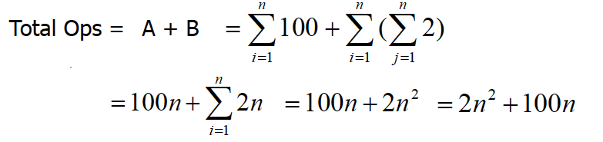
Example: Counting Operations
How many operations are required?
for (int i = 1; i <= n; i++) { perform 100 operations; // A for (int j = 1; j <= n; j++) {
perform 2 operations; // B
}
}

Slide 47
Example: Counting Operations
Knowing the number of operations required by the algorithm, we can state that
  Algorithm X takes 2n² + 100n operations to solve problem of size n
If the time t needed for one operation is known, then we can state
  Algorithm X takes (2n² + 100n)t time units
\

Slide 48
Example: Counting Operations
However, time t is directly dependent on the factors mentioned earlier
  e.g. different languages, compilers and computers
Instead of tying the analysis to actual time t, we can state
  Algorithm X takes time that is proportional to
2n² + 100n for solving problem of size n

Slide 49
Approximation of Analysis Results
Suppose the time complexity of
  Algorithm A is 3n² + 2n + log n + 1/(4n)
  Algorithm B is 0.39n³ + n
Intuitively, we know Algorithm A will outperform B
  When solving larger problem, i.e. larger n
The dominating term 3n² and 0.39n³ can tell us approximately how the algorithms perform
The terms n² and n³ are even simpler and preferred
These terms can be obtained through asymptotic analysis

Slide 50
Asymptotic Analysis
Asymptotic analysis is an analysis of algorithms that focuses on
  Analyzing problems of large input size
  Consider only the leading term of the formula
  Ignore the coefficient of the leading term

Slide 51
Why Choose Leading Term?
Lower order terms contribute lesser to the overall cost as the input grows larger
Example
  f(n) = 2n² + 100n
f(1000)
= 2(1000)² + 100(1000)
= 2,000,000 + 100,000
f(100000) = 2(100000)² + 100(100000)
= 20,000,000,000 + 10,000,000
Hence, lower order terms can be ignored

Slide 52
Examples: Leading Terms
a(n) = ½ n + 4
  Leading term:?
b(n) = 240n + 0.001n²
  Leading term: ?
  c(n) = n lg(n) + lg(n) + n lg( lg(n) )
  Leading term:?

Slide 53
Examples: Leading Terms
a(n) = ½ n + 4
  Leading term: ½ n
b(n) = 240n + 0.001n²
  Leading term: 0.001n²
c(n) = n lg(n) + lg(n) + n lg( lg(n) )
  Leading term: n lg(n)
  Note that lg(n) = log₂(n)

Slide 54
Why Ignore Coefficient of Leading Term?
Suppose two algorithms have 2n² and 30n² as the leading terms, respectively
Although actual time will be different due to the different constants, the growth rates of the running time are the same
Compare with another algorithm with leading term of n³, the difference in growth rate is a much more dominating factor
Hence, we can drop the coefficient of leading term when studying algorithm complexity

Slide 55
More examples
The two functions in the last two examples were
f( n ) = 3n + 3
g( n ) = 3n² + 4n + 3
These two functions have different shapes when graphed

Slide 56
Determining a Time Complexity
If a function for the number of instructions has at least one term with n, we can determine the time complexity by:
  Removing the least significant terms from the function
  Removing the coefficient of the remaining term

Slide 57
Example
For f( n ) = 3n + 3
3n+ 3
n

Slide 58
Example
For g( n ) = 3n² + 4n + 3
3n² + 4n + 3

Slide 59
Example
For g( n ) = 3n² + 4n + 3
3n² + 4n + 3
Remove the least significant terms

Slide 60
Example
For g( n ) = 3n² + 4n + 3
3n²

Slide 61
Example
For g( n ) = 3n² + 4n + 3
3n²
Remove the coefficient of the remaining term.

Slide 62
Example
For g( n ) = 3n² + 4n + 3
3n²

Slide 63
Example
For g( n ) = 3n² + 4n + 3
3n²
The time complexity that g( n ) belongs to

Slide 64
Upper Bound: The Big-O Notation
If algorithm A requires time proportional to f(n)
  Algorithm A is of the order of f(n)
  Denoted as Algorithm A is O(f(n))
  f(n) is the growth rate function for Algorithm A

Slide 65
The Big-O Notation
Formal definition
  Algorithm A is of O(f(n)) if there exist a constant k, and a positive integer n₀ such that Algorithm A requires no more than k * f(n) time units to solve a problem of size n >= n₀
Time
k*f(n)
Algorithm A
f(n)
n₀
Problem Size

Slide 66
The Big-O Notation
When problem size is larger than n₀, Algorithm A is
bounded from above by k * f(n)
Observations
  n₀ and k are not unique
  There are many possible f(n)
Time
k*f(n)
Algorithm A
f(n)
n₀
Problem Size

Slide 67
Example: Finding n₀ and k
Given complexity of Algorithm A is 2n² + 100n
Claim: Algorithm A is of O(n²)
Solution
  2n² + 100n < 2n² + n² = 3n² whenever n >100
  Set the constants to be k = 3 and n₀ = 100
  By definition, we say Algorithm A is O(n²)
Questions
  Can we say A is O(2n²) or O(3n²)?
  Can we say A is O(n³)?

Slide 68
Growth Terms
In asymptotic analysis, a formula can be simplified to a single term with coefficient 1 (how?)
Such a term is called a growth term (rate of growth, order of growth, order of magnitude)
The most common growth terms can be ordered as follows (note that many others are not shown)
O(1) < O(log n) < O(n) < O(n log n) < O(n²) < O(n³) < O(2^{n}) < …
“fastest” “slowest”
“log” = log₂
In big-O, log functions of different bases are all the same (why?)

Slide 69
Common Growth Rates
O(1) — constant time
  Independent of n
O(n) — linear time
  Grows as the same rate of n
  E.g. double input size -> double execution time
O(n²) — quadratic time
  Increases rapidly w.r.t. n
  E.g. double input size -> quadruple execution time
O(n³) — cubic time
  Increases even more rapidly w.r.t. n
  E.g. double input size -> 8 * execution time
O(2^{n}) — exponential time
  Increases very very rapidly w.r.t. n

Slide 70
Example: Exponential-Time Algorithm
Suppose we have a problem that, for an input consisting of n items, can be solved by going through 2^{n} cases
We use a supercomputer, that analyses 200 million cases per second
  Input with 15 items — 163 microseconds
  Input with 30 items — 5.36 seconds
  Input with 50 items — more than two months
  Input with 80 items — 191 million years

Slide 71
Example: Quadratic-Time Algorithm
Suppose solving the same problem with another algorithm will use 300n² clock cycles on a Handheld PC, running at 33 MHz
  Input with 15 items — 2 milliseconds
  Input with 30 items — 8 milliseconds
  Input with 50 items — 22 milliseconds
  Input with 80 items — 58 milliseconds
Therefore, to speed up program, don't simply rely on the raw power of a computer
  Very important to use an efficient algorithm

Slide 72
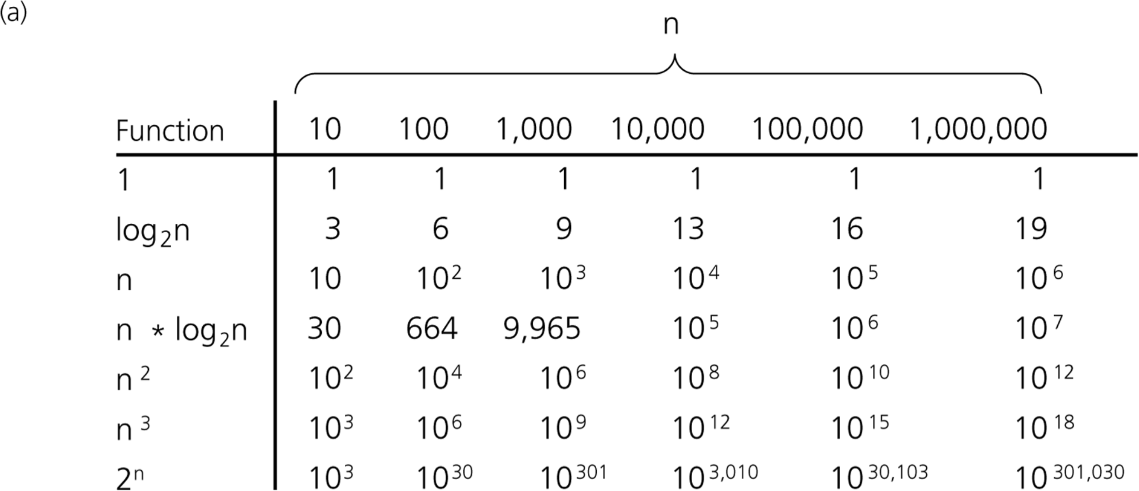
Comparing Growth Rates

Slide 73
Comparing N ² and N log N
The difference between O(N ²) and O(N log N) is enormous for large values of N, as shown in this table:
N
N ²
N log₂ N
10
100
33
100
10,000
664
1,000
1,000,000
9,966
10,000
100,000,000
132,877
100,000
10,000,000,000
1,660,964
1,000,000
1,000,000,000,000
19,931,569
Based on these numbers, the theoretical advantage of using merge sort over selection sort on a vector of 1,000,000 values would be a factor of more than 50,000.

Slide 74
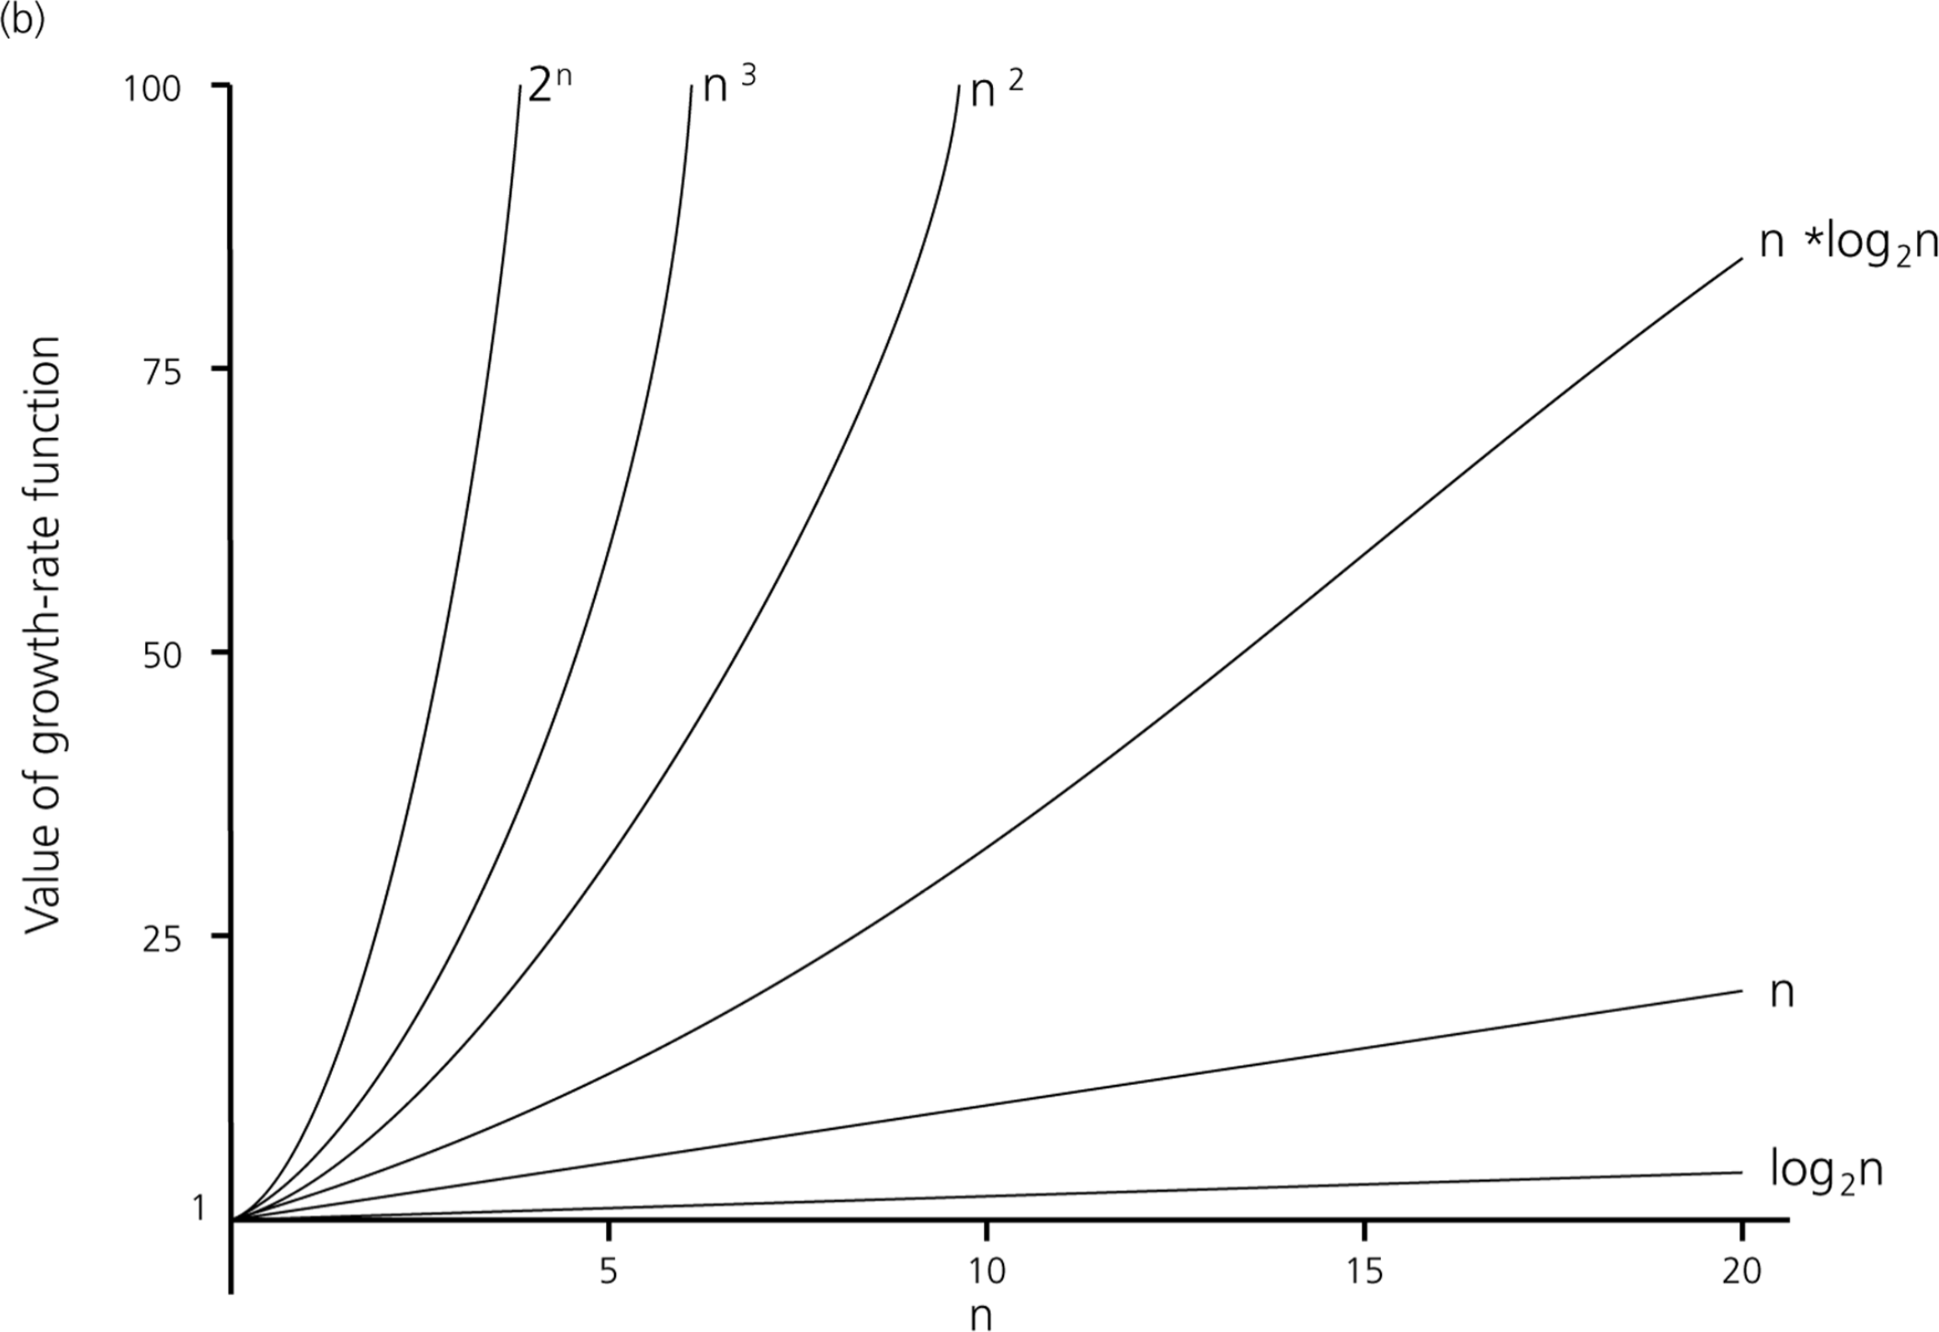
Comparing Growth Rates

Slide 75
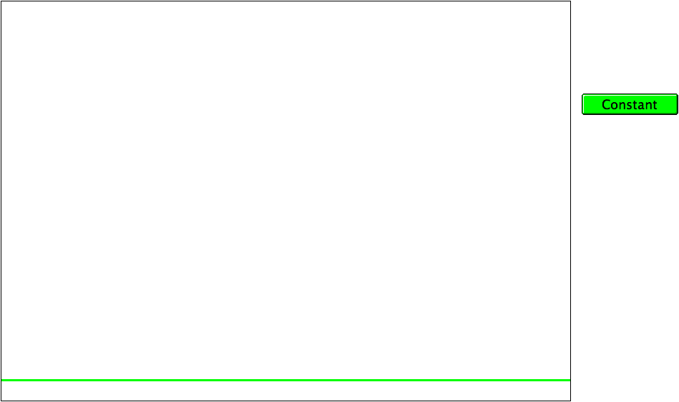
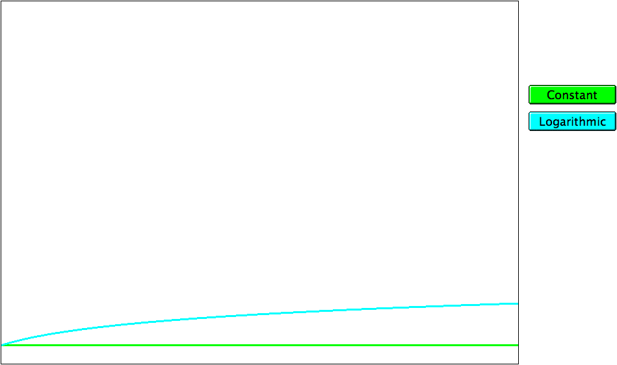
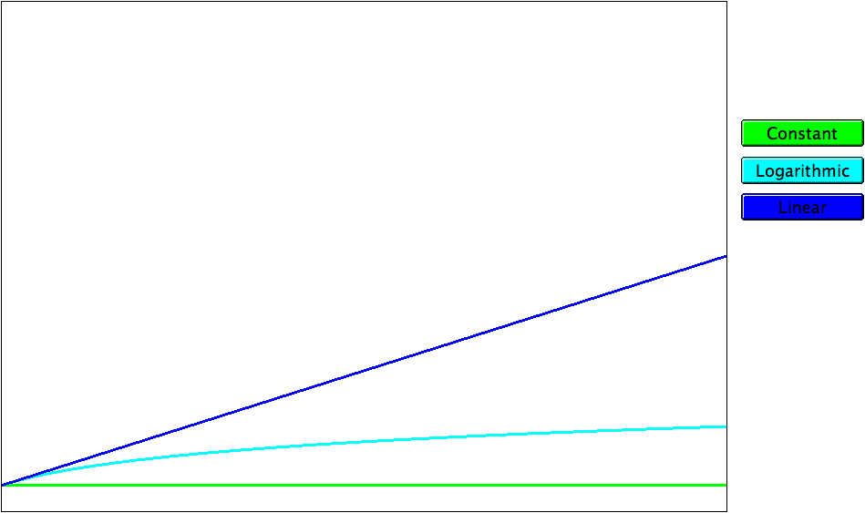
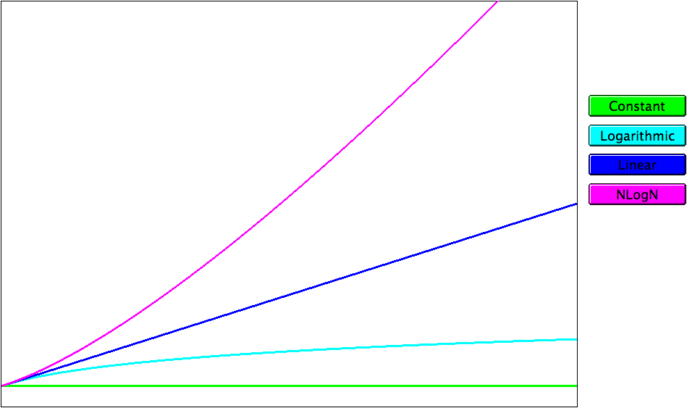
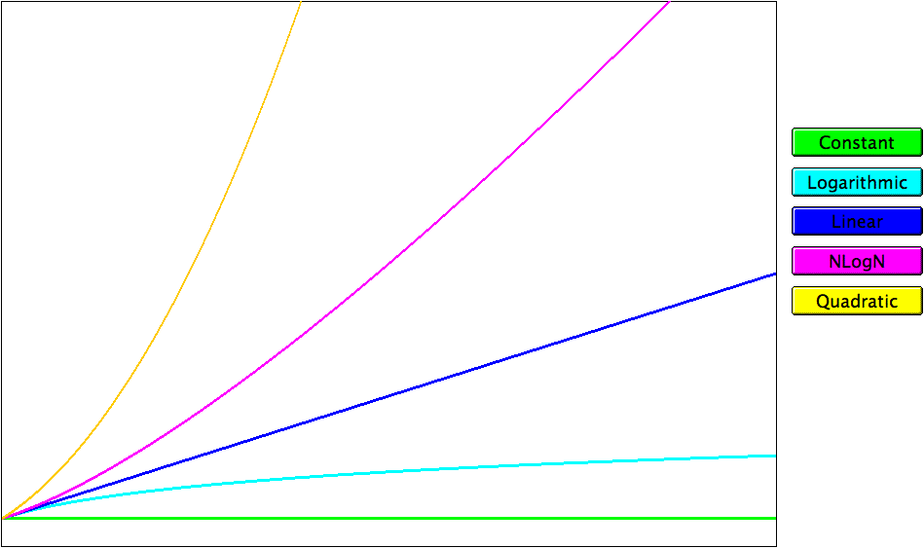
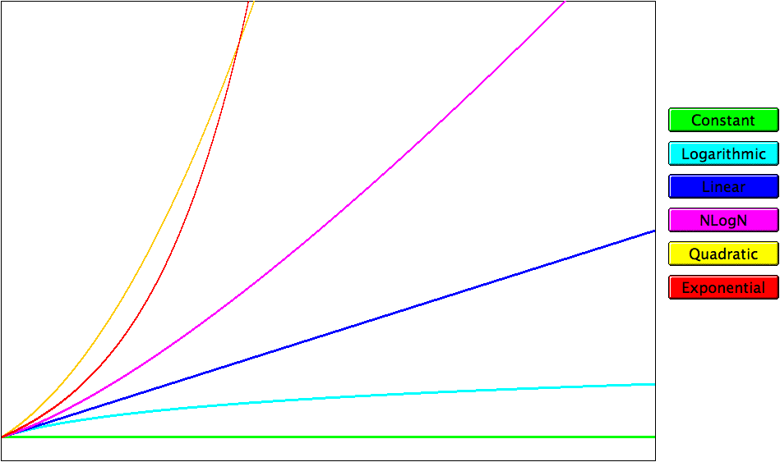
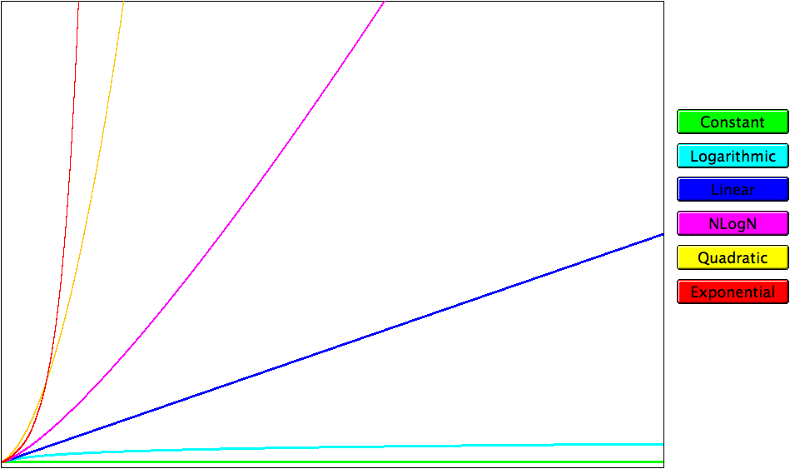
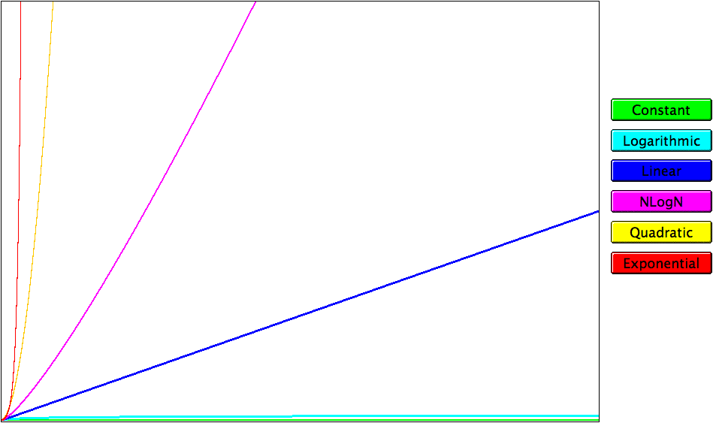
Graphs of the Complexity Classes
running time
problem size

Slide 76
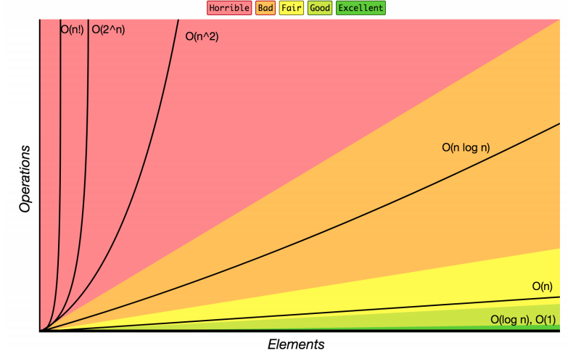
Review: Complexity Class
complexity class: A category of algorithm efficiency based on the algorithm's relationship to the input size N.
Complexity Class | Big-O | Runtime if you double N | Example Algorithm
constant | O(1) | unchanged | Accessing an index of an array
logarithmic | O(log₂ N) | increases slightly | Binary search
linear | O(N) | doubles | Looping over an array
log-linear | O(N log₂ N) | slightly more than doubles | Merge sort algorithm
quadratic | O(N²) | quadruples | Nested loops!
... | ... | ... | ...
exponential | O(2^{N}) | multiplies drastically | Fibonacci with recursion

Slide 77
How to Find Complexity?
Some rules of thumb
  Basically just count the number of statements executed
  If there are only a small number of simple statements in a program — O(1)
  If there is a ‘for’ loop dictated by a loop index that goes up to n — O(n)
  If there is a nested ‘for’ loop with outer one controlled by n
and the inner one controlled by m — O(n *m)
  For a loop with a range of values n, and each iteration reduces the range by a fixed constant fraction (eg: ½)
— O(log n)
  For a recursive method, each call is usually O(1). So
    If n calls are made — O(n)
    If n log n calls are made — O(n log n)

Slide 78
Example: Finding Complexity (1/2)
What is the complexity of the following code fragment?
int sum = 0;
for (int i = 1; i < n; i = i*2) { sum++;
}
It is clear that sum is incremented only when
i = 1, 2, 4, 8, …, 2^{k} where k = log₂n
There are k + 1 iterations.
So the complexity is O(k) or O(log n)

Slide 79
Example: Finding Complexity (2/2)
What is the complexity of the following code fragment?
  For simplicity, let’s assume that n is some power of 3
int sum = 0;
for (int i = 1; i <= n; i = i*3) for (int j = 1; j <= i; j++)
sum++;
f(n) = 1 + 3 + 9 + 27 + … + 3 ^{(log} ₃^{n)}
= 1 + 3 + … + n/9 + n/3 + n
= n + n/3 + n/9 + … + 3 + 1
= n * (1 + 1/3 + 1/9 + …)
≤ n * (3/2)
= 3n/2
= O(n)

Slide 80
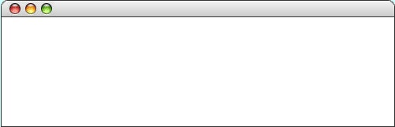

The Towers of Hanoi Solution
int main() {
int nDisks = 3;
initHanoiGraphics(nDisks);
moveTower(nDisks, 'A', 'B', 'C');
return 0;
}
int main() {
int nDisks = 3;
initHanoiGraphics(nDisks);
moveTower(nDisks, 'A', 'B', 'C');
return 0;
}
void moveTower(int n, char start, char finish, char temp) {
if (n == 1) {
moveSingleDisk(start, finish);
} else {
moveTower(n - 1, start, temp, finish);
moveSingleDisk(start, finish);
moveTower(n - 1, temp, finish, start);
}
}
void moveTower(int n, char start, char finish, char temp) {
if (n == 1) {
moveSingleDisk(start, finish);
} else {
moveTower(n - 1, start, temp, finish);
moveSingleDisk(start, finish);
moveTower(n - 1, temp, finish, start);
}
}
void moveTower(int n, char start, char finish, char temp) {
if (n == 1) {
moveSingleDisk(start, finish);
} else {
moveTower(n - 1, start, temp, finish);
moveSingleDisk(start, finish);
moveTower(n - 1, temp, finish, start);
}
}
void moveTower(int n, char start, char finish, char temp) {
if (n == 1) {
moveSingleDisk(start, finish);
} else {
moveTower(n - 1, start, temp, finish);
moveSingleDisk(start, finish);
moveTower(n - 1, temp, finish, start);
}
}
void moveTower(int n, char start, char finish, char temp) {
if (n == 1) {
moveSingleDisk(start, finish);
} else {
moveTower(n - 1, start, temp, finish);
moveSingleDisk(start, finish);
moveTower(n - 1, temp, finish, start);
}
}
void moveTower(int n, char start, char finish, char temp) {
if (n == 1) {
moveSingleDisk(start, finish);
} else {
moveTower(n - 1, start, temp, finish);
moveSingleDisk(start, finish);
moveTower(n - 1, temp, finish, start);
}
}
void moveTower(int n, char start, char finish, char temp) {
if (n == 1) {
moveSingleDisk(start, finish);
} else {
moveTower(n - 1, start, temp, finish);
moveSingleDisk(start, finish);
moveTower(n - 1, temp, finish, start);
}
}
void moveTower(int n, char start, char finish, char temp) {
if (n == 1) {
moveSingleDisk(start, finish);
} else {
moveTower(n - 1, start, temp, finish);
moveSingleDisk(start, finish);
moveTower(n - 1, temp, finish, start);
}
}
nDisks
3
n
start
finish
temp
n
start
finish
temp
'C'
3
'C'
3
'A'
'A'
'B'
n
'B'
n
start
start
finish
finish
temp
temp
'B'
2
'A'
2
'A'
'C'
'C'
n
'B'
n
n
n
start
start
start
start
finish
finish
finish
finish
temp
temp
temp
temp
'C'
'A'
'B'
1
'C'
1
1
1
'A'
'B'
'C'
'A'
'B'
'C'
'A'
'B'
Hanoi

Slide 81
Analysis 1: Tower of Hanoi
Number of moves made by the algorithm is 2^{n} − 1
  Prove it!
    Hints: f(1)=1, f(n)=f(n-1) + 1 + f(n-1), and prove by induction
Assume each move takes c time, then
f(n) = c(2^{n} − 1) = O(2^{n})
The Tower of Hanoi algorithm is an exponential time algorithm

Slide 82
Review: Sequential Search
sequential search: Locates a target value in a collection by examining each element sequentially
  Example: Searching the array below for the value 42:
index | 0 | 1 | 2 | 3 | 4 | 5 | 6 | 7 | 8 | 9 | 10 | 11 | 12 | 13 | 14 | 15 | 16
value | -4 | 2 | 7 | 10 | 15 | 20 | 22 | 25 | 30 | 36 | 42 | 50 | 56 | 68 | 85 | 92 | 103
i
How many elements will be examined?
  What is the best case?
  What is the worst case?
  What is the average case?
int search(int[] a, int val) {
for (int i = 0; i < a.length; i++) {
if (a[i] == val) {
return i;
}
}
return –1;
}
element found at index 0, 1 item examined, O(1)
f(n) = n
element found at index 16 or not found, all
elements examined, O(n)
most elements examined, O(n)

Slide 83
Review: Binary Search
binary search: Locates a target value in a sorted array or list by successively eliminating half of the array from consideration.
  Example: Searching the array below for the value 42:
index | 0 | 1 | 2 | 3 | 4 | 5 | 6 | 7 | 8 | 9 | 10 | 11 | 12 | 13 | 14 | 15 | 16
value | -4 | 2 | 7 | 10 | 15 | 20 | 22 | 25 | 30 | 36 | 42 | 50 | 56 | 68 | 85 | 92 | 103
min
mid
max
static void binarySearch(int[] a, int val){
…
while (first <= last){
if (arr[mid] < key ){
first = mid + 1;
} else if ( arr[mid] == key ){
return mid;
} else{
last = mid - 1;
}
mid = (first + last)/2;
}
return -1;
}
How many elements will be examined?
  What is the best case?
  What is the worst case?
  What is the average case?
element found at index 8, 1 item examined, O(1)
element found at index 9 or not found, ½ elements examined, O(?)

Slide 84
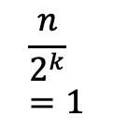
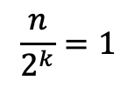
Analyzing Binary Search
What is the pattern?
  At each iteration, we eliminate half of the remaining elements
How long does it take to finish?
  1st iteration – N/2 elements remain
  2nd iteration – N/4 elements remain
  Kth iteration - N/2^{k} elements remain
Finishes when
-> multiply right side by 2^{K}
N = 2^{K}
-> isolate K exponent with logarithm
log₂N = k
index | 0 | 1 | 2 | 3 | 4 | 5 | 6 | 7 | 8 | 9 | 10 | 11 | 12 | 13 | 14 | 15 | 16
value | -4 | 2 | 7 | 10 | 15 | 20 | 22 | 25 | 30 | 36 | 42 | 50 | 56 | 68 | 85 | 92 | 103

Slide 85
Linear Search
The simplest strategy for searching is to start at the beginning of the array and look at each element in turn. This algorithm is called linear search.
Linear search is straightforward to implement, as illustrated in the following method that returns the first index at which the value key appears in array, or -1 if it does not appear at all:
int linearSearch(int key, Vector<int> array) {
for (int i = 0; i < array.size(); i++) {
if (key == array[i]) return i;
}
return -1;
}

Slide 86
Analysis 2: Sequential Search
Check whether an item x is in an unsorted array a[ ]
  If found, it returns position of x in array
  If not found, it returns -1
public int seqSearch(int a[], int len, int x) { for (int i = 0; i < len; i++) {
if (a[i] == x) return i;
}
return -1;
}

Slide 87
Analysis 2: Sequential Search
Time spent in each iteration through the loop is at most some constant c₁
Time spent outside the loop is at most some constant c₂
Maximum number of iterations is n
Hence, the asymptotic upper bound is
c₁n + c₂ = O(n)
Observation
  In general, a loop of n iterations will lead to O(n) growth rate
  This is an example of Worst Case Analysis

Slide 88
Analysis 3: Binary Search
Important characteristics
  Requires array to be sorted
  Maintain sub-array where x might be located
  Repeatedly compare x with m, the middle of current sub-array
    If x = m, found it!
    If x > m, eliminate m and positions before m
    If x < m, eliminate m and positions after m
Iterative and recursive implementations

Slide 89
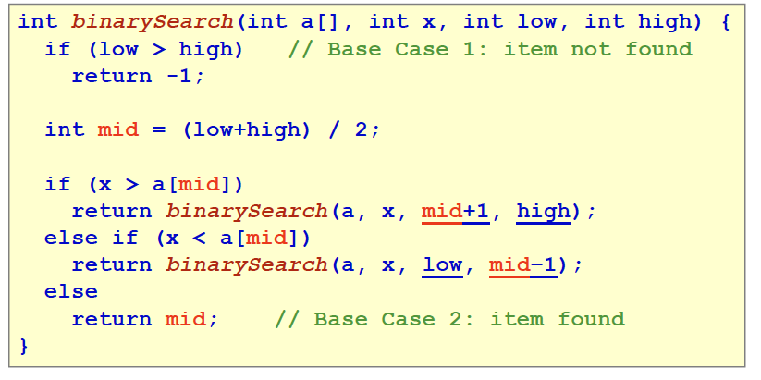
Binary Search (Recursive)

Slide 90
Binary Search (Iterative)
int binSearch(int a[], int len, int x) { int mid, low = 0;
int high = len-1;
while (low <= high) { mid = (low+high) / 2; if (x == a[mid])
return mid;
else if (x > a[mid]) low = mid+1;
else
high = mid-1;
}
return -1; // item not found
}

Slide 91
Analysis 3: Binary Search (Iterative)
Time spent outside the loop is at most c₁
Time spent in each iteration of the loop is at most c₂
For inputs of size n, if the program goes through at most f(n) iterations, then the complexity is
c₁ + c₂f(n) or O(f(n))
i.e. the complexity is decided by the number of iterations (loops)

Slide 92
Analysis 3: Finding f(n)
At any point during binary search, part of array is “alive” (might contain x)
Each iteration of loop eliminates at least half of previously “alive” elements
At the beginning, all n elements are “alive”, and after
  One iteration, at most n/2 are left, or alive
  Two iterations, at most (n/2)/2 = n/4 = n/2² are left
  Three iterations, at most (n/4)/2 = n/8 = n/2³ are left
  . . .
  k iterations, at most n/2^{k} are left
  At the final iteration, at most 1 element is left

Slide 93
Analysis 3: Finding f(n)
In the worst case, we have to search all the way up to the last iteration k with only one element left
We have
n/2^{k} = 1  2^{k} = n  k = log₂(n) = lg(n)
Hence, the binary search algorithm takes O(f(n)), or O(lg(n)) time
Observation
  In general, when the domain of interest is reduced by a fraction for each iteration of a loop, then it will lead to O(log n) growth rate

Slide 94
Analysis of Different Cases
For an algorithm, three different cases of analysis
  Worst-Case Analysis
    Look at the worst possible scenario
  Best-Case Analysis
    Look at the ideal case
    Usually not useful
  Average-Case Analysis
    Probability distribution should be known
    Hardest/impossible to analyze
Example: Sequential Search
  Worst-Case: target item at the tail of array
  Best-Case: target item at the head of array
  Average-Case: target item can be anywhere

Slide 95
Asymptotic Analysis
asymptotic analysis – the process of mathematically representing runtime of a algorithm in relation to the number of inputs and how that relationship changes as the number of inputs grow
Two step process
Model – reduce code run time to a mathematical relationship with number of inputs
Analyze – compare runtime/input relationship across multiple algorithms

Slide 96
Summary
Algorithm Definition
Algorithm Analysis
  Counting operations
  Asymptotic Analysis
  Big-O notation (Upper-Bound)
Three cases of analysis
  Best-case
  Worst-case
  Average-case

Slide 97
CS 2121: Data Structures
Recitation HW3
Bernard Ku
Fall 2019

Slide 98
How Many Instructions?
1 sum = 0;
2 i = 4;
3 while ( i > 3 && i < 10) {
4 sum += A[ i ];
5 i++;
6 }

Slide 99
Functions of n - How many instructions?
The number of instructions can often be written as a function of n:
sum = 0;
for ( i=0; i < numElements; i++ ) {
sum += A[ i ];
}

Slide 100
How Many Instructions?
1 sum = 0;
2 for ( i=0; i < n; i++ ) {
3 for (j=0; j < n; j++ ) {
4 sum += i * j;
5 }
6 }

Slide 101
HW4 Deliverables
Write down no of instructions for each problem
What can they be reduced to?
Submit your HW4 as FirstLastHw4.txt or .docx

Slide 102
CS 2123: Data Structures
L3 - Algorithm Analysis
09/05/19
Bernard Ku
Fall 2019

