Slide 1
Attention and Augmented Neural Networks
Korbinian Riedhammer
Based on https://distill.pub/2016/augmented-rnns/

Slide 2
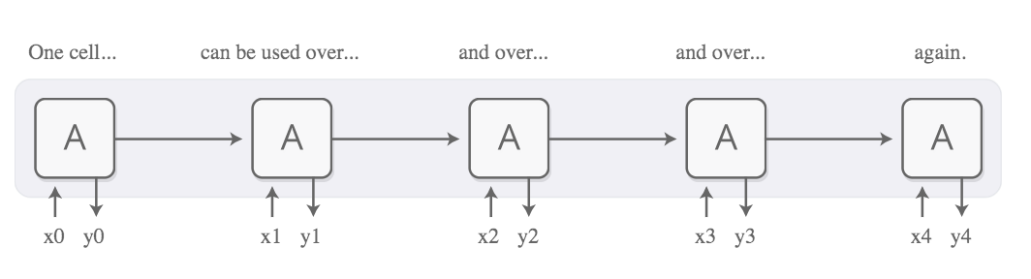
Recurrent Neural Networks

Slide 3
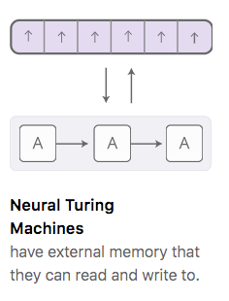
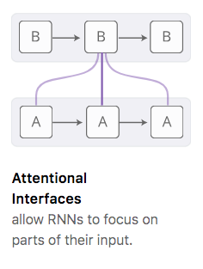
Variants

Slide 4
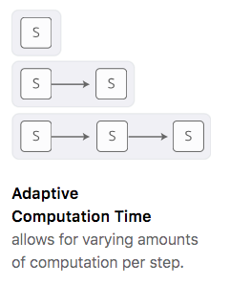
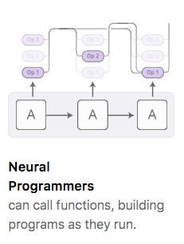
Variants

Slide 5
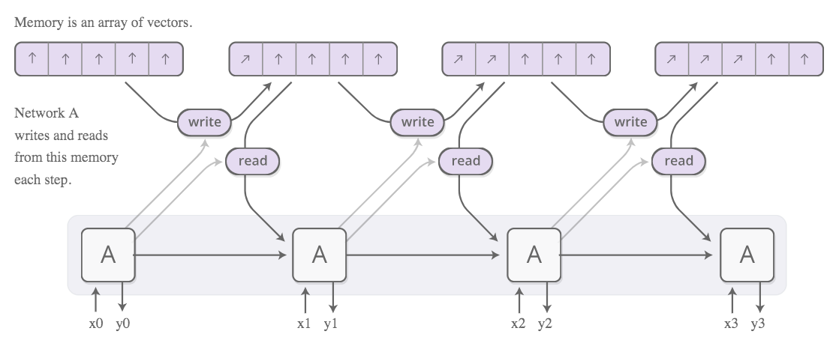
Neural Turing Machines

Slide 6
Neural Turing Machines
Vectors are “natural language” of neural nets
How to read/write from memory?
How to differentiate?
In every step, read and
write everywhere!

Slide 7
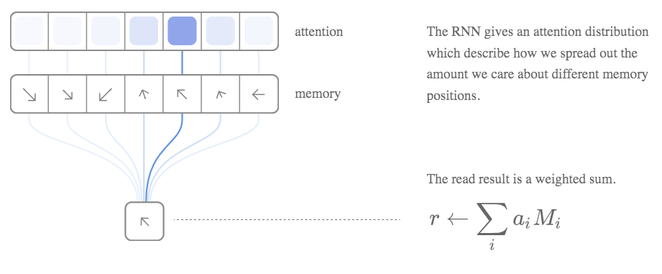
“Read” from Memory

Slide 8
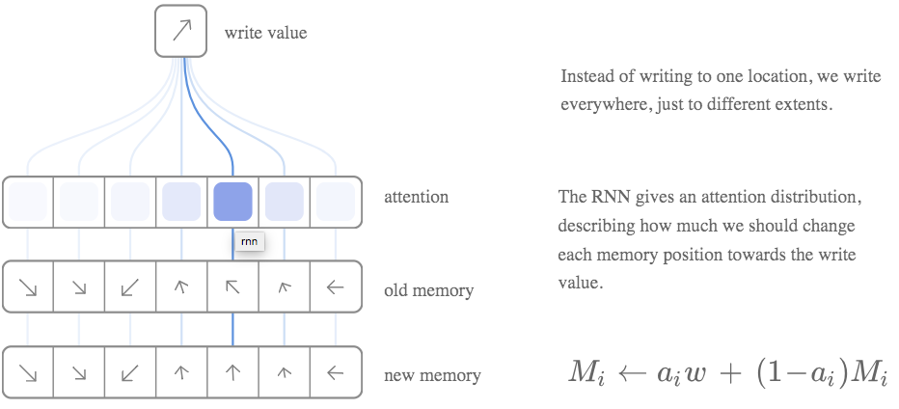
“Write” to Memory

Slide 9
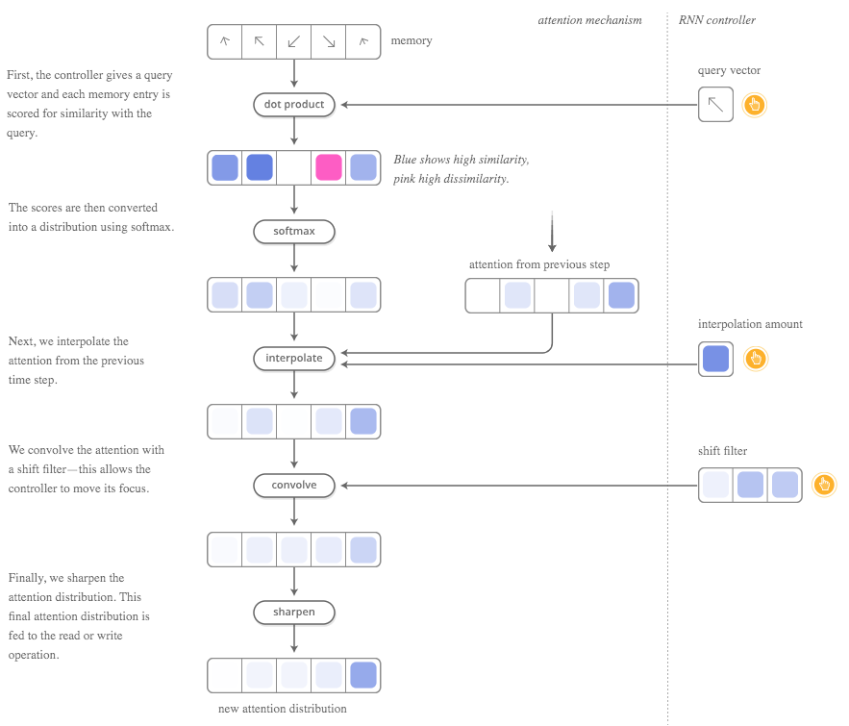
Content based and Location based Attention
Notes:
Demo at https://distill.pub/2016/augmented-rnns/

Slide 10
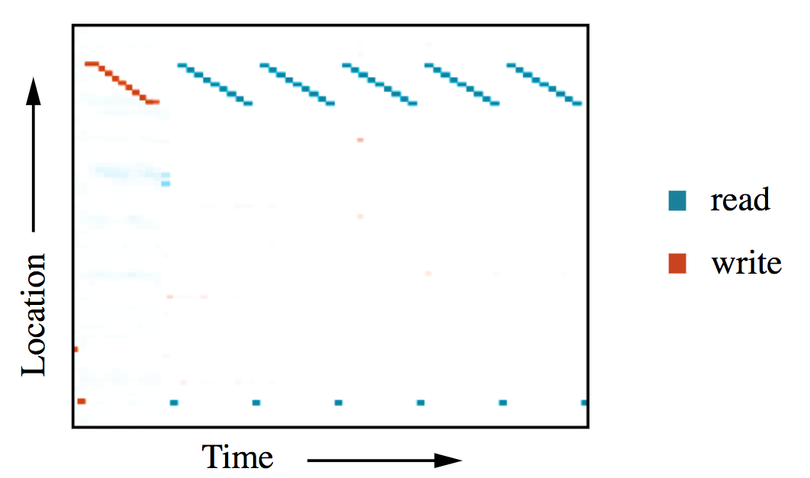
Visualization

Slide 11
Attentional Interfaces
Observation: In many complex human tasks (eg. translation, transcription, description, …), you pay attention to different aspects (in time and space)
Model this “attention” in neural nets?
How can we incorporate hidden state of previous time steps? …and be differentiable?
Similar to NTM, focus
everywhere
but with different amount

Slide 12
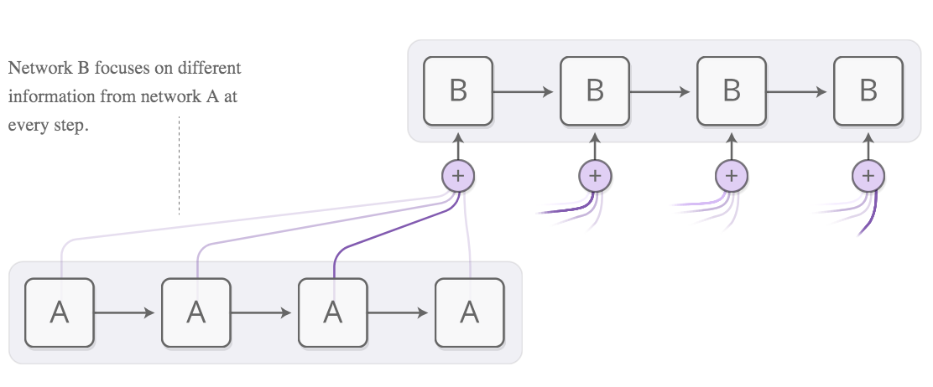
Attentional Interfaces

Slide 13
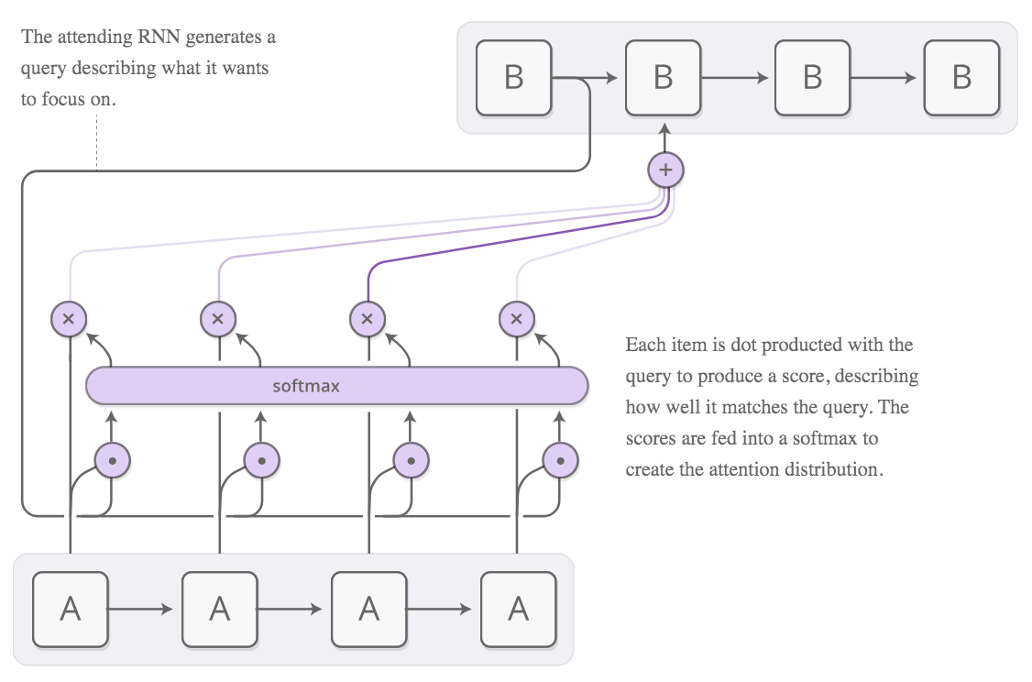
Content-Based Attention

Slide 14
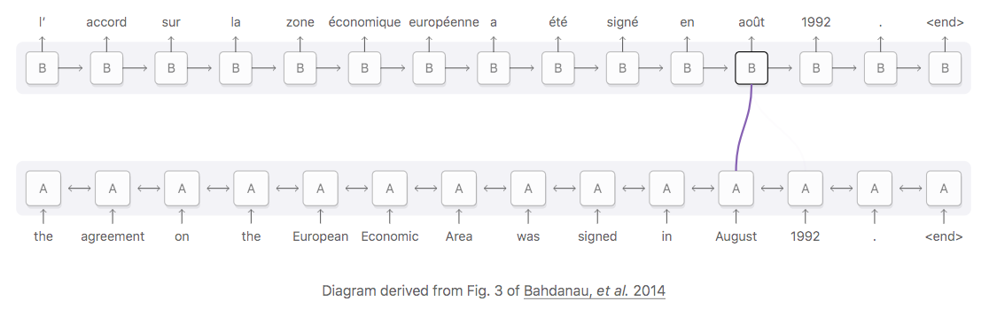
Example: direct dependency
Notes:
Demo at https://distill.pub/2016/augmented-rnns/

Slide 15
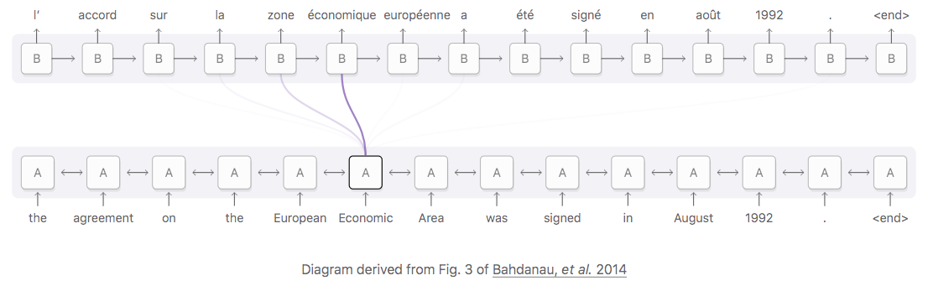
Example: multi-dependency
Notes:
Demo at https://distill.pub/2016/augmented-rnns/

Slide 16
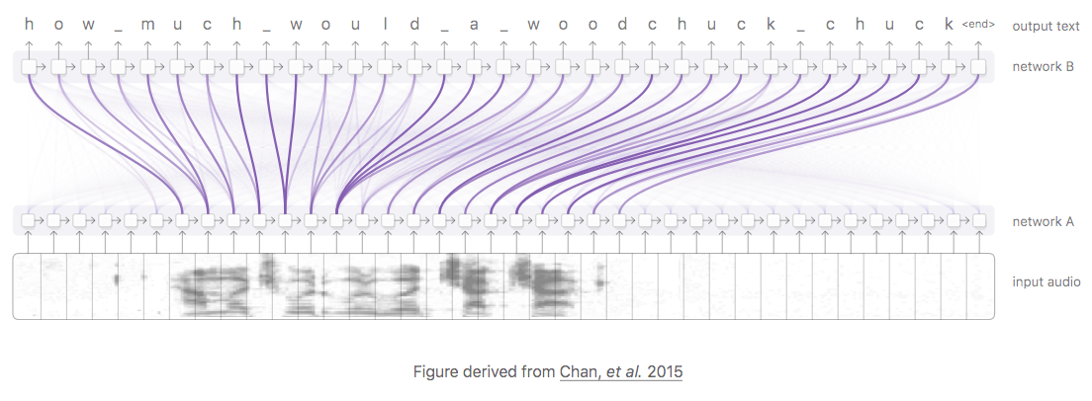
Attention in Speech
Notes:
Demo at https://distill.pub/2016/augmented-rnns/

Slide 17
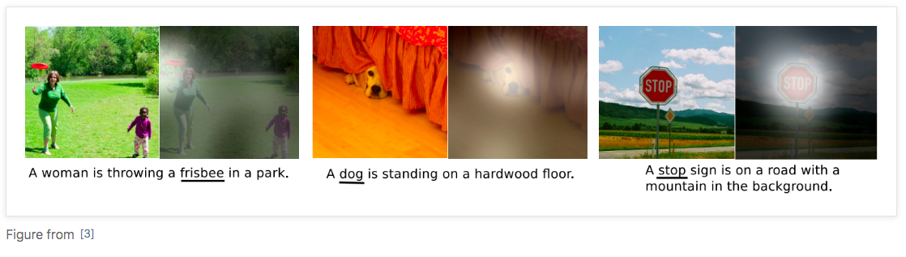
Attention in Images

Slide 18
General Principle
Everything in neural net needs to be differentiable (→ learning with backprop!)
Model discrete selections (single outputs) as continuous selections (select all with different weight)
Neural networks become “computational graphs”

Slide 19
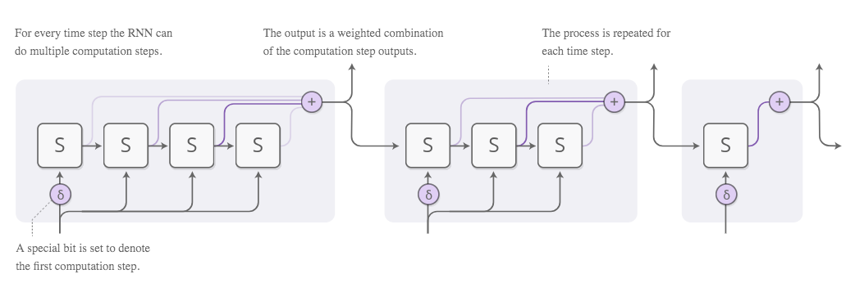
Adaptive Computation Time
Allow RNN to execute variable amounts of computation for each timestep?
How many timesteps? …attention!

Slide 20
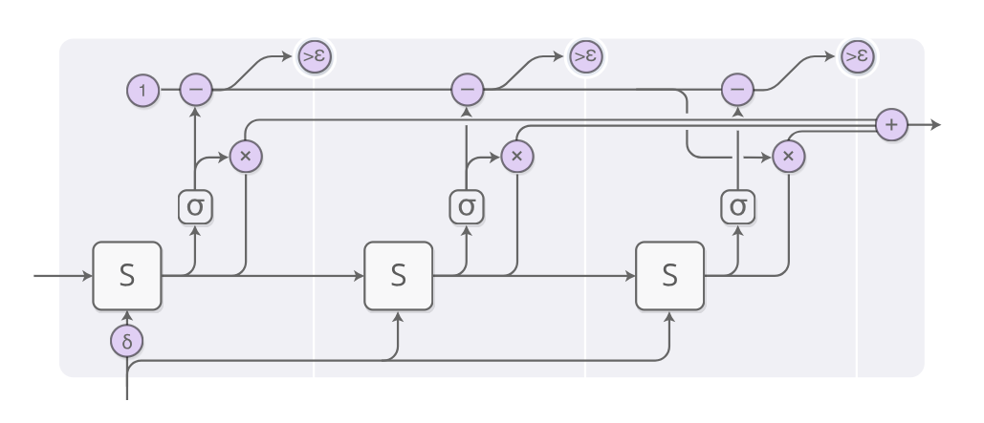
Adaptive Compute Time
ACT in detail

Slide 21
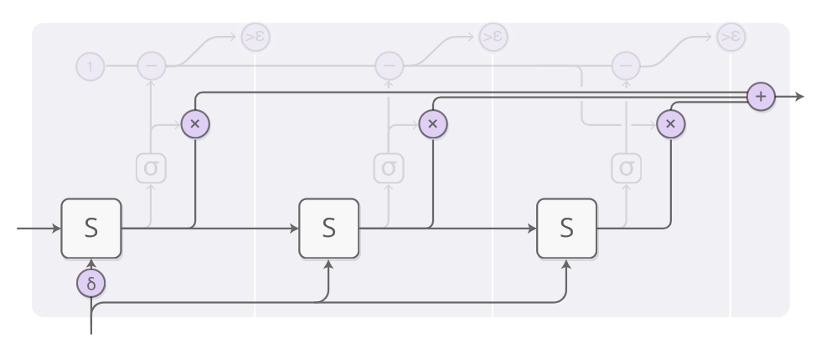
Adaptive Compute Time
Output: weighted combination of states

Slide 22
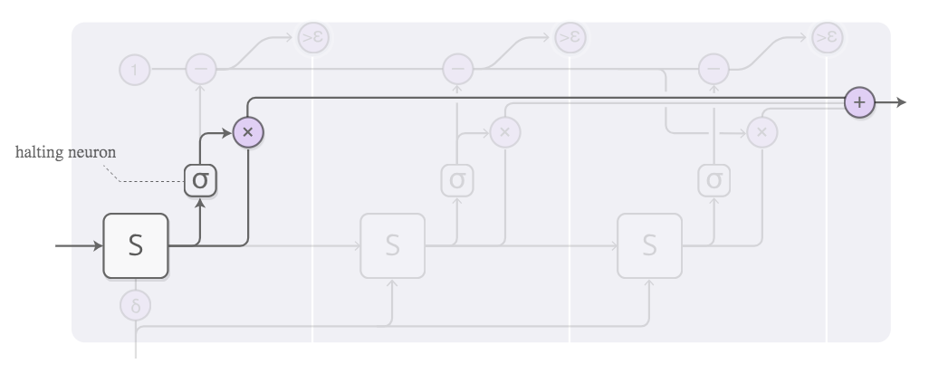
Adaptive Compute Time
Individual weights determined by “halting neuron”
(sigmoid activation, read “likelihood to stop here”)

Slide 23
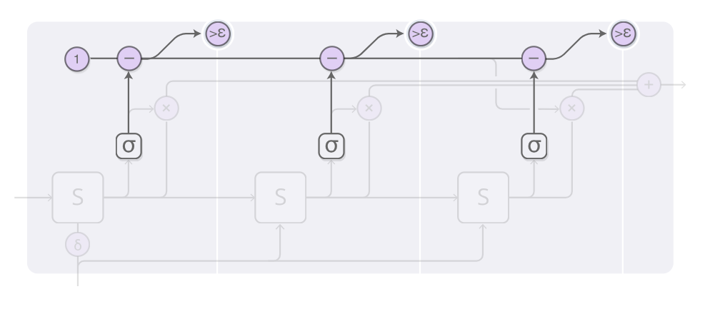
Adaptive Compute Time
Make sure that weights sum up to 1!
Stop when no weight is left

Slide 24
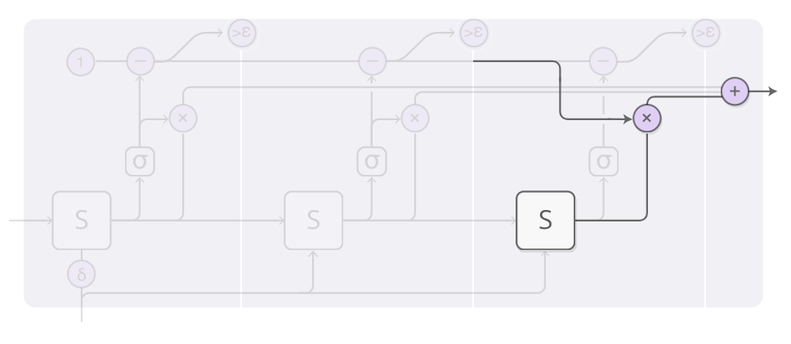
Adaptive Compute Time
Add residual weight to output by forcing last state

Slide 25
Still not creepy enough?
There is even more!

Slide 26
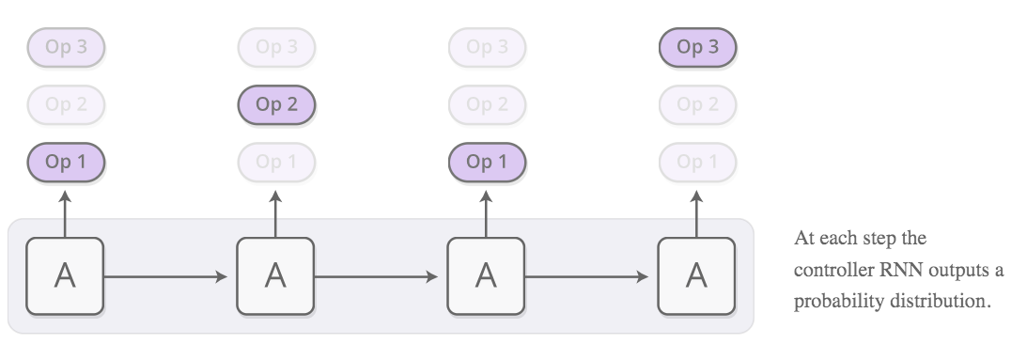
Neural Programmer
How about modeling actions/operations?
Like arithmetic, loops, etc.?
Model as distribution of operations

Slide 27
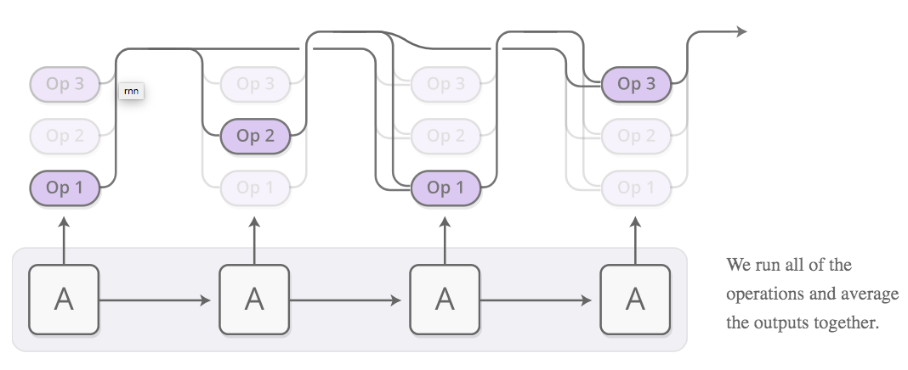
Neural Programmer
…and use attention to make it differentiable!

