Slide 1
UNITED NATIONS · 2030 AGENDA
The Sustainable Development Goals
A course project exploring all 17 goals, what they mean, and how technology can help people understand them better
Li Shuhang · Feng Jingyi · Wang Luyang · Lu Jianning
Academic Course Presentation · June 2026
1

Slide 2
Presentation Outline
What we'll cover in the next 20 minutes
01 Introduction to the SDGs
02 The 17 Goals at a Glance
03 Why the SDGs Exist
Where they came from, what they cover, and how they're structured
A walk through all 17 goals, how they group together, and two deep dives
The problems they're trying to solve and how they approach them differently
04 Our Team & This Project
05 What We Built
06 What We Learned & What's Next
Four people, four backgrounds, one website about the SDGs
The carbon footprint calculator, action guides, and how the site works under the hood
Key takeaways from this project and how to get involved
2

Slide 3
What Are the SDGs?
A quick background on where they came from and what they're trying to do
The Sustainable Development Goals are 17 interconnected global objectives adopted unanimously by all 193 United Nations Member States in September 2015. They form the core of the 2030 Agenda for Sustainable Development — a shared blueprint for peace and prosperity for people and the planet. The goals balance the three dimensions of sustainable development: economic, social, and environmental.
2015
2023
2030
SDGs Adopted
Midpoint Review
Target Deadline
193 countries sign UN General Assembly
Progress at 15% Off-track on most goals
Goals to be achieved Urgent acceleration needed
3

Slide 4
Key Statistics
The SDGs by the numbers
17
193
2030
169
Global Goals
Member States
Target Year
Specific Targets
Interconnected objectives
Unanimously adopted in 2015
Only 4 years remaining
Measured by 232 indicators
4

Slide 5
Why the SDGs Exist
Three reasons the old approach wasn't working
The Problems Don't Stop at Borders
A Framework That Connects the Dots
Measurable, Not Just Nice Words
Temperatures are up about 1.1°C since the Industrial Revolution. Over 700 million people still live on less than $2.15 a day. Species are going extinct at rates not seen in millions of years. These aren't separate issues — they feed into each other, and no country can fix them by acting alone.
Before the SDGs, development goals tended to be siloed — health over here, environment over there. The 2030 Agenda explicitly links economic, social, and environmental dimensions. The idea is simple: you can't lift people out of poverty while destroying the ecosystems they depend on.
Unlike many international agreements, the SDGs come with teeth — 169 specific targets and 232 indicators that can be tracked. The 'Leave No One Behind' principle means looking past national averages to see who's being excluded: women, children, people with disabilities, and the extreme poor.
5

Slide 6
The 17 Sustainable Development Goals
From ending poverty to protecting the oceans — all 17 goals at a glance
01
02
03
04
05
06
No Poverty
Zero Hunger
Good Health & Well-being
Quality Education
Gender Equality
Clean Water & Sanitation
07
08
09
10
11
12
Clean Energy
Decent Work & Economic Growth
Industry, Innovation & Infrastructure
Reduced Inequalities
Sustainable Cities & Communities
Responsible Consumption & Production
13
14
15
16
17
Climate Action
Life Below Water
Life on Land
Peace, Justice & Strong Institutions
Partnerships for the Goals
6

Slide 7
Goals Grouped — The 5P Framework
The 17 goals organized into five clusters — the UN calls this the 5P framework
People
Planet
End poverty and hunger in all forms, and ensure dignity and equality for every human being
Protect Earth's natural resources and climate to sustain future generations
No Poverty · Zero Hunger · Good Health & Well-being · Quality Education · Gender Equality
Clean Water & Sanitation · Responsible Consumption & Production · Climate Action · Life Below Water · Life on Land
7

Slide 8
Goals Grouped — Prosperity, Peace & Partnership
The remaining groups: prosperity, peace, and the partnerships that make it all possible
Prosperity
Peace
Ensure all human beings can enjoy prosperous and fulfilling lives in harmony with nature
Foster peaceful, just, and inclusive societies free from fear and violence
Clean Energy · Decent Work & Economic Growth · Industry, Innovation & Infrastructure · Reduced Inequalities · Sustainable Cities & Communities
Peace, Justice & Strong Institutions
Partnership
Mobilize the means required to implement this agenda through global solidarity
Partnerships for the Goals
8

Slide 9
Spotlight: SDG 13 — Climate Action
The science is clear, the solutions exist — why this goal matters most
Why Climate Action Matters
Rising Temperatures
Global average temperature has risen ~1.1°C above pre-industrial levels. The past decade (2014–2024) was the warmest on record.
Extreme Weather
Climate-related disasters have increased over 80% in the last decade, affecting millions and costing billions in damages globally.
Emissions Gap
To limit warming to 1.5°C, global greenhouse gas emissions must peak before 2025 and decline 43% by 2030 from 2019 levels.
Sea Level Rise
The difference between 1.5°C and 2°C of warming means 10 million more people at risk from coastal flooding and saltwater intrusion.
Ecosystem Impact
Coral reefs could decline 70–90% at 1.5°C warming, and over 99% at 2°C — threatening marine biodiversity and coastal livelihoods.
9

Slide 10
Spotlight: SDG 4 — Quality Education
Why education is the foundation for every other SDG
Why Quality Education Matters
Learning Crisis
Before COVID-19, 258 million children and youth were out of school. Only 58% of students worldwide achieve minimum proficiency in reading and math.
Gender Disparity
Girls in conflict-affected areas are 2.5× more likely to be out of school. Education reduces child marriage and improves health outcomes.
Economic Multiplier
Each additional year of schooling raises individual earnings by ~10%. Education is the single most powerful driver of economic mobility.
Digital Divide
Over 1.3 billion school-age children lack home internet access, creating a homework gap that widens inequality in the digital era.
Foundational Goal
Quality education underpins every other SDG — from poverty reduction (SDG 1) to innovation (SDG 9) and climate awareness (SDG 13).
10

Slide 11
Meet the Team
Four students, four different majors, one project
L
F
W
L
Li Shuhang
Feng Jingyi
Wang Luyang
Lu Jianning
Project Lead
Tech Development
Policy Research
Data Analyst
Finance ID: 8168667
Accounting ID: 8168308
Accounting ID: 8168505
Finance ID: 8168379
11

Slide 12
Team SDG Assignments
Who worked on which goals, and why
Team Member | Assigned SDGs | Rationale for Assignment | Academic Background
Li Shuhang | SDG 6, 13, 15 | Finance and environmental research background aligns with climate action, biodiversity conservation, and clean water — planet-focused goals requiring both analytical rigor and ecosystem understanding | Finance
Feng Jingyi | SDG 7, 9, 12 | Technology and innovation expertise drives solutions for clean energy transition, sustainable industry, and responsible consumption — using intelligent platforms to make sustainability measurable and actionable | Accounting
Wang Luyang | SDG 5, 10, 16, 17 | Policy research and governance analysis underpins equity, justice, and partnership goals — focusing on inclusive institutions, gender equality, and multi-stakeholder cooperation frameworks | Accounting
Lu Jianning | SDG 1, 2, 3, 4 | Data analysis and quantitative methods enable rigorous assessment of poverty, hunger, health, and education outcomes — using statistical models to reveal where interventions are most needed | Finance
12

Slide 13
What We're Trying to Do
The point of this project, honestly stated
What We Set Out to Do
What We'd Like to See
Build a website that explains all 17 SDGs clearly, includes an interactive carbon calculator people can actually use, and shows how individual choices connect to global issues. Nothing revolutionary — just making the information accessible.
More people understanding that the SDGs aren't just for governments and NGOs. The choices we make every day — what we eat, how we get around, what we throw away — are directly connected to global sustainability. Small changes at scale matter.
01
02
03
04
Make the SDGs Understandable
Give People Tools, Not Just Information
Work Across Disciplines
Make It Relevant to Daily Life
Most people have heard of the SDGs but can't name more than two. We wanted to build something that makes all 17 easy to explore.
Reading about carbon footprints is one thing. Actually calculating yours and getting personalized tips is more useful.
You can't understand the SDGs from just one angle. Our team covers environmental science, CS, international affairs, and statistics.
Global goals feel abstract. We tried to connect each SDG to choices people actually make — what they eat, how they travel, what they buy.
13

Slide 14
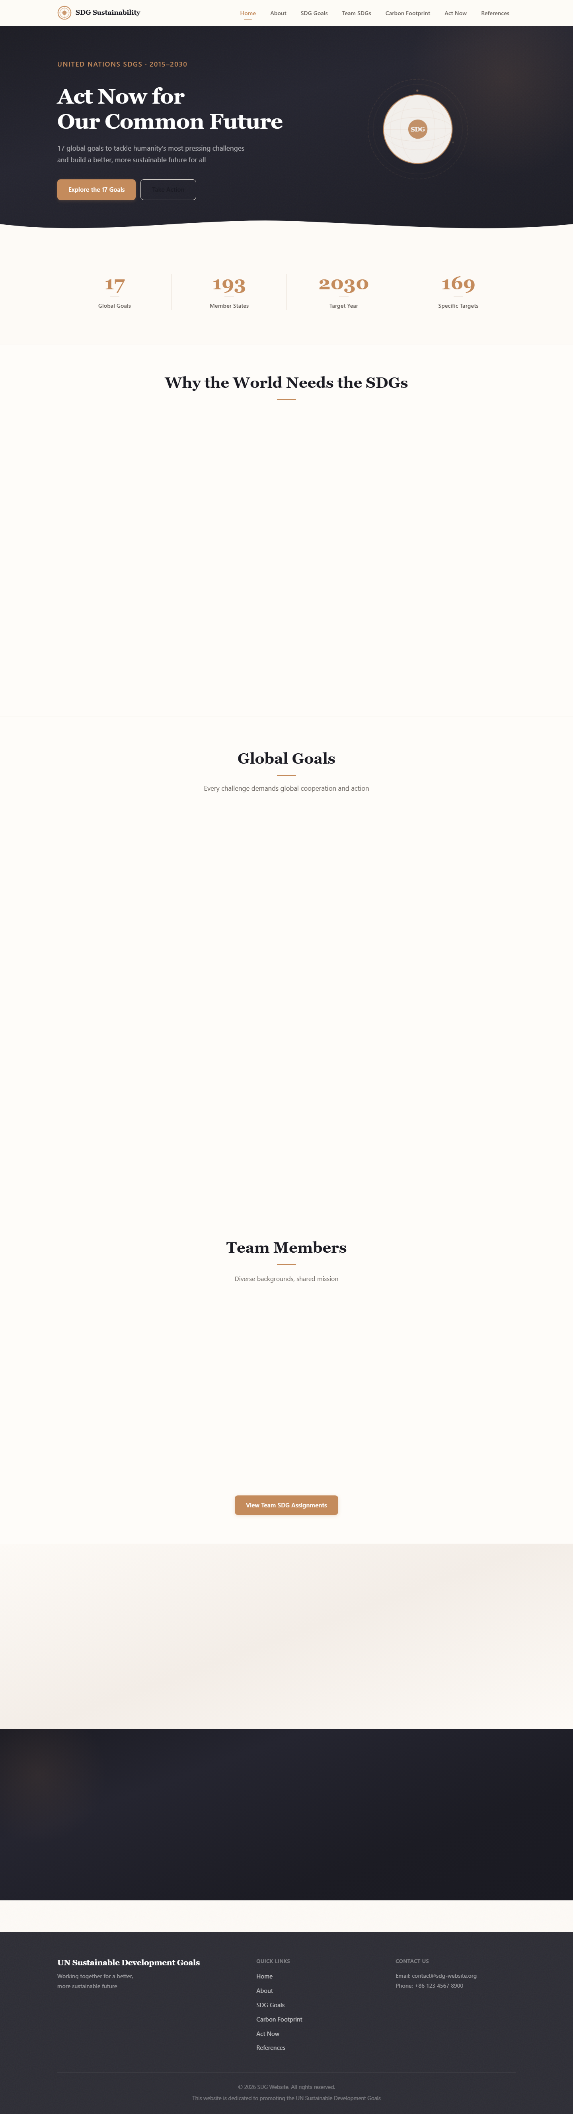
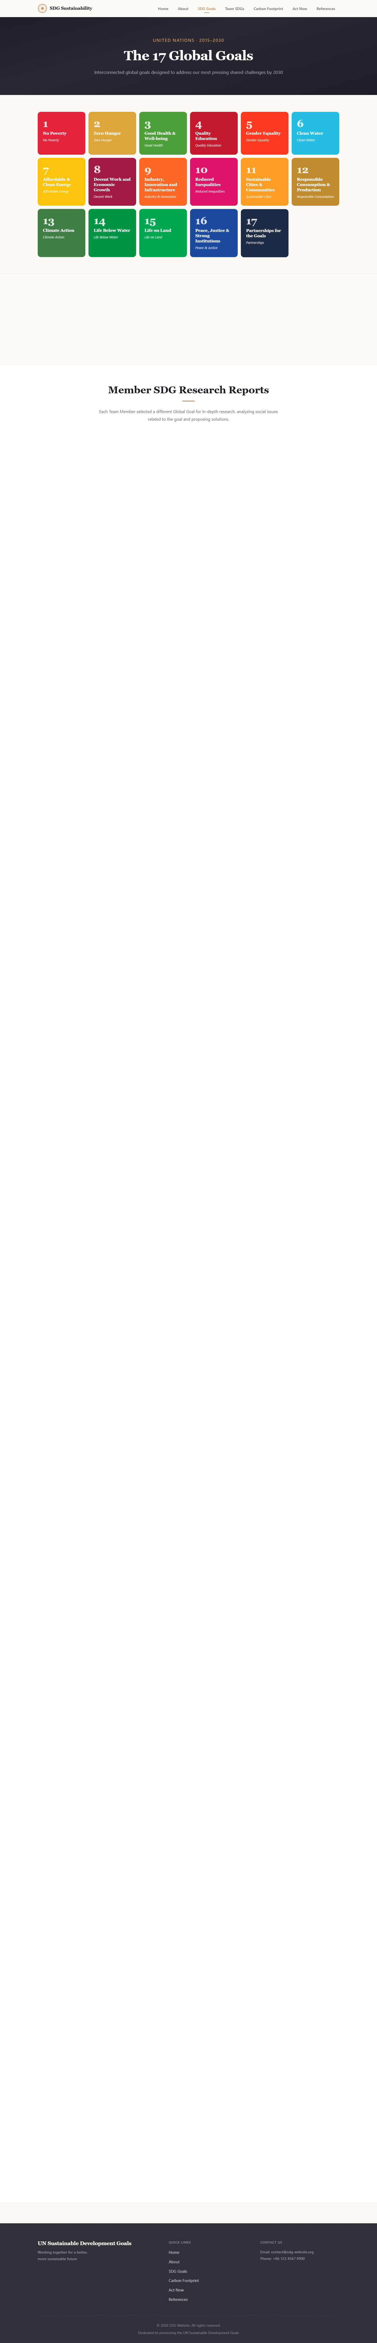
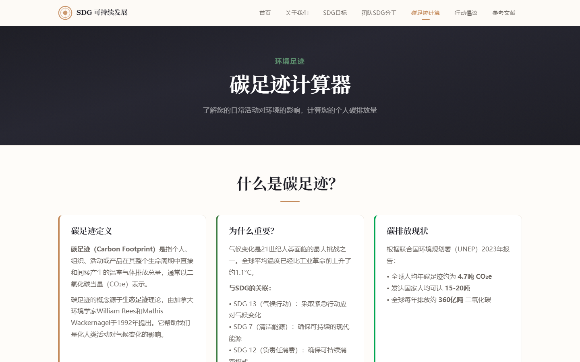
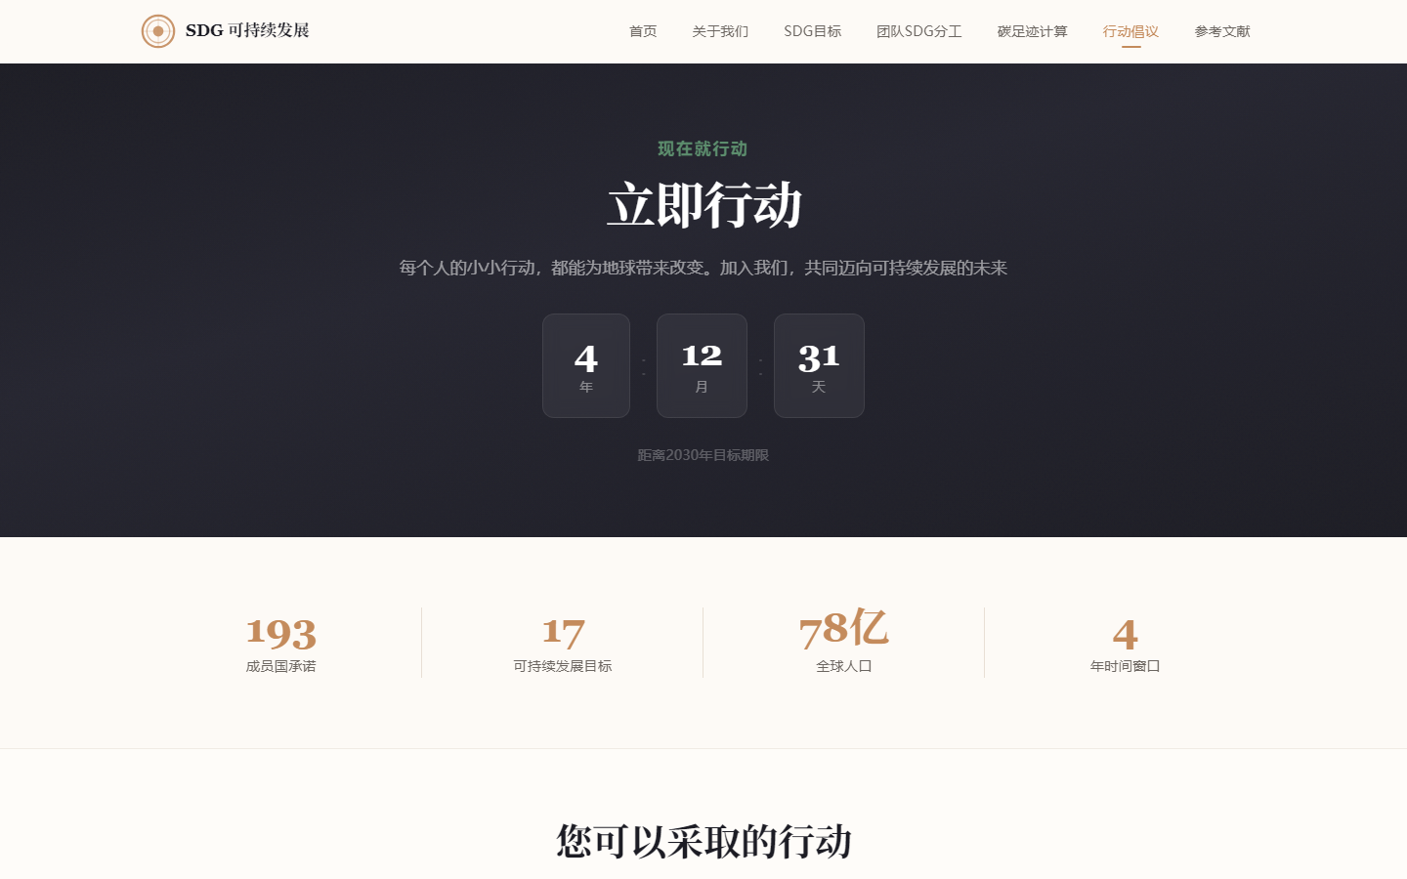
Website Walkthrough
A quick tour of the main pages we built
Homepage
SDGs Explorer
Carbon Calculator
Act Now
Built with: Vue 3 + TypeScript + Vue Router 4 + GSAP + Vite 6
14

Slide 15
Carbon Footprint Calculator
How our interactive calculator estimates your annual CO₂ emissions
Transportation
Energy
Food
Waste
• Private car: 0.2 kg CO₂ per km
• Public transport: 0.05 kg CO₂ per km
• Air travel: 250 kg CO₂ per flight
• Short-haul flights are worse per km than long-haul
• Electricity: 0.5 kg CO₂ per kWh
• Natural gas: 2.3 kg CO₂ per m³
• Heating: 1.8 kg CO₂ per unit
• Switching to renewables cuts this category most
• Meat-heavy diet = higher footprint
• Eating more plant-based meals earns credits
• Locally sourced food: 0.1 kg CO₂ benefit
• Food production = ~26% of global emissions
• Not recycling: +100 kg CO₂ penalty
• Not composting: +50 kg CO₂ penalty
• Methane from landfills is 25× worse than CO₂
• Better waste habits are the easiest win
Rating Thresholds:
Excellent: Below 3,000 kg CO₂/year — Your footprint is well below average — keep it up!
Good: 3,000 – 6,000 kg CO₂/year — Moderate footprint with clear room for improvement
Average: 6,000 – 10,000 kg CO₂/year — Above sustainable levels — consider targeted reductions
High: Above 10,000 kg CO₂/year — Urgent action needed to reduce environmental impact
15

Slide 16
What You Can Actually Do
Simple changes that make a real difference — no heroics required
Transportation
Energy at Home
✓ Take the bus or subway instead of driving — even once a week adds up ✓ One fewer round-trip flight per year saves about 1.6 tonnes of CO₂ ✓ If you need a car, carpool or look into electric options
✓ LED bulbs use 75% less energy and last years longer than incandescent ✓ Standby power from plugged-in devices can be 5-10% of your bill — unplug things ✓ If your area offers green power plans, they're often not much more expensive
Food Choices
Waste
✓ Cutting meat consumption in half roughly cuts your food footprint by 40% ✓ Seasonal local produce doesn't need to be flown or trucked across continents ✓ A third of all food gets wasted — meal planning helps more than people think
✓ Separate your trash: recyclables, kitchen scraps for compost, and actual landfill ✓ Composting turns food waste into soil instead of methane in a landfill ✓ Bring a reusable bag and water bottle — simple but effective over time
16

Slide 17
How We Built It
The tech stack and architecture behind the website
Browser
Router
View Layer
Core Features
User Interface Vue 3 SPA
▸
Vue Router 4 6 Route Views
▸
Home · About SDGs · Team Carbon · Act Now
▸
GSAP Animations Scoped CSS Modules TypeScript Types
Layer | Technology | Why We Chose It
Frontend Framework | Vue 3 (Composition API) | Component-based, easy to refactor, good TypeScript support
Type System | TypeScript (strict mode) | Catches mistakes before runtime, makes the code self-documenting
Routing | Vue Router 4 | Client-side routing with clean URLs, no page reloads
Animations | GSAP + ScrollTrigger | Industry standard for scroll-linked animation, works reliably across browsers
Build Tooling | Vite 6 | Fast dev server, quick HMR, straightforward production builds
Styling | Scoped CSS | Styles are tied to components so they don't leak or conflict
17

Slide 18
What We Learned
Five things this project taught us about the SDGs
1
Everything Is Connected
You can't fix poverty without also addressing education, health, and gender equality. The SDGs work as a system, not a list. That's both the challenge and the point.
2
Everyone Is in This
It's easy to think international goals are for governments and the UN. But businesses, local communities, and individual choices are how these goals actually get implemented — or don't.
3
Tech Helps, But It's Just a Tool
Our carbon calculator makes an abstract concept feel personal. But the hard part isn't the technology — it's getting people to care enough to use it and act on the results.
4
Small Changes Compound
One person switching to public transit doesn't matter. Millions doing it changes emissions trajectories. The scale problem cuts both ways — individual actions feel tiny, but they're the only lever we have.
5
2030 Is Close and We're Behind
The UN's own midpoint review found only 15% of SDG targets are on track. Four years isn't much time. This isn't a future problem we're preparing for — it's happening now.
18

Slide 19
So, What Can You Do?
The whole point of learning about the SDGs is doing something with that knowledge
Check out the 17 goals on our site. Try the carbon calculator. Pick one thing to change and see if it sticks.
The SDGs aren't just for the UN. They're for everyone.
19

Slide 20
Thanks
Questions, comments, arguments — all welcome
Thanks for Listening
Sources We Used
• United Nations. (2015). Transforming Our World: The 2030 Agenda. A/RES/70/1.
• IPCC. (2023). Climate Change 2023: Synthesis Report.
• UN DESA. (2024). The Sustainable Development Goals Report 2024.
• UN Stats. SDG Indicators Database. https://unstats.un.org/sdgs
Team
Li Shuhang — Project Lead
Finance · 8168667
Feng Jingyi — Tech Development
Accounting · 8168308
Wang Luyang — Policy Research
Accounting · 8168505
Lu Jianning — Data Analyst
Finance · 8168379
Happy to take questions — or just chat about the SDGs
20

Slide 21
Appendix A: Complete SDG Reference
All 17 Sustainable Development Goals with official short descriptions
# | Goal | Official Short Description
1 | No Poverty | End poverty in all its forms everywhere
2 | Zero Hunger | End hunger, achieve food security and promote sustainable agriculture
3 | Good Health & Well-being | Ensure healthy lives and promote well-being for all at all ages
4 | Quality Education | Ensure inclusive and equitable quality education for all
5 | Gender Equality | Achieve gender equality and empower all women and girls
6 | Clean Water & Sanitation | Ensure availability of water and sanitation for all
7 | Clean Energy | Ensure access to affordable, reliable, sustainable energy for all
8 | Decent Work & Economic Growth | Promote sustained, inclusive economic growth and decent work
9 | Industry, Innovation & Infrastructure | Build resilient infrastructure and foster innovation
10 | Reduced Inequalities | Reduce inequality within and among countries
11 | Sustainable Cities & Communities | Make cities inclusive, safe, resilient and sustainable
12 | Responsible Consumption & Production | Ensure sustainable consumption and production patterns
13 | Climate Action | Take urgent action to combat climate change and its impacts
14 | Life Below Water | Conserve and sustainably use the oceans, seas and marine resources
15 | Life on Land | Protect, restore and promote sustainable use of terrestrial ecosystems
16 | Peace, Justice & Strong Institutions | Promote peaceful and inclusive societies for sustainable development
17 | Partnerships for the Goals | Strengthen the means of implementation and revitalize global partnerships
21

Slide 22
Appendix B: Carbon Calculator Methodology
Emission factors, calculation logic, and rating thresholds used in our interactive tool
Calculation Formula
Rating Thresholds & Interpretation
▹ Car: carDistance × 0.2 kg CO₂ / km
▹ Public Transport: publicTransport × 0.05 kg CO₂ / km
▹ Flights: flights × 250 kg CO₂ per flight
▹ Electricity: electricity × 0.5 kg CO₂ / kWh
▹ Natural Gas: gas × 2.3 kg CO₂ / m³
▹ Heating: heating × 1.8 kg CO₂ per unit
▹ Meat Offset: (21 − meatDays) × 0.05 kg CO₂ credit
▹ Local Food: localFood × 0.1 kg CO₂ benefit
▹ No Recycling Penalty: +100 kg CO₂
▹ No Composting Penalty: +50 kg CO₂
Excellent (Below 3,000 kg CO₂/year)
Your footprint is well below average — keep it up!
Good (3,000 – 6,000 kg CO₂/year)
Moderate footprint with clear room for improvement
Average (6,000 – 10,000 kg CO₂/year)
Above sustainable levels — consider targeted reductions
High (Above 10,000 kg CO₂/year)
Urgent action needed to reduce environmental impact
Data Sources
Global Context
IPCC Fifth & Sixth Assessment Reports EPA Greenhouse Gas Equivalencies Calculator World Bank CO₂ Emissions Data UNEP Emissions Gap Reports
Global average: ~4,000 kg CO₂/person/year Sustainable target: < 2,000 kg CO₂/person/year China average: ~7,400 kg CO₂/person/year USA average: ~14,700 kg CO₂/person/year
22

