Slide 1
CD106 JAVA PROGRAMMING 1
CHAPTER 05:
Java Operators, Strings, Math and Boolean

Slide 2
JAVA OPERATORS
Used to perform operations on variables and values.
int sum1 = 100 + 50; // 150 (100 + 50)
int sum2 = sum1 + 250; // 400 (150 + 250)
int sum3 = sum2 + sum2; // 800 (400 + 400)

Slide 3
JAVA OPERATORS
Divides the operators into the following groups:
Arithmetic operators
Assignment operators
Comparison operators
Logical operators
Bitwise operators

Slide 4
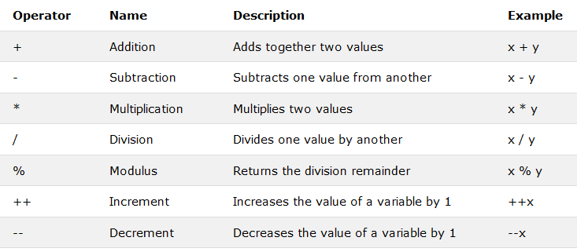
JAVA ARITHMETIC OPERATORS

Slide 5
JAVA ARITHMETIC OPERATORS
EXAMPLE 1:
public class Main {
public static void main(String[] args) {
int x = 5;
int y = 3;
System.out.println(x + y);
}
}
EXAMPLE 2:
public class Main {
public static void main(String[] args) {
int x = 5;
int y = 3;
System.out.println(x * y);
}
}

Slide 6
JAVA ARITHMETIC OPERATORS
EXAMPLE 3:
public class Main {
public static void main(String[] args) {
int x = 5;
double y = 2.1;
System.out.println(x / y);
}
}
EXAMPLE 4:
public class Main {
public static void main(String[] args) {
int x = 5;
int y = 2;
System.out.println(x % y);
}
}

Slide 7
JAVA ARITHMETIC OPERATORS
EXAMPLE 5:
public class Main {
public static void main(String[] args) {
int x = 5;
++x; //pre-increment
// x++ post-increment
System.out.println(x);
}
}
EXAMPLE 6:
public class Main {
public static void main(String[] args) {
int x = 5;
--x; //pre-decrement
//x-- post-decrement
System.out.println(x);
}
}

Slide 8
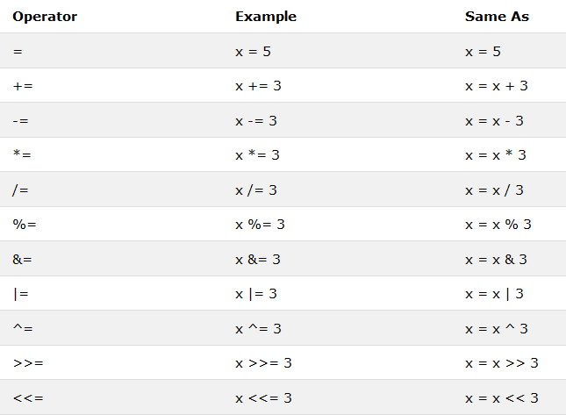
JAVA ASSIGNMENT OPERATORS
Arithmetic operators
Bitwise operators

Slide 9
JAVA ASSIGNMENT OPERATORS
EXAMPLE 7:
public class Main {
public static void main(String[] args) {
int x = 5;
x += 3; // x = x+3
System.out.println(x);
}
}
EXAMPLE 8:
public class Main {
public static void main(String[] args) {
int x = 5;
x *= 3; // x = x*3
System.out.println(x);
}
}

Slide 10
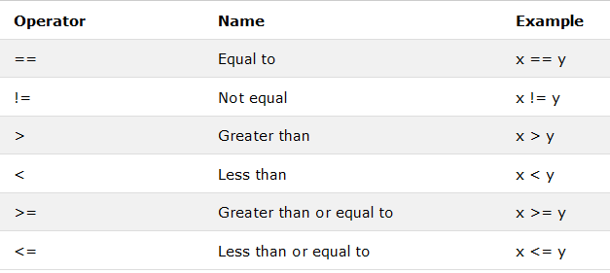
JAVA COMPARISON OPERATORS

Slide 11
JAVA COMPARISON OPERATORS
EXAMPLE 9:
public class Main {
public static void main(String[] args) {
int x = 5;
int y = 3;
System.out.println(x == y);
// returns false because 5 is not equal to 3
}
}
EXAMPLE 10:
public class Main {
public static void main(String[] args) {
int x = 5;
int y = 3;
System.out.println(x != y);
// returns true because 5 is not equal to 3
}
}

Slide 12
JAVA COMPARISON OPERATORS
EXAMPLE 11:
public class Main {
public static void main(String[] args) {
int x = 5;
int y = 3;
System.out.println(x > y);
// returns true because 5 is greater than 3
}
}
EXAMPLE 12:
public class Main {
public static void main(String[] args) {
int x = 5;
int y = 3;
System.out.println(x < y);
// returns false because 5 is not less than 3
}
}

Slide 13
JAVA COMPARISON OPERATORS
EXAMPLE 13:
public class Main {
public static void main(String[] args) {
int x = 5;
int y = 3;
System.out.println(x >= y);
// returns true because 5 is greater, or equal, to 3
}
}
EXAMPLE 14:
public class Main {
public static void main(String[] args) {
int x = 5;
int y = 3;
System.out.println(x <= y);
// returns false because 5 is neither less than or equal to 3
}
}

Slide 14
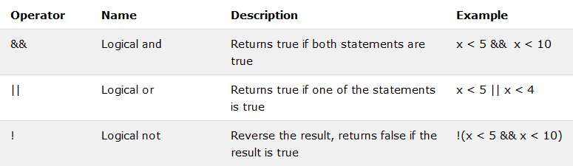
JAVA LOGICAL OPERATORS
Logical operators are used to determine the logic between variables or values:

Slide 15
JAVA LOGICAL OPERATORS
EXAMPLE 15:
public class Main {
public static void main(String[] args) {
int x = 5;
System.out.println (x > 3 && x < 10);
// returns true because 5 is greater than 3 AND 5 is less than 10
}
}
EXAMPLE 16:
public class Main {
public static void main(String[] args) {
int x = 5;
System.out.println(x > 3 || x < 4);
// returns true because one of the conditions are true (5 is greater than 3, but 5 is not less than 4)
}
}

Slide 16
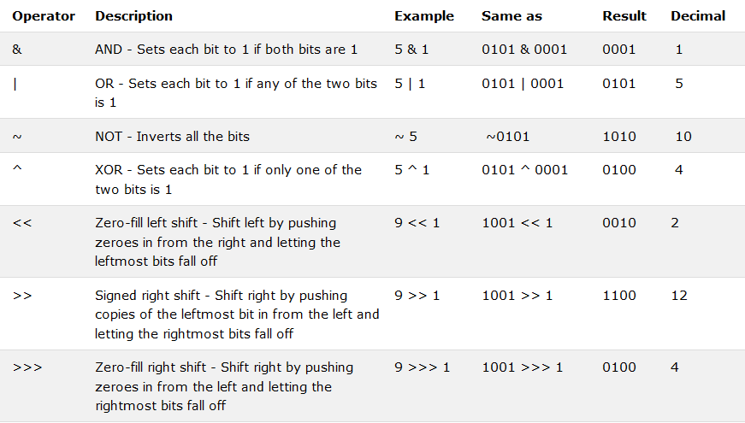
JAVA BITWISE OPERATORS
Bitwise operators are used to perform binary logic with the bits of an integer or long integer.

Slide 17
JAVA BITWISE OPERATORS
EXAMPLE 17:
public class Main {
public static void main(String[] args) {
int x = 5;
x &= 3;
System.out.println(x);}}
5 = 0101
3 = 0011
5&3 = 0 0 01 = 1
EXAMPLE 18:
public class Main {
public static void main(String[] args) {
int x = 5;
x ^= 3;
System.out.println(x);}}
5 = 0101
3 = 0011
5^3 = 0 1 1 0 = 6

Slide 18
JAVA STRINGS
Used for storing text.
A String variable contains a collection of characters surrounded by double quotes
String greeting = "Hello";

Slide 19
JAVA STRINGS
STRING LENGTH
A String in Java is an object, which contain methods that can perform certain operations on strings.
To find the string length, we can use length( ) method.
EXAMPLE 19:
public class Main {
public static void main(String[] args) {
String txt = "ABCDEFGHIJKLMNOPQRSTUVWXYZ";
System.out.println("The length of the txt string is: " + txt.length());
}
}

Slide 20
JAVA STRINGS
UPPERCASE METHOD
toUpperCase ( )
LOWERCASE METHOD
toLowerCase ( )
EXAMPLE 20:
public class Main {
public static void main(String[] args) {
String txt = "Hello World";
// Outputs “HELLO WORLD”
System.out.println(txt.toUpperCase());
// Outputs “hello world”
System.out.println(txt.toLowerCase());
}
}

Slide 21
JAVA STRINGS
The indexOf( ) method return the index (the position) of the first occurrence of a specified text in a string (including whitespace).
EXAMPLE 21:
public class Main {
public static void main(String[] args) {
String txt = "Please locate where 'locate' occurs!";
System.out.println(txt.indexOf("locate"));
}
}

Slide 22
JAVA STRINGS
// Three strings are concatenated
String message = "Welcome " + "to " + "Java";
// String Chapter is concatenated with number 2
String s = "Chapter " + 2; // s becomes Chapter 2
// String Supplement is concatenated with character B
String s1 = "Supplement " + 'B'; // s1 becomes Supplement B

Slide 23

JAVA STRINGS
Special Characters
Because strings must be written within quotes, Java will misunderstand this string, and generate error.

Slide 24
JAVA STRINGS
Special Characters
The solution is to use the backslash escape character.
\’ inserts quote in a string, \” inserts double quote in a string, and \\ inserts a single backslash in a string.
String txt = "We are the so-called \"Vikings\" from the north.";
Output: We are the so-called “Vikings” from the north

Slide 25
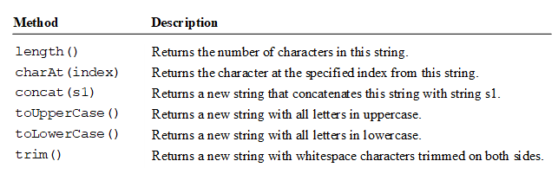
JAVA STRINGS
Other methods for Java Strings:

Slide 26
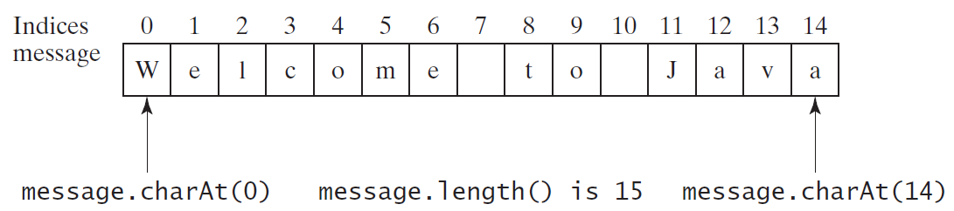
JAVA STRINGS
Example of charAt( ) method:

Slide 27
JAVA MATH
The Java Math class has many methods that allows you to perform mathematical tasks on numbers.

Slide 28
JAVA MATH
The Math.max(x,y) method can be used to find the highest value of x and y.
EXAMPLE 22:
public class Main {
public static void main(String[] args) {
System.out.println(Math.max(5.5, 10));
}
}

Slide 29
JAVA MATH
The Math.min(x,y) method can be used to find the lowest value of x and y.
EXAMPLE 23:
public class Main {
public static void main(String[] args) {
System.out.println(Math.min(5, 10));
}
}

Slide 30
JAVA MATH
The Math.sqrt(x) method returns the square root of x.
EXAMPLE 24:
public class Main {
public static void main(String[] args) {
System.out.println(Math.sqrt(64));
}
}

Slide 31
JAVA MATH
The Math.abs(x) method returns the absolute (positive) value of x.
EXAMPLE 25:
public class Main {
public static void main(String[] args) {
System.out.println(Math.abs(-4.7));
}
}

Slide 32
JAVA BOOLEANS
The Java Booleans can take the values true or false.
boolean isJavaFun = true;
boolean isFishTasty = false;
System.out.println(isJavaFun); // Outputs true
System.out.println(isFishTasty); // Outputs false

Slide 33
END OF CHAPTER 05

