Slide 1
How to create a hacking toolkit thanks to the pageinspect extension and some Linux commands like dd, od…?
Bertrand Drouvot
PGConf NYC 2022

Slide 2

About me
Working in databases for about 20 years
Oak table member
Oracle ACE
Fell in love for PostgreSQL
Working at AWS (RDS Open Source Databases)
Twitter: @bertranddrouvot
https://bdrouvot.github.io/

Slide 3
Agenda
How to retrieve Information from PostgreSQL blocks “on disk” with Shell scripts
Demos
Read the checksum from a block
Extract how many tuples (dead or not) are stored in a block
Read a tuple xmin, xmax, infomask2, infomask
Get the tuple user data
Get the whole tuple data (including HeapTupleHeaderData and user data)
Write counterparts of some of the pageinspect’s functions
Get the xact status directly from the filesystem files with a shell script
Get the multixid members directly from the filesystem files with a shell script
Cool stuff with pageinspect
The why?

Slide 4
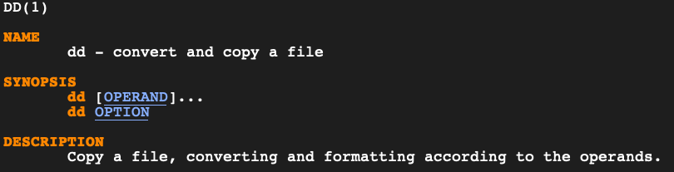
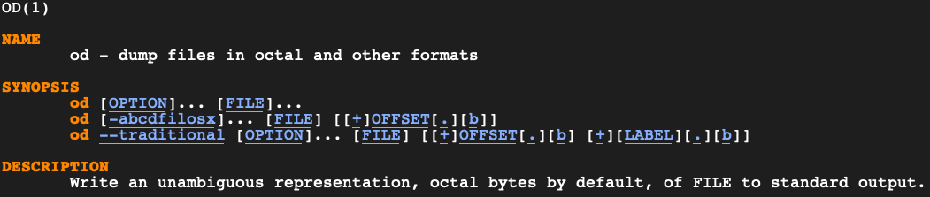
We’ll Use
pageinspect https://www.postgresql.org/docs/current/pageinspect.html
dd
od

Slide 5
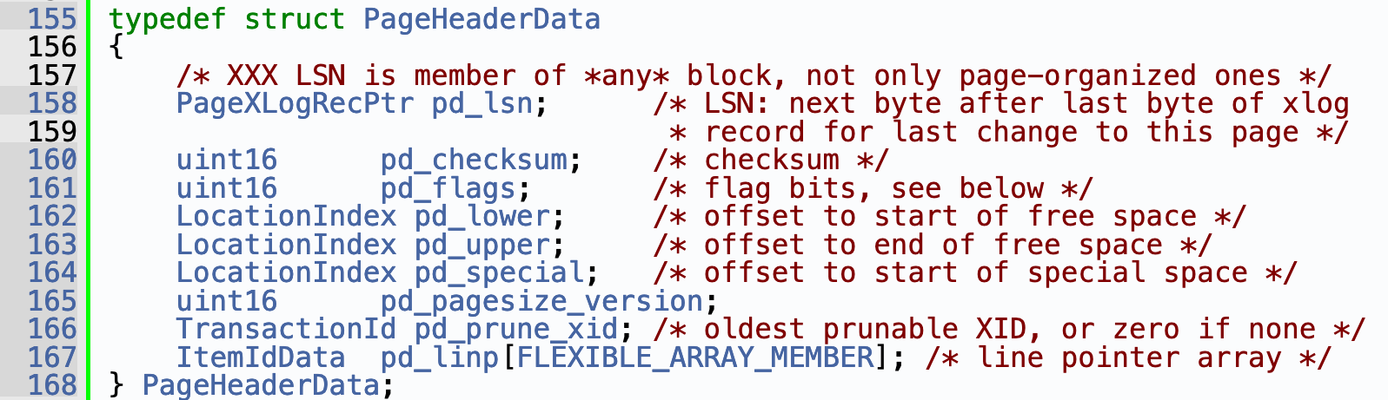
We’ll Use
The beauty of Open Source Software
https://doxygen.postgresql.org/

Slide 6
We’ll see
With Shell scripts (no C coding is needed) from the files on “disk”
Read the checksum from a block
Extract how many tuples (dead or not) are stored in a block
Read a tuple xmin, xmax, infomask2, infomask
Get the tuple user data
Get the whole tuple data (including HeapTupleHeaderData and user data)

Slide 7
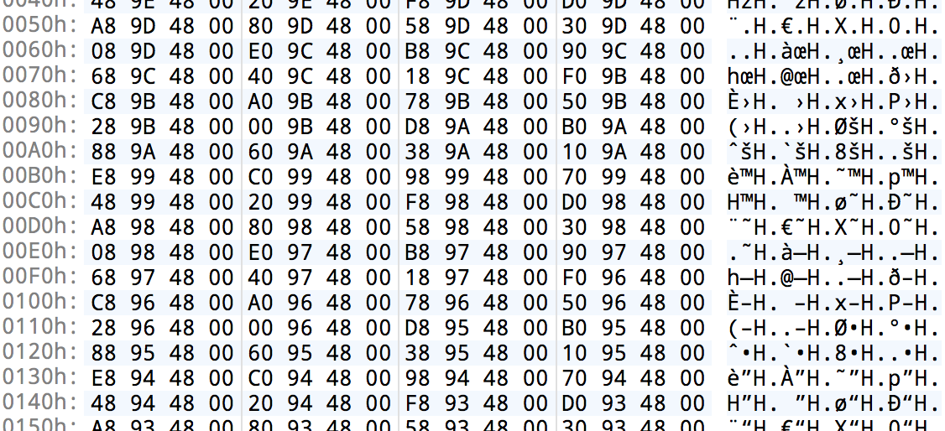
Demo

Slide 8
Now we can write Shell scripts to…
Be the counterparts of the pageinspect’s:
page_header
heap_page_items
bt_metap
bt_page_items
bt_page_stats
functions to get the same information directly from the “disk”

Slide 9
And…
get the xact status directly from the filesystem files with a shell script
get the multixid members directly from the filesystem files with a shell script
…..

Slide 10
Demo

Slide 11
Cool stuff with pageinspect
Link the user table tuples to the toast pages making use of the user table tuples and toast index data (not querying the toast at all)
Search for tuples (dead or not) based on attributes values

Slide 12
Demo

Slide 13
That’s nice but why? How is it useful?
It could be useful when working on edge cases when for example:
You want to compare the page content from “disk” and memory
The engine does not start and you want to have a look at some of the content on the “disk”

Slide 14
Questions?

Slide 15
Thank you!

