Slide 1
IOTA-sensors
Sensors data from anyone to everyone

Slide 2
IOTA
IOTA could be used to sending messages
Messages can contain data
Messages can have attached tokens

Slide 3
Idea
Can we use IOTA to exchange data between interested participants?
Can we sell data using IOTA network as transaction medium?
Can we do it ad-hoc?

Slide 4
Implementation
PyOTA + REST API
Sensor with vendor app and wallet
Client with client app and wallet
Sending messages to vendor wallet will trigger response with sensor data targeted to client wallet

Slide 5
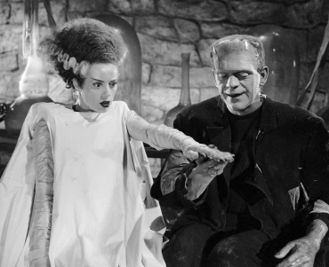
Live demo

Slide 6
TODO
Define standard for broadcasting location, sensors type, price, etc.
Define standard for data points messages
Identification of 0i senders

Slide 7
Upgrades
Implement and test payments for data points
QOS – make sure if everyone who paid received requested data
Public sensors network explorer

Slide 8
Problems?
It takes ~30s to respond to single request
Requests than can't be handled will be dropped
How to refund when vendor app will be offline? Scan whole tangle for unhanded requests?
How to create ad-hoc private communication?

Slide 9
Thanks
IOTA
Baltic Data Science
Datarella
Crowdstart Capital
Bright Inventions

