Slide 1
Week 2: Python for Historical Research
Why Historians Code HIST 501D - Digital History

Slide 2
Why Python?
Most popular language in digital humanities
Readable syntax - looks like pseudocode
Rich ecosystem for text analysis, data cleaning, visualization
AI-assisted - Copilot helps you write code
You’re historians, not CS majors - computational literacy, not mastery
Notes:
You’re not training to be software engineers. You’re learning to use computation as a research tool, like learning to use an archive or a statistical package.

Slide 3
The Scale Problem in History
Traditional archival research:
Read 500 documents over months
Analyze patterns manually
Write based on what you remember
Computational research:
Process 50,000 documents in hours
Extract structured data automatically
Identify patterns impossible to see manually

Slide 4
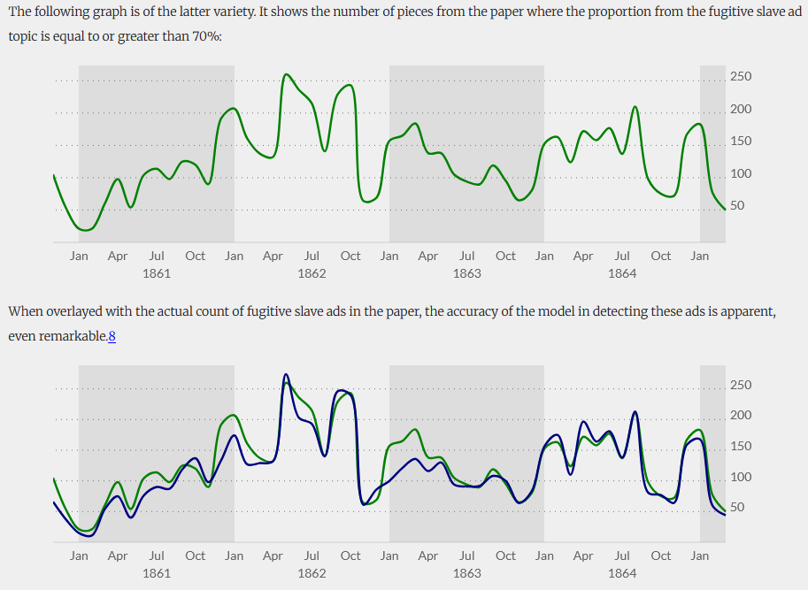
Example: Mining the Dispatch
Richmond Daily Dispatch (1860-1865)
24,000 newspaper articles
Topic modeling reveals: shifting war coverage, economic concerns, enslaved people fleeing
Impossible without computational methods
🔗 dsl.richmond.edu/dispatch
Mining the Dispatch - Civil War Richmond newspaper

Slide 5
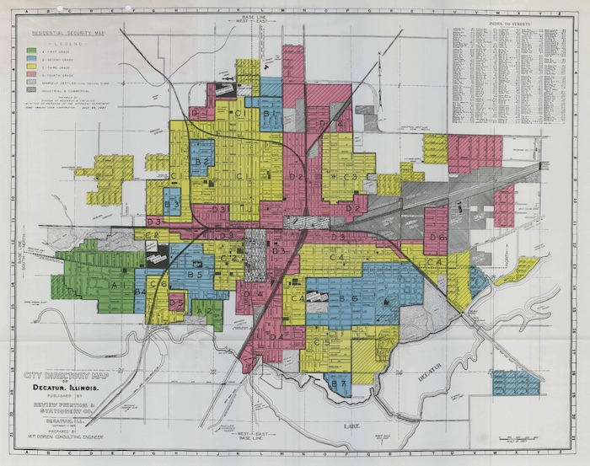
Example: Mapping Inequality
Digital Scholarship Lab - University of Richmond
Historical impact: Visualized systemic racism in housing policy
Digitized 1930s redlining maps from 200+ cities
Python scripts extract/geocode 100s neighborhood boundaries -> create searchable database + interactive maps
HOLC Redlining Maps

Slide 6
What Python Does for Historians
Data cleaning - Fix messy spreadsheets, inconsistent dates
Text analysis - Find patterns in documents
Web scraping - Collect data from websites/archives
Visualization - Create charts, maps, networks
Automation - Repeat tasks across thousands of files

Slide 7
Example: Presidential State of the Union Addresses
Research question: How has presidential rhetoric changed over time?
# Count mentions of "freedom" per decade for speech in speeches: count = speech.text.count("freedom") print(f"{speech.year}: {count} mentions")
Manual approach: Weeks of reading
Python approach: 5 minutes

Slide 8
What is a Variable?
A container that stores data
president = "Abraham Lincoln" birth_year = 1809 is_alive = False
Think of it like a label you stick on a box:
president → box containing “Abraham Lincoln”
birth_year → box containing 1809
is_alive → box containing False

Slide 9
What is a List?
An ordered collection of items
presidents = [ "Washington", "Adams", "Jefferson", "Madison" ] print(presidents[0]) # "Washington" print(len(presidents)) # 4
Like a numbered filing cabinet - access items by position.

Slide 10
What is a Dictionary?
Key-value pairs (like a real dictionary: word → definition)
battle = { "name": "Gettysburg", "year": 1863, "state": "Pennsylvania", "casualties": 51000 } print(battle["year"]) # 1863
Perfect for structured historical data!

Slide 11
What is a Loop?
Repeat an action multiple times
years = [1776, 1812, 1865, 1917, 1945] for year in years: print(f"Major event in {year}")
Why useful?
Process thousands of files
Analyze every line in a document
Calculate statistics across datasets

Slide 12
Real Code Example: Analyzing Battle Data
battles = [ {"name": "Gettysburg", "year": 1863, "casualties": 51000}, {"name": "Antietam", "year": 1862, "casualties": 22717}, {"name": "Shiloh", "year": 1862, "casualties": 23746}

Slide 13
Find deadliest battle
deadliest = max(battles, key=lambda b: b["casualties"]) print(f"Deadliest: {deadliest['name']}") # Total casualties total = sum(b["casualties"] for b in battles) print(f"Total casualties: {total}")

Slide 14
AI-Assisted Coding: GitHub Copilot
Your AI pair programmer
Autocompletes code as you type
Suggests entire functions
Explains error messages
Translates plain English → code
Philosophy: Understand what code does and why. Let Copilot handle how.

Slide 15
AI Policy for This Week
🚫 Copilot OFF: Core concepts (30 min)
Variables, data types, basic loops
Type these yourself to build understanding
✅ Copilot ON: Everything else
Writing functions
File operations
Debugging
Anything you’ve seen demonstrated
Must document: What AI help you used (AI-use-log.md)

Slide 16
What You’ll Build This Week
Assignment 1: Python Fundamentals Notebook
10 exercises with historical data
Variables, lists, dictionaries, loops, functions
Assignment 2: Programming Historian Tutorial
Read/write text files
Practical file operations
Build 3 Python scripts
Due: Monday, February 9 at 9:00 AM

Slide 17
By End of Semester…
You’ll be able to:
Clean 10,000-row datasets in minutes
Analyze hundreds of historical documents
Create interactive visualizations
Build web maps of historical events
Scrape data from online archives
All with Python + AI assistance

Slide 18
Learning Strategy
Don’t memorize syntax - look things up
Expect errors - they’re learning opportunities
Commit frequently - version control is your safety net
Ask for help - office hours, Copilot, classmates
Think like a historian - what question am I answering?

Slide 19
Today’s Plan
Part 1 (just finished): Why Python + basic concepts
Part 2: Live demo + hands-on coding
Variables and data types
Lists and loops
Working with historical data
You’ll code along with me

Slide 20
Questions?
Resources:
Week 2 Quick Reference (in your repo)
Programming Historian tutorials
Office hours: Mon 3:15-4:45pm, Tue 9:30-11am
Ready to write some code? 💻

