Slide 1
Week 3 — Regex Primer
Dr. B. Skopyk

Slide 2
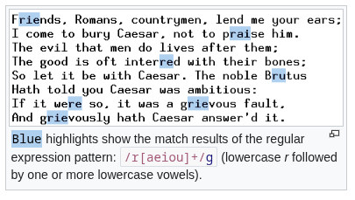
What is a regular expression (regex)?
A compact language for describing text patterns.
Used to match, extract, and transform text.
Implemented in many tools: VSCode Finder, Python (re), grep/rg, editors, and programming languages.
regex example
Notes:
NB1: regex is not a parser for complex formats (like quoted CSV) but is ideal for spotting patterns and quick normalizations.

Slide 3

The History of regex
Originated in 1950s formal language theory (Noam Chomsky, Stephen Kleene).
Adopted in Unix tools in the 1970s (e.g., grep).
Now ubiquitous in programming languages and text editors.
Ken Thompson (seated) with Dennis Ritchie, creator of C

Slide 4
Regex basics
Literals: exact characters (e.g. , or a)
Character classes: [abc]
ranges [A-Z]
negation [^0-9]

Slide 5
Metacharacters: . ^ $ * + ? {} [] () |
Anchors: - ^ (start of line), $ (end), \b (word boundary)
Quantifiers: - * (0+), + (1+), ? (0|1), {m}, {m,n}
Groups & captures: - ( ... ) and non-capturing (?: ... )
Escaping: - backslash \ to treat metacharacters literally (e.g., \. matches a dot)

Slide 6
Common tokens & examples
. : any character
\d : digit (0-9) | \D : non-digit
\w : word character | \W : non-word character
\s : whitespace | \S : non-whitespace
\b : word boundary
\n : newline
| : alternation (OR)
Example: \b\d{4}\b — matches 4-digit numbers as whole words (e.g., years).

Slide 7
Capture groups & replacements
Groups capture parts of a match for extraction or replacement
Example pattern:
(\d{1,2})/(\d{1,2})/(\d{2,4}) (e.g. 2/9/26)
Group 1: month (\d{1,2})
Group 2: day (\d{1,2})
Group 3: year (\d{2,4})
Replacement in VSCode:
$3-$1-$2 → reorder to YYYY-M-D

Slide 8
Reference Docs
VSCode regex guide: https://learn.microsoft.com/en-us/visualstudio/ide/using-regular-expressions-in-visual-studio?view=visualstudio
Class Repo: github course repo: /ref-guides – https://github.com/bds134/hist501d-coursework-template/blob/main/ref-guides/regex-cheat.md

Slide 9
GREP – Global Regular Expression Print
Command-line tool for searching text using regex
E.G. Find 4-digit years from 1800 to 2099 in data.csv
grep -n -i -E '\b(18|19|20)\d{2}\b' ./data.csv

Slide 10
grep example explained
grep -n -i -E '\b(18|19|20)\d{2}\b' ./data.csv
Flags:
-n : print line numbers
-i : case-insensitive
-E : use extended regex (enables +, ?, {} without backslashes)

Slide 11
Next steps / in-class plan
10–15 minute practice of VSCode Finder with annotated patterns
open VSCode and then ctrl/cmd+shift+f to open the search panel
Click results to see matches in context
Try replacing with capture groups on a test file

