Slide 1
Databases for Historians
flat, hierarchical, relational B. Skopyk

Slide 2
What is a “database”?
A structured collection of data that is stored and accessed electronically.
Allows for efficient storage, retrieval, and management of data.
Can be simple (a spreadsheet) or complex (a relational database).

Slide 3
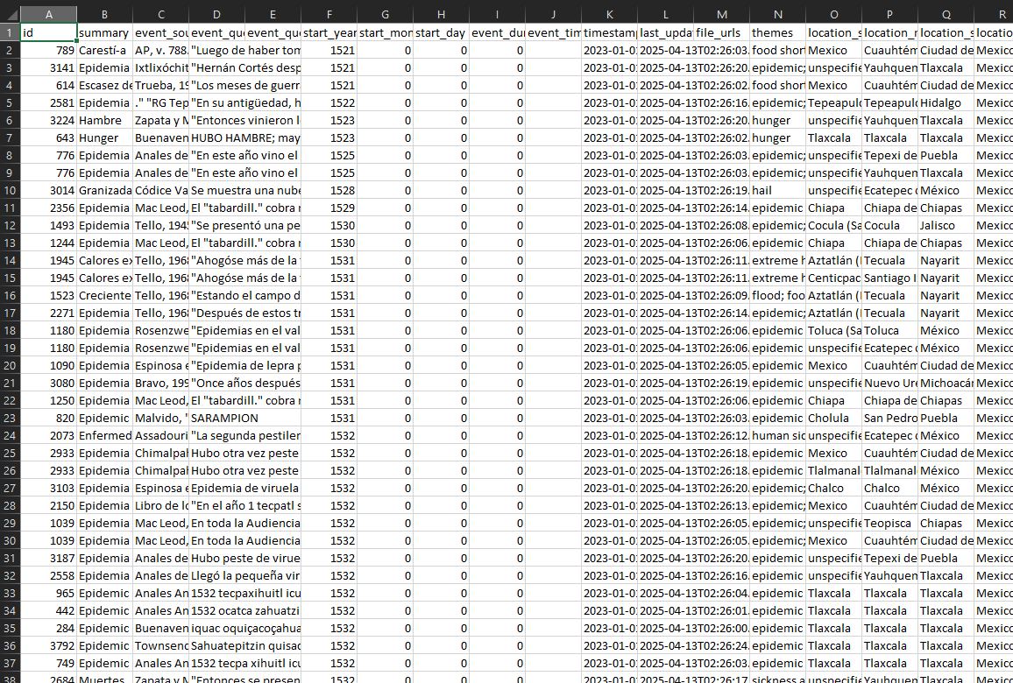
Flat database
Stores data in a single table (e.g., CSV files, spreadsheets)

Slide 4
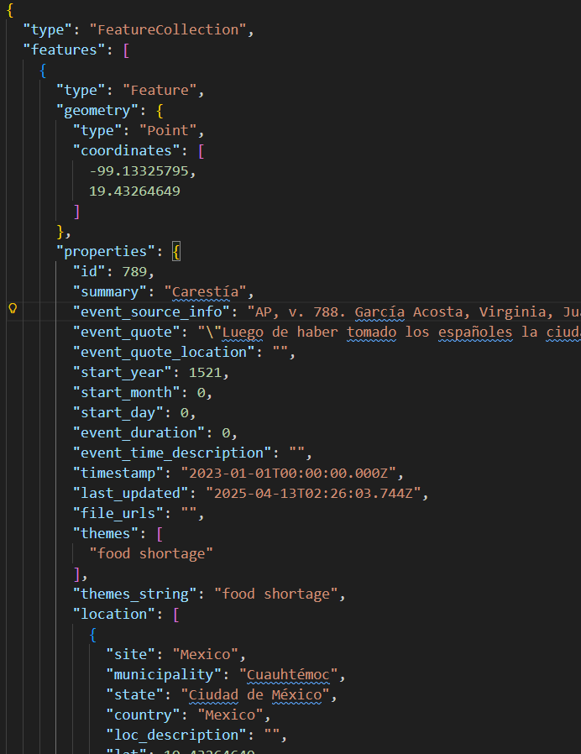
Hierarchical database
Organizes data in a tree-like structure (e.g., XML, JSON)

Slide 5
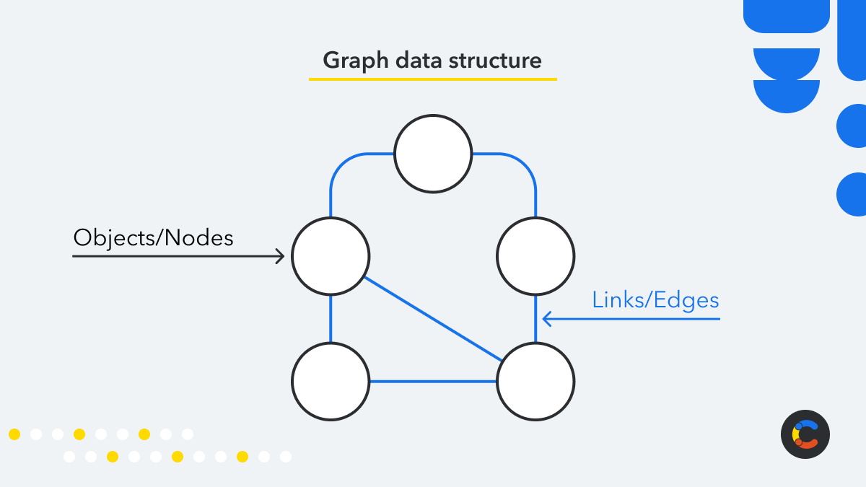
GraphQL database
Uses nodes and edges to represent data (e.g., social networks)

Slide 6
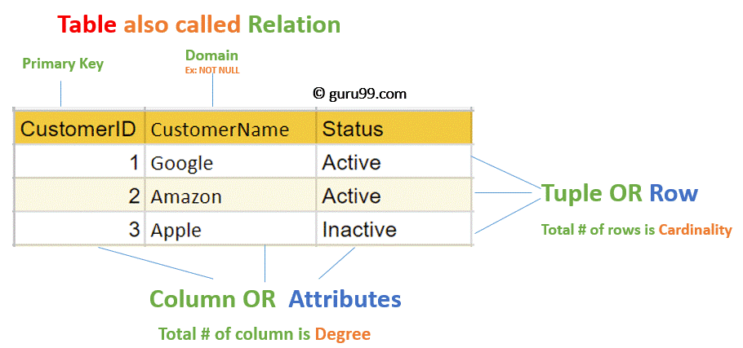
Relational Database Management System (RDBMS)
RDBMS: A software system that manages relational databases. It provides tools for creating, querying, and managing databases using SQL (Structured Query Language)

Slide 7
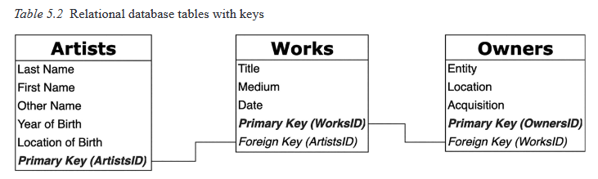
Artists <-> Works <-> Owners
Drucker’s Example of Artists, Works, Owners

Slide 8
Primary and Foreign Keys
Primary Key: A unique identifier for each record in a table. It ensures that each record can be uniquely identified and accessed.
Foreign Key: A field in one table that refers to the primary key in another table. It establishes a relationship between the two tables and allows for data to be linked across tables.

Slide 9
SQL (Structured Query Language)
A programming language used to manage and manipulate relational databases.
Allows users to create, read, update, and delete data in a database [CRUD operations]
Example: SELECT * FROM artists WHERE name = 'Leonardo da Vinci';
This query retrieves all records from the “artists” table where the name is “Leonardo da Vinci”.

Slide 10
Parts of a SQL Query
SELECT: Specifies the columns to retrieve
FROM: Specifies the table to query
WHERE: Specifies the conditions for filtering records
JOIN: Combines rows from two or more tables based on a related column

Slide 11
Some Important SQL Commands 1 of 3
SELECT: Query data
SELECT column1, column2 FROM table_name WHERE condition;

Slide 12
Some Important SQL Commands 2 of 3
CREATE TABLE: Create a new table
CREATE TABLE table_name ( column1 datatype, column2 datatype, ... );
INSERT INTO: Add new data
INSERT INTO table_name (column1, column2) VALUES ('value1', 'value2');

Slide 13
Some Important SQL Commands 3 of 3
UPDATE: Modify data
UPDATE table_name SET column1 = 'new_value' WHERE condition;
DELETE: Remove data
DELETE FROM table_name WHERE condition;

Slide 14
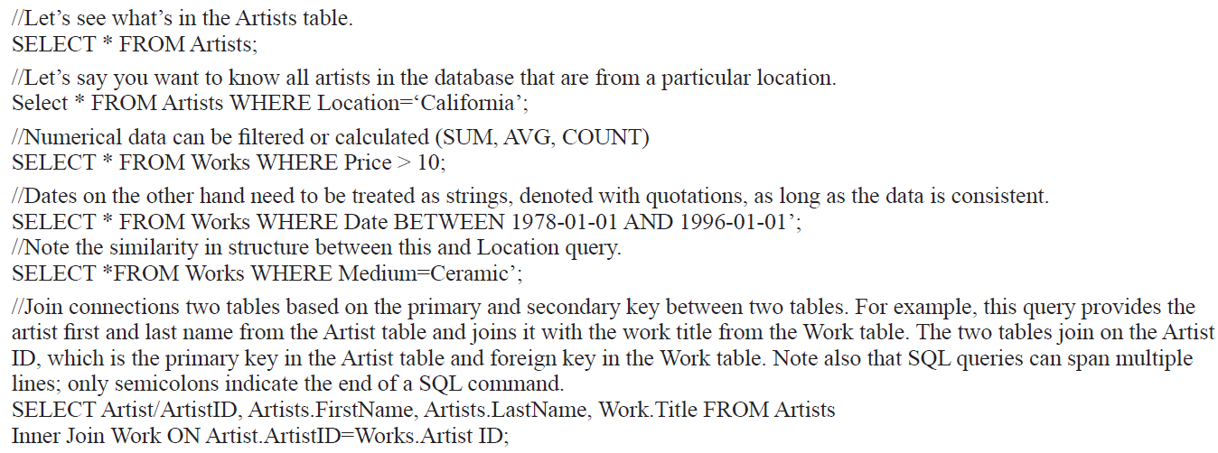
SQL Example
Example of SQL query from Drucker

Slide 15
Data Types in SQL
Varchar
Text
Integer
Float
Boolean
Date
Primary Key
Foreign Key

Slide 16
Integer
An integer data type is a whole number (e.g., 1, 42, -5).
CREATE TABLE artists ( id SERIAL PRIMARY KEY, name VARCHAR(100), birth_year INTEGER, death_year INTEGER );

Slide 17
Varchar
A variable-length string (e.g., ‘Hello’, ‘World’). Typically, it has a maximum length defined which is a positive integer representing the number of characters.
CREATE TABLE artists ( id SERIAL PRIMARY KEY, name VARCHAR(100), birth_year INTEGER, death_year INTEGER );

Slide 18
Dates: date, varchar, and integers
Date type: ‘YYYY-MM-DD’ (ISO 8601) –> calculations
Integer: year or month or day
Varchar: preserves resolution: 1990, ‘1990-05’, ‘1990-05-15’
CREATE TABLE events ( id SERIAL PRIMARY KEY, event_name VARCHAR(100), event_date DATE, date_iso8601 VARCHAR(10), event_year INTEGER);

Slide 19
Boolean
A true/false value (e.g., TRUE, FALSE). Useful for binary attributes such as “was_soldier”, “was_civilian”, etc.
CREATE TABLE people ( id SERIAL PRIMARY KEY, name VARCHAR(100), was_soldier BOOLEAN );

Slide 20
Float
A number with a decimal point (e.g., 3.14, -0.001). Useful for economic values or even heights and weights on things like army registration cards.
CREATE TABLE measurements ( id SERIAL PRIMARY KEY, soldier_name VARCHAR(100), weight FLOAT, height FLOAT );

Slide 21
Primary Key
The Primary Key: A unique identifier for each record in a table (e.g., an auto-incrementing integer`). It is good practices to have a primary key in every table (except for join tables that only have foreign keys).
CREATE TABLE artists ( id SERIAL PRIMARY KEY, name VARCHAR(100) );

Slide 22
Foreign Key
A field in one table that refers to the primary key in another table
CREATE TABLE relationships ( id SERIAL PRIMARY KEY, soldier_id INTEGER REFERENCES soldiers(id), individual_id INTEGER REFERENCES individuals(id), relationship_type VARCHAR(50) );

Slide 23
Serials
Serials are auto-incrementing integers that are often used as primary keys in SQL tables. When a new record is inserted into the table, the serial value is automatically generated and incremented by 1 from the previous value.
CREATE TABLE artists ( id SERIAL PRIMARY KEY, name VARCHAR(100) );

Slide 24
One to Many (1:M) vs Many to Many (M:N) Relationships
Relational databases: named as such b/c they model relationships
There are two main types of relationships: one to many (1:M) and many to many (M:N).
One to Many (1:M): record in a table associated with multiple records in another table
Many to Many (M:N): multiple records associated with multiple records in another table

Slide 25
Modeling Relationships in SQL
To model a 1:M relationship, you can use a foreign key in the “many” table that references the primary key of the “one” table
To model a M:N relationship, you need to create a join table that contains foreign keys referencing the primary keys of both tables.

