Slide 1
Data Visualization
Matplotlib, Seaborn, Plotly, Bokeh, and Scikit-learn B. Skopyk

Slide 2
Python Libraries for Data Visualization
Matplotlib
Seaborn
Plotly
Bokeh
Scikit-learn

Slide 3
Why Word Counting?
Reveals patterns in language use
Useful for literary analysis, social media, reviews, large corpora
Can be visualized to show differences between groups or document sets

Slide 4
DATA PREPARATION

Slide 5
Data Preparation
Fetch online data with requests (endpoints) or BeautifulSoup (web scraping)
Load text data into pandas DataFrames
Clean and normalize text
Remove stopwords and unwanted tokens

Slide 6
nltk for Tokenization
Break text into individual words (tokens)
Use nltk’s word_tokenize()
Handle punctuation and contractions

Slide 7
pandas for Data Manipulation
DataFrames for organizing text and word counts
Grouping, filtering, and pivoting data

Slide 8
Stopwords
What are stopwords?
Why remove them?
Using wordcloud’s STOPWORDS set
Notes:
Stopwords are common words that often don’t carry much meaning (e.g., “the”, “and”, “is”). Removing them can help focus on more meaningful words in the analysis.

Slide 9
Text Normalization
Lowercasing, removing punctuation
Handling contractions and special characters

Slide 10
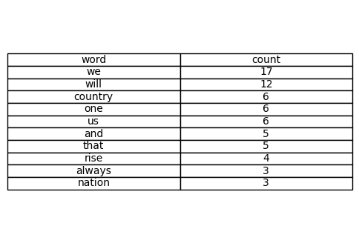
Top Ten Words as Table Graphic
Top 10 Words Table

Slide 11
DATA ANALYSIS

Slide 12
Frequency Analysis
Counting word occurrences
Calculating relative frequencies with value_counts(normalize=True)
value_counts is a method in pandas that counts the occurrences of each unique value in a Series. Setting normalize=True returns the relative frequencies instead of raw counts
Notes:
Relative frequencies can be more informative than raw counts, especially when comparing documents of different lengths.

Slide 13
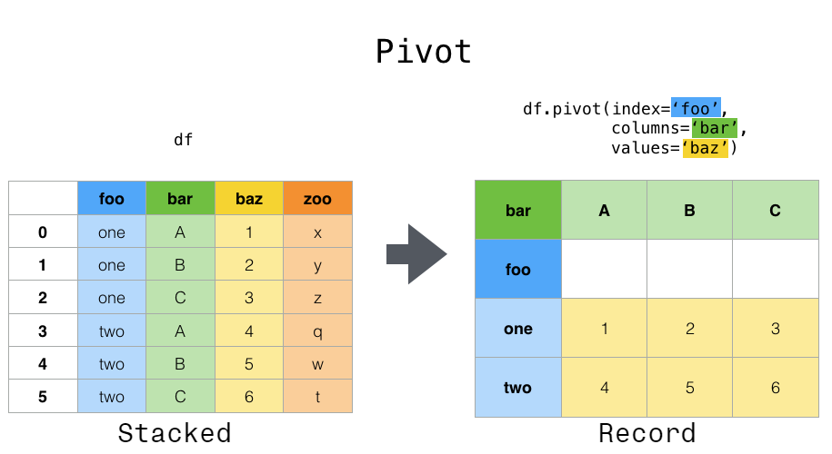
Comparing Groups
Analyzing differences between categories (e.g., genres, ratings)
Pivot tables for side-by-side comparison
A pivot table groups data by a specified index and then aggregates values from columns
Pivot Table

Slide 14
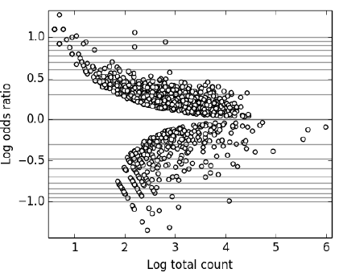
Log Ratio Concept
Why use log ratios?
Symmetric visualization of frequency differences
Formula: $log\left(\text{ratio}\right)$
Log Ratio
Notes:
If a word is twice as common in movies as in shows, the ratio is 2.
If a word is twice as common in shows as in movies, the ratio is 0.5.
These numbers are not symmetric: 2 and 0.5 are not equally “far” from 1.
Taking the logarithm (usually base 10 or natural log) of the ratio makes the comparison symmetric around zero:
log(2) ≈ 0.301 (indicating higher frequency in movies)
log(0.5) ≈ -0.301 (indicating higher frequency in shows)
Log ratios help to visualize differences in word usage between groups. A log ratio of 0 means equal frequency, positive values indicate higher frequency in one group, and negative values indicate higher frequency in the other group.

Slide 15
DATA VISUALIZATION

Slide 16
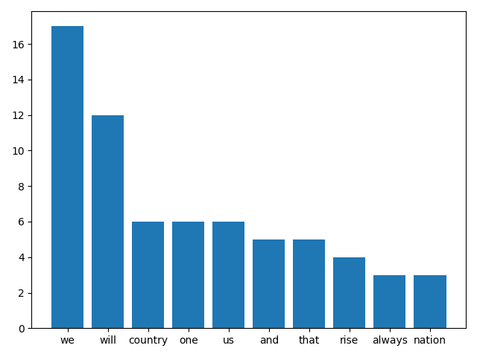
Visualization with Matplotlib
Creating bar plots for word frequencies
Customizing axes, labels, and colors
Matplotlib barplot

Slide 17
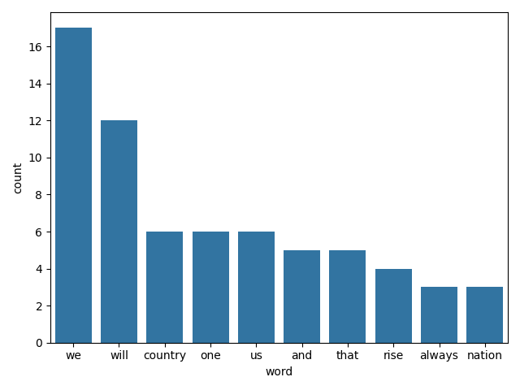
Seaborn for Enhanced Plots
High-level interface for statistical graphics
Example: barplot for top words
barplot

Slide 18
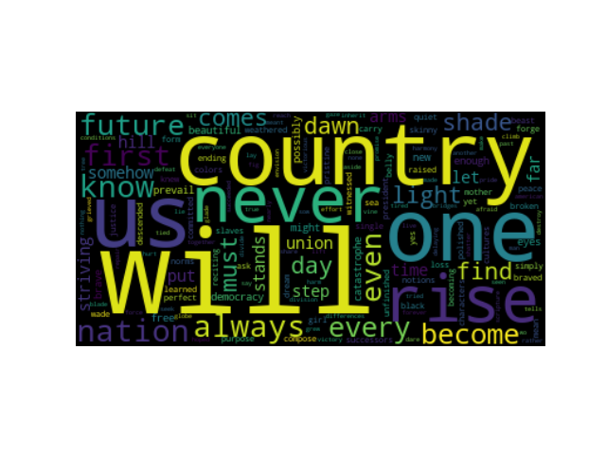
Word Clouds
Visualizing most frequent words
Customizing shape, color, and layout
Not commonly used in academic research but can be a fun way to explore data
wordcloud

Slide 19
Exporting Results
Saving DataFrames as CSV
Saving plots as PNG
NB: Call savefig() before plt.show()

Slide 20
Beyond Single Texts
Analyzing multiple documents
Comparing authors, genres, or time periods

Slide 21
Advanced Grouping
Grouping by binary or categorical features
Examples: rating, year, sentiment

Slide 22
Exercises and Challenges
Try new datasets: hotel reviews, spam vs ham, poetry
Explore different groupings and visualizations

Slide 23
Key Libraries Recap
pandas: data manipulation
matplotlib: plotting
seaborn: statistical graphics
wordcloud: word visualization
nltk: text processing

Slide 24
Resources and Further Reading
pandas documentation
matplotlib and seaborn tutorials
nltk book
wordcloud package docs

Slide 25
Summary
Word counting and visualization are powerful tools
Python ecosystem offers flexible, robust solutions
Experiment with your own texts and datasets

Slide 26
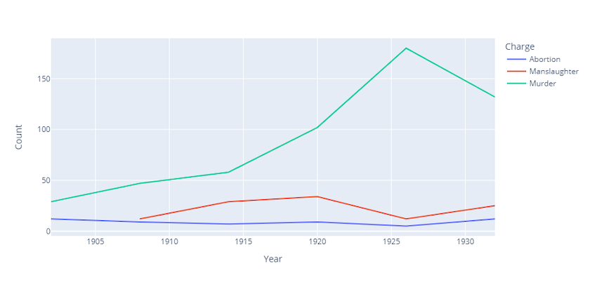
Interactive Visualizations with Plotly
Plotly enables interactive, web-based visualizations
Features: hover, zoom, pan, filter, export
Useful for exploring data dynamically and sharing results online
https://programminghistorian.org/assets/interactive-visualization-with-plotly/interactive-visualization-with-plotly-03.html

Slide 27
Plotly in Python
Use plotly.express for quick, high-level plots
Use plotly.graph_objects for more customization
Plots can be exported as HTML or static images

Slide 28
Introduction to Clustering
Clustering: grouping data points based on similarity
Unsupervised learning: no labels, algorithm finds structure
Common in text analysis, digital history, and exploratory data analysis

Slide 29
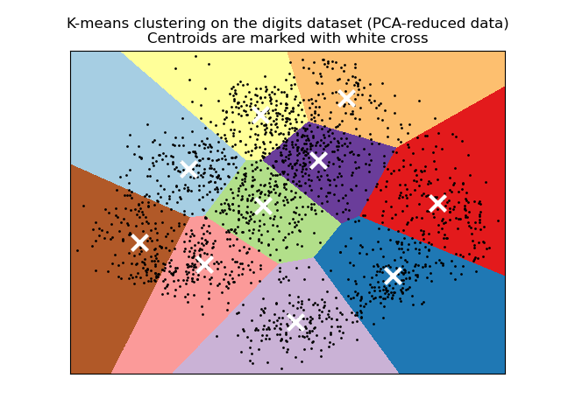
K-Means Clustering with Scikit-Learn
K-means: partitions data into k clusters by minimizing within-cluster variance
Steps: choose k, assign points to nearest centroid, update centroids, repeat
Visualize clusters in 2D/3D to interpret groupings
K-Means Clustering Example

Slide 30
Interpreting Clusters
Clusters reveal patterns or subgroups in data
Useful for discovering themes, genres, or communities
Limitations: sensitive to k, may not capture complex structures

