Slide 1
Introduction to Docker
Bud Seemann, Java Developer

Slide 2
Overview
What are containers
Containers vs. Virtual Machines
Install Docker
Creating a Dockerfile
Building and Running images

Slide 3
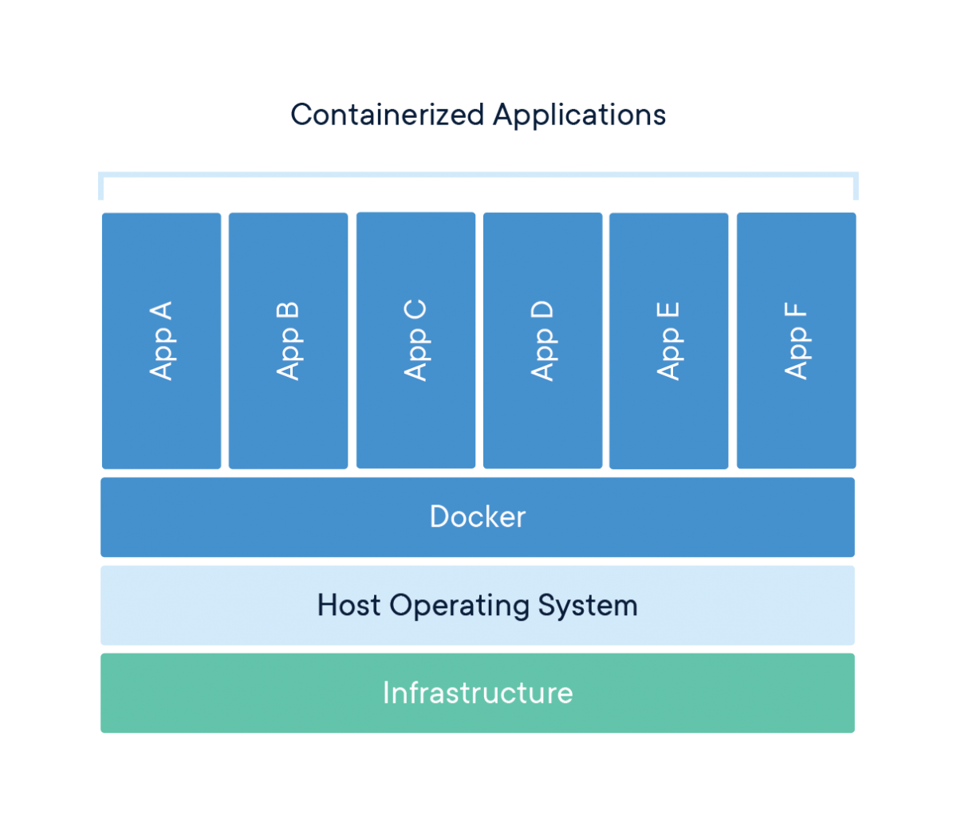
Containers
A Standardized unit of software

Slide 4
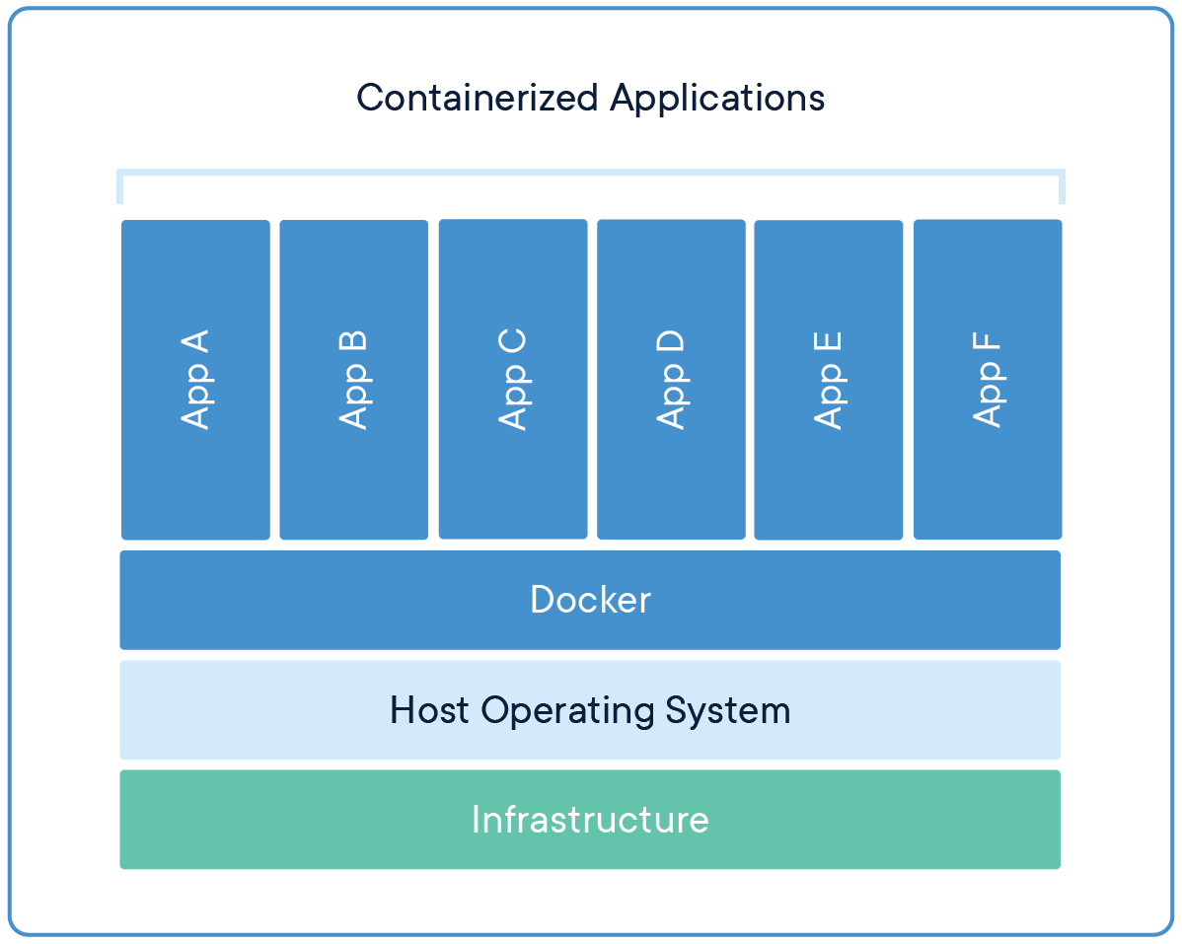
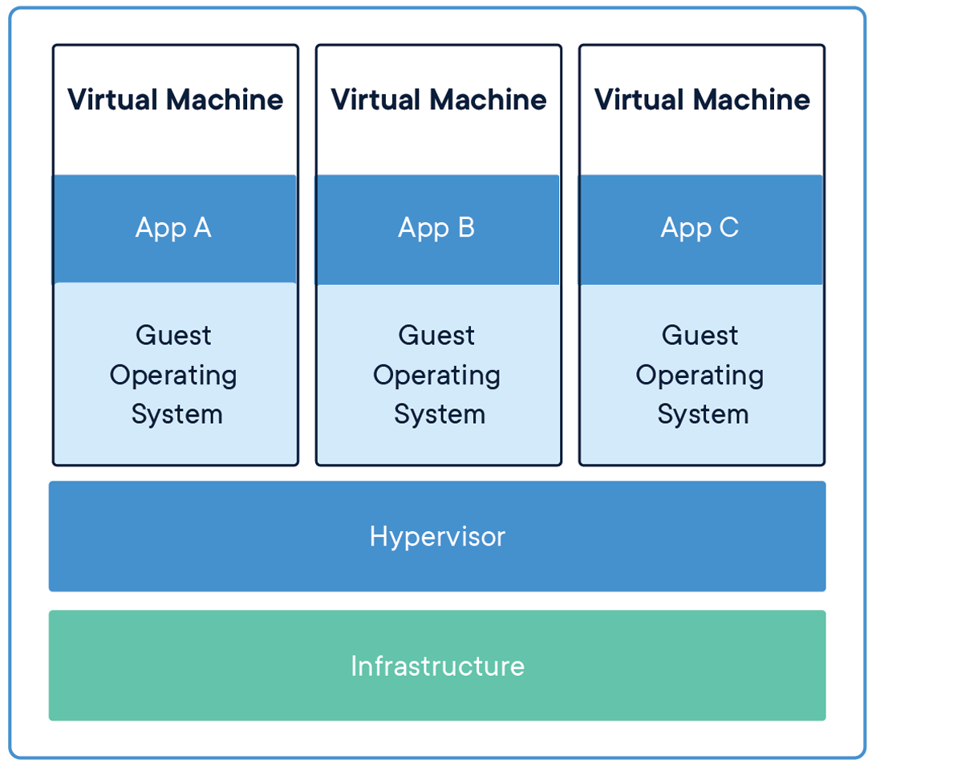
Containers vs Virtual Machines
Containers virtualize the operating system instead of hardware

Slide 5
Installing Docker
Docker Desktop
https://www.docker.com/products/docker-desktop
Need to create Docker Hub account
Download and install
Windows 10 Enterprise or Mac
May need to install HyperV on Windows
Check if running
Open command prompt > docker run hello-world

Slide 6
Am I running?

Slide 7
Creating a Dockerfile
Instructions to build a docker image
Must start with a ‘FROM’ instruction
Docker Hub
‘COPY’, ‘ADD’
‘EXPOSE’ necessary ports
‘RUN’, ‘CMD’, and ‘ENTRYPOINT’

Slide 8
Building and Running Images
docker build
Docker context
docker run
docker container ls
docker container stop

