Slide 1

Data Integrity and Consistency in Distributed Database Systems
Authors: Hisham Ahmed Mahmoud & Hajar MaseehYasin
Journal: Engineering and Technology Journal (Vol.10, Issue 05)
Published: May 2025
A presentation for the course Distributed Database System (6201)
Presented By:
Md Hasibul Islam Shanto
Student ID: 20204011
M.Engg, Dept of CSE
Presented To:
Dr. Md. Nasim Akhta
Professor
Department of CSE
Saturday, 27 September, 2025
Dhaka University of Science & Technology

Slide 2
Outline
Introduction - The Distributed Dilemma
Foundational Concepts
The DDBI Project: A New Approach
Comparing Approaches to Integrity
Real-World Applications
Performance Metrics: DDBI vs. Traditional Systems
Performance Deep Dive: 2PC vs. Rule-Based Enforcement
Adaptability of Consistency Models
Conclusion and Future Directions
Dhaka University of Science & Technology

Slide 3
Introduction - The Distributed Dilemma
The Shift: Traditional centralized databases are giving way to distributed systems for scalability, availability, and local autonomy.
The Challenge: How do we maintain a consistent and accurate view of data across geographically and logically separated nodes.
Key Areas of Focus:
The pioneering Database Integrity (DDBI) project.
A comparison of consistency models.
Performance trade-offs in distributed systems.
Dhaka University of Science & Technology

Slide 4
Foundational Concepts
ACID Properties: (Atomicity, Consistency, Isolation, Durability) - The gold standard for database transactions, but more complex to enforce in a distributed environment.
CAP Theorem: A fundamental trade-off. You can only pick two of three guarantees: Consistency, Availability, and Partition Tolerance.
Two-Phase Commit (2PC): A classic protocol to ensure all nodes either commit or abort together. It's safe but can be slow and prone to blocking.
Dhaka University of Science & Technology

Slide 5
The DDBI Project: A New Approach
What is it? A research project by SRI International to address data integrity in mission-critical, real-time systems (like Command, Control & Communication).
Key Innovations:
Rule-Based Enforcement: Defining integrity rules (e.g., "a balance cannot be negative") directly within the database.
Active Triggers: Instead of waiting for a central check, the database reacts instantly to events and updates to enforce these rules locally.
Multi-Version Concurrency Control (MVCC): Keeps a history of data changes, allowing for easier rollbacks and auditing without locking data.
Intelligent Management Objects (IMOs): Adds another layer of autonomous control for managing consistency.
Dhaka University of Science & Technology

Slide 6
Comparing Approaches to Integrity
Feature | Two-Phase Commit (2PC) | Eventual Consistency | DDBI Project
Primary Goal | Strong Consistency | High Availability | Hybrid/Adaptive Consistency
Mechanism | Global Coordinator | Data Replication | Active Rules & Triggers
Latency | High | Low | Moderate (but responsive)
Best For | Financial Transactions | Social Media Feeds | Mission-Critical Systems
Dhaka University of Science & Technology

Slide 7
Real-World Applications
Strong Consistency (2PC): Bank Transfer
You can't have the money leave one account but not arrive in the other. Every node must agree. Latency is acceptable for this level of safety.
Eventual Consistency: Social Media Likes
If you see 100 likes and your friend sees 101 for a few seconds, the system is still usable. Availability and performance are more important than perfect, instant consistency.
Hybrid/Adaptive (DDBI): Air Traffic Control
You need real-time, consistent data on plane locations (no stale data allowed!), but you also can't afford for the system to lock up or become unavailable. DDBI's responsive, rule-based model is a perfect fit here.
Dhaka University of Science & Technology

Slide 8
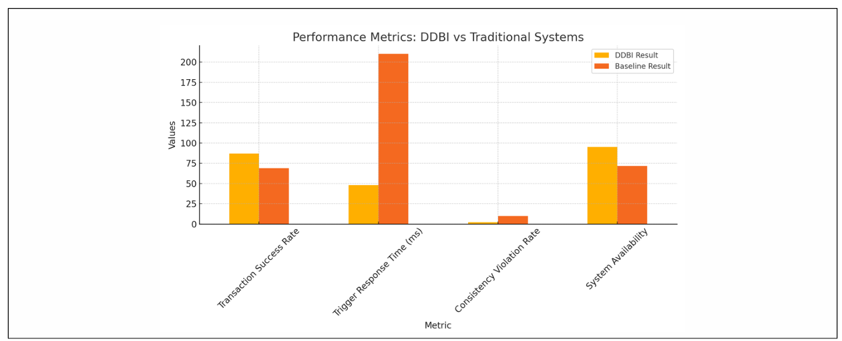
Performance Metrics: DDBI vs. Traditional Systems
Figure 2: Transaction Success Rate, Response Time, Violation Rate, Availability, and Rollback Accuracy
DDBI demonstrates clear advantages in several key areas:
Transaction Success Rate: More operations complete successfully.
Trigger Response Time: The system reacts to changes almost instantly.
Dhaka University of Science & Technology

Slide 9
Performance Metrics: DDBI vs. Traditional Systems (Cont.)
Figure 2: Transaction Success Rate, Response Time, Violation Rate, Availability, and Rollback Accuracy
DDBI demonstrates clear advantages in several key areas:
Consistency Violation Rate: Far fewer data integrity errors occur.
System Availability: The system remains online and responsive more often.
Dhaka University of Science & Technology

Slide 10
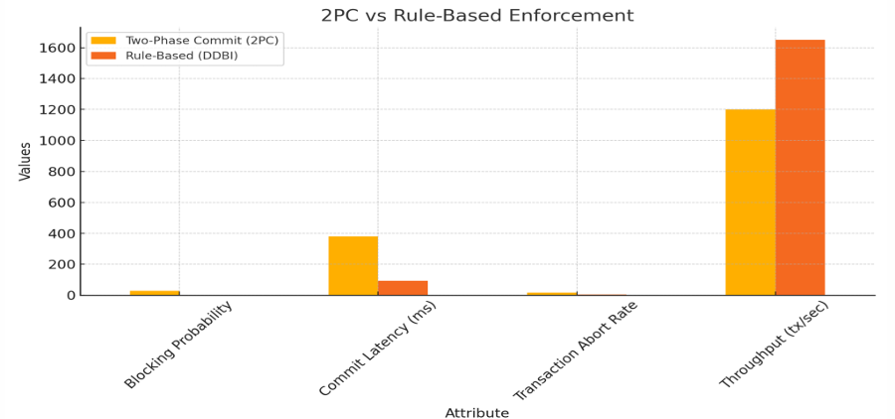
Performance Deep Dive: 2PC vs. Rule-Based Enforcement
Figure 3: Latency, Throughput, and Abort Rate Comparison Between 2PC and DDBIAccuracy
Blocking Probability: Rule-based systems have a near-zero blocking probability.
Commit Latency: The time to finalize a transaction is significantly lower.
Throughput: DDBI can handle a much higher volume of transactions per second.
Dhaka University of Science & Technology

Slide 11
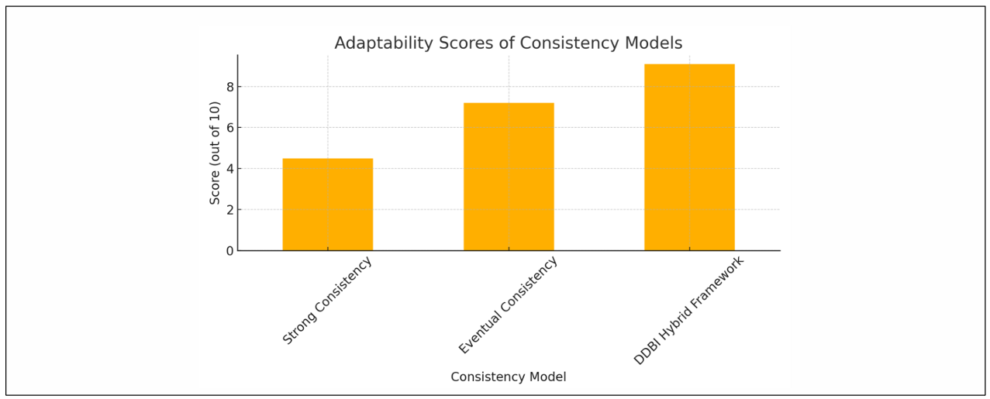
Adaptability of Consistency Models
Fieger 4: Evaluation of Strong, Eventual, and DDBI Hybrid Consistency Models Based on Scalability, Responsiveness, and Configuration Ease
This chart rates different models on their adaptability:
Strong Consistency: Rigid and less adaptable.
Eventual Consistency: Very flexible, but at the cost of accuracy.
DDBI Hybrid Framework: The most adaptable, providing a balance of consistency and performance tailored to the application's needs.
Dhaka University of Science & Technology

Slide 12
Conclusion and Future Directions
DDBI's Legacy: Provides a robust, responsive, and flexible framework for data integrity that outperforms traditional methods on key metrics.
The Trade-Off: This power comes with increased complexity in designing, managing, and debugging the rules and triggers.
Future Research:
Integrating machine learning to optimize the rules automatically.
Applying these principles to blockchain and distributed ledgers.
Scaling rule-based systems for massive IoT and cloud environments.
Dhaka University of Science & Technology

Slide 13
Q&A
Thank you!
Dhaka University of Science & Technology

