Slide 1


Slide 2

Welcome

Slide 3

D.L. Simmons & C0mpany presents
Custom Church Organs

Slide 4
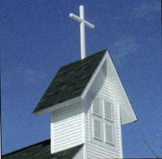
Organs for Chapel…
Church…

Slide 5
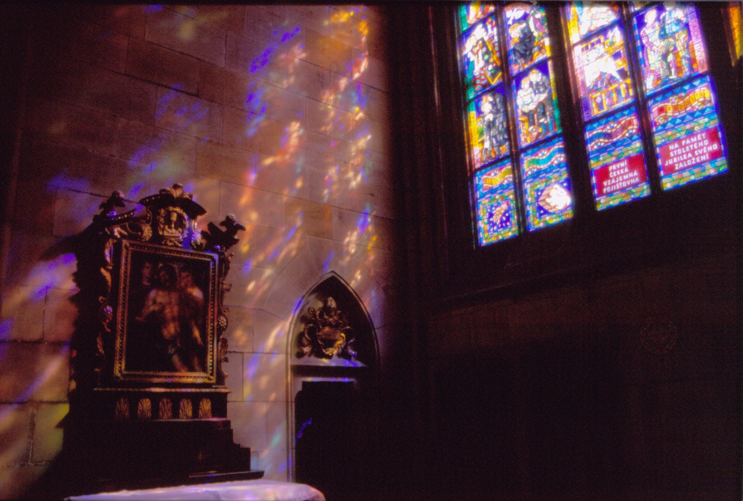
…or the largest Cathedral

Slide 6
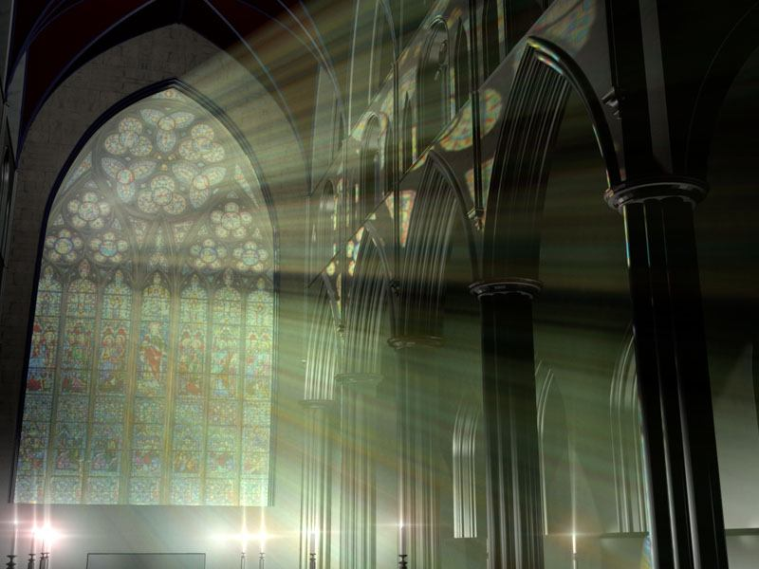
Phoenix Organs
…provide unsurpassed quality
…in sound production,
…in finely crafted consoles,
…inspire artistry,
…meet the demands
…of any Music Ministry

Slide 7
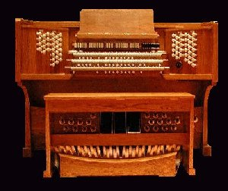

Slide 8
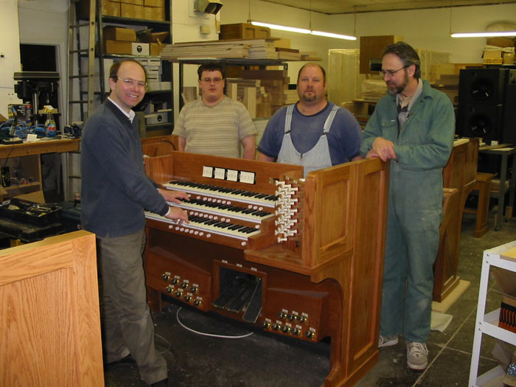
The same high quality components and the same artistic digital samples go into EVERY Phoenix organ… large or small.

Slide 9
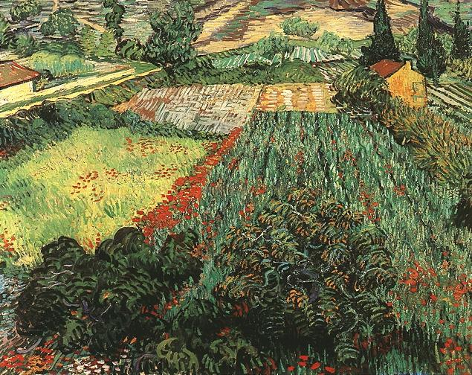
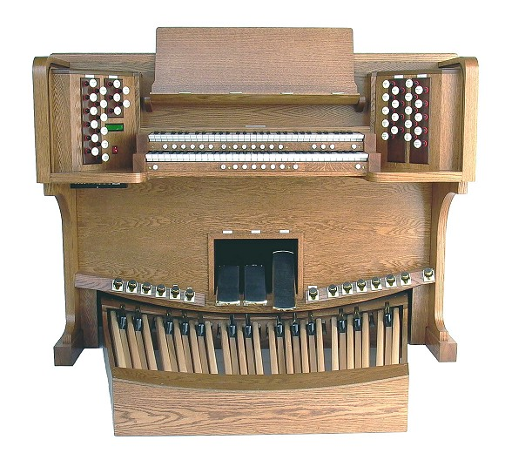
Phoenix Weybridge Opus 1

Slide 10

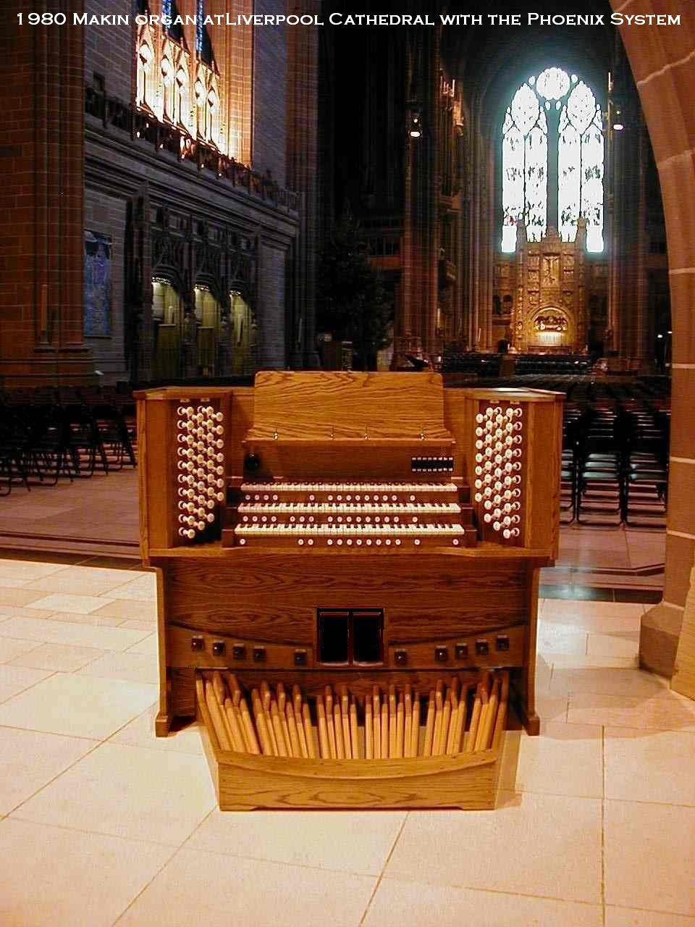

Slide 11
Selected Features available in all Phoenix Organs…
Minimum of 11 voicing parameters of each note of each stop.
Up to 64 independent audio channels.
Four possible independent stoplists in each organ.
Programmable delay for each division to represent distance.
Multiple historic tuning temperaments.
MIDI in-thru-out for Midi-recorder or Sound expander unit.
Up to 256 pistons in capture system.
Up to 99 memory levels in programmable capture system.
ANY Phoenix organ can control pipe ranks.
FULLY configurable and updateable even after installation!

Slide 12
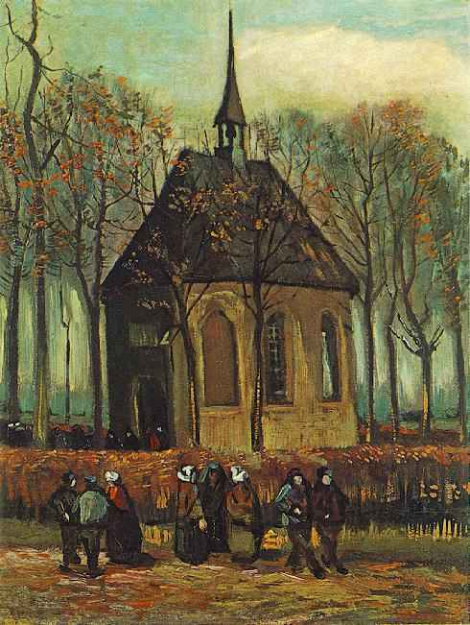
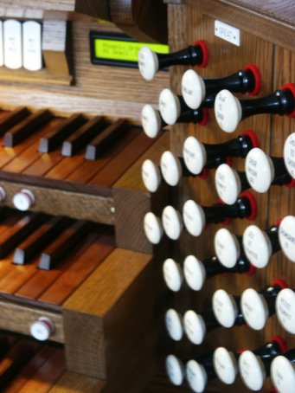
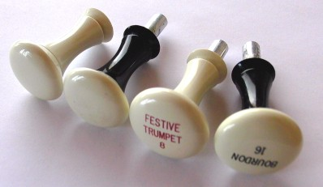
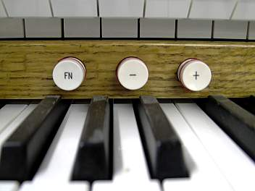
…quality in every detail

Slide 13
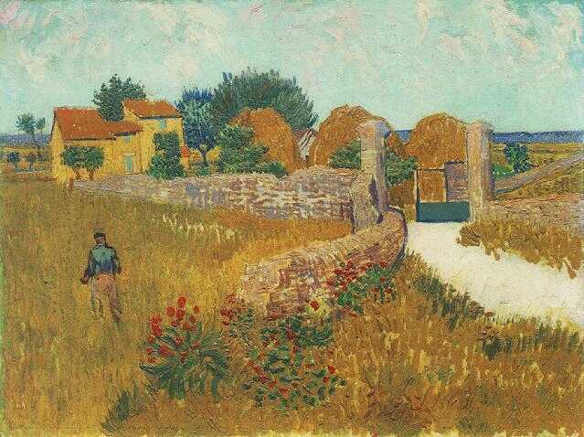
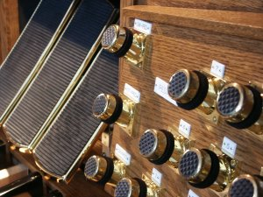
…the feel and appearance of a pipe organ, using hardware from pipe organ suppliers.

Slide 14
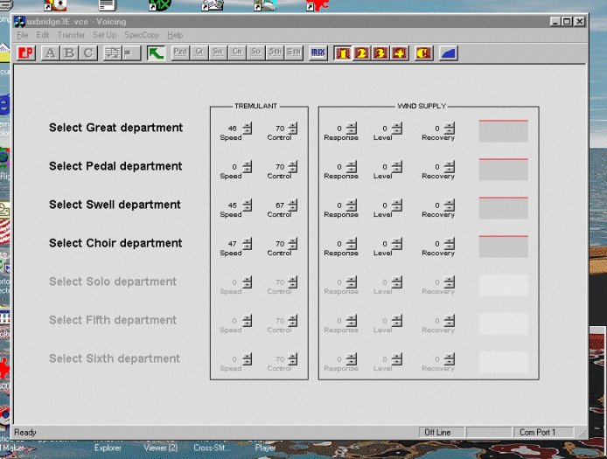
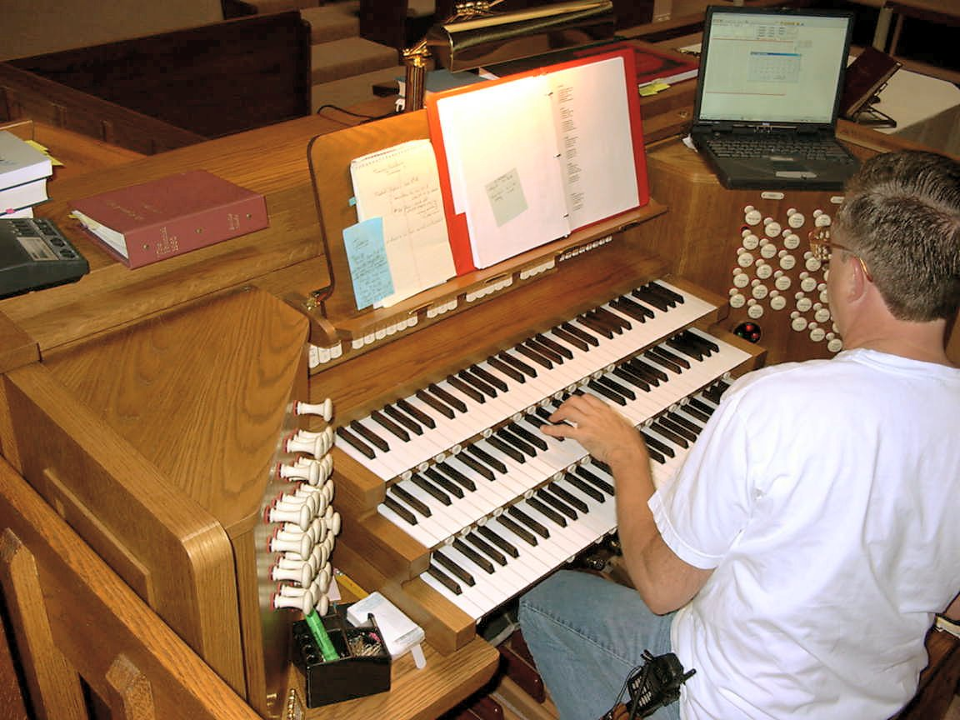
Voicing Session

Slide 15
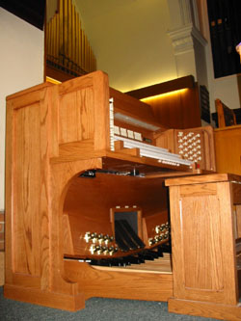
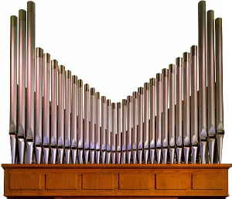
Pipe / Digital
Combination Organs

Slide 16
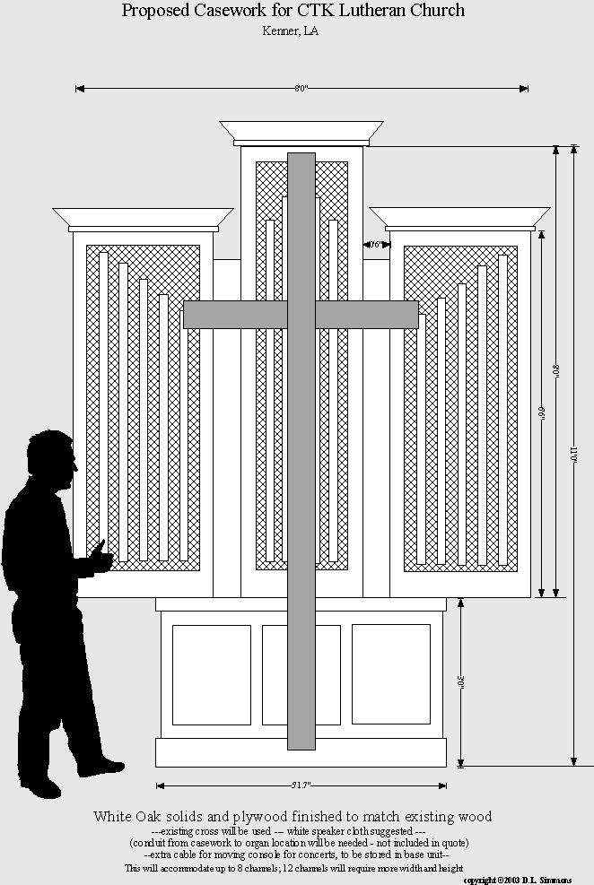
Custom Casework and
Speaker Facades

Slide 17
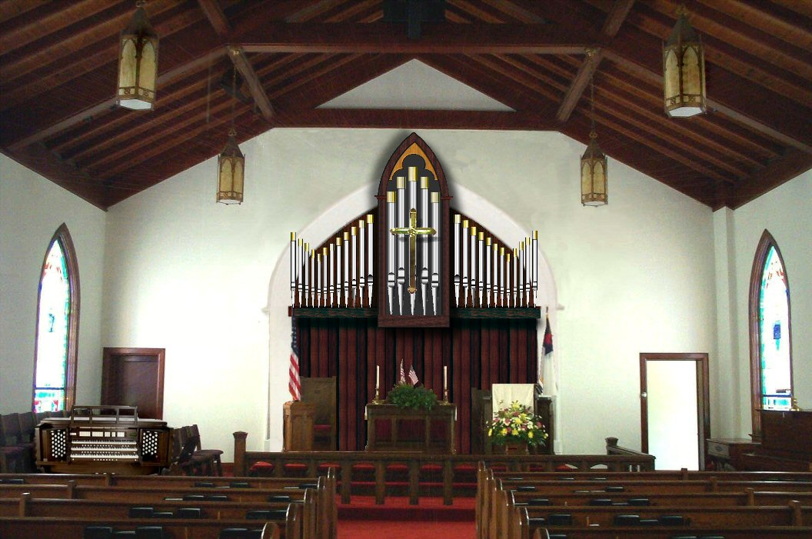
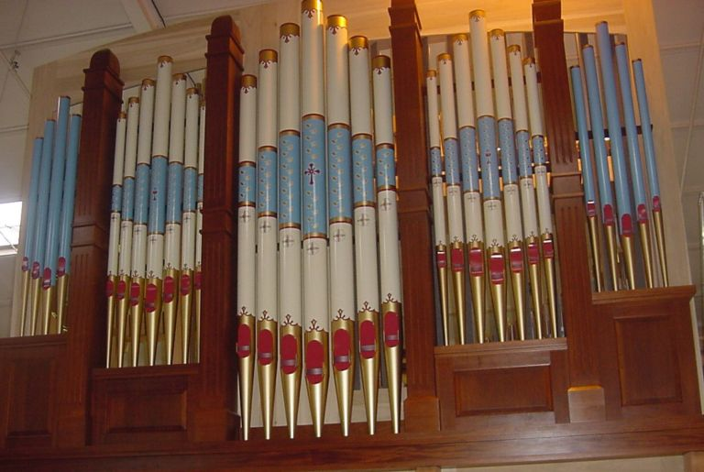
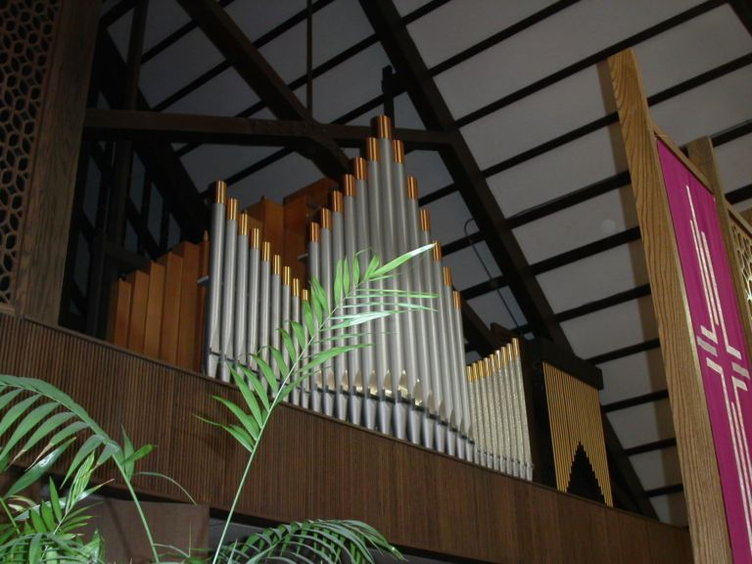
Custom Casework and Pipe Facades

Slide 18
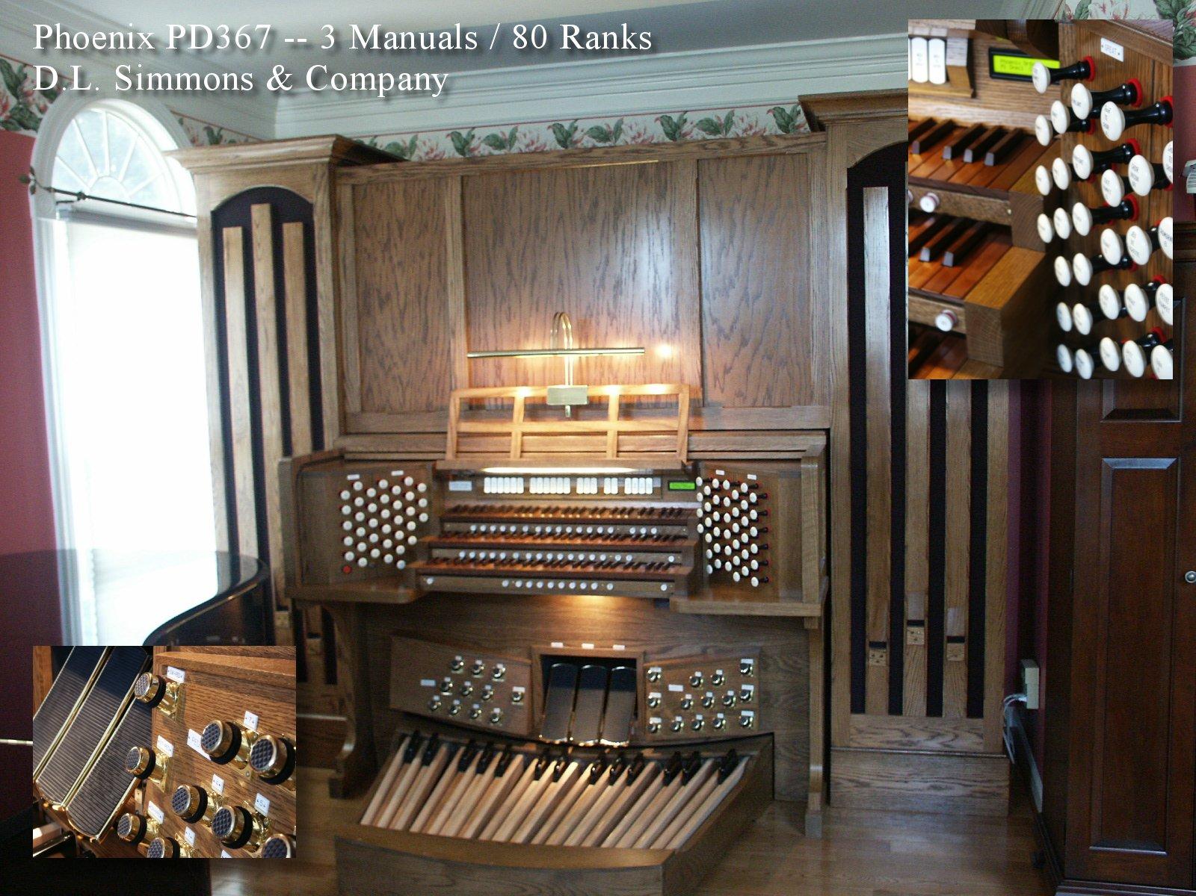

Slide 19
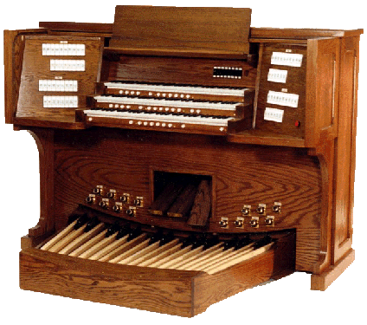
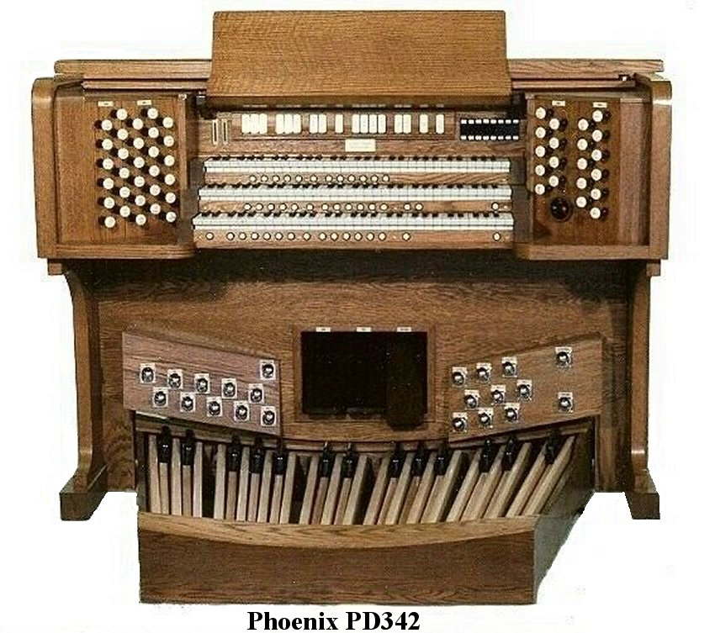
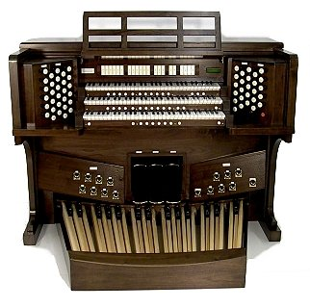
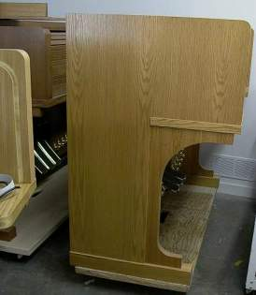
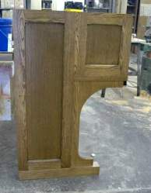
Custom Console Choices are endless….

Slide 20
D.l. Simmons & Company
8120 Dyer Road
Fairhope, Alabama 36532
For More Information Contact:
CALL: 1(251) 928-6820 OR 1(251)751-6722 (cell)
SEE:
www.qualityorgans.com

Slide 21
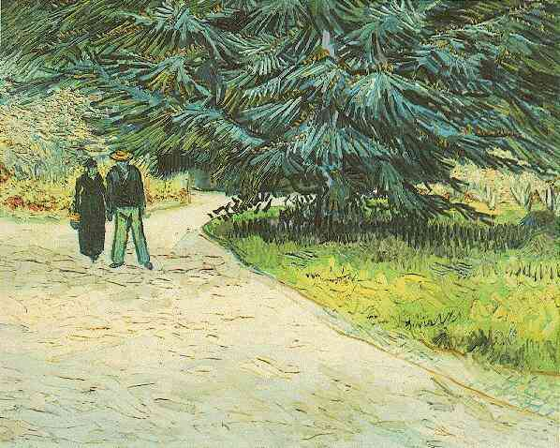
Thank You

Slide 22
Photos Courtesy of:
D.L. Simmons & Company, Fairhope, AL
Phoenix Organs, NA
Phoenix Organs, UK
DesertSounds, Phoenix, AZ
COPYRIGHTED ©2005 BY RESPECTIVE OWNERS

