Slide 1
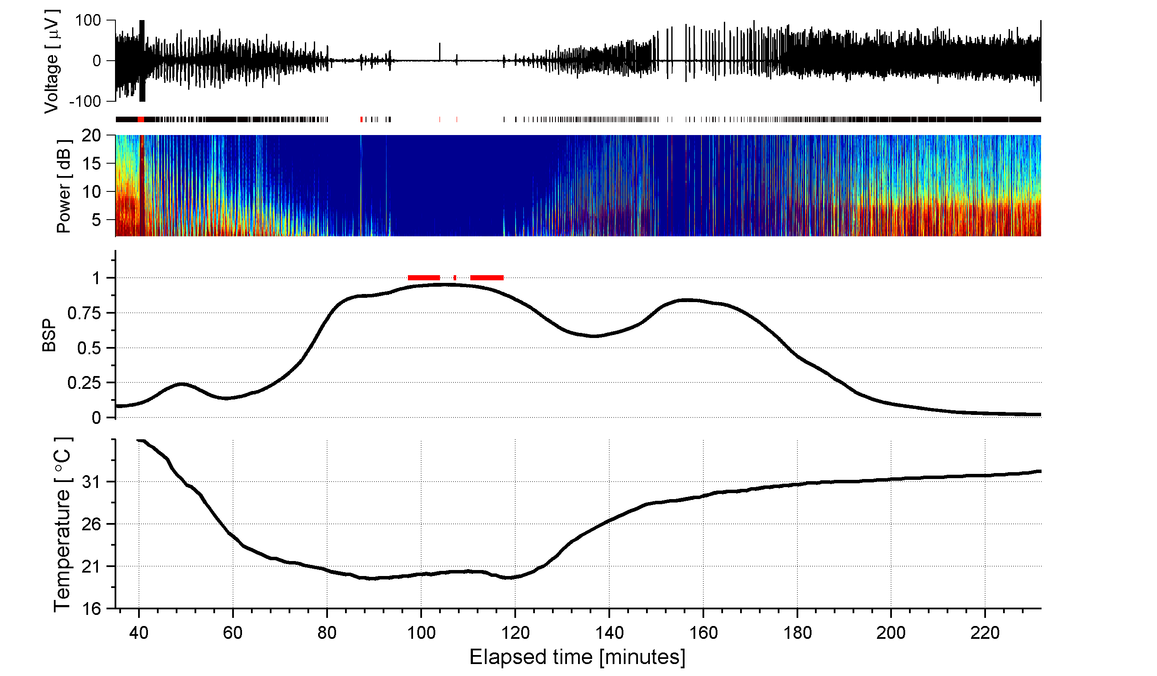
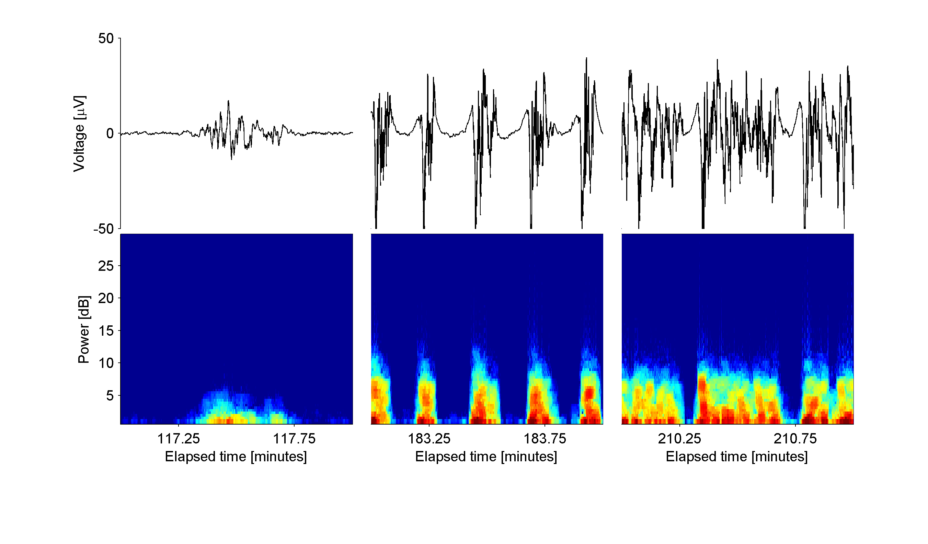
Figure 1
Case 7
A
B
C
D
E
F
19.6°C
30.8°C
31.5°C
19.6°C
30.8°C
31.5°C
G

Slide 2
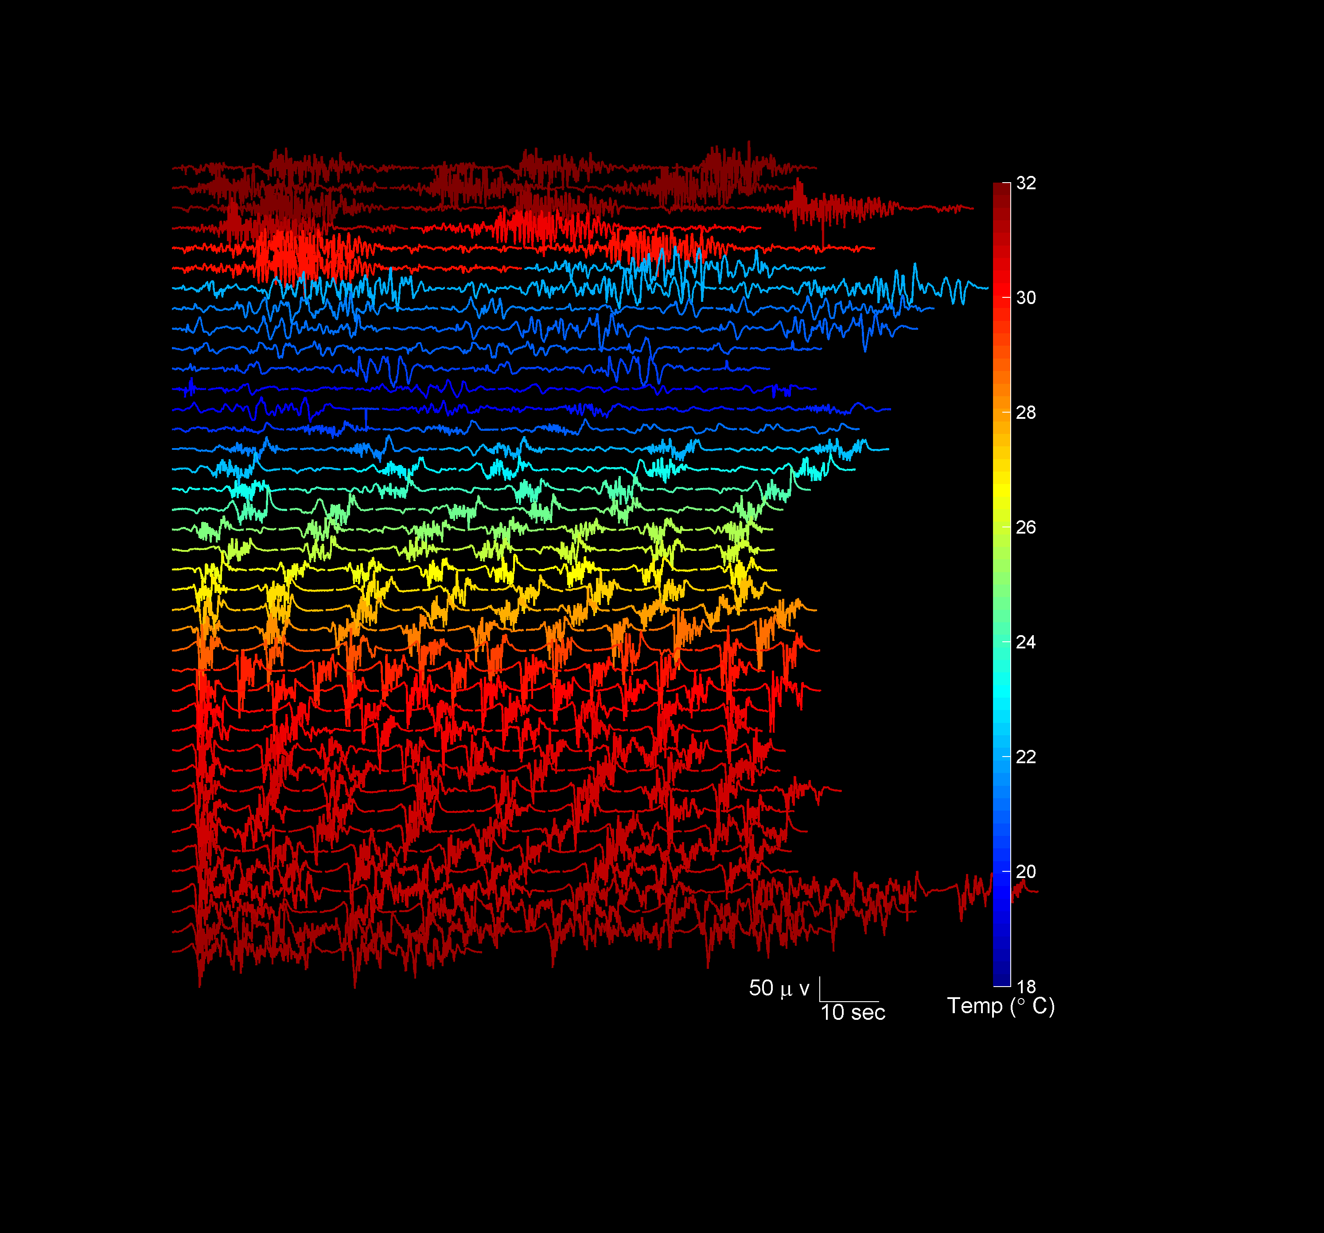
Figure 1H
Case 7

Slide 3
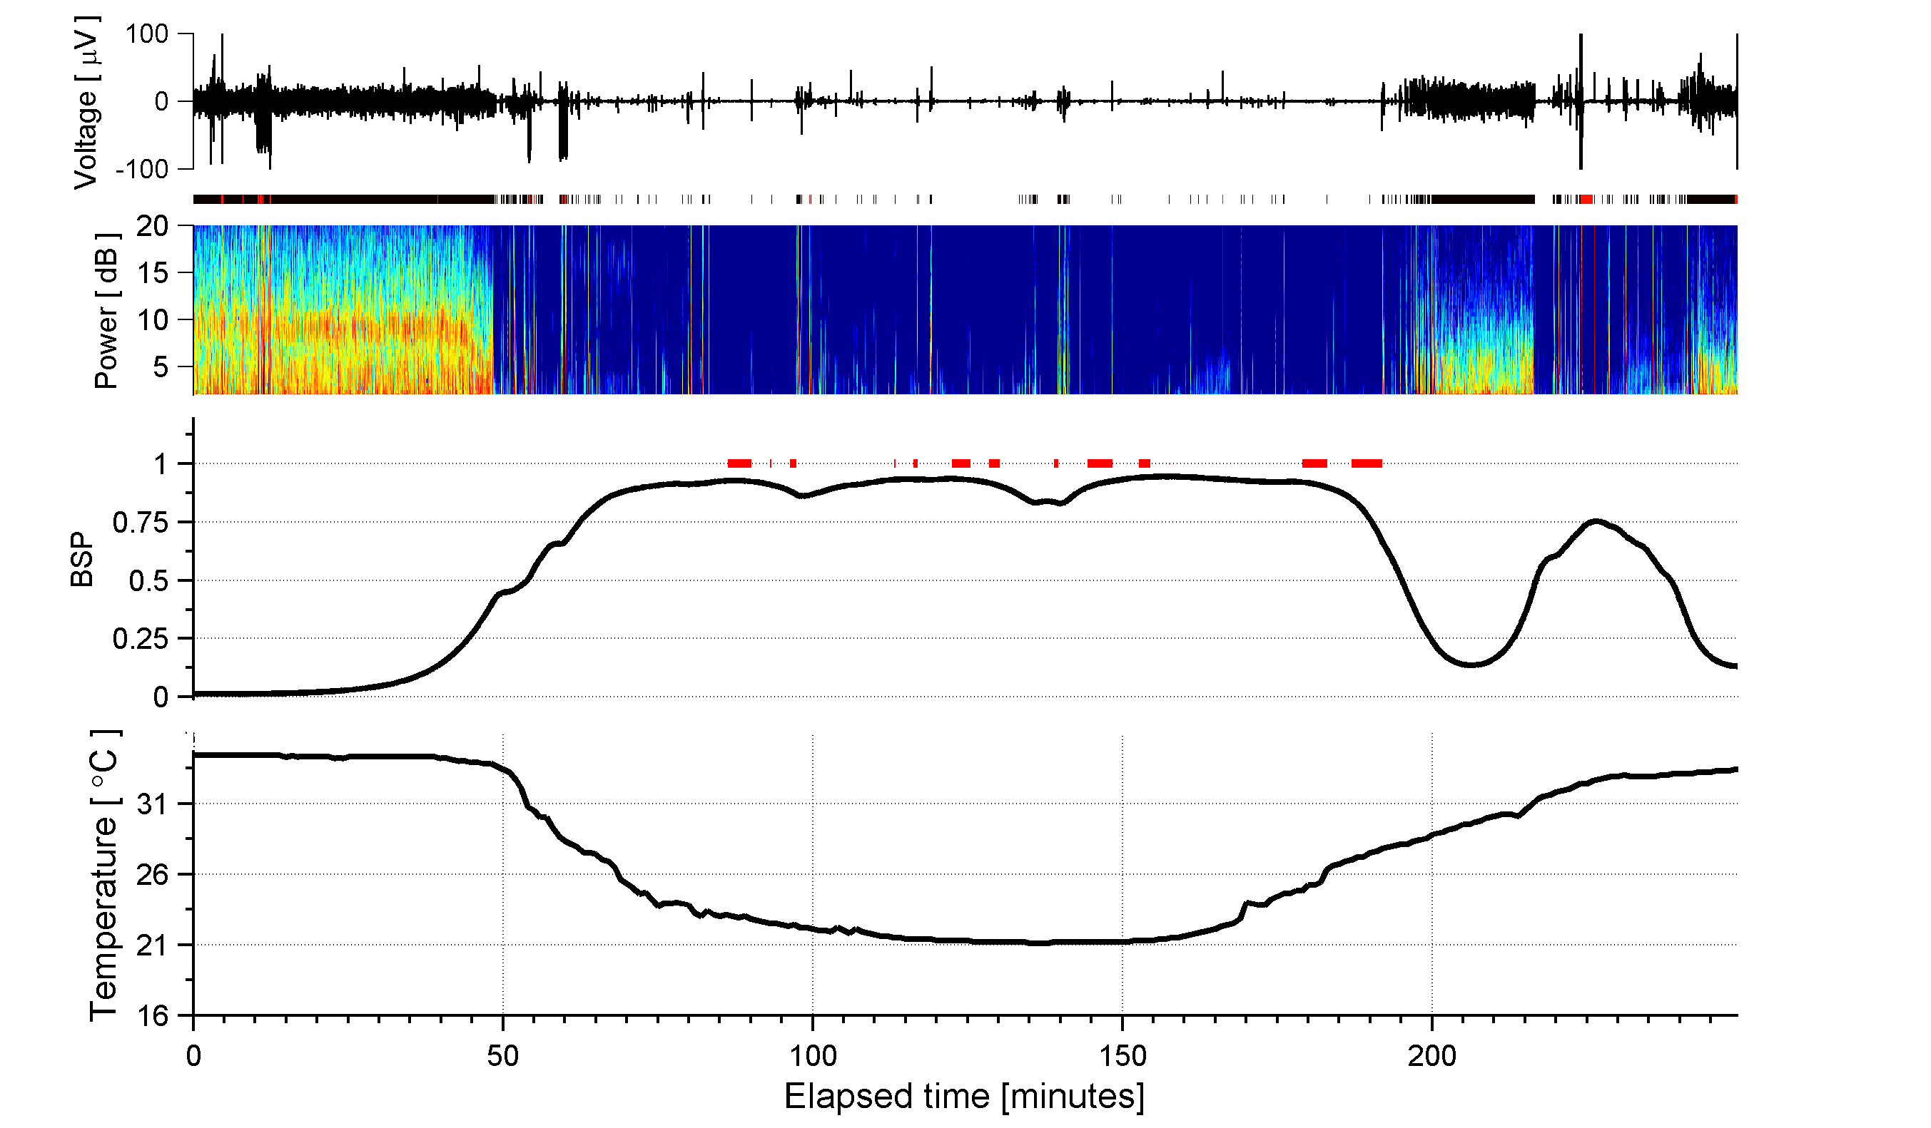
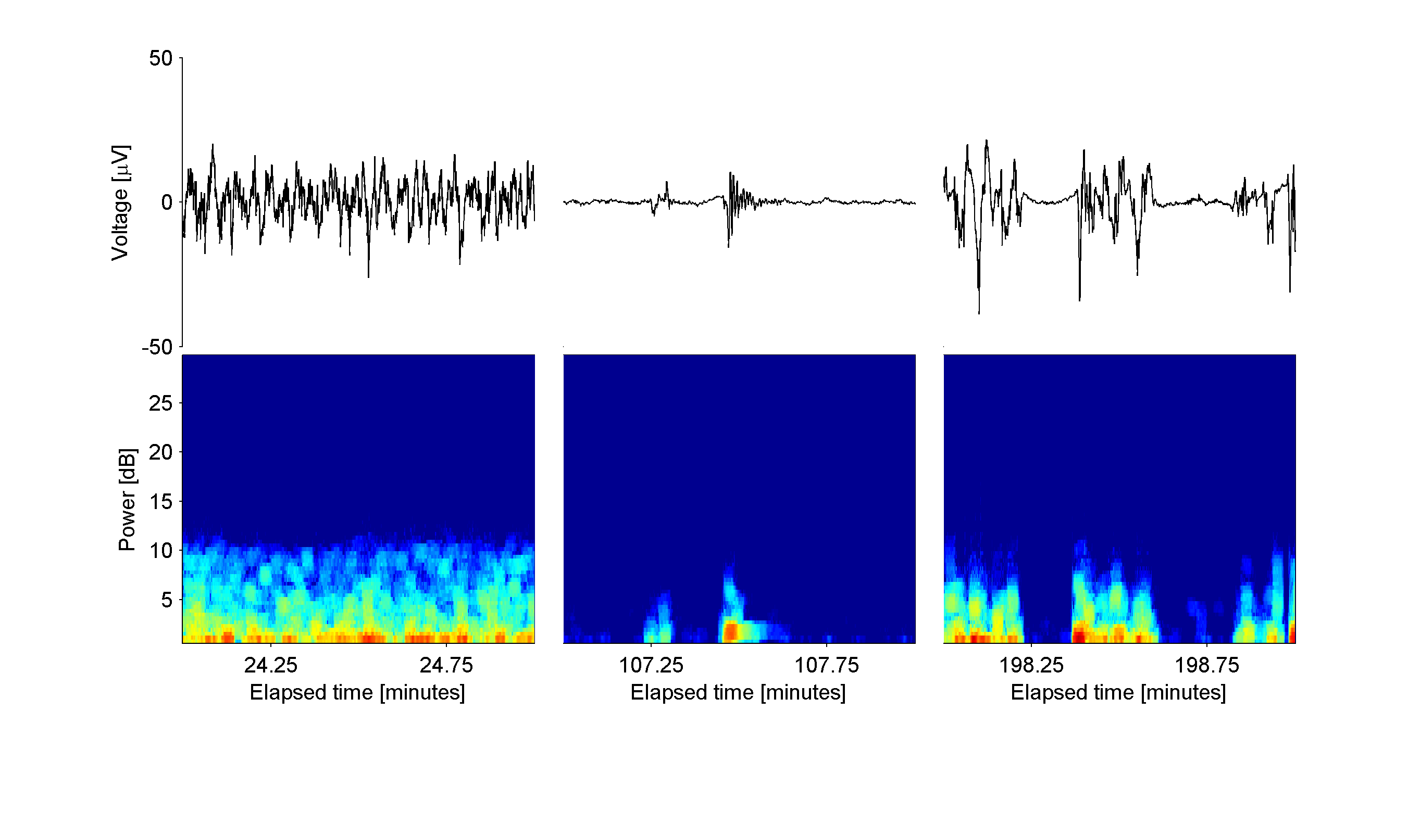
Figure 2
Case 1
A
B
C
D
E
F
34.2°C
21.9°C
28.5°C
G
Case 1
Notes:
From top to bottom: Time aligned EEG voltage trace; segmentation of EEG (suppressions in white, bursts in black, artifact in red); estimated burst suppression probability (BSP); and temperature.
Example EEG traces of bursts at three different temperatures (top) with corresponding burst spectrograms (bottom) at three different temperatures.

Slide 4
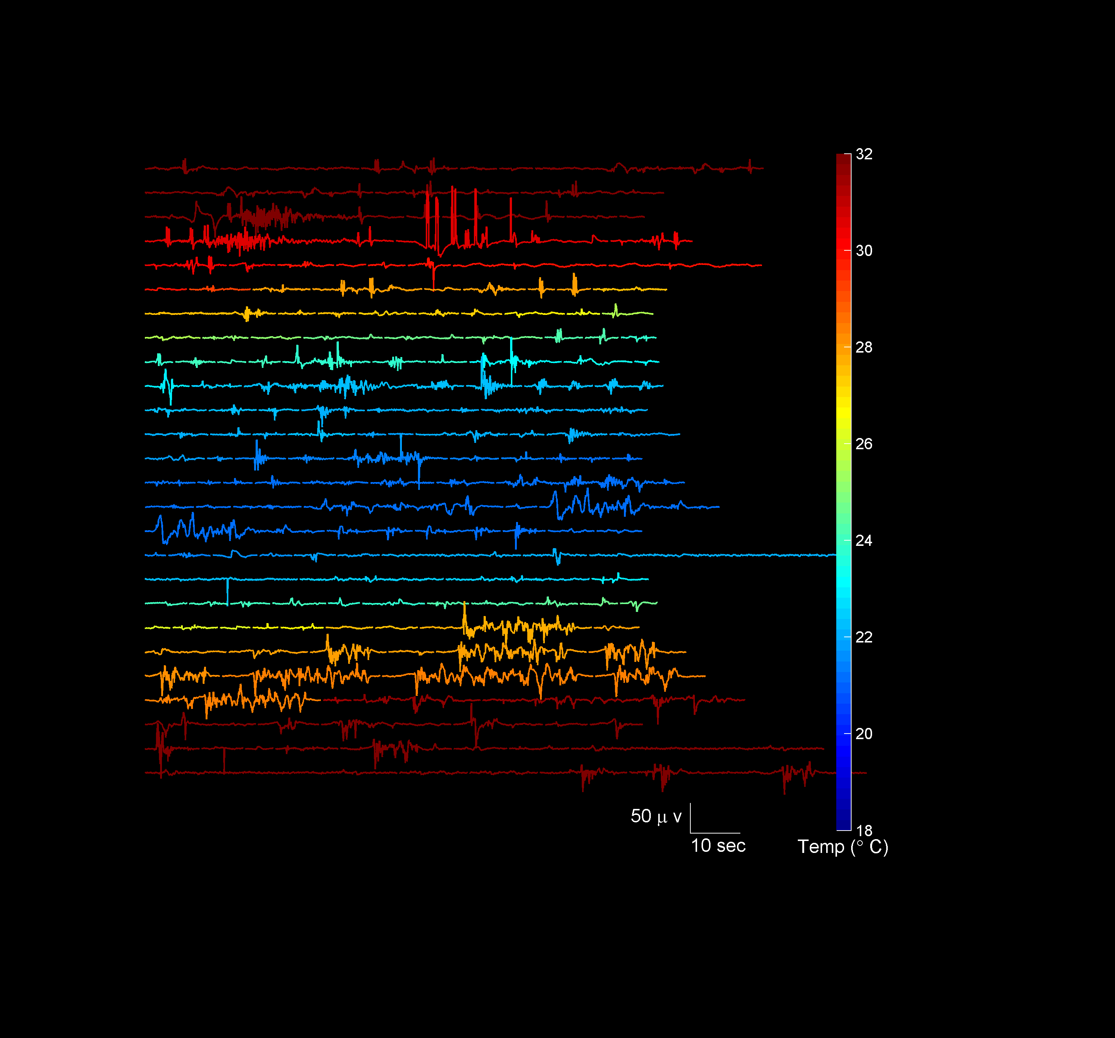
Figure 2H
Case 1

Slide 5
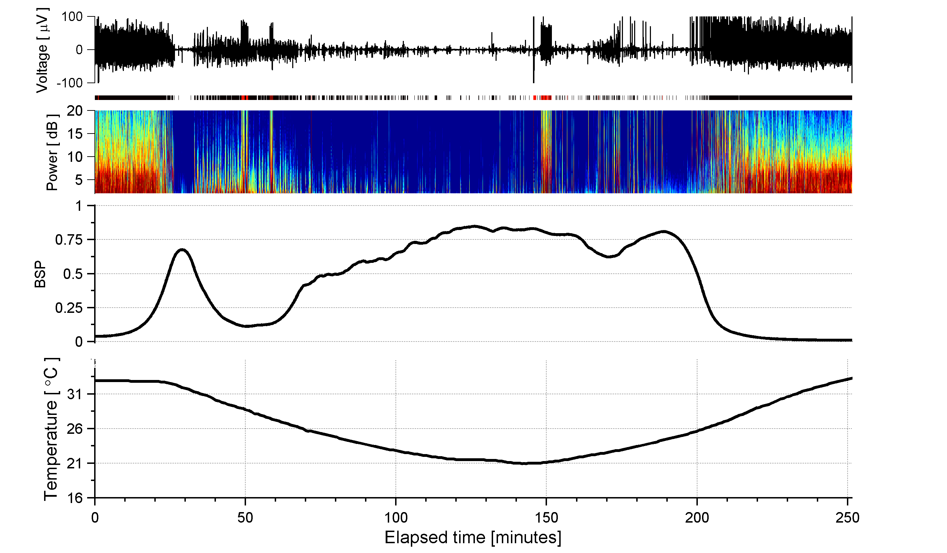
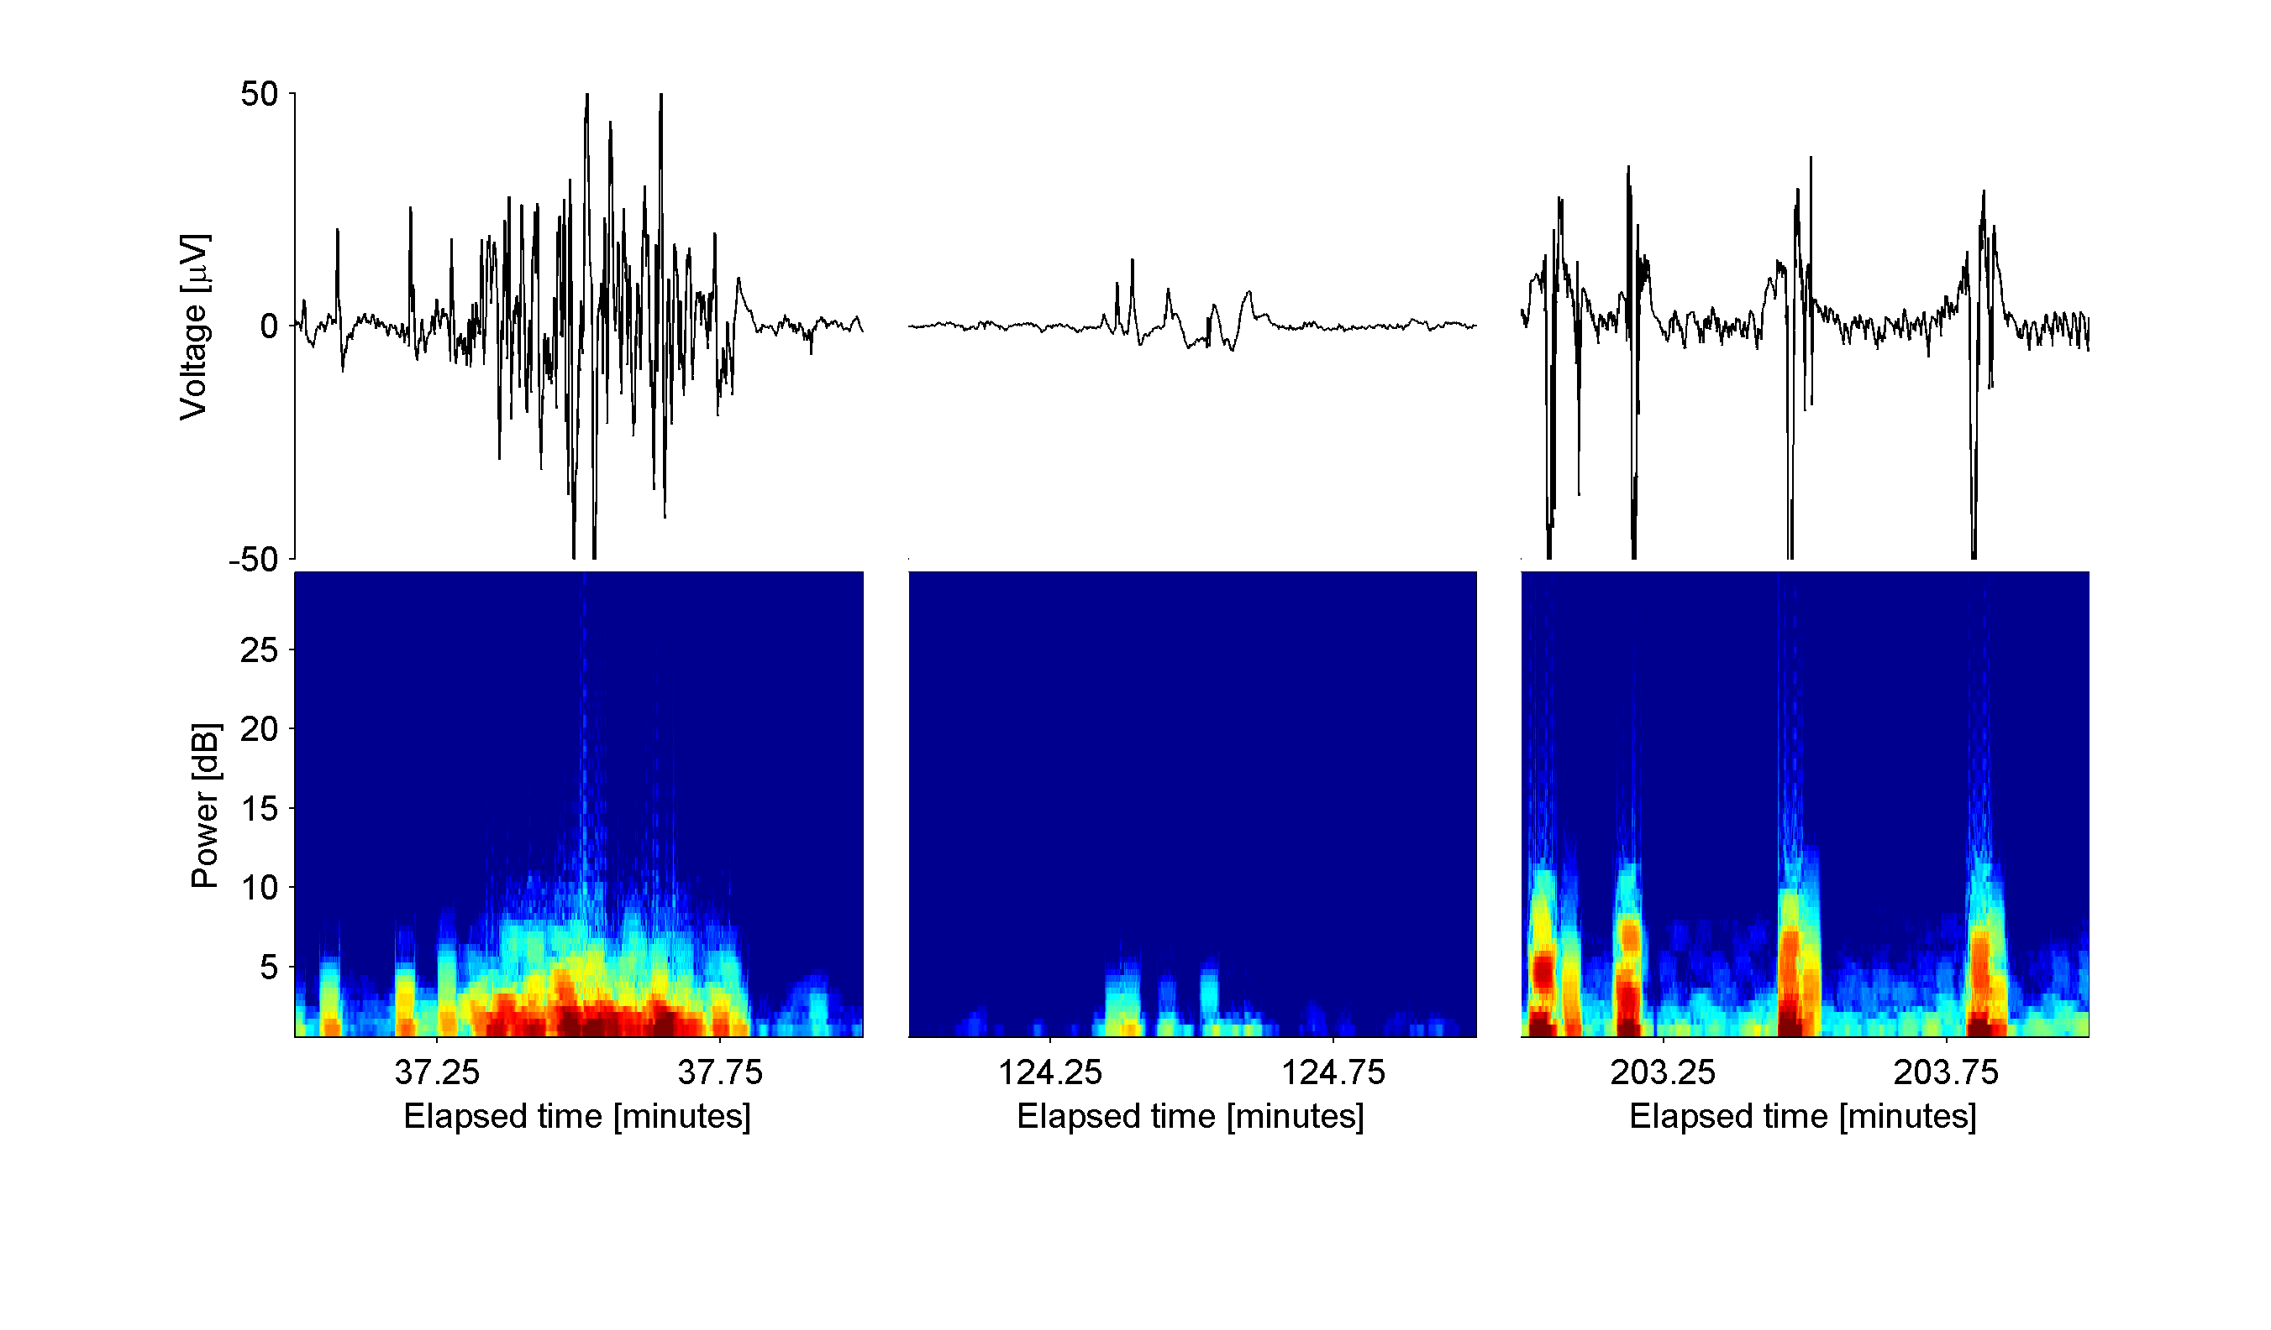
Figure 3
Case 3
A
B
C
D
E
F
30.8°C
21.5°C
26.2°C
G

Slide 6
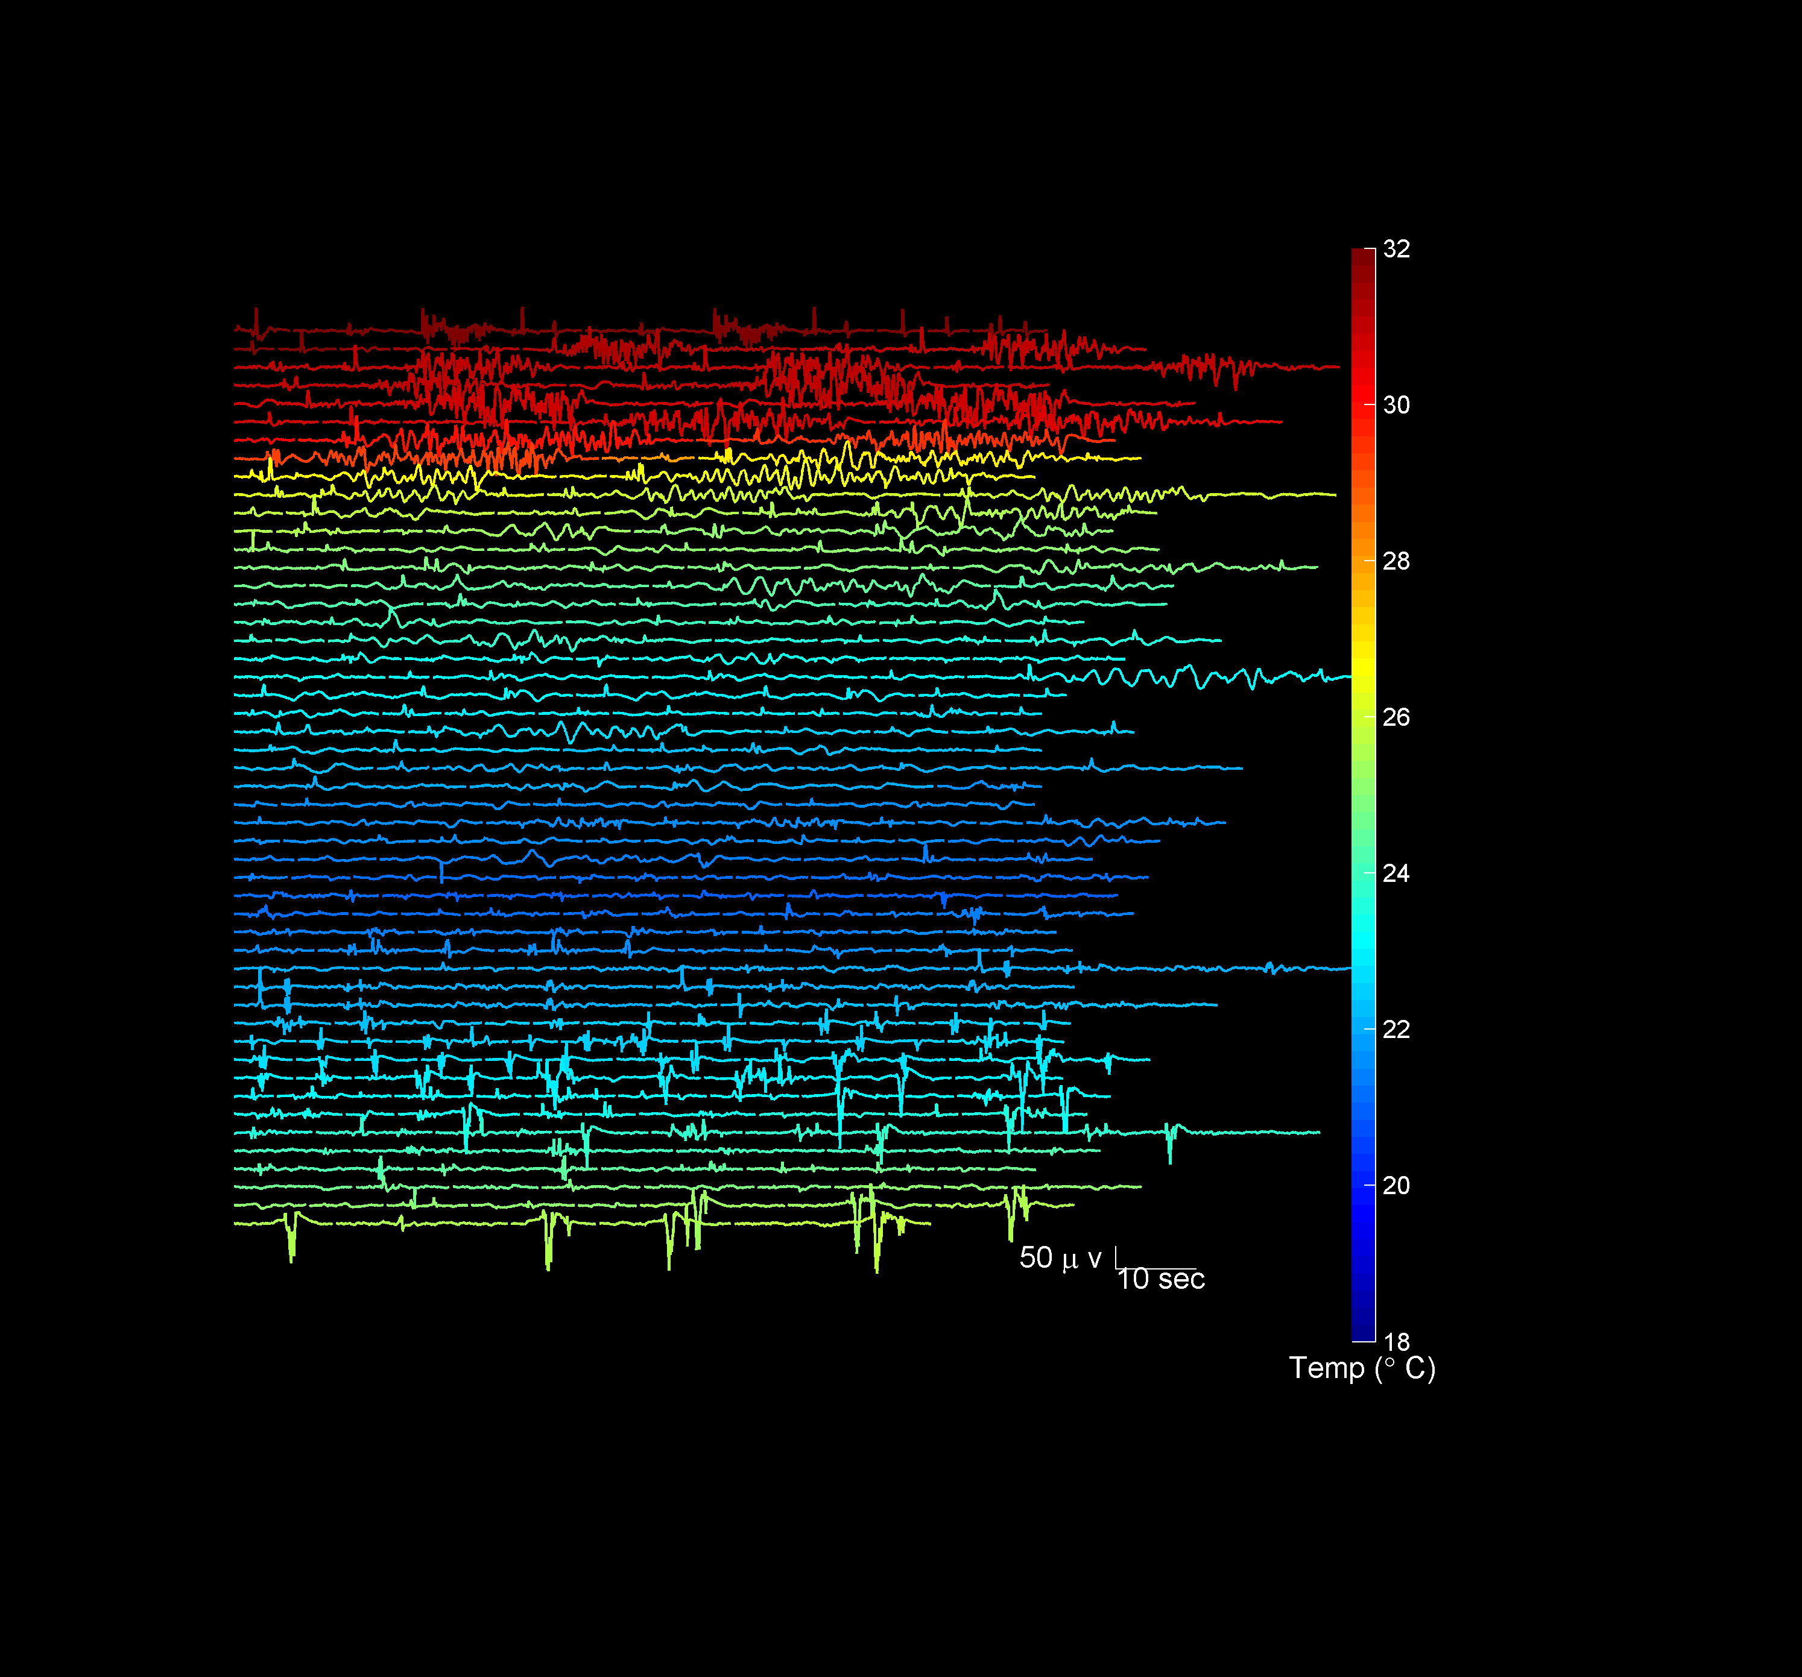
Figure 3H
Case 3

Slide 7
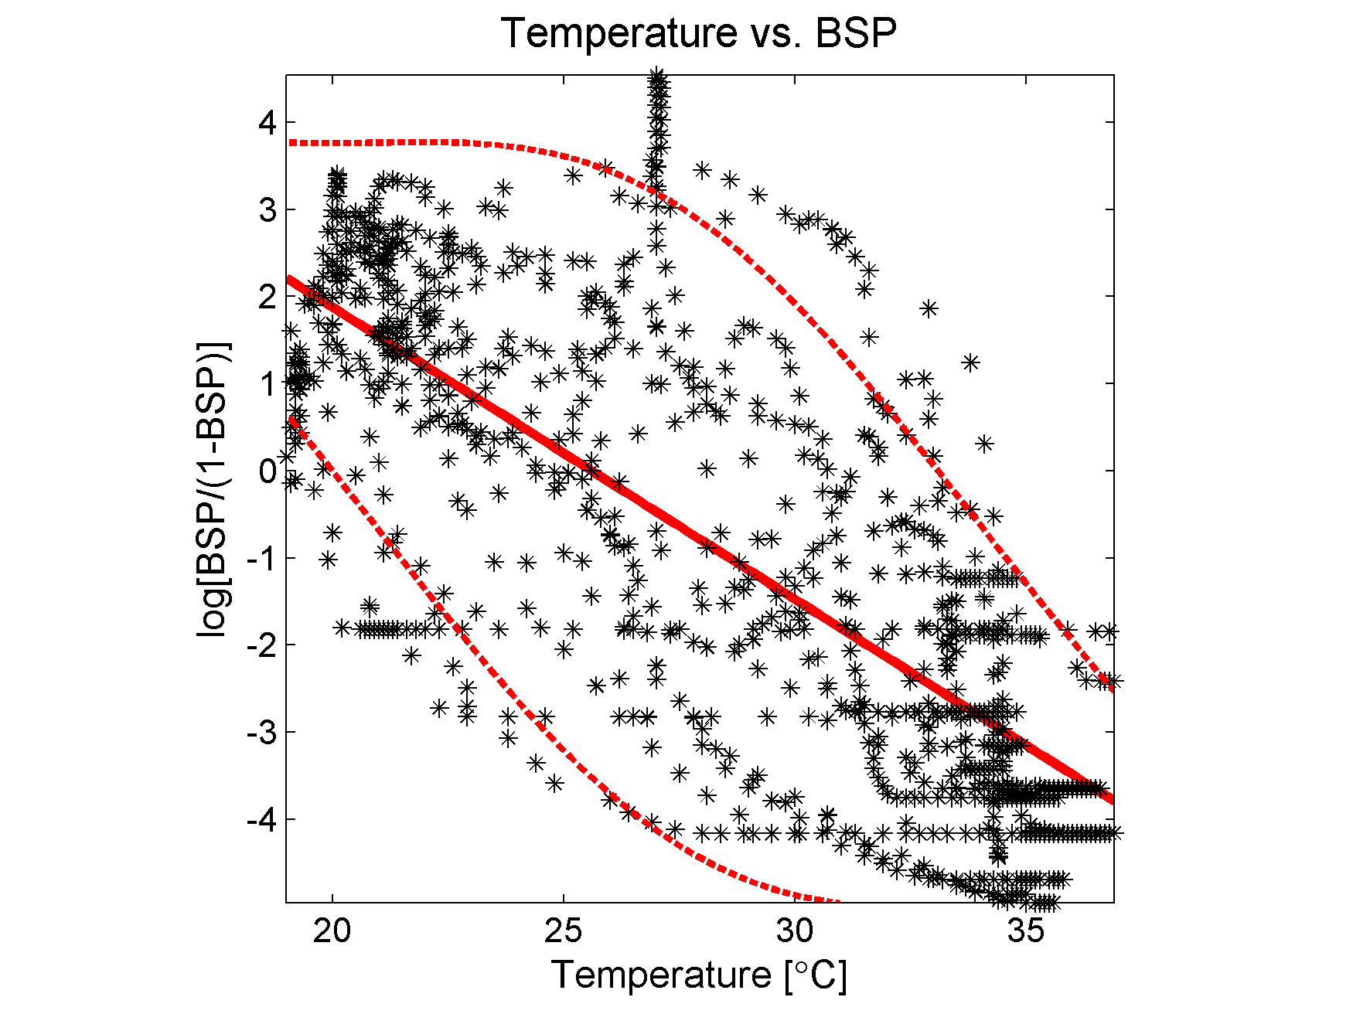
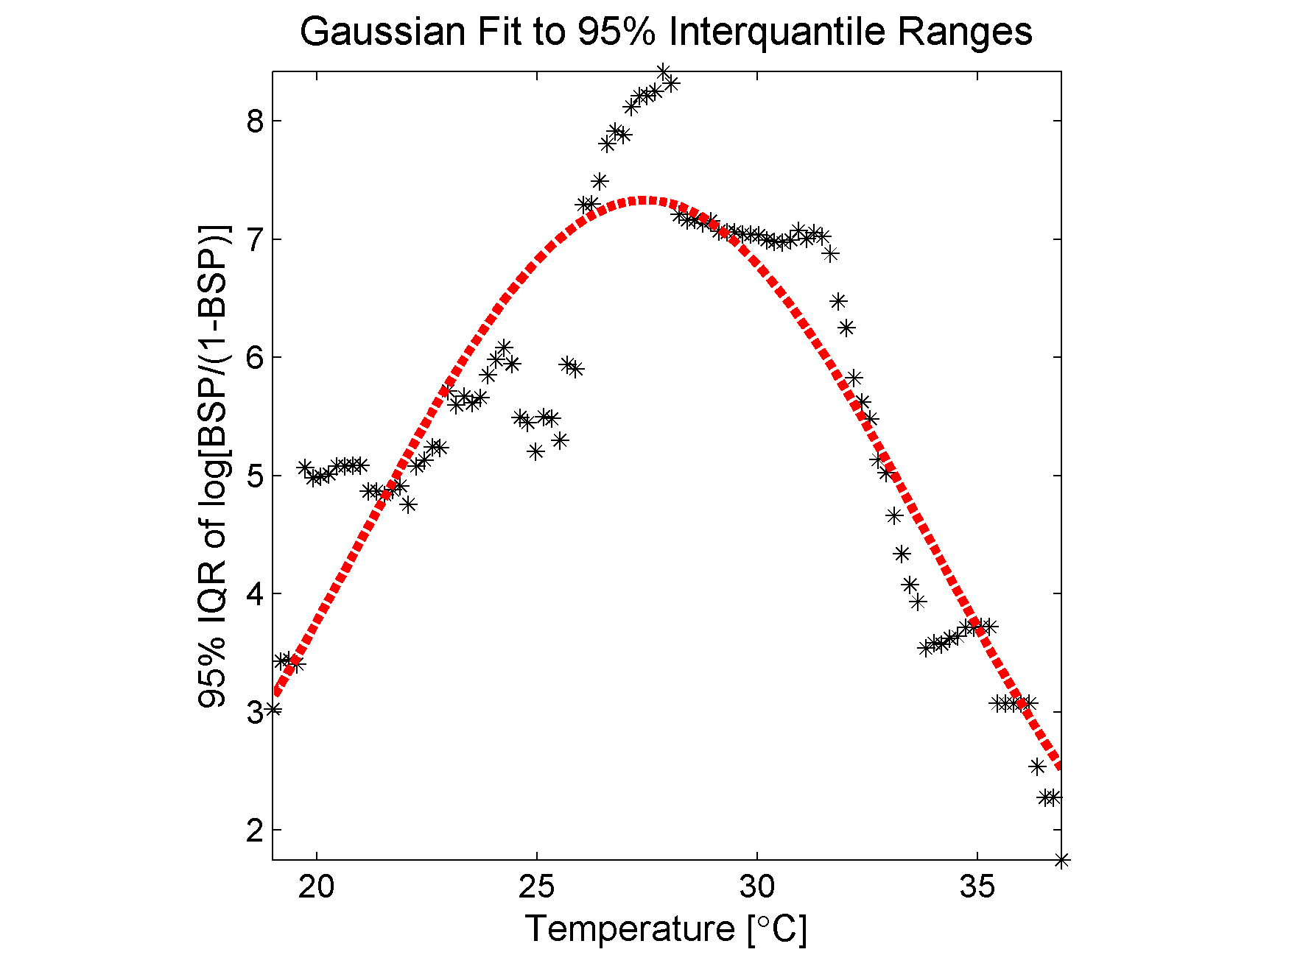
Figure 4
A
B

Slide 8
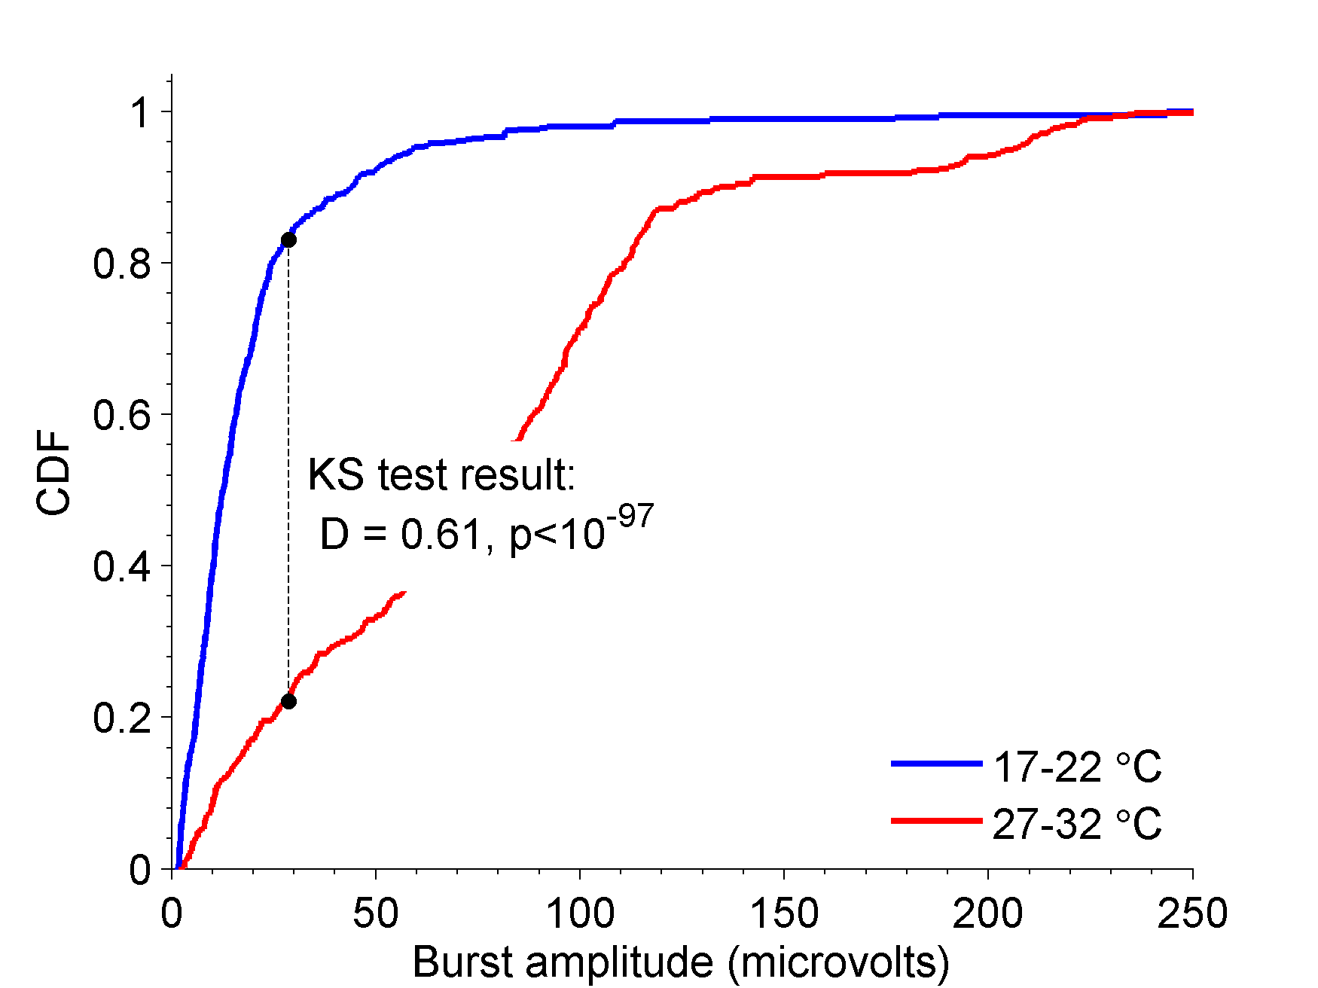
Figure 5

Slide 9
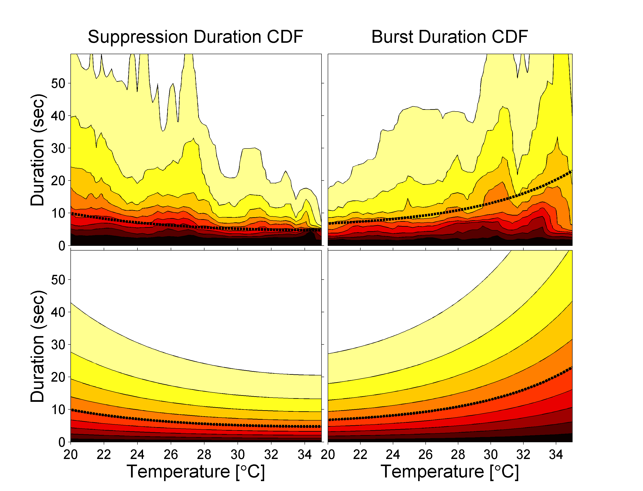
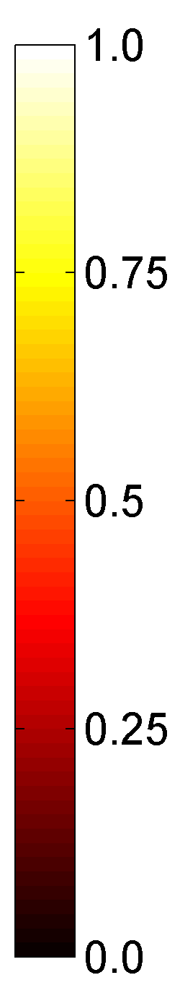
Figure 6
A
B
C
D

Slide 10
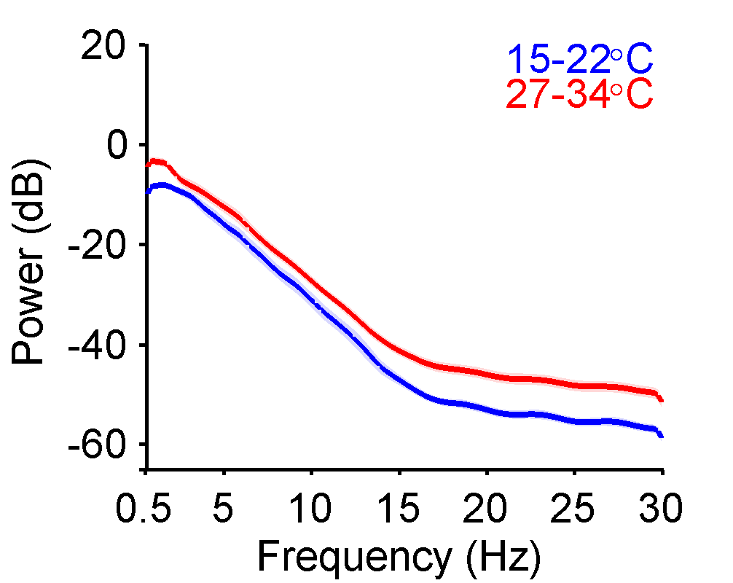
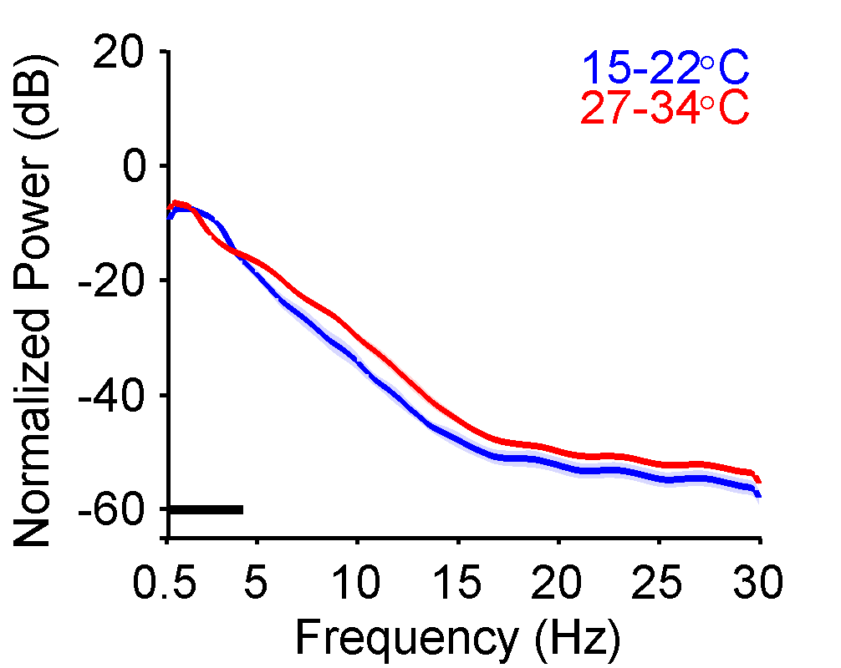
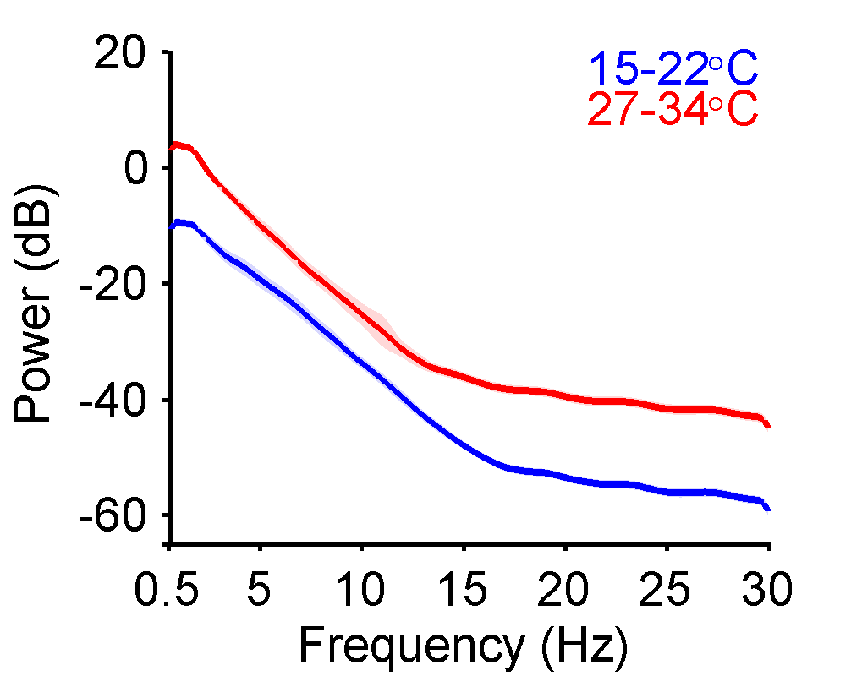
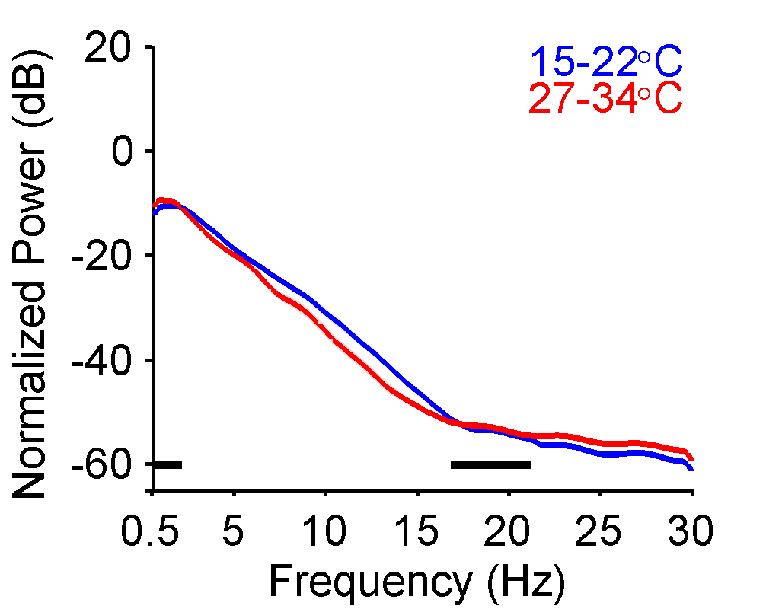
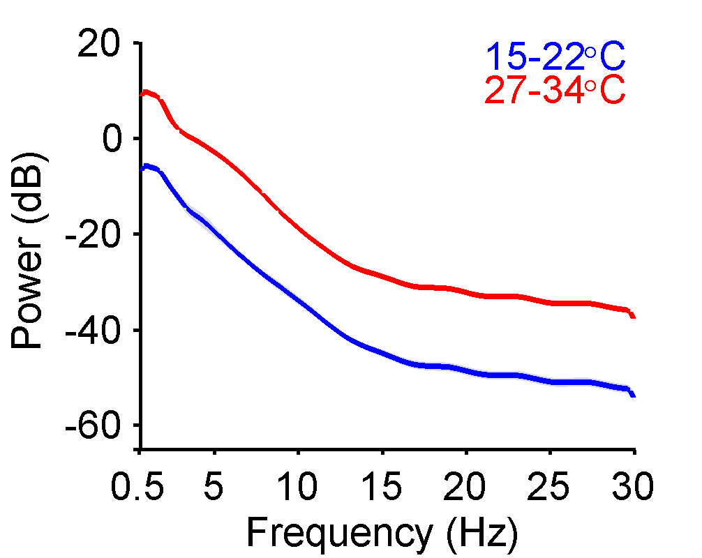
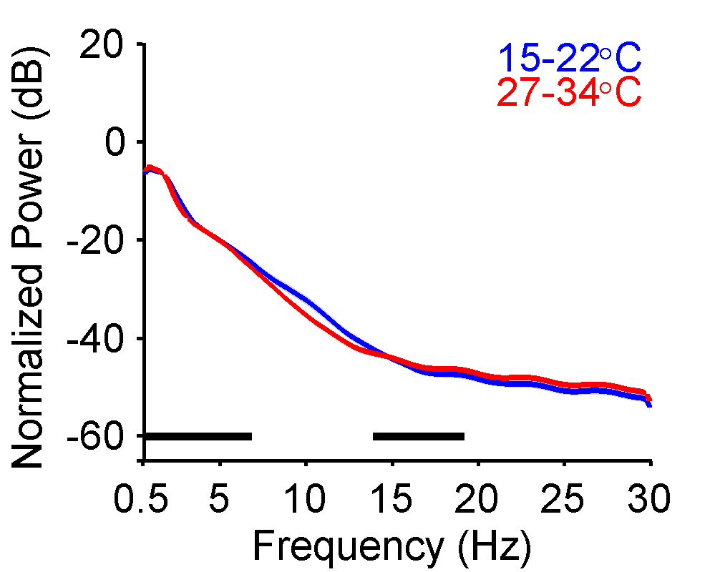
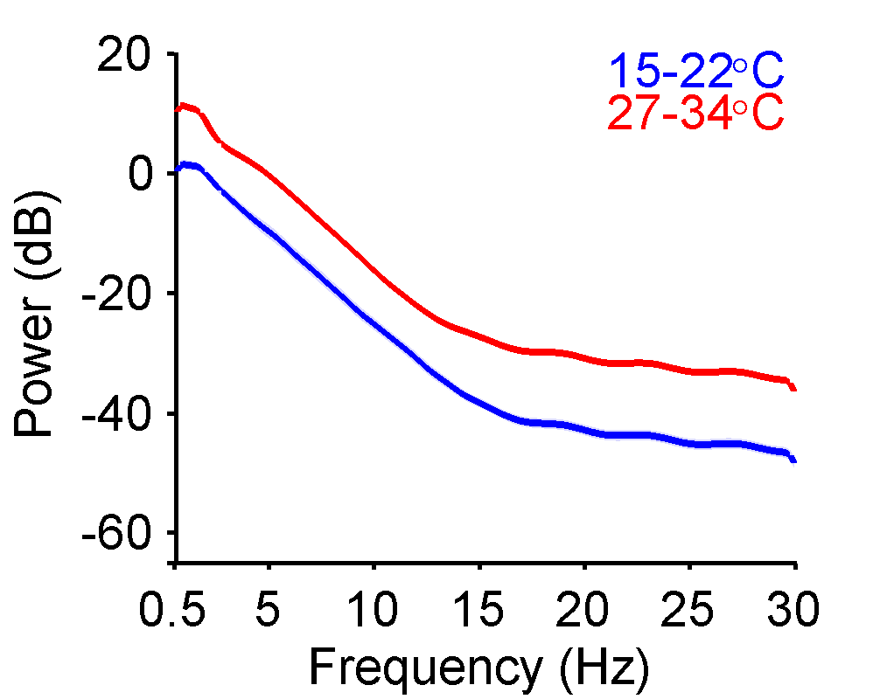
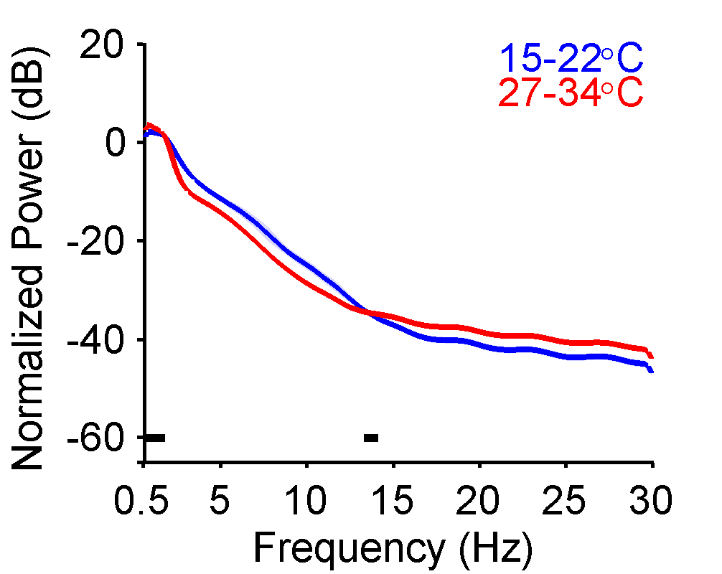
Figure 7
A
B
Case 1
Case 1
Case 3
Case 3
Case 7
Case 7
All cases
All cases

Slide 11
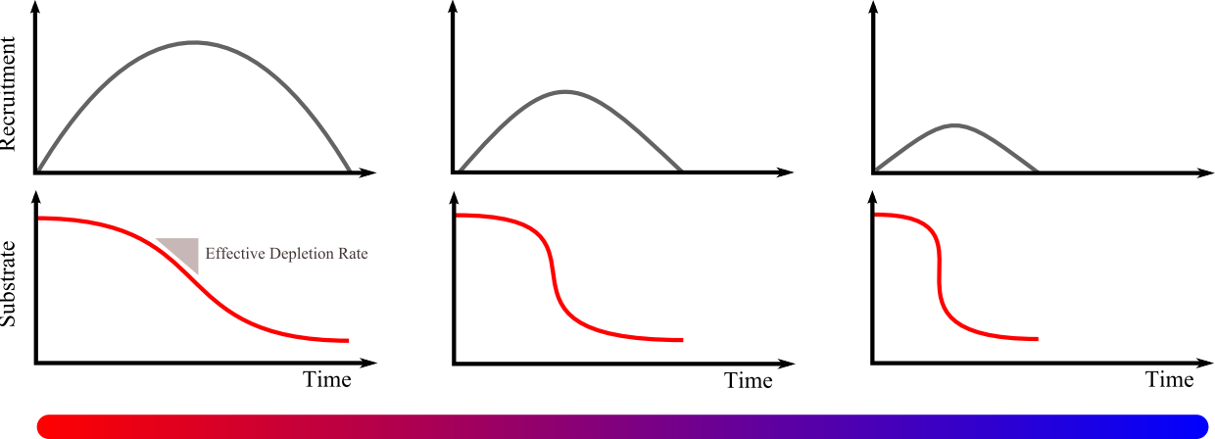
Figure 8

