Slide 1
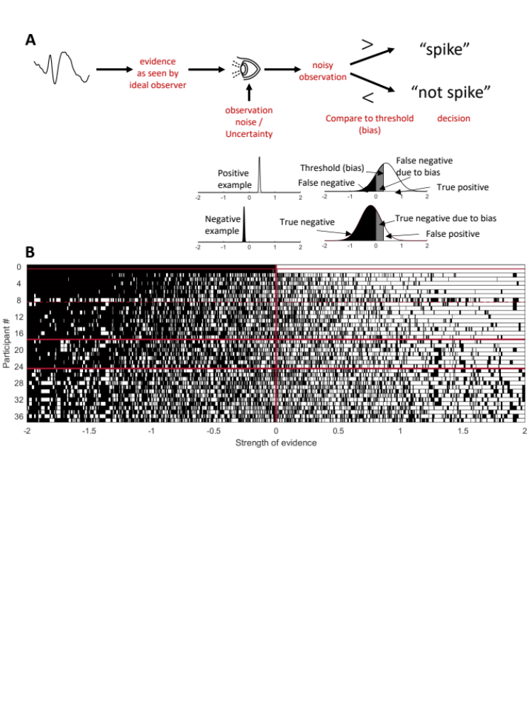
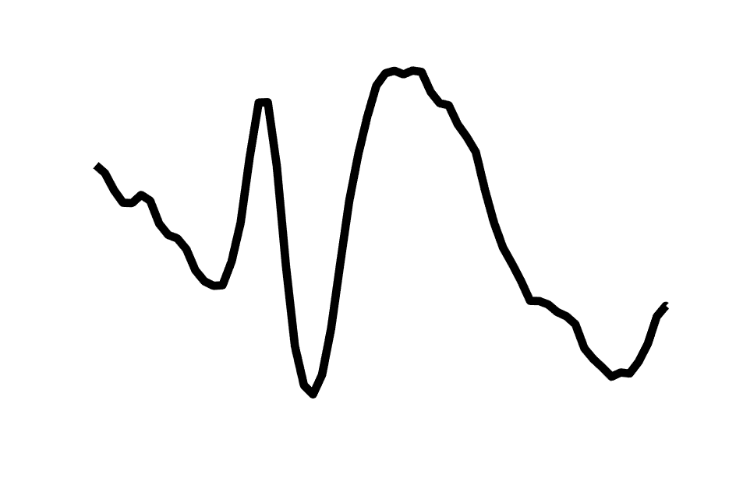
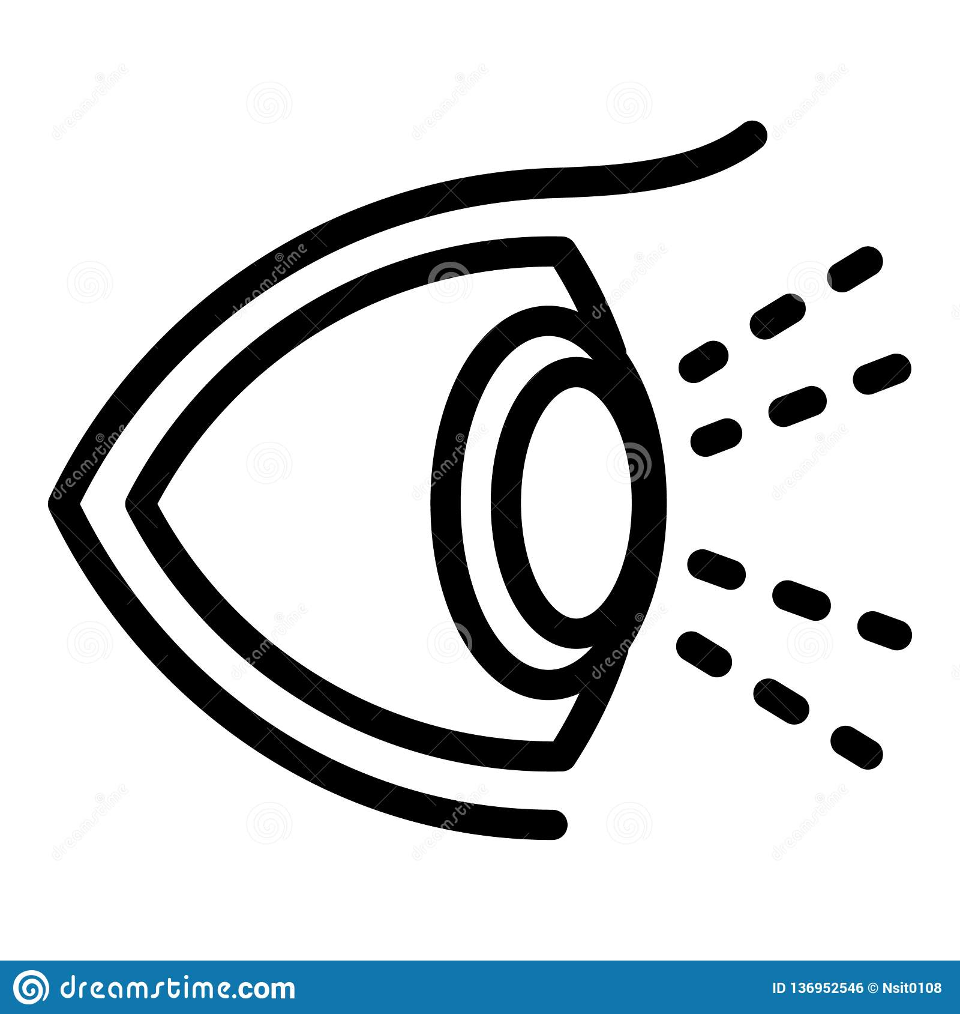
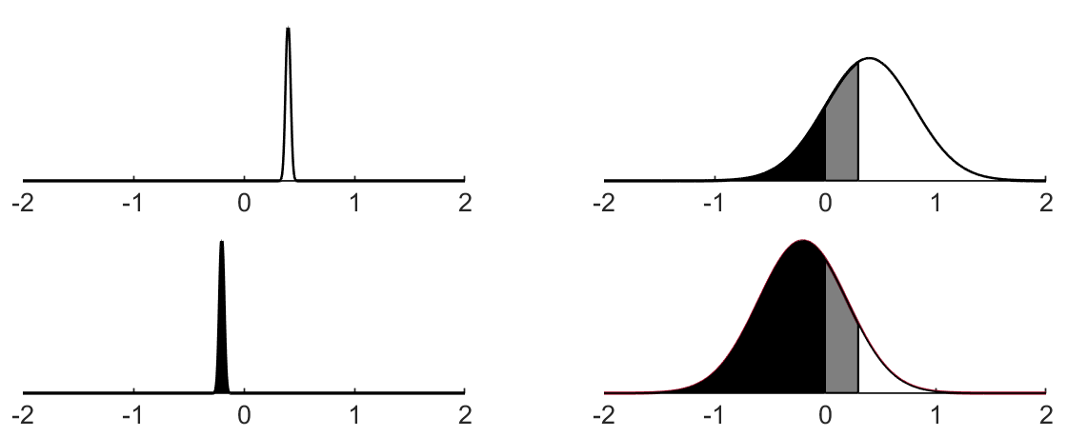
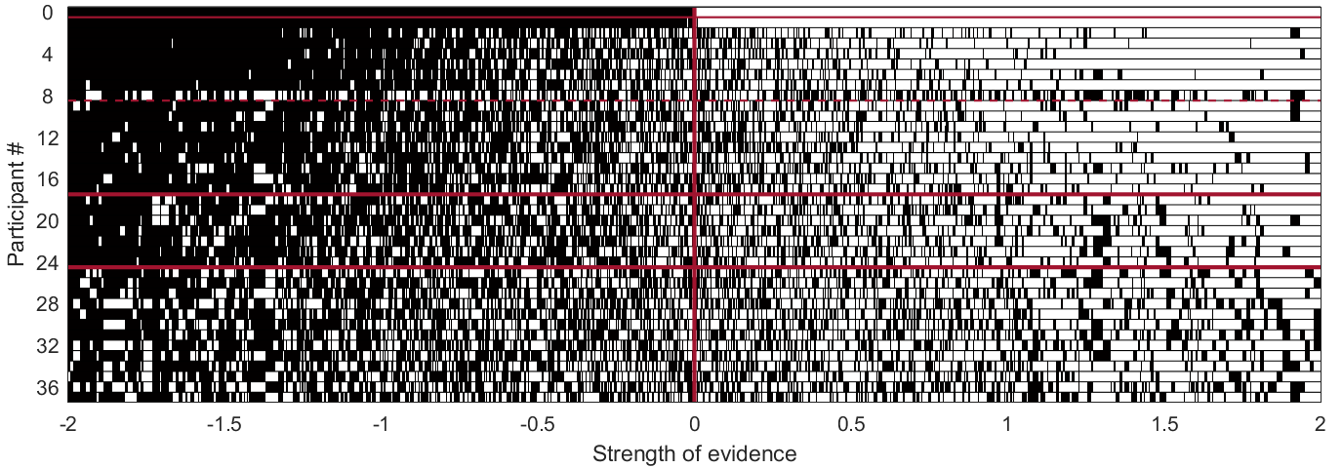


A
$$>$$
“spike”
evidence
as seen by
ideal observer
noisy
observation
$$<$$
“not spike”
observation
noise /
Uncertainty
Compare to threshold
(bias)
decision
Positive example
Threshold (bias)
False negative
due to bias
False negative
True positive
Negative example
True negative
True negative due to bias
B
False positive
Notes:
Figure 4: The “Latent trait” framework for analyzing level of expertise in spike detection, with (A) the schematic of our framework for measuring a scorer’s level of expertise in recognizing epileptiform discharges; and (B) simulation of the decision process for the ideal observer (top row) and each scorer.
Need to label the different rows to say below ideal are experts then experienced then novices
-----------
Figure 3: The “Latent trait” framework for analyzing level of expertise in spike detection, with (A) the schematic of our framework for measuring a scorer’s level of expertise in recognizing epileptiform discharges; and (B) simulation of the decision process for the ideal observer (top row) and each scorer.

Slide 2
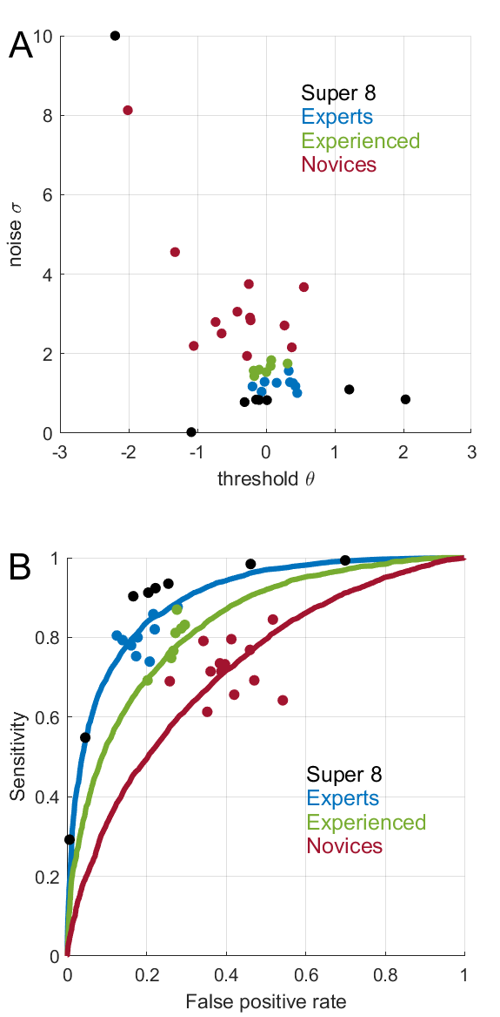
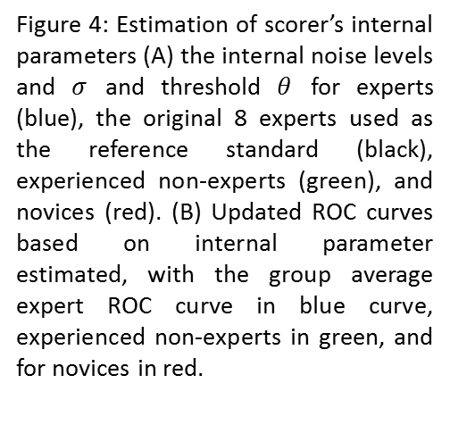
Figure 4
Figure 4: Estimation of scorer’s internal parameters (A) the internal noise levels and $σ$ and threshold $θ$ for experts (blue), the original 8 experts used as the reference standard (black), experienced non-experts (green), and novices (red). (B) Updated ROC curves based on internal parameter estimated, with the group average expert ROC curve in blue curve, experienced non-experts in green, and for novices in red.
Notes:
Figure 5: Estimation of scorer’s internal parameters (A) the internal noise levels and $σ$ and threshold $θ$ for experts (blue), experienced non-experts (green), and novices (red). (B) Updated ROC curves based on internal parameter estimated, with the group average expert ROC curve in blue curve, experienced non-experts in green, and for novices in red.

Slide 3



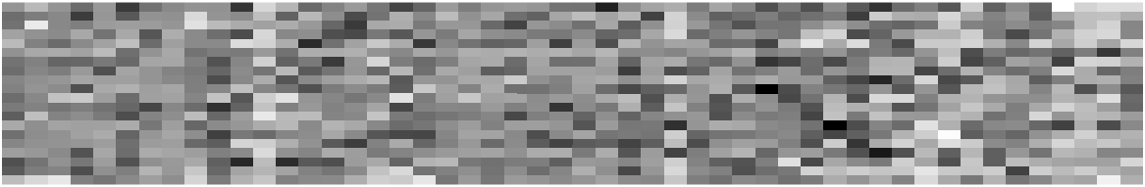
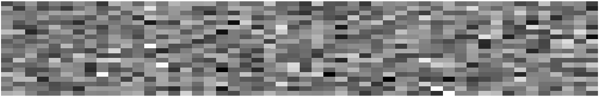





Figure 2
Swap in
Question 2
(black and white)
Make this blue + red)
System Noise
Occasion noise:
Occasion 1
Diagnoses: Occasion 1
Level noise
+
+
+
Occasion noise:
Occasion 2
Diagnoses: Occasion 2
Pattern noise
20 physicians
Case differences
(signal)
50 cases
Differences
between diagnoses
on occasions 1 and 2

Slide 4
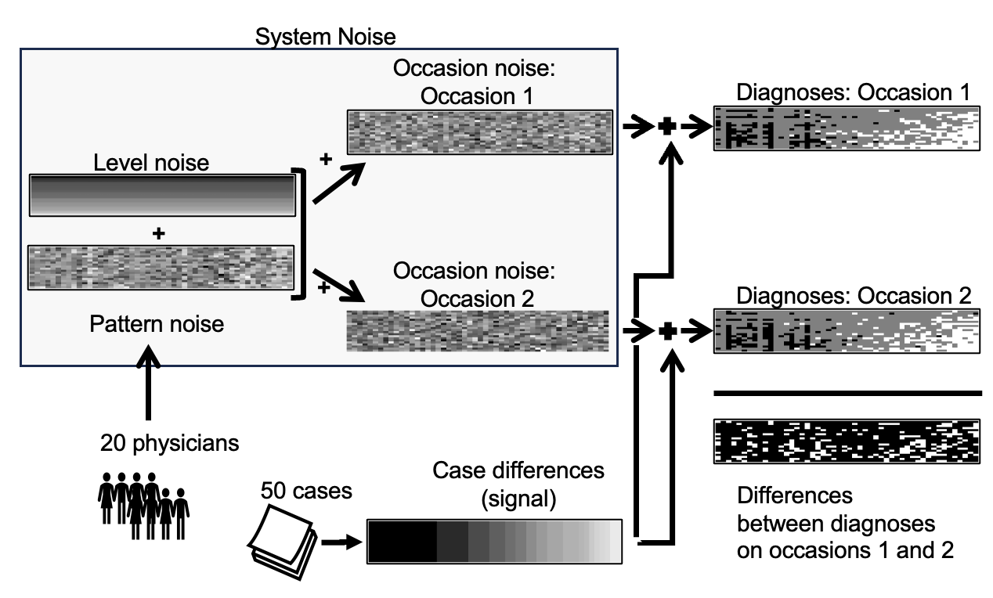

Slide 5
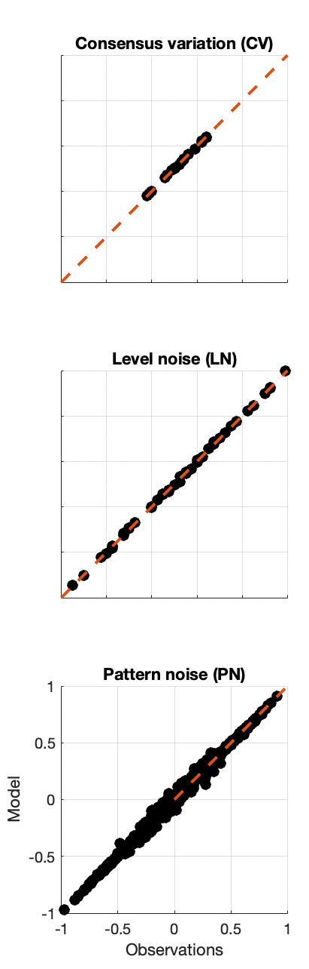
Figure S1

