Slide 1
Pipeline for Rapid IIIC Annotation
JIN JING
2023-Jan

Slide 2
Requirements
Windows PC (??)
MATLAB (https://www.mathworks.com/products/matlab.html)
EEGLAB (https://sccn.ucsd.edu/eeglab/index.php)
Python 3.6 (Anaconda)
Demo https://www.dropbox.com/scl/fo/1p24ylexzdtw5oowqz18j/h?dl=0&rlkey=5nvqq8yg7v5wl11a3eb64ojmt

Slide 3
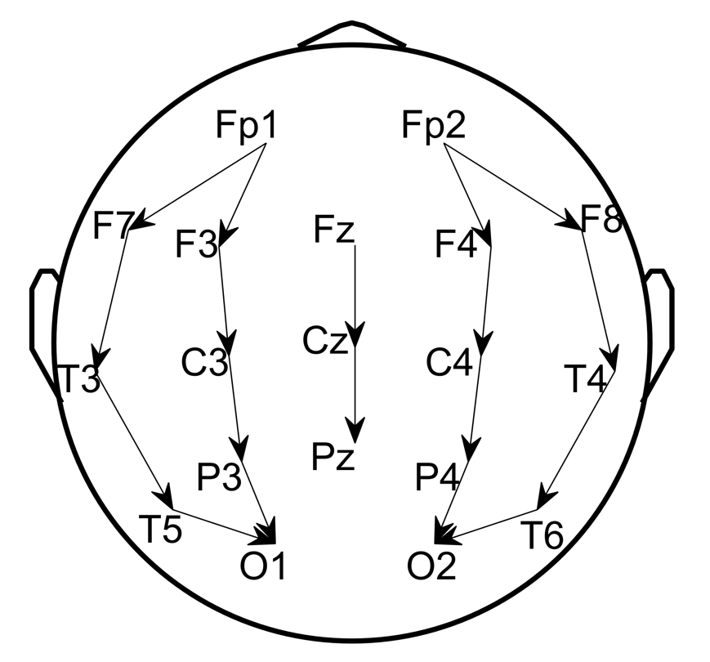
Input – EDF
Scalp EEG in monopolar/ C2 referential montage
Full set of 19 standard 10-20 EEG channels + 1 EKG channel (optional)
Fp1 F3 C3 P3 F7 T3 T5 O1 Fz Cz Pz Fp2 F4 C4 P4 F8 T4 T6 O2 (EKG)
Stored in folder .\Data\EDF\

Slide 4
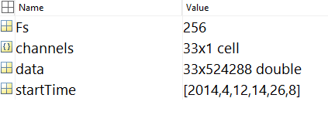
Step 1: Read EDF
EEGLAB toolbox to convert to MAT format
Run script step1_readEDF2MAT.m
Output stored in .\Data\MAT\
Variables in each file
data: EEG array
channels: list of channel names in data
Fs: the sampling rate of data
startTime: the start time vector of data

Slide 5
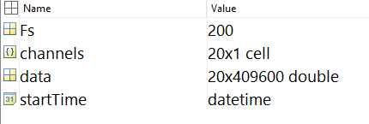
Step 2: Preprocess
Run step2_preprocess.m
Select and rearrange channels
Resample to 200Hz where SPaRCNet operates
Denoise (bandpass and powerline frequency*)
Output stored in .\Data\processed\

Slide 6
Step 3: Run SPaRCNet
Configure Python
Install anaconda3 and open a terminal
$ conda create -n iiic python=3.6
$ activate iiic
$ conda install -c conda-forge hdf5storage
$ pip install mne
$ pip install torch==1.5.0+cpu torchvision==0.6.0+cpu -f https://download.pytorch.org/whl/torch_stable.html

Slide 7
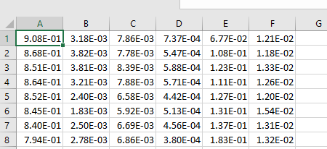
Step 3: Run SPaRCNet
Run step3_runSPaRCNat.m
Output stored in .\Data\iiic\
Csv table
Probabilities for 6 classes: Other, Seizure, LPD, GPD, LRDA, and GRDA
Start from the 1st 10sec segment and move at 2sec step in time
E.g. row #1: scores for [0 10sec], row #2: scores for [2 12sec], ...

Slide 8
Step 4: Read CSV
Run step4_readCSV.m to read CSV to MAT
Every 2sec segment got a score
Output stored in .\Data\iiic\model_prediction\.

Slide 9
Step 5: Compute Spectrograms
Run step5_computeSpectrograms
Regional average spectrograms
Output stored in .\Data\Spectrograms\
Variables:
Sdata: 4 regional average spectrograms
stimes: time coordinates
sfreqs: frequency coordinates
params: spectrogram parameters

Slide 10

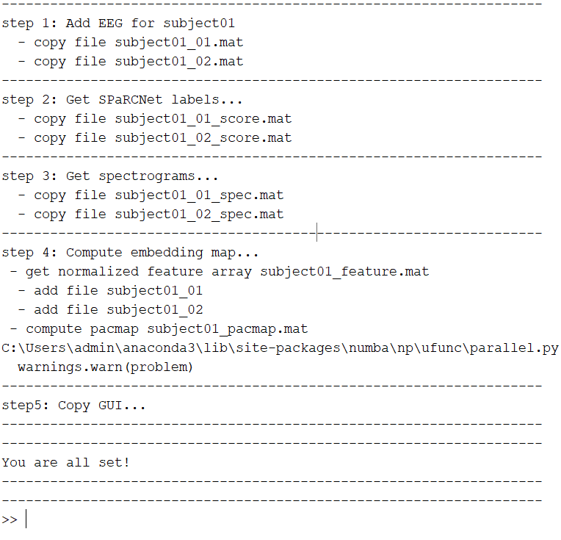
Step 6: Wrap up for GUI
Configure PaCMAP (Python library: https://github.com/YingfanWang/PaCMAP)
Run step6_prepare4GUI.m

Slide 11
Step 7: Run GUI - Demo

