Slide 1
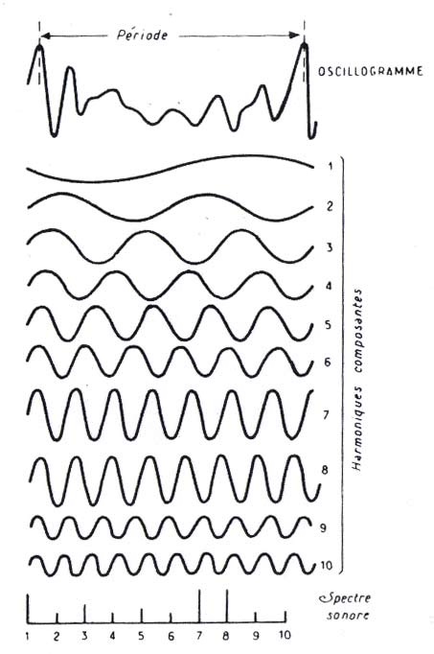
finite-duration functions can be represented as a Fourier series

Slide 2
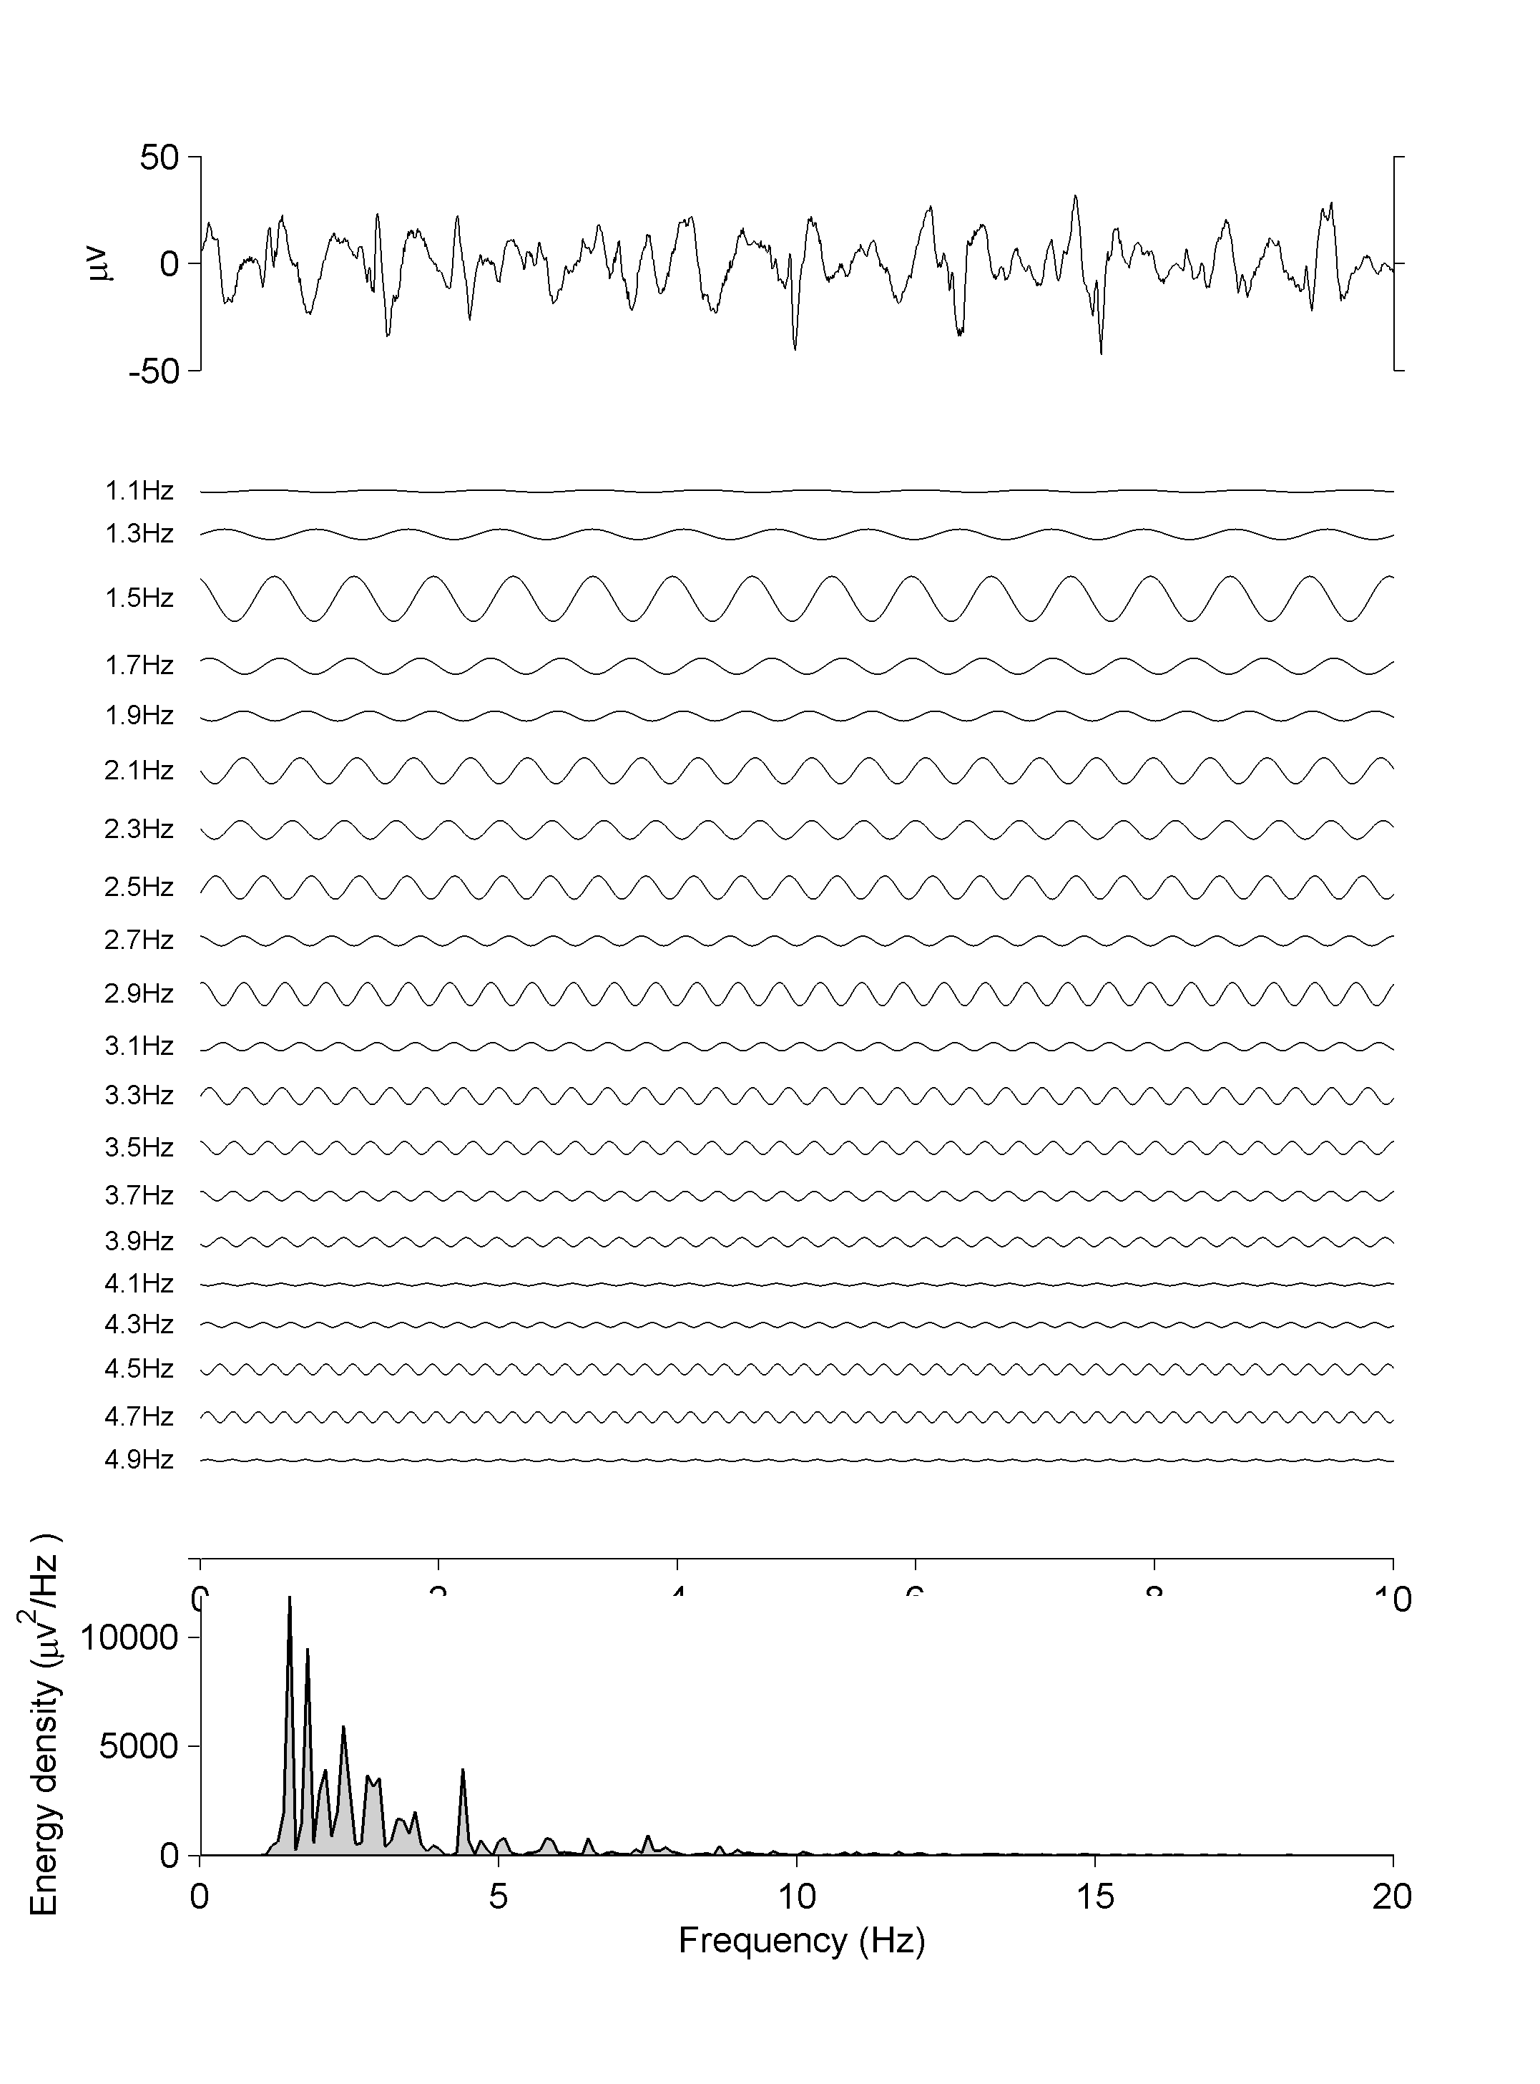

Slide 3
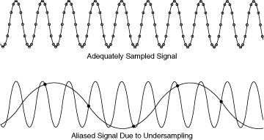
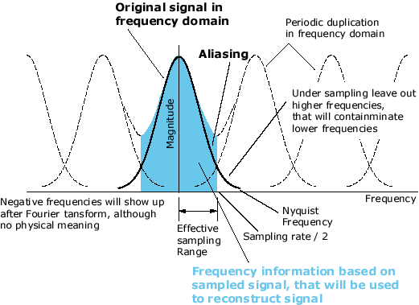

Slide 4
Ok to explain things to eeg’ers in terms of filtering in time
-filtered spike
-filtered square wave
-filtered discontinuity

Slide 5
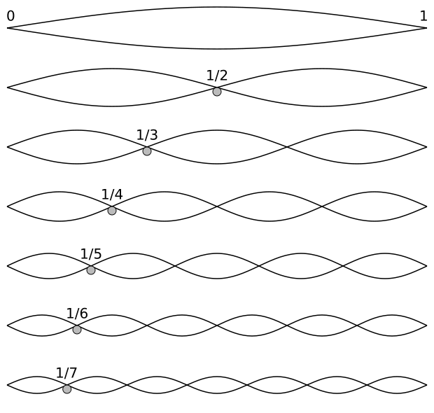
Harmonic_partials_on_strings.svg ‎(SVG file, nominally 620 × 590 pixels, file size: 10 KB)
Notes:
The fundamental frequency, often referred to simply as the fundamental, is defined as the lowest frequency of a periodic waveform. In terms of a superposition of sinusoids (e.g. Fourier series), the fundamental frequency is the lowest frequency sinusoidal in the sum. In some contexts, the fundamental is usually abbreviated as f₀ (or FF), indicating the lowest frequencycounting from zero.^{[1][2][3]} In other contexts, it is more common to abbreviate it as f₁, the firstharmonic.^{[4][5][6][7][8]} (The second harmonic is then f₂ = 2⋅f₁, etc. In this context, the zeroth harmonic would be 0 Hz.)
All sinusoidal and many non-sinusoidal waveforms are periodic, which is to say they repeat exactly over time. A single period is thus the smallest repeating unit of a signal, and one period describes the signal completely. We can show a waveform is periodic by finding some period Tfor which the following equation is true:
Where x(t) is the function of the waveform.

