Slide 1
DATA 606 CAPSTONE · FINAL PRESENTATION
Predicting Movie Box-Office
Success Before Release
Bennett Speicher · MPS Data Science, UMBC · Summer 2026
Prepared for the UMBC Data Science Capstone — Dr. Chaojie (Jay) Wang

Slide 2
BACKGROUND
A multi-million-dollar bet
1. Studios commit $100M+ years before a single ticket sells
2. Reviews, word of mouth, competition — only appear after release
3. But real signals ARE known early: budget, genre, timing, studio
4. Goal: predict financial success from pre-release info alone
Deliverable: Data → EDA → ML models → interactive app

Slide 3
THE TARGET
What counts as “success”?
Success = Revenue ≥ 2 × Budget
56%
1. Marketing ≈ doubles the cost
2. Theaters keep ~half the gross
3. → must gross ~2× budget to break even
of films clear the bar
balanced target — ideal for classification

Slide 4
THE DATA
TMDB 5000 Movie Dataset (via Kaggle)
4,803
3,215
16
1916–2016
raw movies
after cleaning
model features
release years
1. One row = one movie (budget, revenue, genres, runtime, date, studio)
2. Dropped unknown financials + 13 impossible budgets ($1–$250)
3. Engineered: season · release window · sequel flag · studio flag

Slide 5
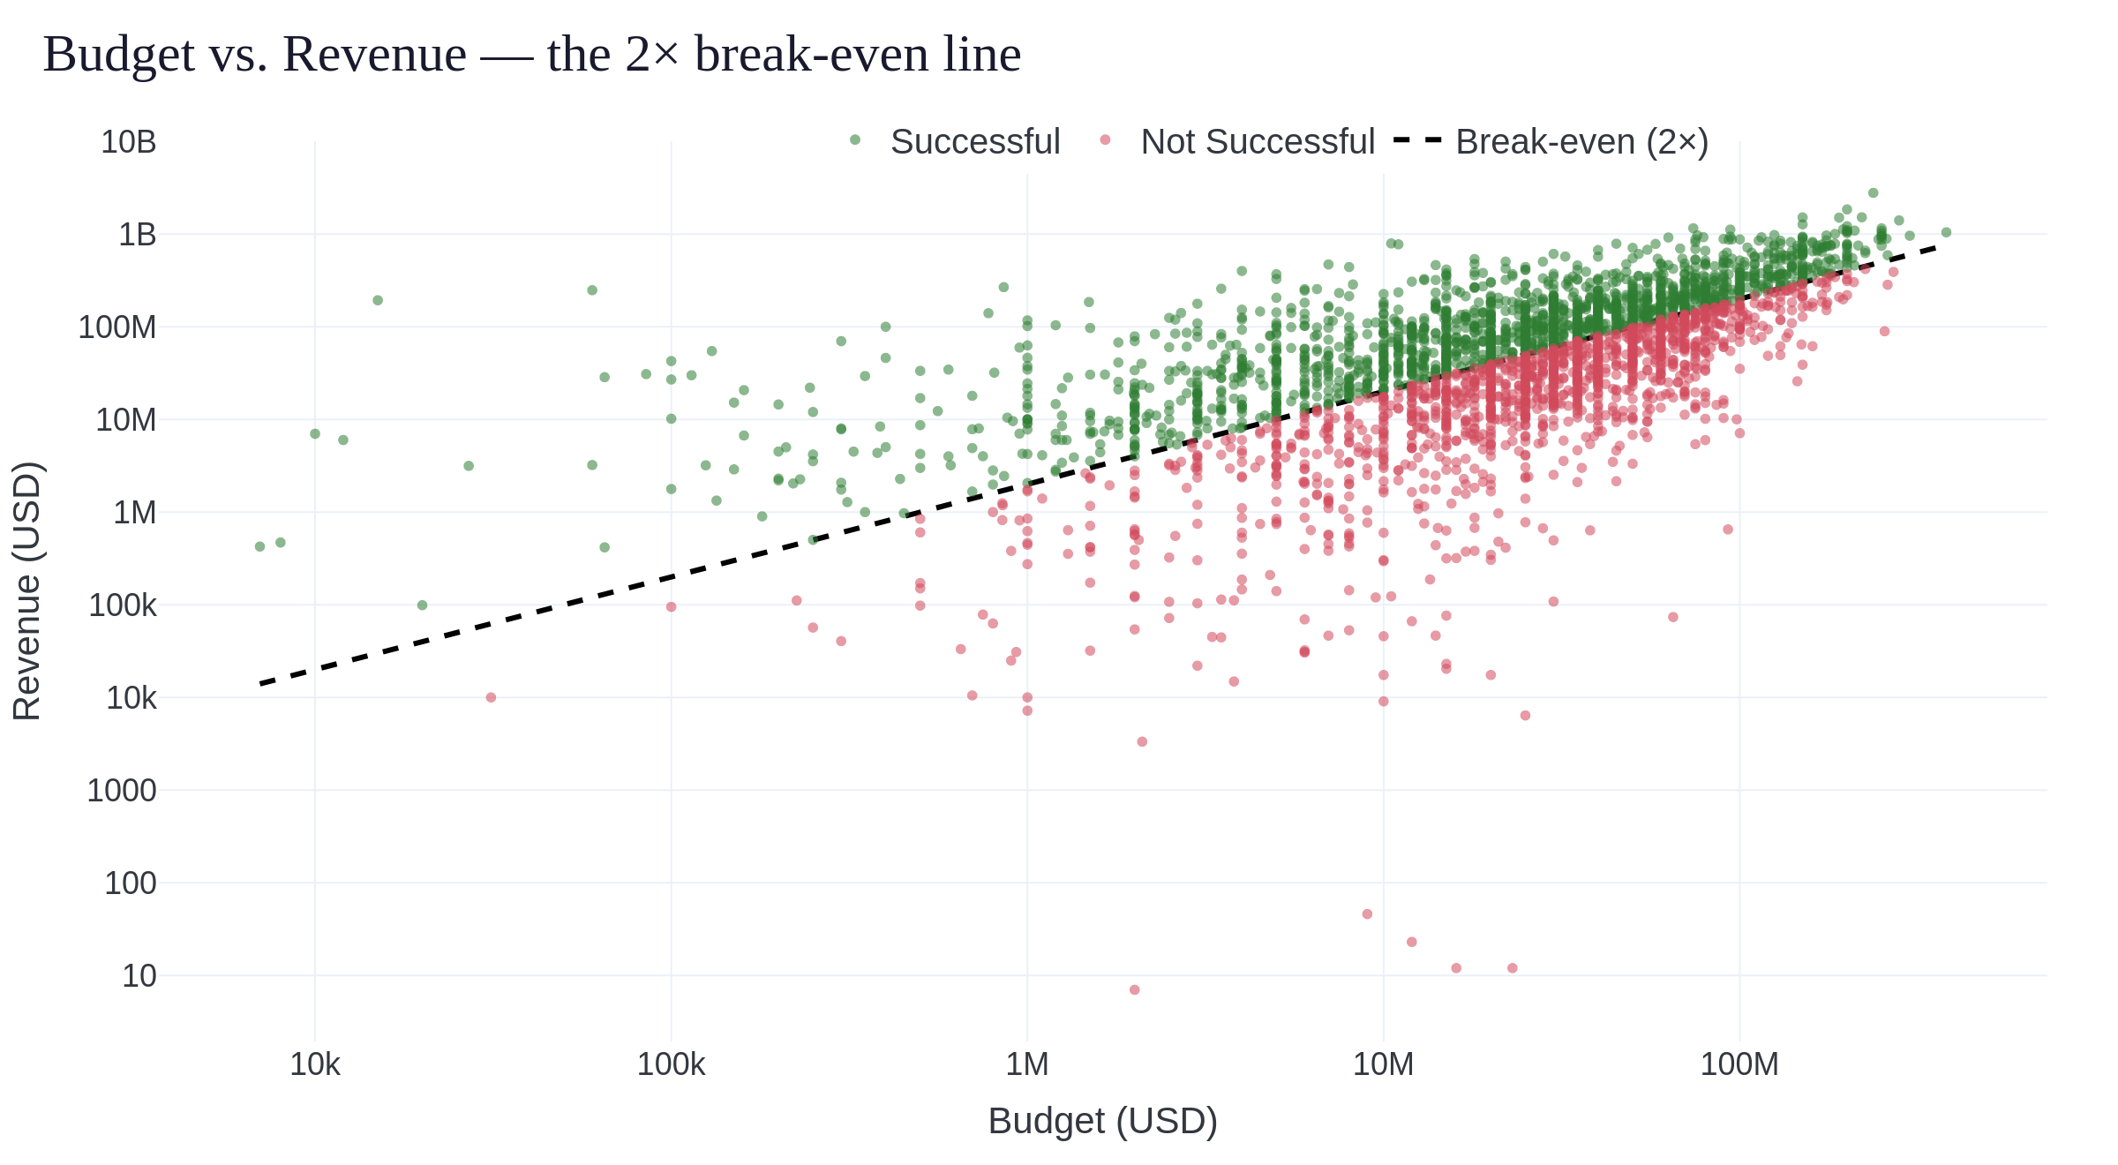
EDA

Slide 6
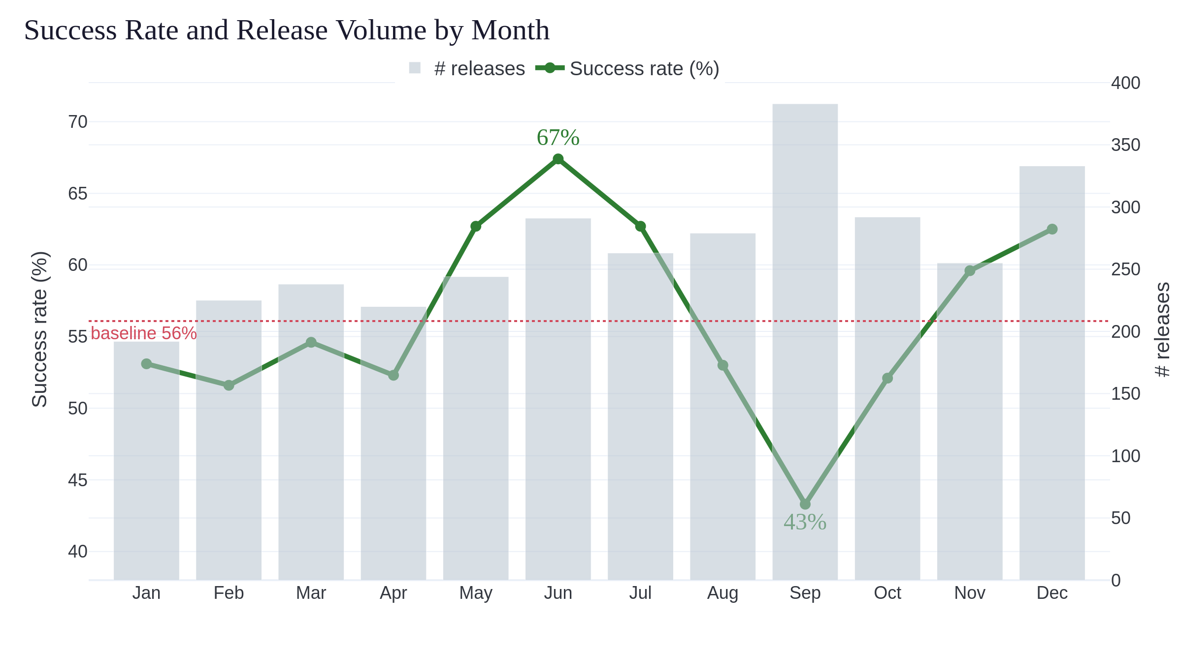
EDA — RELEASE TIMING

Slide 7
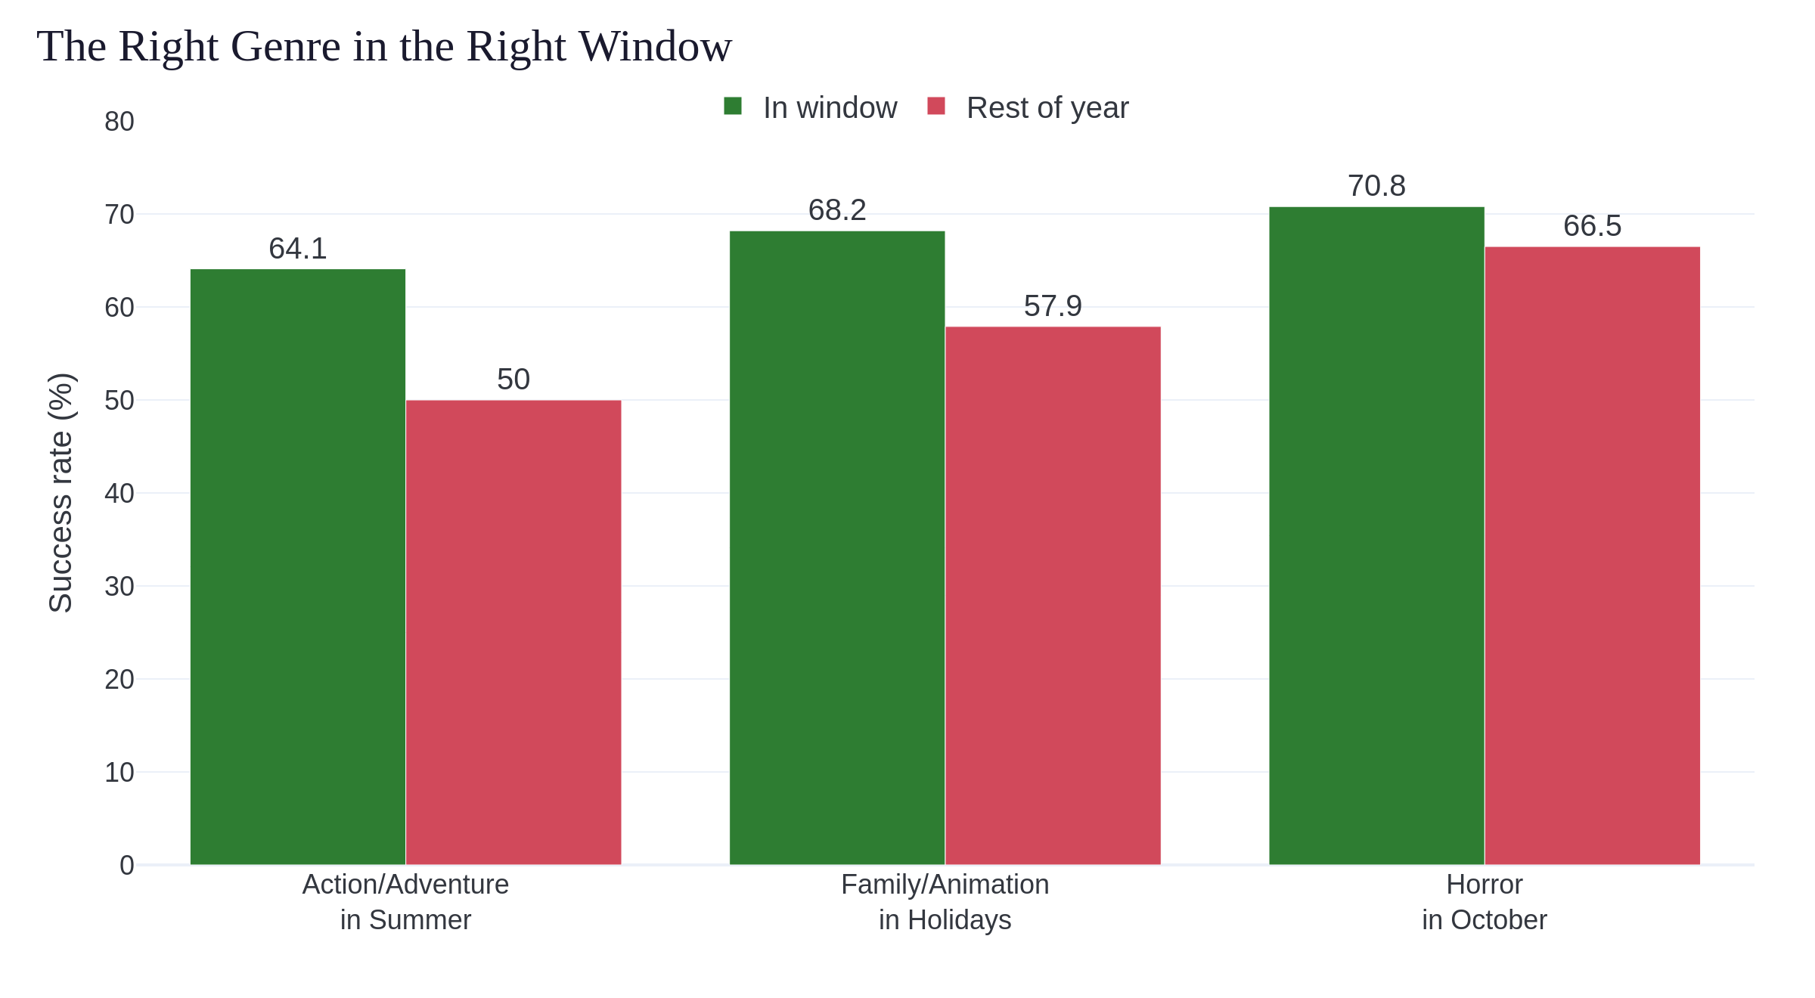
EDA — GENRE × TIMING

Slide 8
MACHINE LEARNING
Approach — no leakage
16 features — all pre-release
Excluded (post-release)
Financial: budget · spend intensity
Content: genre · runtime · language
Timing: year · season · window
Production: studios · sequel flag
Revenue · ROI · profit
Ratings · popularity · votes
Model sees only what a studio knows at greenlight
Setup: 80/20 split + 5-fold CV · 3 classifiers

Slide 9
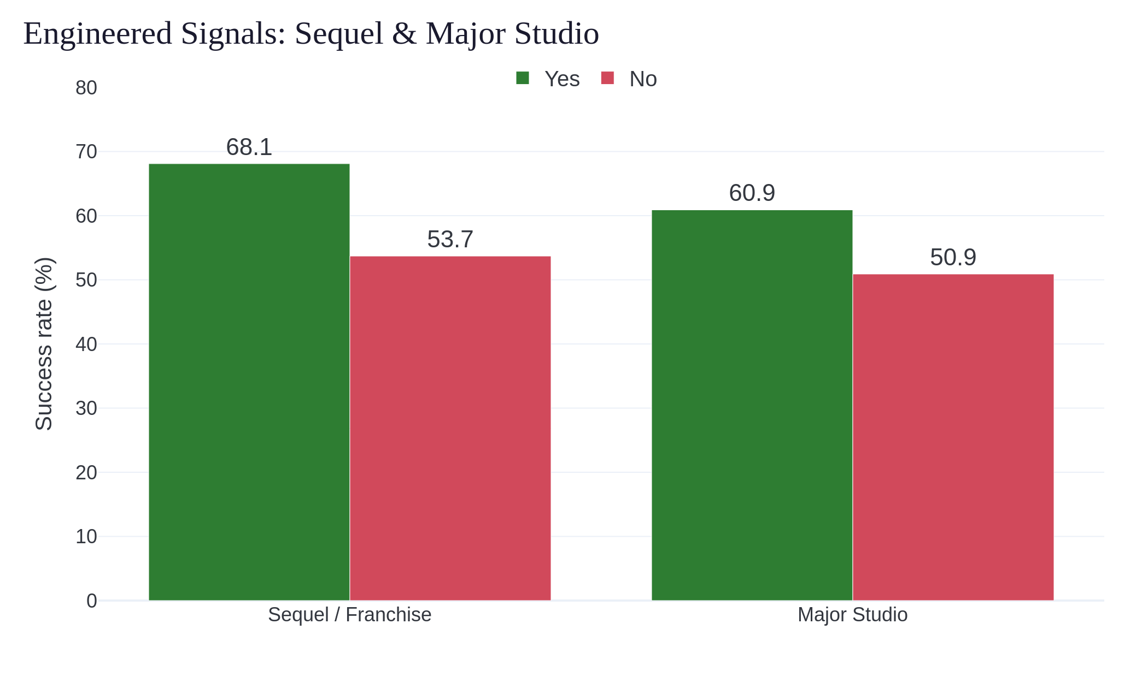
MACHINE LEARNING
Sequels: +14 pts · Major studios: +10 pts · with year + spend intensity → AUC 0.66 → 0.71

Slide 10
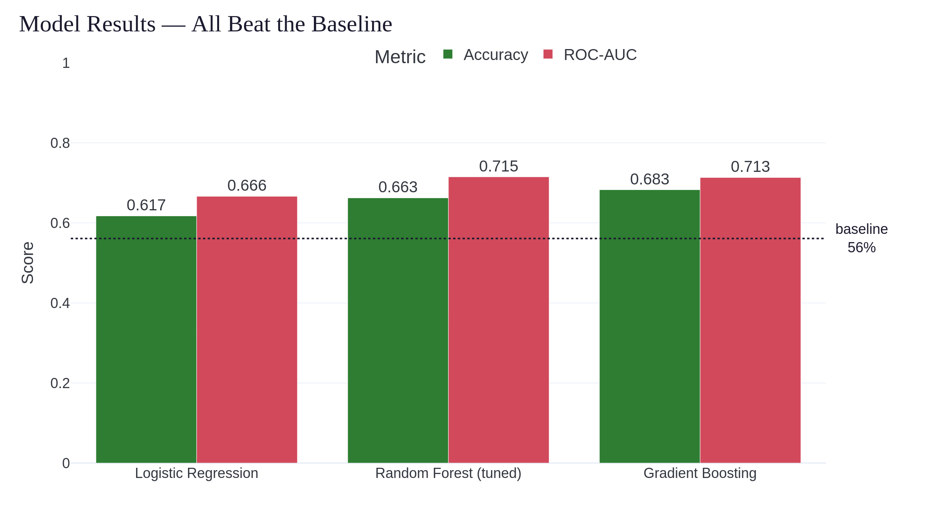
MACHINE LEARNING
68%
best accuracy
0.715
best ROC-AUC
(baseline 56%)

Slide 11
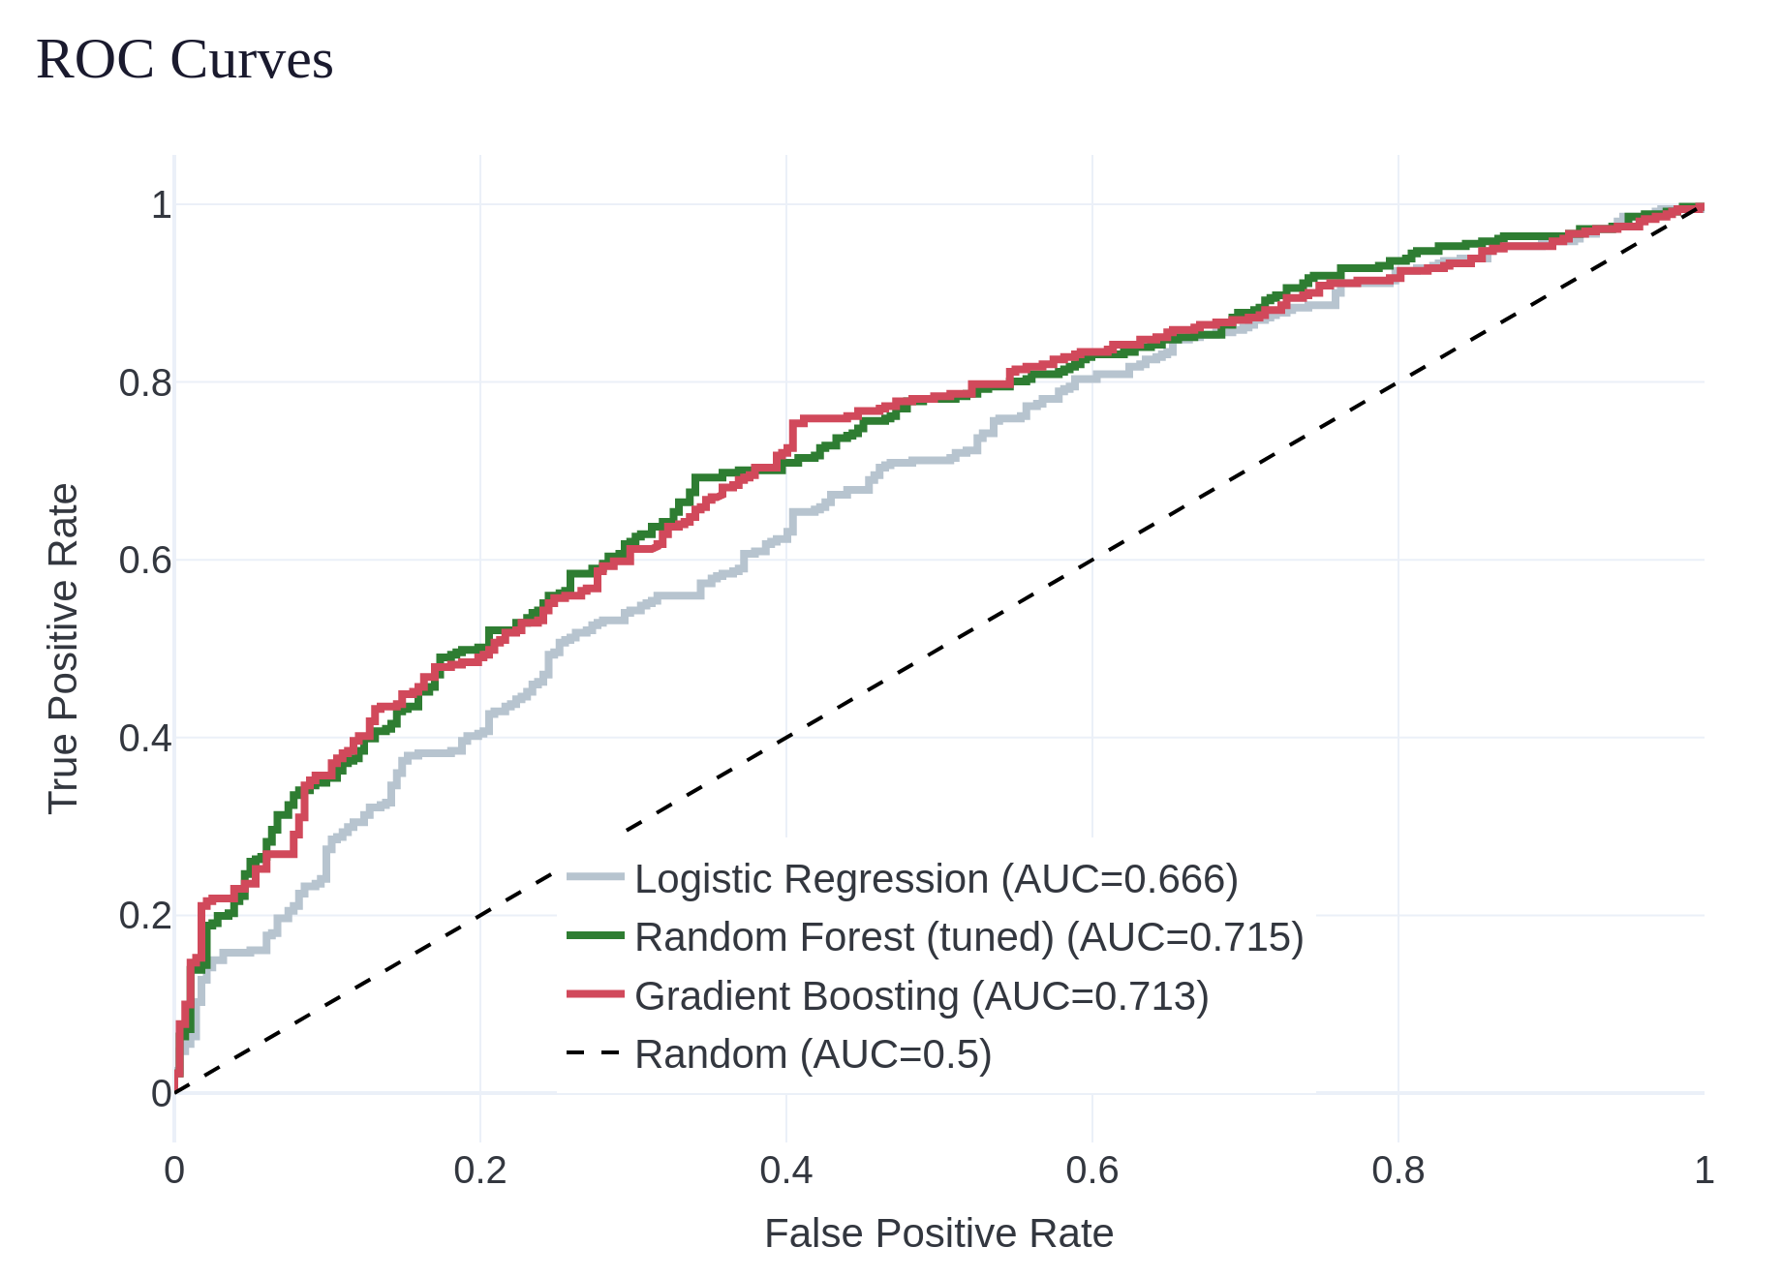
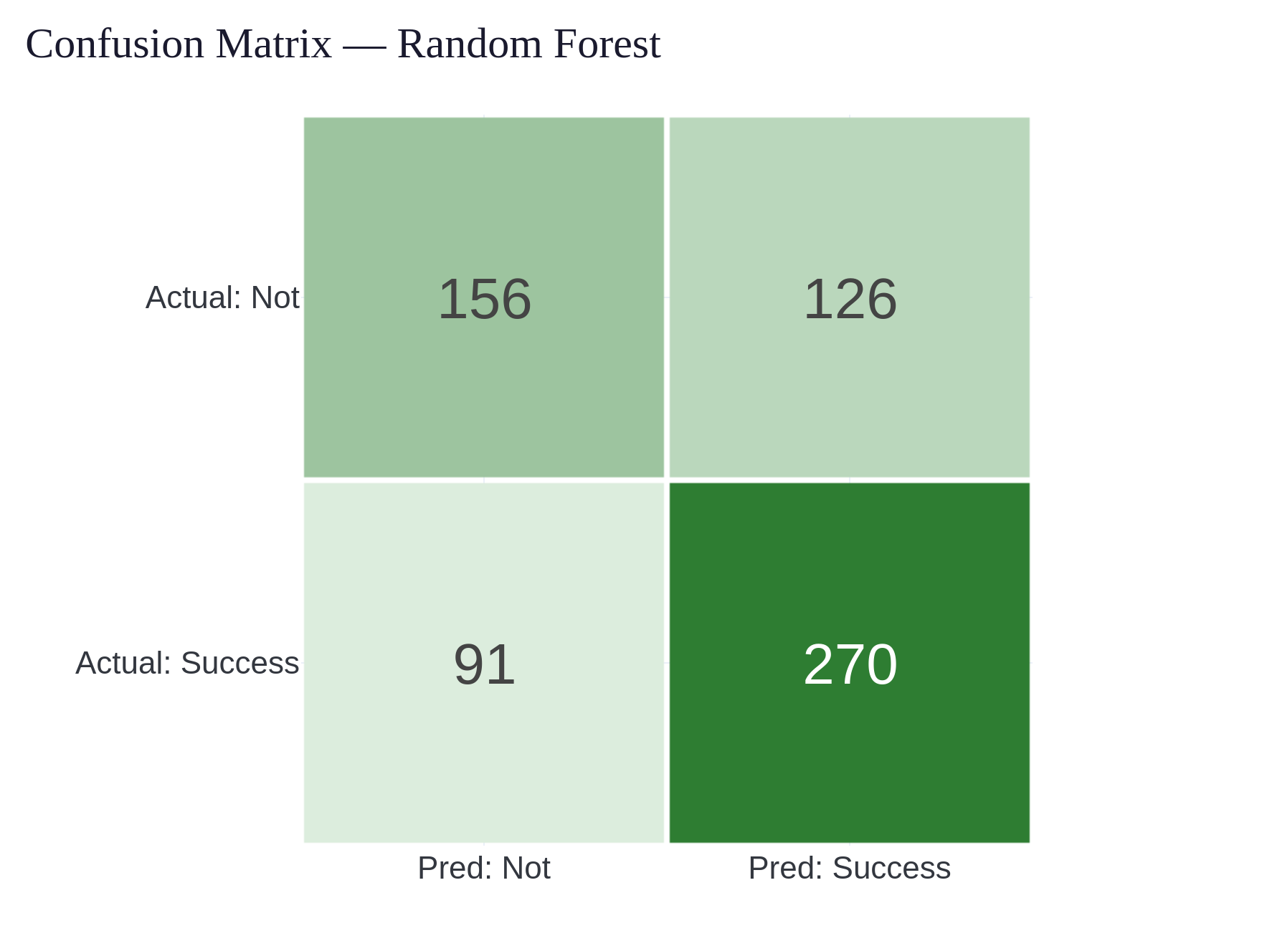
MACHINE LEARNING
Robust across splits — CV: 64% · 0.68 AUC

Slide 12
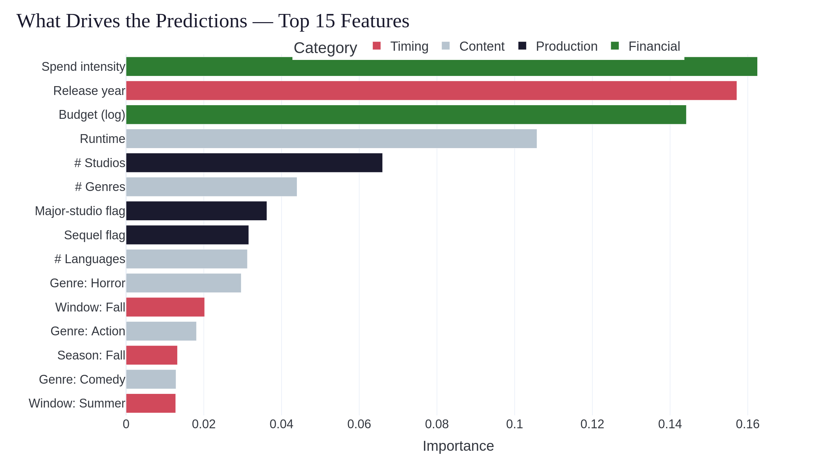
MACHINE LEARNING

Slide 13
LIVE DEMO
Streamlit app · enter a film's pre-release profile → probability of success
72%
72%
48%
Summer franchise tentpole
Low-budget October horror
Big-budget September drama

Slide 14
CONCLUSION
Takeaways & limitations
Takeaways
Limitations
Pre-release info beats chance — clearly
Budget dominates
Genre + timing + franchise add real lift
2× rule = proxy for profit
Data ends in 2016, skews large
Post-release factors excluded by design

Slide 15
FUTURE WORK
Where this goes next
Star power & marketing spend as features
Newer data + streaming-era releases
NLP on plot summaries
ROI tiers instead of a single 2× cutoff
Thank you — questions welcome. github.com/bdspeicher12/UMBC-DATA606-Capstone

