Slide 1
DATA 606 CAPSTONE · PROPOSAL
Predicting Movie Box-Office
Success Before Release
Bennett Speicher · MPS Data Science, UMBC · Summer 2026
Prepared for the UMBC Data Science Capstone — Dr. Chaojie (Jay) Wang

Slide 2
BACKGROUND
A multi-million-dollar bet, made on incomplete information
Studios commit tens to hundreds of millions of dollars to a film years before a single ticket is sold.
Many drivers of success (reviews, word of mouth, competition) only emerge after release.
But meaningful signals are known beforehand: budget, genre, runtime, release timing, language, and the studios involved.
This project predicts a film's financial success from those pre-release attributes alone.
THE GOAL
A decision-support tool that, given a film's pre-release profile, estimates the probability it will make money.

Slide 3
OBJECTIVES
Research questions
1
Can a film's financial success be predicted from pre-release attributes alone?
2
Which factors — budget, genre, runtime, release timing, language — matter most?
3
Does release timing (summer / holiday windows) change the odds of success?
4
Which classification models predict success most accurately?

Slide 4
THE TARGET
What counts as “success”?
Success = Revenue ≥ 2 × Budget
Why 2× is the break-even rule of thumb:
Marketing roughly doubles the cost — studios spend ~50–100% of the production budget again on advertising.
Theaters keep about half of box-office gross, so the studio nets only ~50% of reported revenue.
→ A film must gross roughly twice its budget just to break even.
56%
of usable films are successes — a balanced target, ideal for classification.

Slide 5
THE DATA
TMDB 5000 Movie Dataset
4,803
3,228
20
1916–2016
movies (raw)
usable after cleaning
original columns
release years
Each row = one movie. We keep released films with a real budget and revenue (>0), since TMDB stores 0 for “unknown.” JSON fields like genres are parsed into usable features.
Source: The Movie Database (TMDb), via Kaggle.

Slide 6
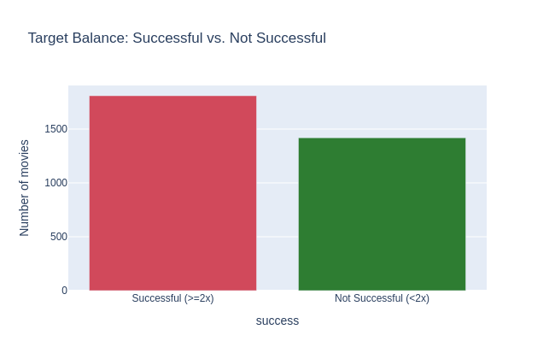
PRELIMINARY EDA
The target is well balanced
Under the 2× rule, ~56% of films are successes and ~44% are not.
A near-even split means the model isn’t biased toward one class and metrics like accuracy are meaningful.

Slide 7
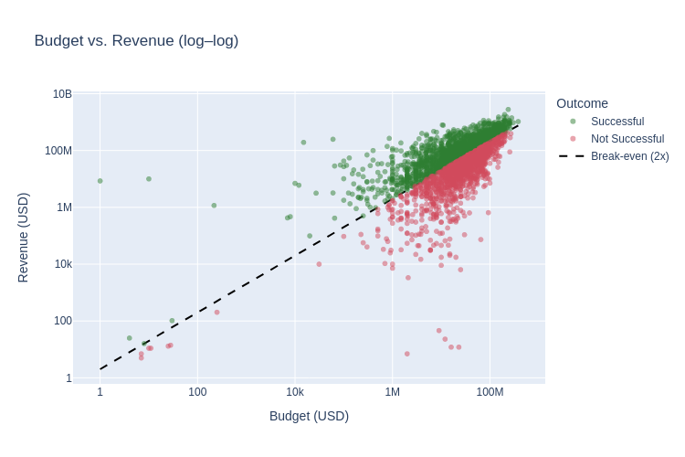
PRELIMINARY EDA
Budget vs. revenue — the break-even line
Green = success, red = not. The dashed line is break-even (revenue = 2× budget).
Bigger budgets earn more in absolute terms, but plenty of films still fall below the line.
Budget alone is informative but far from deterministic — other features matter.

Slide 8
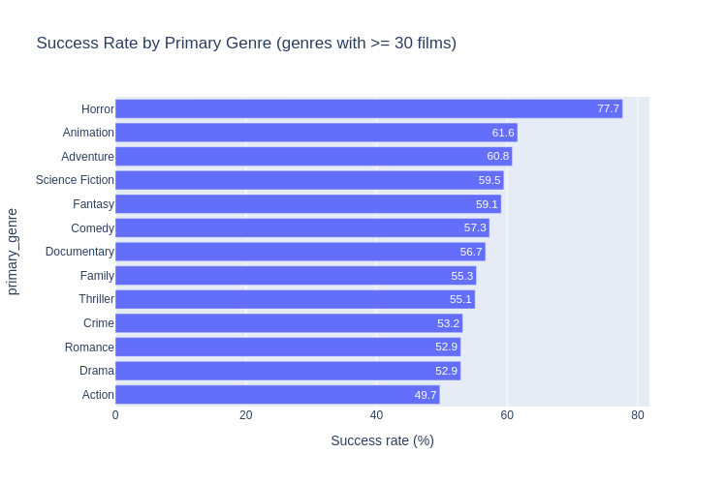
PRELIMINARY EDA
Success rate varies by genre
Some primary genres are far more likely to clear the 2× bar than others.
Genre, release month, and language all show usable signal — strong candidate predictors.

Slide 9
PLAN
Approach & next steps
Pre-release features (no leakage)
Modeling
Deliverable
Budget
Genre
Runtime
Release month / year
Original language
# production companies
80 / 20 train-test split
Logistic Regression
Random Forest
Gradient Boosting
Compare accuracy, precision/recall, ROC-AUC
A Streamlit web app where a user enters a hypothetical film’s pre-release attributes and gets a predicted success probability.
Honest framing: revenue is box-office gross and budget excludes marketing, so the target is a grounded proxy for profit — a stated limitation.

Slide 10
Predicting movie success
before the cameras roll.
Bennett Speicher · github.com/bdspeicher12/UMBC-DATA606-Capstone

