Slide 1
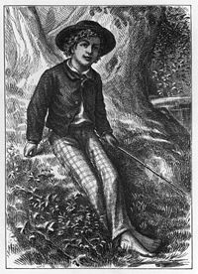

The Adventures of Tom Sawyer
Next page
By: Mark Twain
Chapter 32
Turn Out!
They’re Found!
Look for opportunities for student interaction in the yellow box on each page.
Touching correct answers will animate the image. Try this one:
(Make sure your volume is on.)

Slide 2



Next page
We are going to read a chapter from Tom Sawyer.
In this chapter listen for:
setting
plot
emotion

Slide 3


Next page
On Tuesday evening, the village of St. Petersburg was still sad, because Tom and Becky had not been found.
Most of the people had given up on searching the cave and had gone back to work.
Why had the people gone back to work?

Slide 4


Next page
Becky’s mother, Mrs. Thatcher was so worried about her daughter that she had become sick.
Tom’s Aunt Polly was quiet and sad and her worry had turned her grey hair white.
Why was Mrs. Thatcher sick and Aunt Polly’s hair white?

Slide 5




PREDICTION
What will happen to Tom and Becky?
Next page
They will never be found.
They will escape the cave and will learn how to live in the forest.
They will escape the cave and be rescued by men on a river boat.
Injun Joe will catch them and hurt them.

Slide 6
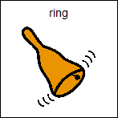

Next page
In the middle of the night the village bells began to peal. In moments the streets were full of excited people, still wearing their pajamas.
“Turn out! Turn out! They’re found! They’re found!” People blew
horns and banged on pots to
add to the celebration.
What does the word “peal” mean?

Slide 7


Next page
The people made their way to the river, where they met Tom and Becky who were being brought in an open carriage.
Everyone was too excited to go back to sleep.
Where did the people go to meet Tom and Becky?

Slide 8


Next page
A messenger was sent to the cave to tell Judge Thatcher, that his daughter, Becky, had been found.
Mrs. Thatcher and Aunt Polly’s happiness was complete.
How did Judge Thatcher find out that the Becky had been found?

Slide 9


Next page
Tom lay on the sofa and told the people around him about their wonderful adventure.
He exaggerated the story to make it seem even more exciting and finished with a description of how he had left Becky and went exploring as far as his
kite string would reach.
What did Tom use to find his way through the cave?

Slide 10


Next page
When Tom came to the end of the kite string, he had seen a far off speck of light ahead. He dropped the string and made his way to the light.
Tom found a hole and when he pushed his head outside he could see the
Mississippi river.
What body of water did Tom see next to the cave?

Slide 11


Next page
Tom felt lucky that he had explored during the day.
At night he would not have been able to see the light shining through the hole.
What would the hole have looked like at night?

Slide 12


Next page
Tom had to work very hard to help Becky to the hole in the cave.
Once she was out of the hole they were so happy that they cried for gladness.
Why did Tom and Becky cry?

Slide 13


Next page
Some men came along the river in a small boat called a skiff.
Tom called out to the men and told them their story about being lost in the cave.
Where did Tom and Becky find people to rescue them?

Slide 14

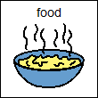
Next page
The men took the children aboard and brought them to a home where they fed them supper and made them rest.
After dark, they brought the children home.
What did Tom and Becky need before they could go home?

Slide 15
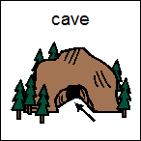

Next page
Before day break, Judge Thatcher and a handful of other searchers made their way out of the cave and heard the good news that the children had come home.
Where was Judge Thatcher when he heard that the children were safe?

Slide 16


Next page
Tom and Becky were exhausted from their time in the cave, and were bedridden all of Wednesday and Thursday.
On Friday Tom began to feel better and on Saturday he was completely recovered.
Becky began to recover on
Sunday, but still did not feel
very well.
The children were safe, but how did they feel?

Slide 17


Next page
Judge Thatcher explained to Tom that no one could enter the cave again.
He had covered the door with a big piece of iron and had triple locked it with a set of keys.
Why had the Judge locked the cave?

