Slide 1
Welcome

Slide 2
KALAIGNAR KARUNANIDHI ARTS COLLEGE FOR WOMEN (AUT)
PUDUKKOTTAI.
TEAM LEADER
M.NIVETHAA
TEAM MEMBERS
S. NANTHINI DEVI
C. NIVETHA
J. NISHA

Slide 3
THE TABLEAU HR SCORECARD: MEASURING SUCCESS IN TALENT MANAGEMENT

Slide 4
PROJECT REPORT TEMPLATE
1 INTRODUCTION
1.1 overview The HR indicators of business performance. They are also known as HR metrics, and more specifically HR KPIs, as they are metrics that are linked to the business strategy.

Slide 5
1.2 Purpose Consider, for instance, an apparel retailer that wants to transition its business model from simply supplying clothes to delivering customers a truly service-based experience.

Slide 6
2. Problem Definition & Design Thinking
2.1 Empathy Map
The first element is what we called workforce success. The second element is called we called Right HR costs.
An HR Dashboard is a business intelligence tool that allows Human Resources teams to tracks and report on HR KPIs.

Slide 7
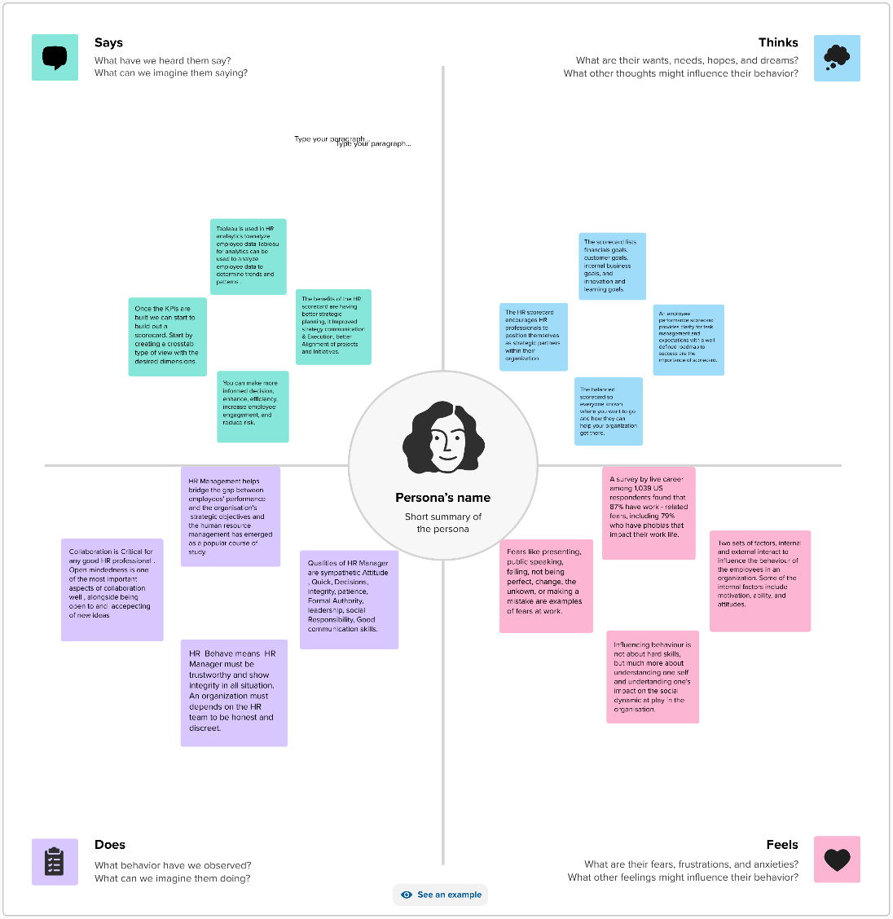

Slide 8
2.2 Brainstorming Map
An HR Scorecard visually represent the critical measures of the HR department’s achievements, productivity levels. Other parameters- such as hiring costs, retention rate, time to fill, quality of hire, and so on- critical to the company’s growth.

Slide 9
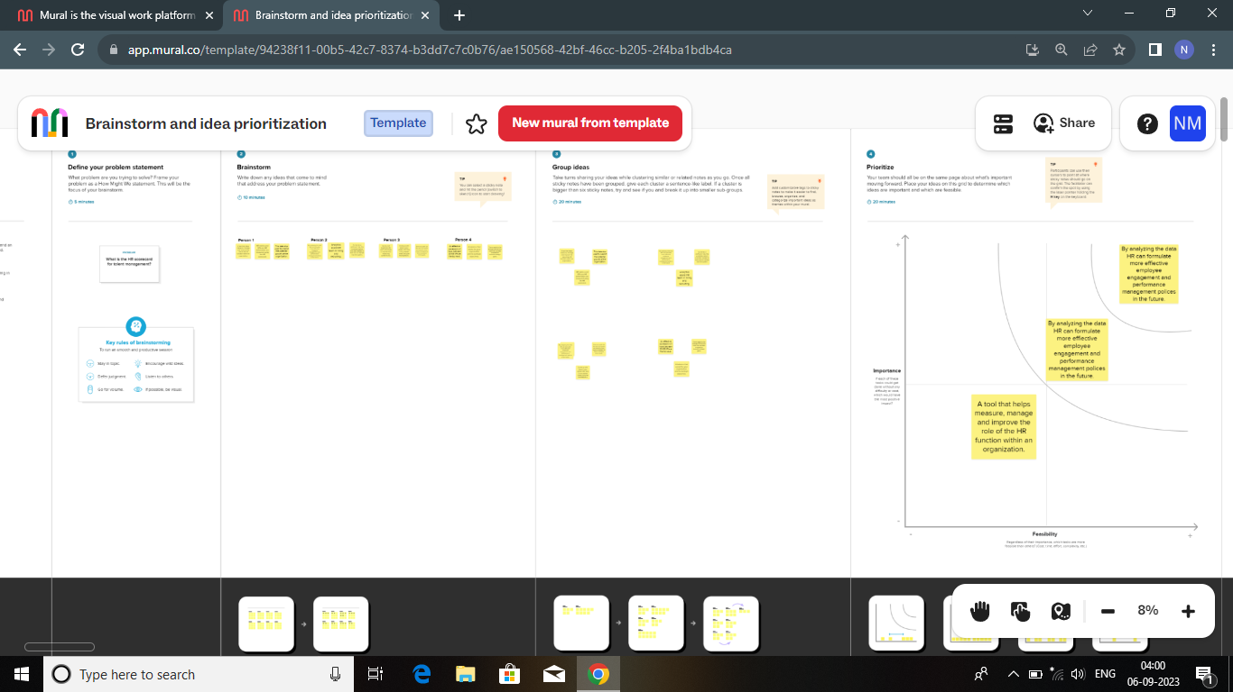

Slide 10
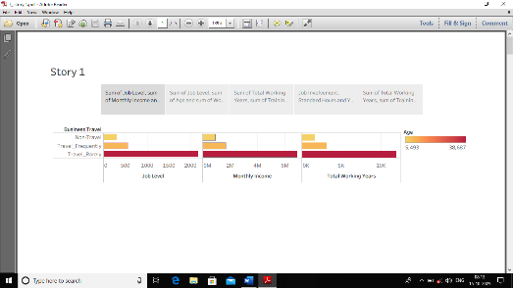
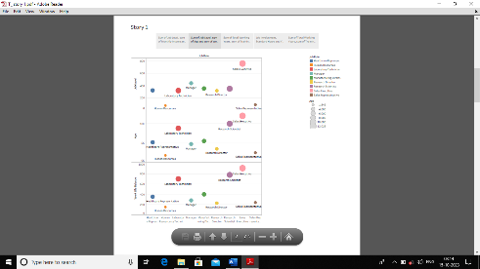
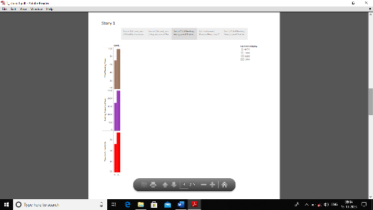
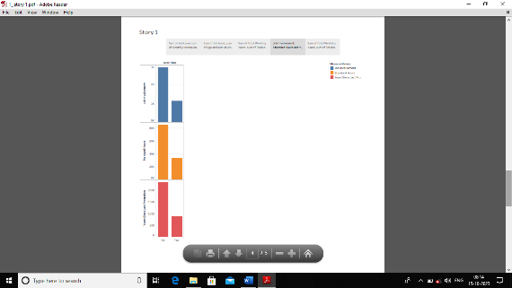
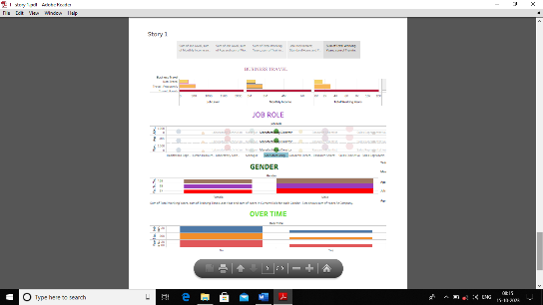
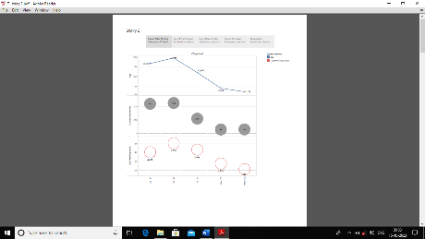
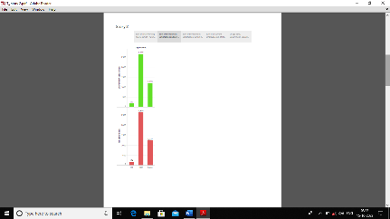
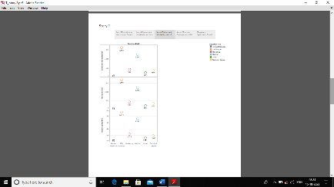
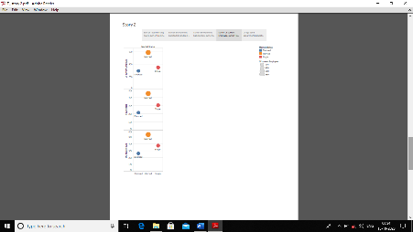
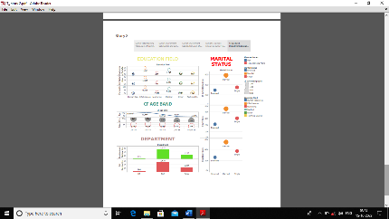
3 Result
Story:1
Story: 2
4 Advantages & Disadvantages:
Advantages:

Slide 11
4 Advantages & Disadvantages
Advantages
This linkage can help in communicating performance and results to the various stakeholders. A well-designed and balanced scorecard with solid supplementary processes will help increase accountability.
Disadvantages:
One of the disadvantages of the HR scorecard is that measuring intangibles is difficult, if not impossible, a degree of subjectivity on the part of Hr staff.

Slide 12
5 .Applications
The HR scorecard is meant to measure leading HR indicators of business performance.
Leading indicators are measurements that predict future business growth.

Slide 13
Conclusion:
As the name denotes, balanced scorecard creates a ring balance between the components of organization objectives and vision.
The balanced scorecard focuses attention not only on the financial attention not only on the financial objectives of the company but also highlights.

Slide 14
7.Future Scope:
We spoke to some of the global award-winning HR leaders to find out. I will look at the following period
2023: Right now
2025: HR Management in a few years
2030: Human resources many years into the future.The change in HR workings will also have an impact on the future of work itself.

Slide 15
8.APPENDIX
My Project Links:
Data Set Link: Excel
https://drive.google.com/file/d/1Dzfd8MeXY1Zm0ZWykPq7IHYOJm8HhW0Z/view?usp=sharing
Tableau Link:
https://github.com/bdu1621me1300/The-Tableau-HR-Scorecard-Measuring-Success-in-Talent-Management_-NM2023TMID25646/upload/main

Slide 16
Thank You

