Slide 1

Automating Workflows for the City of Montgomery
Brannon Walden
Data Science Fundamentals | June 2018

Slide 2
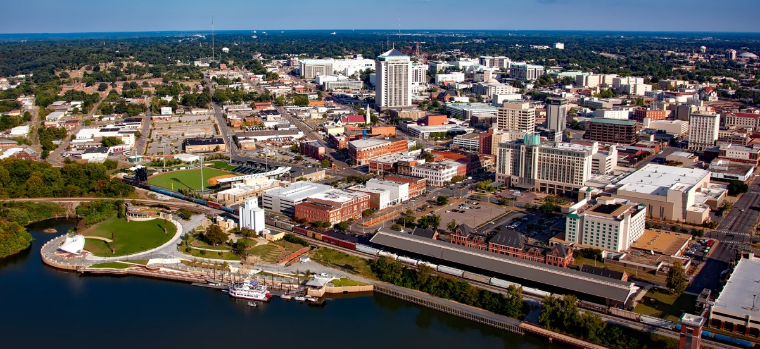
Contents
Introduction
Explanation of Data
Exploratory Data Analysis
Feature Engineering
Model Benchmarking
Conclusion
Bibliography

Slide 3
Introduction
City of Montgomery Inspections Department:
Document and issue building permits for construction projects
To process applications employees enter long descriptions of project scope along with many other fields such as location, owner, estimated costs, permit types, zoning, etc.
Data entry is time consuming and diverts staff attention away from code enforcement and other tasks
Hypothesis:
The UseType field, and possibly others, could be automatically populated with better than average results using text recognition and machine learning algorithms.

Slide 4
Explanation of Data
Data Source:
https://data.montgomeryal.gov/Permits/Building-Permit-2014-Present-Download-/qvzc-ejq2
Fields of Interest:
Description – text field includes an explanation of the project’s scope
UseType – categorical field ['Residential', 'Commercial’, 'Mixed Occupancy’]
JobType – categorical field ['New', 'Existing', 'Alteration', 'Repair', 'Other', 'Addition’]
Physical Location – latitude and longitude coordinates (-86.302972, 32.377624)

Slide 5
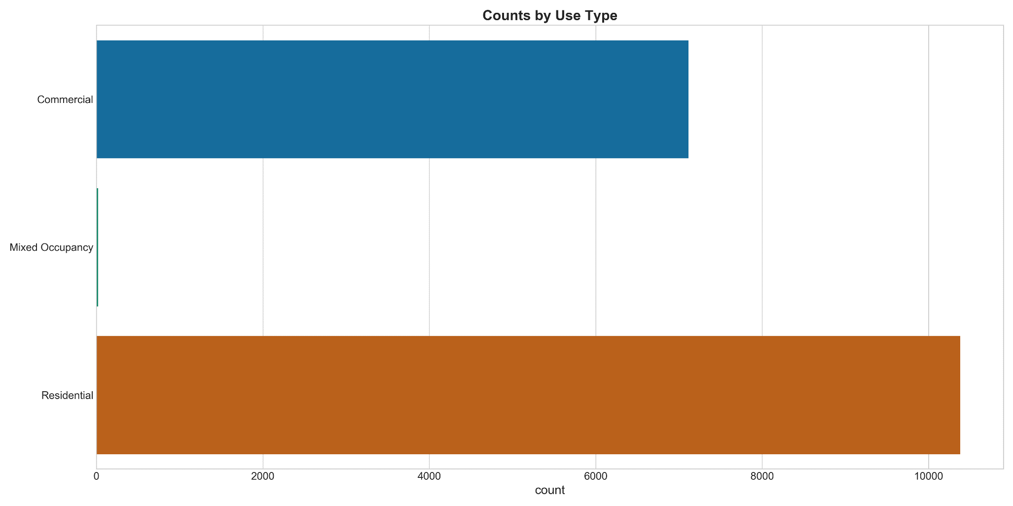
Exploratory Analysis

Slide 6
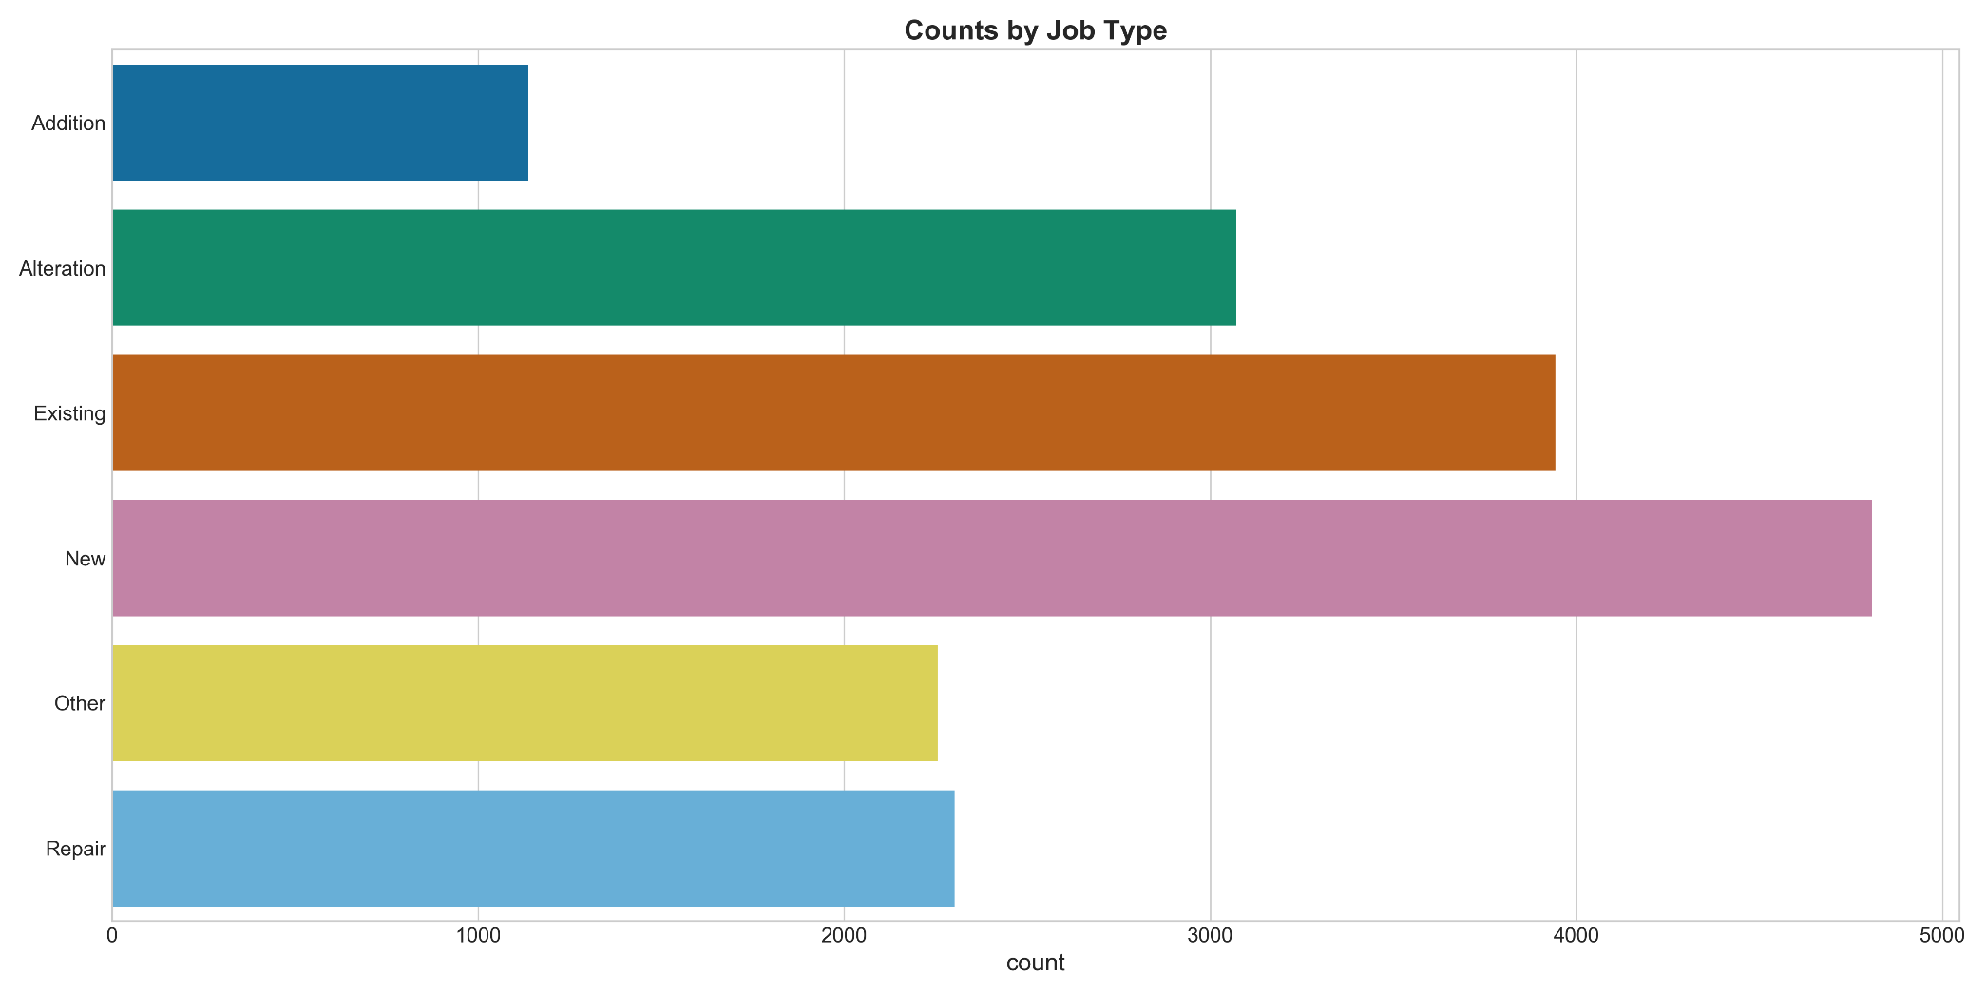
Exploratory Analysis

Slide 7
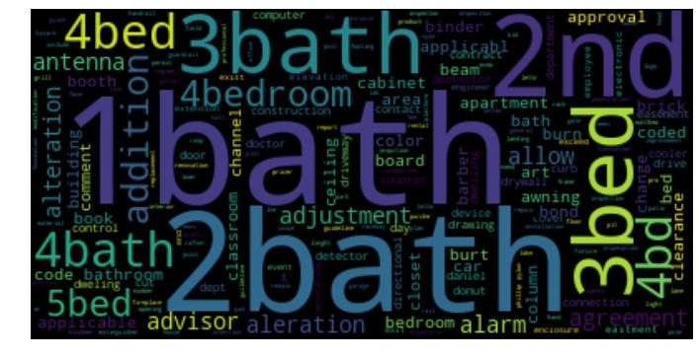
Feature Engineering
Wordcloud Representation of Bag of Words Corpus

Slide 8
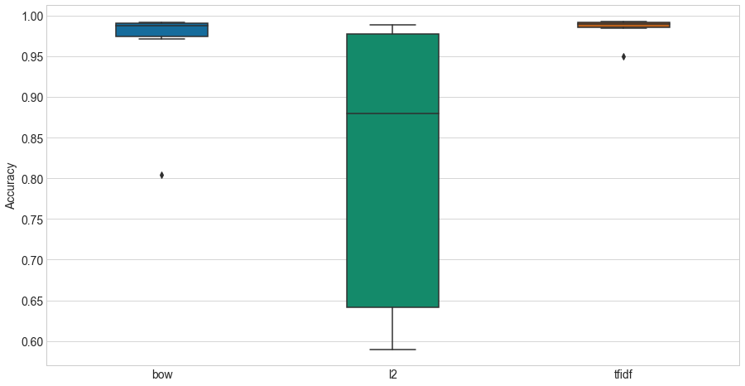
Feature Engineering
Comparison of Text Transformations and Accuracy using Logistic Regression

Slide 9
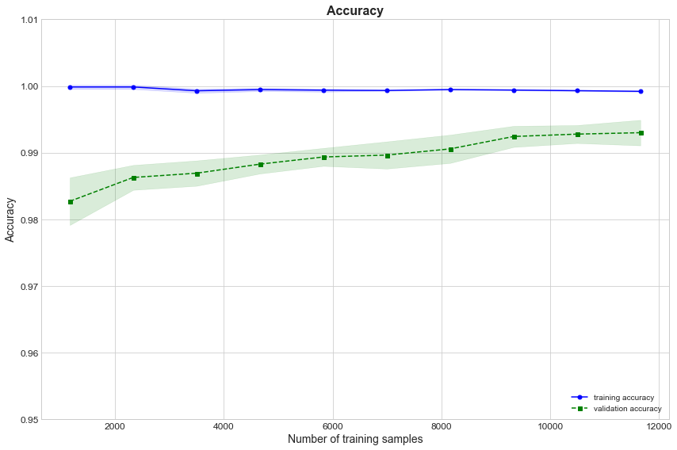
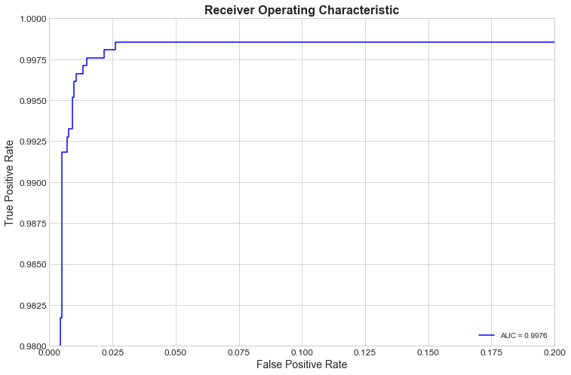
Model Benchmarking
Logistic Regression

Slide 10
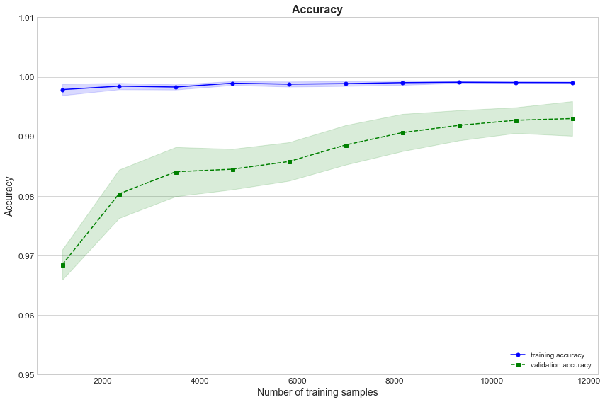
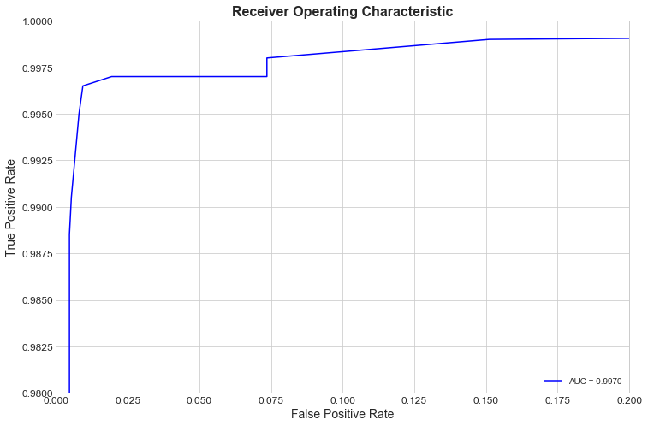
Model Benchmarking
Random Forest

Slide 11
Model Benchmarking
Multilayer Perceptron

Slide 12
Summary
Business Understanding: In addition to star data, the GAIA observatory recorded many objects within the solar system that could be potential dangers to Earth. To protect earth, determine which objects are heading towards us that may pose a future threat, or that have a particular interesting characteristic yet to be determined.
Data Understanding: The object data contains a sample of 14,099 SSOs for a total 1,977,702 different observations. Summary statistics, histograms, correlation coefficients and other analyses will be useful to determine key features. Dimensionality reduction or clustering may be employed to help identify classifications of objects.
http://cdn.gea.esac.esa.int/Gaia/gdr2/sso_observation/csv/
Data Preparation: SSO observations are contained in four separate CSV files which will need importing and joining. Caution: the complexity of the data and the math to determine orbital paths could be out of reach to the novice. Standardization and dimensionality reduction are likely necessary.
Modeling: Potential candidates for modelling may include Support Vector Machines, K-Nearest Neighbors, Random Forests or even Neural Networks. Caution: The very large volume of data under consideration may lead to high computational costs in which sampling or a cloud computing environment may be required.

Slide 13
Conclusion
Business Understanding: In addition to star data, the GAIA observatory recorded many objects within the solar system that could be potential dangers to Earth. To protect earth, determine which objects are heading towards us that may pose a future threat, or that have a particular interesting characteristic yet to be determined.
Data Understanding: The object data contains a sample of 14,099 SSOs for a total 1,977,702 different observations. Summary statistics, histograms, correlation coefficients and other analyses will be useful to determine key features. Dimensionality reduction or clustering may be employed to help identify classifications of objects.
http://cdn.gea.esac.esa.int/Gaia/gdr2/sso_observation/csv/
Data Preparation: SSO observations are contained in four separate CSV files which will need importing and joining. Caution: the complexity of the data and the math to determine orbital paths could be out of reach to the novice. Standardization and dimensionality reduction are likely necessary.
Modeling: Potential candidates for modelling may include Support Vector Machines, K-Nearest Neighbors, Random Forests or even Neural Networks. Caution: The very large volume of data under consideration may lead to high computational costs in which sampling or a cloud computing environment may be required.

Slide 14
Works Cited
Business Understanding: In addition to star data, the GAIA observatory recorded

