Slide 1

Automating Workflows for the City of Montgomery
Brannon Walden
Data Science Fundamentals | June 2018

Slide 2

Contents
Introduction
Explanation of Data
Feature Engineering
Model Analysis
Model Summary
Next Steps
Appendix

Slide 3
Introduction
The City of Montgomery Inspections Department:
Issues building permits for construction projects.
Documents permit applications by entering long descriptions of the projects scope along with many other fields such as location, owner, estimated costs, permit types, zoning, etc.
Data entry is time consuming and diverts staff attention away from code enforcement and other tasks.
Hypothesis:
The Use Type field, and possibly Job Type, could be automagically populated without human input and with better than average (>52.81%) results using natural language processing and machine learning techniques.

Slide 4
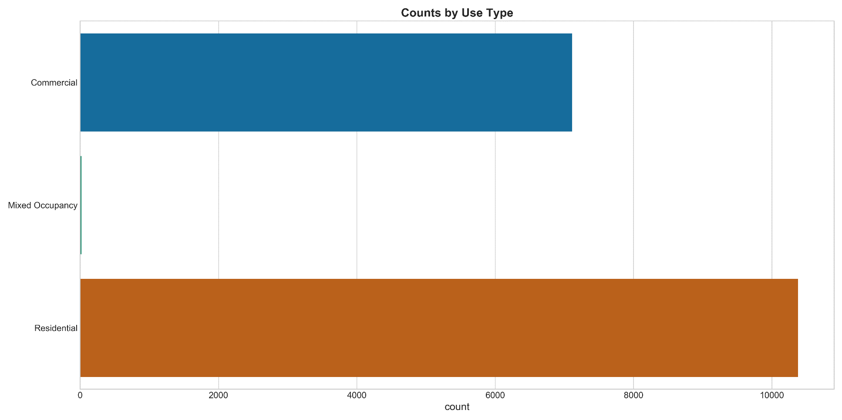
Explanation of Data
After removing Mixed Occupancy values, which are rare occurrences, the Use Type field looks good for binary classification.
Baseline metric =
52.81% accuracy

Slide 5
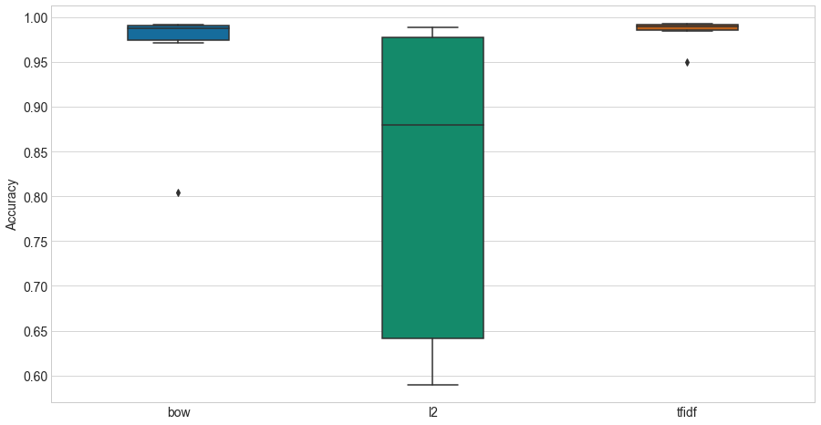
Feature Engineering
The Description Field was converted to Bag of Words, l2 normalized and tf-idf representations and compared using logistic regression.
The results indicated the tf-idf representation as the top performer.

Slide 6
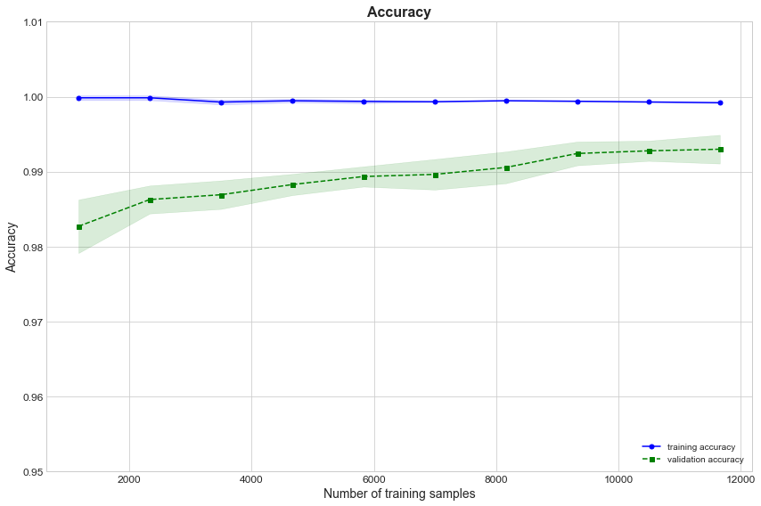
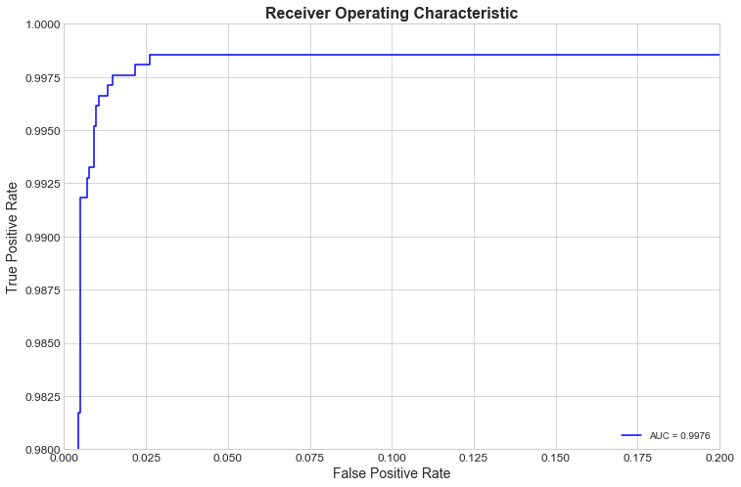
Model Analysis
Logistic Regression

Slide 7
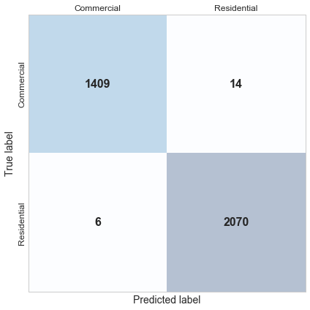
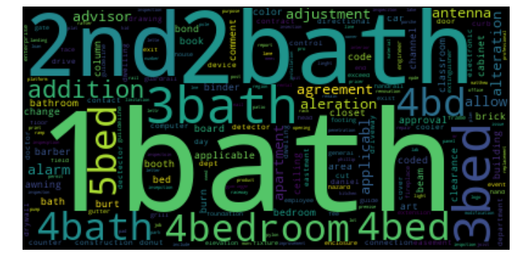
Model Analysis
Logistic Regression

Slide 8
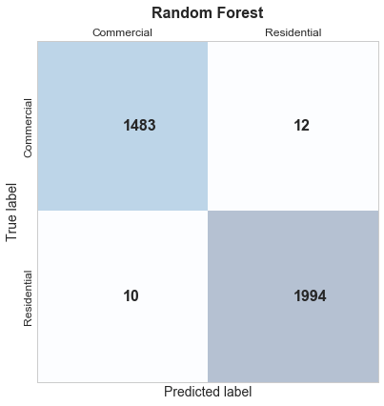
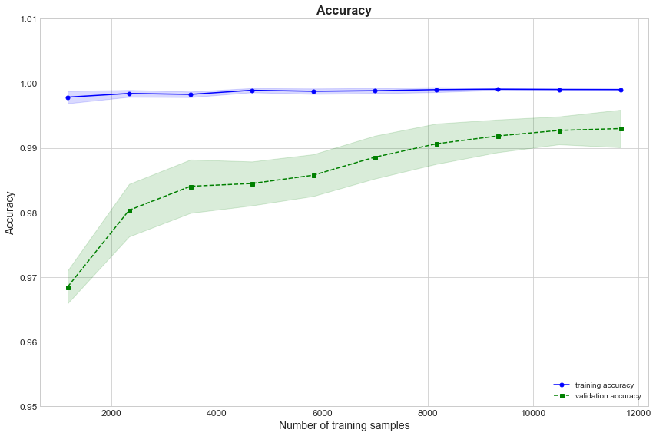
Model Analysis
Random Forest

Slide 9
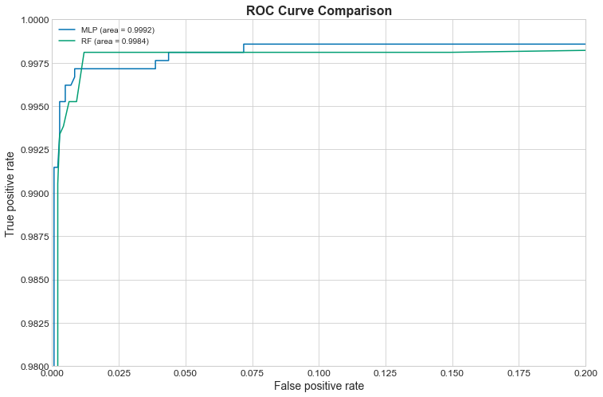
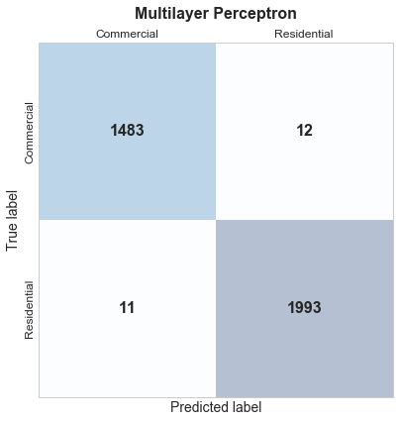
Model Analysis
Multilayer Perceptron outperforms Random Forest

Slide 10
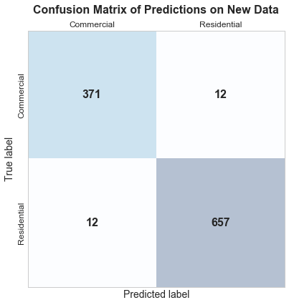
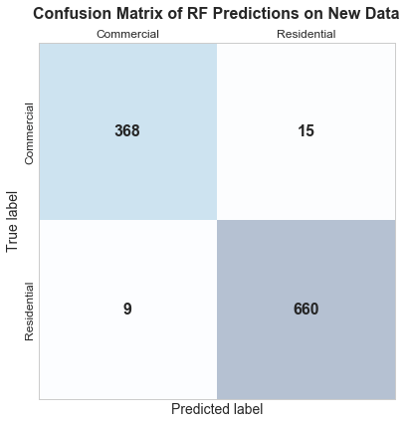
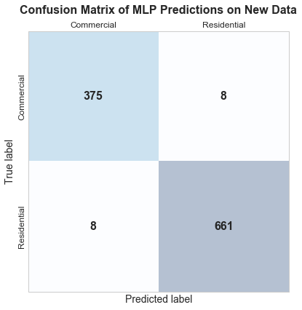
Model Summary
 | Logistic Regression | Random Forest | Multilayer Perceptron
Test Accuracy | 99.34% | 97.97% | 99.34%
Validation Accuracy | 97.71% | 97.71% | 98.47%
Confusion Matrix of model on validation set

Slide 11
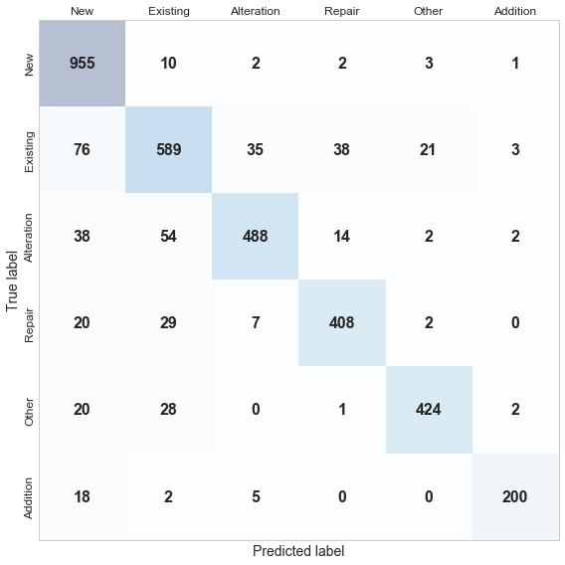
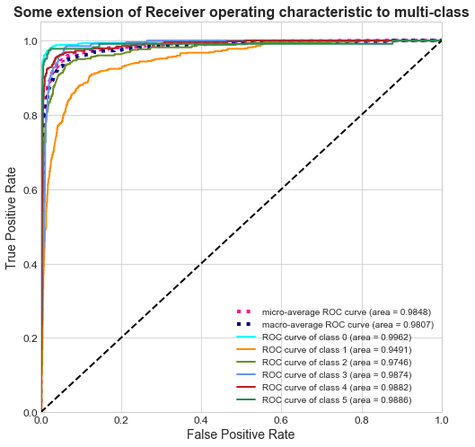
Next Steps
Logistic Regression Multiclass Classification | Initial Test Accuracy: 86.04%

Slide 12

Next Steps
Continue to fine tune and evaluate models and model performance
Simplify code and isolate each model into its own notebook
Save models for quicker analysis
Further develop models for Job Type multiclass classification
Create a project proposal and deck for presentation to city stakeholders
Setup and meet with city stakeholders

Slide 13
Appendix
Data Source: https://data.montgomeryal.gov/Permits/Building-Permit-2014-Present-Download-/qvzc-ejq2
Project Repository: https://git.generalassemb.ly/bdub595217/project-final
Other Sources: https://scikit-learn.org
https://machinelearningmastery.com
Zheng, Alice, and Amanda Casari. “Feature Engineering for Machine Learning: Principles and Techniques for Data Scientists.” O'Reilly, 2018.
Géron, Aurélien. “Hands-On Machine Learning with Scikit-Learn and TensorFlow.” O'Reilly, 2017.

