Slide 1
Analyzing the Influence of Neighbourhood and Other Property Attributes on Calgary’s 2025 Property Assessment Values
By: Bhuvan Dubey, Jimoh Adewumi and Adewale Adewumi
Notes:
Our project is more of descriptive and inferential statistics

Slide 2
Guiding Question
How does assessed value per square foot vary across land use designations and communities?
Which communities show the highest average assessed values and lowest average assessed values?
Motivation
Our team is passionate about transforming parcel-level data into actionable insights that empower a wide range of stakeholders—analysts, urban planners, real estate professionals, researchers, residents, and even prospective home buyers. By unlocking the value hidden in property data, we aim to support smarter decisions and create a clearer picture of Calgary’s housing landscape.
Notes:
Land Use Designation refers to the official zoning or planning category assigned to a parcel of land by the municipality. It determines what types of activities or developments are permitted on that property.

Slide 3
Background
Data Background
Methods
Property assessments guide municipal tax allocation.
Influenced by:
Parcel size
Land-use designation
Building characteristics (age, type, floor area etc.)
Community/location
Assessments help analyze socio-economic differences and land-use diversity across communities.
Prior literature: neighbourhood location is a strong predictor of housing value (Gyourko et al., 2006).
Parcel size and built form also major contributors.
Data source: City of Calgary — Current Year Property Assessments (2025).
Population: all taxable parcels across all communities and property types.
Key variables:
Assessed value,Land size,Property type ,Land-use designation and Community
Statistical tools used:
Descriptive statistics
Multiple linear regression
Best subset models
Diagnostics: residual plots, VIF, assumption checks
Notes:
During our preliminary review of the dataset, we realized that analyzing all building classes together—such as residential, commercial, and multi-residential—would not be appropriate because these categories differ significantly in characteristics and valuation drivers. To maintain consistency and accuracy, we narrowed the scope of our analysis to residential buildings only, which gives us a robust dataset of approximately 330,000 records.
It’s important to note that, aside from the factors we are focusing on—neighbourhood, land use designation, building age, and land size—property assessment values are also influenced by market dynamics and policy decisions. However, these external factors are outside the scope of this analysis.

Slide 4
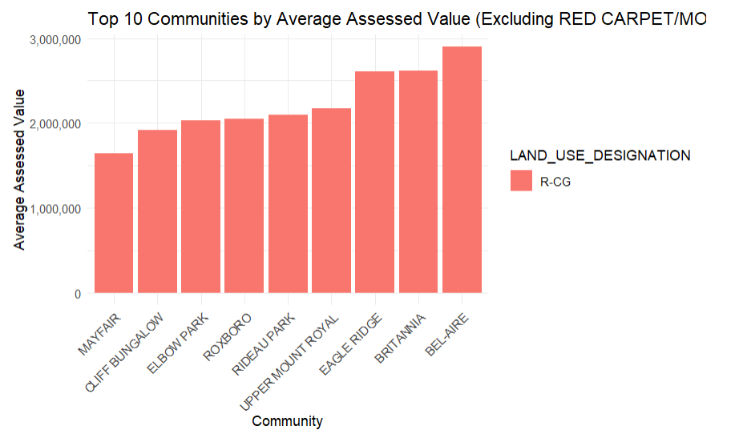
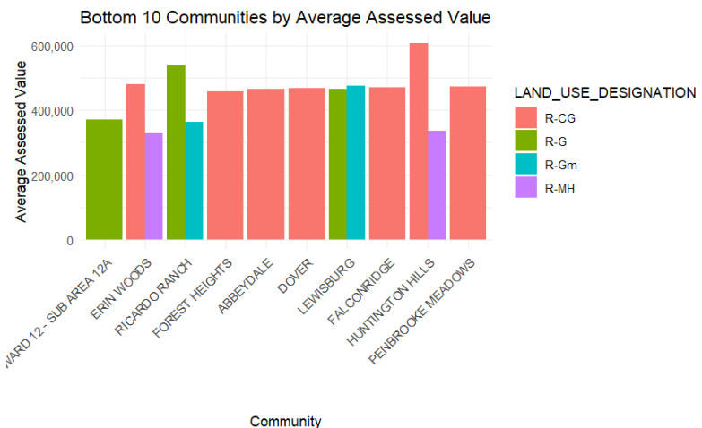
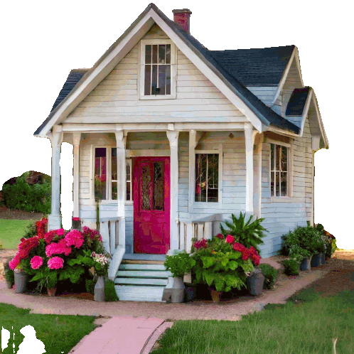
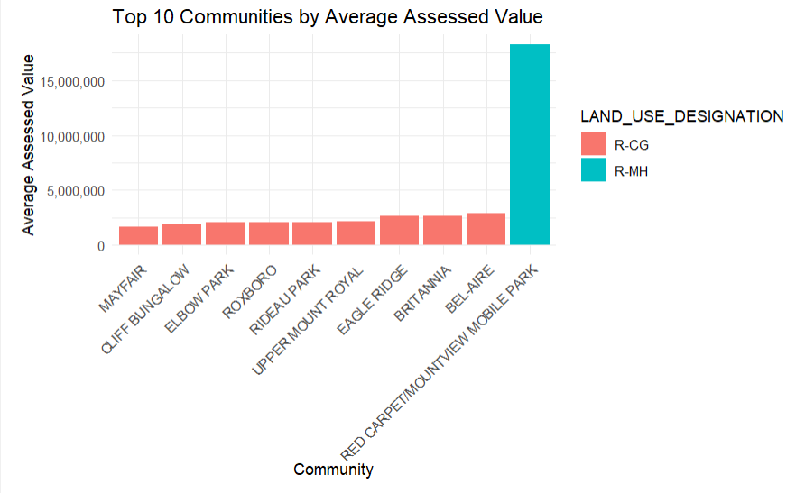
Visualization For Average Assessed Values
Statistical Question: Which communities show the highest average assessed values and lowest average assessed values?
Null Hypothesis : No difference in mean assessed values across communities.
Alternate Hypothesis : At least one community differs in mean assessed value.
R-CG is a residential designation that is primarily for rowhouses but also allows for single detached, side-by-side and duplex homes that may include a secondary suite.
The R-G district is for a mix of low density housing forms in suburban greenfield locations , including single-detached, side by side, duplex , cottage housing clusters and rowhouse development, all of which may include secondary suite.
R-MH is a residential designation that is for mobile home parks.
The R-Gm district is for a range of low density housing forms in suburban greenfield locations , including side by side, duplex , cottage housing clusters and rowhouse development (but excluding single detached), all of which may include a secondary suite.
Notes:
Now, we’re looking at a visualization of the average assessed property values across different communities. The goal here is to answer our statistical question: Which communities show the highest and lowest average assessed values. The null hypothesis states that there is no difference in mean assessed values across communities. The alternative hypothesis suggests that at least one community differs in its average assessed value.
This plots factor in land use designation, since pvalue for COMM_NAME is less than alpha, we reject the null hypothesis in favor of the Alternate Hypothesis
On the right, we have the Top 10 communities by average assessed value. Here, we can see that communities like Bel-Aire, Britannia, and Eagle Ridge stand out significantly, with average assessed values approaching three million dollars. The remaining top communities—such as Upper Mount Royal, Rideau Park, and Elbow Park—also show consistently high values, generally in the range of 1.8 to two-and-a-half million dollars. These areas represent some of the most affluent neighbourhoods in the dataset.
On the left, we have the Bottom 10 communities by average assessed value. These communities—show much lower average assessments, typically between three hundred thousand and 600 hundred thousand dollars. These neighbourhoods tend to be older, more affordable, and in some cases, more densely populated.

Slide 5
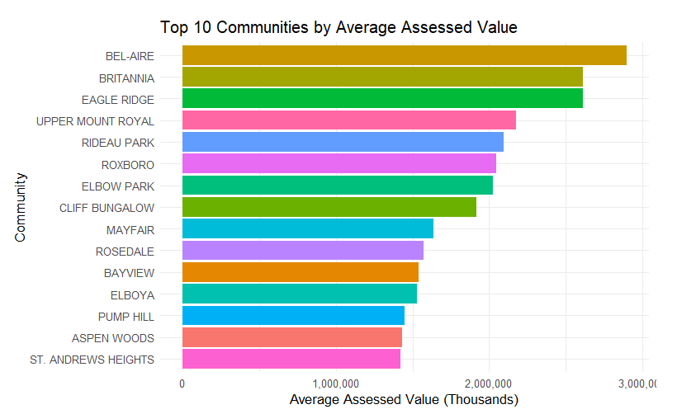
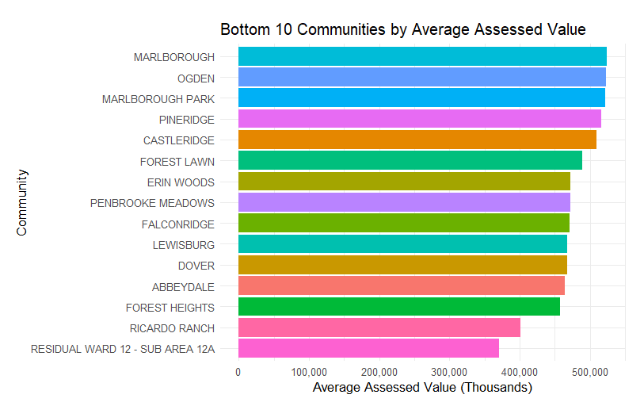
Visualization For Average Assessed Values
Statistical Question: Which communities show the highest average assessed values and lowest average assessed values?
Null Hypothesis : No difference in mean assessed values across communities.
Alternate Hypothesis : At least one community differs in mean assessed value.
There is substantial gap between the highest and lowest valued communities, often more than two million dollars in difference.
Notes:
These plot does not consider land use designation. Overall, what these two charts show is a substantial gap between the highest- and lowest-valued communities—often more than two million dollars in difference. This spread strongly suggests that the null hypothesis is unlikely to hold, as property values vary considerably across different neighbourhoods.

Slide 6
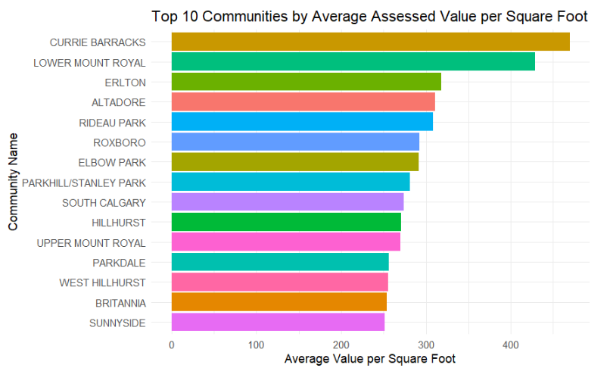
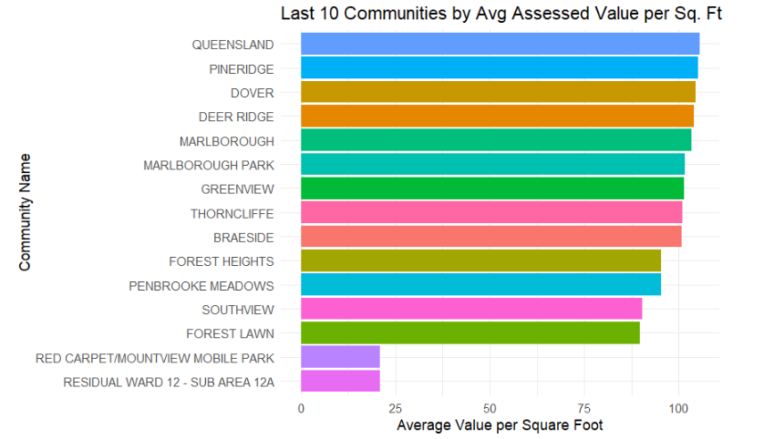
Bar chart for assessed value per square foot across communities
Statistical Question: How does assessed value per square Foot vary across land use designations and communities?
Null Hypothesis : No difference in assessed value per square foot across communities.
Alternate Hypothesis : At least one community differs in assessed value per square foot.
Notes:
Since p-value for LAND USE DESIGNATION is less than alpha at alpha = 0.05, we reject the null hypothesis in favor of the Alternate Hypothesis

Slide 7
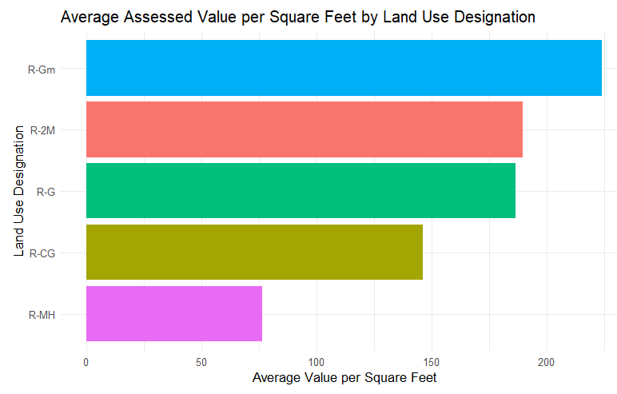
Bar chart for assessed value per square foot land use designations
Notes:
Since pvalue for LAND USE DESIGNATION is less than alpha at alpha = 0.05, we reject the null hypothesis in favor of the Alternate Hypothesis

Slide 8
Statistical Methods (Regression)
Rationale for Regression
Model:
Multiple linear regression on:
Total assessed value (ASSESSED_VALUE)
Model Features:
Land Size,Land Use Designation + neighbourhood-level predictors
Diagnostics: VIF, residuals, assumption checks
Evaluation:
Adjusted R²
Model parsimony via AIC/BIC
Both outcomes are continuous.
Allows simultaneous assessment of multiple predictors.
Controls for confounders such as land use & community location.
Provides interpretable effect sizes and direction of associations.
Suitable for assessing valuation drivers and policy relevance.

Slide 9
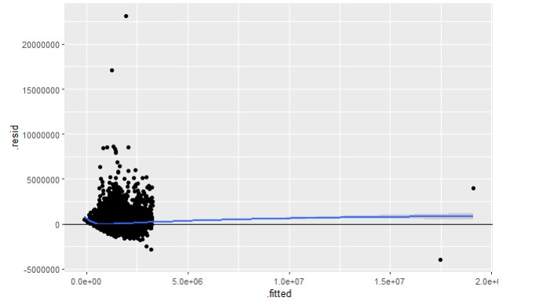
Multiple Linear Regression Models
Regression Assumptions
full_model <- lm(ASSESSED_VALUE ~ LAND_SIZE_SM + LAND_SIZE_SF + LAND_SIZE_AC + YEAR_OF_CONSTRUCTION + LAND_USE_DESIGNATION + PROPERTY_TYPE + COMM_NAME, data = residential_mut_df)
Multicollinearity | Variance Inflation Factor
Multicollinearity may be due to LAND_SIZE_SM LAND_SIZE_SF LAND_USE_DESIGNATIONR-CG LAND_USE_DESIGNATIONR-G regressors
1 --> COLLINEARITY is detected by the test
LAND_SIZE_SM 4.197213e+08 1
LAND_SIZE_SF 4.197227e+08 1
YEAR_OF_CONSTRUCTION 3.346900e+00 0
LAND_USE_DESIGNATIONR-CG 7.208780e+01 1
LAND_USE_DESIGNATIONR-G 1.711400e+01 1
LAND_USE_DESIGNATIONR-Gm 1.978100e+00 0
LAND_USE_DESIGNATIONR-MH 1.270600e+00 0
T test, LAND_SIZE_AC and PROPERTY_TYPE are not statistically significant with p value of 0.065944 and 0.800345 respectively,LAND_SIZE_SM is statistically significant but positive to VIF test.
Adjusted R-squared: 0.5171
reduced_model <- lm(ASSESSED_VALUE ~ LAND_SIZE_SF + YEAR_OF_CONSTRUCTION + LAND_USE_DESIGNATION + COMM_NAME, data = residential_mut_df)
Most covariates in the model are statistically significant, with the exception of some community-level variables. LAND_SIZE_SM removed from model because of multicollinearity.
Adjusted R-squared: 0.5566
Linearity | Residual Plot
reduced_model <- lm(log(ASSESSED_VALUE) ~ LAND_SIZE_SM + LAND_SIZE_SF + YEAR_OF_CONSTRUCTION + LAND_USE_DESIGNATION + COMM_NAME, data = residential_mut_df)
Most covariates in the model are statistically significant, with the exception of some community-level variables.
Adjusted R-squared: 0.5571
No evident pattern to suggest non linearity
Notes:
Why Log Transform Assessed Value?
Stabilizes Variance: Reduces heteroskedasticity by compressing large values and spreading small ones, improving regression assumptions.
Normalizes Distribution: Converts right-skewed property values into a more normal shape, enhancing model fit and inference.
Interpretation Becomes Percentage-Based:
Numeric predictors: Coefficients ≈ % change in assessed value for a one-unit change. Example: β₁ = 0.02 → ~2% increase per unit.
Categorical predictors: Difference ≈ (𝑒𝛽−1)×100%(eβ−1)×100%.
Improves Model Performance: Often increases R² and reduces influence of outliers.

Slide 10

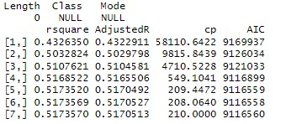
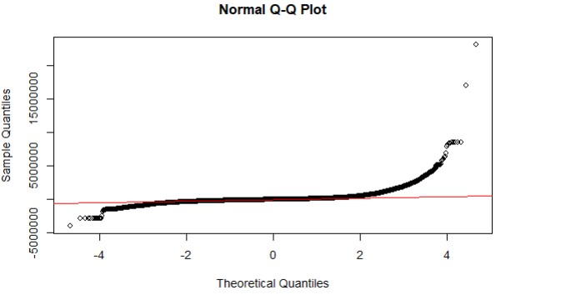
Multiple Linear Regression Models
Regression Assumptions
Best Subset
Kolmogorov–Smirnov test: Not Normally distributed
Both AIC and AdjustedR recommends the 6th model
LAND_SIZE_SF YEAR_OF_CONSTRUCTION COMM_NAME LAND_USE_DESIGNATION
Adjusted R-squared: 0.5566
As the data appears not normally distributed, we tried log transformation of the assessed value and also robust regression using rlm instead of lm, QQ plot and Kolmogorov test still appear to support that the data is not normally distributed.
Notes:
Why Log Transform Assessed Value?
Stabilizes Variance: Reduces heteroskedasticity by compressing large values and spreading small ones, improving regression assumptions.
Normalizes Distribution: Converts right-skewed property values into a more normal shape, enhancing model fit and inference.
Interpretation Becomes Percentage-Based:
Numeric predictors: Coefficients ≈ % change in assessed value for a one-unit change. Example: β₁ = 0.02 → ~2% increase per unit.
Categorical predictors: Difference ≈ (𝑒𝛽−1)×100%(eβ−1)×100%.
Improves Model Performance: Often increases R² and reduces influence of outliers.

Slide 11
Interpretation & Insights
Future Directions
High mean ≠ wealthy residential area → often large institutional parcels.
High SD/IQR highlights community heterogeneity and potential valuation disparities.
Spatial patterns reflect land-use intensity, development mix, and historical zoning.
Results support need for neighbourhood-specific assessment equity analysis.
Spatial regression (e.g., GWR, spatial lag/error models).
Incorporate historical assessment trends.
Compare assessed values vs. actual market sales.
Equity analysis: examine over- and under-assessment by neighbourhood demographics.
Machine-learning models for improved predictive accuracy.
Factor other covariates like number of amenities in the community, average prices of recently sold properties.
Notes:
Firstly, a high mean assessed value doesn’t always indicate a wealthy residential area—sometimes it’s driven by large institutional parcels that inflate averages.

Slide 12
Conclusion
References
Parcel characteristics (size, type, land use) significantly shape assessed values.
Community location remains one of the strongest predictors.
All of the top 10 communities be average assessed value are established, affluent neighbourhoods in Calgary, concentrated mostly in the southwest quadrant near the Elbow River and Glenmore Reservoir, except Rosedale, which is in the northwest quadrant.
Most of the bottom 10 communities are in southeast Calgary (Forest Lawn, Erin Woods, Penbrooke Meadows, Dover, Forest Heights, Ricardo Ranch).A few are in the northeast quadrant (Falconridge, Abbeydale, Lewisburg).
Ricardo Ranch and Residual Ward 12 Sub Area 12A are new or planned developments in the city’s southeast growth corridor.
City of Calgary Open Data Portal: Current Year Property Assessments (Parcel). Current Year Property Assessments (Parcel) | Open Calgary
Gyourko, J., Mayer, C., & Sinai, T. (2006). Superstar Cities(NBER Working Paper No. 12355). National Bureau of Economic Research. Microsoft Word - superstar_cities_06-16-06-final.doc

Slide 13
Thank you

