Slide 1
Cross-Asset and Sector-Wide Analysis to Predict Suncor Returns
DATA 611 - Predictive Analysis | Winter 2026 | Final Project
Group 3 Members: Andrea Abenoja and Bhuvan Dubey

Slide 2

Introduction
The oil and gas sector is a major contributor to Canada's economy
gasoline stations
oil drilling
refining
rank among the top revenue sectors (Government of Canada, 2024).
Suncor, a key Canadian energy company, operates across these sectors.
In November 2025, Suncor's CEO expressed strong confidence in the company's stock (Suncor Energy, 2025).
Stock returns are influenced by broader market factors: crude oil prices, USD/CAD exchange rate, and peer company performances.
Objective: Use supervised learning models to predict Suncor’s daily returns based on these factors.

Slide 3





Data Collection & Methodology Overview
Data retrieved via GOOGLEFINANCE in Google Sheets for period: Jan 2, 2015 – Jan 1, 2026.
Tickers: TSE:SU, NYSEARCA:USO, CURRENCY:USDCAD, NYSE:SHEL, TSE:IMO, TSE:CVE, TSE:CNQ.
Proxy for crude oil: USO ETF (since Google Finance lacks WTI data).
Data alignment: Constructed a date table, used XLOOKUP for matching prices.
Daily returns formula: (Current Day’s Closing Price - Previous Day’s Closing Price)/Previous Day’s Closing Price

Slide 4
Final Dataset & Data Processing
Columns: 8
Date
suncor_daily_return
USOF_daily_return
USDtoCAD_daily_return
shell_daily_return
imperial_oil_daily_return
cenovus_daily_return
cnrl_daily_return
Observations: 2,769.
Exported with formula values for Python analysis.

Slide 5

Analytical Methods Overview
Models employed:
Multiple Linear Regression (MLR) for interpretability.
Random Forest Regression for capturing nonlinearities.
Evaluation metrics: RMSE, Adjusted R², ROC AUC (for classification).
Data split: 70% training, 30% testing, respecting time series order.

Slide 6
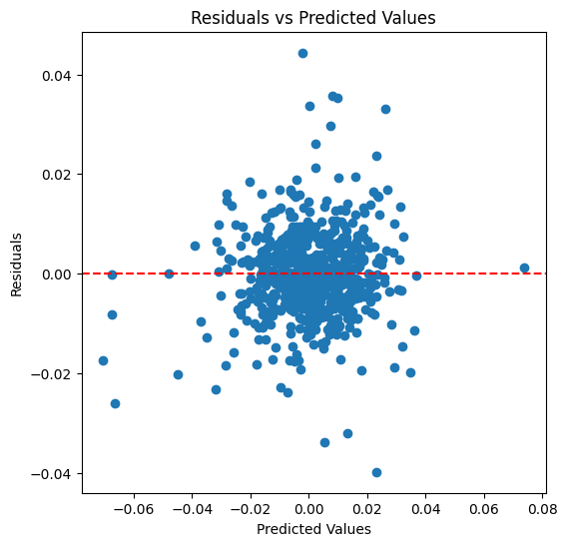
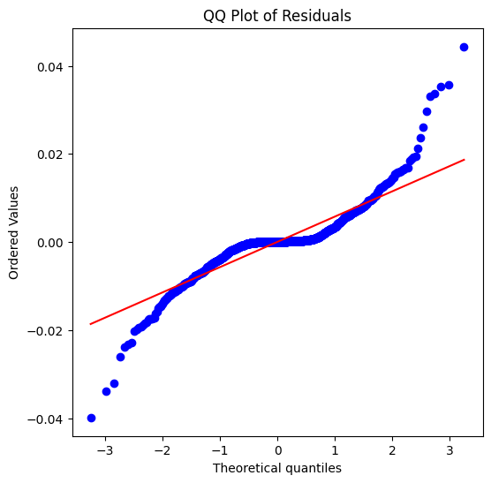
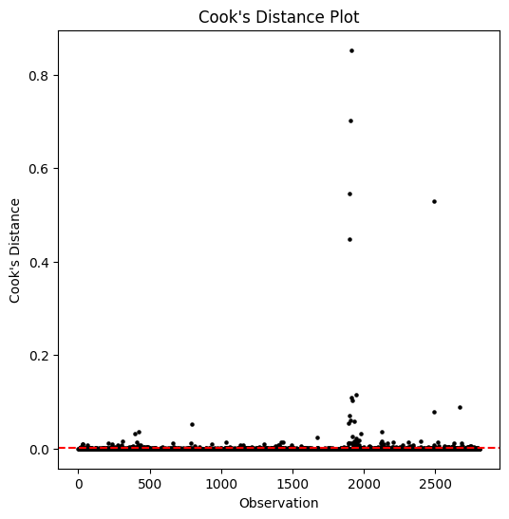
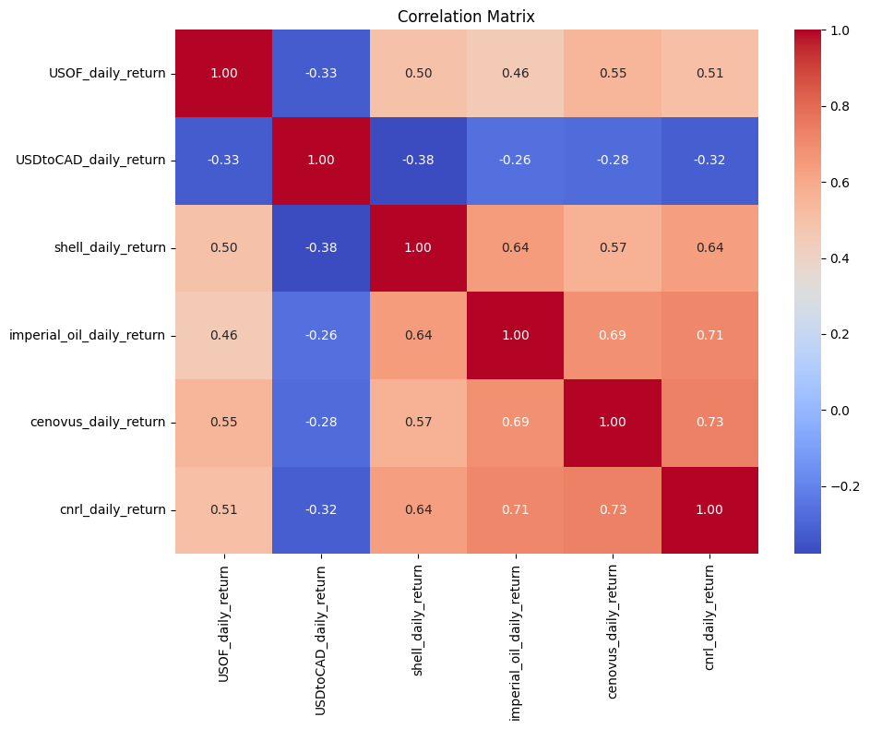
MLR Diagnostics
Residual normality issues: Deviations seen in Q-Q Plot.
No heteroscedasticity: Residuals vs. predicted plot.
Influential observations: 5 points identified via Cook’s Distance.

Slide 7
MLR Results – Model Performance
Adjusted R² = 0.755 on test data (explains 75.5% of variance).
RMSE = 0.00630 (prediction error).
50.6% lower than baseline prediction error

Slide 8
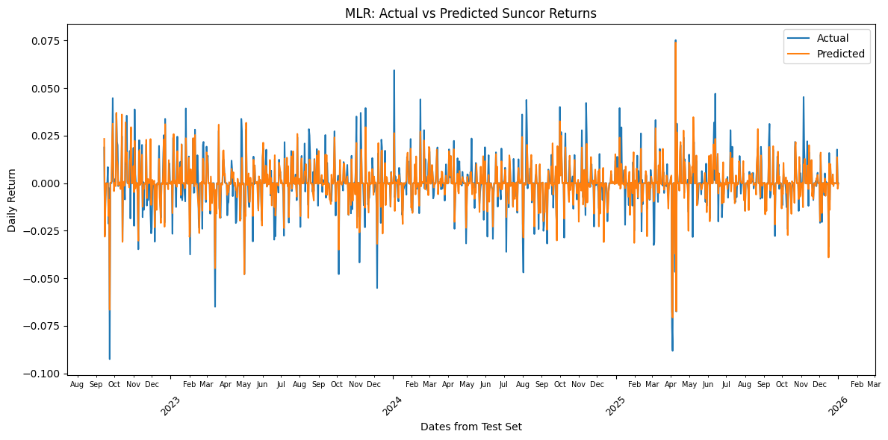
Actual vs. Predicted – MLR
Predictions generally follow actual returns but tend to underestimate during large market swings.

Slide 9
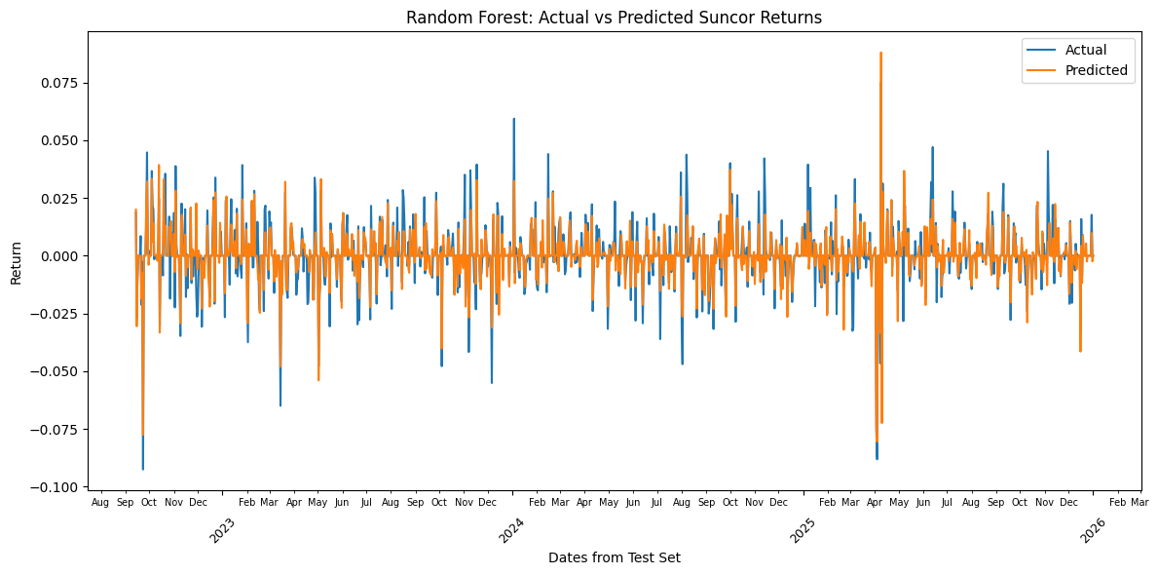
Random Forest Regression – Performance
RMSE = 0.006265, indicating high accuracy.
Predicted vs. actual returns are closely aligned.

Slide 10
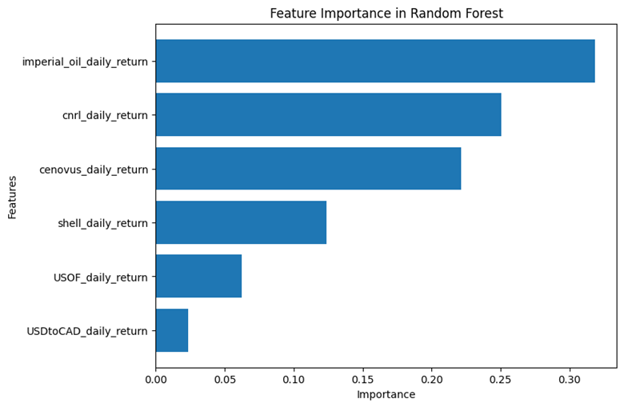
Feature Importance (Random Forest)
Top predictors:
Imperial Oil: 0.3185
CNRL: 0.2508
Cenovus: 0.2214
Shell: 0.1236
USO: 0.0624
USD/CAD: 0.0233

Slide 11
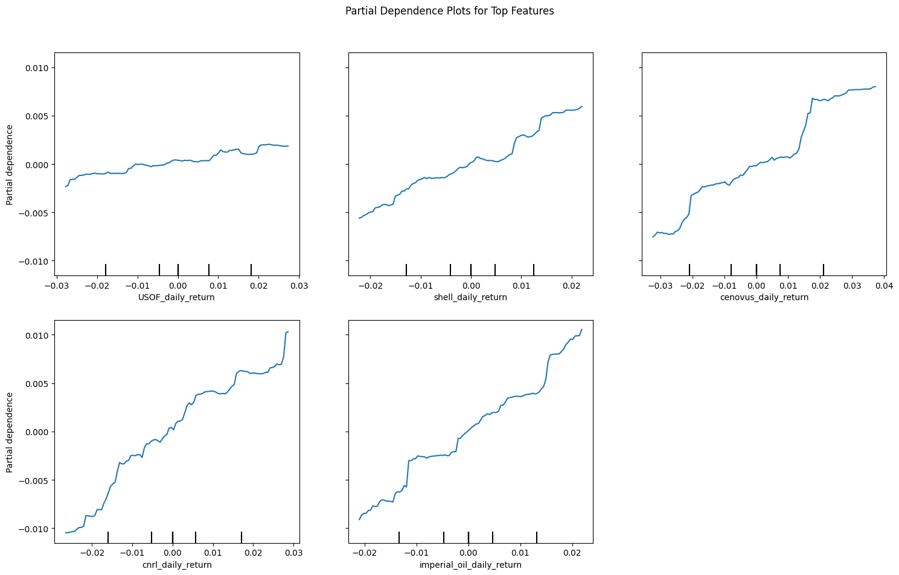
Partial Dependence Plots
Show how changes in top features influence Suncor’s returns.
Increasing Imperial Oil, CNRL, Cenovus returns correlates with Suncor’s rise.
External signals (USO, USD/CAD) have more gradual, weaker effects.

Slide 12
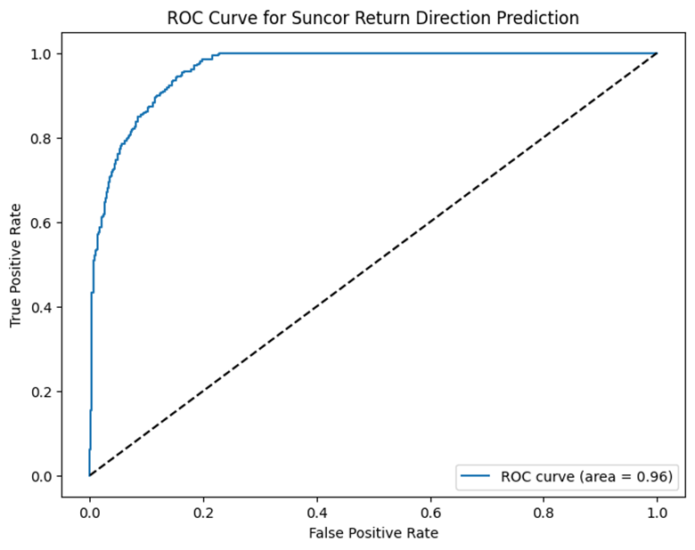
Direction Prediction – ROC Curve
AUC = 0.964, indicating excellent discrimination between positive and negative return days.
Useful for trading strategies.

Slide 13
Discussion – Key Insights
Sector peers and currency exchange are primary drivers of Suncor’s returns.
Nonlinear models capture complex relationships better than linear models.
External market signals have a smaller but still significant impact.

Slide 14
Limitations & Future Directions
Reliance on historical data which limits the prediction of shocks
Need to include macroeconomic indicators and volatility measures
Future work should focus on integrating diverse data sources for improved predictions

Slide 15

Conclusions
MLR explains 75.5% of variance; sector peers and FX are key drivers.
Random Forest provides high predictive accuracy and can capture nonlinear effects.
Sector influence dominates, external signals less so.
Combining models with trading strategies can improve decision-making.

Slide 16

References
Carpenter, J. W. (n.d.). The 10 biggest Canadian Energy Companies. Investopedia. https://www.investopedia.com/articles/markets/091115/7-biggest-canadian-energy-companies.asp
Fama, E. F. (1965). The behavior of stock-market prices. The Journal of Business, 38(1), 34-105.
Government of Canada, C. E. R. (2024, July 3). Canada energy regulator / Régie de l’énergie du Canada. CER. https://www.cer-rec.gc.ca/en/data-analysis/canada-energy-future/2020/covid/index.html
IBISWorld, Inc. (n.d.). Biggest Industries by revenue in Canada in 2026. https://www.ibisworld.com/canada/industry-trends/biggest-industries-by-revenue/
Suncor Energy. (2025, November 5). Suncor Energy third quarter 2025 financial results call. https://www.suncor.com/-/media/project/suncor/files/investor-centre/transcripts/2025-q3-suncor-energy-financial-results-call-transcript-en.pdf?modified=20251113152919&created=20251113152919

