Slide 1
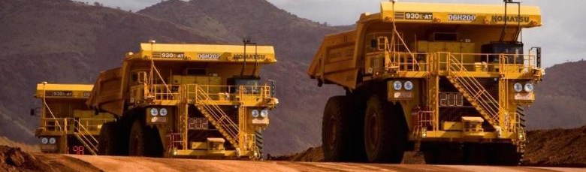
Insights into Suncor (TSX:SU) Stock Prices
DATA 611 - Project 1
Winter 2026
By: Andrea Abenoja and Bhuvan Dubey
Group 3

Slide 2

Why Suncor Stock?
Let’s analyze the claim!
DATA 611 - Project 1
Winter 2026
“At today's oil price, I strongly believe buying our stock is our best investment and we intend to keep buying it month after month after month. “

Slide 3
Why Suncor Stock?
Let’s analyze the claim!
How have Suncor’s stock prices evolved over time?
How volatile and extreme are the stock’s returns
Does trading activity and/or seasonal patterns influence market behaviour?
DATA 611 - Project 1
Winter 2026

Slide 4
Data Summary
DATA 611 - Project 1
Winter 2026
Source
Dimensions & Key Variables
Closing price of the specified day
Specified day’s lowest price
Data
Google Sheets
closing_price
closing price
low
lowest price
Attributes:
price, high, low, volume
Specified day’s highest price
total shares traded for the specified day
Function
GOOGLEFINANCE()
high
highest price
daily_trading_volume
daily trading volume

Slide 5
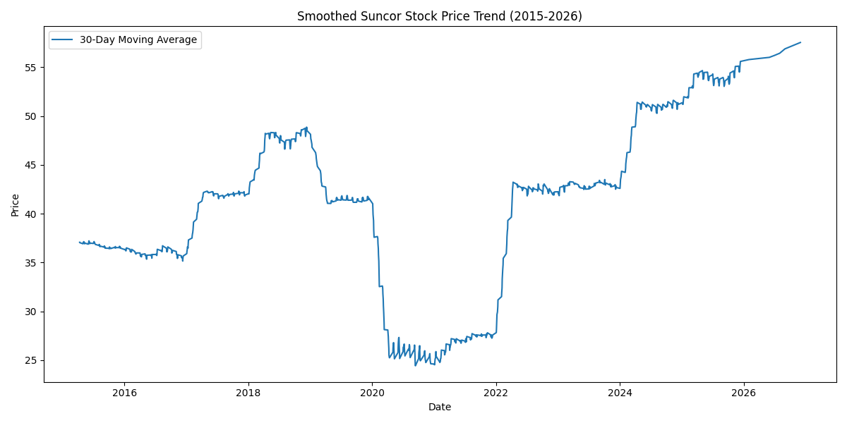
Results:
Price Evolvement over Time
DATA 611 - Project 1
Winter 2026
Line Chart:
Long-term Price Trend
Market disruption between 2020-2022
COVID influence?
Steady increase in price after
All time high reached in January 2026.
Project name
Name of client or internal team

Slide 6
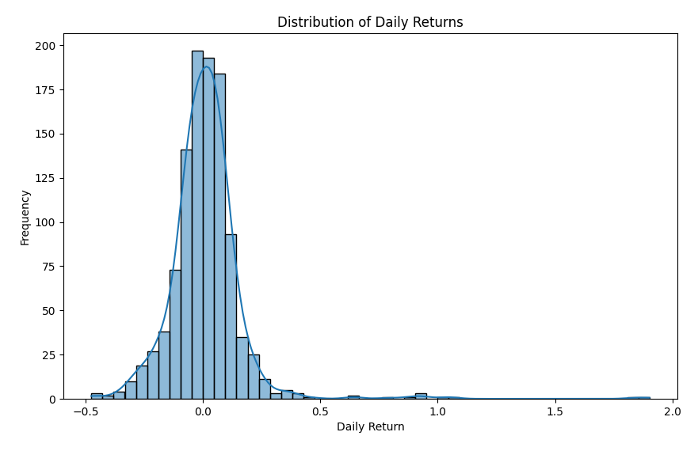
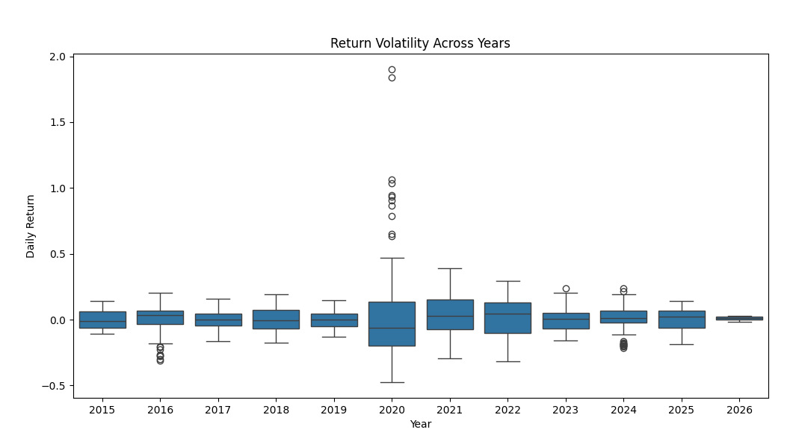
Results:
Return Volatility and Extremity
DATA 611 - Project 1
Winter 2026
Frequency Distribution Histogram:
Return Distribution
Daily returns clustered near zero -> small daily price movements
Right-skewed -> periods of large positive returns
Boxplot:
Return Volatility Across Years
Generally narrow interquartile ranges -> not highly volatile
Outliers in 2020 on upper end of the distribution
Strong rebounds despite market disruption

Slide 7
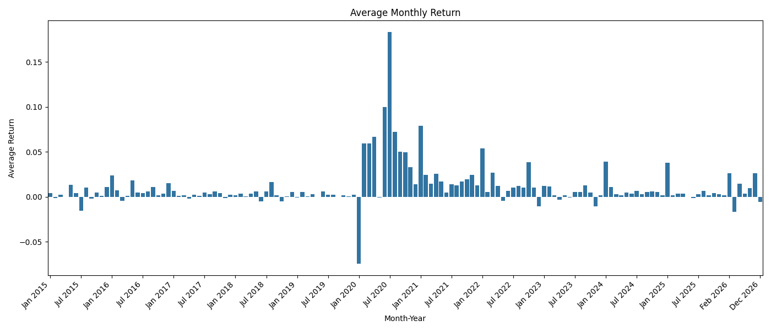
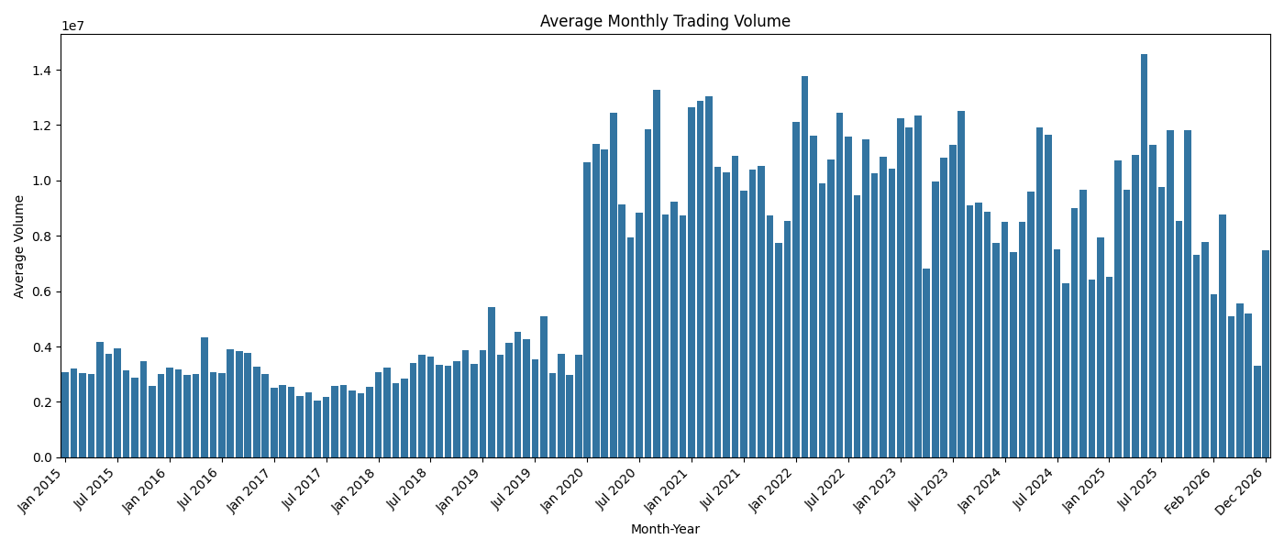
Results:
Trading Activity & Seasonal Patterns
DATA 611 - Project 1
Winter 2026
Bar graph: Average Volume per Month
Consistent average monthly trading volume until market disruption in 2020.
Trading volume remained consistently elevated pass 2020
Suggests investor activity and market participation remained high
Bar graph: Monthly Average Return
Most months monthly average is around zero, greatest variation seen in 2020 to 2022.
Reflection of heightened volatility at this time

Slide 8
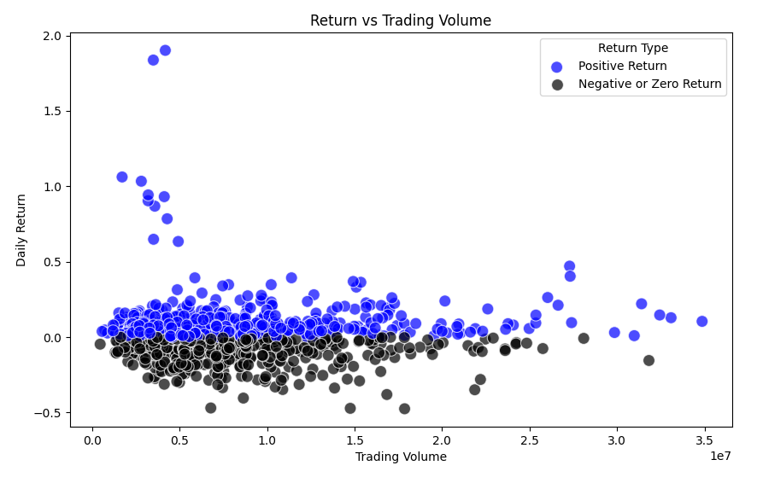
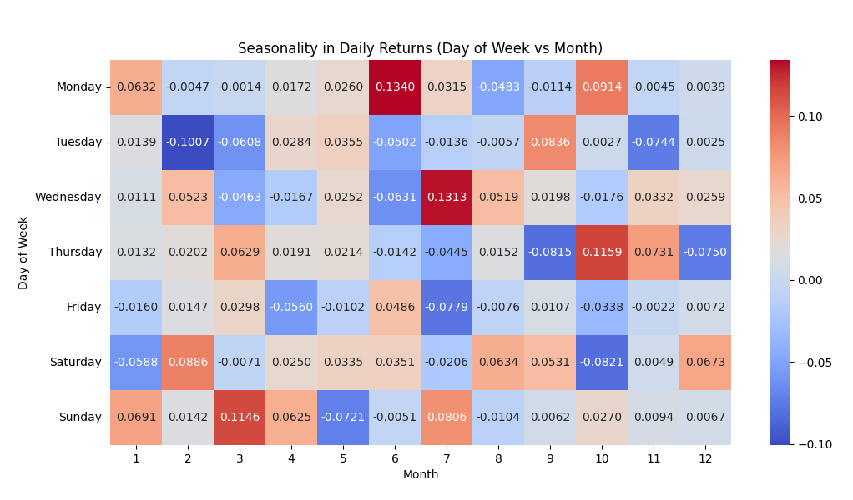
Results:
Trading Activity & Seasonal Patterns
DATA 611 - Project 1
Winter 2026
Scatter plot: Return vs Trading Volume
Trading volume varies greatly
Returns remain close to zero
Weak association between return and trading volume
Heat map: Seasonality - Average Monthly Return by Month and Day of Week
No strong seasonal patterns existing throughout the year

Slide 9

Conclusion
High volatility during COVID-19 in 2020, with sharp declines and strong rebounds.
Overall, Suncor’s stock has shown a steady upward trend, reaching new highs in 2026.
Daily returns are mostly small, with occasional large spikes during market shocks.
Trading volume surged during the pandemic and remained elevated afterward.
No clear seasonal patterns found in returns or trading volume.
Market movements are more influenced by major industry and global events than seasonality.
Suncor demonstrates resilience with a strong recovery and growth over time.

Slide 10
References
DATA 611 - Project 1
Winter 2026
Government of Canada, Canada Energy Regulator. (2020). CER – Canada’s Energy Future 2020 - Energy Supply and Demand in a Pandemic: Effects of COVID-19. Cer-Rec.gc.ca. https://www.cer-rec.gc.ca/en/data-analysis/canada-energy-future/2020/covid/index.html
IBIS World. (2023). IBISWorld - Industry Market Research, Reports, and Statistics. Www.ibisworld.com. https://www.ibisworld.com/canada/industry-trends/biggest-industries-by-revenue/
Suncor Energy Third Quarter 2025 financial results call. (n.d.). https://www.suncor.com/-/media/project/suncor/files/investor-centre/transcripts/2025-q3-suncor-energy-financial-results-call-transcript-en.pdf?modified=20251113152919&created=20251113152919

