Slide 1

The Impact of Monetary Policy on Calgary's Rental Market (2026)
Group 4: Bhuvan Dubey, Gurmol Sohi, Bilal Naseem DATA 613, Winter 2026

Slide 2

Introduction
Housing affordability is a growing concern across Canada, especially in Alberta (Statistics Canada, 2024)
Calgary’s housing market has experienced rapid changes due to population growth and economic shifts (Government of Alberta, 2024)
Increasing costs impact both homebuyers and renters, creating a need for policy analysis
Notes:
Housing affordability has become a growing concern across Canada, with Alberta experiencing some of the most significant challenges. According to Statistics Canada, the rising housing costs are impacting both the homeowners and renters. Calgary’s housing market, in particular, has experienced rapid changes driven by a combination of population growth and economic shifts. The increasing costs are straining household budgets. This situation shows the importance of doing a policy analysis for future housing strategies.

Slide 3



Motivation
Since 2022, the Bank of Canada has raised interest rates sharply, increasing borrowing costs (Bank of Canada, 2024)
Higher rates have shifted demand toward rental housing, affecting vacancy rates and rental prices (Canada Mortgage and Housing Corporation, 2024)
Understanding how macroeconomic policy influences rental supply, prices, and landlord incentives is key for housing policy in Calgary (Statistics Canada, 2024)
Our goal: Examine the link between Bank of Canada's interest rate and rental market outcomes in Calgary by 2026
Notes:
Since 2022, the Bank of Canada has been raising interest rates quite sharply to control inflation. These increases make borrowing more expensive for everyone. As a result, fewer people are choosing to buy, and the demand for rental housing has shifted upward. This has affected vacancy rates and rental prices across the country, including Calgary. What we want to understand is how these macroeconomic policies—interest rate changes—are actually impacting the rental market here. Our goal is to examine the link between the Bank of Canada's interest rate and rental market outcomes in Calgary by 2026.

Slide 4



Key Research Questions
How does the Bank of Canada (BoC) policy rate predict rental inventory in Calgary?
Secondary Question 1.1: Does the sensitivity to interest rates differ between "Full Homes" and "Apartments"?
Secondary Question 1.2: Is there a statistically significant lag (e.g., 3 months) between rate change and rental price response?
What is the impact of property features (bedrooms, size) on rental prices?
Secondary Question 2.1: After controlling for size, does the "Shared" segment still offer lower rents?
Can landlord incentives (rent discounts, free months) be predicted based on market conditions?
Secondary Question 3.1: How do incentives vary across rent segments?
Secondary Question 3.2: Are incentives more common in high vacancy segments?
Notes:
Some key questions for our research is:
How does the Bank of Canada’s policy rate predict rental inventory in Calgary? Our secondory question was does the sensitivity to interest rates differ between "Full Homes" and "Apartments"? And Is there a statistically significant lag (e.g., 3 months) between rate change and rental price response?
Our second key question was What is the impact of property features (bedrooms, size) on rental prices? After controlling for size does the "Shared" segment still offer lower rents?
Our final question was Can landlord incentives (rent discounts, free months) be predicted based on market conditions? Particulary, we looked at How incentives vary across rent segments and whether incentives are more common in high vacancy segments?

Slide 5
Methodology Overview
Data collection from multiple sources (APIs, datasets)
Data cleaning & merging for consistency
Statistical analysis: regression, cross-correlation, logistic regression
Feature engineering (lag variables, segments, incentives)
Visualization for insights and interpretation
Notes:
Gurm

Slide 6
Data Collection & Technical Workflow
Scraper Engine: Automated collection of 5,525 rental listings via RentFaster API and Bank of Canada Valet API
Data Pipeline Components:
Cleaning: jsonlite flattening, janitor cleaning, coalesce for robust column mapping
Merging: Joining daily interest rates with monthly rental snapshots using lubridate
Feature Engineering: Creating segment categories & binary incentive flags
Notes:
Gurm

Slide 7
Data Sources & Variables
Interest Rates: Monthly policy interest rates from Bank of Canada API
Rental Listings: Data from RentFaster API (price bands, property features)
Housing & Economic Data: CREB, AREA, StatCan datasets (prices, population, economic indicators)
Key Variables:
Rental price, number of bedrooms, property size (sq ft.), property type
Incentive indicators (rent discounts, free months)
Interest rate lagged variables (1-6 months)
Notes:
Gurm

Slide 8
Data Preparation & Cleaning
01
02
03
04
05
Standardized date formats (YYYY-MM)
Created lagged interest rate variables to analyze delayed effects
Removed duplicates based on listing IDs
Addressed missing data via interpolation or removal
Ensured consistency across datasets for reliable merging
Notes:
Gurm

Slide 9
Exploratory Data Analysis (EDA) & Visualization
Histogram: Distribution of Calgary rents (Feb 2026) with segment overlays
Key Stats:
Shared: Median $750
Apartments: Median $1,500
Full Homes: Median $2,150
Insight: Inventory at a 3-year high (~5,500+ units), indicating a supply surge
Visuals: Use scatterplots, heatmaps, and box plots for initial insights
Notes:
Gurm

Slide 10

Analytical Techniques
Regression Analysis: Test relationships between interest rates and rental supply/prices
Cross-Correlation: Detect lagged effects (1-6 months) between interest rate changes and rental prices
Logistic Regression: Predict likelihood of landlord incentives based on market conditions
Visualizations: Scatterplots, correlation heatmaps, box plots to illustrate findings
Notes:
Gurm

Slide 11
Research Question 1 — Rental Inventory & Interest Rates
Objective: Determine if changes in policy rate predict rental supply
Hypothesis: Interest rates influence rental supply
Model: Simple linear regression: Rental Inventory ~ Policy Rate
Notes:
Our first objective is to determine whether changes in the policy rate of the Bank of Canada predict rental supply in Calgary.
The hypothesis was that Interest rates influence rental supply, with higher rates potentially reducing demand for home purchases and increasing rental inventory.
To test this, we used a simple linear regression model where we looked at Rental Inventory relationship with policy rate

Slide 12
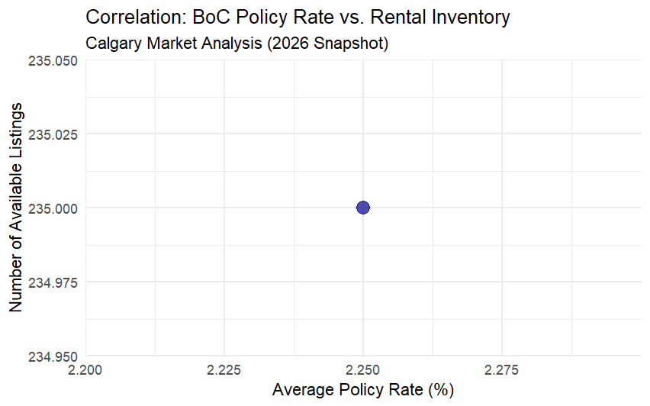
Visual — Scatterplot of Policy Rate vs Rental Inventory
Clustering around 2.25% rate
No clear trend indicating influence of interest rates on rental supply during this period.
Notes:
To answer our question - We created a scatterplot which shows the relationship between the Bank of Canada's policy rate and rental inventory levels in Calgary. This plot shows the clustering of rental inventory around a policy rate of 2.25%. So no clear trend indicates a direct influence of interest rates on rental supply during this period.

Slide 13

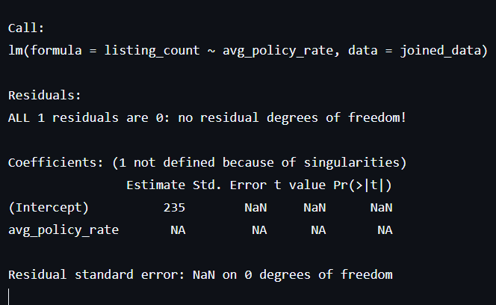
Results for Q1 — Rental Inventory & Rate
Regression equation: Rental Inventory = 235 + 0.0225 * Policy Rate
Coefficient: ~0.0225 (near zero)
P-value: > 0.05 (not statistically significant)
Implication: No significant relationship in 2026 between rate changes and rental inventory
Notes:
Our regression results indicate that the coefficient for the policy rate is close to zero and statistically insignificant. This suggests that, during 2026, changes in the policy rate did not have a direct impact on rental supply in Calgary.
Instead, factors like housing starts, regional migration, and local economic conditions are likely more influential.

Slide 14
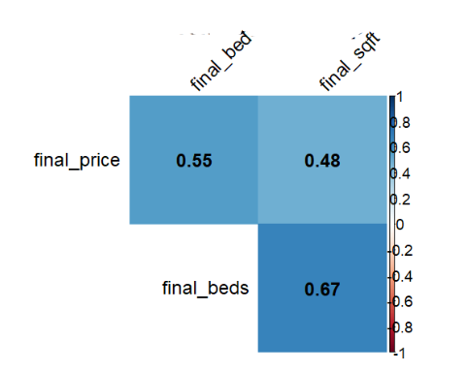
Secondary Question 1.2 — Lagged Effects on Rental Prices
Method: Cross-correlation analysis
Resuts: Found a 3-6 month delay in rental price response to rate changes
Implication: Interest rate changes influence rental prices with delay
Notes:
We also did a cross-correlation analysis, where we examined whether rental prices respond with a delay following interest rate adjustments. Our findings point to a lag of approximately 3 to 6 months, meaning that the market takes some time to adjust to monetary policy changes. This insight emphasizes the importance of considering time delays when evaluating policy impacts.

Slide 15
Summary — Q1 Findings
Short-term interest rate shifts did not significantly predict rental inventory
Rent prices show delayed response (3-6 months)
Market driven more by local factors and supply surges
Notes:
In summary, short-term interest rate shifts did not significantly predict rental inventory. Rent prices show delayed response (3-6 months). Instead, local supply surges and migration trends played a more prominent role.

Slide 16
Research Question 2 — Property Features & Rent Prices
Method: Multiple linear regression
Method: Multiple Linear Regression. final_price ~ final_beds + final_sqft + segment.
Notes:
gurm

Slide 17
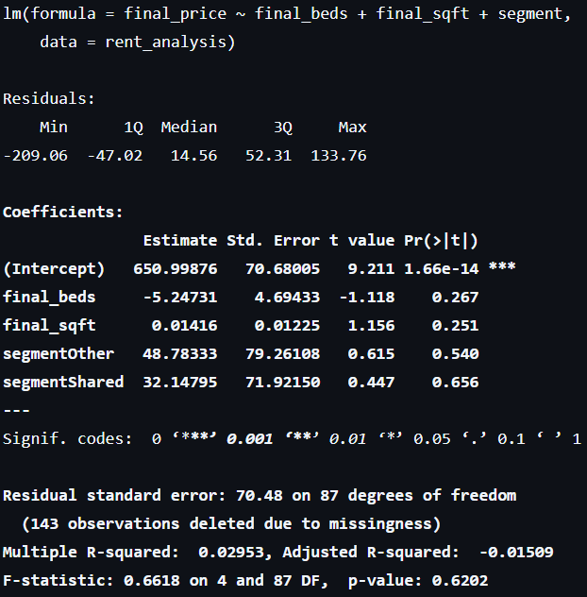
Results for Q2 — Property Features & Rent
Model 2 – The Property Feature Pricing Model
Final Price=650.99876−5.24731×Final Beds+0.01416×Final SqFt+48.78333×SegmentOther+32.14795×SegmentShared+ϵ
Variables: number of bedrooms, property size, property type (segment)
Coefficients:
Beds: -$5.25 (not significant, p > 0.05)
SqFt: +$0.014 (not significant)
Regression coefficients not statistically significant
Model R-squared: ~3%, indicating poor fit
F-test: p > 0.05, overall model not significant
Notes:
gurm

Slide 18
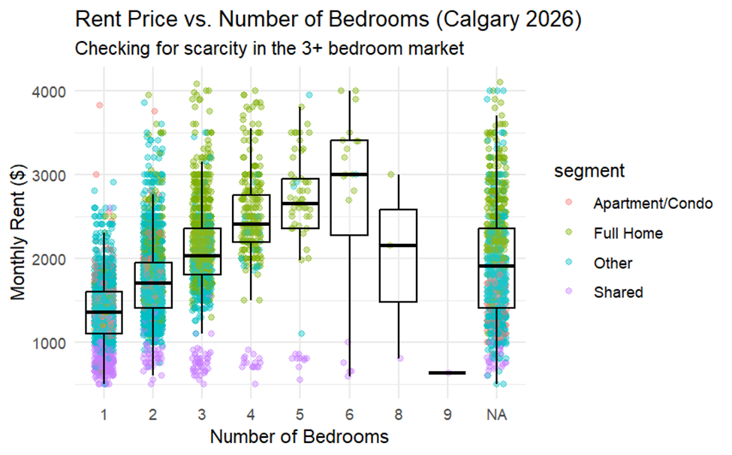
Visual — Boxplots of Rent by Bedrooms & Property Type
Median rent increases with number of bedrooms
Full homes have higher median rent than apartments/shared units
Notes:
gurm

Slide 19
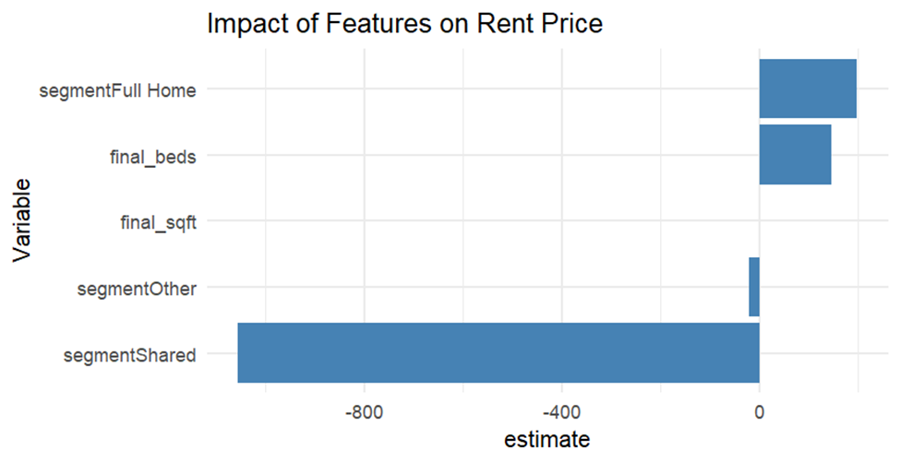
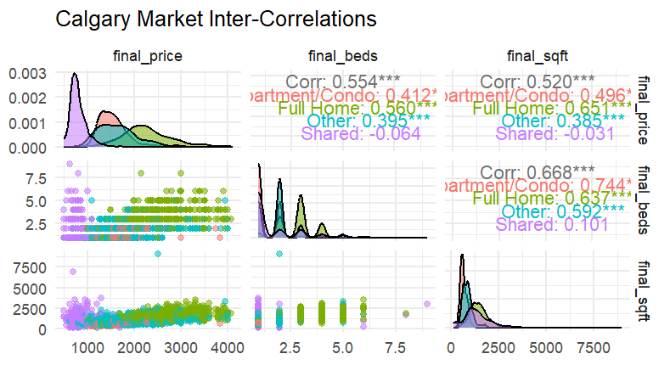
Figures – Impact of Features & Market Inter-Correlations
Notes:
gurm

Slide 20
Key Takeaway — Q2
Larger properties and more bedrooms command higher rents
However, size and bedroom count alone are weak predictors
Other factors (location, amenities) likely influential
Model
R-squared: ~3%, indicating limited predictive power
Regression coefficients not statistically significant
Notes:
gurm

Slide 21
Research Question 3 — Landlord Incentives & Market Conditions
Objective: To predict incentives based on rent and segment
Method: Logistic Regression (Binary outcome: Incentive vs. No Incentive)
Variables: rent price, property segment
Notes:
bilal

Slide 22
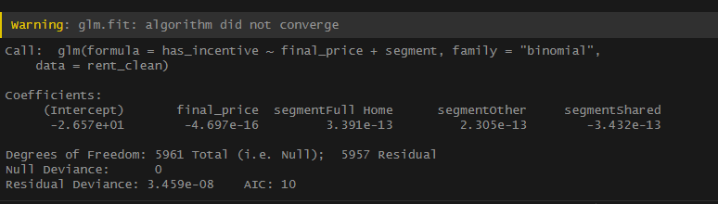
Results for Q3 — Landlord Incentives & Market Conditions The logistic regression model did not work.
Notes:
Bilal

Slide 23
Research Question 3 — Cost of additional Sq. ft. vs Property Type
Objective: Is it more expensive to have a bigger house vs condo/apartment
Linear Regression (Interaction terms): (final_price ~ final_sqft * segment)
Notes:
bilal

Slide 24
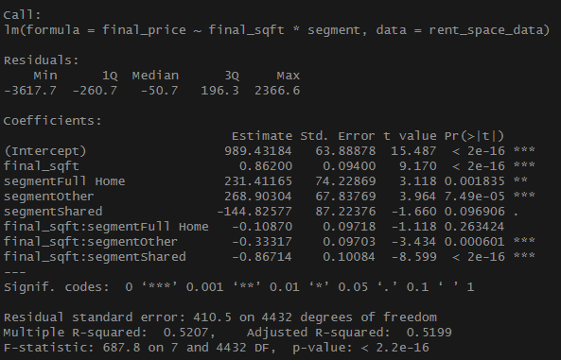
Research Question 3 — Cost of additional Sq. ft. vs Property Type
Model interpretation:
Explains roughly 52% variance.
Statistically significant(p-value < 0.05)
Starting price: Homes $231.41 higher than apt/condo.
Interaction terms:
sq ft. doesn’t affect shared rooms pricing.
Price per Sq. Ft. is lower for the ‘other category’
Only flat fee premium for homes vs apt/condo
Notes:
bilal

Slide 25
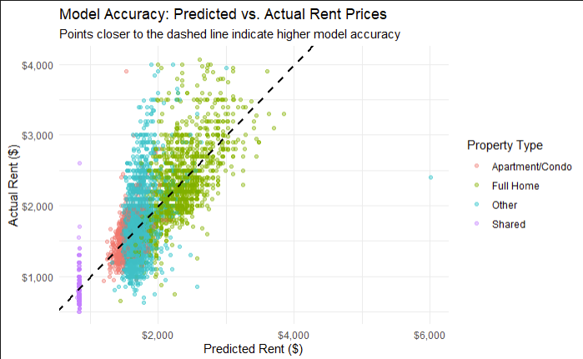
Research Question 3 — Cost of additional Sq. ft. vs Property Type
Key Observations:
Shared accommodation is predictable.
Apt/Condo - follow closely between 1-2k, model seems reliable here
Homes: Heteroscedasticity - harder to predict with Sq Ft alone as they get expensive.
Outliers:
Luxury?
Notes:
bilal

Slide 26
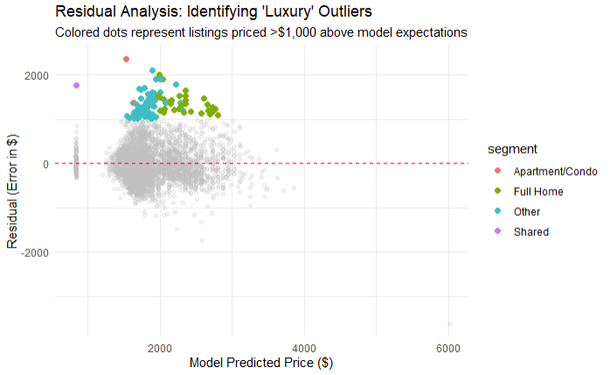
Research Question 3 — Cost of additional Sq. ft. vs Property Type
Key Observations:
108 outliers.
min price: $2,599.
Medium price $3,300.
Max price $4,075.
Notes:
bilal

Slide 27
Summary — Q3
Sq. Ft. is a statistically significant predictor.
Full homes consistent with $231 premium regardless of Sq. Ft. compared to Apartments
The Heteroscedasticity problem: As properties get more expensive, the model becomes less accurate.
The Prestige tier: 108 outliers of very expensive properties.
Notes:
bilal

Slide 28
Overall Market Insights
Segment Sensitivity: Full homes more volatile; shared units stable
Lag Effect: Rent prices respond after 3-6 months to rate changes
Market Drivers: Supply surge, property size, and segment preferences dominate
Policy Implication: Focus on increasing family-sized units and understanding delayed effects
Notes:
bilal

Slide 29
Limitations of the Study
External factors: migration, utility prices
Model assumptions: normality, multicollinearity
Snapshot data: limited to 2026, not longitudinal trends
Need for neighborhood-specific analyses
Notes:
bilal

Slide 30
Conclusions
Interest rate changes in 2026 had limited immediate impact on rental supply
Supply surge primarily driven by local factors
Rental prices are influenced with a delay, especially for larger properties
Homes cost approx $230 more than Apt/Condo - additional Sq. Ft. cost the same.
Townhomes/basement suites offer the best ‘value’ in terms Sq. Ft.
Notes:
bilal

Slide 31
Recommendations & Next Steps
Develop neighborhood GIS mapping for detailed insights
Build ARIMAX models to forecast 2027 rental trends
Incorporate additional variables: migration, utility costs
Use findings to inform housing policies, especially for family-sized units
Notes:
bilal

Slide 32
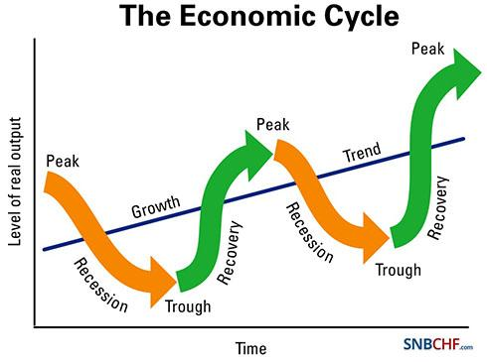
Final Remarks
"Data-driven housing policy is the only way to navigate Alberta’s boom-bust cycles."
Notes:
WIth so many variables impacting Calgary’s housing market - Data driven housing policy is the way to go
bilal

Slide 33
References
Bank of Canada. (2024). Policy interest rate. Bank of Canada. Retrieved February 20, 2026, from https://www.bankofcanada.ca/rates/interest-rates/
Canada Mortgage and Housing Corporation. (2024). Rental market report. CMHC. Retrieved February 20, 2026, from https://www.cmhc-schl.gc.ca/en/professionals/housing-markets-data-and-research
Government of Alberta. (2024). Alberta population statistics. Government of Alberta. Retrieved February 20, 2026, from https://www.alberta.ca/population-statistics.aspx
Statistics Canada. (2024). Interprovincial migration, by province and territory. Statistics Canada. Retrieved February 20, 2026, from https://www150.statcan.gc.ca/n1/daily-quotidien/220630/dq220630b-eng.htm
Notes:
bilal

