Slide 1
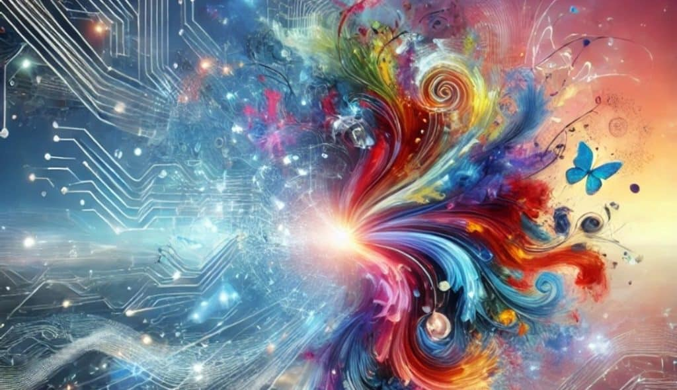
Image generation with Autoguidance
SDD 2025-2026
Baptiste Dusollier

Slide 2
Table of Contents
01
02
03
04
05
Diffusion models
Classifier-free guidance
Autoguidance
Code Demonstration
Discussion & future work

Slide 3
01
Diffusion Models

Slide 4
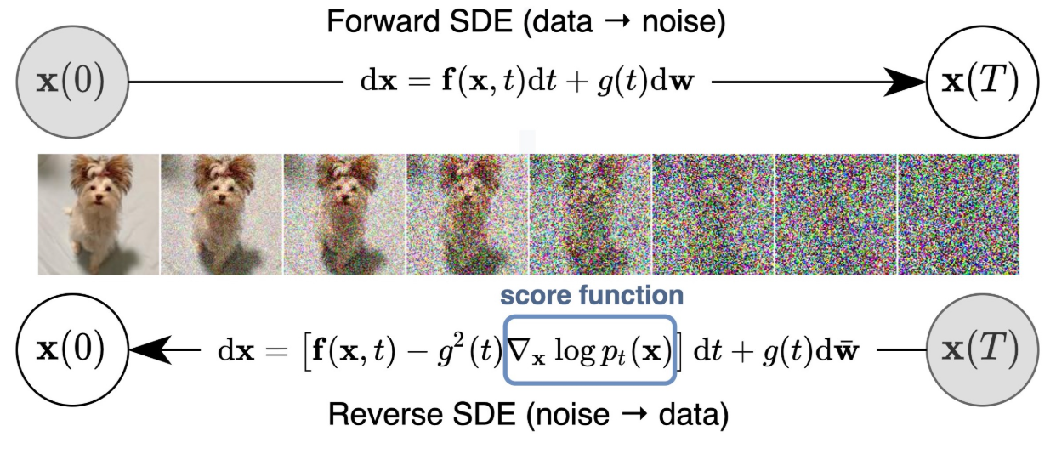


Diffusion models

Slide 5
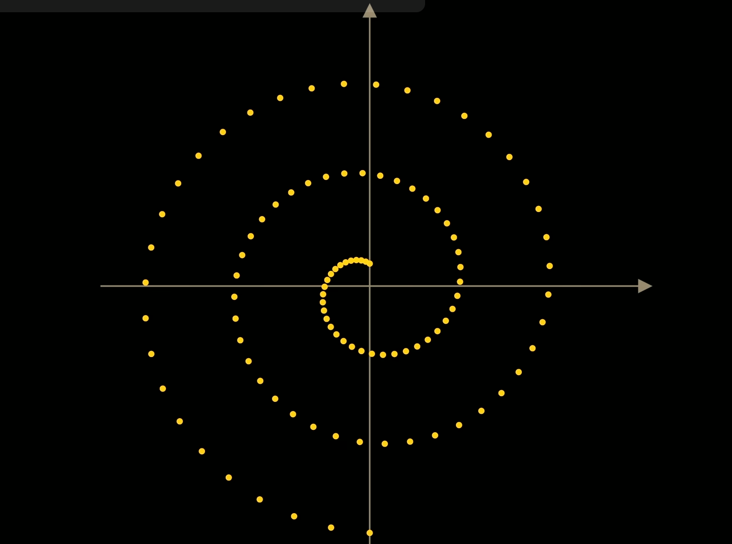
Visualization

Slide 6
02
Classifier-free guidance (CFG)

Slide 7
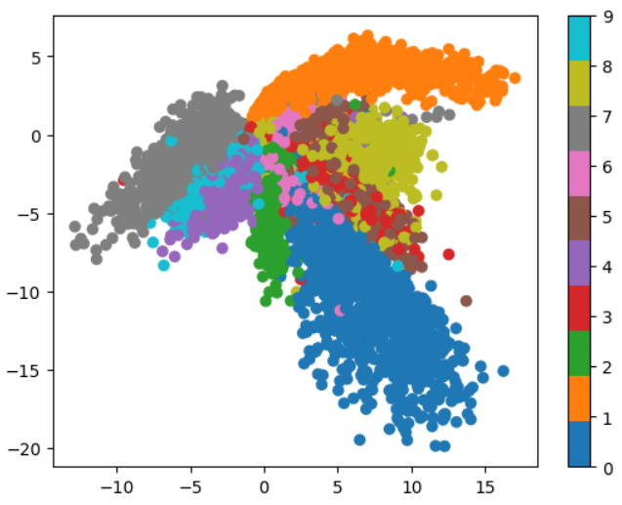


Conditioning
High probability
Low probability

Slide 8


CFG
Prompt Adherence
Improves the image quality : enhances contrast and sharpness
Loss of Diversity
Simplifies the style and layout of the image

Slide 9
03
Autoguidance

Slide 10
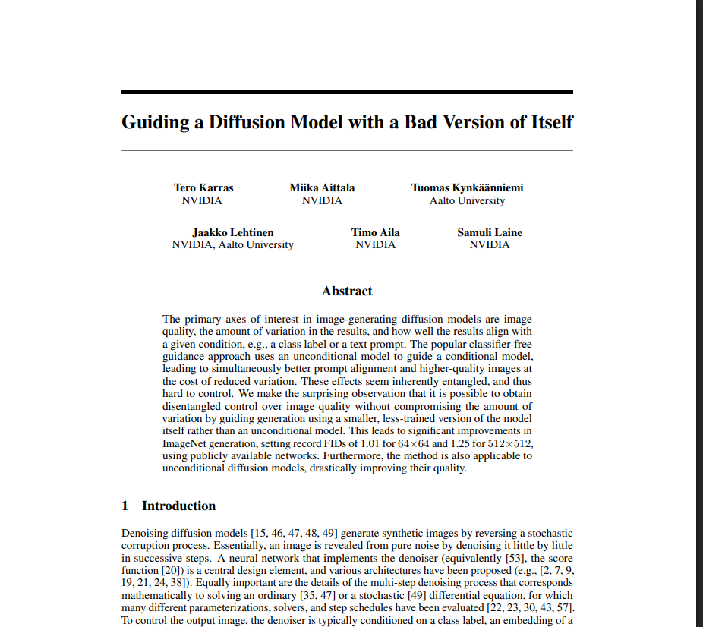
https://proceedings.neurips.cc/paper_files/paper/2024/file/5ee7ed60a7e8169012224dec5fe0d27f-Paper-Conference.pdf

Slide 11

Autoguidance
Idea : -> the model is guided with an inferior version of itself
Inferior version : Less trained (nb epochs) AND/OR less layers
BUT should have similar errors in the same regions,
2 models to train
May exhibit less prompt alignment compared to CFG.
Improves the image quality
Preserves Identity: Better at keeping the "soul" of an image intact while changing its geometry.

Slide 12
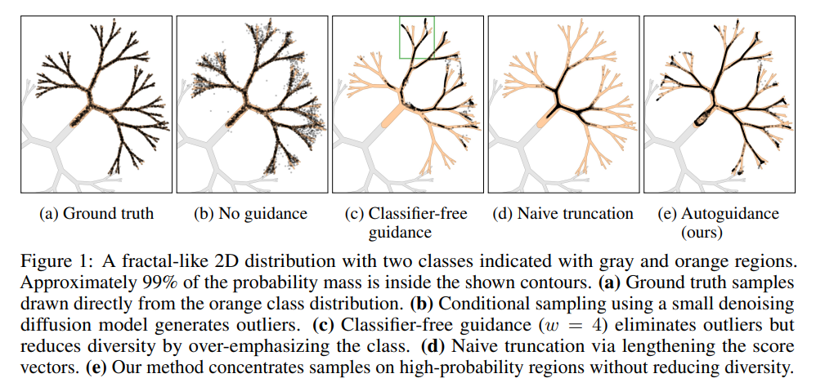

Slide 13
04
Results

Slide 14
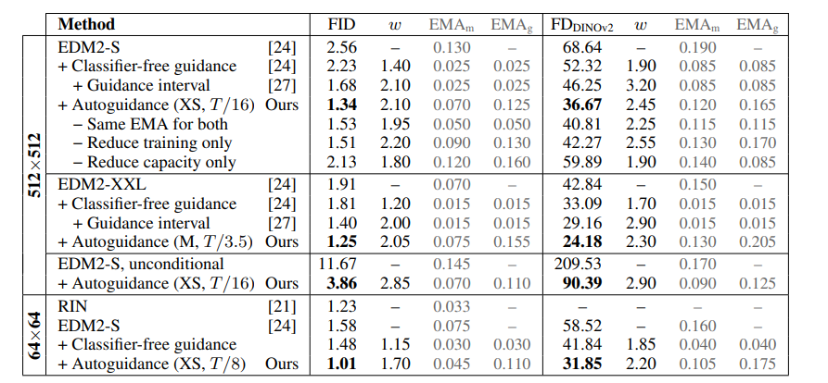
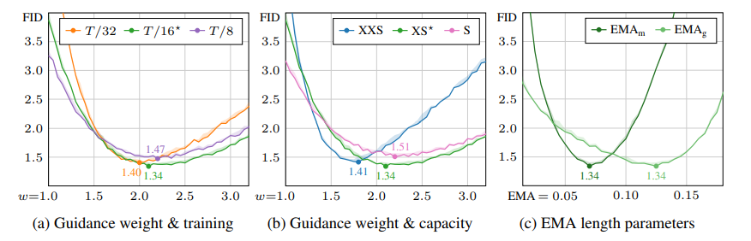
FID Score (Fréchet Inception Distance) :
metric that measures how "real" and "diverse"
AI-generated images are compared to a real dataset.

Slide 15
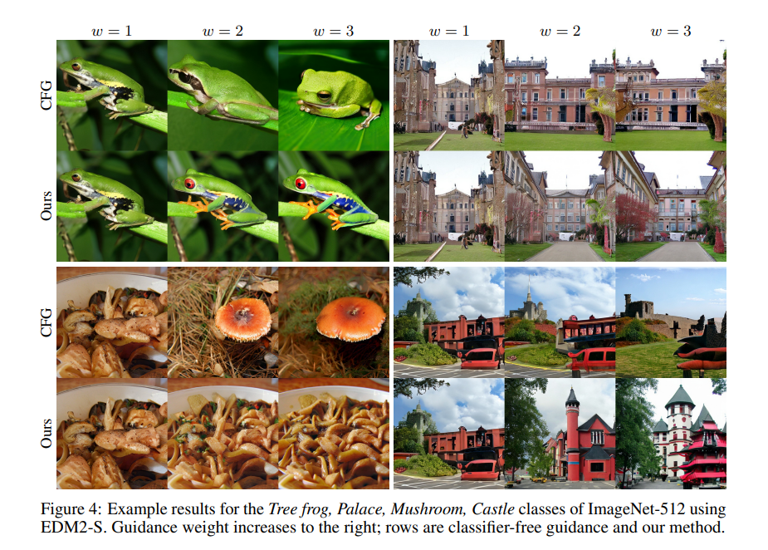

Slide 16
04
Code demonstration (cf. Notebook)

Slide 17
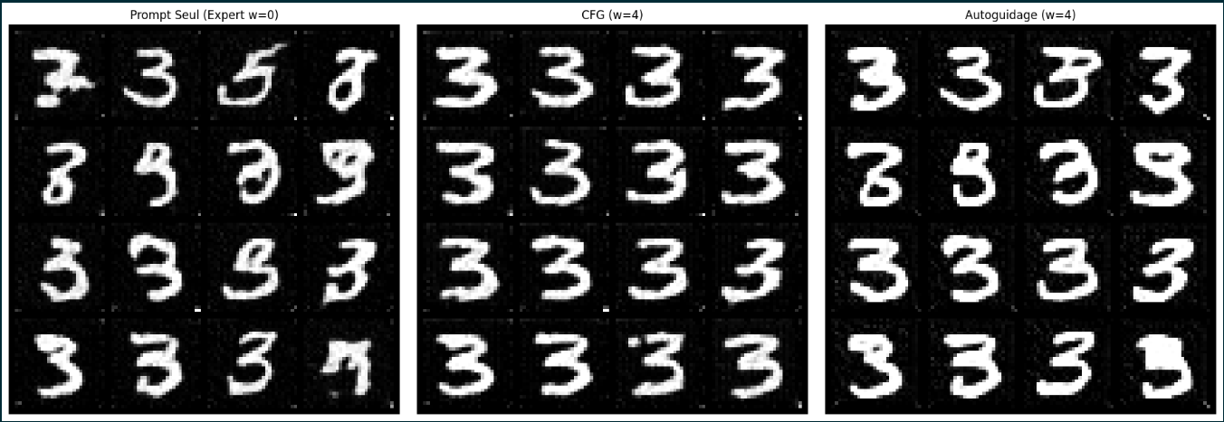
Architecture : U-Net
Sampler : Euler-Maruyama

Slide 18
05
Discussion & future work

Slide 19
Challenges & Limitations
Snapshot Availability: Using early snapshots of smaller models is ideal but rarely available for current large-scale generators.
Distribution Shifts: Successive training stages with changing data can cause shifts between snapshots, potentially violating model assumptions.
Future Directions
Selection Rules: Developing rules to automatically select the optimal guiding model.
New Metrics: Using Human Preference Scores or PickScore to further isolate the origins of image quality improvements.
Hybrid Methods: Studying combinations of autoguidance with other techniques like attention perturbation or noise-dependent schedules.

Slide 20
Resources
NeurIPS Paper (2024): Karras, T., Aittala, M., Kynkäänniemi, T., Lehtinen, J., Aila, T., & Laine, S. (2024). Guiding a Diffusion Model with a Bad Version of Itself. In Advances in Neural Information Processing Systems 37 (NeurIPS 2024). Retrieved from https://proceedings.neurips.cc/paper_files/paper/2024/file/5ee7ed60a7e8169012224dec5fe0d27f-Paper-Conference.pdf
ArXiv Paper (2025): Lai, C.-H., Song, Y., Kim, D., Mitsufuji, Y., & Ermon, S. (2025). The Principles of Diffusion Models. arXiv preprint arXiv:2510.21890. Retrieved from https://arxiv.org/abs/2510.21890
YouTube Video: Welch Labs. (2024, July 25). But how do AI images and videos actually work? | Guest video by Welch Labs [Video]. YouTube. Retrieved from https://www.youtube.com/watch?v=iv-5mZ_9CPY (Featured on the 3Blue1Brown channel).

Slide 21
Thanks!

