Slide 1
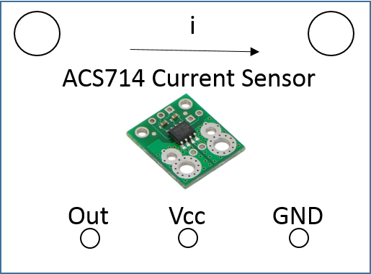
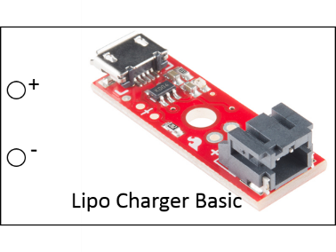
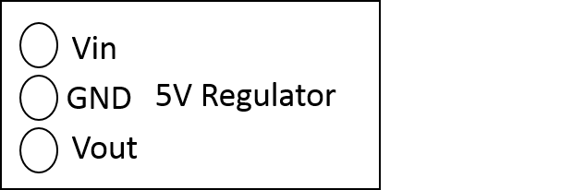
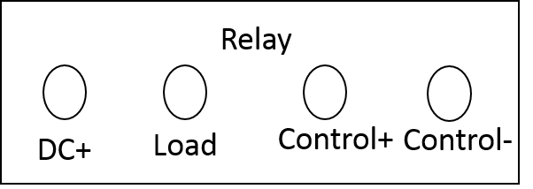
Bat 3.7-4.2V
Due Vin
Due I/O Pin
Due 5V
Due Control Pin
5V High current line
Batt GND
Due GND

Slide 2
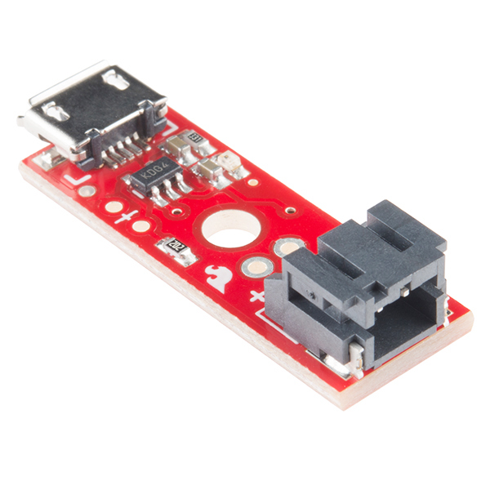
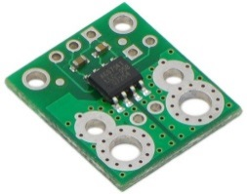
Vin
WW
GND
Vout
+
-
Lipo Charger Basic
i
Relay
ACS714 Current Sensor
DC+
Load
Control+
Control-
Out
Vcc
GND

Slide 3
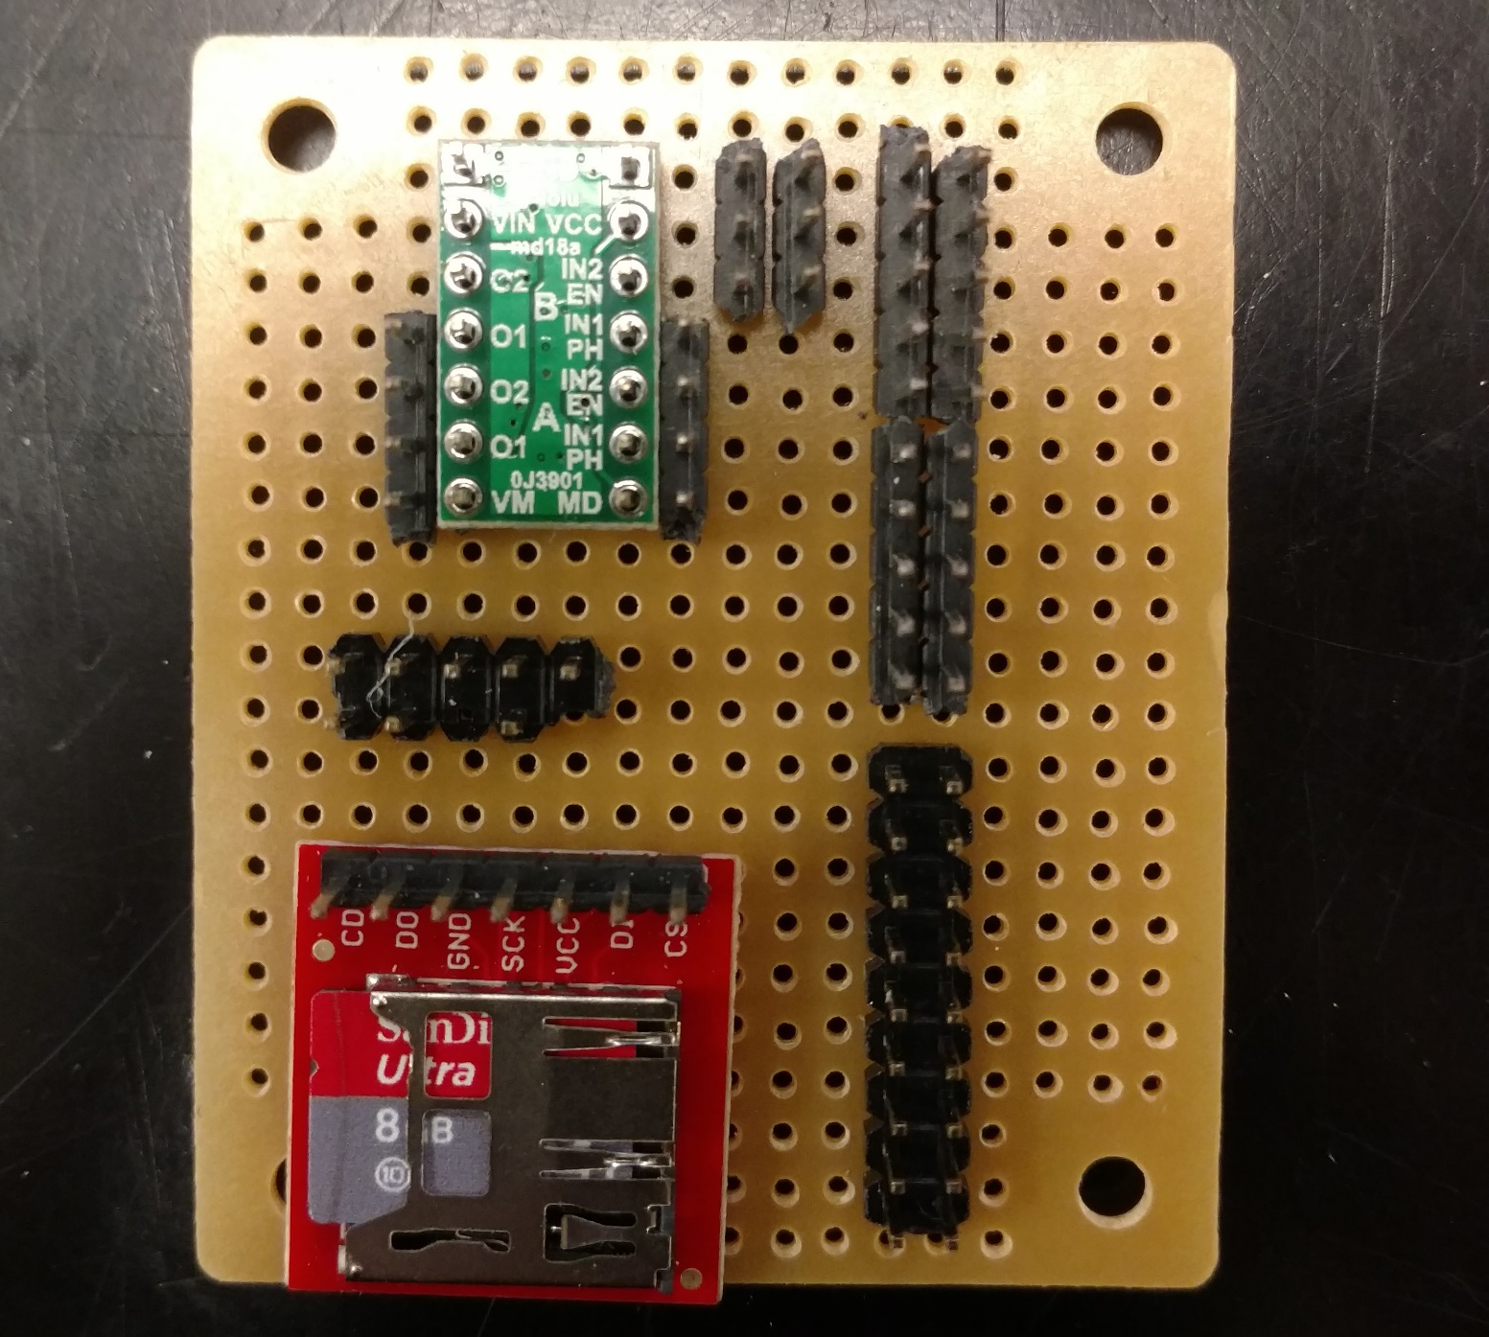
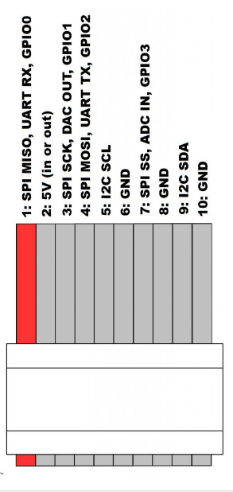
5V High Current
GND Due
GND
5V Due
3.3V Due
Due Pin 4

Slide 4
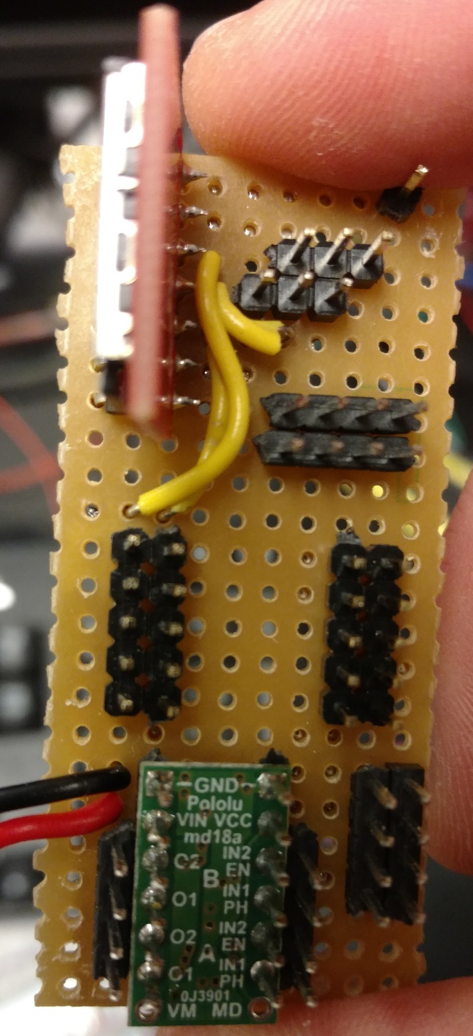
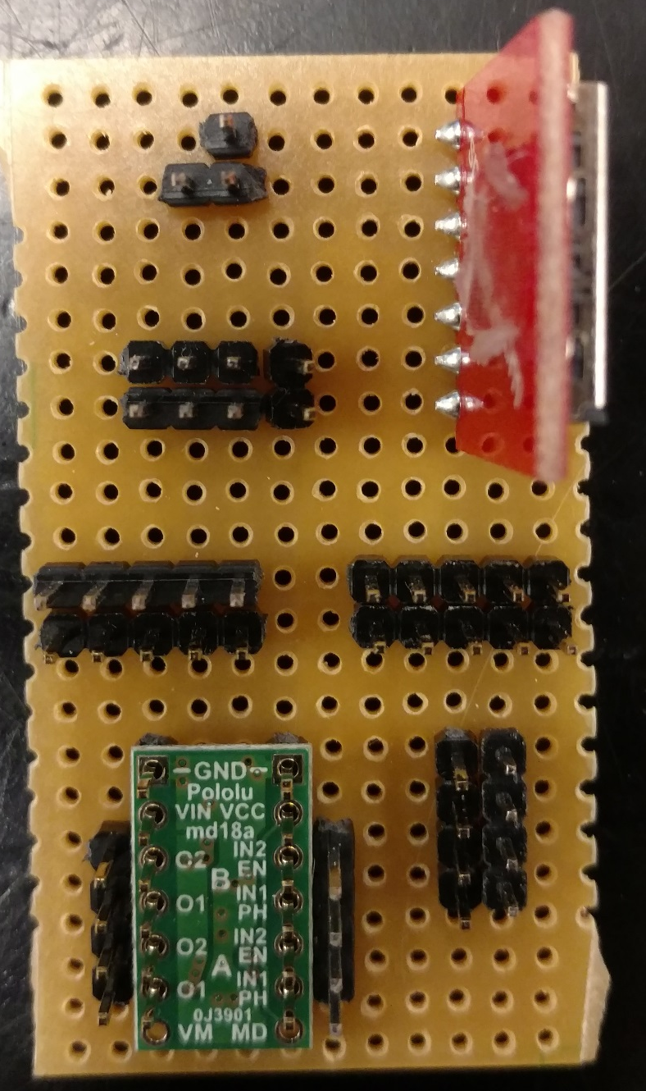
1 2
3 4
5 6
7 8
9 10
SPI Ribbon - Chip Reader:
1 – D0
3 – SCK
4 – D1

