Slide 1
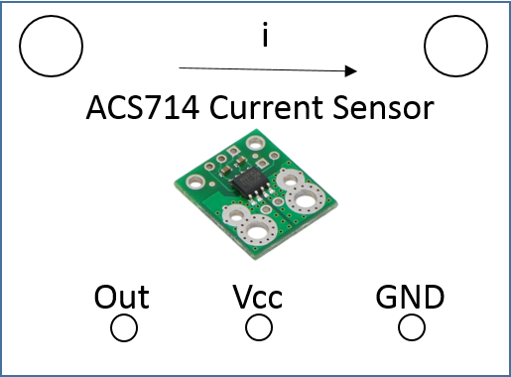
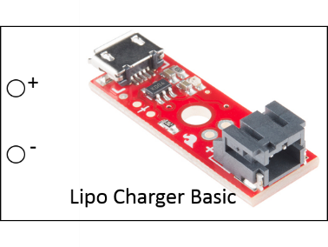
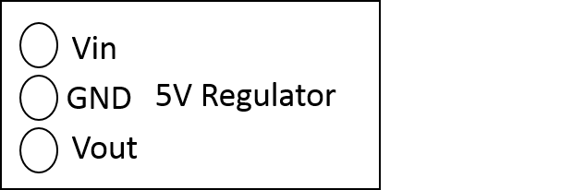
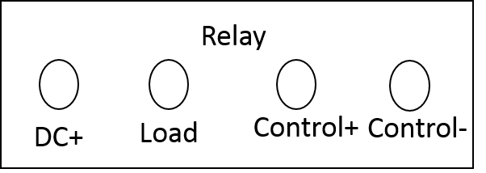
Bat 3.7-4.2V
Due Vin
Due I/O Pin
Due 5V
Due Control Pin
5V High current line
Batt GND
Due GND

Slide 2
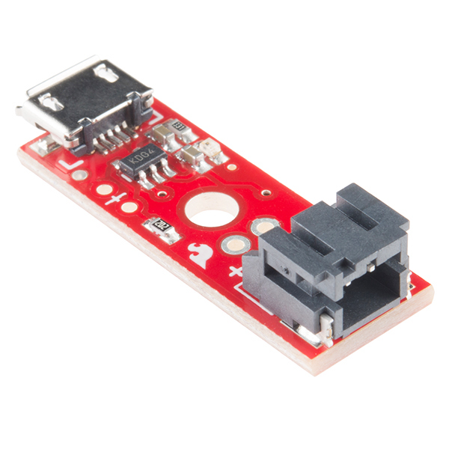
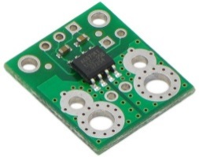
Vin
WW
GND
Vout
+
-
Lipo Charger Basic
i
Relay
ACS714 Current Sensor
DC+
Load
Control+
Control-
Out
Vcc
GND

Slide 3
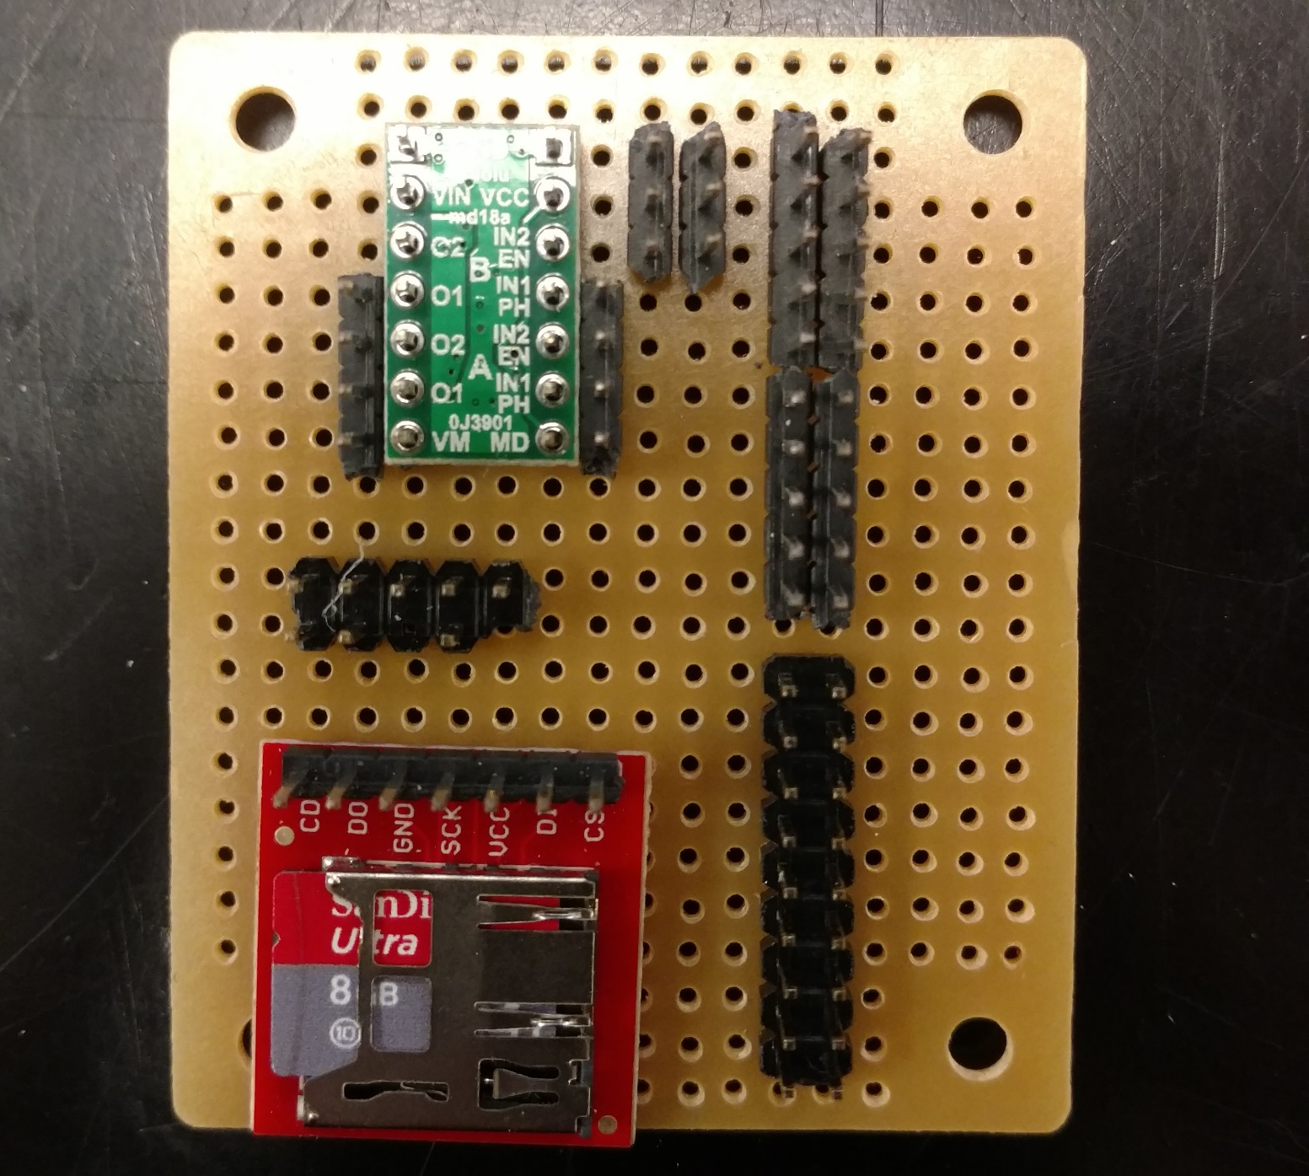
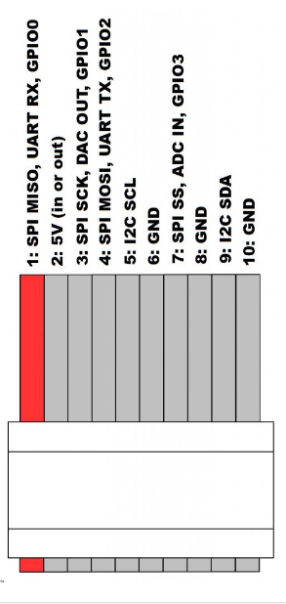
GND Due
GND
5V Due
5V High Current
3.3V Due
Due Pin 4

