Slide 1
How to run ant digger robots
QuickStart Guide

Slide 2
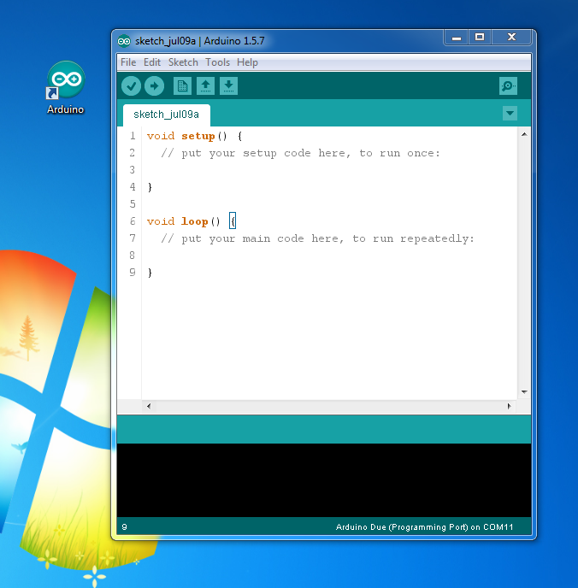
About Arduino IDE
Can be opened by clicking Can this icon
This button will compile the current C/C++ code and check for errors
This button will compile and upload current code to the connected Arduino board

Slide 3
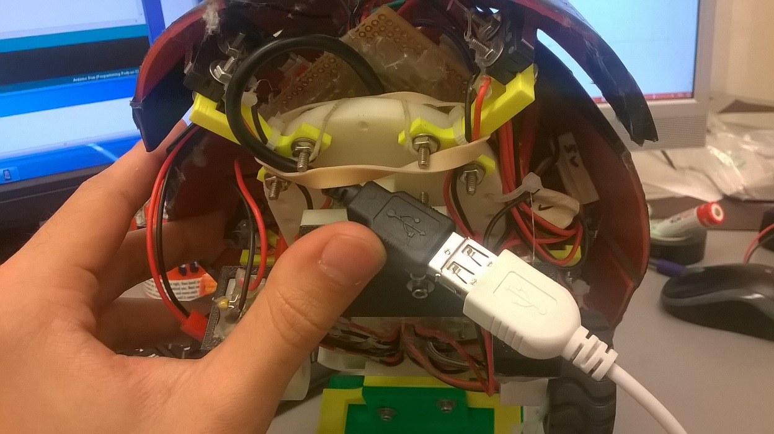
Connecting Arduino to PC
USB Cable connected to Arduino DUE
Look for a male USB connector underneath the robot. Use a USB extension cable
USB extension cable, goes to PC USB port

Slide 4
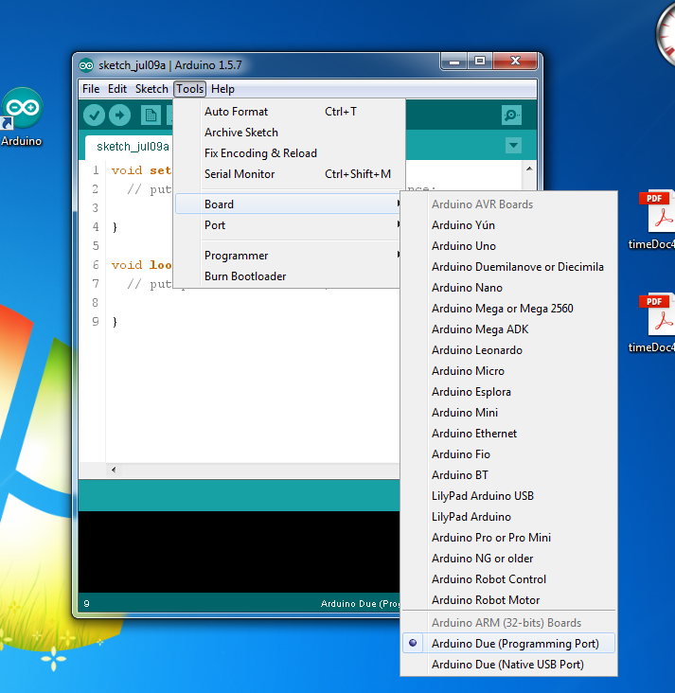
Set up Arduino IDE to properly talk to robot
Go to Tools > Board > Arduino Due (Programming Port). We need to tell the IDE which board is connected so that the code can be properly compiled. It should say “Arduino Due Programming Port” here when done.

Slide 5
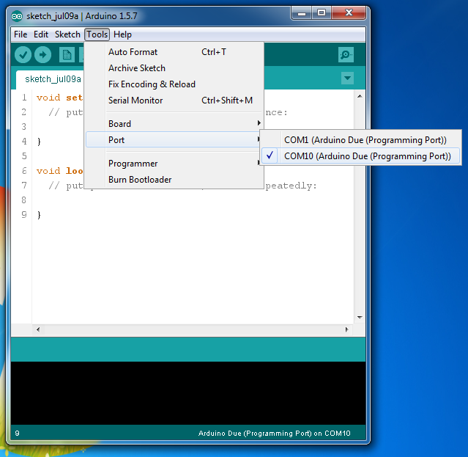
Check if PC sees your board on COM port
Go to Tools > Port >
Look for a COM port (not COM 1)

Slide 6
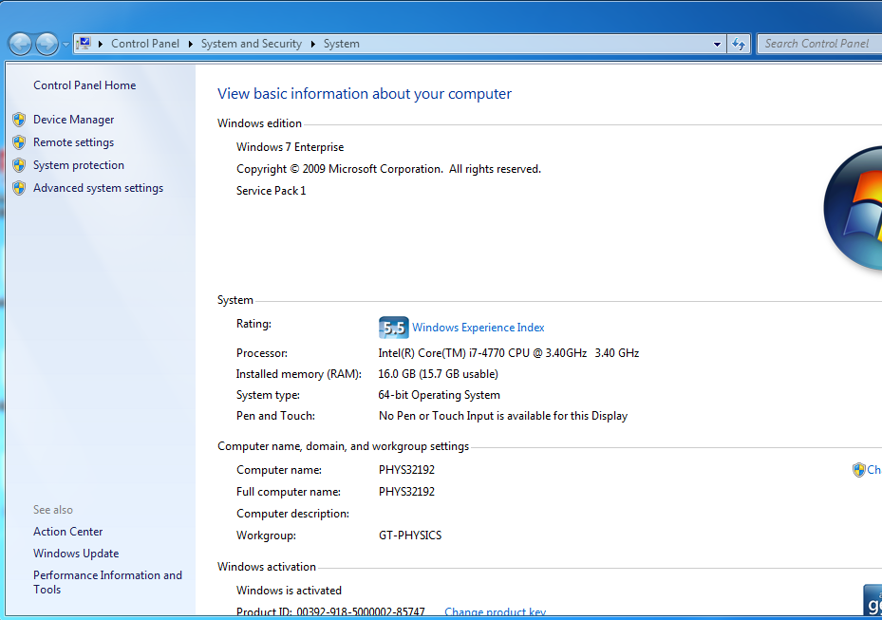
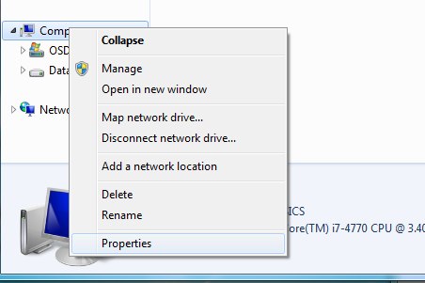
Not sure which COM port?
STEP 2
Click on Device Manager
STEP 1
Go to Device Manager. In the explorer, left click on computer > Properties

Slide 7
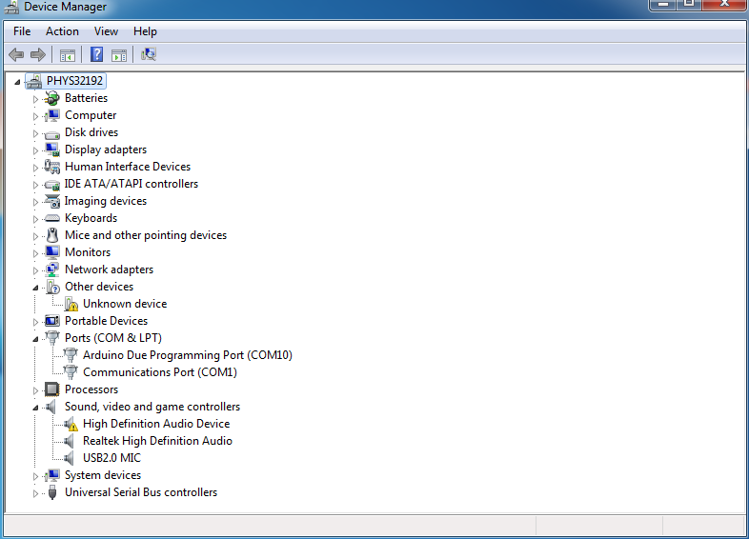
Not sure which COM port?
STEP 3
Look for your Arduino Board

Slide 8
If the Arduino Doesn’t show up on the COM
Unplug the USB connection from the computer, plug it back again.
Try it several times, it will work.
If not, drivers may be corrupted and will need to be reinstalled. Very unlikely. Refer to forums. (Maybe ill add a tutorial later)

Slide 9
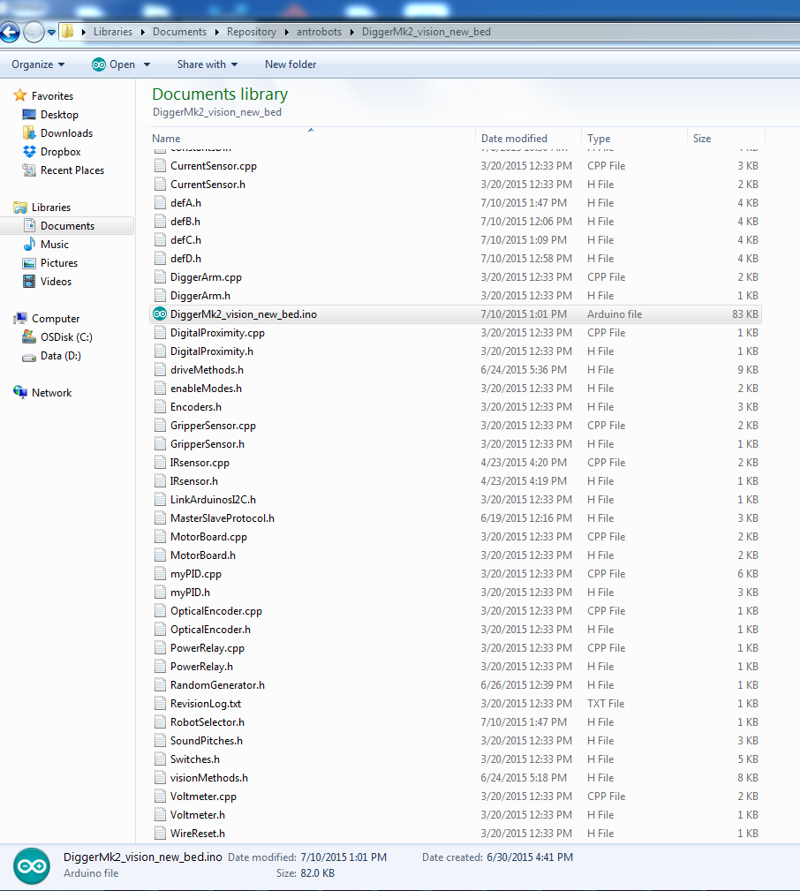
Uploading a code to the robot
Go to Documents > Repository > antrobots > DiggerMk2_vision_new_bed folder
Find DiggerMk2_vision_new_bed.ino file. There should be only one file with .ino extension. Open it.

Slide 10
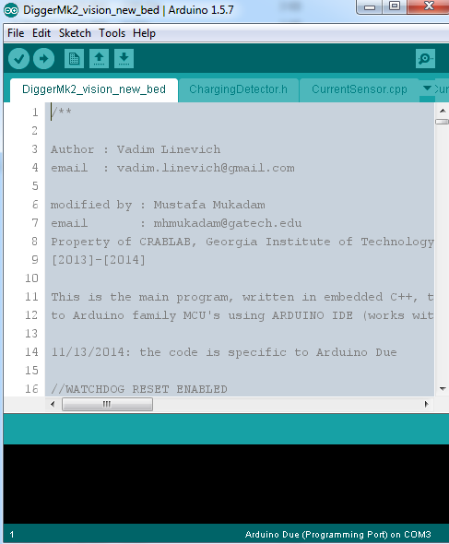
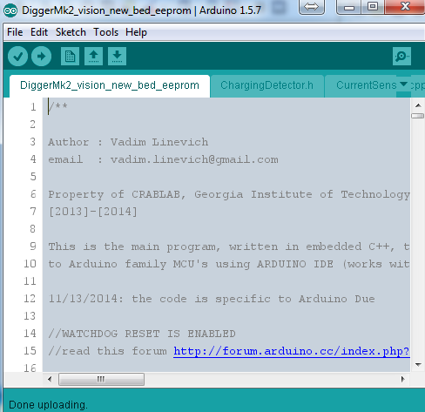
You should see this window
Note how the canvas is grayed out. This is because in the File> Preferences “use external editor” option is enabled. This prevents us from using Arduino IDE itself to edit the code and just use the IDE to compile and upload code
Since the, I code is long and complicated suggest using Notepad++. Its easier and more convenient to navigate around
Having external editor option checked will make sure that the code is reloaded into the IDE from the disk before compilation
For Lorenz+hold switch key when start

Slide 11
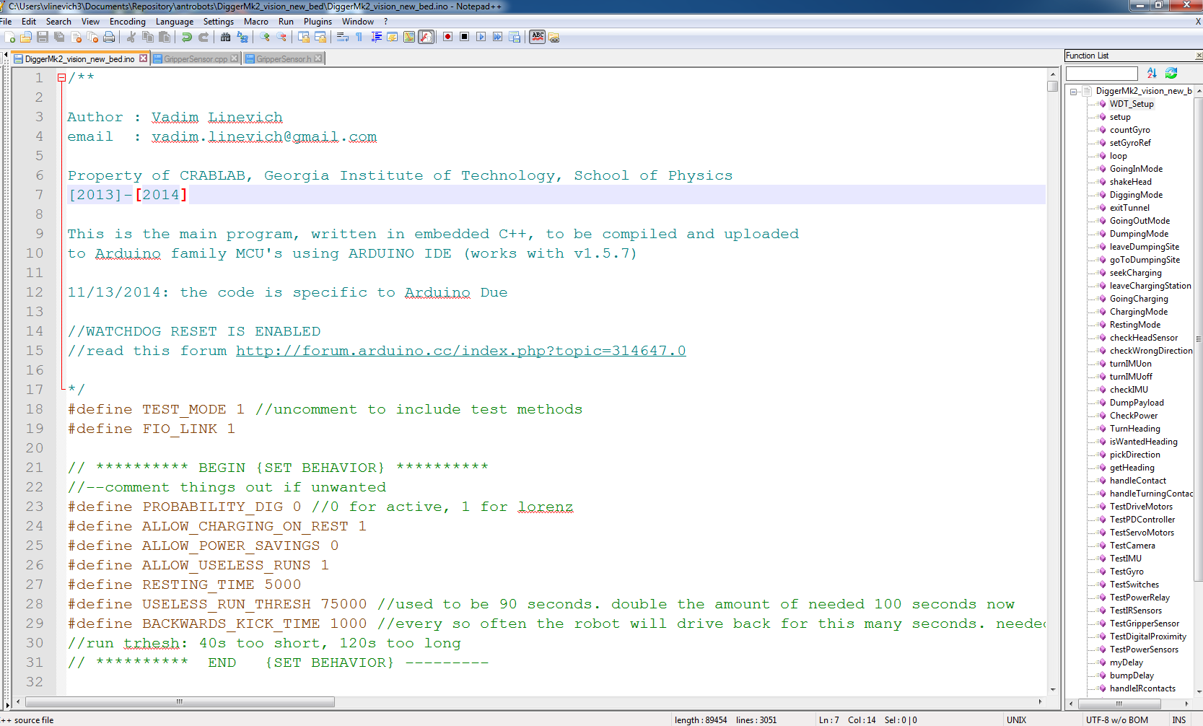
I like editing the main code (DiggerMk2_vision_new_bed.ino) with Notepad++, that’s why I have a check box “use external editor” enabled in the Arduino IDE.
If you open the main file with Notepad++, you should see something like this
My contact info

Slide 12
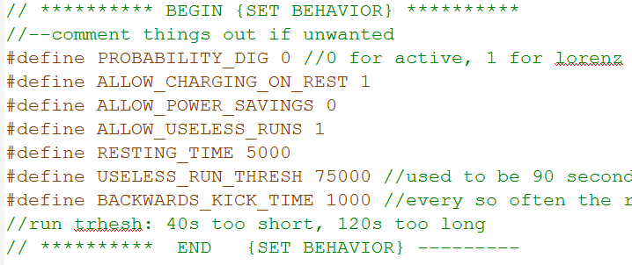
This is probably the only thing that you may want to tweak

Slide 13
Each robot has a set of its own configuration files: “constantsX.h” and “defX.h” where X could be A,B,C,D (to represents four robots named A,B,C, and D).
“def.h” tells the software how the hardware and sensors are connected, plus some convenience macros. Don’t worry about(or mess with) these unless you really know what you are doing.
“constants.h” contains various tunable constants. For example, it will tell the robot compass directions, PID controller gains, base velocity and such. This is where you would set Lorenz probability distributions. I would not recommend to mess with anything else.

Slide 14
How to program a robot
Establish a USB connection with a robot and figure out which COM port its connected to
This robot was set to connect to COM10

Slide 15
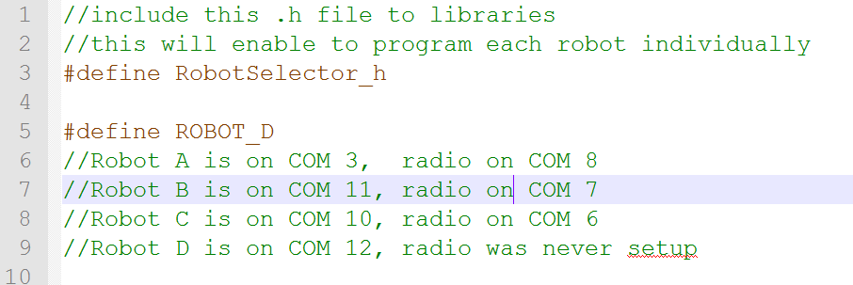
Now open RobotSelector.h and look for a robot name which matches given COM port name
COM 10 implies that we need to change line 5 to
#define ROBOT_C
Once you select (or define) a correct robot, SAVE this file.

Slide 16
If you have Probability Digging enabled (#define PROBABILITY_DIG 1 ), set correct probabilities for each robot that you are programming. This is done in “constantsX.h” file.
GO_DIG_PROB specifies a probability chance (in percent) for a robot to go dig after making a deposit. Make sure that GO_DIG_PROB + GO_REST_PROB = 100

Slide 17
When done press upload button

Slide 18
Modified Lorenz
1) Small switch to start logging data
2) Large switch to give power to the robot
3) Wait until head moves
4) Press white reset button (the robot will loose power and the camera light will restart)
5) Wait for the head to move again
6) Hold dumping switch
7) Wait for the light on the camera to go off
8) Release the switch

