Slide 1
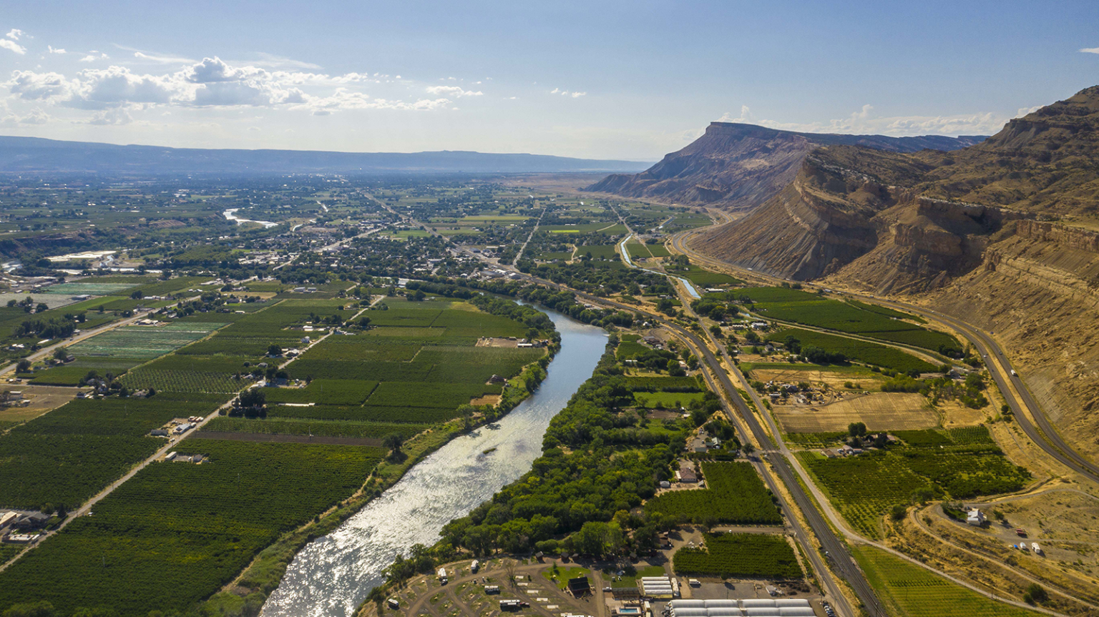

NextGen Research DataStream (NRDS):
Community Contributions Towards Improved Hydrologic Predictions
Lynker: Jordan J. Laser, Zachary Wills, Nels Frazier
Alabama Water Institute: Arpita Patel, Sai Harsha Vemula
Colorado River District/Courtesy photo

Slide 2
"This research utilized AWS resources managed by CIROH Cyberinfrastructure,
supported by the Cooperative Institute for Research to Operations in Hydrology (CIROH) with
funding under award NA22NWS4320003 from the NOAA Cooperative Institute Program. The
authors appreciate support from the CIROH Cyberinfrastructure team. Learn more:
https://docs.ciroh.org/docs/services/intro"
Colorado River District/Courtesy photo

Slide 3
Big thanks to Jordan Laser,
this is mostly his presentation.
I’ve just thrown some fun sprinkles on top.
Colorado River District/Courtesy photo

Slide 4
Road Map
NRDS motivation
NRDS design
Current NRDS State
DatastreamCLI
Future for the NRDS
Colorado River District/Courtesy photo

Slide 5
NRDS Motivation
Need for regionalized parameterization and modeling
Within the NextGen Framework, models and parameters can be configured at any scale, even for each catchment.
Cloud providers offer a cost-effective alternative to purchasing and maintaining expensive on-premise hardware.
The Research DataStream is written in Terraform and made publicly available.
High on-premise cost of HPC
Research 2 Operations
The Research DataStream is open to community contributions.
An evaluation workflow is under development to ensure continued improvement of the system.
Colorado River District/Courtesy photo

Slide 6
Water
NRDS Design: Forecast Configuration
CONUS wide
Distributed processing by Vector Processing Unit (VPU)
Regional hydrologic processes map to compute resources
Outputs are delineated by VPU
Mimic NWM forecast cycles
Short range (18 hourly time steps) 24 times per day
8 ensemble medium range (240 hourly time steps) 4 times per day
Analysis assim extend (28 hourly time steps) 1 per day
Publicly available and editable NextGen configuration files
Automated evaluation drives improvement(in development).
Contributions accompanied by automated workflows
Colorado River District/Courtesy photo

Slide 7
Water
NRDS Design: Current State
VPUs available : 02, 03N, 03S, 03W, 04, 05, 06, 08, 09, 10L, 10U, 11, 12, 13, 14, 15, 16, 18
(05, 10L, 10U, 11 not available for medium range)
Complete!
Run Types –
short range (all initialization cycles),
medium range (all cycles, 1st member),
analysis assim extend
Cold start
NextGen configuration - NOAH-OWP, PET, CFE, and troute.
Dynamically read on each execution from publicly available realizations that now hold mutable community parameters.
Colorado River District/Courtesy photo

Slide 8
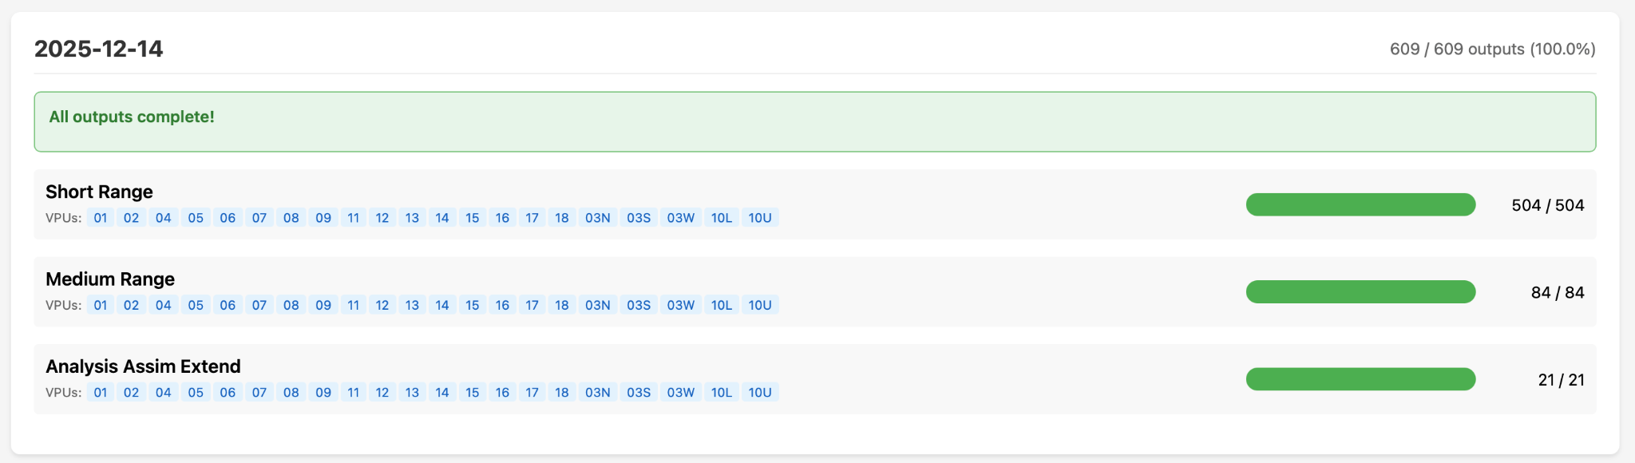
Water
NRDS Status
https://ciroh-community-ngen-datastream.s3.amazonaws.com/status/dashboard.html
Colorado River District/Courtesy photo

Slide 9
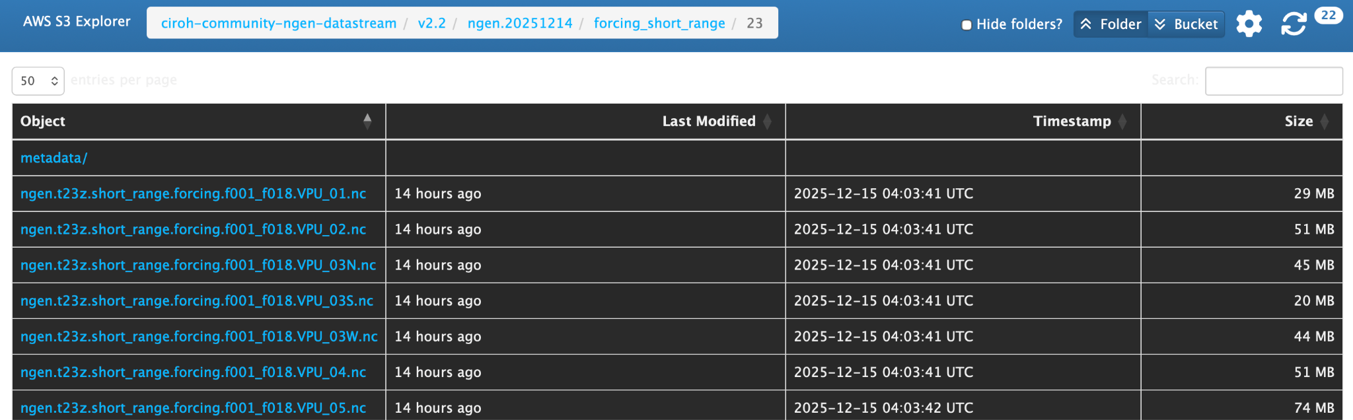
Water
NRDS
Forcings Available
https://datastream.ciroh.org/#v2.2/ngen.20251214/forcing_short_range/23/
Colorado River District/Courtesy photo

Slide 10
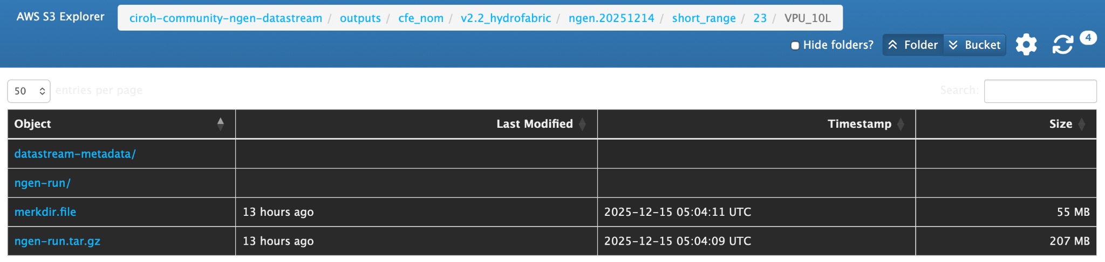
Water
NRDS
Configurations, Parameters, and Outputs Available
https://datastream.ciroh.org/#outputs/cfe_nom/v2.2_hydrofabric/ngen.20251214/short_range/23/VPU_10L/
Colorado River District/Courtesy photo

Slide 11
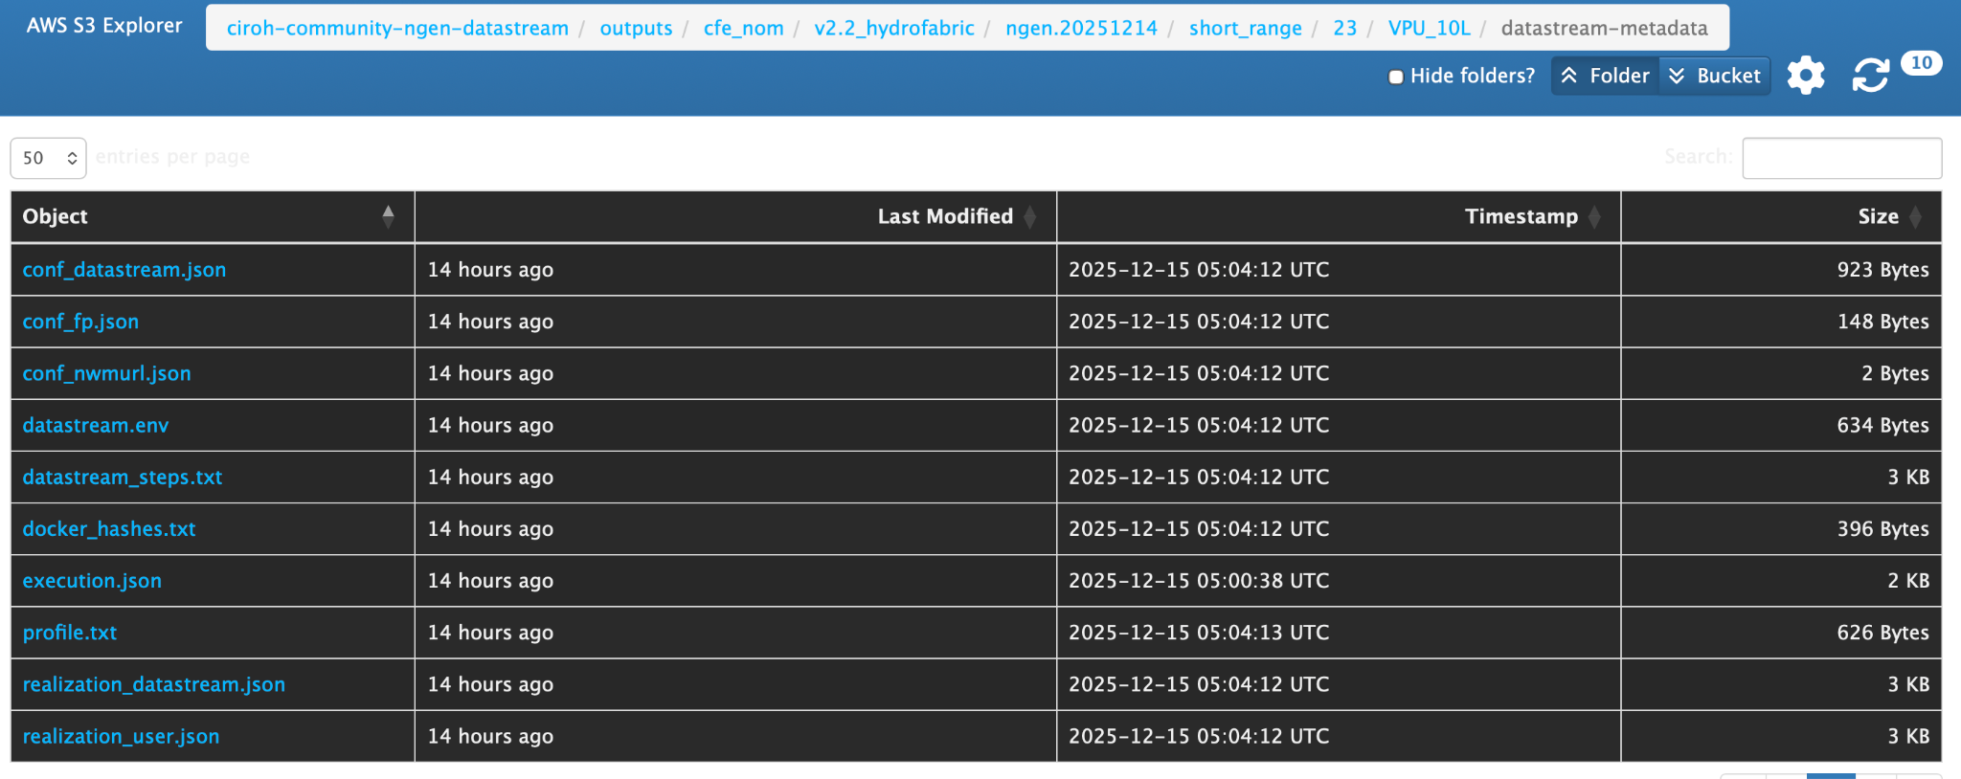
Water
NRDS
Completely Reproducible, with Benchmark
Colorado River District/Courtesy photo

Slide 12
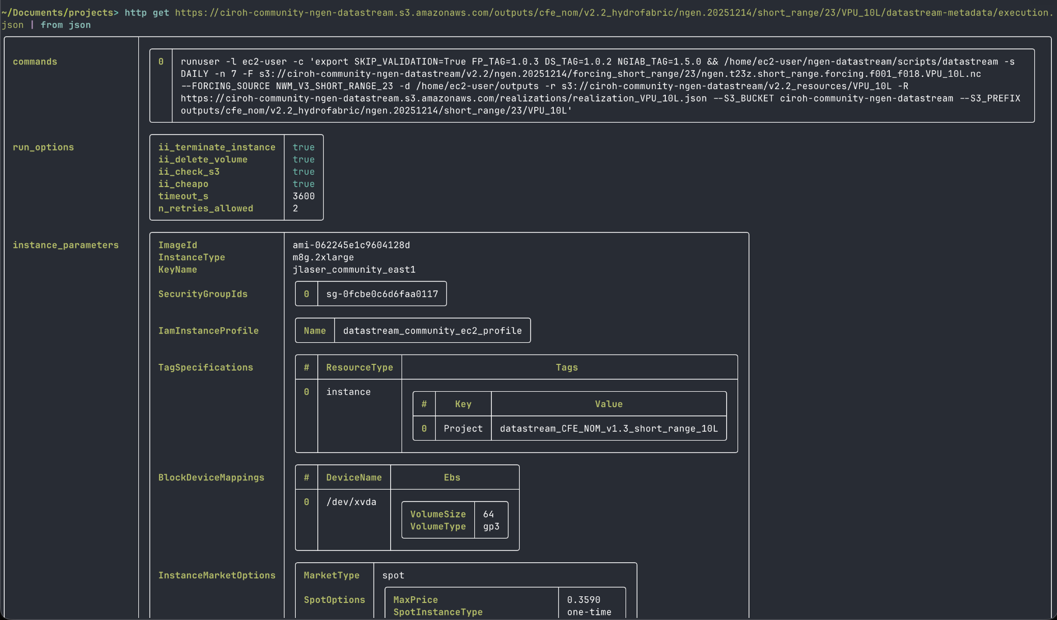
All metadata to recreate all AWS runs also works locally with the same commands using DatastreamCLI.

Slide 13
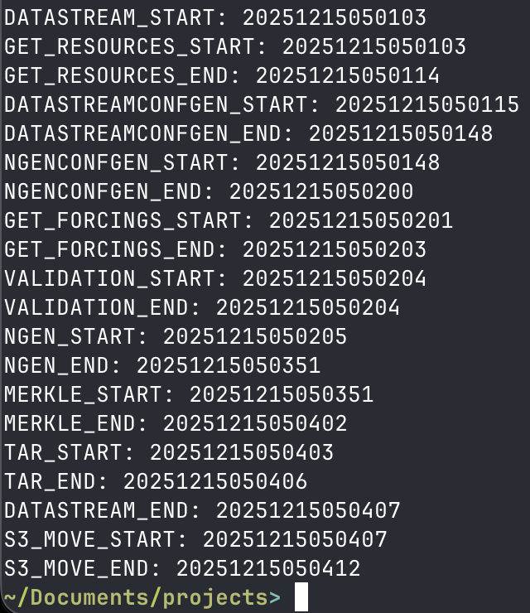
All metadata to recreate all AWS runs also works locally with the same commands using DatastreamCLI.

Slide 14
DataStreamCLI Motivation
DataStreamCLI will perform every step required in executing NextGen. The user can compute steps separately and provide those files directly.
*Batteries included but flexible*
Workflow that abstracts the laborious process of collecting input data and executing NextGen
DataStreamCLI established the NextGen In A Box standard run directory.
Metadata – all relevant information about user inputs, code versions, host architecture, etc. so that a NextGen execution can be understood and reproduced.
Reproducibility
Need baseline NextGen dataset to evaluate new realizations against
Scaling from laptop to HPC
DataStreamCLI can scale from a laptop to the cloud. DataStreamCLI performs the on-server workflow that drives the NextGen Research DataStream.

Slide 15
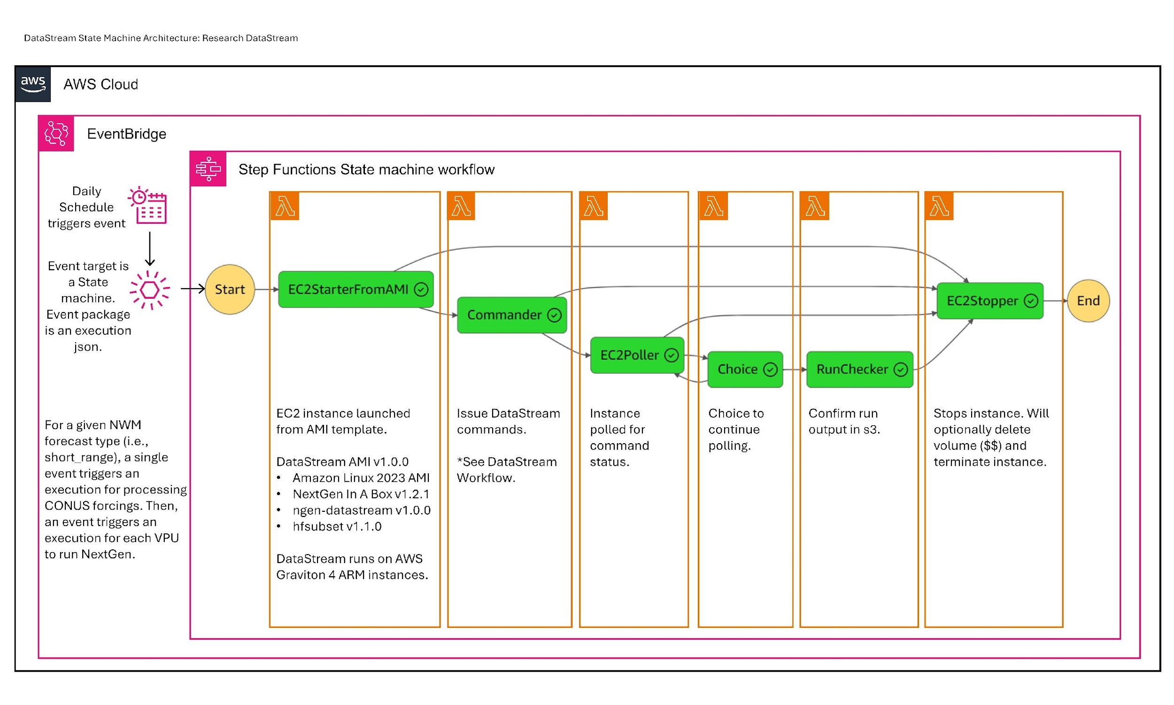
Water
NRDS Design: AWS Infrastructure
Orchestration - accomplished via AWS State Machine
Scheduling - accomplished via AWS Event Bridge Schedules
On-server workflow – DataStreamCLI, NGIAB, and forcingprocessor
Colorado River District/Courtesy photo

Slide 16
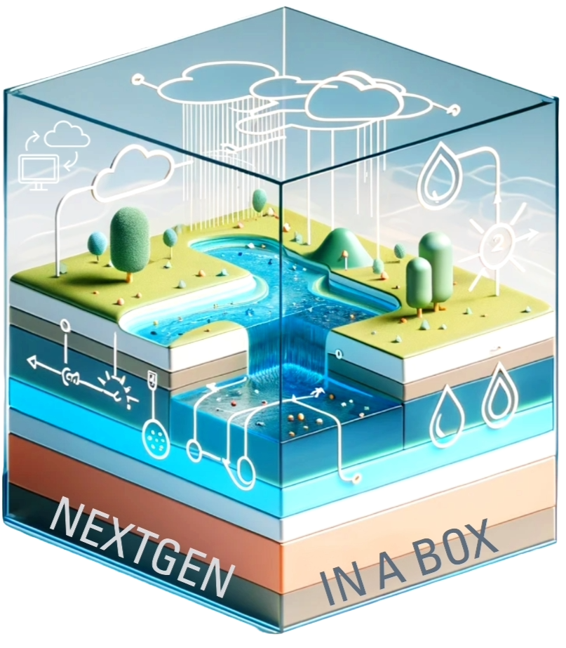
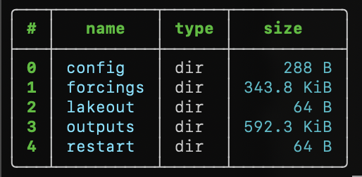
3
Prepare configuration and data inputs
Validation
Merkle Tree
1
2
4
DataStreamCLI
DataStreamCLI refers to the software chain that builds and validates NextGen input packages (ngen-run/), executes NextGen through NextGen In A Box (NGIAB), and versions the entire run for reproducibility.
ngen-run/
This enforces a standard folder (ngen-run/), which enables interoperability and reproducibility.

Slide 17
Required steps to build ngen-run/config and ngen-run/forcings
Prepare configuration and data inputs
1
These are provided by forcingprocessor, a modular and separate project at AWI.
LynkerSpatial
Hydrofabric
Weights
Forcings
NEXTGEN BMI model configuration
GET
CALC
CALC
CALC
Defines spatial domain
Indices and coverage used to extract catchment averaged forcings. Calculated by exactextract.
Performs conversion between National Water Model and NextGen forcings formats
Required files for NextGen BMI modules
ngen-run/

Slide 18
Prepare configuration and data inputs
1
Hydrofabric
Weights
Forcings
GET
CALC
CALC
Defines spatial domain
Indices and coverage used to extract catchment averaged forcings
Performs conversion between National Water Model and NextGen forcings formats

Slide 19
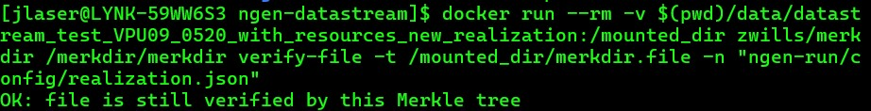
Versioning
Merkle Tree based hashing algorithm
“Root” hash allows for quickly identifying if two ngen-run directories are different.
Ability to query whether some file is a part of the tree represented by the root hash
Ability to compare many files without opening them
4
4
ngen-run/

Slide 20
3
Prepare configuration and data inputs
Validation
Merkle Tree
1
2
4
DataStreamCLI
DataStreamCLI refers to the software chain that builds and validates NextGen input packages (ngen-run/), executes NextGen through NextGen In A Box (NGIAB), and versions the entire run for reproducibility.
ngen-run/
This enforces a standard folder (ngen-run/), which enables interoperability and reproducibility.

Slide 21
Future Work
Implement community contribution workflow
Evaluation
Validation
GUI for DataStreamCLI
Stay up-to-date with hydrofabric
Colorado River District/Courtesy photo

